Slide 1
Navigating Hard Conversations that Matter
Talking About Substance Use With Empathy
Grades 11–12

Slide 2

Essential Questions
How can you have challenging conversations around substance use and misuse with your friends, family and community?
What makes these conversations challenging?
What information do I need to make decisions about substance use, and how might that information influence my choices compared to others?
Why do these conversations matter?

Slide 3

Learning Goals
I can identify the challenges of having conversations about substance use and explain why these conversations are important for making informed decisions.
I can demonstrate effective communication skills to manage social pressures and engage in healthy, respectful conversations about substance misuse while applying empathy and social skills to maintain positive relationships.
I can describe how to access support services for substance misuse and identify resources that help prevent misuse and aid in recovery.

Slide 4


Consider a Time You Had a Difficult Conversation About a Sensitive Topic
How did your body respond during the conversation?
What emotions did you feel, and how did those feelings affect your ability to communicate?
How did you engage in the dialogue?
Record your answer in the worksheet. You may answer this question in a way that best suits your learning style (e.g., writing, drawing, poetry, songwriting, etc.).
Notes:
Provide a model of a topic that could be written about.
Capture student reflections on a white board, straight into the PowerPoint, sticky notes, poster, or other digital tool depending on your classroom context.

Slide 5
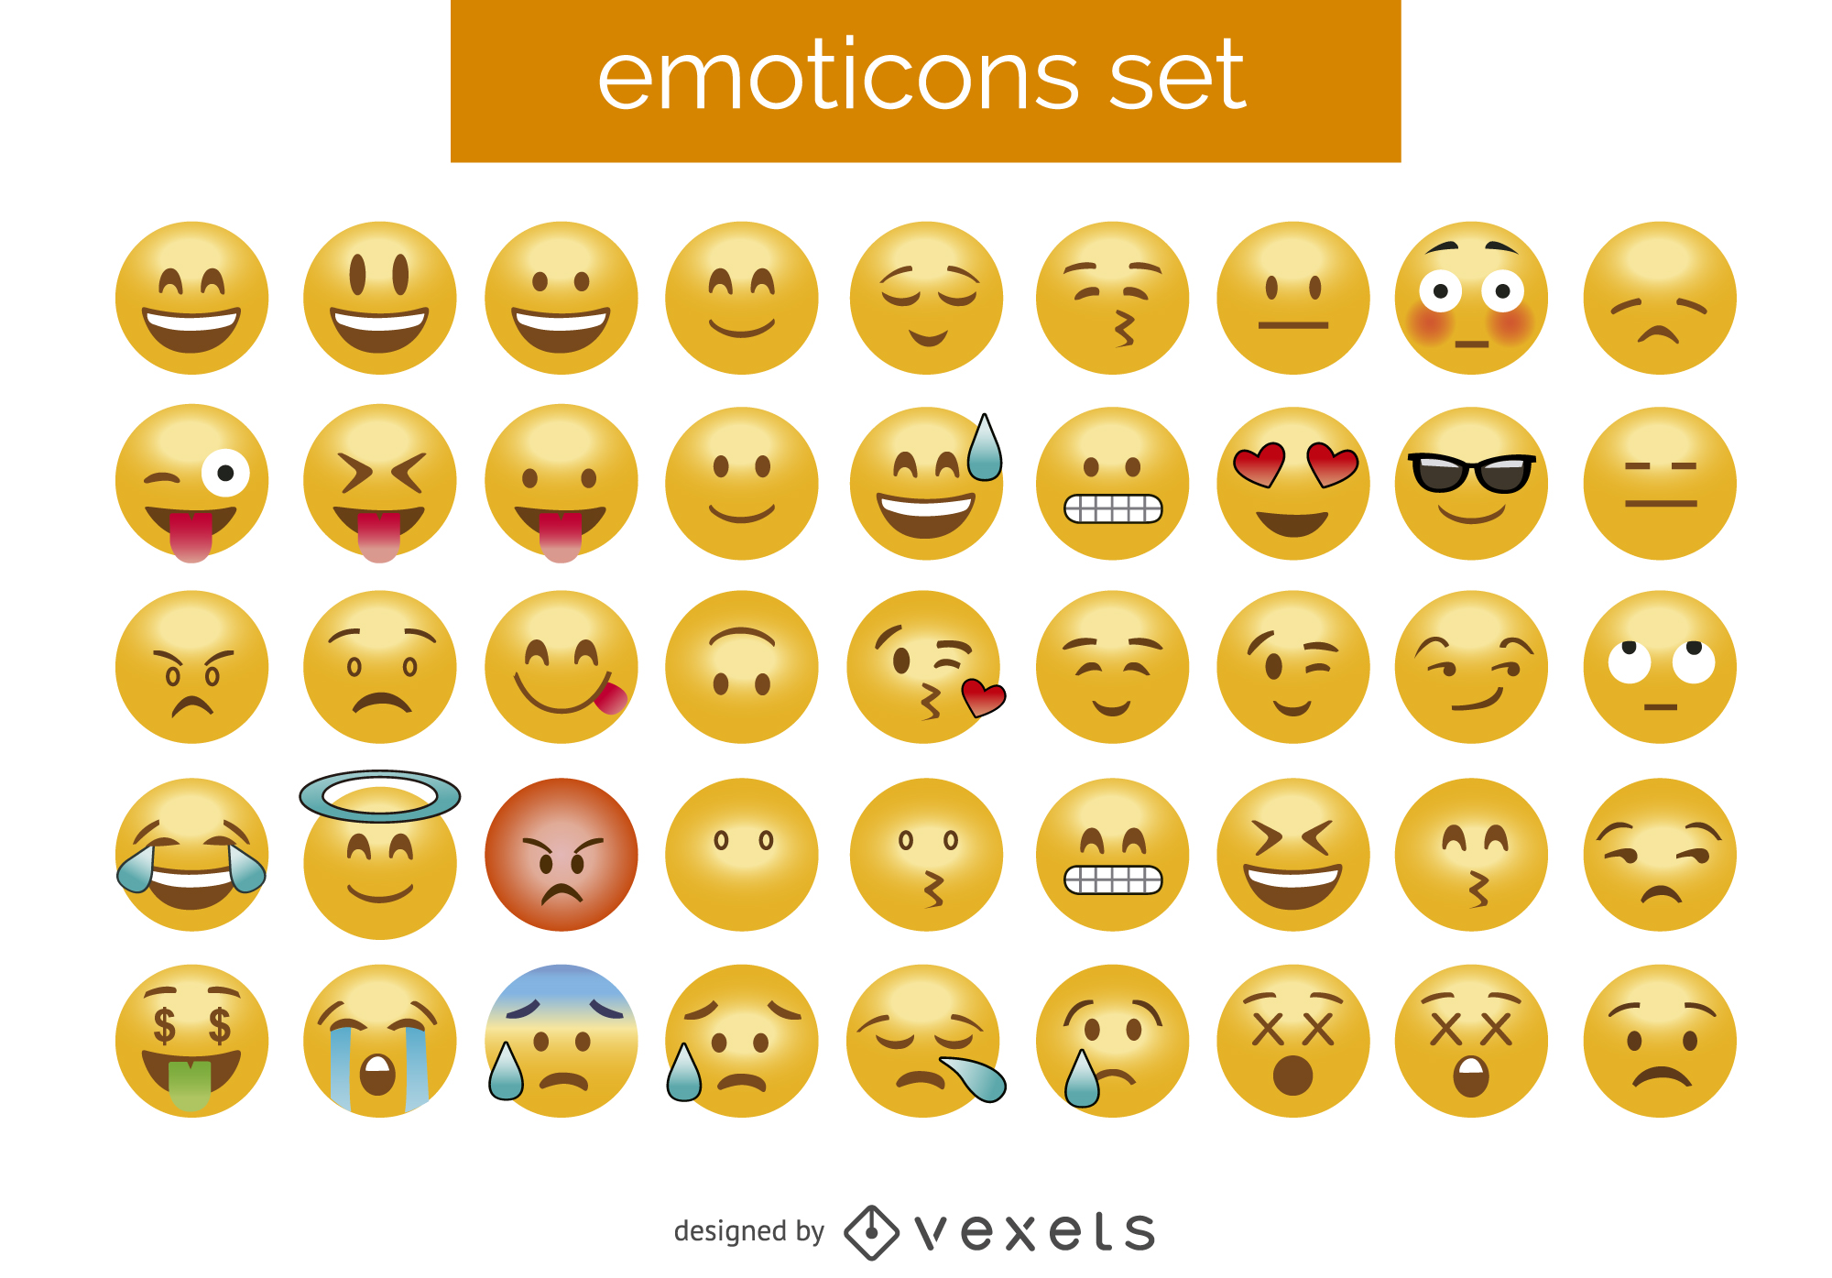
Characteristics of Hard Conversations
Uncomfortable subject matter
Awkward
High emotional intensity
Potential for conflict
Possible impacts on relationships
Physical responses
Notes:
At some point, you’ve probably had a hard conversation with someone, whether that was a family member, friend, partner, boss, or someone else in your life.
There are conversations that may:
Be talking about an uncomfortable subject matter
Awkward to address
Bring High emotional intensity
Have the Potential to start a conflict that may cause fear to wanting to have the conversation at all
Often involves sensitive topics where the outcome could impact a relationships
Sometimes come with physical responses from our bodies including increased heart rate, sweating, rapid breathing, muscle tension, clenched jaw, stomach upset, dry mouth, flushed face, trembling hands, feeling hot or cold, and a tightening in the chest, all stemming from the body's "fight or flight" response to stress
https://www.health.harvard.edu/mind-and-mood/recognizing-and-easing-the-physical-symptoms-of-anxiety?utm_source=chatgpt.com
https://www.mayoclinic.org/healthy-lifestyle/stress-management/in-depth/stress/art-20046037?utm_source=chatgpt.com

Slide 6
When and why do hard conversations happen?
Giving negative feedback
Addressing a conflict with a friend
Discussing a difficult decision with a family member
Delivering bad news
Telling a restaurant server that your food is not what you ordered
Waiting in a line and someone cuts in front of you
Can you think of other examples?
Notes:
Hard conversations can look and feel differently depending on the context. For example, they may include
Giving negative feedback
Addressing a conflict with a friend
Discussing a difficult decision with a family member
Delivering bad news
Telling a restaurant server that your food is not what you ordered
Waiting in a line and someone cuts in front of you
Other examples
Someone is being noisy at night and affecting your sleep
Someone eats your leftovers
You’ve waited well past your appointment time at the doctor
Your friend shared something with someone else that you told them in confidence

Slide 7
Why are these conversations important?
They can promote change.
They can resolve conflicts and prevent issues from escalating.
They can improve relationships
Build trust.
Encourage authenticity.
Bring clarity.
Grow empathy.
Notes:
Even though these conversations are difficult to have and experience, they are very important to strengthen relationships, build advocacy, and reinforce transparent communication.

Slide 8
Return to the Reflection From the Beginning of Class
What specific characteristics made your conversation hard?
Why was this conversation important to have?
Notes:
Teacher provides a model of a topic that could be written about.
Capture student reflections on a white board, straight into the PowerPoint, sticky notes, poster, or other digital tool depending on your classroom context.

Slide 9


Having Conversations About Substance Misuse

Slide 10
In 2023, 48.5 million people in the United States aged 12 or older (17.1%) had a substance use disorder in the past year.
Substance misuse impacts individuals and those around them.
Physical and mental effects
Relationship shifts and changes
Community consequences: crimes, violence, hospitalizations, public spaces
Notes:
Statics: https://www.samhsa.gov/data/sites/default/files/NSDUH%202023%20Annual%20Release/2023-nsduh-main-highlights.pdf
Physical impacts: https://americanaddictioncenters.org/health-complications-addiction

Slide 11

Conversations About Substance Misuse
Say “no” to substances you don’t want to take.
Express a concern to a friend or loved one over their substance use
Share your own personal struggles with a friend or trusted adult.
Notes:
Hard conversations about drug use may take many forms including
Saying “no” to substances you don’t want to take to a friend or peer
Expressing a concern to a friend or loved one over their substance use
Sharing your own personal struggles with a friend or trusted adult

Slide 12
Conversation About Substance Use
Why are conversations about substance use important?
Positively impact individual behavior, including encouraging safer and healthier behaviors
Strengthen relationships through gaining understanding and empathy
What makes these conversations particularly hard?
Denial
Strong emotions
Personal experiences
Fear
Notes:
Talking about substance misuse is a sensitive and difficult subject to discuss with anyone. A few reasons why having hard conversations about substance misuse may include
Denial: people may deny that they have an issue at all
Strong emotions: substance misuse is a deeply personal topic and can feel like a shameful thing to discuss. These deep personal feelings may result in strong emotional reactions including anger, becoming defensive, or …
Sharing personal experiences: Drug misuse is extremely personal and challenging to open up about the reasons behind someone’s drug misuse, and don’t want to share intimate or personal details.
Fear of response: someone bringing up a substance misuse issue may fear the response they will get. There may also be a fear of response in saying no to someone who is asking you to use a substance you don’t want to.
These conversations should not make them feel guilty or shameful.

Slide 13
Group Work (1)
Read the scenarios. Select 1-2 you are most interested in.
Saying “no”
Expressing concern
Sharing personal struggles
Answer the questions in your “Navigating Hard Conversations” worksheet. After 10 minutes, we will come back as a group and share.

Slide 14
Strategies for Hard Conversations
Listen.
Approach the conversation with compassion and empathy.
Use facts and specifics to engage in the conversation.
Focus on specifics instead of generalizations, provide concrete examples and facts to avoid misunderstandings.
Express your thoughts and feelings honestly while still being respectful.
Acknowledge the feelings of the other person.
Focus on contribution, not blame.
Notes:
Hard conversations often require
careful navigation of emotions
Focusing on specific facts or examples
active listening to reach a productive resolution
Empathy and understanding, curiosity, and respect for boundaries
Approach the conversation with compassion and empathy. This supports making the conversation a space where it’s safe to talk and both parties feel comfortable expressing their thoughts and feelings.
Context matters.
https://eye.hms.harvard.edu/files/eye/files/difficult-conversations-summary.pdf

Slide 15
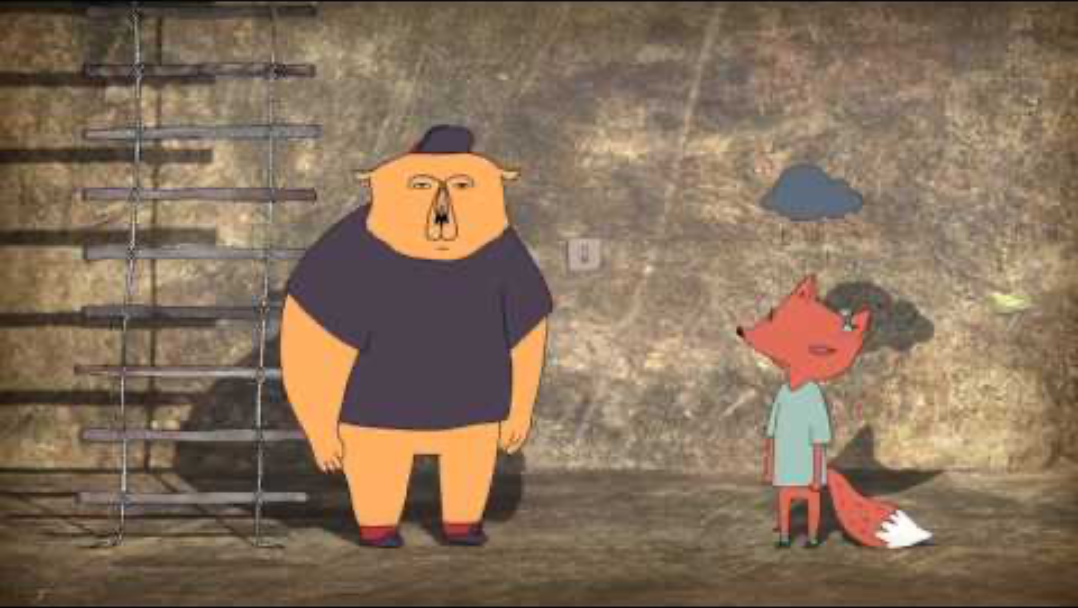
Approaching Conversations with Empathy vs. Sympathy
https://www.youtube.com/watch?v=KZBTYViDPlQ
Notes:
Watch the following video from Brene Brown on the difference between empathy vs. sympathy: https://www.youtube.com/watch?v=KZBTYViDPlQ

Slide 16

Starting a Difficult Conversation
https://www.cmich.edu/podcast/episode/why-are-difficult-conversations-important#Dialogue
Notes:
Min 7:48- 12:10 https://www.cmich.edu/podcast/episode/why-are-difficult-conversations-important#Dialogue

Slide 17
Group Work (2)
In your groups, return to your scenario and consider the strategies in the stories.
How did the characters start their conversations?
How could they approach the conversation with compassion and empathy?
How could they engage in the conversation with facts and resources?
What other strategies could they use?
Be prepared to share.
Notes:
Capture shared ideas on a whiteboard, chart paper, sticky notes, or other digital resource.

Slide 18
Not All Conversations Go Well
No resolution and unresolved issues
Hurt feelings
Change in the relationship dynamic
Rejection
Progress often takes multiple conversations over time
Notes:
Even if you use all of the strategies we just talked about, the conversation may still not work out the way you hoped. The other person may still have a different perception than you, bring it or have assumptions about the intent of the conversation, and hold strong feelings or blame.
There may not be a resolution and there may be hurt feelings, rejection, unresolved issues, and it may affect the dynamic between individuals involved.
But this doesn’t mean these conversations shouldn’t happen. And although the results of the conversation may be disappointing, there are certain strategies you can lean on such as seeking support from other people, including friends, trusted adults, or a therapist, and personally reflect on the experience to consider how you may approach the conversation in the future.

Slide 19
Think About the Conversation From the Beginning of Class
What strategies did you use in the conversation?
How could these strategies change the outcome or how you felt before, during or after the conversation?
If you had the same conversation again, would you change your approach? What would you do the same way? Why?
Capture your response in the same format you used in your reflection at the beginning of the lesson.

Slide 20
Key Ideas
Hard conversations are uncomfortable, but they are important and necessary.
Emotions play a key role in hard conversations, so using strategies to engage in these discussions is critical, including listening and using facts, specifics, compassion and empathy.
Not all conversations go the way we hope, and some topics require multiple conversations over time.
Notes:
Hard conversations are necessary for personal growth, healthier relationships, and addressing critical issues like substance misuse. They can be difficult, but with the right strategies — including empathy, listening, and using facts — they can lead to meaningful change. Even when they don’t go well, they open the door for future conversations and progress over time.

Slide 21
Resources
School resources
[insert school resources that align with your context]
XXX
XXX
XXX
XXX
Other resources
How to talk to someone about their drinking or drug use
Difficult conversations: How to discuss what matters most
Tips for talking with your friends about their behavior
Kids Help Phone resources
5 ways to talk to a friend about their substance use
9 tips for difficult conversations with teachers
8 tips for difficult conversations with friends
How can I talk to a parent/caregiver about something?

