Slide 1
Making Safe and Healthy Choices
Grades 2–3
Authored by Oregon Department of Education

Slide 2


Essential Questions
What are some reasons people take medicine?
What can make medicine and other substances helpful or harmful to my body?
How can my trusted adult help me make safe choices about substances?

Slide 3


Learning Goals
I can name two examples of why people take medicine.
I can describe basic safety rules for medicine.
I can tell the difference between helpful and harmful substances
I can make choices that help me stay safe

Slide 4
Why do you think people take medicine?
Medicine helps prevent people from getting sick.
Medicine makes people feel better when they are sick.

Slide 5
What are some rules for taking medicine?
A trusted adult should always help.
A trusted adult can make sure people take the right amount.

Slide 6
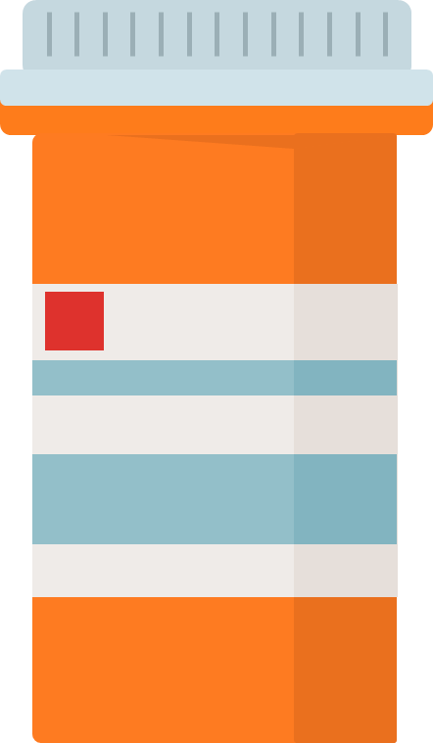

Example Prescription (1)
Pharmacy Name
Amoxicillin
250 mg pill
Qty: 10
Take 1 pill by mouth 2 times a day
Jasmine Smith
111 Street
City, Oregon 11111
Refills: 0

Slide 7


Share What You Know With a Partner (1)
What do you notice about the medicine label?

Slide 8
Example Prescription (2)
Number of pills in the bottle when first filled
Dose
Pharmacy Name
Medicine name
Amoxicillin
250 mg pill
Qty: 10
How much medicine to give
How to give it
How often to give it
Take 1 pill by mouth 2 times a day
Jasmine Smith
111 Street
City, State 11111
Refills: 0
Patient name
Number of refills you have left

Slide 9
What can help us take medicine safely?
Let’s talk about rules.
Let’s talk about trusted adults.

Slide 10


Substance Use Sort
Safe if used
correctly
Safe
Unsafe

Slide 11
Substance Sort
Safe: These are items that are safe for children.
Unsafe: These are items that are unsafe for children.
Safe only if used correctly: These are items that can be safe with adult help.

Slide 12
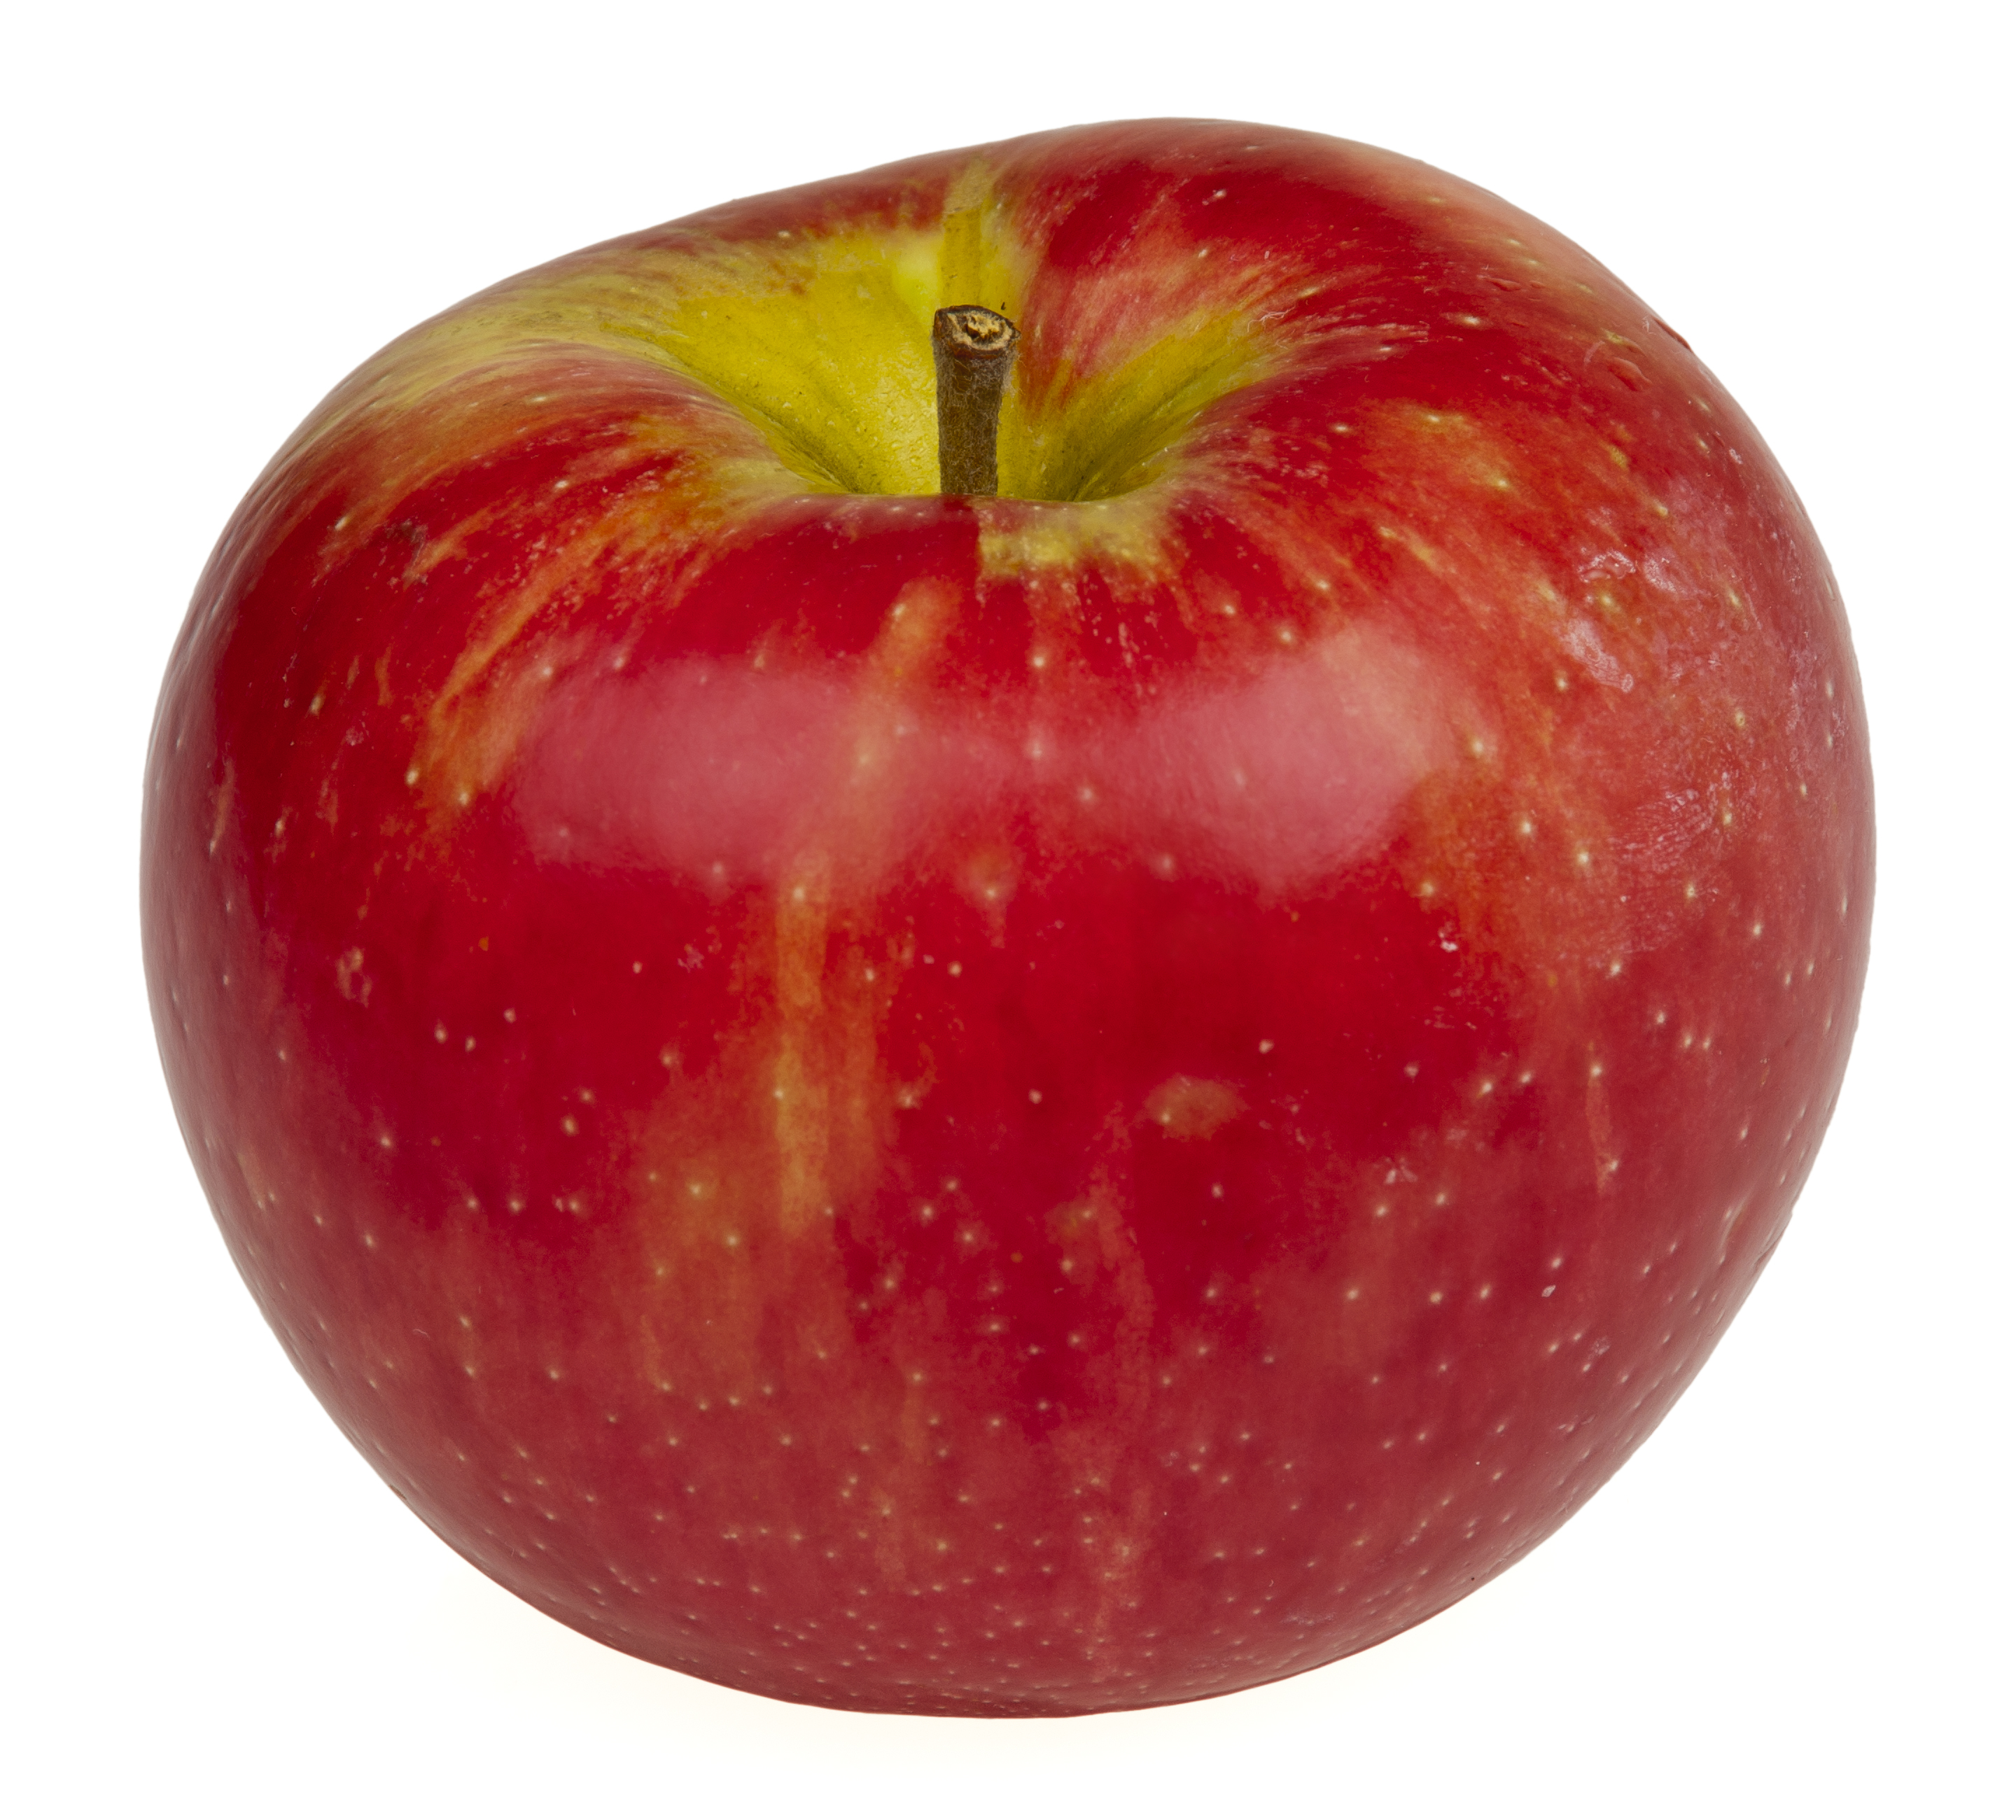
Substance
1

Slide 13
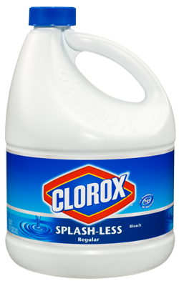
Substance
2

Slide 14
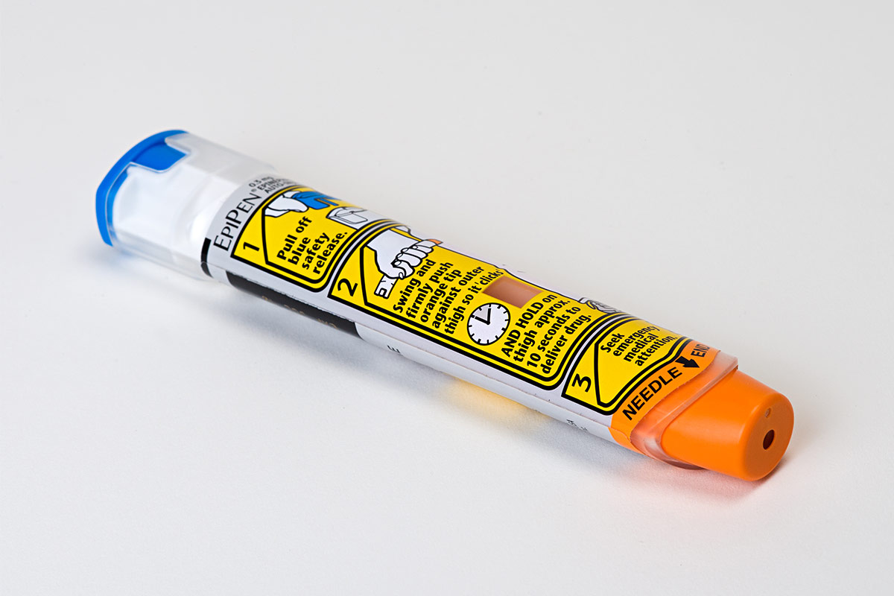
Substance
3

Slide 15
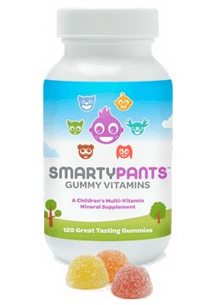
Substance
4

Slide 16
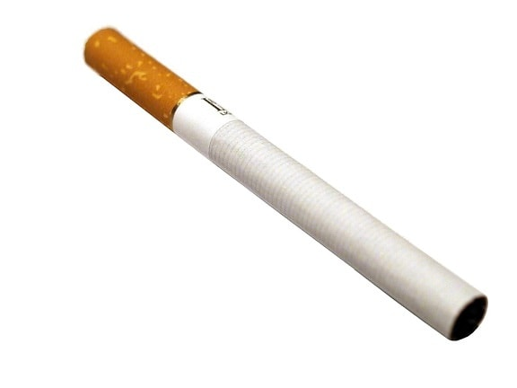
Substance
5

Slide 17
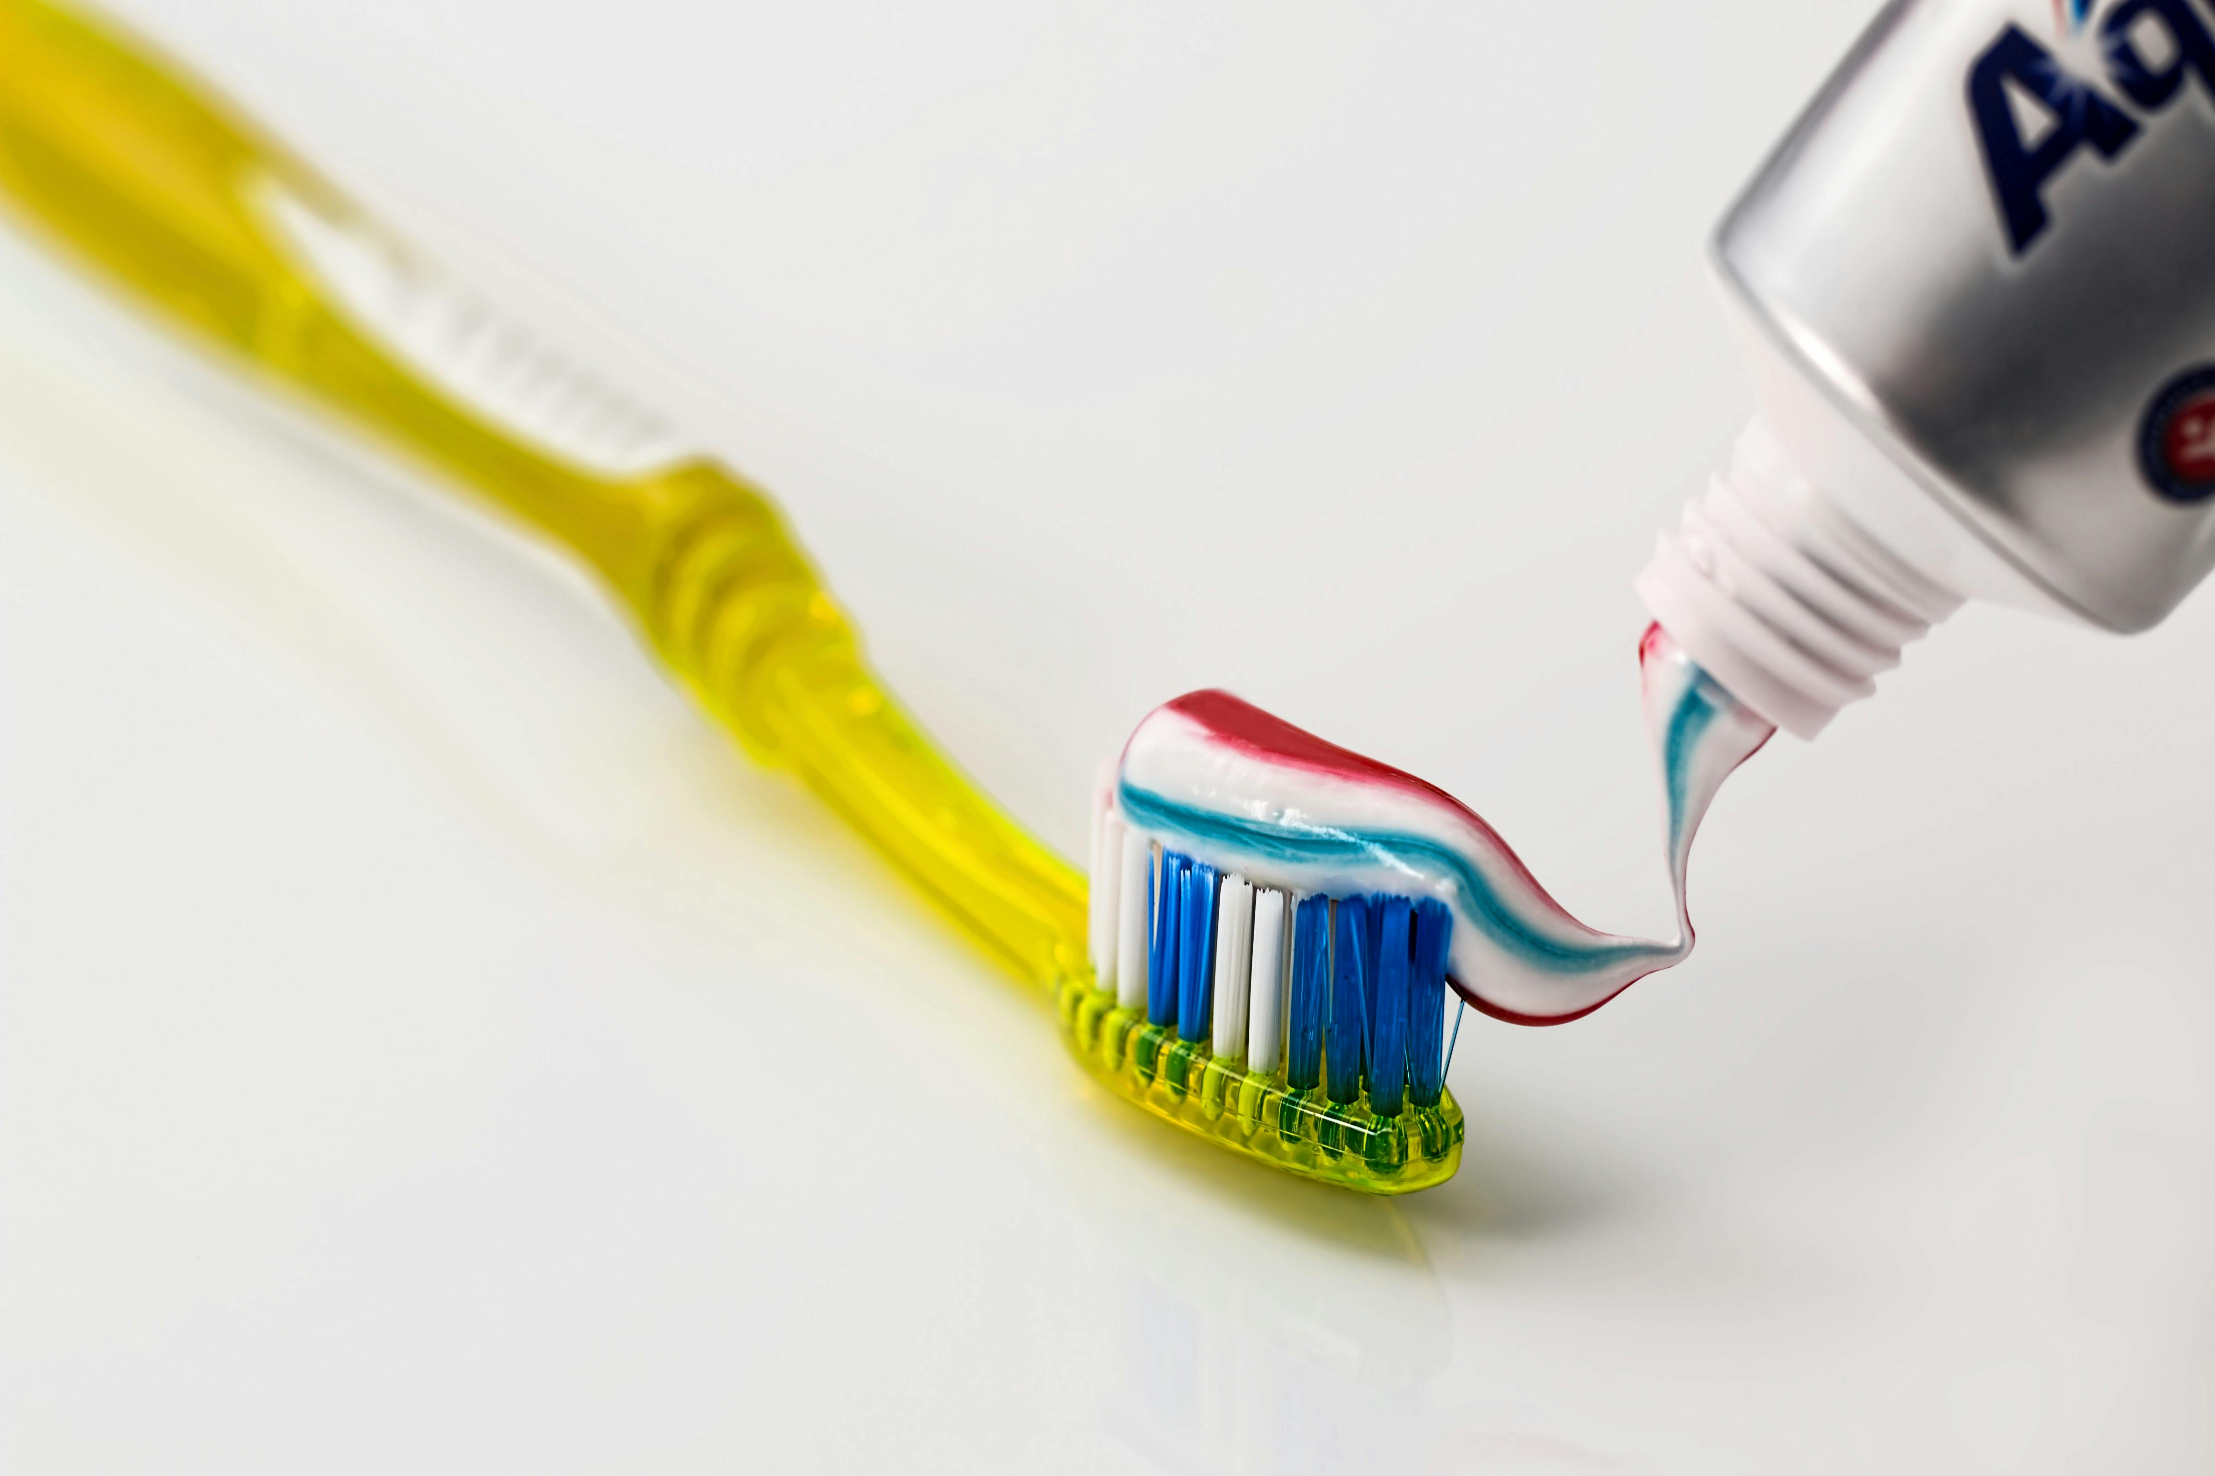
Substance
6

Slide 18
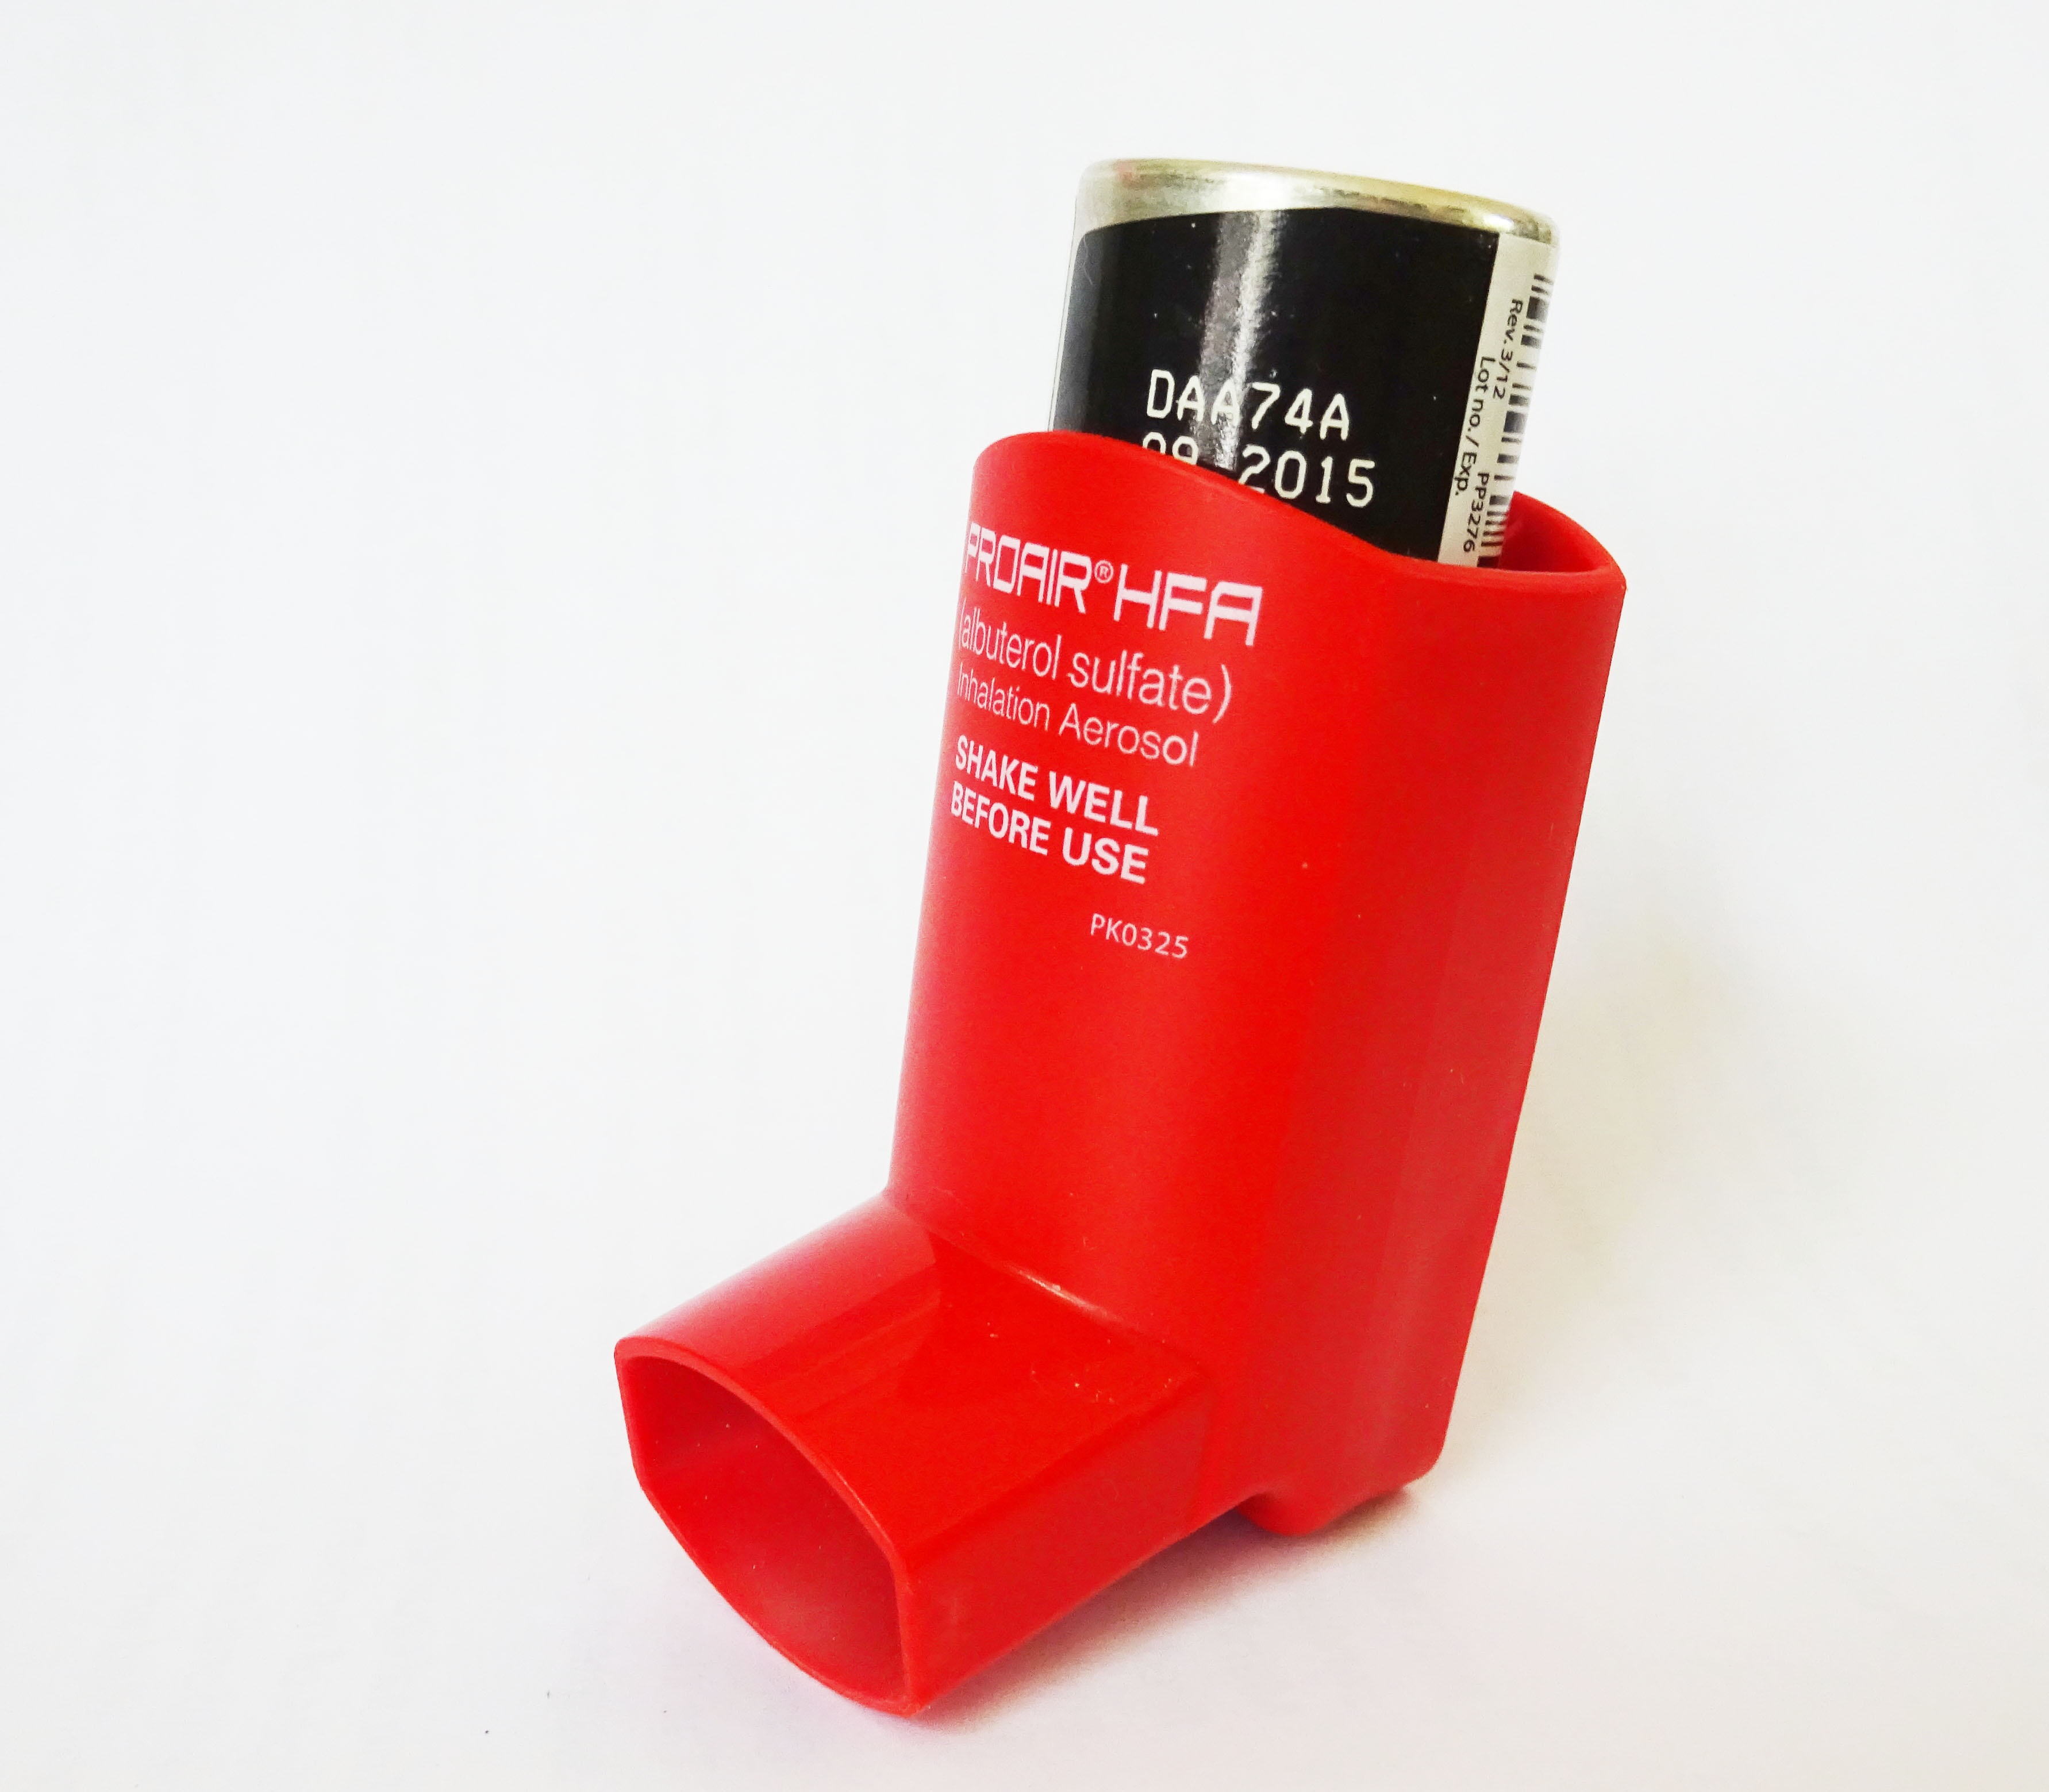
Substance
7

Slide 19
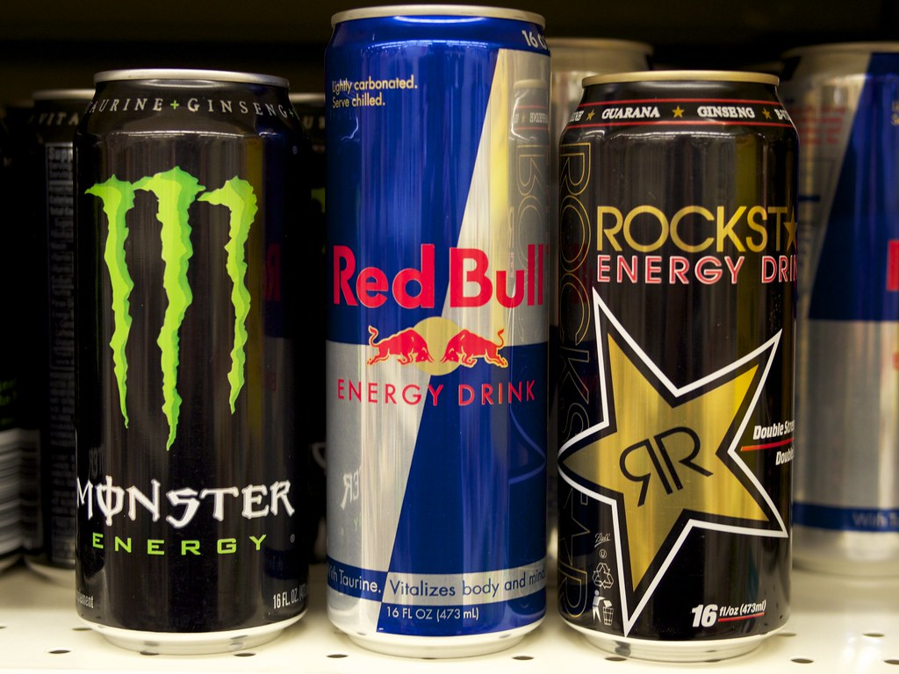
Substance
8

Slide 20
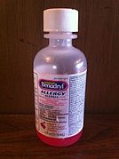
Substance
9

Slide 21
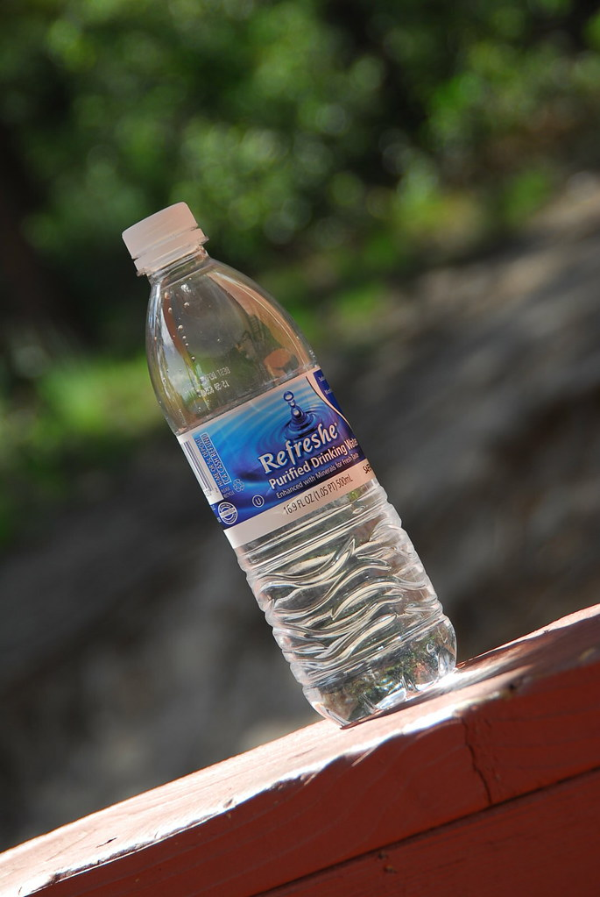
Substance
10

Slide 22
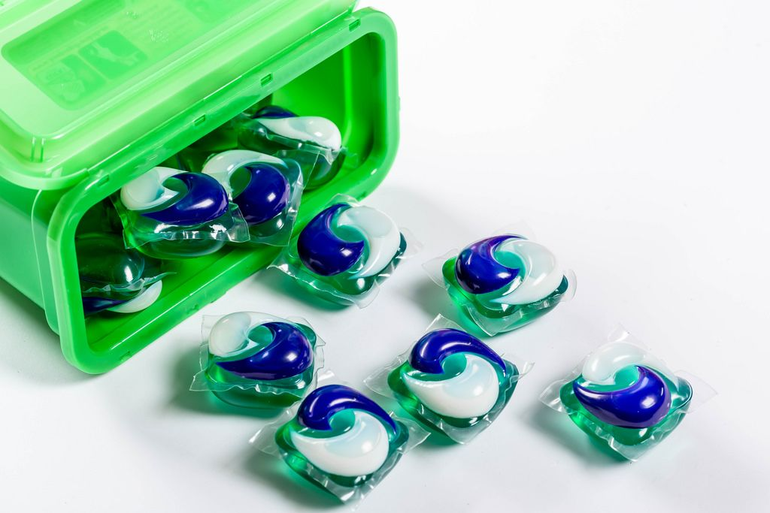
Substance
11

Slide 23
Think of Two Items in Your House
Complete the sentence frame:
I chose the substance _____________________.
_______________ is safe/unsafe/safe only if used correctly because ____________________
_______________________________________.

Slide 24
Scenario
1
You find a small pill on the floor at home, and you are not sure where it came from.
What do you do?

Slide 25
Scenario
2
Your friend has something that looks like candy, but it smells weird and doesn’t have a wrapper. They want to try it.
What do you do?

Slide 26
Scenario
3
You see a bottle of medicine in your bathroom cabinet. It smells sweet, and you want to try it.
What do you do?

Slide 27
Essential Questions
Review
What are some reasons people take medicine?
What can make medicine and other substances helpful or harmful to my body?
How can my trusted adult help me make safe choices about substances?

Slide 28
Learning Goals
Review
I can name two examples of why people take medicine.
I can describe basic safety rules for medicine.
I can tell the difference between helpful and harmful substances
I can make choices that help me stay safe

Slide 29
Share What You Know With a Partner (2)
What is one action you can take to keep yourself and your community safe with medicine?

