Slide 1
Safe and Healthy Use of Medicine and Other Substances
Grades 4–5
Authored by Oregon Department of Education

Slide 2


Essential Questions
When and how can medicine or substances be used safely to promote wellness?
What can I do to protect myself against the addictive and harmful effects of some substances?
What is substance use disorder?

Slide 3

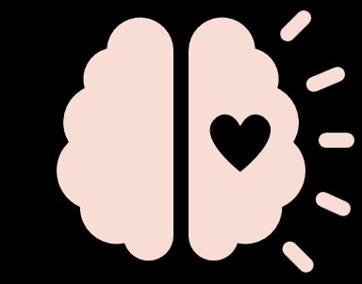
Learning Goals
I can describe how to take medicine and other substances safely.
I can recognize the difference between helpful and harmful ways to use medicine and other substances.
I can demonstrate understanding of substance use disorder and resources that help people with this medical condition.

Slide 4


Share What You Know With a Partner
Medicine
Over-the-counter (OTC)
Prescription
Substance
Substance use disorder

Slide 5


Words to Know (1)
Medicine: a substance or preparation used in treating a condition
Over-the-counter (OTC): medicine available for purchase without a prescription from a doctor
Prescription: medicine prescribed by a doctor

Slide 6
Words to Know (2)
Substance: a material, such as alcohol or drugs, that affects how the brain and the body work and causes changes in mood, awareness, thoughts, feelings or behavior
Substance use disorder: a treatable disease that affects a person’s brain and behavior
Causes problems a doctor would consider very serious, like the inability to meet major responsibilities at work, school and home.
Can be hard to stop using substances even when a person may want to

Slide 7

How can medicine help us?
Take medicine only when needed.
Take medicine under adult supervision.
Follow directions for using medicine.
Take only your own medicine.
Do not mix different medicines.
Accurately measure medicine dosage using appropriate tools.

Slide 8
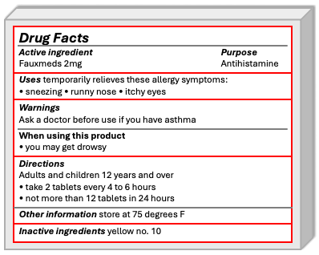
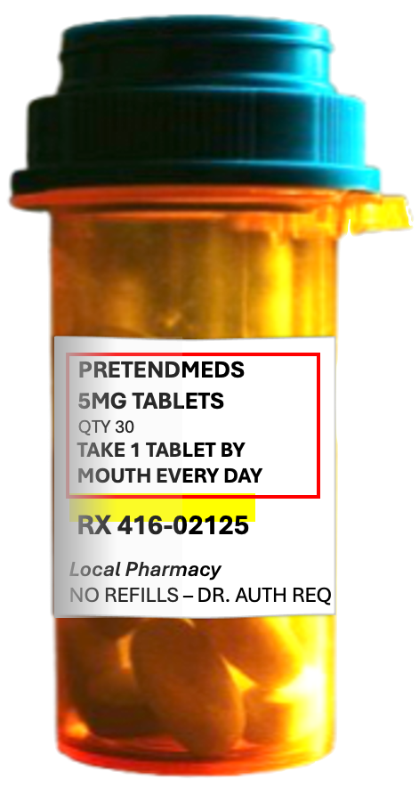
Labels Help Us Take Medicine Safely
Over-the-counter medicine label
Prescription medicine label

Slide 9

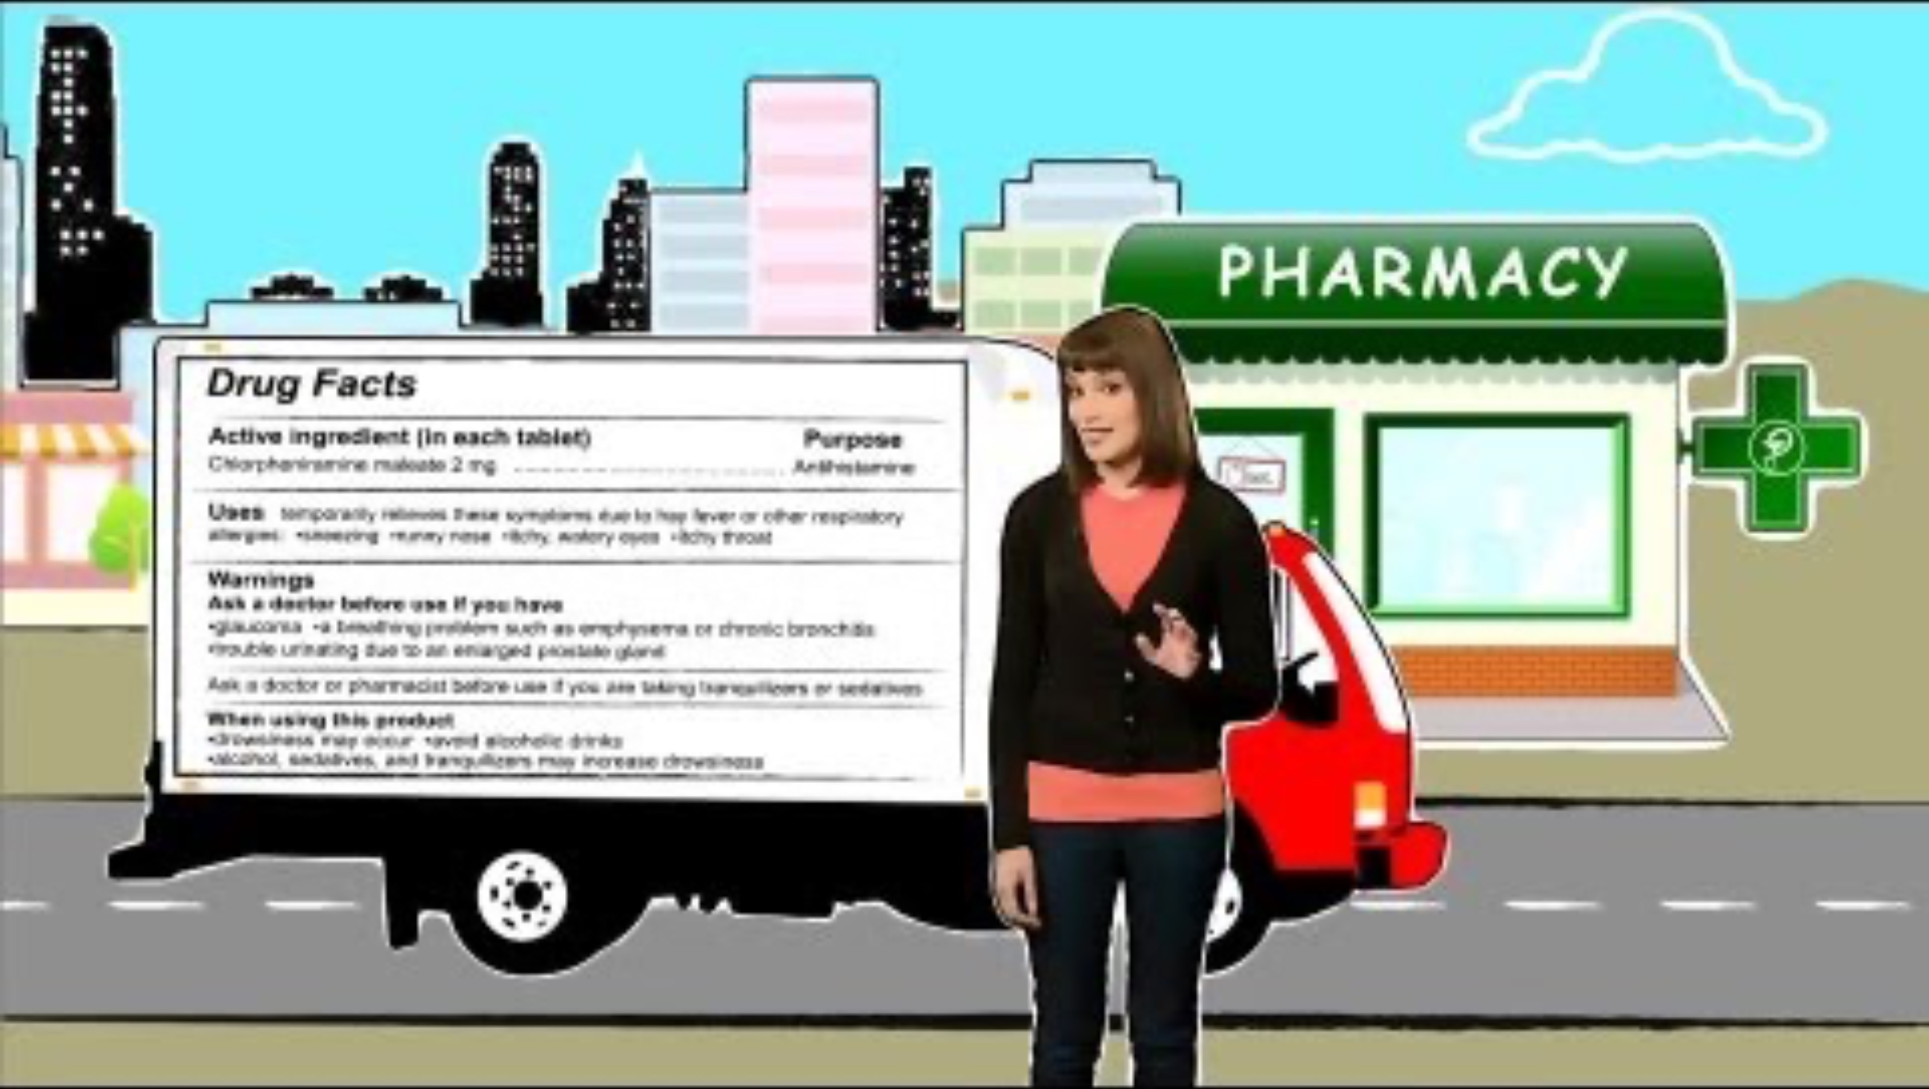
Medicine In My Home
https://youtu.be/hT6Th_QfQKE?si=qIMbjEMm6Z6JOTHy

Slide 10
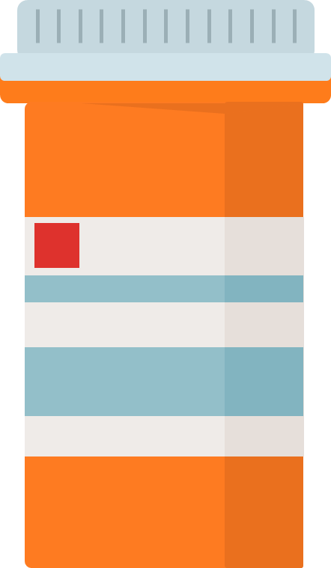

Prescription Medicine Label Handout
Pharmacy Name
Amoxicillin
250 mg pill
Qty: 10
Take 1 pill by mouth 2 times a day
Jasmine Smith
111 Street
City, Oregon 11111
Expiration: 10/15/2025
Refills: 0

Slide 11
Prescription Medicine Label Handout: Answers
Whose prescription is it? Jasmine Smith
What is the name of the medicine? Amoxicillin
How often should the medicine be taken? Twice a day
How much medicine should be taken for each dose? 1 pill
How many times can the medicine be refilled? 0 times
When will the medicine expire? 10/15/2025

Slide 12
Harmful Ways of Using Medicine
Taking medicine when it’s not necessary
Taking medicine without adult supervision
Not following directions for using medicine
Skipping medications that you need to stay safe or healthy
Taking other peoples’ medicine
Mixing different medicines
Inaccurately measuring medicine dosage or using inappropriate tools

Slide 13
Medicine and Substance
Medicine: a substance or preparation used in treating a condition
Substance: a material, such as alcohol or drugs, that affects how the brain and the body work and causes changes in mood, awareness, thoughts, feelings or behavior
Can include medicine but also includes things like alcohol and cigarettes

Slide 14
Substance Use Spectrum
Beneficial Use
Substance use disorder
Nonuse
No use of substances.
Example: Does not take any medicine.
Use that has a positive health, social or spiritual effect.
Example: Taking medication as prescribed.
A treatable disease that affects a person’s brain and behavior. It causes problems a doctor would consider very serious like the inability to meet major responsibilities at work, school and home. It can be hard to stop even though they may want to.
Example: Inability to stop using alcohol or other substances when wanted
A person may move back and forth between stages over time.
Adapted from: Save Lives Oregon Learning Collaborative

Slide 15
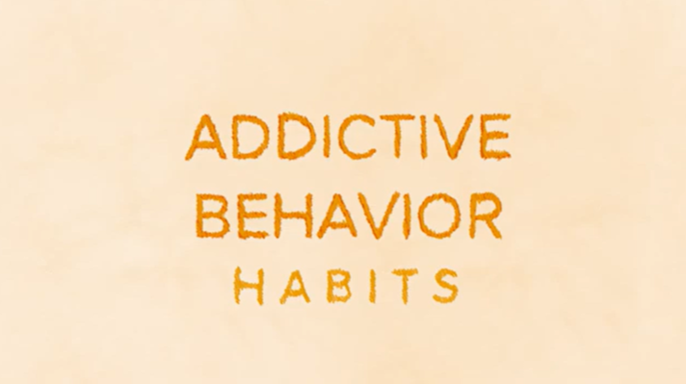
Understanding Habits and Addiction
https://www.youtube.com/watch?v=oV38woahNso

Slide 16
Key Understandings From the Video
Addictive behaviors are more powerful than habits.
People can pretend they don’t have an addictive behavior.
People can be addicted to many different things (cigarette smoking, computer games, social media)
Addiction can cause personality changes.
People have a hard time resisting what they are addicted to.
Breaking free of addiction is very difficult.

Slide 17
What can I do to protect myself?
Consider your choices.
Follow directions for medicine.
Seek support from a trusted adult.

Slide 18
Where can I find support?
Trusted adults
School counselor
School nurse

Slide 19
Essential Questions Review
When and how can medicine or substances be used safely to promote wellness?
What can I do to protect myself against the addictive and harmful effects of some substances?
What is substance use disorder?

Slide 20
Learning Goals Review
I can describe how to take medicine and other substances safely.
I can recognize the difference between helpful and harmful ways to use medicine and other substances.
I can demonstrate understanding about substance use disorder and resources that help people with this medical condition.

Slide 21

Take Action
What is one action you can take to be safe and healthy when using medicine?

