Slide 1
Youth Brain Development
Affects of Substance Use
Grades 9–10

Slide 2

Essential Questions
What is substance use disorder?
How does substance use affect the brain and brain development?
What can I do if I or someone I know has a substance use disorder?

Slide 3

Learning Goals
I can define substance use disorder.
I can explain how substances affect the youth brain and impact brain development.
I can name at least one way to seek support for someone who has a substance use disorder.

Slide 4


Stop and Jot 1
How does it feel to be your age?

Slide 5
Stop and Jot 2
How does that differ from when you were younger?

Slide 6
Stop and Jot 3
How do you think it will differ from when you are an adult?

Slide 7
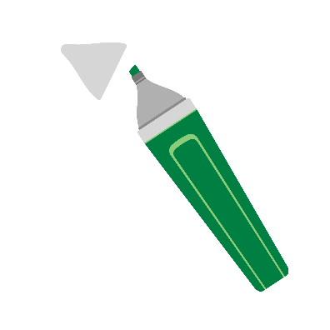
Stages of Healthy Adolescent Development
Highlight or underline what stands out to you.
Be prepared to share!

Slide 8
Characteristics of Middle Adolescence
Characteristics of middle adolescence (ages 15–17) include
Growth in abstract thought reverts to concrete thought under stress
Cause and effect relationships are better understood
Strong peer allegiances can lead to fad behaviors
Experimentation can lead to risk-taking behavior

Slide 9
Substance Use Spectrum (1)
Nonuse
Avoid the use of substances.
_____________
Example No drugs, tobacco or alcohol
Beneficial use
Use that has a positive health, social or spiritual effect.
_____________
Example Taking medication as prescribed or ceremonial or religious use of tobacco
Lower-risk use
Use that has a minimal impact on a person, their family or others.
_____________
Example Drinking following low-risk alcohol drinking guidelines
Higher-risk use
Use that has a harmful or negative impact on a person, their family or others.
_____________
Example Impaired driving, binge drinking or increasing frequency and quantity
Substance use disorder
A treatable medical condition that affects the brain and involves compulsive and continuous substance use despite negative impacts to a person, their family or others.
_____________
Example Inability to stop using alcohol or other substances when wanted
A person may move back and forth between stages over time.
Adapted from: Save Lives Oregon Learning Collaborative

Slide 10
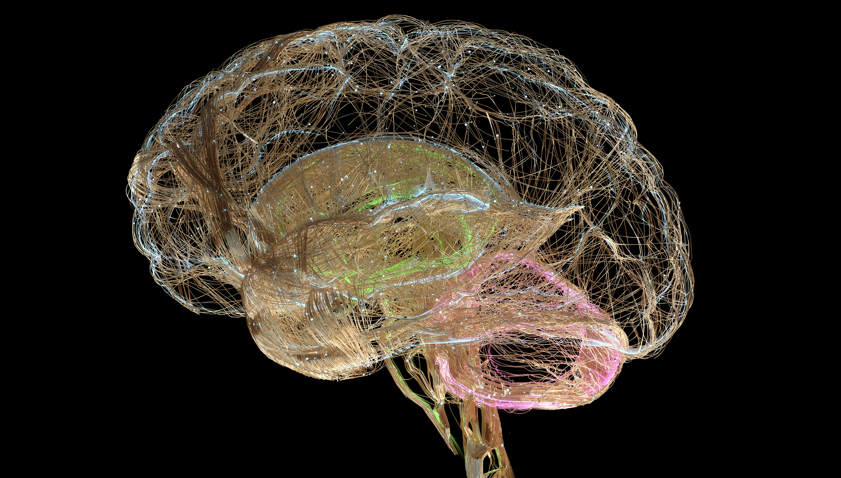
What does your brain do for you?
What does your brain do for you?

Slide 11
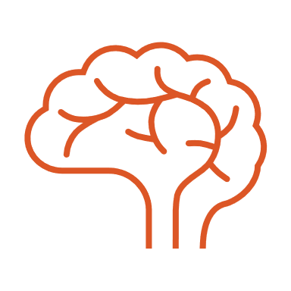
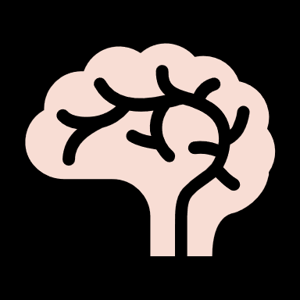
Your brain…
Helps you figure out what you do and do not like
Allows you to learn new things and more about things you already know
Helps you plan and think about the future
Helps you make choices
…is unique

Slide 12



Like or Dislike 1

Slide 13

Like or Dislike 2

Slide 14
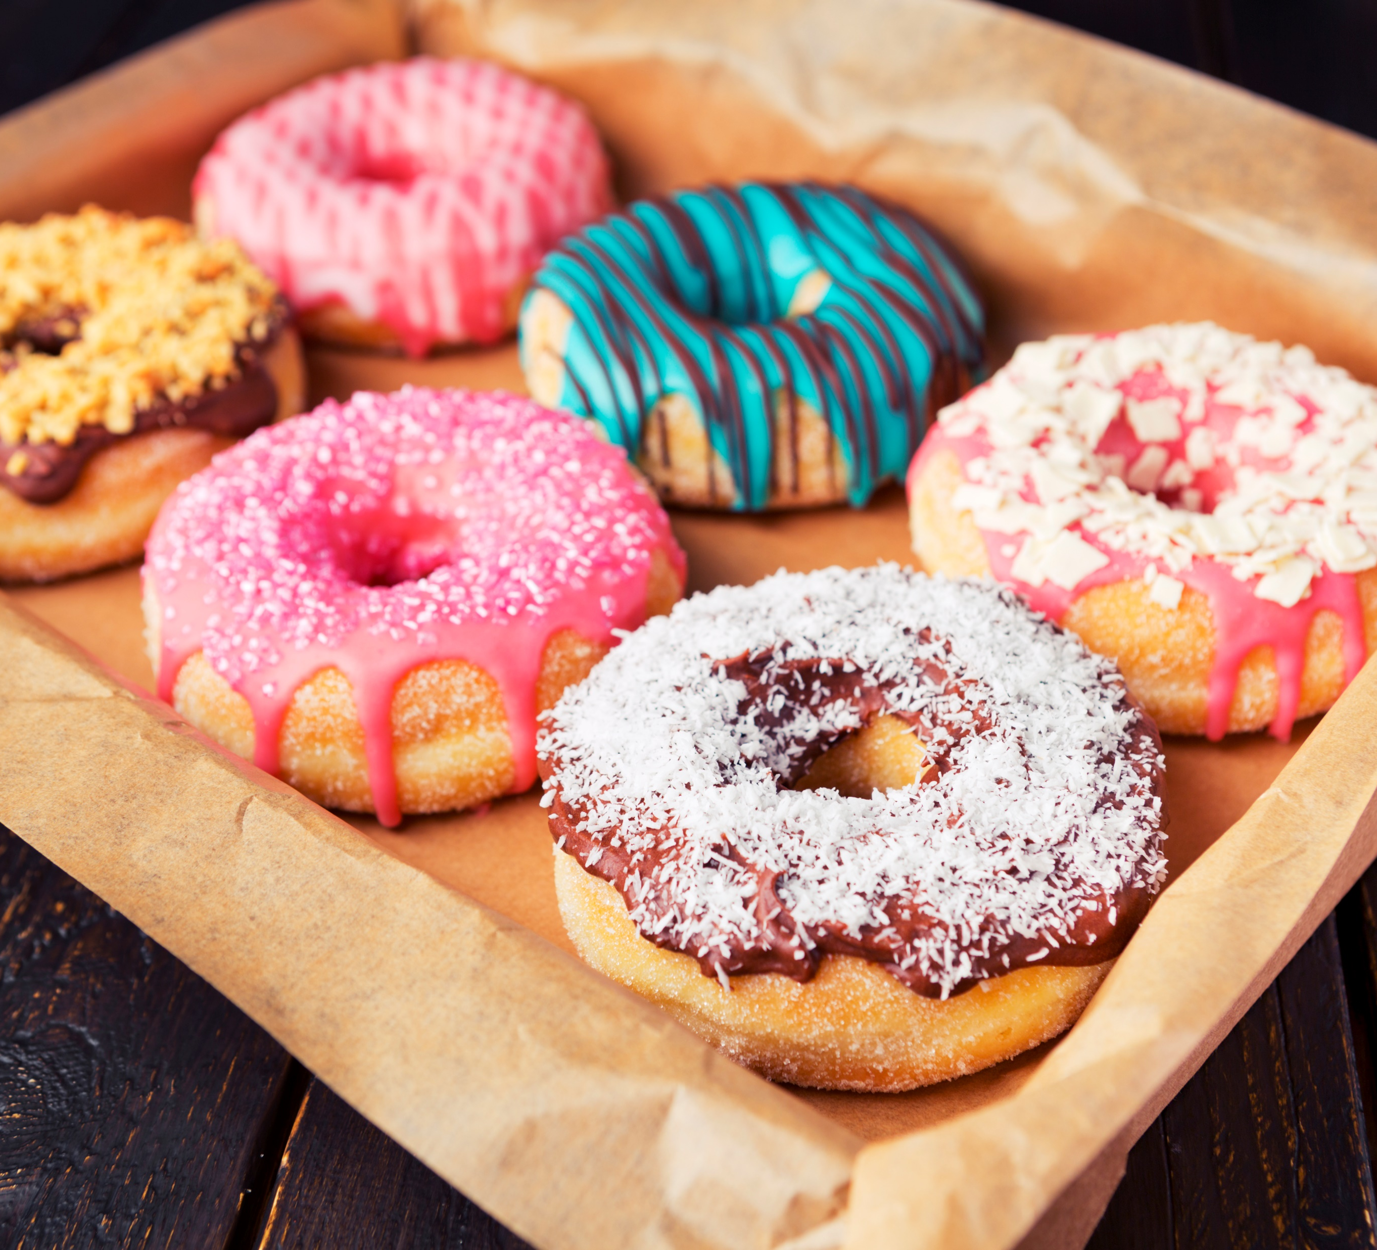
Like or Dislike 3

Slide 15

Like or Dislike 4

Slide 16

Group Discussion
Did you notice yourself feeling influenced by others in the room when choosing a side?
What roles do emotions, social pressure and personal values play in how we make choices?
What role do brain development and decision-making play in using substances?
How do you think brain development impacts the way decisions are made, especially when it comes to substance use?

Slide 17
Stop and Jot 4
What do you know about how your brain is developing?

Slide 18

Youth Brain Development
Youth Brain Development

Slide 19
Brain Basics
The brain develops and matures into the mid-to-late 20’s.
Experiences impact brain development and how it works.
Using substances while the brain is developing can have long-term consequences.

Slide 20
Youth Brain vs. Adult Brain
The prefrontal cortex is one of the last parts of the youth brain to mature. It is responsible for skills like planning, prioritizing and making decisions. It does not stop developing until around 25.
During adolescence, the brain undergoes major changes, so it is extremely risky to use substances.
Developing brains are more susceptible to damage than adult brains, so youth substance use creates more risk for harm.
Nine in ten people who struggle with substance use disorder started when they were teens.

Slide 21
Stop and Jot 5
What comes to mind when you hear substance use disorder?

Slide 22
Key Vocabulary
Tolerance: A person’s reaction to a substance goes down as the person continues to use it.
Withdrawal: A person stops using a substance and has negative symptoms.
Dependency: A person is physically reliant on the substance despite negative consequences.
Substance use disorder (also known as addiction): A chronic brain disease where a person is preoccupied with obtaining and using a substance despite adverse consequences.

Slide 23

Why are drugs so hard to quit?
Why are drugs so hard to quit?

Slide 24
What is substance use disorder?
Substance use disorder (SUD), as a recognized medical brain disorder, refers to the use of illegal substances (such as marijuana, heroin, cocaine or methamphetamine) or the misuse of legal substances (such as alcohol, nicotine or prescription medicines).
https://www.hopkinsmedicine.org/health/conditions-and-diseases/substance-abuse-chemical-dependency

Slide 25
Who experiences a SUD?
In 2022, more than one in six Americans aged 12 or older reported experiencing a SUD.
SUDs can range in severity from mild to severe and can affect people of any race, gender, income level or social class.
(https://www.cdc.gov/overdose-prevention/treatment/index.html)

Slide 26
Remember…
SUD is a disease, not a character flaw. People experiencing SUDs have trouble controlling their drug use even though they know drugs are harmful.

Slide 27
Substance Use Spectrum (2)
Nonuse
Avoid the use of substances.
_____________
Example No drugs, tobacco or alcohol
Beneficial use
Use that has a positive health, social or spiritual effect.
_____________
Example Taking medication as prescribed or ceremonial or religious use of tobacco
Lower-risk use
Use that has a minimal impact on a person, their family or others.
_____________
Example Drinking following low-risk alcohol drinking guidelines
Higher-risk use
Use that has a harmful or negative impact on a person, their family or others.
_____________
Example Impaired driving, binge drinking or increasing frequency and quantity
Substance use disorder
A treatable medical condition that affects the brain and involves compulsive and continuous substance use despite negative impacts to a person, their family or others.
_____________
Example Inability to stop using alcohol or other substances when wanted
A person may move back and forth between stages over time.
Adapted from: Save Lives Oregon Learning Collaborative

Slide 28
Support Available
Alcohol and Drug Helpline: (800) 923-4357
Oregon Hopeline: (833) 975-0505
SAMHSA National Helpline: (800) 662-HELP (4357)

Slide 29
Key Ideas
Everyone’s brain is unique.
The adolescent brain is developing and more vulnerable to substances.
Substance use disorder is a treatable medical condition.
Make informed choices using your knowledge of adolescent characteristics and brain development.

