Slide 1
Messaging, Media and Substance Use
Making Informed Decisions
Grades 9–10

Slide 2

Essential Questions
How do I critically review media and messages from social media, direct marketing and entertainment?
How do media and messaging influence my choices about using substances and my beliefs about people who use substances?

Slide 3

Learning Goals
I understand the strategies used by the media to influence people’s actions and beliefs.
I can use the media responsibly as a tool to stay informed.
I can identify relevant information from credible sources.

Slide 4

Stop and Jot (1)
You hear of a new energy drink. It promises to give you the energy to tackle everything at school and in your personal life.
How will you decide whether or not to try it?
What information will you need?
How will you gather this information?
Take a few minutes to brainstorm all your ideas.

Slide 5

Pair, Share, Rank
Share your list with your partner.
Add to your list if your partner has ideas that you think are relevant to the decision.
Now rank your list with 1 being the most reliable source.
Be prepared to share!

Slide 6
Examples of Credible Health Organizations
The National Institute on Drug Abuse
The Centers for Disease Control and Prevention
The Substance Abuse and Mental Health Services Administration
The National Institute on Alcohol Abuse and Alcoholism
The Truth Initiative

Slide 7
Partner Chat
With your partner, discuss the following:
Why do you need to know where your information comes from?
How can inaccurate information on substance use be harmful?
Be prepared to share!

Slide 8
Marketing and Substance Use
“Drugs are present in nearly half of all music videos, including alcohol (35%), tobacco (10%), and illicit drugs (13%).”
“More than 1/3 of all drinking scenes on television shows are humorous, while less than 1/4 of drinking scenes show any negative consequences.”
“A total of 73 studies, which covered 15,905,182 substance‐related posts on Twitter, YouTube, Instagram, Pinterest, TikTok and Weibo, were identified. A total of 76.3% of all substance‐related content was positive in its depiction of substance use, with 20.2% of content depicting use negatively. Sentiment regarding opiate use however was commonly negative (55.5%).”
Notes:
(1) Quoted from https://americanaddictioncenters.org/blog/entertainments-influence-on-addiction. Original source: Gruber, E.L., Thau, H.M., Hill, D.L., Fisher, D.A., & Grube, J.W. (2005). Alcohol, tobacco and illicit substances in music videos: a content analysis of prevalence and genre. Journal of Adolescent Health, 37(1), 81–83
(2) Quoted from https://americanaddictioncenters.org/blog/entertainments-influence-on-addiction. Original source: Greenberg, B.S., Rosaen, S.F., Worrell, T.R., Salmon, C.T., & Volkman, J.E. (2009). A portrait of food and drink in commercial TV series. Health Communication, 24(4), 295-303.
(3) https://pmc.ncbi.nlm.nih.gov/articles/PMC10087142/

Slide 9
Pair and Reflect
How might seeing substance use in media influence someone’s choices or beliefs about drugs and alcohol?
What other factors—like family, friends or cultural messages—might affect how people interpret these media messages?

Slide 10
Stop and Jot (2)
Take a moment and write down all the fictional characters (books, movies or television) who have or had a substance use disorder AND are positively portrayed.
Positive portrayal means…
Not selfish
Able to recover
Not associated with criminal behavior
Notes:
After students write down these characters:
how difficult this task was.
Ask if it would be easier to brainstorm characters that are negatively portrayed.
Ask the class how the negative portrayal impacts how people think about substance use disorders.

Slide 11
Media Literacy
According to the National Association for Media Literacy Education, media literacy is “the ability to access, analyze, evaluate, create, and act using all forms of communication.”
Access
Analyze
Evaluate
Create
Act

Slide 12
Pair and Share
How does engaging in social media benefit you? What are the risks?
What are the benefits and risks in entertainment (music, TV, movies, commercials, etc.)?
What misleading information or misinformation do they provide about substance use?
What are other sources of misleading information or misinformation about substance use?

Slide 13
4 Steps to be a Savvy Consumer
Look at the message source.
Look at how the message gets your attention.
Look at the message itself.
Consider how the message can be interpreted.

Slide 14
CRAAP Test
C
Currency: Review the timeliness of the information.
Relevance: Consider how important the information is for your needs.
Authority: Review the source for the information.
Accuracy: Consider the reliability, truthfulness and correctness of the information.
Purpose: Consider why the information exists.
R
A
A
P
Notes:
What is the CRAAP test? The CRAAP Test is an evaluation method and provides you with a method and list of questions to evaluate the nature and value of the information that you find.

Slide 15
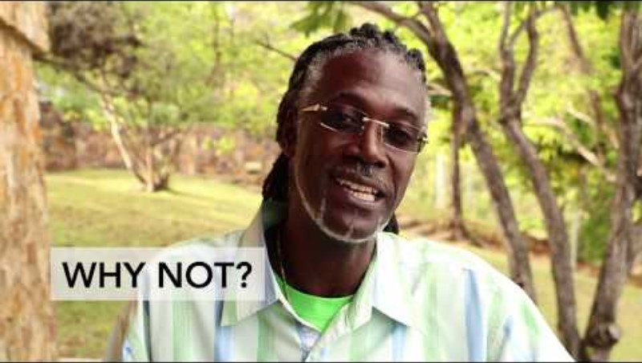
Example 1
Example 1

Slide 16
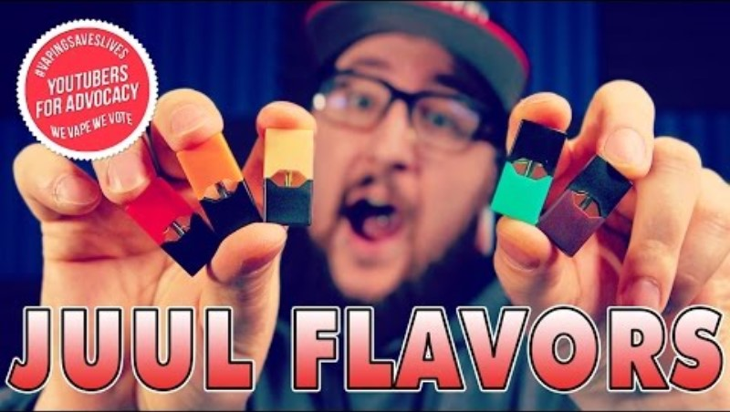
Example 2

Slide 17
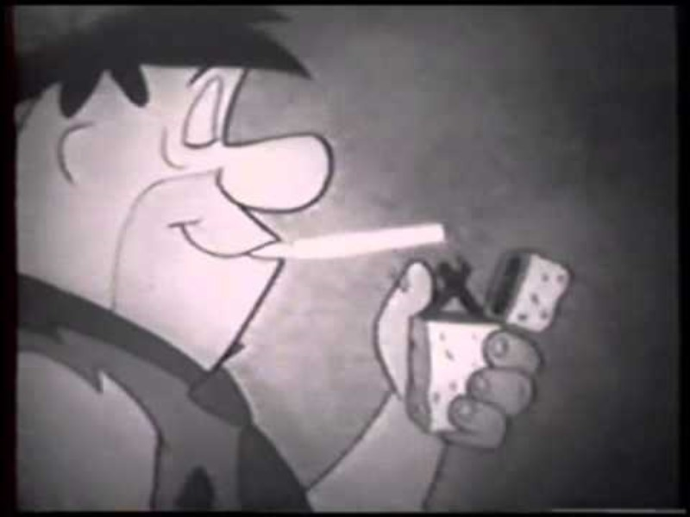
Example 3
Example 3

Slide 18

Group Discussion
What factors influenced your group’s decision in answering the CRAAP test questions? What stood out to you the most during your review?
Did your group members initially agree, or did you have different perspectives? How did your background knowledge or personal experiences impact the way you interpreted the information?
After hearing other groups' perspectives, would you change or adjust any part of your decision? Why or why not?

Slide 19
Stop and Jot (3)
Take a moment to reflect on today’s lesson:
What role do you play in shaping societal attitudes toward substance use?
What changes would you advocate for in future drug policies or education?
Notes:
After students write down these characters:
how difficult this task was.
Ask if it would be easier to brainstorm characters that are negatively portrayed.
Ask the class how the negative portrayal impacts how people think about substance use disorders.

Slide 20
Key Ideas
Media is all around all the time and aims to influence our choices.
By taking a critical look at media, we can use it responsibly as a tool.
Before acting on information shared via social media, direct markets or entertainment, stop, review and reflect on it.

Slide 21
Exit Ticket
What are at least two strategies media uses to influence people’s actions?
Name at least two things you should review to determine if a source is credible.
Rate your ability to use media responsibly to inform decisions.
1: I am not sure how to review media to inform decisions.
3: I have a few strategies for reviewing and reflecting on media to inform my decisions.
5: I feel confident that I can critically review media that informs my decisions.

