Slide 1
Medicine Safety
Grades K–1
Authored by Oregon Department of Education

Slide 2


Essential Questions
What is a trusted adult?
Who are my trusted adults?
How can a trusted adult help me be safe with medicine?

Slide 3


Learning Goals
I can name a trusted adult who can help me be safe with medicine.
I can explain why I need a trusted adult to help me be safe with medicine.

Slide 4


Share What You Know With a Partner
What do you know about medicine?

Slide 5


Words to Know
Medicine: Something we use to help our bodies stay healthy.

Slide 6

How can medicine help us?
Keep us healthy
Make us feel better when we are sick

Slide 7

How can medicine hurt us?
Take medicine when we don’t need any
Take too much medicine
Take the wrong medicine or someone else’s medicine
Don’t follow directions for using medicine
Mix different medicines together

Slide 8
Trusted Adults
We don’t take medicine on our own. We only take medicine from an adult we trust.
Can you think of a trusted adult you know?
Who can help you know if someone is a trusted adult?
A trusted adult is a grown-up in our life who we count on to keep us safe. Trusted adults can help us take medicine safely and help keep medicine from hurting us.

Slide 9
Discussion Activity
At my signal, move and find a partner to have a conversation.
I will share a picture of a trusted adult on the slide. Look at the picture and talk about the person on the slide with your partner. Who is this trusted adult? How can they help us be safe with medicine?
I will ask some partners to share their ideas, and we will talk about the picture as a whole group.
Then, I will ask you to move and find a new partner. We will repeat the activity with new pictures.

Slide 10
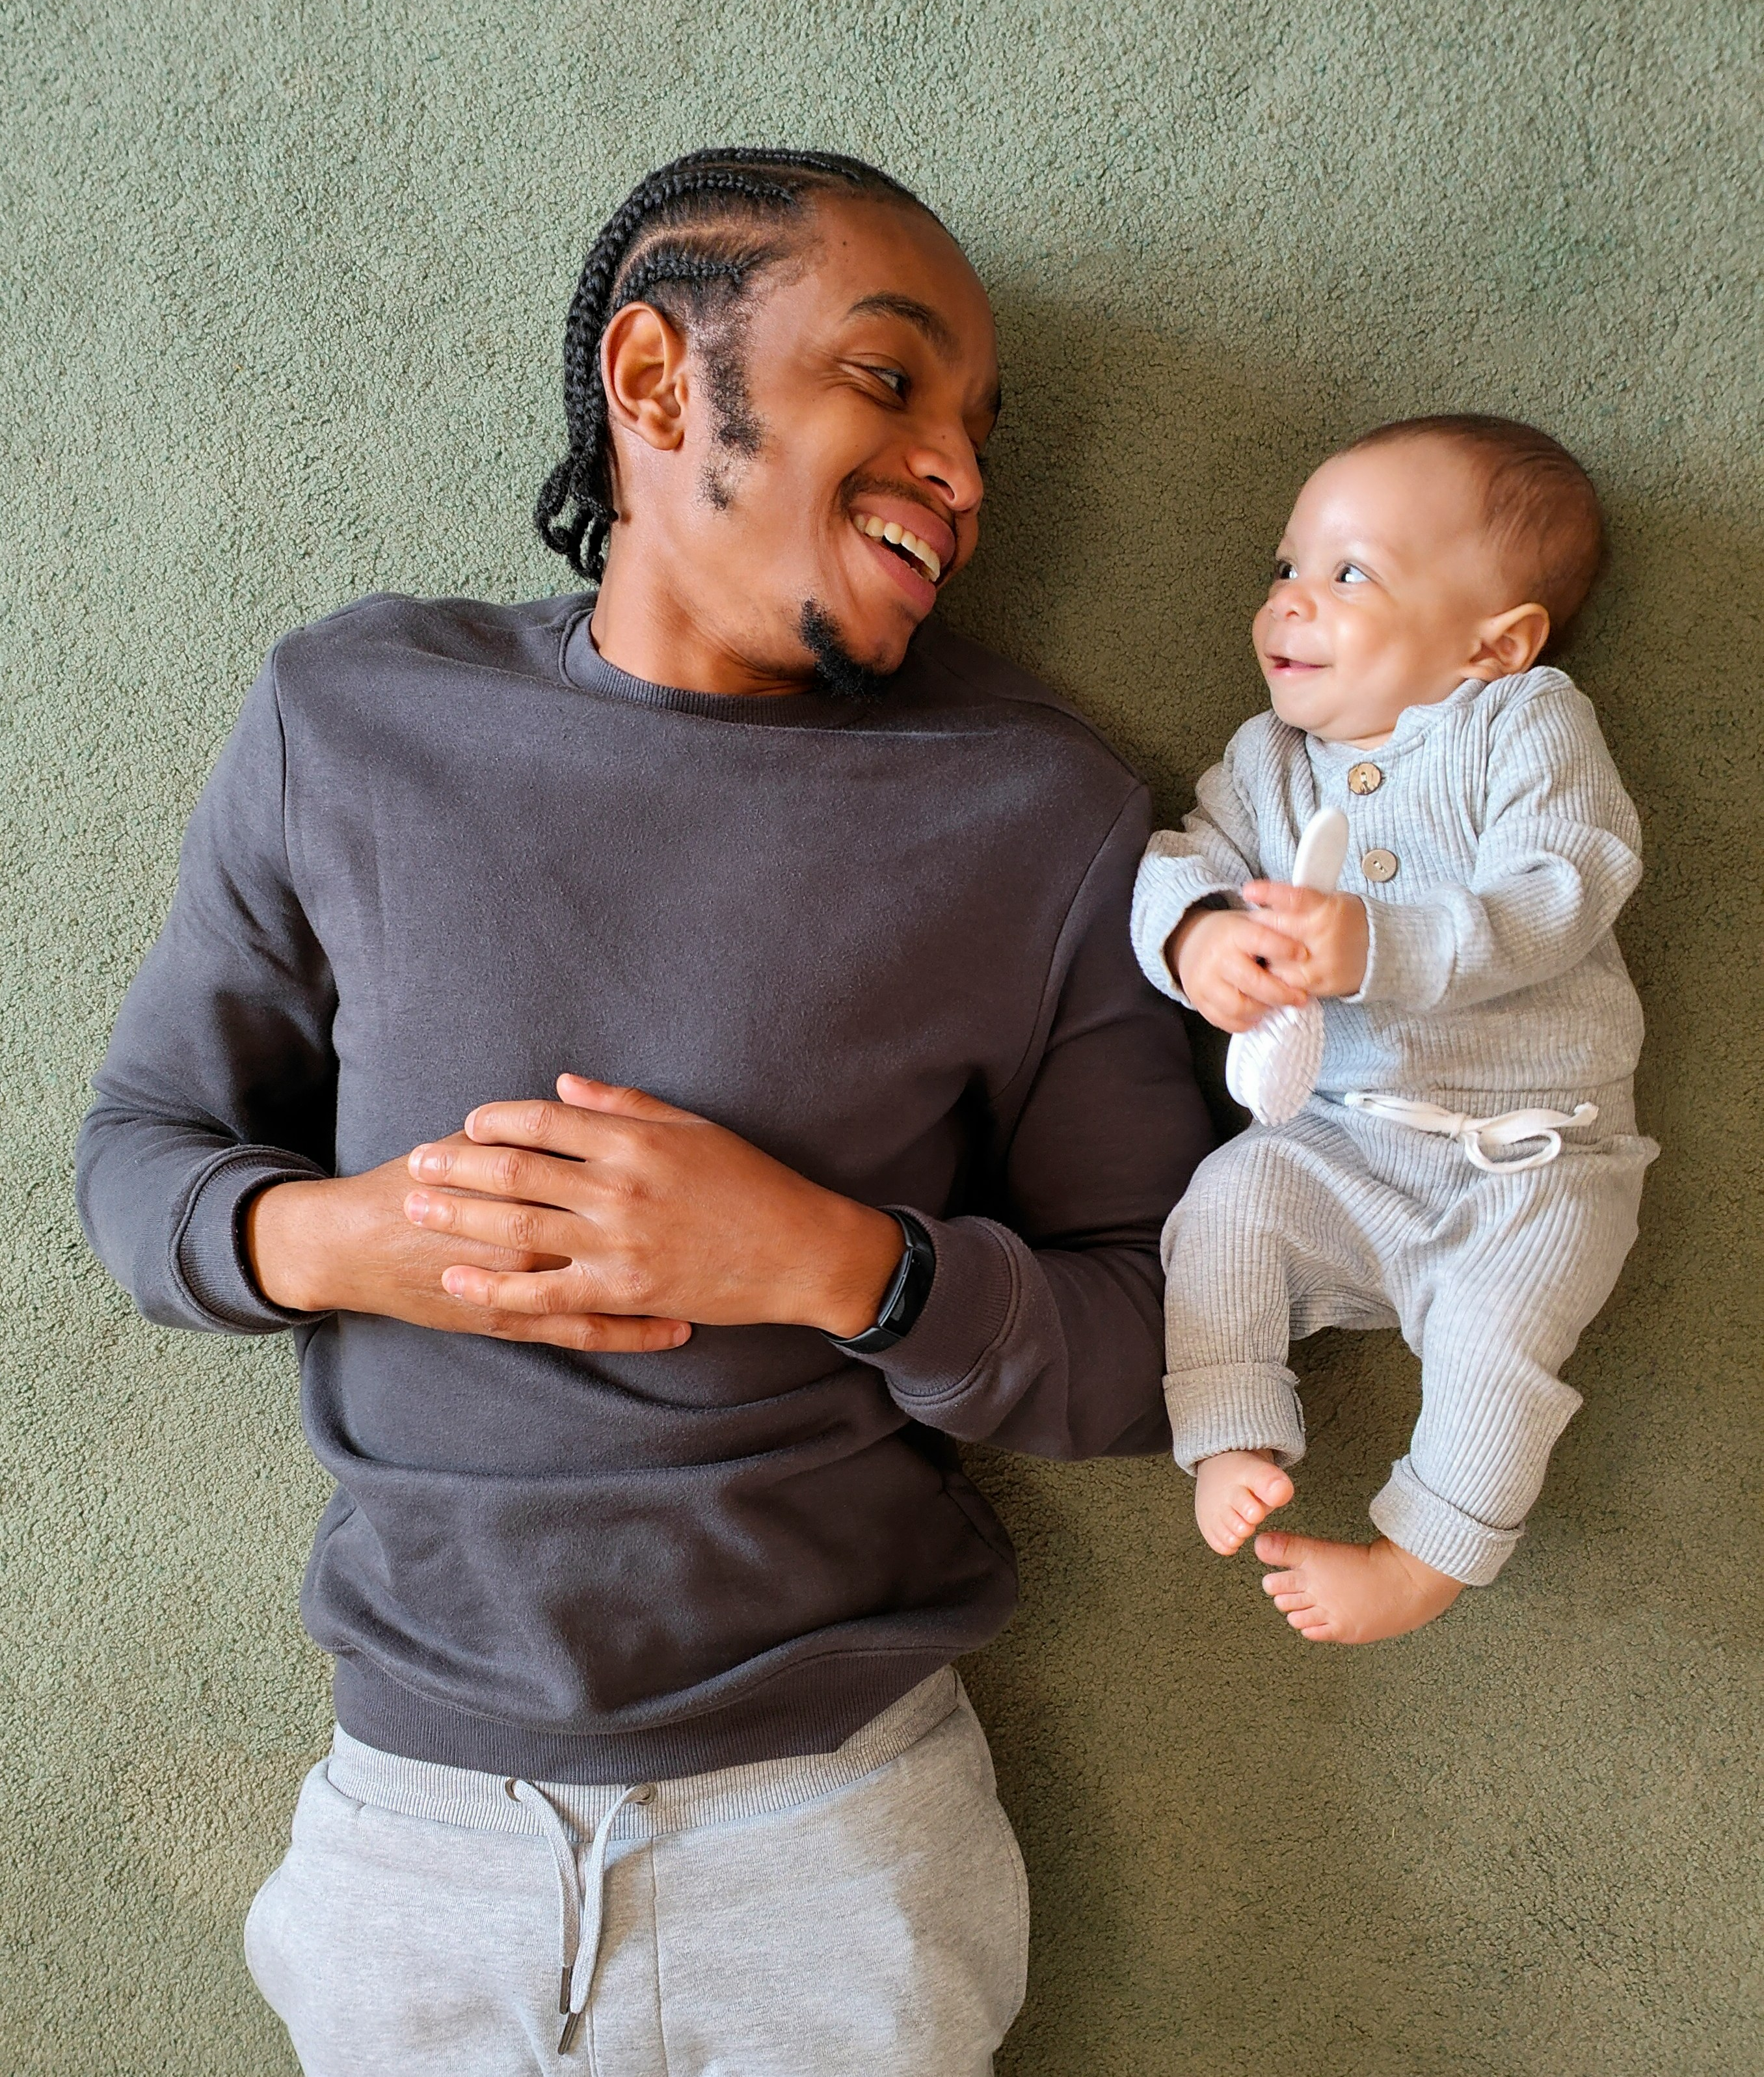
Trusted Adult 1

Slide 11
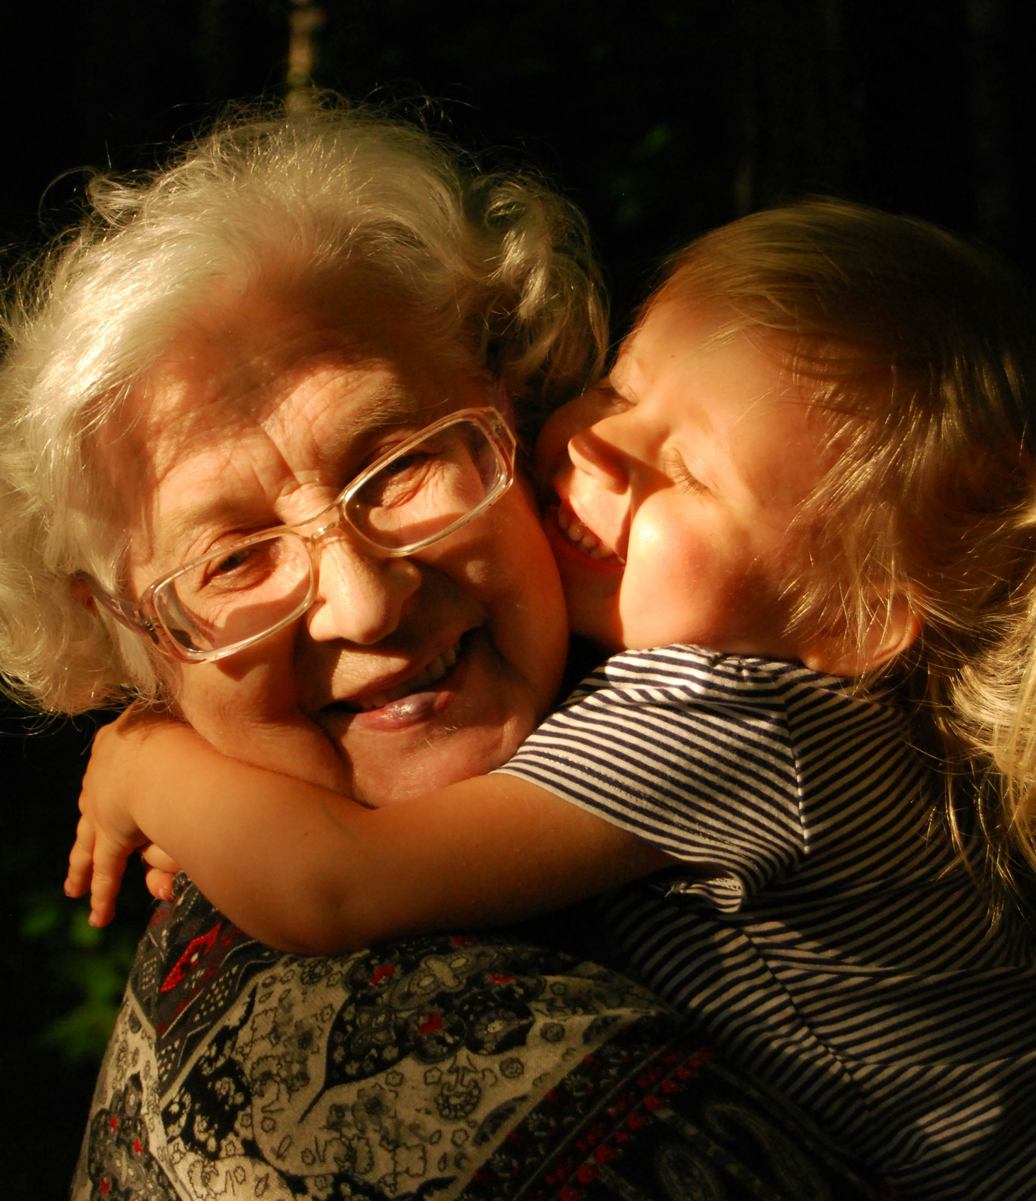
Trusted Adult 2

Slide 12

Trusted Adult 3

Slide 13

Trusted Adult 4

Slide 14
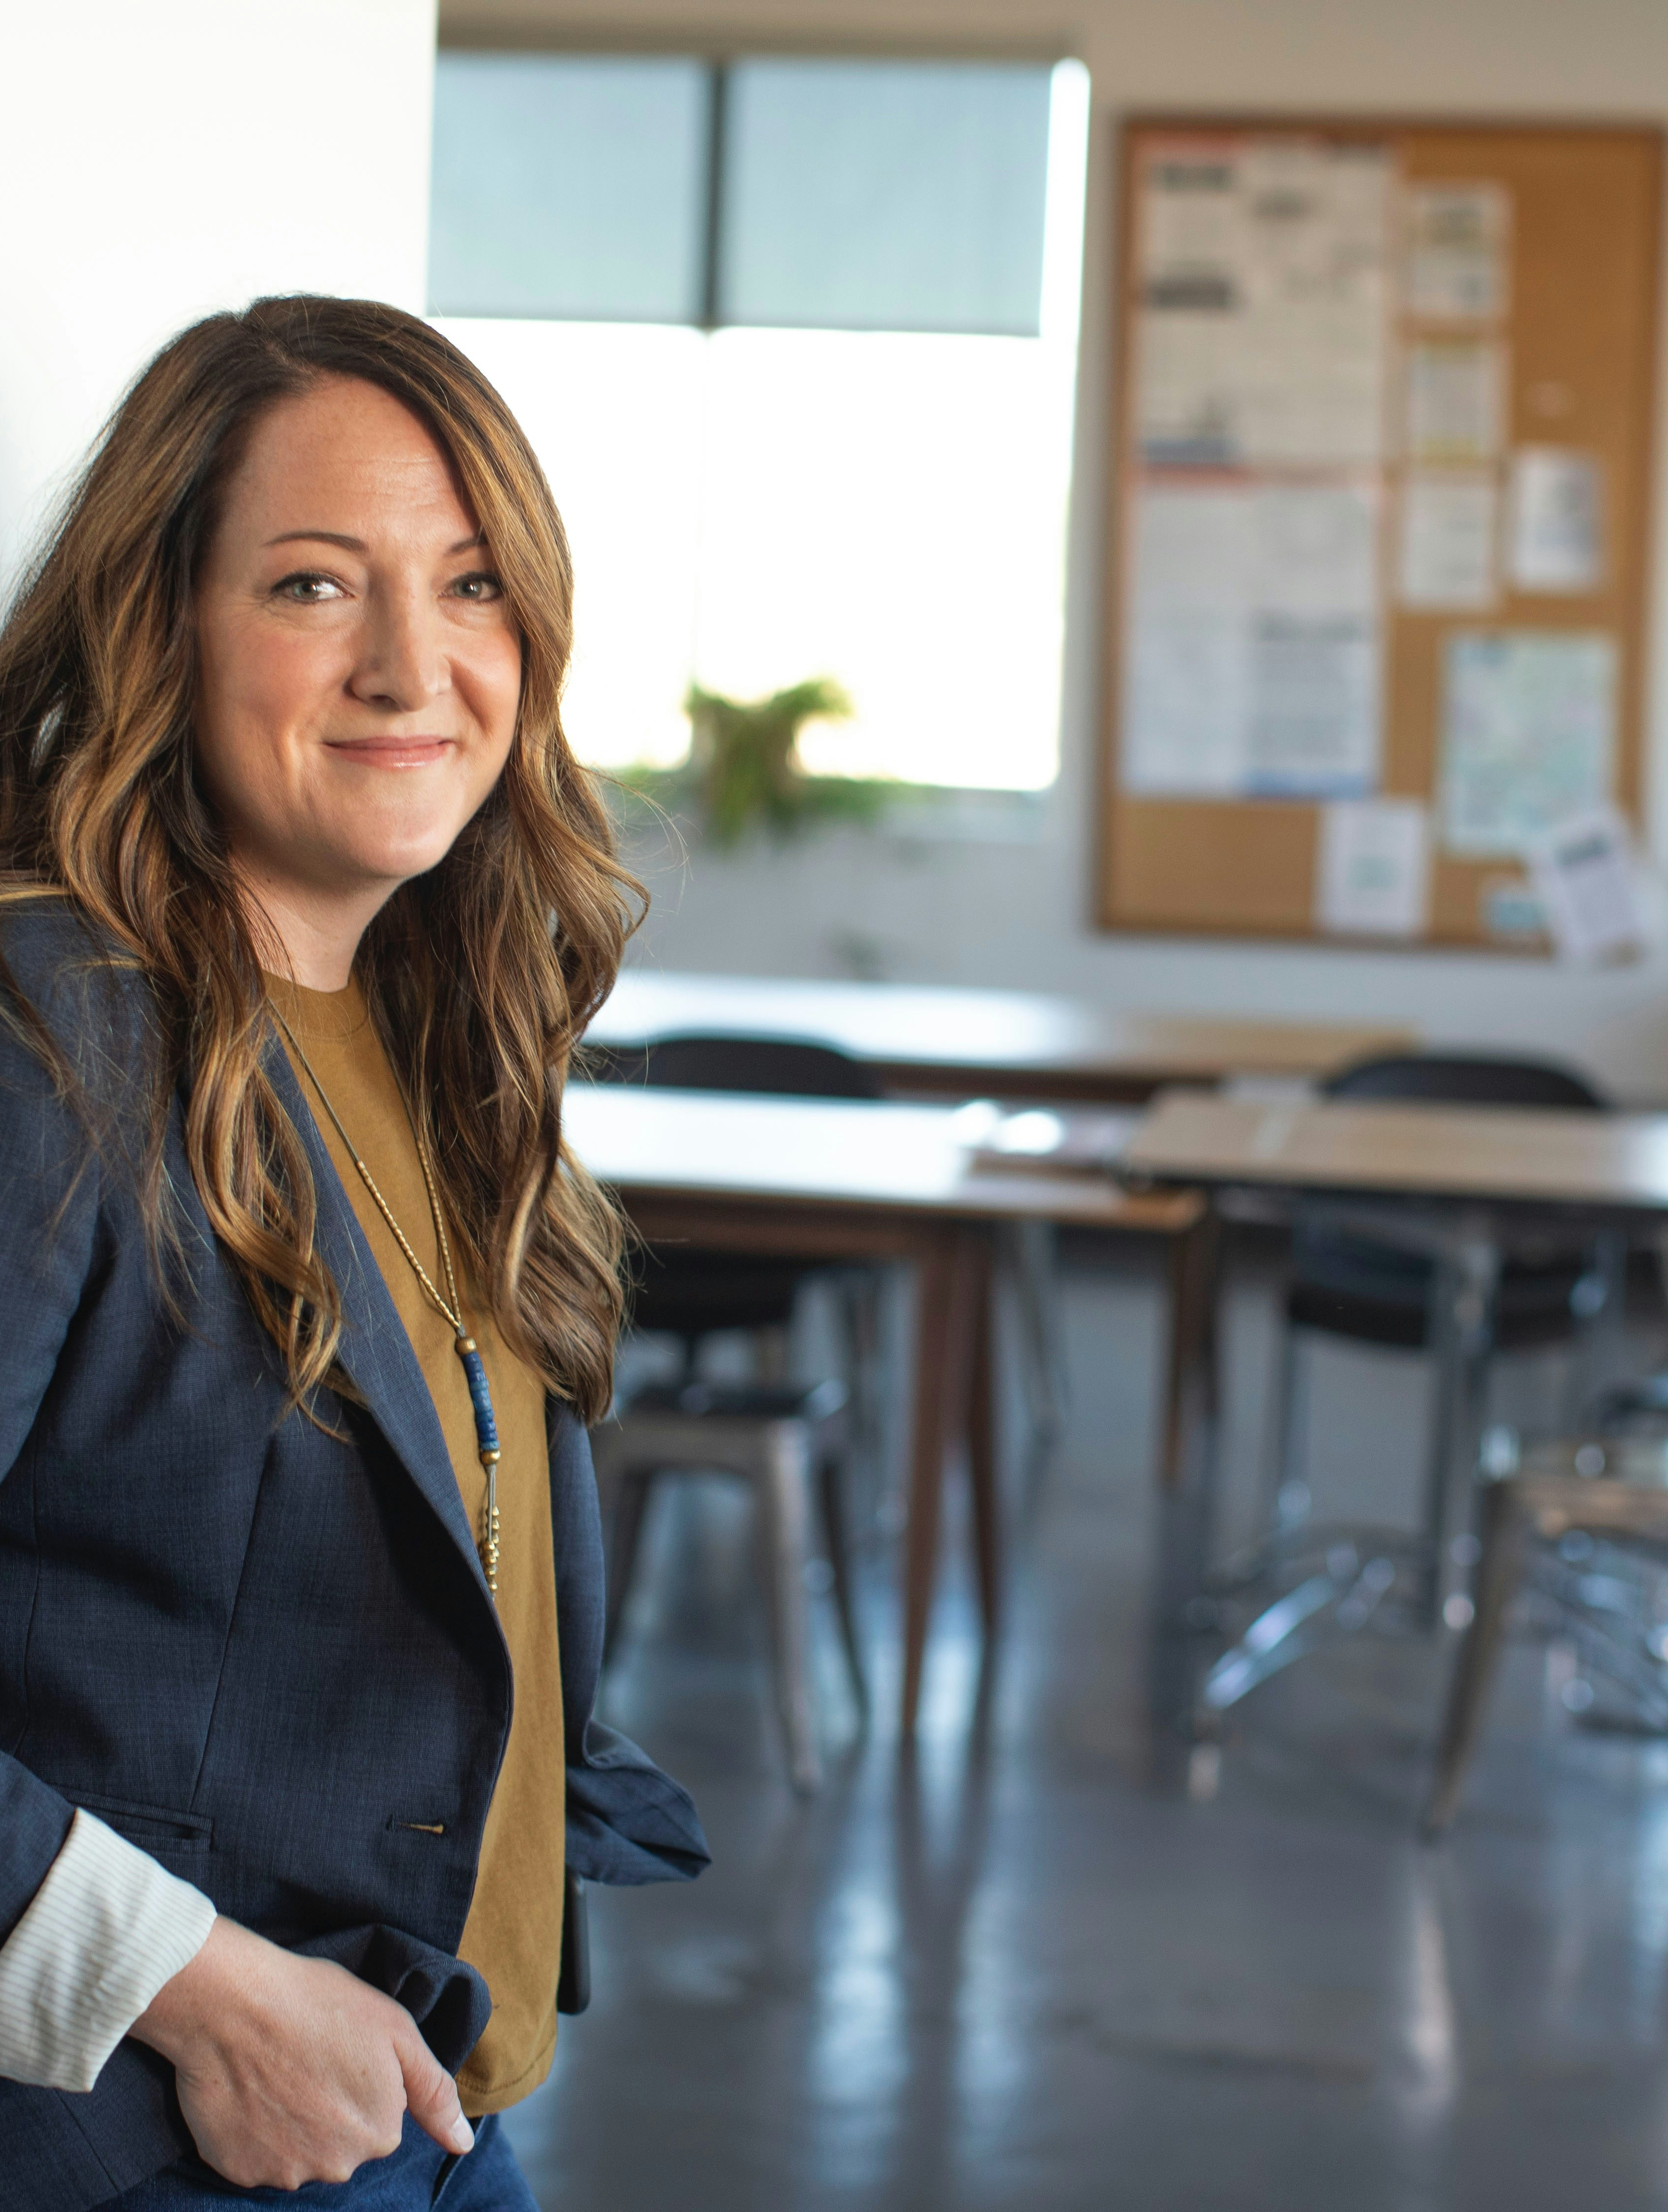
Trusted Adult 5

Slide 15
Essential Questions Review
What is a trusted adult?
Who are my trusted adults?
How can a trusted adult help me be safe with medicine?

Slide 16
Learning Goals Review
I can name a trusted adult who can help me be safe with medicine.
I can explain why I need a trusted adult to help me be safe with medicine.

Slide 17


Think On Your Own
Who is a trusted adult you know who can help you be safe with medicine?

