Slide 1
Medicine Rules to Follow
Grades K–1
Authored by Oregon Department of Education

Slide 2


Essential Questions
What are some rules about medicine?
Why do we have rules about medicine?

Slide 3


Learning Goals
I can name some rules for using medicine safely.
I can explain why we have rules about medicine.

Slide 4


Share What You Know With a Partner
What rules about medicine do you know?

Slide 5

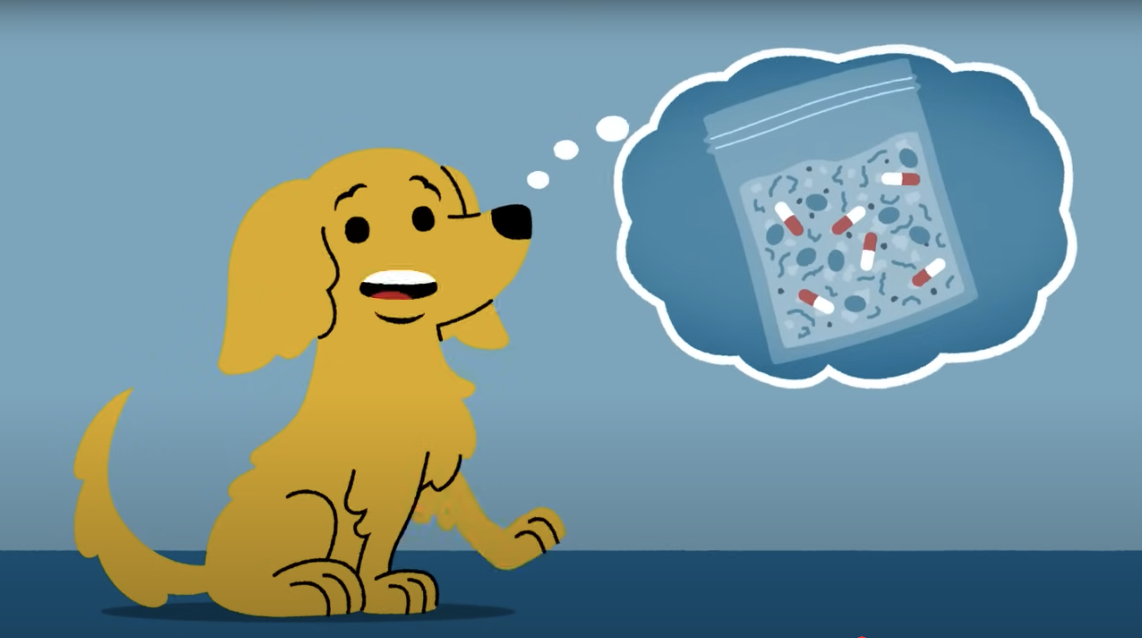
Video: Using and Keeping Medicine Safe
Using and Keeping Medicine Safe
For Kids 5–8 Years Old: Using and Keeping Medicine Safe

Slide 6
Medicine Rules
Keep medicine out of reach and secure safety caps.
Only trusted adults can give us medicine.
Take the right amount of medicine when we need it.
Follow medicine instructions.
Throw away medicine safely.
Don’t share medicine or take someone else’s medicine.

Slide 7


I Can Follow Rules About Medicine
Think about the medicine rules we learned today.
What is one medicine rule you can follow?
Draw a picture that shows you following this rule.

Slide 8
Essential Questions Review
What are some rules about medicine?
Why do we have rules about medicine?

Slide 9
Learning Goals Review
I can name some rules for using medicine safely.
I can explain why we have rules about medicine.

Slide 10


Think On Your Own
What is one medicine rule you want to remember?

