Slide 1
Module 0
Supplemental resources and learning activities to support facilitators of Modules 1 - 3

Slide 2
Welcome to Module 0
Module 0 is a leader-facing module with resources and activities intended to support facilitators of Modules 1 - 3. These resources aim to answer the following essential questions:
What is the role of leaders in promoting ambitious math teaching?
How can we build teachers' capacity to do this work?
Notes:
Facilitator Notes:
Orange Facilitator Guide slides orient facilitators in making sense of upcoming sections.
These slides are intended to be hidden from the deck during sessions.

Slide 3
Module 0: Table of contents
Part 1: Preparing for critical conversations
Supplement 1: Preparing for critical conversations: The discontinuation of tracking
Supplement 2: Preparing for critical conversations: Narratives about mathematics and students
Part 2: Supporting teachers' instructional practice
Supplement 3: Supporting teachers’ instructional practice: Facilitating rehearsals
Supplement 4: Supporting teachers’ instructional practice: Providing teachers with feedback

Slide 4
Module 1, 2 and 3
Module 1
Module 2
Module 3
Use Supplements 1 and 2 to prepare for critical conversations in Module 1.
Use Supplement 3 to prepare to facilitate rehearsals in Module 2.
Use Supplement 4 to prepare to provide teachers with feedback.

Slide 5
Preparing for critical conversations:
The discontinuation of tracking
Leader Supplement 1

Slide 6
Work through the following:
Read NCTM President Robert Berry’s message entitled Initiating Critical Conversations on the Discontinuation of Tracking
Then select ONE of the following:
  Reading 1: Opportunity Gap: A Call for Detracking Mathematics (position statement from NCSM, Spring 2020)
  Reading 2: Access and Equity (Principles to Actions excerpt)
Drawing on Robert Berry’s presidential message, reflect on how you would use your selected reading with your colleagues.
  What would be most important to emphasize with your colleagues and why?
  What questions might you ask?
  What might be difficult for you and/or your colleagues?

Slide 7
Optional Workspace
Use this space to record reflections on the readings, as it is helpful.
Drawing on Robert Berry’s presidential message, reflect on how you would use your selected reading with your colleagues.
What would be most important to emphasize with your colleagues and why?
What questions might you ask?
What might be difficult for you and/or your colleagues?

Slide 8
Initiating Critical Conversations on the Discontinuation of Tracking
NCTM Presidential Message, June 2018 from Robert Berry
Open: 1 Initiating Critical Conversations on the Discontinuation of Tracking_Berry
Quote: “Detracking is more than simply grouping students heterogeneously. Detracking is a deep commitment and an investment in people, curricula, and time to reach the goal of supporting and engaging each and every student in learning mathematics and increasing their opportunities. Teachers and leaders must be committed to the actions above when working towards the discontinuation of tracking.”

Slide 9
Opportunity gap: A call from detracking mathematics
Position Statement from NCSM, Spring 2020
Open: 2 Opportunity Gap: A Call for Detracking in Mathematics_NCSM
Quote: “More generally, a number of studies point to the influence course-taking patterns have on academic outcomes. This influence is true for student subgroups like emergent bilingual students and students from low income backgrounds, different racial and ethnic groups, and different genders. It may disable students from pursuing whatever course of study interests them when they get to high school, college, career or beyond. Tracking becomes worse for students year-over-year, as each consecutive year in a track makes it more difficult to move out of that track” (p. 1).

Slide 10
Access and equity
An excerpt from NCTM’s Principles to Actions, 2014
Open NCTM’s Principles to Actions, pp. 59 - 65 (“Access and Equity”)
Quote: “Research also shows that the learning of students assigned to lower-ability groups is depressed, regardless of their ability levels (Stiff, Johnson, and Akos 2011). When middle-level students thought to be “at risk” in mathematics are placed in grade-level mathematics courses and provided the support necessary to be successful in those courses, their achievement gains are greater, and they are more likely to enroll in upper-level math courses in the following years, than when they are placed in lower-ability math courses (Boaler and Staples 2008; Burris, Heubert, and Levin 2006). Further, evidence suggests that high-achieving students in heterogeneous classes are not statistically different from homogeneously tracked students in achievement and participation in Advanced Placement (AP) mathematics courses (Burris, Heubert, and Levin 2006; Staples 2008).”

Slide 11
Optional Workspace
Use this space for further reflection after reading.
Identify quotes or talking points from the reading(s) that would be most impactful in your work as a leader working with teachers.
Draft a beginning idea for how to use the quotes or talking points in a conversation with teachers.

Slide 12


Other helpful readings as you continue to reflect on tracking
Catalyzing Change in High School Mathematics, NCTM (2018)
“Tracking students into weak, low-quality, and dead-end course pathways creates a gap that widens as it puts students further and further behind in the curriculum…The placement of students in instructionally, qualitatively different, and dead-end course pathways …severely limits, and all too often ends, students’ opportunities in mathematics and mathematics-related careers.” (p 17)
Mathematical Mindsets, Jo Boaler (2016)
“One key factor in student achievement is known as ‘opportunity to learn.’ Put simply, if students spend time in classes where they are given access to high-level content, they achieve at higher levels. Of course, this is not surprising to any of us, but what is surprising is that even though we know opportunities to learn are the most important condition for student learning (Wang, 1998; Elmore & Furman 1995), millions of students are denied opportunities to learn the content they need, and that they can master, as they are placed in low-level classes.” (p.111)

Slide 13
Preparing for critical conversations:
Narratives about mathematics and students
Leader Supplement 2

Slide 14
The work of the ambitious teaching modules is likely to surface deficit narratives
Deficit narratives about students are deeply rooted in mathematics education systems and are grounded in long-standing structures and practices which are particularly harmful to students on the basis of their racial, gender, linguistic, cultural, and ethnic identities.
  2+1 is an effort to reorganize some of these structures!
Deficit narratives impact all of us and translate into our practice.
In addition to making changes at a system-wide level, it is important to look for and question how our own practices are impacted by deficit narratives.
  This is brave and courageous work for us and for our participants!
      (NCTM, 2018 p. 21-22; Aguirre et al., 2013 p. 20-21)

Slide 15
Productive mindsets and practices to support new narratives
Read: Continuing the Journey: Mathematics Learning 2021 and Beyond (NCTM, 2021). In particular, note the table on page 6 entitled “Disrupting unproductive mindsets and practices that inhibit learning”
Reflect: Which productive mindsets and practices do you especially want to foster at your site? Why? What unproductive mindsets feel especially important for you to work to look for and question? Why?
Productive mindsets and practices (from p. 6)
Create a mindset that views mathematics as an interconnected web of concepts, knowledge and skills
Believe that all students are mathematically brilliant
Deeply understand standard(s) and learning goals in a unit
Elicit and examine your knowledge of students
Invite students into the mathematics of the unit
Make connections explicit
Value reflection and revision
Establish a culture of feedback.
Practice responsive teaching
Notes:
Additional Resource:
You might consider further reflection on how your particular site is supporting systems that help teachers enact and learn to enact ambitious math instruction by taking this self assessment from NCSM: School-Based Mathematics Program Needs Assessment Tool

Slide 16
Work through the following:
Read Coaching for equity demands deeper dialogue (Bocala & Holman, 2021)
Listen to or watch the Math Teacher Lounge podcast episode “Wrong but brilliant” with Megan Franke
Reflect: How do the ideas and perspectives from these two resources support your thinking around how you might approach deficit narratives that circulate in your context, and how you might respond when they arise in conversations?

Slide 17
Planning for critical conversations about mathematics and students
Optional Workspace
Select 3-4 “Unproductive Mindsets and Practices That Inhibit Learning” (from page 6 of Continuing the Journey) that you would like to look for and question. Use ideas from “Continuing the journey,” “Coaching for equity demands deeper dialogue,” and “Wrong but brilliant” to support you in responding. Rehearse or script out what you might say, do, or how you would set up your planning/PD sessions to challenge this mindset/idea. Record some rough draft thinking.

Slide 18
Supporting ambitious instructional practice:
Facilitating rehearsals
Leader Supplement 3

Slide 19
Work through the following:
Read the Teacher Education by Design primer entitled Leading Rehearsals
Reflect on key takeaways from the primer.
  What are three key points that resonate with you? Why?
  What are some implications for your practice?
  What action steps do you plan to take as a result of the reading?

Slide 20
Leading Rehearsal
Primer from Teacher Education by Design (TEDD.org)
Open: Leading rehearsals primer_TEDD
Quote: “Rehearsals are a problem solving space in which teachers can practice coordinating the complexities of classroom teaching, attending to the interactions between teacher, students, and the disciplinary content to be learned. Through rehearsals, teacher educators can support teachers to discuss and analyze instructional decision-making by trying out a planned instructional activity.” (p. 1)

Slide 21
Optional Workspace
Use this space to record reflections on the readings, as it is helpful.
Reflect on key takeaways from the primer.
What are three key points that resonate with you? Why?
What are some implications for your practice?
What action steps do you plan to take as a result of the reading?

Slide 22
Now, prepare to facilitate your own rehearsal.
Read the Teacher Education by Design primer entitled Getting Started With Rehearsals
Turn to Sessions 12 and 13 in Module 2 and remind yourself of the content of these sessions. In Session 12, participants will plan a lesson, with careful attention to eliciting students’ rough draft thinking and maintaining the cognitive demand of the lesson. In Session 13, participants will rehearse the lesson with colleagues.
Drawing on the primer, consider how you will facilitate the rehearsal with participants in your context.

Slide 23
Getting started with rehearsals
Primer Teacher from Teacher Education by Design (TEDD.org)
Open: Getting started with rehearsals_TEDD
Quote: “How will you maintain a productive learning environment for teachers? During the initial rehearsals, the facilitator must support teachers to develop identities as capable leaders of ambitious instruction while also helping teachers refine their practice. It is the role of the facilitator to make sure that teachers face actual problems of practice during the rehearsal and have the opportunity to try out different solutions. This calls for a thoughtful balance of teacher educator moves that offer pressure and support without interrupting the flow of the lesson. Consider the following types of moves that teacher educators can make during rehearsals and how you can use these strategically.” (p. 2)

Slide 24
Optional Workspace
Use this space for planning after reading.
Drawing on the primer, reflect on how you will facilitate the rehearsal in Session 13 (Module 2 Part 3) with participants in your context.
Notes:
You can use one of the planning templates at the Leading Rehearsals TEDD.org page, if that feels appropriate and helpful.

Slide 25
Other resources when preparing for rehearsals from Teacher Education by Design (TEDD.org)
The Leading Rehearsals page at TEDD.org has a number of other resources you might find helpful in preparing for the Session 12 lesson-planning and Session 13 rehearsal:
Videos of rehearsals, to get a sense of what they can look like
Planning templates to support you as you prepare
A sample script for introducing rehearsals
Sample norms for rehearsals

Slide 26
Supporting ambitious instructional practice:
Providing teachers with feedback
Leader Supplement 4

Slide 27
Providing teachers with feedback is critical to supporting their ongoing efforts to practice ambitious math teaching.
Self-assess how you or your school/district site provides teachers feedback by considering the statement below from NCSM’s School-Based Mathematics Program Needs Assessment Tool:
“We collectively monitor progress in attaining the mathematics teaching and learning vision, and feedback is provided to teachers and staff in meeting the shared vision.”
On a scale of 1-4 (1 being “we’re stuck” and 4 being “we’re thriving”) how would you rate your current feedback practices?
Note: See the second row of the table on page 1, for additional self-assessment prompts related to feedback.

Slide 28
How do you currently give teachers feedback?
Hallway conversation with an individual teacher
Formal observations/evaluations
Small group discussion in a PD or planning session
??
One way to sustainably and regularly offer feedback to teachers is through the use of “Data Snaps”

Slide 29
What are data snaps?
A “Data Snap” is a 7-10 minute classroom observation in which one or more data collectors document student actions and interactions that relate to one or two instructional focus questions selected by an inquiry group. In some instances, the data collectors also document instructional moves that relate to the student data. The data collected during a Data Snap Cycle provide a snapshot for reflection by the inquiry group members. The purpose is professional learning, not teacher evaluation.
An inquiry group could be a grade-level or cross grade-level team of teachers working together on a particular aspect of instruction and/or mathematical idea, or the inquiry group could be school leaders wanting to gain a broad perspective of what typifies mathematical talk, thinking, and/or engagement across their school(s). A data collector could be the principal and/or other administrators from the school or district, a member (or all members) of the inquiry group, classroom coaches, classroom teachers, and/or an outside consultant.
One Data Snap Cycle involves collecting data from several classrooms, and Data Snap Cycles may repeat regularly (e.g., monthly or quarterly), focusing each cycle on:
The same instructional focus question, providing data for reflection about change over time
A set of related focus questions (e.g., a set of questions from one or several Tools or TDG’s Habits, Routines, and Actions tool).

Slide 30
Offering “Mathematically Productive Feedback” in the context of data snaps
Read Mathematically Productive Feedback to Teachers (TDG, 2020b) and consider the following prompts:
How might you incorporate “Data Snaps” into your existing practices for observing teachers’ work and offering feedback?
What new ideas or questions do you have about giving feedback to teachers about their work?
Which of the four aspects of “Mathematically Productive Feedback” offered in the tool feel most important for you to practice and work on? Why?
Guidelines for the content and structure of the feedback.
Descriptive
Purposeful
Focused
Motivating

Slide 31
Examples of written “Data Snap” feedback
Read the example feedback between M (teacher) and K (coach). What do you notice/wonder? What might the affordances of written feedback be? How might you support dialogue between observers and teachers?
Hi K:
I’m glad you came in today. Come in anytime, my door is always open. Here are my ideas about how to replicate this productive discussion.
This might have been a good time to stop the class and call out the math habits that were demonstrated. In other words Erik explained, the group ‘Listened to understand’, asked genuine questions and this helped all of them get past their ‘stuck point’. It might have leveraged more groups to persevere and help each other.
Maybe Erik could have explained to the class?
Another idea might be to call a huddle to get the information about the rule back to each group.
Or…maybe a plenary (whole class discussion) to discuss the confusion about the rule may have been in order.
What ideas do you have? M
Hi M:
It is always fun to be in your classroom-lots going on. I am practicing giving data snap feedback and you are my first try. We are in this together!
I noticed today in 4th period in Eric’s group that he was able to explain to his partner who was confused about the algebraic rule, 2x,2y, and why it worked. He was justifying his ordered pairs. This happened because you asked for Eric to clarify to his group why his rule worked. From this clarification the group was able to get beyond their stuck point. This also gave the group an example of mathematically productive talk—what it looks like and sounds like. One of my wonderings is how to replicate this productive discussion with the rest of the groups. Would like to hear a couple of ideas you have?
Thanks— K

Slide 32
Optional Workspace
Use this space to record reflections on the readings, as it is helpful.
Reflect on the example written Data Snap feedback.
What do you notice/wonder?
What might the affordances of written feedback be?
How might you support dialogue between observers and teachers?

Slide 33
Ideas for how different stakeholders might implement “Data Snaps”
Admin:
Leaders could arrange to do Data Snaps with Admin in math teachers’ classrooms to heighten the awareness of Ambitious Mathematics teaching practices for Admin. After a short classroom visit 5-7 minutes the group could discuss in the hallway the Ambitious Mathematics Teaching principles and/or practices observed and begin to develop feedback rehearsals of what might be shared with teachers using Mathematically Productive Feedback questions as a reference. After practicing together, this could move into writing a short feedback email to a teacher.
Teachers:
Build a schedule that allows each teacher to observe at least 2 other teachers for 5-10 minutes. Debrief outside the classroom using the Ambitious Teaching principles and/or practices and/or Math Habits, Routines and Actions tool to focus discussion.
Department Leaders/ Teacher Leaders & Admin Team:
Teacher Leaders and Admin Team spend around 7 minutes per classroom. Together they brainstorm and rehearse Mathematically Productive Feedback in the hallway, then one person pulled the teacher to share their feedback (for about 1-2 min) while another person stepped into the classroom to cover the class. Alternatively, construct an email or post note of feedback for the teacher. Teachers knew this was for their learning and to support the practice of teacher leaders and admin in sustaining ambitious math teaching.

Slide 34
Practice analyzing feedback to teachers
When I dropped into your room today I noticed that you had students up front sharing their work from their graphing calculators and comparing it to the paper, pencil graphing. This gives students a visual comparison and you mentioned, a better understanding of the value of the calculators. I wonder what might be a variety of strategies to motivate students to compare and contrast their methods with each other? This is something that could occur over and over in lessons. I would be happy to brainstorm with you, if you want a thought partner.
What do you notice and wonder about this feedback to a teacher?
How does the feedback relate to the guidelines for the content and structure of the feedback?
Descriptive
Purposeful
Focused
Motivating

Slide 35
Reflect on your own feedback practices
Consider the list on the right: What percent of your communication with teachers represents each of the bullets?
Giving advice?
Criticizing?
Asking questions and finding out what the teacher intended?
Sharing curiosity about students’ thinking?
Problem-solving collaboratively on a specific issue?
Praising or affirming?
Other
What makes these modes of communication productive or unproductive?

Slide 36
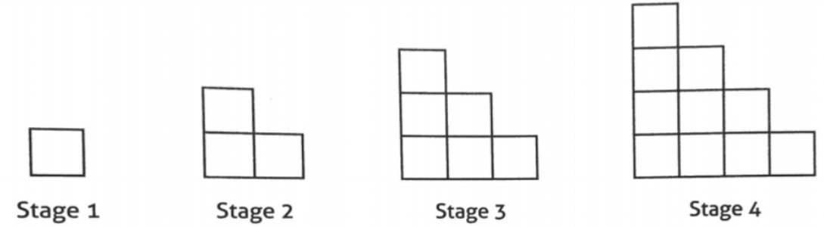
Practice giving feedback to teachers using video
Decide on the lens you plan to use to support your “observation”
  NCTM’s 8 practices of ambitious math instruction
  TDG’s Habits, Routines, & Actions tool
Examine the student task (below). What do you anticipate student discourse will sound like?
Watch the video from chapter 2 of The 5 Practices in Practice: Successfully Orchestrating Mathematics Discussions in Your High School Classroom from (Smith et al., 2020)
  As needed, draw on the the transcript of the lesson from Use the Mathematically Productive Feedback to Teachers tool (page 2) to support your work crafting feedback to the teacher

Slide 37
Practices of ambitious mathematics teaching (NCTM, 2014)
Which of these practices will you look for or focus on in your “observation”?
Establish mathematical goals to focus learning
Implement tasks that promote reasoning and problem solving
Use and connect mathematical representations
Facilitate meaningful mathematical discourse
Pose purposeful questions
Build on procedural fluency from conceptual understanding
Support productive struggle in learning mathematics
Elicit and use evidence of student thinking

Slide 38
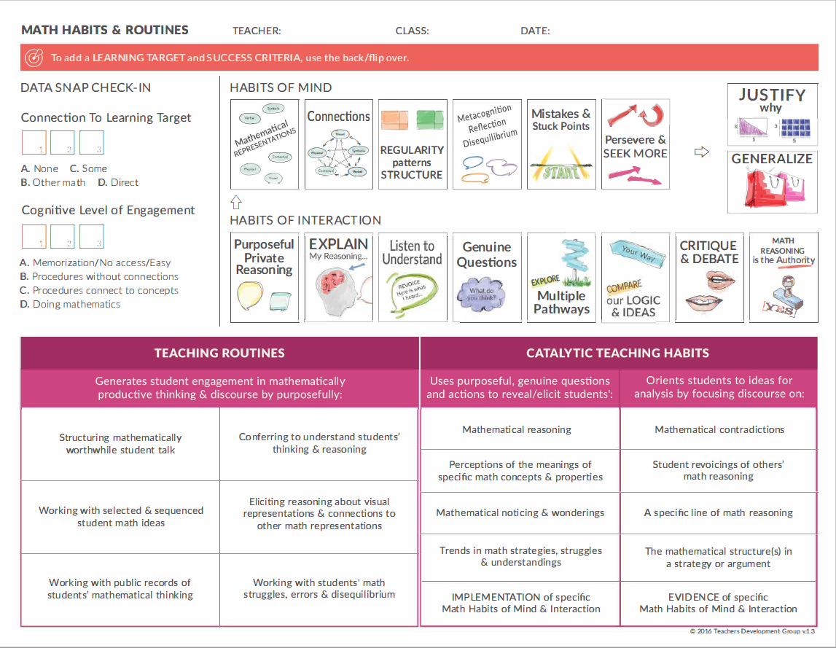
Habits, Routines, and Actions Tool (TDG, 2020a)
What habits did you see students use?
What teacher actions supported student use of the habits to make sense of the mathematics?
Link to the Habits, Routines, and Action Tool

Slide 39
Digging deeper: What does “descriptive” feedback sound like?
Descriptive feedback: Avoid judgments. Instead, give descriptive data grounded by student mathematical discourse (i.e., students’ mathematical thinking, actions, and interactions) that involves one or more students’ math reasoning, conjectures, justifications, and generalizations (Foreman, 2020 p. 1).
Example 1: When you invited the class to discuss Nyleah’s pattern, I heard several students make connections to the structure of the pattern. These connections will help students generalize about the patterns. I am wondering if any students saw it differently.
Example 2: When Nyleah said “so you see on stage 4 there are 4 here” and pointed towards the board, you asked her if she would come draw on the board. This was an important move because the visual helps students understand the connections that Nyleah is making between the pattern and the figure number. I am wondering if Eli understood then how his revoicing was different from Nyleah’s initial idea.
What do you notice/wonder about the two examples? How are they the same/different?

Slide 40
Digging deeper: What does “motivating” feedback sound like?
Motivating: Provide a specific “building block” statement or wondering that is likely to motivate focused inquiry, wondering, and/or mathematically productive action (e.g.,to continue, modify, or extend a practice) by the teacher. May include an invitation to inquire together about some aspect of student thinking.
Example 1:
I wonder if an opportunity for students to turn and talk with their partner would increase engagement.
Example 2:
I wonder how what happened is the same/different from what you had planned.
Example 3:
I wonder how your respect for Jasmine’s stuck points impacted the mathematical identities of all students in the class.
What do you notice/wonder about the three examples? How are they the same/different?

Slide 41
Using continuums to support the work of offering feedback
Click to view the Mathematical Teaching Practices Continuums from NCSM
Reflect on the following prompts:
  Do a quick survey of the titles of the different continuums: Which one would be most helpful at your site? Why?
  How are the continuums related to your understanding of ambitious math teaching?
  How could the continuums help with giving teachers feedback?
    What specific ideas or language from the continuums might you be able to make use of?

Slide 42
Optional Workspace
Use this space to record reflections on the readings, as it is helpful.
Reflect on the continuums.
Do a quick survey of the titles of the different continuums: Which one would be most helpful at your site? Why?
How are the continuums related to your understanding of ambitious math teaching?
How could the continuums help with giving teachers feedback?
What specific ideas or language from the continuums might you be able to make use of?

