Slide 1
Module 1
Part 2: Tracking and a 2 + 1 model alongside our understandings of ambitious math teaching

Slide 2
Facilitator Guide: Welcome to Module 1, Part 2!
In Module 1, we will work to understand the foundations of high school math teaching, including what ambitious math teaching is and how a 2 + 1 model can support ambitious math teaching.
In Module 1, Part 2, we focus especially on clarifying our visions of ambitious math teaching, reflecting on our expectations for students, the principles and practices guiding our work, and the importance of solving authentic problems.
Notes:
Facilitator Notes:
Orange Facilitator Guide slides orient facilitators in making sense of upcoming sections.
These slides are intended to be hidden from the deck during sessions.

Slide 3





Facilitator Guide: Professional learning activity types
Setting and maintaining norms: These activities support participants to establish norms that will guide participation in sessions.
Doing math together: These activities engage participants in a mathematics task.
Studying teaching: These activities involve analysis of video, vignettes, live teaching, or instructional tools.
Connecting to research: These activities involve unpacking and understanding the research in mathematics education underpinning focal ideas and concepts.
Planning for action: These activities involve making links between session content and our own practice and contexts.
Notes:
Facilitator Notes:
Icons appear on section header slides throughout the slide deck, both for facilitators and participants

Slide 4
Facilitator Guide: Table of contents
Session 4: Understanding ambitious math teaching: Considering tracking and a 2 + 1 model alongside our understandings of ambitious math teaching (90 minutes)
Setting and maintaining norms: Reconnect with and revise our norms for interacting together
Connecting to research: Understanding the aims of the Oregon Math Project effort
Connecting to research: Considering tracking in relation to ambitious math teaching
Connecting to research: Considering a 2 + 1 model in relation to ambitious math teaching
Planning for action: Planning to overcome barriers to implementing ambitious math teaching
Session 5: Deepening our understanding of what a 2 + 1 model can look like in practice (90 minutes)
Setting and maintaining norms: Reconnect with and revise our norms for interacting together
Doing math together: Experiencing what a task might look and sound like in a 2 + 1 model (the Anime Festival task)
Connecting to research: Noticing and building on students’ strengths in a 2 + 1 model
Planning for action: Applying our learning about ambitious math teaching and a 2 + 1 model
Session 6: Returning to key aspects of ambitious teaching in light of a 2 + 1 model (1 hr 45 minutes)
Setting and maintaining norms: Reconnect with and revise our norms for interacting together
Connecting to research: The role of cognitive demand in supporting all students’ learning
Connecting to research: The role of discourse in supporting all students’ learning
Doing math together: Seeing key aspects of ambitious math teaching in a data talk (Teen Behaviors)
Planning for action: Analyzing and revising a data talk in light of key aspects of ambitious math teaching
Notes:
Facilitator Notes:
Each of the sessions is designed to be enacted within a professional learning meeting.
We suggest that the sessions and activities within session be enacted in order if possible, as some of the content and ideas build on one another.

Slide 5
Essential Questions of the Ambitious Teaching Modules
Module 1: Foundations of High School Math Instruction | What is ambitious math teaching? Why is a 2 + 1 model important for equitable outcomes in mathematics?
Module 2: Principles and Practices of Ambitious Math Teaching | What does ambitious math teaching look like at the unit, lesson, and task levels? How do we value and build on the mathematical strengths of students who are often excluded by schooling?
Module 3: Principles and Practices of Sustainability | What planning, teaching, and assessment practices can be used to sustain ambitious math teaching?
Notes:
Facilitator Notes:
You might say: Let’s remind ourselves of the Essential Questions that drive the Ambitious Math Teaching Professional Learning Modules.

Slide 6
Reconnecting to our thinking from the previous sessions
Notes:
Facilitator Notes:
Optional: Paste excerpts of participants’ reflections from previous sessions to support the group in reconnecting with the work you have done together previously.
You might ask: What learning from our previous sessions are you excited to or hoping to build on today?

Slide 7
Considering tracking and a 2 + 1 model alongside our understandings of ambitious math teaching
Session 4
The focus of this session is to consider tracking and a 2 + 1 model alongside our understandings of ambitious math teaching.
Agenda for this session:
Setting and maintaining norms: Reconnect with and revise our norms for interacting together
Connecting to research: Understanding the aims of the Oregon Math Project effort
Connecting to research: Considering tracking in relation to ambitious math teaching
Connecting to research: Considering a 2 + 1 model in relation to ambitious math teaching
Planning for action: Planning to overcome barriers to implementing ambitious math teaching
Time estimate: 90 minutes
M1 P2 Table of Contents
Notes:
Facilitator Notes:
Module 1 Part 2 especially supports our thinking around the second essential question of this module: Why is a 2 + 1 model important for equitable outcomes in mathematics?
We estimate this session will take 90 minutes. If you need to break the section into smaller pieces, please note the activities listed in the agenda are intended to be enacted in this order.

Slide 8

Setting and maintaining norms
Reconnect with and revise our norms for interacting together

Slide 9
Facilitator Guide: Setting and Maintaining Norms
Rationale for setting and maintaining norms:
  To create spaces where we can vulnerably share about our teaching, learning and mathematics (Elliott et al., 2009; Little, 2002; Horn, 2010)
  To support us in sharing in-process, “rough draft” ideas (Thanheiser & Jansen, 2016)
  To foster a community where all members are valued (Grossman et al., 2001)
Recommendations for setting and maintaining norms:
  Include everyone’s ideas and perspectives when setting norms
  Regularly revisit norms and adjust norms as needed
Notes:
Upholding norms is a responsibility of participants and leaders/facilitators. It may be helpful to come up with a protocol that supports participants in naming and problem solving in the event that norms are breached.
Additional resources: If you are interested in learning more about setting and maintaining norms check out these resources.
TEDD.org: Setting norms for collaborative work
References
Elliott, R. & Lesseig, K., & Kazemi, E.. (2009). Sociomathematical norms in professional development: Examining leaders’ use of justification and its implication for practice. The Montana Mathematics Enthusiast Journal monograph, 7.
Grossman, P., Wineburg, S., & Woolworth, S. (2001). Toward a theory of teacher community. Teachers College Record, 103, 942–1012.
Horn, I. S. (2010). Teaching replays, teaching rehearsals, and re-visions of practice: Learning from colleagues in a mathematics teacher community. Teachers College Record, 112(1), 225–259.
Little, J. W. (2002). Professional community and the problem of high school reform. International Journal of Educational Research, 37(8), 693–714.
Thanheiser, E. & Jansen, A. (2016). Inviting prospective teachers to share rough draft mathematical thinking. Mathematics Teacher Educator, 4(2), 145–163.

Slide 10
Revisiting norms
[Insert your group norms]
Rights of a Learner
You have the right to:
Be confused
Make mistakes
Say what makes sense to you
Share unfinished or rough draft thinking and not be judged
(Kalinec-Craig, 2017)
Notes:
Facilitator Notes:
Orient participants to the norms you set in prior sessions and Rights of the Learner
You might ask questions like:
How do the productive norms and Rights of the Learner support our learning together?
Choose one of our norms that you want to focus on in particular. Why does that norm feel important for your learning today?
Invite participants to revise or add onto existing norms as needed
Remind participants of the importance of norms in developing a community of learners.
You might say: As we have opportunities to get to know each other better and better it allows for us to develop trust and feel more and more comfortable asking questions, getting help, revealing our shortcomings with others.

Slide 11

Connecting to research:
Understanding the aims of the
Oregon Math Project reform effort
Notes:
Facilitator Notes:
The purpose of Session 1 is to consider tracking and a 2 + 1 model alongside our understandings of ambitious math teaching. Here, we begin this work by grounding ourselves in the aims of the Oregon Math Project effort.
This activity can involve critical and challenging conversations among participants. You might refer back to Module 0, Resource 1 to prepare for these conversations.
You might frame the purpose of this activity:
I want to acknowledge that we are starting today with what is often a challenging topic: tracking in mathematics. We want to explore this topic and relate it to our work on ambitious math teaching.
We also want to ground ourselves in some of the data and research that has informed the state’s decision to move away from tracking so that we can help our colleagues appreciate the rationale behind this policy shift.
The move to ambitious math teaching will allow us to explore strategies and actions that we can use to support heterogenous groups of students.

Slide 12
Facilitator Guide: Connecting to Research
Rationale for connecting to research:
  To infuse new ideas into our conversations about instruction and challenge or deepen our existing understandings (Cain, 2015).
  To support us in using evidence to inform our professional learning
Recommendations for connecting to research:
  Honor and make space for participants’ existing knowledge and expertise.
  Support participants to collectively grapple with the complexity of what the research offers and carefully consider how the research relates to their own teaching context and work.
  Closely pair opportunities to connect to research with opportunities to plan for action on the basis of what they’ve read.
Notes:
Additional resources: If you are interested in learning more about these ideas, check out these resources.
Module 0, Resource 1:
References
Cain, T (2015). Teachers’ engagement with research texts: beyond instrumental, conceptual or strategic use. Journal of Education for Teaching, 41(5), 478-492.

Slide 13
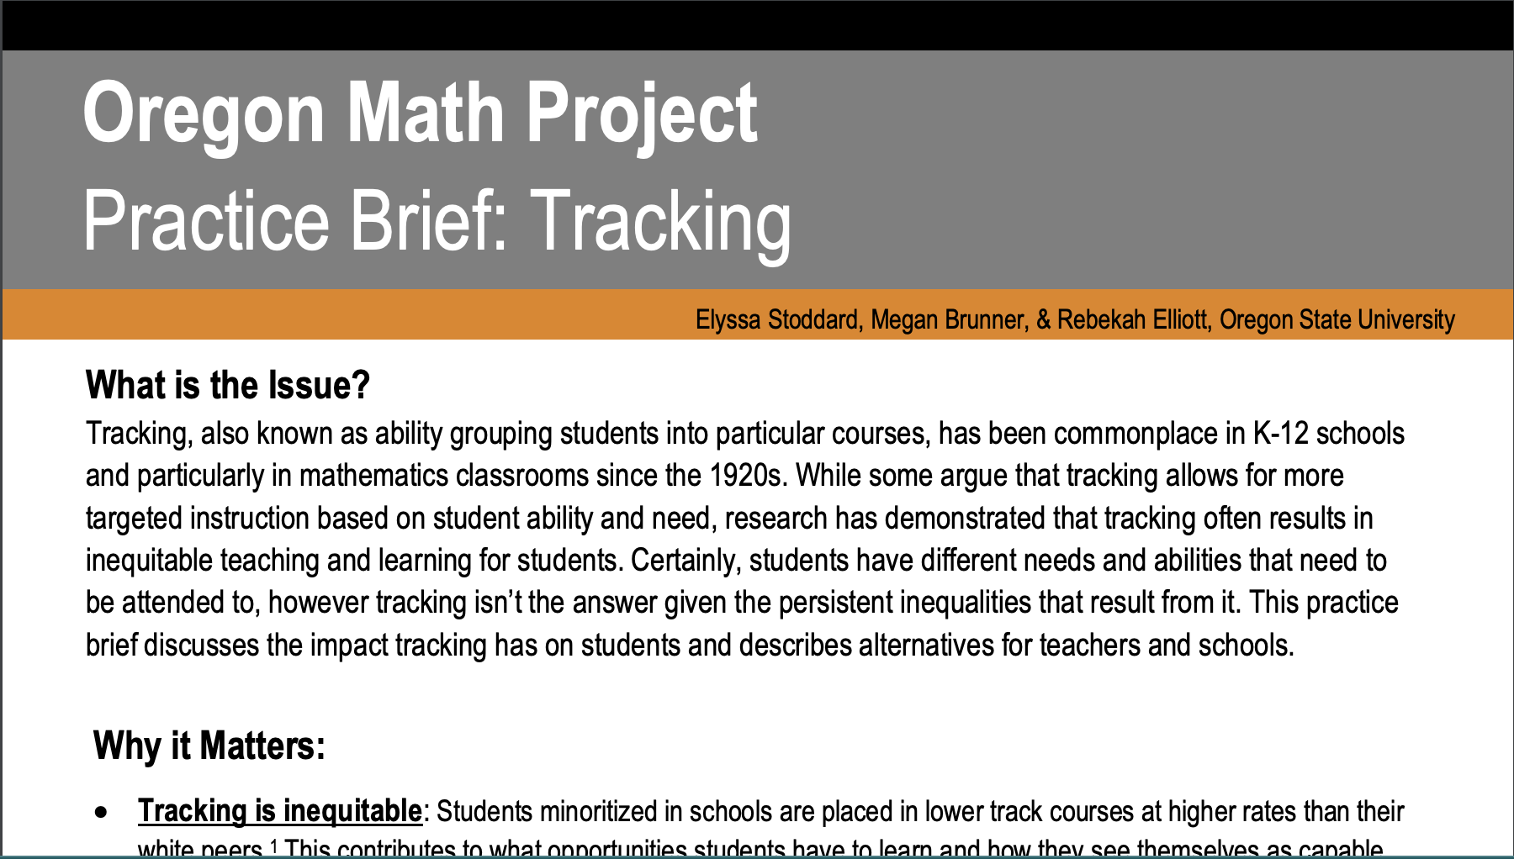
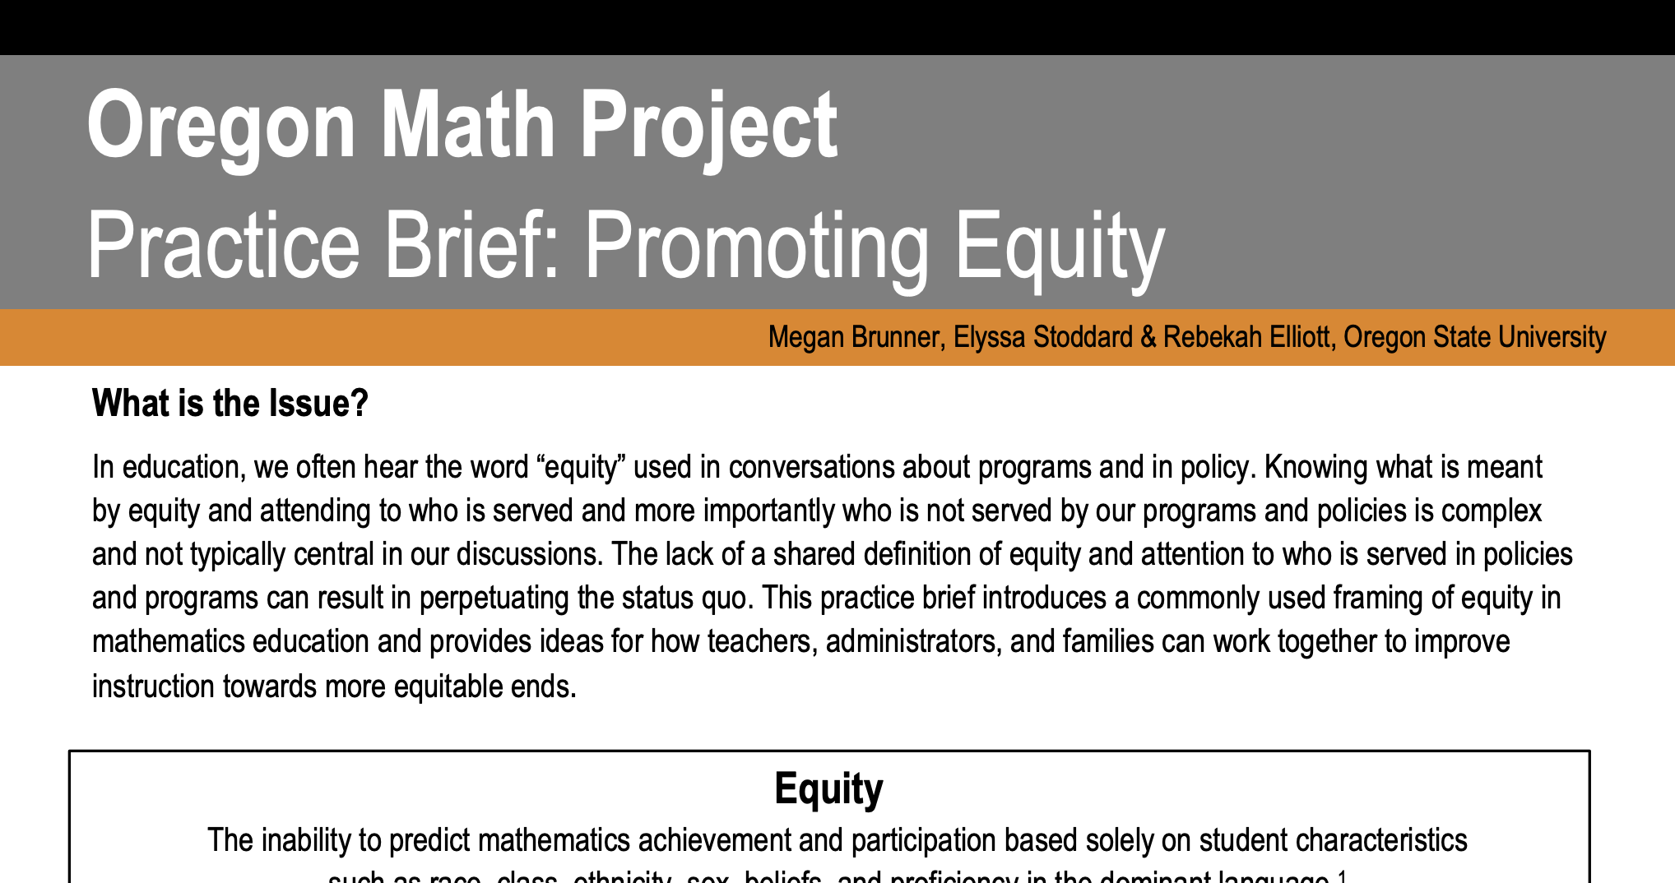
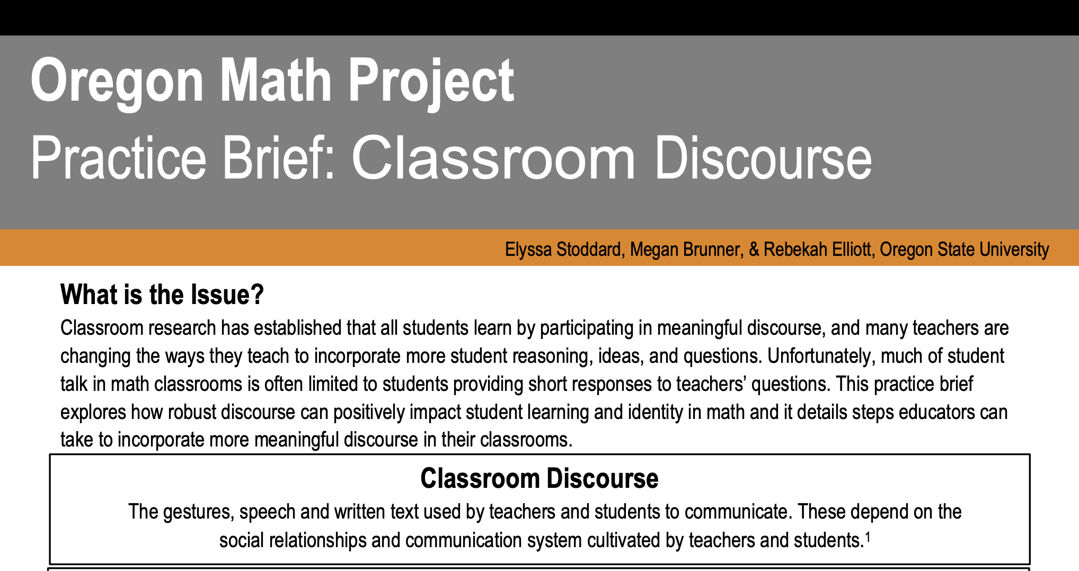
Oregon Math Project practice briefs
What connections do you see among these three ideas (tracking, promoting equity and classroom discourse)?
What connections do you see between our work so far and these three ideas?
Notes:
Facilitator Notes:
Have participants open 5a Promoting Equity_OMP Practice Brief, 5b Tracking_OMP Practice Brief, and 5c Classroom Discourse_OMP Practice Brief.
Give participants time (~10 min) to read the briefs individually and write notes in response to these questions.

Slide 14
Discussing the Oregon Math Project practice briefs
Tracking | Classroom Discourse | Promoting Equity
How can students’ diverse needs and abilities be met and challenged in a heterogeneous setting? | What instructional opportunities engage students in meaningful discourse that deepens their understanding of mathematics? | How are our expectations of students shaped by biases and perspectives on learning that we bring to the math classroom?
Notes:
Facilitator Notes:
Use the slide to preview the work participants will be doing in small groups to reflect on the practice briefs.

Slide 15
Small Group Activity
Directions: Use the workspace slide to reflect on the Oregon Math Project practice briefs – the research underpinning this effort.
Notes:
Facilitator Notes:
Aspects of small group directions you might consider:
It may be helpful to specify roles for participants in the small groups. For example, you might:
Specify who will go first and in what order participants will share. For example, in a virtual session, you might say, “The second person who enters the breakout room will share first, and sharing will move counterclockwise until everyone has shared.”
Specify who will record. For example, in a virtual session, you might say, “The first person who enters the breakout room will be the recorder and jot down ideas from the group onto the workspace slide.
Specify who will keep time. For example, in a virtual session, you might say, “The third person will be the time keeper and let each team member know if airtime goes over a minute and how much time is left.”
It may be helpful to specify where participants will record and show them how to access it. As we have suggested, you might have an assigned Google Slide for each group which is a copy of this activity’s workspace slide.
It may be helpful to specify how much time participants will have in their small group.
It may be helpful to preview what their workspace will look like (e.g., share the next slide).

Slide 16
Preview of Workspace Slide
Team names:
Tracking | Classroom Discourse | Promoting Equity
How can students’ diverse needs and abilities be met and challenged in a heterogeneous setting? | What instructional opportunities engage students in meaningful discourse that deepens their understanding of mathematics? | How are our expectations of students shaped by biases and perspectives on learning that we bring to the math classroom?
Notes:
Facilitator Notes:
Groups / breakout rooms: Participants should work in groups on the workspace slide for ~15 minutes.
Whole group: Select 1 - 2 groups to share out.
Important points to highlight regarding what the research says about tracking:
Tracking is inequitable
Tracking has a negative impact on student learning
Labels send a message to students
Students see the inequity of tracking
Teacher tracking hinders system coherence

Slide 17
Debrief: Principles of ambitious mathematics teaching
Which of these ideas are you thinking about in light of our work? What questions do you have?
“Ambitious teaching is teaching that deliberately aims for all students – across ethnic, racial, class, and gender categories – not only to acquire, but also to understand and use knowledge, and to use it to solve authentic problems.”
(Lampert & Graziani, 2009, p. 492)
Ambitious teaching:
Engages students in making sense of mathematical concepts
Centers students’ thinking and reasoning through discourse
Views students as capable of using their understandings and assets to solve authentic problems
Values students’ thinking, including emergent understanding and errors
Attends to student thinking in an equitable and responsive manner
(Anthony et al., 2015)
Notes:
Facilitator Notes:
Debrief “Connecting to Research” or “Planning for Action” through the lens of this definition from Lampert and Graziani (2009) and the five principles listed.
If you are facilitating online, you might offer an opportunity to “stamp” the principles that are on participants’ minds and discuss trends or questions that emerge.
If you are facilitating in person, you might offer a turn and talk so participants can discuss what principles are on their minds with a partner/group and then come back to share trends or questions that emerge.
[written reflection option]
References for these ideas: Anthony et al., 2015; Huinker & Bill, 2017; Lampert et al., 2011; Lampert & Graziani, 2009

Slide 18
Connecting to research:
Considering tracking in relation to
ambitious math teaching
Notes:
Facilitator Notes:
The purpose of Session 1 is to consider tracking and a 2 + 1 model alongside our understandings of ambitious math teaching. We continue this work by considering tracking in relation to the understandings of ambitious math teaching we were developing in Sessions 1 - 3.
This activity can involve critical and challenging conversations among participants. You might refer back to Module 0, Resource 1 to prepare for these conversations.

Slide 19
Facilitator Guide: Connecting to Research
Rationale for connecting to research:
  To infuse new ideas into our conversations about instruction and challenge or deepen our existing understandings (Cain, 2015).
  To support us in using evidence to inform our professional learning
Recommendations for connecting to research:
  Honor and make space for participants’ existing knowledge and expertise.
  Support participants to collectively grapple with the complexity of what the research offers and carefully consider how the research relates to their own teaching context and work.
  Closely pair opportunities to connect to research with opportunities to plan for action on the basis of what they’ve read.
Notes:
Additional resources: If you are interested in learning more about these ideas, check out these resources.
Module 0, Resource 1:
References
Cain, T (2015). Teachers’ engagement with research texts: beyond instrumental, conceptual or strategic use. Journal of Education for Teaching, 41(5), 478-492.

Slide 20
What makes a great mathematics program?
An excellent mathematics program intentionally gives access to students who are often excluded by schooling such that all students have access to:
high quality mathematics curriculum
effective teaching and learning
high expectations
support and resources needed to maximize their learning potential
(NCTM, 2014)

Slide 21
Obstacles to these aims
Tracking (or separating students academically on the basis of presumed ability) is an obstacle to equity because it creates differential opportunities to learn high quality grade-level mathematics (Jackson et al. 2013; Phelps et al. 2012; Walker 2003).
Tracking is found in over 85 percent of U.S. schools (Biafora and Ansalone 2008).
Tracking consigns some students to content that offers little significant mathematical substance (Burris et al. 2008).
  Students in low tracks are often confronted with a narrow and fragmented mathematics curriculum, delivered with a limited set of teaching and learning strategies, (Ellis 2008; Tate and Rousseau 2002).
      (NCTM, 2014, p. 61)
Notes:
Facilitator Notes:
This slide is an important one for participants and with which they may grapple. You might offer opportunities to engage with the slide more than once, for example:
Asking a participant to read the slide aloud for the group
Asking participants to read the slide privately a second time
Asking participants to identify something that resonates about the ideas
References for the ideas on this slide:
Burris, C. C., Wiley, E., Welner, K., & Murphy, J. (2008). Accountability, rigor, and detracking: Achievement effects of embracing a challenging curriculum as a universal good for all students. Teachers College Record, 110(3), 571–607.
Jackson, K., Garrison, A., Wilson, J., Gibbons, L., & Shahan, E. (2013). Exploring relationships between setting up complex tasks and opportunities to learn in concluding whole-class discussions in middle-grades mathematics instruction. Journal for Research in Mathematics Education 44(4), 642–682.
Phelps, G., Corey, D., DeMonte, J., & Ball, D. L. (2012). How much English Language Arts and mathematics instruction do students receive? Investigating variation in instructional time. Educational Policy 26(5), 631–62.
Tate, W. F., & Rousseau, C. (2002). Access and opportunity: The political and social context of mathematics education. In L. D. English (Ed.) Handbook of International Research in Mathematics Education, pp. 271–299. Erlbaum.
Walker, E. N. (2003). Who can do mathematics? In B. R. Vogeli & A. Karp (Eds.) Activating mathematical talent, pp. 15–27. Houghton Mifflin and National Council of Supervisors of Mathematics.

Slide 22
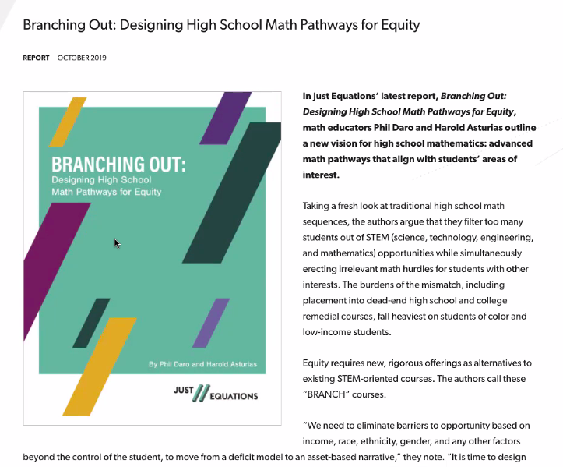
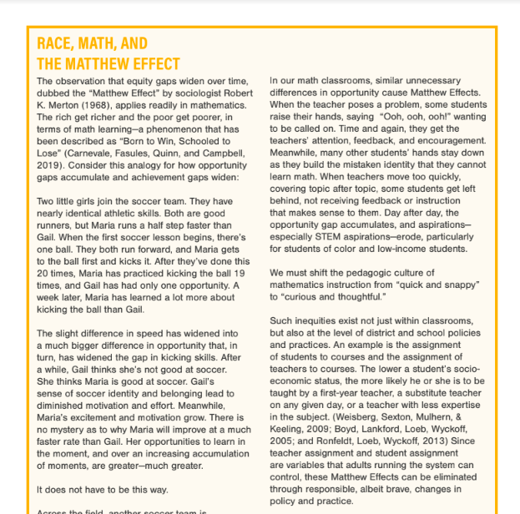
Branching Out: Designing High School Math Pathways for Equity
(Daro & Asturias, 2019, p. 10)
Notes:
Facilitator Notes:
Have participants open 6a Branching Out_Just Equations p. 10 EXCERPT
Participants who are interested may also choose to read the full report: 6b Branching Out_Just Equations
Give participants 4 minutes to read privately.
Context for the report, from Just Equations:
In Just Equations’ latest report, Branching Out: Designing High School Math Pathways for Equity, math educators Phil Daro and Harold Asturias outline a new vision for high school mathematics: advanced math pathways that align with students’ areas of interest.
Taking a fresh look at traditional high school math sequences, the authors argue that they filter too many students out of STEM (science, technology, engineering, and mathematics) opportunities while simultaneously erecting irrelevant math hurdles for students with other interests. The burdens of the mismatch, including placement into dead-end high school and college remedial courses, fall heaviest on students of color and low-income students.
Equity requires new, rigorous offerings as alternatives to existing STEM-oriented courses. The authors call these “BRANCH” courses.
“We need to eliminate barriers to opportunity based on income, race, ethnicity, gender, and any other factors beyond the control of the student, to move from a deficit model to an asset-based narrative,” they note. “It is time to design high-quality alternatives that work for many more students, preparing them for a postsecondary world that branches into exciting careers, such as journalism, politics, education, marketing, law, and entertainment.”
In outlining the need for these pathways, the authors note that they must be designed to articulate with postsecondary policies —and that, in some cases, postsecondary admissions and readiness policies need to be revised to support the move to multiple math pathways in college.
Also important, note Daro and Asturias, is the relevance of pathway content to students’ interests as well as flexibility for students to switch pathways if those interests change. Pathway design must also support educators to address the role of bias and privilege in traditional school structures and dislodge harmful preconceptions about who can and cannot do math. The authors also underscore the need for intentional strategies to recruit students to pathways in equitable ways, and to provide support that addresses uneven prior opportunities and vulnerable math identities.

Slide 23
Small Group Activity
Directions: Discuss the excerpt from the Branching Out report and use the workspace slide to reflect.
Notes:
Facilitator Notes:
Have participants open 6a Branching Out_Just Equations p. 10 EXCERPT
Give directions and have participants work in small groups for 5 minutes.
Aspects of small group directions you might consider:
It may be helpful to specify roles for participants in the small groups. For example, you might:
Specify who will go first and in what order participants will share. For example, in a virtual session, you might say, “The second person who enters the breakout room will share first, and sharing will move counterclockwise until everyone has shared.”
Specify who will record. For example, in a virtual session, you might say, “The first person who enters the breakout room will be the recorder and jot down ideas from the group onto the workspace slide.
Specify who will keep time. For example, in a virtual session, you might say, “The third person will be the time keeper and let each team member know if airtime goes over a minute and how much time is left.”
It may be helpful to specify where participants will record and show them how to access it. As we have suggested, you might have an assigned Google Slide for each group which is a copy of this activity’s workspace slide.
It may be helpful to specify how much time participants will have in their small group.
It may be helpful to preview what their workspace will look like (e.g., share the next slide).

Slide 24
Preview of Workspace Slide
Team names:
Consider the soccer metaphor on page 10. How would you alter your instruction so that everyone gets to practice with the ball? Be specific.
I will ….
I will …
I will …
I will …
What is the ball? What is an opportunity to kick the ball in a math classroom?
Notes:
Facilitator Notes:
Groups / breakout rooms: Participants should work in groups for 5 minutes.
Whole group: Highlight key ideas.
In a virtual setting, you might use a waterfall approach:
Prompt participants to type a response to the question into the chat box of Zoom without yet hitting "enter".
Once participants have had time to type, have them hit enter all at the same time ("on the count of 3."). This creates the waterfall effect in the chat box of Zoom where everyone's responses come in at the same time.
Ask participants to read each other’s responses.
In an in-person setting, you might ask 2 people to share something that they want to remember for their own practice that represents their thinking or a teammate's thinking.

Slide 25
The impact of mathematics on identity
Society views mathematics as a valued and high-status subject. Schools perpetuate this through the gatekeeping structures which control students’ access to mathematics
  e.g., tracking policies, reliance on standardized test scores, and specialized programs such as Advanced Placement.
Students see and understand these structures and draw conclusions about who they are in relation to mathematics and what is valued by society.
  Students experiences in mathematics classrooms and access to high quality math instruction has implications for children’s academic identities and life transitions, including their economic and educational access, career decisions, and civic engagement or activism.
(Aguirre et al, 2013, p. 37)
Notes:
Facilitator Notes:
You might say: Mathematics has a huge impact on identity.
You might offer opportunities to engage with the slide more than once, for example:
Asking a participant to read the slide aloud for the group
Asking participants to read the slide privately a second time
Asking participants to identify something that resonates about the ideas

Slide 26
Students’ social and emotional needs
In math class, social-emotional learning focuses on mindset, perseverance, risk-taking, relationships, and attitude.
Ideas for addressing social and emotional needs (especially for students often excluded from rich mathematics by schooling)
Provide structured choice
Encourage student to solve tasks in multiple ways
Affirm safety
Allow students to work collaboratively
NOTICE:
Who is stuck at the moment and will need additional time to think on it tonight?
Who has disequilibrium at the moment and why?
What strengths are you noticing in the work of typically disengaged students? How could you celebrate that?
Notes:
Facilitator Notes:
Support participants to make connections between the impact of mathematics on identity and the need to focus on social-emotional learning.
Offer space for participants to add to this list and/or share what resonates with them.

Slide 27
Debrief: Principles of ambitious mathematics teaching
Which of these ideas are you thinking about in light of our work? What questions do you have?
“Ambitious teaching is teaching that deliberately aims for all students – across ethnic, racial, class, and gender categories – not only to acquire, but also to understand and use knowledge, and to use it to solve authentic problems.”
(Lampert & Graziani, 2009, p. 492)
Ambitious teaching:
Engages students in making sense of mathematical concepts
Centers students’ thinking and reasoning through discourse
Views students as capable of using their understandings and assets to solve authentic problems
Values students’ thinking, including emergent understanding and errors
Attends to student thinking in an equitable and responsive manner
(Anthony et al., 2015)
Notes:
Facilitator Notes:
Debrief “Connecting to Research” or “Planning for Action” through the lens of this definition from Lampert and Graziani (2009) and the five principles listed.
If you’re facilitating online, you might offer an opportunity to “stamp” the principles that are on participants’ minds and discuss trends or questions that emerge.
If you’re facilitating in person, you might offer a turn and talk so participants can discuss what principles are on their minds with a partner/group and then come back to share trends or questions that emerge.
[written reflection option]
References for these ideas: Anthony et al., 2015; Huinker & Bill, 2017; Lampert et al., 2011; Lampert & Graziani, 2009

Slide 28
Connecting to research:
Considering a 2 + 1 model in relation to
ambitious math teaching
Notes:
Facilitator Notes:
The purpose of Session 1 is to consider tracking and a 2 + 1 model alongside our understandings of ambitious math teaching. We continue this work by considering a 2 + 1 model in relation to the understandings of ambitious math teaching we were developing in Sessions 1 - 3.
Note that it may be helpful
This activity can involve critical and challenging conversations among participants. You might refer back to Module 0, Resource 1 to prepare for these conversations.

Slide 29
Facilitator Guide: Connecting to Research
Rationale for connecting to research:
  To infuse new ideas into our conversations about instruction and challenge or deepen our existing understandings (Cain, 2015).
  To support us in using evidence to inform our professional learning
Recommendations for connecting to research:
  Honor and make space for participants’ existing knowledge and expertise.
  Support participants to collectively grapple with the complexity of what the research offers and carefully consider how the research relates to their own teaching context and work.
  Closely pair opportunities to connect to research with opportunities to plan for action on the basis of what they have read.
Notes:
Additional resources: If you are interested in learning more about these ideas, check out these resources.
Module 0, Resource 1:
References
Cain, T (2015). Teachers’ engagement with research texts: beyond instrumental, conceptual or strategic use. Journal of Education for Teaching, 41(5), 478-492.

Slide 30
A bit of history: The Committee of Ten
High school mathematics typically begins with a year of algebra followed by a year of geometry and a second year of algebra.
This was first recommended by the Committee of Ten in 1892.
This pathway still identifies the courses offered by more than 90 percent of high schools to students in the United States (Dossey et al., 2016, p. 33).
(Dossey et al., 2016; NCTM, 2018)
Notes:
Facilitator Notes:
These ideas laid the foundation for the 2 + 1 model.
You might have participants read the slide silently or ask a participant read the slide aloud.

Slide 31
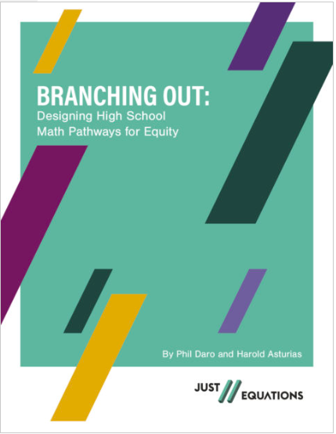
A common math pathway?
Traditionally a 4-course math sequence in the US
  8th grade Pre-Alg, HS Alg, HS Geometry, and HS Alg. 2
Scope of Algebra 2 has changed over time
  Historically focused on solution methods for a variety of types of equations.
  As calculus became a primary entry point for college, Alg. 2 added study of functions that resulted in:
    Too much content and too little focus
    A confusion of topics and explosion of notational devices and
    Led to development of precalculus to better prepare students for calculus
Moved to a 6-course math sequence in the US
  7th grade Pre-Alg, 8th grade Alg, HS Geometry, HS Alg.2, PreCalc, Calculus or Statistics
  Alg. 2 was a terminal course for many students and student’s exposure to math varied widely
Introduction of the Common Core State Standards
  Most states spread Alg 1 content across grades eight and nine
(Daro & Asturias, 2019, p. 7)
Notes:
Facilitator Notes:
These ideas laid the foundation for the 2 + 1 model.
You might have participants read the slide silently or ask a participant to read the slide aloud.

Slide 32
The role and importance of mathematics today
Mathematics is at the heart of our data driven “information economy”
Mathematics is the foundation for careers in science, technology, engineering, and mathematics (STEM) and, increasingly, as the foundation for careers outside STEM.
Mathematical literacy is needed more than ever to filter, understand, and act on the enormous amount of data and information that we encounter every day.
“Everyone involved in the mathematics education of high school students must be committed to ensuring that each and every student has the opportunity to learn the mathematics necessary to be well prepared for whatever the future may hold….When the potential of so many students is squandered, the loss is not only to individual students but also to society at large” (p. 3)
(NCTM, 2018)
Notes:
Facilitator Notes:
These ideas laid the foundation for the 2 + 1 model.
You might have participants read the slide silently or ask a participant yo read the slide aloud.

Slide 33
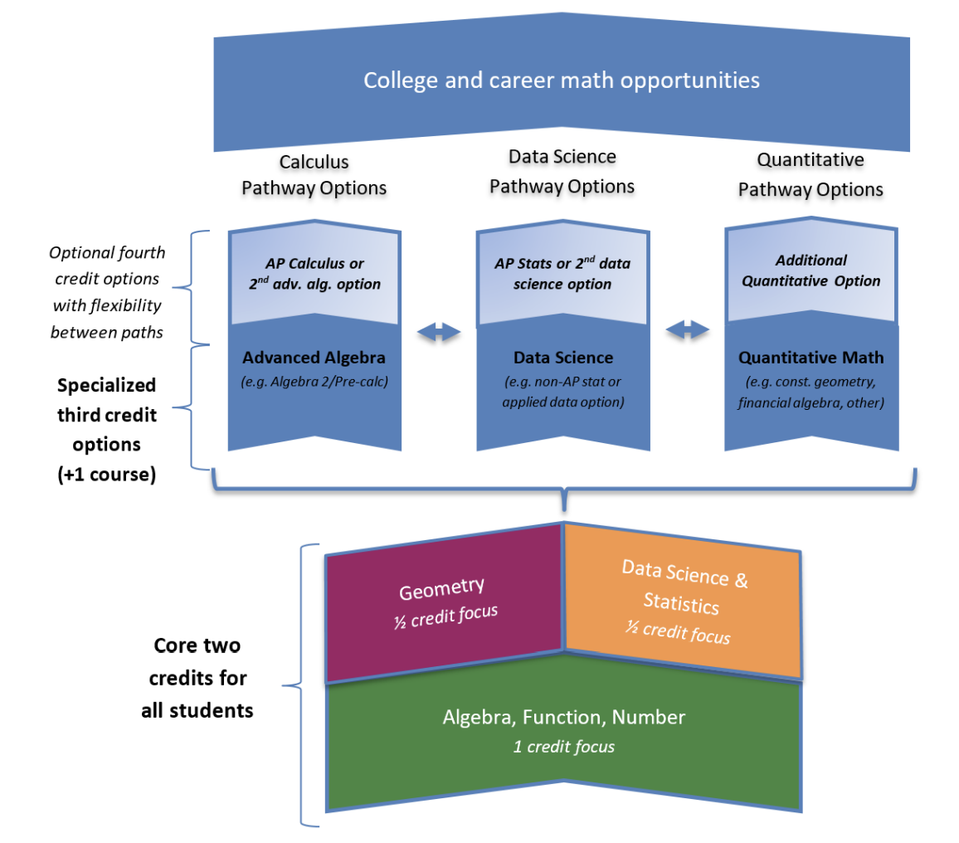
2 + 1 Model Focus
The 2+1 Model
The 2+1 Model for high school mathematics breaks from the tradition of a single sequence of high school math courses to a two-credit core of high school mathematics followed by at least one credit of high school math that addresses student interests and aspirations. The core is tightly focused on algebra, geometry, and statistics necessary for all students to be college and career ready. For most students, the three credits would be taken during the first three years of high school. Some schools may choose to provide accelerated options or options to take additional high school level mathematics beyond the initial three credits.
(Oregon Mathways Initiative, 2022)
Notes:
Facilitator Notes:
Have participants open 7 High School Math Pathways - 2 + 1 Model_OMP
The slide displays:
a key figure in the document, a diagram of the 2 + 1 Model showing one possible sequence for the first three credits in high school mathematics
an excerpt from the document describing the 2 + 1 model
Give participants 5 minutes to read privately.
You might highlight the bolded section of text, and connections to our hopes for students’ experiences as math learners. The two-credit core of the 2 + 1 model is tightly focused on algebra, geometry, and statistics necessary for all students to be college and career ready.

Slide 34
Ambitious teaching supports implementation of the 2+1 model
Embodied in the 2+1 model is a change in the way students engage with mathematics.
The core two credits of high school math should include exposure to relevant applications, connect to math practices, and provide opportunities for deeper conceptual understanding.
Implementing the 2+1 model may require districts to rethink existing course placement practices.
Existing placement practices should be examined to assure all students have access to math identified in the High School Standards as well as opportunities to explore mathematics beyond those standards.
(Oregon Mathways Initiative, 2022)
Notes:
Facilitator Notes:
This slide includes connections between ambitious math teaching and the 2 + 1 model as described in the document participants just read: 7 High School Math Pathways - 2 + 1 Model_OMP
You might have participants read the slide silently or ask a participant to read the slide aloud. You might ask participants to raise key ideas or wonderings from the slide.

Slide 35
2 + 1 Model Question Considerations
As you reflect on the 2+1 model and the work we have done so far, what questions emerge for you?
(Oregon Mathways Initiative, 2022)
Notes:
Facilitator Notes:
The slide displays a key figure in the 7 High School Math Pathways - 2 + 1 Model_OMP, a diagram of the 2 + 1 Model showing one possible sequence for the first three credits in high school mathematics
Ask participants to study the diagram in the document and be prepared to share out questions that emerge for them.
Generate a list of questions together in a whole group discussion.
You might record the questions on a poster or slide as a public record.
Recording participants’ questions honors that this is a complex effort with which they can authentically engage and contribute.
Examples of questions participants might raise:
If we are only going to have ½ credit of Geometry, what standards will be addressed or cut out?
What content will be included in the ½ credit of Data Science & Statistics?
Use participants’ wonderings to land on the need to deeply understand the content of the standards. You might say: If we are going to shift to a 2 + 1 model, then we need to know what the math standards are going to be in each course.

Slide 36
Creating Pathways in High School
From High School Core Math Guidance – Publication Version 4.1 (Aug. 2020)
Detracking the first two credits of core math content is a long-term goal for Oregon
  For the purposes of ODE guidance, the term “tracking” will refer to the practice of creating different levels of the same course that group students by perceived abilities.
For the 2022-23 school year, it is likely that existing courses such as Algebra 1, Geometry, and Algebra 2 would still be provided, with a focus on prioritized content.
The term “pathway” refers to a specialized math course sequence that leads to career and college readiness.
  This could include the traditional advanced algebra pathway to prepare for calculus, a statistics pathway or a quantitative applied pathway that leads to specific career and college options for students after high school graduation.
(Oregon Department of Education, 2020)
Notes:
Facilitator Notes:
These ideas laid the foundation for the 2 + 1 model.
You might have participants read the slide silently or ask a participant to read the slide aloud.

Slide 37
Changes in higher education math coursework
“Calculus is rarely required for university admission outside of specific majors, such as engineering, physical science, and math. The report mentions how some selective institutions, most prominently the University of California, have made clear that non-traditional courses such as data science are not only accepted for admission but are considered advanced math courses. AP Statistics has the same weight as AP Calculus. However, Anderson and Burdman highlight the mixed messages high school students often receive about math classes, leading many to pursue calculus to err on the safe side.”
(Anderson and Burdman, 2022)
Notes:
Facilitator Notes:
This is an opportunity to emphasize the value and importance of data science and to press participants to see all pathways can support students’ in engaging in rich mathematics in college and beyond, and to challenge the assumption that calculus is a proxy for more advanced math students.
You might have participants read the slide silently or ask a participant to read the slide aloud.
You can share these resources with participants who are interested in reading further:
A New Calculus for College Admissions: How Policy, Practice, and Perceptions of High School Math Education Limit Equitable Access to College, Just Equations
Common Vision Report, Mathematical Association of America

Slide 38
A 2 + 1 model in relation to ambitious math teaching
What connections do you see between a 2 + 1 model and our prior work on ambitious math teaching?
What are you wondering about?
Resources:
Branching Out: Designing High School Math Pathways
Oregon Mathways Initiative
Oregon Mathematics HS Standards
Catalyzing Change in High School Mathematics: Initiating Critical Conversations
Launch Years: Reimagining Mathematics Education
Invigorating High School Math
Notes:
Facilitator Notes:
Give participants time to privately consider the questions. They may peruse the resources linked on the screen as they are considering the 2 + 1 model’s connections to ambitious math teaching.

Slide 39
Small Group Activity
Directions: Use the workspace slide to consider connections between a 2 + 1 model and ambitious math teaching.
Notes:
Facilitator Notes:
Give directions and have participants work in small groups.
Aspects of small group directions you might consider:
It may be helpful to specify roles for participants in the small groups. For example, you might:
Specify who will go first and in what order participants will share. For example, in a virtual session, you might say, “The second person who enters the breakout room will share first, and sharing will move counterclockwise until everyone has shared.”
Specify who will record. For example, in a virtual session, you might say, “The first person who enters the breakout room will be the recorder and jot down ideas from the group onto the workspace slide.
Specify who will keep time. For example, in a virtual session, you might say, “The third person will be the time keeper and let each team member know if airtime goes over a minute and how much time is left.”
It may be helpful to specify where participants will record and show them how to access it. As we have suggested, you might have an assigned Google Slide for each group which is a copy of this activity’s workspace slide.
It may be helpful to specify how much time participants will have in their small group.
It may be helpful to preview what their workspace will look like (e.g., share the next slide).

Slide 40
Preview of Workspace Slide
Team names:
What connections do you see between a 2 + 1 model and our prior work on ambitious math teaching?
What are you wondering about?
Be prepared to share your rough draft thinking with others.
Notes:
Facilitator Notes:
Groups / breakout rooms: Participants should work in groups for ~7 minutes.
Whole group: Highlight key connections.

Slide 41
Debrief: Principles of ambitious mathematics teaching
Which of these ideas are you thinking about in light of our work? What questions do you have?
“Ambitious teaching is teaching that deliberately aims for all students – across ethnic, racial, class, and gender categories – not only to acquire, but also to understand and use knowledge, and to use it to solve authentic problems.”
(Lampert & Graziani, 2009, p. 492)
Ambitious teaching:
Engages students in making sense of mathematical concepts
Centers students’ thinking and reasoning through discourse
Views students as capable of using their understandings and assets to solve authentic problems
Values students’ thinking, including emergent understanding and errors
Attends to student thinking in an equitable and responsive manner
(Anthony et al., 2015)
Notes:
Facilitator Notes:
Debrief “Connecting to Research” or “Planning for Action” through the lens of this definition from Lampert and Graziani (2009) and the five principles listed.
If you’re facilitating online, you might offer an opportunity to “stamp” the principles that are on participants’ minds and discuss trends or questions that emerge.
If you’re facilitating in person, you might offer a turn and talk so participants can discuss what principles are on their minds with a partner/group and then come back to share trends or questions that emerge.
[written reflection option]
References for these ideas: Anthony et al., 2015; Huinker & Bill, 2017; Lampert et al., 2011; Lampert & Graziani, 2009

Slide 42

Planning for action:
Planning to overcome barriers to implementing
ambitious math teaching
Notes:
Facilitator Notes:
The purpose of Session 1 is to consider tracking and a 2 + 1 model alongside our understandings of ambitious math teaching. We continue this work by planning to overcome barriers to implementing ambitious math teaching.
This activity can involve critical and challenging conversations among participants. You might refer back to Module 0, Resource 1 to prepare for these conversations.

Slide 43
Facilitator Guide: Planning for Action
Rationale for planning for action:
  To see connections to our contexts and goals (Putnam & Borko, 2000)
  To apply new ideas to upcoming work (Horn & Kane, 2015)
  To surface complexities when taking up new ideas
Recommendations for planning for action:
  Use teachers’ own curricular resources when possible
  Create space to discuss anticipated challenges and strategies for trying new ideas within those challenges
  Follow up on teachers’ plans; return to them to build on and refine ideas
Notes:
Planning for action involves making links between session content and our own practice and contexts.
Additional resources: If you are interested in learning more about these ideas, check out these resources.
Module 0, Resource 2: Sometimes, planning conversations can surface unproductive ideas about particular students or student groups that circulate in our schools or broader contexts. This resource is designed to support leaders preparing for difficult conversations, especially when unproductive language about students emerges.
References
Horn, I. S., & Kane, B. D. (2015). Opportunities for professional learning in mathematics teacher workgroup conversations: Relationships to instructional expertise. Journal of the Learning Sciences, 24(3), 1–46.
Putnam, R. T., & Borko, H. (2000). What do new views of knowledge and thinking have to say about research on teacher learning? Educational Researcher, 29(1), 4-15.

Slide 44
Where to begin with a 2 + 1 model
What is your district’s rationale for using a 2+1 model?
What feels exciting to you about a 2 + 1 model?
What support do you anticipate needing as you begin to work in a 2 + 1 model?
Resources:
Branching Out: Designing High School Math Pathways
Oregon Mathways Initiative
Oregon Mathematics HS Standards
Catalyzing Change in High School Mathematics: Initiating Critical Conversations
Launch Years: Reimagining Mathematics Education
Invigorating High School Math
Notes:
Facilitator Notes:
Now you will have some time to consider where your district is and where you want to begin with the Model. Some may districts may have been considering the 2 + 1 model for a while and others may be just beginning.
Give participants time to privately consider the questions and peruse the resources linked on the screen and below:
Branching Out: Designing High School Math Pathways
Oregon Mathways Initiative
Oregon Mathematics HS Standards
Catalyzing Change in High School Mathematics: Initiating Critical Conversations
Launch Years: Reimagining Mathematics Education
Invigorating High School Math
The amount of time you allot for this may vary depending on where your context is in the 2 + 1 effort.

Slide 45
Small Group Activity
Directions: Use the workspace slide to reflect on your context.
Notes:
Facilitator Notes:
Give directions and have participants work in small groups. The amount of time you allot for this may vary depending on where your context is in the 2 + 1 effort.
Aspects of small group directions you might consider:
It may be helpful to specify roles for participants in the small groups. For example, you might:
Specify who will go first and in what order participants will share. For example, in a virtual session, you might say, “The second person who enters the breakout room will share first, and sharing will move counterclockwise until everyone has shared.”
Specify who will record. For example, in a virtual session, you might say, “The first person who enters the breakout room will be the recorder and jot down ideas from the group onto the workspace slide.
Specify who will keep time. For example, in a virtual session, you might say, “The third person will be the time keeper and let each team member know if airtime goes over a minute and how much time is left.”
It may be helpful to specify where participants will record and show them how to access it. As we have suggested, you might have an assigned Google Slide for each group which is a copy of this activity’s workspace slide.
It may be helpful to specify how much time participants will have in their small group.
It may be helpful to preview what their workspace will look like (e.g., share the next slide).

Slide 46
Preview of Workspace Slide
Team names:
What is your school/district’s rationale for using a 2+1 model?
What feels exciting to you about a 2 + 1 model?
What support do you anticipate needing as you begin to work in a 2 + 1 model?
Be prepared to share your rough draft thinking with others.
Notes:
Facilitator Notes:
Each person may respond to these questions individually, or you might use this workspace slide for groups / breakout rooms to pool ideas.
Whole group: Highlight key ideas.
Aim: Support participants in thinking about what is possible. Name problems / barriers that can be addressed with particular support, and honor participants’ frustrations for ones that cannot be addressed at the moment.

Slide 47
Debrief: Principles of ambitious mathematics teaching
Which of these ideas are you thinking about in light of our work? What questions do you have?
“Ambitious teaching is teaching that deliberately aims for all students – across ethnic, racial, class, and gender categories – not only to acquire, but also to understand and use knowledge, and to use it to solve authentic problems.”
(Lampert & Graziani, 2009, p. 492)
Ambitious teaching:
Engages students in making sense of mathematical concepts
Centers students’ thinking and reasoning through discourse
Views students as capable of using their understandings and assets to solve authentic problems
Values students’ thinking, including emergent understanding and errors
Attends to student thinking in an equitable and responsive manner
(Anthony et al., 2015)
Notes:
Facilitator Notes:
Debrief “Connecting to Research” or “Planning for Action” through the lens of this definition from Lampert and Graziani (2009) and the five principles listed.
If you’re facilitating online, you might offer an opportunity to “stamp” the principles that are on participants’ minds and discuss trends or questions that emerge.
If you’re facilitating in person, you might offer a turn and talk so participants can discuss what principles are on their minds with a partner/group and then come back to share trends or questions that emerge.
[written reflection option]
References for these ideas: Anthony et al., 2015; Huinker & Bill, 2017; Lampert et al., 2011; Lampert & Graziani, 2009

Slide 48
Debriefing Session 4
Reflecting on our work in the activities in the session

Slide 49




Debriefing Session 4: Four cornerstone principles of the OMP
What connections do you see between any of the cornerstones and our work in this session?
Focus: Learning experiences in every grade and course are focused on core mathematical content and practices that progress purposefully across grade levels.
Engagement: Mathematical learning happens in environments that motivate all students to engage with relevant and meaningful issues in the world around them.
Pathways: All students are equipped with the mathematical knowledge and skills necessary to identify and productively pursue any postsecondary paths in their future. Students have agency to choose from a variety of courses, contexts, and applications they find relevant.
Belonging: Participation in mathematical learning builds students’ identities as capable math learners and fosters a positive self-concept. Students’ cultural and linguistic assets are valued in ways that contribute to a sense of belonging to a community of learners.
Any proposed instructional approach, curricular change, or system design element should be evaluated by the degree to which it builds on these four cornerstones. When new approaches are built within the framework of all four-cornerstone principles, we will be on our way to engineering a reimagined system.
(ODE, 2022)
Notes:
Facilitator Notes:
Option 1: Debrief the session through the lens of the four cornerstone principles of the Oregon Mathematics Project.

Slide 50
Debriefing Session 4: Focus of the session
What new insights do you have related to our session focus, to consider tracking and a 2 + 1 model alongside our understandings of ambitious math teaching?
Take a couple of minutes to reflect on our work in the session.
Agenda for this session:
Setting and maintaining norms: Reconnect with and revise our norms for interacting together
Connecting to research: Understanding the aims of the Oregon Math Project effort
Connecting to research: Considering tracking in relation to ambitious math teaching
Connecting to research: Considering a 2 + 1 model in relation to ambitious math teaching
Planning for action: Planning to overcome barriers to implementing ambitious math teaching
Notes:
Facilitator Notes:
Option 2: Debrief the session through the lens of the focus of the session.
Module 1 Part 2 especially supports our thinking around the second essential question of this module: Why is a 2 + 1 model important for equitable outcomes in mathematics?
The focus of this session in particular is to consider tracking and a 2 + 1 model alongside our understandings of ambitious math teaching.
You might offer participants time to think individually about new insights before sharing aloud.

Slide 51
Deepening our understanding of what a 2 + 1 model can look like in practice
Session 5
The focus of this session is to deepen our understanding of what a 2 + 1 model can look like in practice.
Agenda for this session:
Setting and maintaining norms: Reconnect with and revise our norms for interacting together
Doing math together: Experiencing what a task might look and sound like in a 2 + 1 model (the Anime Festival task)
Connecting to research: Noticing and building on students’ strengths in a 2 + 1 model
Planning for action: Applying our learning about ambitious math teaching and a 2 + 1 model
Time estimate: 90 minutes
M1 P2 Table of Contents
Notes:
Facilitator Notes:
This session especially supports our thinking around the second essential question of this module: Why is a 2 + 1 model important for equitable outcomes in mathematics?
We estimate this session will take 90 minutes. If you need to break the section into smaller pieces, please note the activities listed in the agenda are intended to be enacted in this order.
Resources for this session are in the Module 1 Resources folder with the exception of a set of blog posts. You might share the links of these blog posts with participants during the session. Optionally before the session, you make .pdfs or copies of them:
Challenging deficit language in the math classroom (Maria Zavala)
The trouble with “high” and “low” (Matthew Felton)

Slide 52

Setting and maintaining norms
Reconnect with and revise our norms for interacting together

Slide 53
Facilitator Guide: Setting and Maintaining Norms
Rationale for setting and maintaining norms:
  To create spaces where we can vulnerably share about our teaching, learning and mathematics (Elliott et al., 2009; Little, 2002; Horn, 2010)
  To support us in sharing in-process, “rough draft” ideas (Thanheiser & Jansen, 2016)
  To foster a community where all members are valued (Grossman et al., 2001)
Recommendations for setting and maintaining norms:
  Include everyone’s ideas and perspectives when setting norms
  Regularly revisit norms and adjust norms as needed
Notes:
Upholding norms is a responsibility of participants and leaders/facilitators. It may be helpful to come up with a protocol that supports participants in naming and problem solving in the event that norms are breached.
Additional resources: If you are interested in learning more about ideas regarding setting and maintaining norms check out these resources.
TEDD.org: Setting norms for collaborative work
References
Elliott, R. & Lesseig, K., & Kazemi, E.. (2009). Sociomathematical norms in professional development: Examining leaders’ use of justification and its implication for practice. The Montana Mathematics Enthusiast Journal monograph, 7.
Grossman, P., Wineburg, S., & Woolworth, S. (2001). Toward a theory of teacher community. Teachers College Record, 103, 942–1012.
Horn, I. S. (2010). Teaching replays, teaching rehearsals, and re-visions of practice: Learning from colleagues in a mathematics teacher community. Teachers College Record, 112(1), 225–259.
Little, J. W. (2002). Professional community and the problem of high school reform. International Journal of Educational Research, 37(8), 693–714.
Thanheiser, E. & Jansen, A. (2016). Inviting prospective teachers to share rough draft mathematical thinking. Mathematics Teacher Educator, 4(2), 145–163.

Slide 54
Revisiting norms
[Insert your group norms]
Rights of a Learner
You have the right to:
Be confused
Make mistakes
Say what makes sense to you
Share unfinished or rough draft thinking and not be judged
(Kalinec-Craig, 2017)
Notes:
Facilitator Notes:
Orient participants to the norms you set in prior sessions and Rights of the Learner
You might ask questions like:
How do the productive norms and Rights of the Learner support our learning together?
Choose one of our norms that you want to focus on in particular. Why does that norm feel important for your learning today?
Invite participants to revise or add onto existing norms as needed
Remind participants of the importance of norms in developing a community of learners.
You might say: As we have opportunities to get to know each other better and better it allows for us to develop trust and feel more and more comfortable asking questions, getting help, revealing our shortcomings with others.

Slide 55

Doing math together:
Experiencing what a task might look and sound like in a 2 + 1 model (the Anime Festival task)
Notes:
Facilitator Notes:
The purpose of Session 5 is to deepen our understanding of what a 2 + 1 model can look like in practice. Here we experience what a task might look and sound like (the Anime Festival task).

Slide 56
Facilitator Guide: Doing Math Together
Rationale for doing math together:
  Deepens our own specialized mathematical content knowledge so we can better support and respond to students (Kazemi & Franke, 2004)
  Gives us a shared context for the study of teaching (Kazemi et al., 2018)
  Helps us think about the experiences of our students
  To foster joy for doing and learning mathematics (Su, 2020)
Recommendations for doing math together:
  Establish norms for doing math together (see slide notes for examples) (Elliott et al., 2009; Yackel & Cobb; 1998).
  Support participants in engaging with the task as learners and as teachers. Be explicit about when/how participants should take up each of these roles.
Notes:
Example norms for doing mathematics together:
Engage with each other’s thinking with curiosity
Support everyone to experience joy for mathematics
Use partial understandings, mistakes, and errors as an opportunity to examine further questions about mathematics
Additional resources: If you’re interested in digging more into ideas about doing math together check out these resources.
TEDD.org: Mathematics Instructional Activities
TEDD.org: Setting norms for collaborative work
Mathematics For Human Flourishing (book)
References
Ball, D. L., & Cohen, D. K. (1999). Developing practice, developing practitioners: Toward a practice-based theory of professional education. In L. Darling-Hammond & G. Sykes (Eds.), Teaching as the learning profession: Handbook of policy and practice (pp. 3–22). Jossey Bass.
Elliott, R., Lesseig, K., & Kazemi, E.. (2009). Sociomathematical norms in professional development: Examining leaders’ use of justification and its implication for practice. The Montana Mathematics Enthusiast Journal monograph, 7.
Kazemi, E., & Franke, M. L. (2004). Teacher learning in mathematics: Using student work to promote collective inquiry. Journal of Mathematics Teacher Education, 7(3), 203–235.
Su, F. (2021). Mathematics for Human Flourishing. Yale University Press.
Yackel E., & Cobb, P. (1998) Sociomathematical norms, argumentation, and autonomy in mathematics. Journal for Research in Mathematics Education, 27(4), 458-477.

Slide 57
Orienting ourselves to the mathematics for this task
Related Oregon Math Standards
HS.DR.C Analyze, summarize, and describe data
HS.DR.C.8 Identify appropriate ways to summarize and then represent the distribution of univariate and bivariate data multiple ways with graphs and/or tables. Use technology to present data that supports interpretation of tabular and graphical representations.
HS.DR.D Interpret data and ask investigative questions
HS.DR.D.13 Use multivariate thinking to articulate how variables impact one another, and measure the strength of association using correlation coefficients for regression curves.
(ODE, 2022)
Notes:
Facilitator Notes:
You might briefly share your screen with the Coherence Map
Grade: HS → Category: HS.S → Domain: HS.S-ID → Standard: HS.S.ID.B.6.c
Zoom out to show the connections among the standards.
This is a helpful reference for teachers in planning.
Frame the focus of the math activity: What factors are important to consider when creating a function to model a dataset?
Have participants open 8a Standards Guidance Document for HS.DR.C.8 (this may be a re-read for participants, as this was one of the standards guiding the math task in Session 1) and 8b Standards Guidance Document for HS.DR.D.13 and privately read.
Orient participants to where these documents come from: the Oregon Mathematics Guidance Document, 2021 Oregon Mathematics Standards.
You might preview that there will be more work us the Standards Guidance Documents in Session 11.

Slide 58
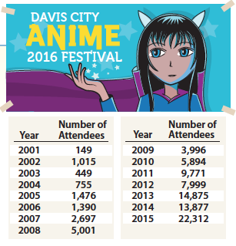

Preview of Workspace Slide
What do you notice?
What do you wonder?
(CITE)
Notes:
Facilitator Notes:
You might have participants look at the data on the slide or open 11 [name]. This is the original task. They should focus on the data in the table and use the prompts on the slide to guide their private reasoning time.
Give participants 2 minutes to privately consider what they notice and wonder about the data.

Slide 59
Preview of Workspace Slide
Team names:
What do you notice?
What do you wonder?
Notes:
Facilitator Notes:
Groups / breakout rooms: Groups record noticings and wonderings for ~3-5 minutes.
Whole group: Pre-select two slides to share whole group. Discuss the slides, and press participants on listening to understand one another.

Slide 60
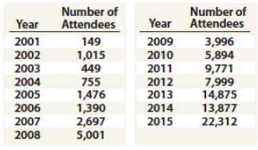
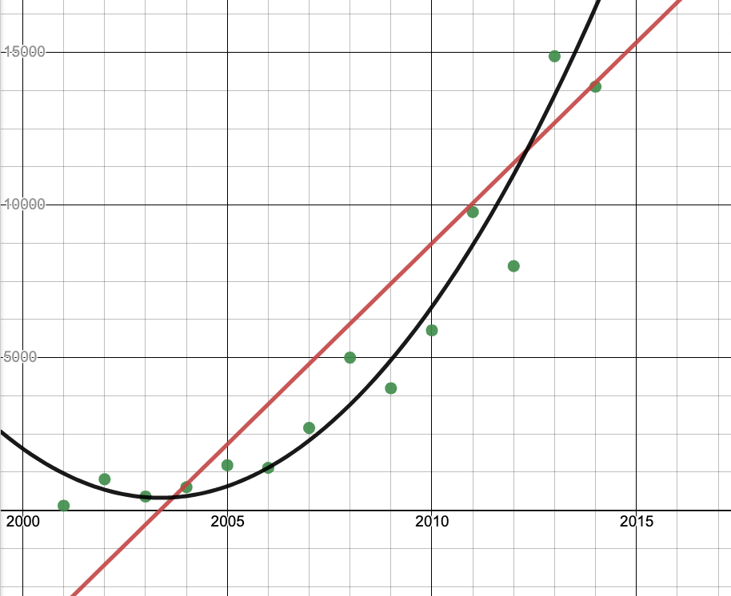
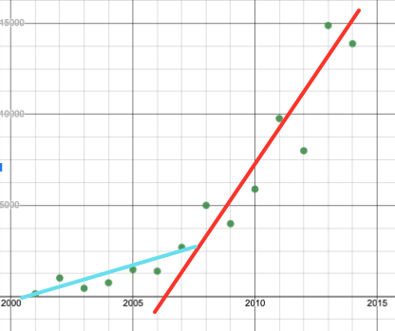
Student Work
Create a graph to show how the attendance
at the festival changed over time. How would
you describe the relationship between the
variables?
What makes sense about this work?
What is incomplete or not reasonable about this work?
Use connections to the graphs and the context to justify your claims.
Student A & B
Student C
Notes:
Facilitator Notes:
You might frame the data by saying: Thank you for sharing how you and your groups made sense of this table. Let’s take a look at how students used this table to show how the attendance at the festival changed over time.
You might have participants look at the data on the slide or open 11 [name].
Give participants time to privately consider responses to the questions.

Slide 61
Small Group Activity
Directions: Record and justify claims about students’ reasoning on the workspace slides.
Notes:
Facilitator Notes:
You might have participants look at the data on the slide or open 11 [name]. This is the original task. They should focus on the data in the table and use the prompts on the slide to guide their conversation.
After giving participants 2 minutes to consider the questions individually, give directions and have them work in small groups for ~7 minutes.
Aspects of small group directions you might consider:
It may be helpful to specify roles for participants in the small groups. For example, you might:
Specify who will go first and in what order participants will share. For example, in a virtual session, you might say, “The second person who enters the breakout room will share first, and sharing will move counterclockwise until everyone has shared.”
Specify who will record. For example, in a virtual session, you might say, “The first person who enters the breakout room will be the recorder and jot down ideas from the group onto the workspace slide.
Specify who will keep time. For example, in a virtual session, you might say, “The third person will be the time keeper and let each team member know if airtime goes over a minute and how much time is left.”
It may be helpful to specify where participants will record and show them how to access it. As we have suggested, you might have an assigned Google Slide for each group which is a copy of this activity’s workspace slide.
It may be helpful to specify how much time participants will have in their small group.
It may be helpful to preview what their workspace will look like (e.g., share the next slide).
Before sending participants into groups, you might say: Share your rough draft thinking: you do not have to have everything totally worked out yet, and it is ok to change your mind after you shared.
Monitor slides while the groups are working in order to pre-select two slides to share whole-group.

Slide 62
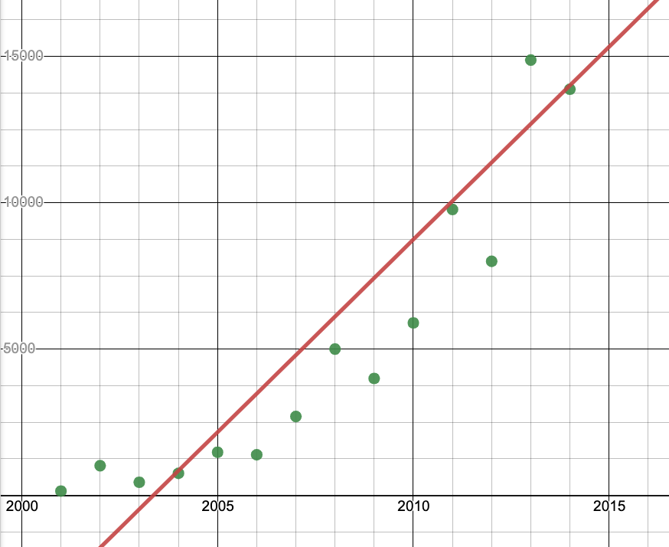
Student work / Preview of Workspace Slide
Create a graph to show how the attendance
at the festival changed over time. How would
you describe the relationship between the
variables?
Student A
What makes sense about this work?
What is incomplete or not reasonable about this work?
Use connections to the graphs and the context to justify your claims.
What makes sense about Student A’s reasoning is…
Notes:
Facilitator Notes:
Groups / breakout rooms: Record and justify claims about the students’ reasoning for ~7 minutes.
Whole group: Pre-select two slides to share whole group. Discuss the slides, and press participants on listening to understand one another.

Slide 63
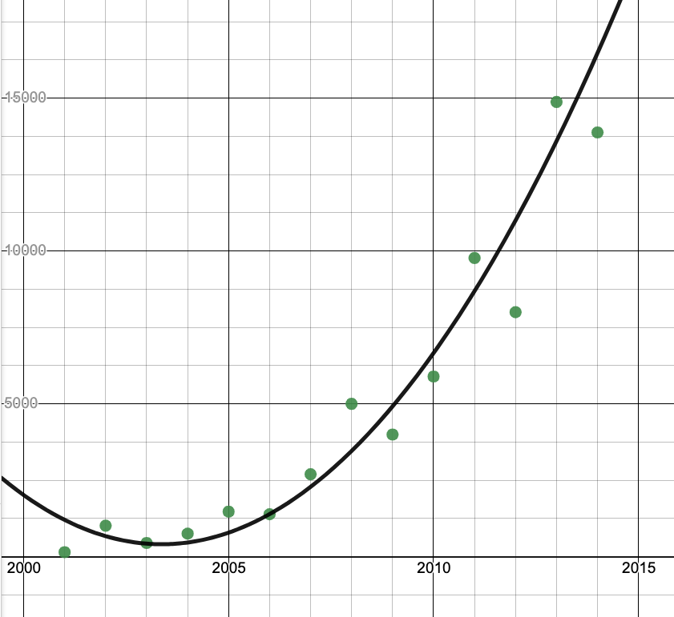
Student Work / Preview of Workspace Slide
Create a graph to show how the attendance
at the festival changed over time. How would
you describe the relationship between the
variables?
Student B
What makes sense about this work?
What is incomplete or not reasonable about this work?
Use connections to the graphs and the context to justify your claims.
What makes sense about Student A’s reasoning is…
Notes:
Facilitator Notes:
Groups / breakout rooms: Record and justify claims about the students’ reasoning for ~7 minutes.
Whole group: Pre-select two slides to share whole group. Discuss the slides, and press participants on listening to understand one another.

Slide 64
Student Work / Preview of Workspace Slide
Create a graph to show how the attendance
at the festival changed over time. How would
you describe the relationship between the
variables?
Student C
What makes sense about this work?
What is incomplete or not reasonable about this work?
Use connections to the graphs and the context to justify your claims.
What makes sense about Student C’s reasoning is…
Notes:
Facilitator Notes:
Groups / breakout rooms: Record and justify claims about the students’ reasoning for ~7 minutes.
Whole group: Pre-select two slides to share whole group. Discuss the slides, and press participants on listening to understand one another.

Slide 65
Point to Ponder
What factors are important to consider when creating a function to model a dataset?
Notes:
Facilitator Notes:
Have participants return to 8a Standards Guidance Document for HS.DR.C.8 and 8b Standards Guidance Document for HS.DR.D.13 and consider the question on the screen.
You might also return to the Coherence Map.
Anticipated responses:
Considering the context is important – a quadratic function might fit the data right now, but are there other factors that might slow the growth rate in the future (size limitations, etc.).
Data/trends can change over time, so the best model might be a piecewise function that using different functions for different stages.
Context gives us clues about reasonable domain – the context will likely limit the domain of our model.
The association between the variables can be linear or nonlinear, or there might be no relationship between the variables.
Graphing datasets helps us notice and name the relationship between the variables.

Slide 66
Debriefing the Anime Festival task
Goals for us as math learners:
Mathematical goal: Deepen our understanding of how a context impacts the creation of a function to model a data set.
Equity goal: Build a community of learners where participants listen to each other and are ready to respond to what they have heard
How did you see me working on each of these goals during the lesson?
What moves could have been made to support our work on these goals even more?
Notes:
Facilitator Notes:
This slide returns to the purpose of math task and orients participants of the goals we have had for them as learners.
Emphasize that we are now asking them to put on their “math learner hat” to debrief their experience with the task as learners using the questions on the slide.
Make connections to the aims of a 2 + 1 model. You might say: One of the aims of a 2 + 1 model is to provide opportunities for deeper conceptual understanding. Did that occur? If so, where? Where could an instructor press on conceptual understanding?
Potential ideas to surface:
Lines of best fit can have more than one option. The context can support your justification of the line of best fit.
What context would account for Student C’s red line being drawn and then the aqua line being added?

Slide 67
Debriefing the Anime Festival task
Goals for us as teachers:
Equity goal: Surface the importance of changing the way we teach to reach diverse students by giving access.
Pedagogical goal: Use worked examples to promote access to and reasoning about important mathematical ideas.
What new ideas do you have about what a task looks like and sounds like in a 2 + 1 model?
What questions do you have about facilitating a task in a 2 + 1 model?
Notes:
Facilitator Notes:
This slide returns to the purpose of math task and orients participants of the goals we have had for them as teachers.
Emphasize that we are now asking them to debrief their experience with the task as teachers using the questions on the slide.

Slide 68
Debrief: Practices of ambitious mathematics teaching
Which of these 8 practices did you notice? What others could have been highlighted? In what ways?
Establish mathematical goals to focus learning
Implement tasks that promote reasoning and problem solving
Use and connect mathematical representations
Facilitate meaningful mathematical discourse
Pose purposeful questions
Build on procedural fluency from conceptual understanding
Support productive struggle in learning mathematics
Elicit and use evidence of student thinking
(NCTM, 2014)
Notes:
Facilitator Notes:
Option 1: Debrief “Doing Math Together” or “Studying Teaching” through the lens of NCTM’s 8 practices of ambitious instruction.
If you’re facilitating online, you might offer an opportunity to “stamp” the practices participants notice and discuss trends or questions that emerge.
If you’re facilitating in person, you might offer a turn and talk so participants can discuss what they noticed with a partner/group and then come back to share trends or questions that emerge.
During the discussion, press for examples/evidence from the shared moment of teaching. This might sound like: “Where/when did you see an example of this practice?”

Slide 69
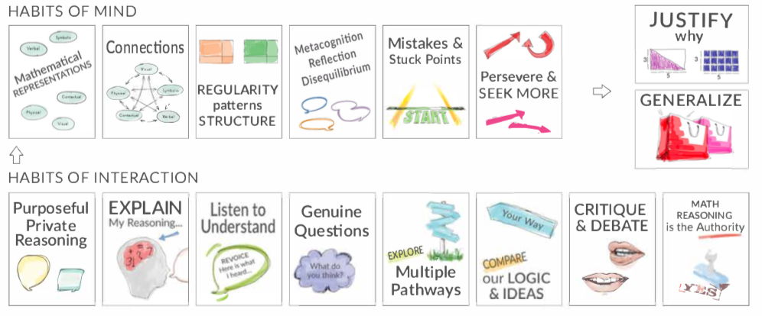
Debrief: Habits, routines, and actions
Which of these habits did you notice? What others could have been highlighted? In what ways?
Habits of Mind: Things we do as individual mathematicians when solving problems.
Habits of Interaction: Things that we do when working with others to make sense of the math.
(TDG, 2020)
Notes:
Facilitator Notes:
Option 2: Debrief “Doing Math Together” or “Studying Teaching” through the lens of TDG’s Habits, routines and actions tool.
If you’re facilitating online, you might offer an opportunity to “stamp” the habits participants notice and discuss trends or questions that emerge.
If you’re facilitating in person, you might offer a turn and talk so participants can discuss what they noticed with a partner/group and then come back to share trends or questions that emerge.
During the discussion, press for examples/evidence from the shared moment of teaching. This might sound like: “Where/when did you see an example of this practice?”

Slide 70

Connecting to research:
Noticing and building on students’ strengths
in a 2 + 1 model
Notes:
Facilitator Notes:
The purpose of Session 5 is to deepen our understanding of what a 2 + 1 model can look like in practice. Here we continue this work by digging into research on what it looks like to notice and build on students’ strengths.

Slide 71
Facilitator Guide: Connecting to Research
Rationale for connecting to research:
  To infuse new ideas into our conversations about instruction and challenge or deepen our existing understandings (Cain, 2015).
  To support us in using evidence to inform our professional learning
Recommendations for connecting to research:
  Honor and make space for participants’ existing knowledge and expertise.
  Support participants to collectively grapple with the complexity of what the research offers and carefully consider how the research relates to their own teaching context and work.
  Closely pair opportunities to connect to research with opportunities to plan for action on the basis of what they’ve read.
Notes:
Additional resources: If you are interested in learning more about these ideas, check out these resources.
Module 0, Resource 1:
References
Cain, T (2015). Teachers’ engagement with research texts: beyond instrumental, conceptual or strategic use. Journal of Education for Teaching, 41(5), 478-492.

Slide 72
Why focus on students’ strengths?
Positions young people as competent learners
Supports students to create positive math identities
Values peers as intellectual resources
Broadens school mathematics to include a rich set of students’ skills, practices, and understandings
Enables students to see themselves in the discipline
Reflects disciplinary practices and norms more accurately and realistically
(Jilk, 2016)
Notes:
Why it’s important to focus on Habits 3 big ideas: position them as competent learners help them value each other broaden school mathematics

Slide 73
Focusing on students’ strengths requires unlearning widespread deficit narratives
Deficit narratives about students are deeply rooted in mathematics education systems and are grounded in long-standing structures and practices which are particularly harmful to students on the basis of their racial, gender, linguistic, cultural, and ethnic identities.
  2+1 is an effort to reorganize some of these structures!
Deficit narratives impact all of us and translate into our practice.
In addition to making changes at a system-wide level, it is important to look for and question how our own practices are impacted by deficit narratives.
  This is brave and courageous work!
      (NCTM, 2018 p. 21-22; Aguirre et al., 2013 p. 20-21)
Notes:
Facilitator Notes:
Share the information on the slide about the importance of shifting language to foster an asset-based view of students.
Pause to make space for questions that come up for participants.

Slide 74
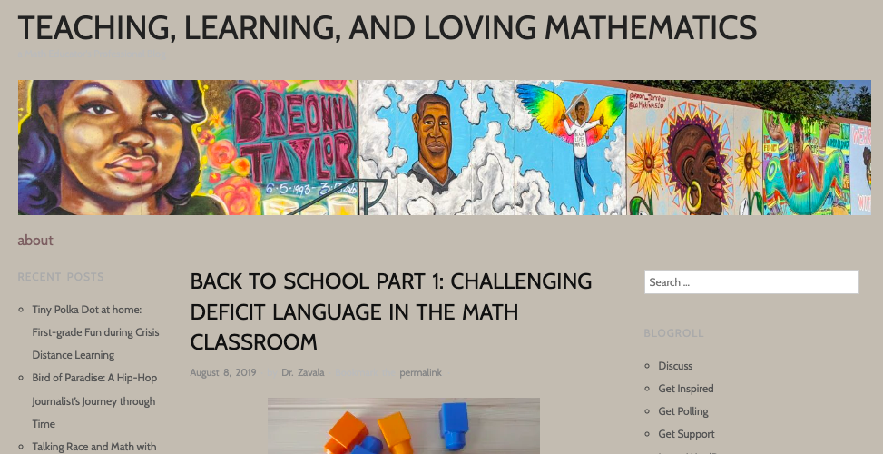
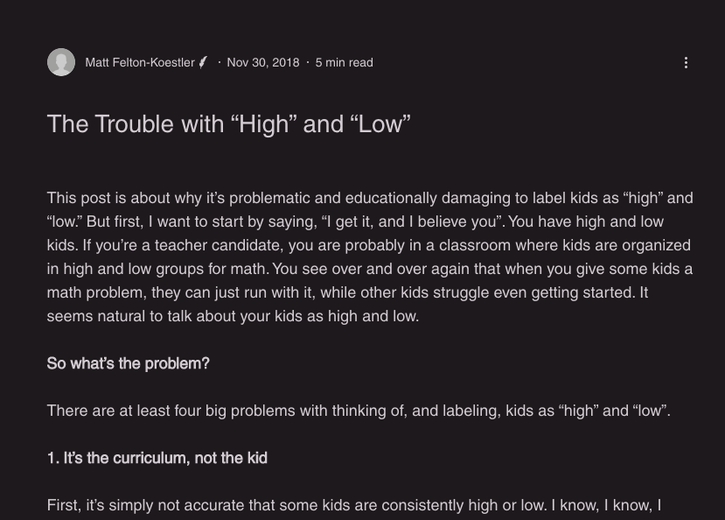
Further reflection on shifting from deficit-based to strengths-based views and language
Challenging deficit language in the math classroom
The trouble with “high” and “low”
Maria Zavala
Associate Professor
San Francisco State
University
Matthew Felton-Koestler
Associate Professor
Ohio University
What are some of the stereotypes and assumptions that emerge in your classroom about who can or cannot do mathematics? How do you and your students deal with these stereotypes and assumptions?
What perceptions about what students can and cannot do mathematically impact your actions, decisions, and system structures?
What steps can be taken to identify and interrogate biases in your setting? Be ready to share.
Notes:
Facilitator Notes:
Have participants open the two blog posts. Give them time to privately read ONE of the two blog posts and begin to consider the questions on the screen.
Optionally, before the session, you might make a .pdf or copy of the blog posts to share with participants.

Slide 75
Small Group Activity
Directions: Use the workspace slide to reflect on shifting from deficit-based to strengths-based views and language
Notes:
Facilitator Notes:
Have participants open the two blog posts. Give them time to privately read ONE of the blog posts.
Give directions and have them work in small groups for ~7 minutes.
Aspects of small group directions you might consider:
It may be helpful to specify roles for participants in the small groups. For example, you might:
Specify who will go first and in what order participants will share. For example, in a virtual session, you might say, “The second person who enters the breakout room will share first, and sharing will move counterclockwise until everyone has shared.”
Specify who will record. For example, in a virtual session, you might say, “The first person who enters the breakout room will be the recorder and jot down ideas from the group onto the workspace slide.
Specify who will keep time. For example, in a virtual session, you might say, “The third person will be the time keeper and let each team member know if airtime goes over a minute and how much time is left.”
It may be helpful to specify where participants will record and show them how to access it. As we have suggested, you might have an assigned Google Slide for each group which is a copy of this activity’s workspace slide.
It may be helpful to specify how much time participants will have in their small group.
It may be helpful to preview what their workspace will look like (e.g., share the next slide).
Before sending participants into groups, you might say: Share your rough draft thinking: you do not have to have everything totally worked out yet, and it is ok to change your mind after you shared.
Monitor slides while the groups are working in order to pre-select ideas to share whole-group.

Slide 76
Preview of Workspace Slide
Team names:
What are some of the stereotypes and assumptions that emerge in your classrooms about who can or cannot do mathematics? How do you and your students deal with these stereotypes and assumptions?
What perceptions about what students can and cannot do mathematically impact your actions, decisions, and system structures?
What steps can be taken to identify and interrogate biases in your setting? Be ready to share.
Notes:
Facilitator Notes:
Groups / breakout rooms: Reflect and record responses to the discussion questions for ~7 minutes.
Whole group: Ask participants to share important takeaways.

Slide 77
Rough draft thinking & building on students’ strengths
“Learning is a messy business. When we learn, we actively work to make sense of an idea that does not make sense to us yet. We try on new ideas by attempting to find words, symbols, or drawings to represent these ideas, either through communicating with others or through communicating with ourselves. When we talk out loud, our rough drafts can sound bumpy, with starts and stops, awkward pauses . . . However, if I say something imperfect, that does not mean I am flawed as a person. No one wants to be defined by how we communicate in a particular moment. … After all, expressing words informally as we try on a new idea is a sign of knowledge in transition. Communicating awkwardly as we try to make sense of things is a sign that learning is taking place.”
(Jansen, 2020, p.3)
(Jansen, 2020)
Notes:
Facilitator Notes:
Share these quotes from Amanda Jansen’s 2020 book called Rough draft math: Revising to learn.
Ask participants to begin to think about the connections they see from supporting students to share rough draft thinking, and building on students’ strengths.

Slide 78
Rough draft thinking & building on students’ strengths
Respond to these prompts independently, then share with a partner / your group.
In what ways can working with rough draft thinking or encouraging revision support students to engage more deeply in ambitious math teaching?
How is rough draft thinking related to building on students’ strengths?
How do these ideas fit with the aims of a 2 + 1 model?
Notes:
Facilitator Notes:
Give participants time to privately consider the questions on the screen.

Slide 79
Small Group Activity
Directions: Use the workspace slide to reflect on rough draft thinking and building on students’ strengths.
Notes:
Facilitator Notes:
Give directions and have them work in small groups for ~7 minutes.
Aspects of small group directions you might consider:
It may be helpful to specify roles for participants in the small groups. For example, you might:
Specify who will go first and in what order participants will share. For example, in a virtual session, you might say, “The second person who enters the breakout room will share first, and sharing will move counterclockwise until everyone has shared.”
Specify who will record. For example, in a virtual session, you might say, “The first person who enters the breakout room will be the recorder and jot down ideas from the group onto the workspace slide.
Specify who will keep time. For example, in a virtual session, you might say, “The third person will be the time keeper and let each team member know if airtime goes over a minute and how much time is left.”
It may be helpful to specify where participants will record and show them how to access it. As we have suggested, you might have an assigned Google Slide for each group which is a copy of this activity’s workspace slide.
It may be helpful to specify how much time participants will have in their small group.
It may be helpful to preview what their workspace will look like (e.g., share the next slide).
Before sending participants into groups, you might say: Share your rough draft thinking: you do not have to have everything totally worked out yet, and it is ok to change your mind after you shared.
Monitor slides while the groups are working in order to pre-select ideas to share whole-group.

Slide 80
Preview of Workspace Slide
Team names:
In what ways can working with rough draft thinking or encouraging revision support students to engage more deeply in ambitious math teaching?
How is rough draft thinking related to building on students’ strengths?
How do these ideas fit with the aims of a 2 + 1 model?
Notes:
Facilitator Notes:
Groups / breakout rooms: Reflect and record responses to the discussion questions for ~7 minutes.
Whole group: Ask participants to share important takeaways.

Slide 81

Recommended reading / resource
      The impact of identity in K-8 mathematics:
      Rethinking equity-based practices
      by Julia Aguirre, Karen Mayfield-Ingram and Danny Martin
(Aguirre et al., 2013)

Slide 82
Debrief: Principles of ambitious mathematics teaching
Which of these ideas are you thinking about in light of our work? What questions do you have?
“Ambitious teaching is teaching that deliberately aims for all students – across ethnic, racial, class, and gender categories – not only to acquire, but also to understand and use knowledge, and to use it to solve authentic problems.”
(Lampert & Graziani, 2009, p. 492)
Ambitious teaching:
Engages students in making sense of mathematical concepts
Centers students’ thinking and reasoning through discourse
Views students as capable of using their understandings and assets to solve authentic problems
Values students’ thinking, including emergent understanding and errors
Attends to student thinking in an equitable and responsive manner
(Anthony et al., 2015)
Notes:
Facilitator Notes:
Debrief “Connecting to Research” or “Planning for Action” through the lens of this definition from Lampert and Graziani (2009) and the five principles listed.
If you’re facilitating online, you might offer an opportunity to “stamp” the principles that are on participants’ minds and discuss trends or questions that emerge.
If you’re facilitating in person, you might offer a turn and talk so participants can discuss what principles are on their minds with a partner/group and then come back to share trends or questions that emerge.
[written reflection option]
References for these ideas: Anthony et al., 2015; Huinker & Bill, 2017; Lampert et al., 2011; Lampert & Graziani, 2009

Slide 83

Planning for action:
Applying our learning about ambitious math teaching
and a 2 + 1 model
Notes:
Facilitator Notes:
The purpose of Session 5 is to deepen our understanding of what a 2 + 1 model can look like in practice. Here we continue this work applying our learning to upcoming work in the classroom.

Slide 84
Facilitator Guide: Planning for Action
Rationale for planning for action:
  To see connections to our contexts and goals (Putnam & Borko, 2000)
  To apply new ideas to upcoming work (Horn & Kane, 2015)
  To surface complexities when taking up new ideas
Recommendations for planning for action:
  Use teachers’ own curricular resources when possible
  Create space to discuss anticipated challenges and strategies for trying new ideas within those challenges
  Follow up on teachers’ plans; return to them to build on and refine ideas
Notes:
Planning for action involves making links between session content and our own practice and contexts.
Additional resources: If you are interested in learning more about these ideas, check out these resources.
Module 0, Resource 2: Sometimes, planning conversations can surface unproductive ideas about particular students or student groups that circulate in our schools or broader contexts. This resource is designed to support leaders preparing for difficult conversations, especially when unproductive language about students emerges.
References
Horn, I. S., & Kane, B. D. (2015). Opportunities for professional learning in mathematics teacher workgroup conversations: Relationships to instructional expertise. Journal of the Learning Sciences, 24(3), 1–46.
Putnam, R. T., & Borko, H. (2000). What do new views of knowledge and thinking have to say about research on teacher learning? Educational Researcher, 29(1), 4-15.

Slide 85
Applying our learning to our work in the classroom
Work with a partner/group or independently to plan a lesson, unit or assessment you will use in the near future:
  What new ideas about ambitious math teaching are you excited to try out?
  How will you work on this new idea?
Make a plan with your colleagues to check-in about how trying this idea out went between now and our next session (e.g., at your next PLC meeting)
Notes:
Facilitator Notes:
Give participants time to work on applying their learning to their work in the classroom (in small groups, pairs or independently).
Invite participants to look at their curricular materials and work on specific lessons, units or assessments
To support continued reflection between sessions, be sure to provide an opportunity for participants to set up time to check-in with one another in the near future about their experiences trying out this idea/plan

Slide 86
Debriefing Session 5
Reflecting on our work in the activities in the session

Slide 87
Debriefing Session 5: Four cornerstone principles of the OMP
What connections do you see between any of the cornerstones and our work in this session?
Focus: Learning experiences in every grade and course are focused on core mathematical content and practices that progress purposefully across grade levels.
Engagement: Mathematical learning happens in environments that motivate all students to engage with relevant and meaningful issues in the world around them.
Pathways: All students are equipped with the mathematical knowledge and skills necessary to identify and productively pursue any postsecondary paths in their future. Students have agency to choose from a variety of courses, contexts, and applications they find relevant.
Belonging: Participation in mathematical learning builds students’ identities as capable math learners and fosters a positive self-concept. Students’ cultural and linguistic assets are valued in ways that contribute to a sense of belonging to a community of learners.
Any proposed instructional approach, curricular change, or system design element should be evaluated by the degree to which it builds on these four cornerstones. When new approaches are built within the framework of all four-cornerstone principles, we will be on our way to engineering a reimagined system.
(ODE, 2022)
Notes:
Facilitator Notes:
Option 1: Debrief the session through the lens of the four cornerstone principles of the Oregon Mathematics Project.

Slide 88
Debriefing Session 5: Focus of the session
What new insights do you have related to our session focus, deepening our understanding of what a 2 + 1 model can look like in practice?
Take a couple of minutes to reflect on our work in the session.
Agenda for this session:
Setting and maintaining norms: Reconnect with and revise our norms for interacting together
Doing math together: Experiencing what a task might look and sound like in a 2 + 1 model (the Anime Festival task)
Connecting to research: Noticing and building on students’ strengths in a 2 + 1 model
Planning for action: Applying our learning about ambitious math teaching and a 2 + 1 model
Notes:
Facilitator Notes:
Option 2: Debrief the session through the lens of the focus of the session.
Module 1 Part 2 especially supports our thinking around the second essential question of this module: Why is a 2 + 1 model important for equitable outcomes in mathematics?
The focus of this session in particular is to deepen our understanding of what a 2 + 1 model can look like in practice.
You might offer participants time to think individually about new insights before sharing aloud.

Slide 89
The role of discourse and cognitive demand in light of a 2 + 1 model
Session 6
The focus of this session is to consider two especially important aspects of ambitious math teaching in light of the aims of a 2 + 1 model: the cognitive demand of tasks, and students’ discourse.
Agenda for this session:
Setting and maintaining norms: Reconnect with and revise our norms for interacting together
Connecting to research: The role of discourse in supporting all students’ learning
Connecting to research: The role of cognitive demand in supporting all students’ learning
Doing math together: Seeing key aspects of ambitious math teaching in a data talk (Teen Behaviors)
Planning for action: Planning a data talk in light of key aspects of ambitious math teaching
Time estimate: 90 minutes
M1 P2 Table of Contents
Notes:
Facilitator Notes:
This section especially supports our thinking around the first essential question of this module: What is ambitious math teaching?
We estimate this section will take 90 minutes. If you need to break the section into smaller pieces, please note the activities listed in the agenda are intended to be enacted in this order.

Slide 90

Setting and maintaining norms
Reconnect with and revise our norms for interacting together

Slide 91
Facilitator Guide: Setting and Maintaining Norms
Rationale for setting and maintaining norms:
  To create spaces where we can vulnerably share about our teaching, learning and mathematics (Elliott et al., 2009; Little, 2002; Horn, 2010)
  To support us in sharing in-process, “rough draft” ideas (Thanheiser & Jansen, 2016)
  To foster a community where all members are valued (Grossman et al., 2001)
Recommendations for setting and maintaining norms:
  Include everyone’s ideas and perspectives when setting norms
  Regularly revisit norms and adjust norms as needed
Notes:
Upholding norms is a responsibility of participants and leaders/facilitators. It may be helpful to come up with a protocol that supports participants in naming and problem solving in the event that norms are breached.
Additional resources: If you are interested in learning more about the ideas of setting and maintaining norms check out these resources.
TEDD.org: Setting norms for collaborative work
References
Elliott, R. & Lesseig, K., & Kazemi, E.. (2009). Sociomathematical norms in professional development: Examining leaders’ use of justification and its implication for practice. The Montana Mathematics Enthusiast Journal monograph, 7.
Grossman, P., Wineburg, S., & Woolworth, S. (2001). Toward a theory of teacher community. Teachers College Record, 103, 942–1012.
Horn, I. S. (2010). Teaching replays, teaching rehearsals, and re-visions of practice: Learning from colleagues in a mathematics teacher community. Teachers College Record, 112(1), 225–259.
Little, J. W. (2002). Professional community and the problem of high school reform. International Journal of Educational Research, 37(8), 693–714.
Thanheiser, E. & Jansen, A. (2016). Inviting prospective teachers to share rough draft mathematical thinking. Mathematics Teacher Educator, 4(2), 145–163.

Slide 92
Revisiting norms
[Insert your group norms]
Rights of a Learner
You have the right to:
Be confused
Make mistakes
Say what makes sense to you
Share unfinished or rough draft thinking and not be judged
(Kalinec-Craig, 2017)
Notes:
Facilitator Notes:
Orient participants to the norms you set in prior sessions and Rights of the Learner
You might ask questions like:
How do the productive norms and Rights of the Learner support our learning together?
Choose one of our norms that you want to focus on in particular. Why does that norm feel important for your learning today?
Invite participants to revise or add onto existing norms as needed
Remind participants of the importance of norms in developing a community of learners.
You might say: As we have opportunities to get to know each other better and better it allows for us to develop trust and feel more and more comfortable asking questions, and asking for and receiving help.

Slide 93

Connecting to research
The role of discourse in supporting all students’ learning
Notes:
Facilitator Notes:
The purpose of Session 6 is to reflect on the role of discourse and cognitive demand in light of a 2+1 model. Here we begin this work by continuing our work understanding of the importance of rich student discourse.

Slide 94
Facilitator Guide: Connecting to Research
Rationale for connecting to research:
  To infuse new ideas into our conversations about instruction and challenge or deepen our existing understandings (Cain, 2015).
  To support us in using evidence to inform our professional learning
Recommendations for connecting to research:
  Honor and make space for participants’ existing knowledge and expertise.
  Support participants to collectively grapple with the complexity of what the research offers and carefully consider how the research relates to their own teaching context and work.
  Closely pair opportunities to connect to research with opportunities to plan for action on the basis of what they’ve read.
Notes:
Additional resources: If you are interested in learning more about these ideas, check out these resources.
Module 0, Resource 1:
References
Cain, T (2015). Teachers’ engagement with research texts: beyond instrumental, conceptual or strategic use. Journal of Education for Teaching, 41(5), 478-492.

Slide 95
The role of discourse in ambitious teaching
Ambitious teaching involves engaging students in making sense of and reasoning about mathematical concepts through discourse.
What do teachers need to do in order to engage students who are often excluded by schooling in rich mathematical conversations?
How does facilitating discussions relate to the work of drawing on students’ strengths?
(Anthony et al., 2015)
Notes:
Facilitator Notes:
Frame the role of discourse in ambitious teaching.
You might say: We know opportunities for students to reason and make sense through discourse are critical aspects of ambitious teaching. In this activity we’re going to think about how teachers can support equitable student discourse.
Ask participants to consider the prompts on the slide and think about the work of a teacher in facilitating discourse between students, with special attention to students who are historically marginalized and excluded by schooling.
References for these ideas: Anthony et al., 2015; Huinker & Bill, 2017; Lampert et al., 2011; Lampert & Graziani, 2009

Slide 96
Small Group Activity
Directions: Use the workspace slide to complete the Teaching Practices Continuum charts
Notes:
Facilitator Notes:
Explain that participants will be working on completing a set of “continuum charts” related to classroom discourse. This charts in their workspace slides are adapted from NCSM (Click here to see the complete charts). Filling in the empty spots on the chart can help teachers anticipate what a classroom looks like and sounds like around specific strategies.
Give directions and have them work in small groups for ~7 minutes.
Aspects of small group directions you might consider:
It may be helpful to specify roles for participants in the small groups. For example, you might:
Specify who will go first and in what order participants will share. For example, in a virtual session, you might say, “The second person who enters the breakout room will share first, and sharing will move counterclockwise until everyone has shared.”
Specify who will record. For example, in a virtual session, you might say, “The first person who enters the breakout room will be the recorder and jot down ideas from the group onto the workspace slide.
Specify who will keep time. For example, in a virtual session, you might say, “The third person will be the time keeper and let each team member know if airtime goes over a minute and how much time is left.”
It may be helpful to specify where participants will record and show them how to access it. As we have suggested, you might have an assigned Google Slide for each group which is a copy of this activity’s workspace slide.
It may be helpful to specify how much time participants will have in their small group.
It may be helpful to preview what their workspace will look like (e.g., share the next slide).

Slide 97
Preview of Workspace Slide (1 of 2)
Team Names:
What does facilitating meaningful mathematical discourse look like in practice?
Teacher Centered | Making Progress | Student Centered
Teacher is fixed at the front of the classroom Minimal or no opportunities for collaboration are provided. | Teacher provides some opportunities for collaboration. | Students question each other, and teacher encourages this behavior.
The final math authority resides with the teacher. | [fill in here] | [fill in here]
[fill in here] | Students’ arguments are focused on what they did, but not why they did what they did. | Students’ arguments are focused on both how and why they did what they did.
(NCSM, 2019)
Notes:
Facilitator Notes:
Groups / breakout rooms: Participants should work in groups on the workspace slide for ~10 minutes to complete the charts.
Whole group: After participants have had time to work in small groups, you might have them briefly share (~4 minutes).

Slide 98
Preview of Workspace Slice (2 of 2)
Team Names:
What does eliciting and using evidence of students’ thinking look like in practice?
Teacher Centered | Making Progress | Student Centered
Teacher relies on a consistent small group of volunteers to share. | Teacher gathers data during the math task, but relies on volunteers to share (doesn’t purposefully select and sequence ideas). | Teacher thoughtfully chooses students to share based on the math goals of the lesson and looking for opportunities to provide status to students who may not always share.
[fill in here] | Teacher provides minimal opportunity for students to reflect on their learning. | [fill in here]
[fill in here] | [fill in here] | Students argue the validity of a mathematical statement or solution through reasoning and justifying.
(NCSM, 2019)
Notes:
Facilitator Notes:
Groups / breakout rooms: Participants should work in groups on the workspace slide for ~7 minutes to complete the charts.
Whole group: After participants have had time to work in small groups, you might have them briefly share (~4 minutes).

Slide 99
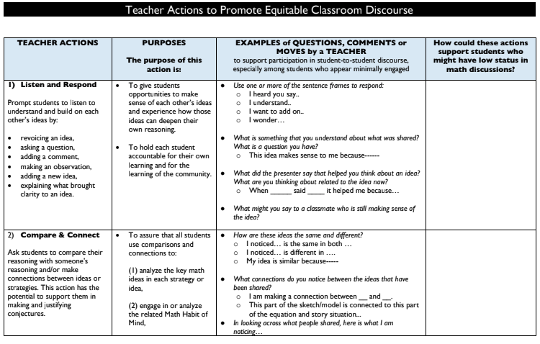
Teacher Actions to Promote Equitable Classroom Discourse
Recall one example from our work doing math together for each of these teacher actions.
How did the teacher actions “Listen and Respond” and “Compare and Connect” keep the group engaged and accountable during the discussion?
How could these actions support your students who might have low status in math classroom?
Read the first 2 pages of the Teacher Actions to Promote Equitable Classroom Discourse tool.
Focus on these two actions:
Listen and Respond
Compare and Connect
(TDG, 2022)
Notes:
Facilitator Notes:
Ask participants to open up 9 Teacher Actions to Promote Equitable Classroom Discourse_TDG and read the first 2 pages (~5-7 min).
Then ask participants to reflect and discuss the prompts on the slide (with partners or in small groups).
Facilitate a whole group discussion related to the prompts on the slide.

Slide 100
Debrief: Principles of ambitious mathematics teaching
Which of these ideas are you thinking about in light of our work? What questions do you have?
“Ambitious teaching is teaching that deliberately aims for all students – across ethnic, racial, class, and gender categories – not only to acquire, but also to understand and use knowledge, and to use it to solve authentic problems.”
(Lampert & Graziani, 2009, p. 492)
Ambitious teaching:
Engages students in making sense of mathematical concepts
Centers students’ thinking and reasoning through discourse
Views students as capable of using their understandings and assets to solve authentic problems
Values students’ thinking, including emergent understanding and errors
Attends to student thinking in an equitable and responsive manner
(Anthony et al., 2015)
Notes:
Facilitator Notes:
Debrief “Connecting to Research” or “Planning for Action” through the lens of this definition from Lampert and Graziani (2009) and the five principles listed.
If you’re facilitating online, you might offer an opportunity to “stamp” the principles that are on participants’ minds and discuss trends or questions that emerge.
If you’re facilitating in person, you might offer a turn and talk so participants can discuss what principles are on their minds with a partner/group and then come back to share trends or questions that emerge.
[written reflection option]
References for these ideas: Anthony et al., 2015; Huinker & Bill, 2017; Lampert et al., 2011; Lampert & Graziani, 2009

Slide 101
Connecting to research
The role of cognitive demand in supporting all students’ learning
Notes:
Facilitator Notes:
The purpose of Session 6 is to return to key tenets of ambitious math teaching in light of a 2 + 1 model. Here we begin this work by returning to the idea of cognitive demand and its role in supporting discourse.
Throughout this activity, it may be helpful to connect the importance of cognitive demand to the work participants just did around discourse.
You might say: If we want students to engage in discourse around their reasoning and sensemaking, we have to give them things that are worthy of discussion and worth talking about.

Slide 102
Facilitator Guide: Connecting to Research
Rationale for connecting to research:
  To infuse new ideas into our conversations about instruction and challenge or deepen our existing understandings (Cain, 2015).
  To support us in using evidence to inform our professional learning
Recommendations for connecting to research:
  Honor and make space for participants’ existing knowledge and expertise.
  Support participants to collectively grapple with the complexity of what the research offers and carefully consider how the research relates to their own teaching context and work.
  Closely pair opportunities to connect to research with opportunities to plan for action on the basis of what they’ve read.
Notes:
Additional resources: If you are interested in learning more about these ideas, check out these resources.
Module 0, Resource 1:
References
Cain, T (2015). Teachers’ engagement with research texts: beyond instrumental, conceptual or strategic use. Journal of Education for Teaching, 41(5), 478-492.

Slide 103
The importance of cognitive demand
Key findings from research:
Not all tasks provide the same opportunities for student thinking and learning.
Student learning is greatest in classrooms where the tasks consistently encourage high-level thinking and reasoning and least in classrooms where the tasks are routinely procedural in nature.
Tasks with high cognitive demands are the most difficult to implement well and are often enacted in ways that decrease cognitive demand during instruction.
What ideas from this list are surprising to you?
What ideas from this list are exciting for you?
(Boaler & Stapels, 2008; Heibert et al., 1997; Hiebert & Wearne, 1993; Stein et al., 2009; Stein et al., 1996; Stein & Lane, 1996; Stigler & Heibert 2004)
Notes:
Facilitator Notes:
Orient participants to some key points from research about the importance of cognitive demand

Slide 104
Resource for analyzing the cognitive demand of tasks
The resource below will help you determine whether tasks are of high or low cognitive demand
Rigor of the Task Analysis Tool (from PMRR)
(PMRR, 2018)
Notes:
Facilitator Notes:
Remind participants of how you have defined cognitive demand together so far:
You might say: You may recall that we refer to the cognitive level of tasks as the kind and level of thinking that students would need in order to be successful with the task. Recall also that we do not equate “hard” with “high level” of tasks. By the same token there may be a place for “low level” tasks, but “high level” tasks engage students in deeper conceptual understanding leading to richer discourse, justifications and generalizations which promote deeper long lasting learning which is our goal.
Have participants open 10 Rigor of Task Analysis Tool_PMRR give participants ~5 minutes to privately read the document.
Alternatively, OR in addition you might consider asking participants to draw on either of the resources below to support their task analysis:
“The Task Analysis Guide” from (Stein, et al. 2000)
“Instructional Quality Assessment in Mathematics Toolkit” (Boston et al., 2009)
Raise participants’ takeaways in the whole group.

Slide 105
Small Group Activity
Directions: Use the workspace slide to reflect on the cognitive demand of tasks from your own curriculum.
Notes:
Facilitator Notes:
Give directions and have them work in small groups for ~7 minutes.
Aspects of small group directions you might consider:
It may be helpful to specify roles for participants in the small groups. For example, you might:
Specify who will go first and in what order participants will share. For example, in a virtual session, you might say, “The second person who enters the breakout room will share first, and sharing will move counterclockwise until everyone has shared.”
Specify who will record. For example, in a virtual session, you might say, “The first person who enters the breakout room will be the recorder and jot down ideas from the group onto the workspace slide.
Specify who will keep time. For example, in a virtual session, you might say, “The third person will be the time keeper and let each team member know if airtime goes over a minute and how much time is left.”
It may be helpful to specify where participants will record and show them how to access it. As we have suggested, you might have an assigned Google Slide for each group which is a copy of this activity’s workspace slide.
It may be helpful to specify how much time participants will have in their small group.
It may be helpful to preview what their workspace will look like (e.g., share the next slide).

Slide 106
Preview of Workspace Slide
Names:
 | Find three tasks or problems from your own curriculum. Decide if the tasks are low cognitive demand tasks or high cognitive demand tasks. Connect your response to the resource you are using to justify your thinking.
Task 1
Task 2
Task 3
Notes:
Facilitator Notes:
Groups / breakout rooms: Consider the tasks alongside the 10 Rigor of Task Analysis Tool_PMRR, and record responses to the discussion questions for ~15 minutes.
Whole group: Call on a couple of groups to share out. Encourage groups to call out specific revisions that raise the cognitive demand of the task. Then, use the next slide to generate a list of strategies together.

Slide 107
Reflecting on cognitive demand and student discourse
Reflect on the connection between tasks of high cognitive demand, discourse and our current understandings of ambitious math teaching.
How do you see cognitive demand and student discourse as related?
How does this relationship relate to our current understandings of ambitious math teaching?
What are your current wonderings about facilitating rich student discourse?
What are your current wonderings or takeaways about selecting, creating, and/or facilitating tasks of high cognitive demand?
Notes:
Facilitator Notes:
Give participants time to privately consider the prompts on the screen.
Share key takeaways whole-group:
In a virtual setting, you might have participants share an answer to this question in the chat window.
In an in-person setting, you might have participants popcorn an answer to this question to the whole group.

Slide 108
Debrief: Principles of ambitious mathematics teaching
Which of these ideas are you thinking about in light of our work? What questions do you have?
“Ambitious teaching is teaching that deliberately aims for all students – across ethnic, racial, class, and gender categories – not only to acquire, but also to understand and use knowledge, and to use it to solve authentic problems.”
(Lampert & Graziani, 2009, p. 492)
Ambitious teaching:
Engages students in making sense of mathematical concepts
Centers students’ thinking and reasoning through discourse
Views students as capable of using their understandings and assets to solve authentic problems
Values students’ thinking, including emergent understanding and errors
Attends to student thinking in an equitable and responsive manner
(Anthony et al., 2015)
Notes:
Facilitator Notes:
Debrief “Connecting to Research” or “Planning for Action” through the lens of this definition from Lampert and Graziani (2009) and the five principles listed.
If you’re facilitating online, you might offer an opportunity to “stamp” the principles that are on participants’ minds and discuss trends or questions that emerge.
If you’re facilitating in person, you might offer a turn and talk so participants can discuss what principles are on their minds with a partner/group and then come back to share trends or questions that emerge.
[written reflection option]
References for these ideas: Anthony et al., 2015; Huinker & Bill, 2017; Lampert et al., 2011; Lampert & Graziani, 2009

Slide 109

Doing math together
Seeing key aspects of ambitious math teaching
in a data talk (Teen Behaviors)
Notes:
Facilitator Notes:
Remind participants that data science:
Involves asking questions, gathering and organizing data, modeling, analyzing and synthesizing, and communicating results.
Is student-centered, connected to students’ lived experiences and the real world.

Slide 110
Facilitator Guide: Doing Math Together
Rationale for doing math together:
  Deepens our own specialized mathematical content knowledge so we can better support and respond to students (Kazemi & Franke, 2004)
  Gives us a shared context for the study of teaching (Kazemi et al., 2018)
  Helps us think about the experiences of our students
  To foster joy for doing and learning mathematics (Su, 2020)
Recommendations for doing math together:
  Establish norms for doing math together (see slide notes for examples) (Elliott et al., 2009; Yackel & Cobb; 1998).
  Support participants in engaging with the task as learners and as teachers. Be explicit about when/how participants should take up each of these roles.
Notes:
Example norms for doing mathematics together:
Engage with each other’s thinking with curiosity
Support everyone to experience joy for mathematics
Use partial understandings, mistakes, and errors as an opportunity to examine further questions about mathematics
Additional resources: If you’re interested in digging more into ideas about doing math together check out these resources.
TEDD.org: Mathematics Instructional Activities
TEDD.org: Setting norms for collaborative work
Mathematics For Human Flourishing (book)
References
Ball, D. L., & Cohen, D. K. (1999). Developing practice, developing practitioners: Toward a practice-based theory of professional education. In L. Darling-Hammond & G. Sykes (Eds.), Teaching as the learning profession: Handbook of policy and practice (pp. 3–22). Jossey Bass.
Elliott, R., Lesseig, K., & Kazemi, E.. (2009). Sociomathematical norms in professional development: Examining leaders’ use of justification and its implication for practice. The Montana Mathematics Enthusiast Journal monograph, 7.
Kazemi, E., & Franke, M. L. (2004). Teacher learning in mathematics: Using student work to promote collective inquiry. Journal of Mathematics Teacher Education, 7(3), 203–235.
Su, F. (2021). Mathematics for Human Flourishing. Yale University Press.
Yackel E., & Cobb, P. (1998) Sociomathematical norms, argumentation, and autonomy in mathematics. Journal for Research in Mathematics Education, 27(4), 458-477.

Slide 111
Goals for this Data Talk
Goals for us as math learners:
Mathematical goal: Engage students in justifying claims using evidence from a graph/data visualization.
Equity goal: Use open-ended prompts to invite thinking from all participants. Orient participants to the strengths and logic of one another’s thinking.
Goals for us as teachers:
Pedagogical goal: Consider how instructional decisions that expand opportunities for equitable discourse using a cognitively demanding task.
Notes:
Facilitator Notes:
This slide orients participants to the goals we have for doing this math activity together.
Emphasize that some of the goals are for us as “math learners” and some of the goals are for us as “teachers.” At different times in the lesson they may take up each of these lenses/roles.

Slide 112
Data preview
These data will show trends in health-related behaviors among high school students from 1989 to 2019. This includes information about students substance abuse/use, sexual activity, and mental health.
Private Reasoning Time: Consider the following questions and reflect on how you want your answers to influence the way you “notice and wonder” about the data:
What story is the author telling with this data?
What are the data’s blind spots? What/whose perspectives are missing?
What assumptions about equity, justice and injustice might this data surface?
Given your equity commitments, what assumptions might you want to bring to this data?
This prompts for our data preview are inspired and adapted by work from the HTH GSE Center for Research on Equity and Innovation. For more protocols visit: https://hthgse.edu/crei/protocols
Notes:
Facilitator Notes:
The data participants will be engaging with shows trends in health-related behaviors among high school students from 1989 to 2019, including information about substance abuse/use, sexual activity, and mental health.
You might give participants time to think about the questions on the screen privately BEFORE looking at the data.
Model/think aloud about the assumptions you might want to bring given your equity commitments: “I know that health related behaviors among high school students are likely different for different groups of students. This data may not accurately reflect the behaviors of students who experience higher levels of inequity or are more marginalized in their communities. I want to be mindful of this as I draw conclusions about what this data is telling me about students’ experiences.”

Slide 113
Data preview
When previewing data it may be helpful to model/think aloud about the assumptions you might want to bring given your equity commitments:
“I know that health-related behaviors among high school students are likely different for different groups of students. This data may not accurately reflect the behaviors of students who experience higher levels of inequity or are more marginalized in their communities. I want to be mindful of this as I draw conclusions about what this data is telling me about students’ experiences.”
These data will show trends in health-related behaviors among high school students from 1989 to 2019. This includes information about students substance abuse/use, sexual activity, and mental health.
This prompts for our Data Preview are inspired and adapted by work from the HTH GSE Center for Research on Equity and Innovation. For more protocols visit: https://hthgse.edu/crei/protocols
Notes:
Facilitator Notes:
Model/think aloud about the assumptions you might want to bring given your equity commitments: “I know that health related behaviors among high school students are likely different for different groups of students. This data may not accurately reflect the behaviors of students who experience higher levels of inequity or are more marginalized in their communities. I want to be mindful of this as I draw conclusions about what this data is telling me about students’ experiences.”

Slide 114
Data Talks are routines that allow students to make sense out of data and engage in discourse using evidence from visual representations.
Teen behaviors
The story this graph is telling us is ______ because _______.
Look closely at the following graph and think about these three questions:
What do you notice?
What do you wonder?
What might be going on in these graphs/charts?
Based on your thinking, what is a claim you could make about the data?
Share what you noticed that supports your claim.
Resources for conducting Data Talks:
Stanford Graduate School of Education:
YouCubed
NYTimes: “What’s going on in this graph?”
Notes:
Facilitator Notes:
This is the protocol for a data talk, and additional resources for participants who are interested in learning more.
Resources for conducting Data Talks:
Stanford Graduate School of Education: YouCubed
NYTimes: “What’s going on in this graph?”

Slide 115
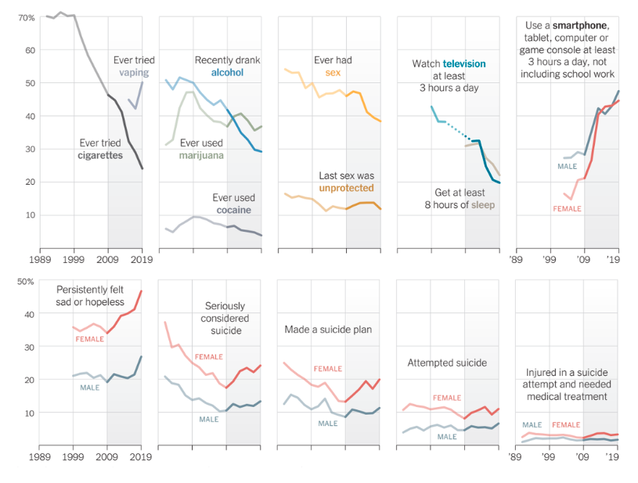
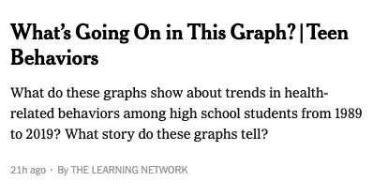
Graph Data of Behaviors
What do you notice?
What do you wonder?
What story do these graphs tell? (claim)
What in the graphs supports your story? (evidence / mathematical justification)
Source: New York Times article titled What's Going on In this Graph (opens in a window)
Notes:
Facilitator Notes:
Give participants time to study the data visualizations privately (Consider sharing the link to the original source for participants, or creating an enlarged version of the graphs on a printed handout.)
Ask participants to consider the prompts on the slide and then move into small groups.

Slide 116
Small Group Activity
Directions: Use the workspace to record your group’s claims about the data (generalizations) and your group’s evidence for those claims (justifications).
Notes:
Facilitator Notes:
Give directions and have them work in small groups for ~7 minutes.
Aspects of small group directions you might consider:
It may be helpful to specify roles for participants in the small groups. For example, you might:
Specify who will go first and in what order participants will share. For example, in a virtual session, you might say, “The second person who enters the breakout room will share first, and sharing will move counterclockwise until everyone has shared.”
Specify who will record. For example, in a virtual session, you might say, “The first person who enters the breakout room will be the recorder and jot down ideas from the group onto the workspace slide.
Specify who will keep time. For example, in a virtual session, you might say, “The third person will be the time keeper and let each team member know if airtime goes over a minute and how much time is left.”
It may be helpful to specify where participants will record and show them how to access it. As we have suggested, you might have an assigned Google Slide for each group which is a copy of this activity’s workspace slide.
It may be helpful to specify how much time participants will have in their small group.
It may be helpful to preview what their workspace will look like (e.g., share the next slide).

Slide 117
Graph Data Example
I Notice …. | I Wonder ….
Claim:
Evidence:
Source: What’s going on in this graph? Teen Behaviors
Notes:
Facilitator Notes:
Groups / breakout rooms: Give participants ~7 minutes to record ideas in groups.
Whole group: Debrief the data talk by asking 2-3 groups to share their a claim and evidence. Then, use the next slides to engage in a conversation about instructional decisions.

Slide 118
Supporting discourse in-the-moment through careful decision-making
Teachers make countless decisions throughout a lesson in an effort to promote student learning. When students are engaged in cognitively demanding tasks, we may hear a range of in-process and/or partial ideas and responses.
Think of a time a student shared something that felt challenging for you to respond to.
What decision did you make?
  In what ways did your decision advance or constrain students’ discourse?
  In what ways did your decision account for issues of equity?
Generally, how can teachers respond to student thinking in ways that open up opportunities for richer reasoning, sensemaking and discourse?
Notes:
Facilitator Notes:
Frame this slide by saying: We are going to pause to consider how the instructional decisions a teacher can make support ambitious math teaching.
Ask participants to reflect on the prompts on the slide about their own experience responding to a challenging student idea.
Then, ask participants to reflect at a more general level. What are some key ideas participants have about what it takes to respond to the range of complex ideas students may have?
You might ask a volunteer to read the slide, or ask participants to read privately.
You might ask participants to engage with the ideas on the slide as / after they are read.
For example, in a virtual space, you might ask participants to use the Zoom feature to stamp with a heart the one that they feel the strongest about and stamp with a question mark the one that they feel stretches them the most.
You might elaborate: Teachers make countless decisions all day long in an effort to promote student learning. Instructional decisions are made in three key places:
Planning: Decisions about student needs (to ensure student learning), the most appropriate goals and objectives, the content to be taught, instructional strategies, lesson delivery techniques, instructional media, classroom climate, and student assessment. Planning helps arrange the appropriate flow and sequence of instructional content and events.
Implementing involves the actual enactment of the instructional plans when interacting with students. Teaching skills that support implementation include questioning, listening, monitoring, giving feedback, and sharing. Additional implementation skills include: use of instructional technology, creation of a positive, respectful learning environment, differentiating instruction for diverse learners, and instructional strategies to promote student access and understanding.
Assessing involves determining the level of student learning. Many aspects of assessment are determined during the planning phase when instructional goals and content are identified.

Slide 119
Small Group Activity
Directions: Use the workspace slide to consider how teachers can productively respond to students’ in-process ideas.
Notes:
Facilitator Notes:
Give directions and have them work in small groups for ~5 minutes.
Aspects of small group directions you might consider:
It may be helpful to specify roles for participants in the small groups. For example, you might:
Specify who will go first and in what order participants will share. For example, in a virtual session, you might say, “The second person who enters the breakout room will share first, and sharing will move counterclockwise until everyone has shared.”
Specify who will record. For example, in a virtual session, you might say, “The first person who enters the breakout room will be the recorder and jot down ideas from the group onto the workspace slide.
Specify who will keep time. For example, in a virtual session, you might say, “The third person will be the time keeper and let each team member know if airtime goes over a minute and how much time is left.”
It may be helpful to specify where participants will record and show them how to access it. As we have suggested, you might have an assigned Google Slide for each group which is a copy of this activity’s workspace slide.
It may be helpful to specify how much time participants will have in their small group.
It may be helpful to preview what their workspace will look like (e.g., share the next slide).

Slide 120
Preview of Workspace Slide
Student idea | Teacher decision: How could we respond in ways that support student discourse and equity in our response?
Student makes a claim with minimal or no justification. | Intentionally select a student with lower math status to share. Support the class in noticing the strengths of their thinking: Julie is making a really interesting claim! What do we all think about it? Let's see if we can build on her thinking by finding evidence from the graphs to prove she's right.
Student shares something that initially doesn’t seem to make sense | [fill in here]
Student makes a claim but the justification doesn’t quite match. | [fill in here]
Notes:
Facilitator Notes:
Groups / breakout rooms: Give participants ~7 minutes to record ideas in groups.
Whole group: Debrief 1-2 groups to share their example teacher decision/response.

Slide 121
Debriefing the data talk
Goals for us as math learners:
Mathematical goal: Engage students in justifying claims using evidence from a graph/data visualization.
Equity goal: Use open-ended prompts to invite thinking from all participants. Orient participants to the strengths and logic of one another’s thinking.
How did you see me working on each of these goals during the lesson?
What moves could have been made to support our work on these goals even more?
Notes:
Facilitator Notes:
This slide returns to the purpose of math task and orients participants to the goals we have had for them as learners.
Emphasize that we are now asking them to debrief their experience with the task as learners using the questions on the slide.

Slide 122
Debriefing the data talk
Goals for us as teachers:
Pedagogical goal: Consider how instructional decisions expand opportunities for equitable discourse when using a cognitively demanding task.
What new ideas or questions do you have about supporting discourse around cognitive demand of a task?
Notes:
Facilitator Notes:
This slide returns to the purpose of a math task and orients participants to the goals we have had for them as teachers.
Emphasize that we are now asking them to debrief their experience with the task as teachers using the questions on the slide.

Slide 123
Debrief: Practices of ambitious mathematics teaching
Which of these 8 practices did you notice? What others could have been highlighted? In what ways?
Establish mathematical goals to focus learning
Implement tasks that promote reasoning and problem solving
Use and connect mathematical representations
Facilitate meaningful mathematical discourse
Pose purposeful questions
Build on procedural fluency from conceptual understanding
Support productive struggle in learning mathematics
Elicit and use evidence of student thinking
(NCTM, 2014)
Notes:
Facilitator Notes:
Option 1: Debrief “Doing Math Together” or “Studying Teaching” through the lens of NCTM’s 8 practices of ambitious instruction.
If you’re facilitating online, you might offer an opportunity to “stamp” the practices participants notice and discuss trends or questions that emerge.
If you’re facilitating in person, you might offer a turn and talk so participants can discuss what they noticed with a partner/group and then come back to share trends or questions that emerge.
During the discussion, press for examples/evidence from the shared moment of teaching. This might sound like: “Where/when did you see an example of this practice?”

Slide 124
Debrief: Habits, routines, and actions
Which of these habits did you notice? What others could have been highlighted? In what ways?
Habits of Mind: Things we do as individual mathematicians when solving problems.
Habits of Interaction: Things that we do when working with others to make sense of the math.
(TDG, 2020)
Notes:
Facilitator Notes:
Option 2: Debrief “Doing Math Together” or “Studying Teaching” through the lens of TDG’s Habits, routines and actions tool.
If you’re facilitating online, you might offer an opportunity to “stamp” the habits participants notice and discuss trends or questions that emerge.
If you’re facilitating in person, you might offer a turn and talk so participants can discuss what they noticed with a partner/group and then come back to share trends or questions that emerge.
During the discussion, press for examples/evidence from the shared moment of teaching. This might sound like: “Where/when did you see an example of this practice?”

Slide 125

Planning for action
Planning a data talk in light of
key aspects of ambitious math teaching

Slide 126
Facilitator Guide: Planning for Action
Rationale for planning for action:
  To see connections to our contexts and goals (Putnam & Borko, 2000)
  To apply new ideas to upcoming work (Horn & Kane, 2015)
  To surface complexities when taking up new ideas
Recommendations for planning for action:
  Use teachers’ own curricular resources when possible
  Create space to discuss anticipated challenges and strategies for trying new ideas within those challenges
  Follow up on teachers’ plans; return to them to build on and refine ideas
Notes:
Planning for action involves making links between session content and our own practice and contexts.
Additional resources: If you are interested in learning more about these ideas, check out these resources.
Module 0, Resource 2: Sometimes, planning conversations can surface unproductive ideas about particular students or student groups that circulate in our schools or broader contexts. This resource is designed to support leaders preparing for difficult conversations, especially when unproductive language about students emerges.
References
Horn, I. S., & Kane, B. D. (2015). Opportunities for professional learning in mathematics teacher workgroup conversations: Relationships to instructional expertise. Journal of the Learning Sciences, 24(3), 1–46.
Putnam, R. T., & Borko, H. (2000). What do new views of knowledge and thinking have to say about research on teacher learning? Educational Researcher, 29(1), 4-15.

Slide 127


Plan your own data talk
THE LEARNING NETWORK
Q.E.L.P Data Math Topics
A project linking and integrating math with environmental science.
The Q.E.L.P team have compiled “ real data on a dozen earth and environmental science topics that can be used in conjunction with each of a dozen college level algebra topics - about 100-150 data sets altogether. Educators can use the data as they see fit; in exercises, homework assignments, in-class examples, etc.”
What’s Going On in this Graph?
A weekly feature produced in collaboration with the American Statistical Association (A.S.A.)
This page includes a compilation of graphs, maps, and charts from the past three years of What’s Going on in this Graph? The feature “invites students to analyze and interpret graphs previously published in The New York Times, first by noticing and wondering, and then by creating a catchy headline and considering what impact this data might have on them and their communities.”
Notes:
Facilitator Notes:
Orient participants to the resources on the slide to support them in planning their own data talk.
You might say: Choose a data visualization from one of these resources to plan a data talk around.

Slide 128
Small Group Activity
Directions: Use the workspace slide to plan your own data talk
Notes:
Facilitator Notes:
Orient participants to the workspace planning slide and have them time to work in small groups for ~15 minutes.
Aspects of small group directions you might consider:
It may be helpful to specify roles for participants in the small groups. For example, you might:
Specify who will go first and in what order participants will share. For example, in a virtual session, you might say, “The second person who enters the breakout room will share first, and sharing will move counterclockwise until everyone has shared.”
Specify who will record. For example, in a virtual session, you might say, “The first person who enters the breakout room will be the recorder and jot down ideas from the group onto the workspace slide.
Specify who will keep time. For example, in a virtual session, you might say, “The third person will be the time keeper and let each team member know if airtime goes over a minute and how much time is left.”
It may be helpful to specify where participants will record and show them how to access it. As we have suggested, you might have an assigned Google Slide for each group which is a copy of this activity’s workspace slide.
It may be helpful to specify how much time participants will have in their small group.
It may be helpful to preview what their workspace will look like (e.g., share the next slide).

Slide 129
Planning your own data talk
Team Names:
Preview of Workspace Slide
Parts of your plan to consider:
Goals/Objectives
  What mathematical content and/or practices do I want to engage students in?
Data preview
  What information about what this graph shows do I want to preview for this group? Why? How does this graph relate to issues of inequity/justice?
Notice and Wonder
  What questions do I want to ask about this graph?
  Are there any features of the graph that are particularly worth diving into with this group given my goal(s)/knowledge of students?
Exit Ticket?
  How will I assess engagement with my goal?
Notes:
Facilitator Notes:
Groups / breakout rooms: Give participants ~15 minutes to plan their data talk
Whole group: Give participants silent time to do a “gallery walk” to look at one another’s plans. Come back together to share interesting insights/ideas that stand out to participants.

Slide 130
Debrief: Principles of ambitious mathematics teaching
Which of these ideas are you thinking about in light of our work? What questions do you have?
“Ambitious teaching is teaching that deliberately aims for all students – across ethnic, racial, class, and gender categories – not only to acquire, but also to understand and use knowledge, and to use it to solve authentic problems.”
(Lampert & Graziani, 2009, p. 492)
Ambitious teaching:
Engages students in making sense of mathematical concepts
Centers students’ thinking and reasoning through discourse
Views students as capable of using their understandings and assets to solve authentic problems
Values students’ thinking, including emergent understanding and errors
Attends to student thinking in an equitable and responsive manner
(Anthony et al., 2015)
Notes:
Facilitator Notes:
Debrief “Connecting to Research” or “Planning for Action” through the lens of this definition from Lampert and Graziani (2009) and the five principles listed.
If you’re facilitating online, you might offer an opportunity to “stamp” the principles that are on participants’ minds and discuss trends or questions that emerge.
If you’re facilitating in person, you might offer a turn and talk so participants can discuss what principles are on their minds with a partner/group and then come back to share trends or questions that emerge.
[written reflection option]
References for these ideas: Anthony et al., 2015; Huinker & Bill, 2017; Lampert et al., 2011; Lampert & Graziani, 2009

Slide 131
Debriefing Session 6
Reflecting on our work on the activities in the session

Slide 132
Debriefing Session 6: Four cornerstone principles of the OMP
What connections do you see between any of the cornerstones and our work in this session?
Focus: Learning experiences in every grade and course are focused on core mathematical content and practices that progress purposefully across grade levels.
Engagement: Mathematical learning happens in environments that motivate all students to engage with relevant and meaningful issues in the world around them.
Pathways: All students are equipped with the mathematical knowledge and skills necessary to identify and productively pursue any postsecondary paths in their future. Students have agency to choose from a variety of courses, contexts, and applications they find relevant.
Belonging: Participation in mathematical learning builds students’ identities as capable math learners and fosters a positive self-concept. Students’ cultural and linguistic assets are valued in ways that contribute to a sense of belonging to a community of learners.
Any proposed instructional approach, curricular change, or system design element should be evaluated by the degree to which it builds on these four cornerstones. When new approaches are built within the framework of all four-cornerstone principles, we will be on our way to engineering a reimagined system.
(ODE, 2022)
Notes:
Facilitator Notes:
Option 1: Debrief the session through the lens of the four cornerstone principles of the Oregon Mathematics Project.

Slide 133
Debriefing Session 6: Focus of the session
What new insights do you have related these two especially important aspects of ambitious math teaching in light of the aims of a 2 + 1 model: the cognitive demand of tasks, and students’ discourse?
Take a couple of minutes to reflect on our work in the session.
Activities in this session:
Setting and maintaining norms: Reconnect with and revise our norms for interacting together
Connecting to research: The role of discourse in supporting all students’ learning
Connecting to research: The role of cognitive demand in supporting all students’ learning
Doing math together: Seeing key aspects of ambitious math teaching in a data talk (Teen Behaviors)
Planning for action: Analyzing and revising a data talk in light of key aspects of ambitious math teaching
Notes:
Facilitator Notes:
Option 2: Debrief the session through the lens of the focus of the session.
Module 1 Part 2 especially supports our thinking around the second essential question of this module: Why is a 2 + 1 model important for equitable outcomes in mathematics?
The focus of this session in particular is to consider two especially important aspects of ambitious math teaching in light of the aims of a 2 + 1 model: the cognitive demand of tasks, and students’ discourse.
You might offer participants time to think individually about new insights before sharing aloud.

Slide 134
Debriefing Module 1 Part 2
Reflecting on our work in Sessions 4 – 6

Slide 135
Debriefing Module 1 Part 2: Important moments
Record important moments that impacted your thinking about ambitious math teaching, a 2 + 1 model, or detracking.
Examples of important moments:
AHA! moments you experienced
Changes in your thinking
WOW! ideas that you hadn’t considered before
Contradictions to or affirmations of prior understandings

Slide 136
Debriefing Module 1 Part 2: Important moments
Take 5 minutes to refine the ideas you jotted.
Synthesize your important moments from Module 1 Part 2.
Based on the work and discussions in these sessions, what ideas do you have for how you will implement your learning?
What else, if anything, would you like to share with the facilitator?
Notes:
Facilitator Notes:
You might pose these questions in the form of a survey or exit card for you to collect and use as feedback to inform your planning and facilitation of the next set of sessions.

Slide 137
Acknowledgements
These Ambitious Teaching Modules exist because of the vision and hard work of a team led by the creative vision, development, and design offered by Kathy Pfaendler and Julie Fredericks, Math Professional Learning Specialists, Teachers Development Group, Cathy Martin, Denver, CO, Taylor Stafford, University of Washington, and Hannah Nieman, University of Washington. Their efforts were supported by the ongoing input and feedback of the entire staff of Teachers Development Group (TDG). These Modules, like all professional learning materials produced by our organization, are based on the collective knowledge, expertise, and ongoing learning of TDG’S Math Professional Learning Specialists and the teachers and leaders with whom we work. Thanks also go to Mark Freed, and Kama Almasi, Oregon Department of Education, and Rebekah Elliott, Oregon State University, who offered vision and feedback throughout the development and design process. Special thanks go to Sophia Vazquez, University of Washington, who did the accessibility formatting of these Modules.
Ruth Heaton, CEO, Teachers Development Group

Slide 138
Our Partners
Thank you for joining us!

