Slide 1
Module 2
Part 3: What ambitious math teaching looks like
at the lesson level

Slide 2
Facilitator Guide: Welcome to Module 2, Part 3!
In Module 2, we dig deeper into ambitious math instruction and our day-to-day work as teachers and leaders. We explore:
What does ambitious math instruction look like at the unit, lesson, and task levels?
How do we value and build on the mathematical strengths of students who are often excluded by schooling?
In Module 2, Part 3, we focus especially on deepening our understanding of what ambitious math instruction looks like at the lesson level.
Notes:
Facilitator Notes:
Orange Facilitator Guide slides orient facilitators in making sense of upcoming sections.
These slides are intended to be hidden from the deck during sessions.

Slide 3
Facilitator Guide: Professional learning activity types
Setting and maintaining norms: These activities support participants to establish norms that will guide participation in sessions.
Doing math together: These activities engage participants in a mathematics task.
Studying teaching: These activities involve analysis of video, vignettes, live teaching, or instructional tools.
Connecting to research: These activities involve unpacking and understanding the research in mathematics education underpinning focal ideas and concepts.
Planning for action: These activities involve making links between session content and our own practice and contexts.
Notes:
Facilitator Notes:
Icons appear on section header slides throughout the slide deck, both for facilitators and participants

Slide 4
Facilitator Guide: Table of contents
Session 12: Ambitious math instruction at the lesson level: Planning a rich lesson that elicits students’ rough draft thinking and maintains the cognitive demand for students (90 minutes)
Connecting to research: Resources for planning a lesson that maintains cognitive demand
Connecting to research: Resources for planning a lesson that elicits students’ rough draft thinking
Planning for action: Using the Lesson Planning Framework to plan a lesson that elicits students’ rough draft thinking and maintains the cognitive demand for students
Session 13: Ambitious math instruction at the lesson level: Rehearsing a rich lesson (90 minutes)
Studying teaching: Trying out a lesson that elicits students’ rough draft thinking and maintains the cognitive demand for students
Notes:
Facilitator Notes:
Each of the sessions is designed to be enacted within a professional learning meeting.
We suggest that the sessions and activities within session be enacted in order if possible, as some of the content and ideas build on one another.

Slide 5
Essential Questions of the Modules
Module 1: Foundations of High School Math Instruction | What is ambitious math teaching? Why is a 2 + 1 model important for equitable outcomes in mathematics?
Module 2: Principles and Practices of Ambitious Math Teaching | What does ambitious math teaching look like at the unit, lesson, and task levels? How do we value and build on the mathematical strengths of students who are often excluded by schooling?
Module 3: Principles and Practices of Sustainability | What planning, teaching, and assessment practices can be used to sustain ambitious math teaching?
Notes:
Facilitator Notes:
You might say: Let’s ground ourselves in the Essential Questions that drive the Ambitious Math Teaching Professional Learning Modules.

Slide 6
Reconnecting to our thinking from the previous sessions
Notes:
Facilitator Notes:
Strategically select key takeaways from the previous session’s reflection forms/feedback to bring up critical ideas that you want to build on.
You might say: By reviewing our reflections we get a second chance to wrestle with ideas, hone our thinking and activate ideas from the last session so we can dig deeper.

Slide 7
Ambitious math instruction at the lesson level:
Planning a rich lesson
Session 12
The focus of this session is to deepen our understanding of how to plan rich lessons that elicit students’ rough draft thinking and maintain the cognitive demand for students.
Agenda for this session:
Setting and maintaining norms: Reconnect with and revise our norms for interacting together
Connecting to research: Resources for planning a lesson that maintains cognitive demand
Connecting to research: Resources for planning a lesson that elicits students’ rough draft thinking
Planning for action: Using the Lesson Planning Framework to plan a lesson that elicits students’ rough draft thinking and maintains the cognitive demand for students
M2 P3 Table of Contents
Notes:
Facilitator Notes:
This section especially supports our thinking around the first essential question of this module: What does ambitious math instruction look like at the unit, lesson, and task levels?
Resources for this session are in the Module 2 Resources folder with two exceptions. Before the session, make .pdfs or copies of:
Journal article Rough-Draft Talk in Mathematics Classrooms (in the NCTM journal Mathematics Teacher: Learning & Teaching PK-12; accessible to NCTM members here).
Journal article Mathematical Tasks as a Framework for Reflection (in the NCTM journal Mathematics Teaching the Middle School; accessible to NCTM members here).

Slide 8
Setting and maintaining norms
Reconnect with and revise our norms for interacting together

Slide 9
Facilitator Guide: Setting and Maintaining Norms
Rationale for setting and maintaining norms:
To create spaces where we can vulnerably share about our teaching, learning and mathematics (Elliott et al., 2009; Little, 2002; Horn, 2010)
To support us in sharing in-process, “rough draft” ideas (Thanheiser & Jansen, 2016)
To foster a community where all members are valued (Grossman et al., 2001)
Recommendations for setting and maintaining norms:
Include everyone’s ideas and perspectives when setting norms
Regularly revisit norms and adjust norms as needed
Notes:
Upholding norms is a responsibility of participants and leaders/facilitators. It may be helpful to come up with a protocol that supports participants in naming and problem solving in the event that norms are breached.
Additional resources: If you are interested in learning more about setting and maintaining norms check out these resources.
TEDD.org: Setting norms for collaborative work
References
Elliott, R. & Lesseig, K., & Kazemi, E.. (2009). Sociomathematical norms in professional development: Examining leaders’ use of justification and its implication for practice. The Montana Mathematics Enthusiast Journal monograph, 7.
Grossman, P., Wineburg, S., & Woolworth, S. (2001). Toward a theory of teacher community. Teachers College Record, 103, 942–1012.
Horn, I. S. (2010). Teaching replays, teaching rehearsals, and re-visions of practice: Learning from colleagues in a mathematics teacher community. Teachers College Record, 112(1), 225–259.
Little, J. W. (2002). Professional community and the problem of high school reform. International Journal of Educational Research, 37(8), 693–714.
Thanheiser, E. & Jansen, A. (2016). Inviting prospective teachers to share rough draft mathematical thinking. Mathematics Teacher Educator, 4(2), 145–163.

Slide 10
Revisiting norms
[Insert your group norms]
Rights of a Learner
You have the right to:
Be confused
Make mistakes
Say what makes sense to you
Share unfinished or rough draft thinking and not be judged
(Kalinec-Craig, 2017)
Notes:
Facilitator Notes:
Orient participants to the norms you set in prior sessions and Rights of the Learner
You might ask questions like:
How do the productive norms and Rights of the Learner support our learning together?
Choose one of our norms that you want to focus on in particular. Why does that norm feel important for your learning today?
Invite participants to revise or add onto existing norms as needed
Remind participants of the importance of norms in developing a community of learners.
You might say: As we have opportunities to get to know each other better and better it allows for us to develop trust and feel more and more comfortable asking questions and asking for and receiving help.

Slide 11
Connecting to research:
Resources for planning a rich lesson that maintains cognitive demand
Notes:
Facilitator Notes:
The purpose of Session 12 is to deepen our understanding of how to plan rich lessons that elicit students’ rough draft thinking and maintain the cognitive demand for students. We begin this work by connecting to research-based resources for planning a lesson that maintains cognitive demand.

Slide 12
Facilitator Guide: Connecting to Research
Rationale for connecting to research:
To infuse new ideas into our conversations about instruction and challenge or deepen our existing understandings (Cain, 2015).
To support us in using evidence to inform our professional learning
Recommendations for connecting to research:
Honor and make space for participants’ existing knowledge and expertise.
Support participants to collectively grapple with the complexity of what the research offers and carefully consider how the research relates to their own teaching context and work.
Closely pair opportunities to connect to research with opportunities to plan for action on the basis of what they’ve read.
Notes:
Additional resources: If you are interested in more about these ideas, check out these resources.
Module 0, Resource 1:
References
Cain, T (2015). Teachers’ engagement with research texts: beyond instrumental, conceptual or strategic use. Journal of Education for Teaching, 41(5), 478-492.

Slide 13
Habit Activators:
Instructional activities to engage students in reasoning & sensemaking
Worked Examples: Using one or more pieces of student work/thinking with a reasoning prompt to engage students in analyzing the work. | True/False Discussions: What “false” conjecture might be productive for your students to explore? Consider conjectures that are partially true and/or lack precision. How will you engage students in exploring and refining the conjecture?
Why? Let’s Justify (Kazemi & Hintz, 2014): Identify/create a task where students will be asked to create a justification. How will you engage students in comparing their ideas with others, reflecting on their own work and then using those reflections to refine/add on to their thinking? | Connecting Representations (Kelemanik, Lucenta, & Creighton, 2016): Identify 3 pairs of representations (e.g. visual model with story context, symbolic expression with story context, etc). Decide which representation you will omit. Task is to have student match representations, using key structures they notice to justify their connections. Then to create the missing representation.
Notice and Wonder (Fetter, 2011): Find a place in the lesson/activity where students would benefit from recording some noticing and wonderings of a figure or worked problem - that they can use to access the task/activity and make/justify conjectures. | And many, many others!
Notes:
Facilitator Notes:
Orient participants toward “habit activators,” or instructional activities they can use to support students’ engagement in reasoning and sensemaking.
Frame habit activators as tools that can support planning a rich lesson that maintains cognitive demand.
References for these instructional activities: Danielson, 2016; Fetter, 2011; Kazemi & Hintz, 2014; Kelemanik et al., 2016

Slide 14
Mathematical tasks as a framework for reflection
Read the chapter.
Then, focus on Figure 4 and consider:
Which of the factors for maintaining high-level cognitive demand do you want to focus on in your own practice? Why?
Which factors that might cause the decline of high-level cognitive demand do you want to be aware of as you plan and implement tasks? Why?
(Stein & Smith, 1998)
Notes:
Facilitator Notes:
Before the session, make a .pdf or copy of journal article Mathematical Tasks as a Framework for Reflection (in the NCTM journal Mathematics Teaching the Middle School; accessible to NCTM members here).
Have participants open Mathematical Tasks as a Framework for Reflection (facilitator-provided resource)
Give participants ~10 minutes to read the chapter and consider the questions on the slide.

Slide 15
Small Group Activity
Directions: Use the workspace slide to reflect on the chapter.
Notes:
Facilitator Notes:
After giving participants 10 minutes to read the chapter (10 Mathematical Tasks as a Framework for Reflection_Stein & Smith.pdf), give directions and have them work in small groups for ~8 minutes.
Aspects of small group directions you might consider:
It may be helpful to specify roles for participants in the small groups. For example, you might:
Specify who will go first and in what order participants will share. For example, in a virtual session, you might say, “The second person who enters the breakout room will share first, and sharing will move counterclockwise until everyone has shared.”
Specify who will record. For example, in a virtual session, you might say, “The first person who enters the breakout room will be the recorder and jot down ideas from the group onto the workspace slide.
Specify who will keep time. For example, in a virtual session, you might say, “The third person will be the time keeper and let each team member know if airtime goes over a minute and how much time is left.”
It may be helpful to specify where participants will record and show them how to access it. As we have suggested, you might have an assigned Google Slide for each group which is a copy of this activity’s workspace slide.
It may be helpful to specify how much time participants will have in their small group.
It may be helpful to preview what their workspace will look like (e.g., share the next slide).

Slide 16
Team names:
Preview of Workspace Slide
Focus especially on Figure 4.
Which of the factors for maintaining high-level cognitive demands do you want to focus on in your own practice? Why?
Which factors that might cause the decline of high-level cognitive demands do you want to be aware of as you plan and implement tasks? Why?
Notes:
Facilitator Notes:
Groups / breakout rooms: Respond to the questions in the workspace for ~8 minutes.
Whole group: Discuss key takeaways

Slide 17
Debrief: Principles of ambitious mathematics teaching
Which of these ideas are you thinking about in light of our work? What questions do you have?
“Ambitious teaching is teaching that deliberately aims for all students – across ethnic, racial, class, and gender categories – not only to acquire, but also to understand and use knowledge, and to use it to solve authentic problems.”
(Lampert & Graziani, 2009, p. 492)
Ambitious teaching:
Engages students in making sense of mathematical concepts
Centers students’ thinking and reasoning through discourse
Views students as capable of using their understandings and assets to solve authentic problems
Values students’ thinking, including emergent understanding and errors
Attends to student thinking in an equitable and responsive manner
(Anthony et al., 2015)
Notes:
Facilitator Notes:
Debrief “Connecting to Research” or “Planning for Action” through the lens of this definition from Lampert and Graziani (2009) and the five principles listed.
If you’re facilitating online, you might offer an opportunity to “stamp” the principles that are on participants’ minds and discuss trends or questions that emerge.
If you’re facilitating in person, you might offer a turn and talk so participants can discuss what principles are on their minds with a partner/group and then come back to share trends or questions that emerge.
[written reflection option]
References for these ideas: Anthony et al., 2015; Huinker & Bill, 2017; Lampert et al., 2011; Lampert & Graziani, 2009

Slide 18
Connecting to research:
Resources for planning a rich lesson that elicits students’ rough draft thinking
Notes:
Facilitator Notes:
The purpose of Session 12 is to deepen our understanding of how to plan rich lessons that elicit students’ rough draft thinking and maintain the cognitive demand for students. We continue this work by connecting to research-based resources for planning a lesson that elicits students’ rough draft thinking.
Rationale:
If students are engaged in cognitively demanding tasks, it needs to be okay to share in-process, rough draft ideas.
It is important that when lesson planning, we plan how to intentionally foster rough draft talk in our lessons in order to leverage the assets of students, in particular students who are often excluded from rich mathematics by schooling.
In this activity, we will dig deeper into ways to elicit rough draft talk by using a Habit Activator that fosters and routinizes metacognition (awareness and understanding of one’s own thought process) and normalizes revision as students’ rough draft ideas are made public.

Slide 19
Facilitator Guide: Connecting to Research
Rationale for connecting to research:
To infuse new ideas into our conversations about instruction and challenge or deepen our existing understandings (Cain, 2015).
To support us in using evidence to inform our professional learning
Recommendations for connecting to research:
Honor and make space for participants’ existing knowledge and expertise.
Support participants to collectively grapple with the complexity of what the research offers and carefully consider how the research relates to their own teaching context and work.
Closely pair opportunities to connect to research with opportunities to plan for action on the basis of what they’ve read.
Notes:
Additional resources: If you are interested in learning more about these ideas, check out these resources.
Module 0, Resource 1:
References
Cain, T (2015). Teachers’ engagement with research texts: beyond instrumental, conceptual or strategic use. Journal of Education for Teaching, 41(5), 478-492.

Slide 20
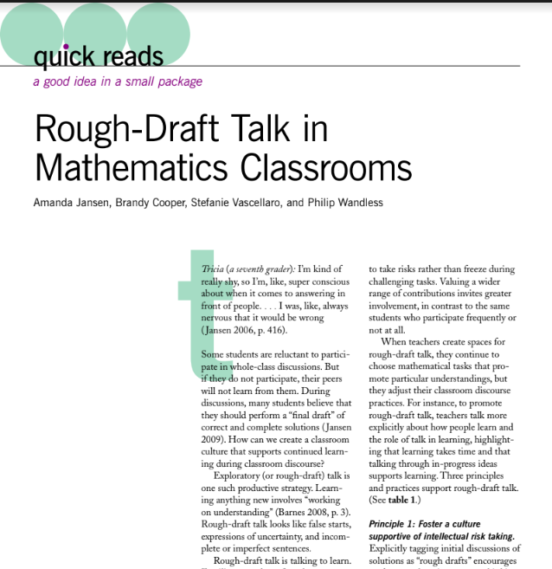
Rough-Draft Talk in Mathematics Classrooms
Read the article and be prepared to share.
How can we foster rough draft thinking?
Why is it important to foster rough draft thinking?
How can we:
develop non-evaluative sharing (rich discourse)
encourage public revisions
position students’ in-progress thinking as valuable
Notes:
Facilitator Notes:
Before the session, make a .pdf or copy of journal article Rough-Draft Talk in Mathematics Classrooms (in the NCTM journal Mathematics Teacher: Learning & Teaching PK-12; accessible to NCTM members here).
Have participants open Rough-Draft Talk in Mathematics Classrooms (facilitator-provided resource)
Give participants ~7-10 minutes to read the article individually and consider the questions on the slide.
Whole group: You might ask participants to share ideas. You might support participants’ reflection on one another’s ideas by then having them record their favorite idea (e.g., in virtual spaces, in the chat window).

Slide 21
Let’s look at a Habit Activator that can support rough draft talk!
Notes:
Facilitator Notes:
Remind participants that “habit activators” are instructional activities they can use to support students’ engagement in reasoning and sensemaking.
Frame habit activators as tools that can also support planning a rich lesson that supports students’ rough draft talk.

Slide 22
Metacognition and Rough Draft Thinking
1st Draft Thinking: “I think (vertex, standard, or factored)................... form is important because it tells us that ……,,,,,”
Why is it helpful to have all three forms of the equation?
What I heard others say: “I heard someone say …… This helped my thinking because …………….”
Revised Explanation: “I used to think…….. But now I think …… Because ………..”
Study the graph and equations. Create a 1st draft answer to the question in yellow. Use the sentence stems if they are helpful.
Notes:
Facilitator Notes:
Give participants time to consider the graph
Ask participants what they anticipate students might say in their first draft thinking. Ask how they anticipate students’ thinking might change as they move into their second and third drafts.

Slide 23
Metacognition and Rough Draft Thinking
Why is it helpful to have all three forms of the equation?
1st Draft Thinking: I think that factored form is important because it helps us by listing out the x-intercepts by doing that we algebraically solve the dilation. This show us if it is concave up or down. Standard form shows us how we need to use all components of gravity to see it go up and down and using what we have in front of us. The vertex is given to us so we can find the x and y intercepts.
What I heard others say: I heard someone say it is important because it helps us understand more aspects of the graph. If you think there is one equation there could be one that fits better because factored form gives x-intercepts standard gives y and the vertex gives the vertex.
Revised Explanation: I used to think that gravity for it to go up and down was vertex now I learned it is actually dilation that shows concave up and down. Because I heard (Nuho) say factored gives us x intercepts, standard gives us y, and vertex gives the vertex of the graph. Now I think that all of them give and show dilation but standard form gives us the y-intercept which is the height of the parabola. Factored form is to help us find what the vertex is and we’re given the x intercepts of the graph where we get to solve it algebraically. Lastly the vertex point is giving us the vertex and we have to find the x and y intercepts.
Study the graph and equations. Create a 1st draft answer to the question in yellow. Use the sentence stems if they are helpful.
Notes:
Facilitator Notes:
Give participants time to read individually and consider students’ thinking.
Whole group: Surface key noticings about the students’ thinking and how it changes over time.

Slide 24
Reflection on rough draft talk
In reflecting on the reading and the Metacognition and Rough Draft Thinking Habit Activator, what do you want to remember about supporting students’ rough draft talk?
How might you use the Metacognition and Rough Draft Thinking Habit Activator in your classroom? Why?
How are you understanding the relationship between cognitive demand and rough draft talk?
Why do you think it is especially important to support rough draft talk when working on cognitively demanding tasks?

Slide 25
Small Group Activity
Directions: Use the workspace slide to reflect on the habit activator.
Notes:
Facilitator Notes:
Give directions and have participants work in small groups for ~5 minutes.
Aspects of small group directions you might consider:
It may be helpful to specify roles for participants in the small groups. For example, you might:
Specify who will go first and in what order participants will share. For example, in a virtual session, you might say, “The second person who enters the breakout room will share first, and sharing will move counterclockwise until everyone has shared.”
Specify who will record. For example, in a virtual session, you might say, “The first person who enters the breakout room will be the recorder and jot down ideas from the group onto the workspace slide.
Specify who will keep time. For example, in a virtual session, you might say, “The third person will be the time keeper and let each team member know if airtime goes over a minute and how much time is left.”
It may be helpful to specify where participants will record and show them how to access it. As we have suggested, you might have an assigned Google Slide for each group which is a copy of this activity’s workspace slide.
It may be helpful to specify how much time participants will have in their small group.
It may be helpful to preview what their workspace will look like (e.g., share the next slide).

Slide 26
Team names:
Preview of Workspace Slide
In reflecting on the reading and the Metacognition and Rough Draft Thinking Habit Activator, what do you want to remember about supporting students’ rough draft talk?
How might you use the Metacognition and Rough Draft Thinking Habit Activator in your classroom? Why?
Notes:
Facilitator Notes:
Groups / breakout rooms: Respond to the questions in the workspace for ~5 minutes.
Whole group: Discuss key takeaways

Slide 27
Debrief: Principles of ambitious mathematics teaching
Which of these ideas are you thinking about in light of our work? What questions do you have?
“Ambitious teaching is teaching that deliberately aims for all students – across ethnic, racial, class, and gender categories – not only to acquire, but also to understand and use knowledge, and to use it to solve authentic problems.”
(Lampert & Graziani, 2009, p. 492)
Ambitious teaching:
Engages students in making sense of mathematical concepts
Centers students’ thinking and reasoning through discourse
Views students as capable of using their understandings and assets to solve authentic problems
Values students’ thinking, including emergent understanding and errors
Attends to student thinking in an equitable and responsive manner
(Anthony et al., 2015)
Notes:
Facilitator Notes:
Debrief “Connecting to Research” or “Planning for Action” through the lens of this definition from Lampert and Graziani (2009) and the five principles listed.
If you’re facilitating online, you might offer an opportunity to “stamp” the principles that are on participants’ minds and discuss trends or questions that emerge.
If you’re facilitating in person, you might offer a turn and talk so participants can discuss what principles are on their minds with a partner/group and then come back to share trends or questions that emerge.
[written reflection option]
References for these ideas: Anthony et al., 2015; Huinker & Bill, 2017; Lampert et al., 2011; Lampert & Graziani, 2009

Slide 28
Planning for action:
Using the Lesson Planning Framework to plan a lesson that elicits students’ rough draft thinking and maintains the cognitive demand for students
Notes:
Facilitator Notes:
The purpose of Session 12 is to deepen our understanding of how to plan rich lessons that elicit students’ rough draft thinking and maintain the cognitive demand for students. We continue this work by planning a lesson, drawing on the research-based resources we have engaged with in the prior activities.

Slide 29
Facilitator Guide: Planning for Action
Rationale for planning for action:
To see connections to our contexts and goals (Putnam & Borko, 2000)
To apply new ideas to upcoming work (Horn & Kane, 2015)
To surface complexities when taking up new ideas
Recommendations for planning for action:
Use teachers’ own curricular resources when possible
Create space to discuss anticipated challenges and strategies for trying new ideas within those challenges
Follow up on teachers’ plans; return to them to build on and refine ideas
Notes:
Planning for action involves making links between session content and our own practice and contexts.
Additional resources: If you’re interested in digging more into these ideas, check out these resources.
Module 0, Resource 2: Sometimes, planning conversations can surface unproductive ideas about particular students or student groups that circulate in our schools or broader contexts. This resource is designed to support leaders preparing for difficult conversations, especially when unproductive language about students emerges.
References
Horn, I. S., & Kane, B. D. (2015). Opportunities for professional learning in mathematics teacher workgroup conversations: Relationships to instructional expertise. Journal of the Learning Sciences, 24(3), 1–46.
Putnam, R. T., & Borko, H. (2000). What do new views of knowledge and thinking have to say about research on teacher learning? Educational Researcher, 29(1), 4-15.

Slide 30
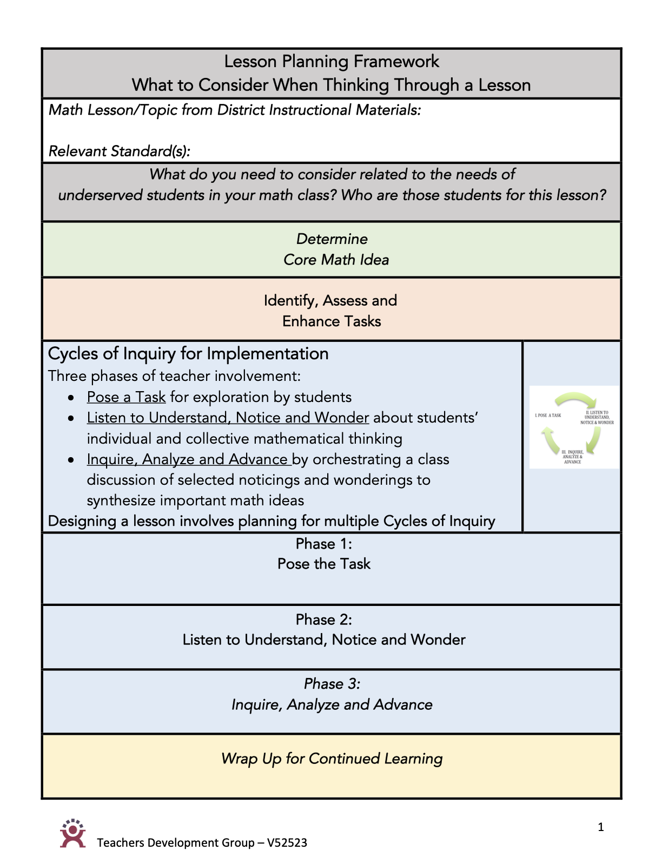
Introduction to the
Lesson Planning Framework
Read page 1, At a Glance
What do you notice?
What do you wonder?
(TDG, 2023)
Notes:
Facilitator Notes:
You might frame the time: Planning a rich lesson that engages students who are often excluded from rich mathematics by schooling requires the consideration of many things. Focusing on a critical component like student discourse might take more time initially, but helps us develop productive planning habits that will take less time in the future, creating space to focus on other lesson components.
Have participants open 8 Lesson Planning Framework_TDG and give participants time to read page 1 and consider:
What do you notice?
What do you wonder?

Slide 31
Introduction to the
Lesson Planning Framework
Read page 1, At a Glance
What do you notice?
What do you wonder?
Read each of the key categories, and highlight two key questions that you want to make sure you address when planning a lesson. Be prepared to share why.
(TDG, 2023)
Notes:
Facilitator Notes:
Give participants time to read each of the key categories in the tool 8 Lesson Planning Framework_TDG and highlight two key questions that they want to make sure you address when planning a lesson.
Whole group: Have participants share key takeaways aloud.

Slide 32
Cycle of Inquiry for Implementation
Let’s focus on
Cycles of Inquiry for Implementation
(TDG, 2023)
Notes:
Facilitator Notes:
You might say: We are going to focus in on Cycles of Inquiry for Implementation.
Ask participants to carefully re-read the sections about Cycles of Inquiry for Implementation on p. 1 and pp. 4 - 5 of the tool 8 Lesson Planning Framework_TDG.

Slide 33
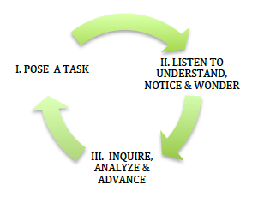
Cycles of inquiry
Cycles of Inquiry for Implementation
Three phases of teacher involvement:
Pose a Task for exploration by students
Listen to Understand, Notice and Wonder about students’ individual and collective mathematical thinking
Inquire, Analyze and Advance by orchestrating a class discussion of selected noticings and wonderings to synthesize important math ideas
Designing a lesson involves planning for multiple Cycles of Inquiry
(TDG, 2023)
Notes:
Facilitator Notes:
Engage participants in a brief discussion: What do you think this sentence means? Designing a lesson requires planning for multiple cycles of inquiry

Slide 34
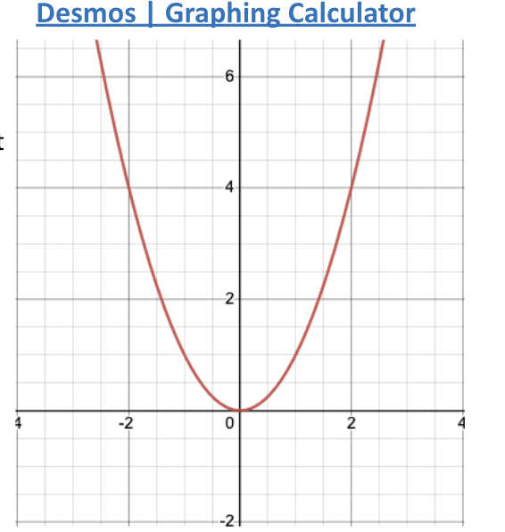
Cycle of Inquiry example from Session 8
Open Desmos and type in the following equation. Add sliders for h and k.
Investigate what happens as you move h and k to different values. What can you generalize and why does that work (justify)?
What happens to the graph when h is positive and when h is negative? Why does that make sense?
What happens to the graph when k is positive and when k is negative? Why does that make sense?
Notes:
Facilitator Notes:
Share this example of a Cycle of Inquiry from session 8.
Orient participants to how we engaged with this math task. Then, on the next slide, highlight how the aspects of this task relate to the parts of a cycle of inquiry

Slide 35
Cycle of Inquiry example from Session 8
1. Pose the task
2. Notice & wonder
Private think time
Small group time to share noticings & wonderings
Record shared noticings & wonderings in workspace
Instructor: Watch workspace development; visit small groups; select and sequence sharing
3. Inquire, analyze, & advance
Share workspace(s) and inquire about learners’ thinking
Ask other participants to Listen to Understand (I heard you say…. I understood…, I want to add on…, I wonder about….)
Synthesize and reflect on learning
Notes:
Facilitator Notes:
Highlight how the aspects of this task we engaged in during session 8 relate to the parts of a cycle of inquiry.

Slide 36
Planning a key lesson from the unit
Use the Lesson Planning Framework questions in your planning.
Select a pivotal lesson with your team from the unit you planned.
Plan the lesson as a team. Think carefully about how you will support students who are often excluded from rich mathematics by schooling.
Enhance the cognitive demand of the lesson as needed.
Use the lesson planning framework questions to deepen your planning and build in ambitious teaching practices.
Create a Habit Activator to use at some point in the lesson to offer greater access & challenge.
Decide how you will structure / promote rich discourse & include how you will use rough draft thinking.
In Session 13, your team will teach (20 minutes) of your planned lesson to another team.
The other team will be your students.
Two people from your team can co-teach the 20 min section, and the third person can give a short overview of the entire lesson.
Notes:
Facilitator Notes:
Have participants open 8 Lesson Planning Framework_TDG
Orient participants to the directions on this slide

Slide 37
Lesson Plan & Design
Remember:
Designing a lesson involves planning for multiple cycles of inquiry
(TDG, 2023)
Notes:
Facilitator Notes:
Highlight the cycles of inquiry part of the 8 Lesson Planning Framework_TDG before asking participants to work on their plans.

Slide 38
Small Group Activity
Directions: Work together to plan a key lesson from the unit your group planned in Session 10
Notes:
Facilitator Notes:
Give directions and have participants work in small groups for 1 hour.
You might set up shared Google slides or documents for participants to work in, or you might leave the format up to small groups.
Aspects of small group directions you might consider:
It may be helpful to specify roles for participants in the small groups. For example, you might:
Specify who will go first and in what order participants will share. For example, in a virtual session, you might say, “The second person who enters the breakout room will share first, and sharing will move counterclockwise until everyone has shared.”
Specify who will record. For example, in a virtual session, you might say, “The first person who enters the breakout room will be the recorder and jot down ideas from the group onto the workspace slide.
Specify who will keep time. For example, in a virtual session, you might say, “The third person will be the time keeper and let each team member know if airtime goes over a minute and how much time is left.”
It may be helpful to specify how much time participants will have in their small group.
It may be helpful to preview what their workspace will look like (e.g., share the next slide).

Slide 39
Debrief: Principles of ambitious mathematics teaching
Which of these ideas are you thinking about in light of our work? What questions do you have?
“Ambitious teaching is teaching that deliberately aims for all students – across ethnic, racial, class, and gender categories – not only to acquire, but also to understand and use knowledge, and to use it to solve authentic problems.”
(Lampert & Graziani, 2009, p. 492)
Ambitious teaching:
Engages students in making sense of mathematical concepts
Centers students’ thinking and reasoning through discourse
Views students as capable of using their understandings and assets to solve authentic problems
Values students’ thinking, including emergent understanding and errors
Attends to student thinking in an equitable and responsive manner
(Anthony et al., 2015)
Notes:
Facilitator Notes:
Debrief “Connecting to Research” or “Planning for Action” through the lens of this definition from Lampert and Graziani (2009) and the five principles listed.
If you’re facilitating online, you might offer an opportunity to “stamp” the principles that are on participants’ minds and discuss trends or questions that emerge.
If you’re facilitating in person, you might offer a turn and talk so participants can discuss what principles are on their minds with a partner/group and then come back to share trends or questions that emerge.
[written reflection option]
References for these ideas: Anthony et al., 2015; Huinker & Bill, 2017; Lampert et al., 2011; Lampert & Graziani, 2009

Slide 40
Debriefing Session 12
Reflecting on our work in the activities in the session

Slide 41
Debriefing Session 12: Four cornerstone principles of the OMP
What connections do you see between any of the cornerstones and our work in this session?
Focus: Learning experiences in every grade and course are focused on core mathematical content and practices that progress purposefully across grade levels.
Engagement: Mathematical learning happens in environments that motivate all students to engage with relevant and meaningful issues in the world around them.
Pathways: All students are equipped with the mathematical knowledge and skills necessary to identify and productively pursue any postsecondary paths in their future. Students have agency to choose from a variety of courses, contexts, and applications they find relevant.
Belonging: Participation in mathematical learning builds students’ identities as capable math learners and fosters a positive self-concept. Students’ cultural and linguistic assets are valued in ways that contribute to a sense of belonging to a community of learners.
Any proposed instructional approach, curricular change, or system design element should be evaluated by the degree to which it builds on these four cornerstones. When new approaches are built within the framework of all four-cornerstone principles, we will be on our way to engineering a reimagined system.
(ODE, 2022)
Notes:
Facilitator Notes:
Option 1: Debrief the session through the lens of the four cornerstone principles of the Oregon Mathematics Project.

Slide 42
Debriefing Session 12: Focus of the session
What new insights do you have related to how to plan rich lessons that elicit students’ rough draft thinking and maintain the cognitive demand for students?
Take a couple of minutes to reflect on our work in the session.
Activities in this session:
Setting and maintaining norms: Reconnect with and revise our norms for interacting together
Connecting to research: Resources for planning a lesson that maintains cognitive demand
Connecting to research: Resources for planning a lesson that elicits students’ rough draft thinking
Planning for action: Using the Lesson Planning Framework to plan a lesson that elicits students’ rough draft thinking and maintains the cognitive demand for students
Notes:
Facilitator Notes:
Option 2: Debrief the session through the lens of the focus of the session.
Module 2 Part 3 especially supports our thinking around both essential questions of this module: What does ambitious math instruction look like at the unit, lesson, and task levels? How do we value and build on the mathematical strengths of students who are often excluded by schooling?
The focus of this session in particular is to plan a rich lesson that elicits students’ rough draft thinking and maintains the cognitive demand for students.
You might offer participants time to think individually about new insights before sharing aloud.

Slide 43
Ambitious math instruction at the lesson level:
Rehearsing a rich lesson
Session 13
The focus of this session is to analyze teaching practice as we try out a lesson designed to elicit students’ rough draft thinking and maintain the cognitive demand for students.
Agenda for this session:
Setting and maintaining norms: Reconnect with and revise our norms for interacting together
Studying teaching: Trying out a lesson that elicits students’ rough draft thinking and maintains the cognitive demand for students
Time estimate: 90 minutes
M2 P3 Table of Contents
Notes:
Facilitator Notes:
This section supports our thinking about both essential questions in this module.
We estimate this session will take 90 minutes. If you need to break the section into smaller pieces, please note the activities listed in the agenda are intended to be enacted in this order.

Slide 44
Setting and maintaining norms
Reconnect with and revise our norms for interacting together

Slide 45
Facilitator Guide: Setting and Maintaining Norms
Rationale for setting and maintaining norms:
To create spaces where we can vulnerably share about our teaching, learning and mathematics (Elliott et al., 2009; Little, 2002; Horn, 2010)
To support us in sharing in-process, “rough draft” ideas (Thanheiser & Jansen, 2016)
To foster a community where all members are valued (Grossman et al., 2001)
Recommendations for setting and maintaining norms:
Include everyone’s ideas and perspectives when setting norms
Regularly revisit norms and adjust norms as needed
Notes:
Upholding norms is a responsibility of participants and leaders/facilitators. It may be helpful to come up with a protocol that supports participants in naming and problem solving in the event that norms are breached.
Additional resources: If you are interested in learning more about setting and maintaining norms check out these resources.
TEDD.org: Setting norms for collaborative work
References
Elliott, R. & Lesseig, K., & Kazemi, E.. (2009). Sociomathematical norms in professional development: Examining leaders’ use of justification and its implication for practice. The Montana Mathematics Enthusiast Journal monograph, 7.
Grossman, P., Wineburg, S., & Woolworth, S. (2001). Toward a theory of teacher community. Teachers College Record, 103, 942–1012.
Horn, I. S. (2010). Teaching replays, teaching rehearsals, and re-visions of practice: Learning from colleagues in a mathematics teacher community. Teachers College Record, 112(1), 225–259.
Little, J. W. (2002). Professional community and the problem of high school reform. International Journal of Educational Research, 37(8), 693–714.
Thanheiser, E. & Jansen, A. (2016). Inviting prospective teachers to share rough draft mathematical thinking. Mathematics Teacher Educator, 4(2), 145–163.

Slide 46
Revisiting norms
[Insert your group norms]
Rights of a Learner
You have the right to:
Be confused
Make mistakes
Say what makes sense to you
Share unfinished or rough draft thinking and not be judged
(Kalinec-Craig, 2017)
Notes:
Facilitator Notes:
Orient participants to the norms you set in prior sessions and Rights of the Learner
You might ask questions like:
How do the productive norms and Rights of the Learner support our learning together?
Choose one of our norms that you want to focus on in particular. Why does that norm feel important for your learning today?
Invite participants to revise or add onto existing norms as needed
Remind participants of the importance of norms in developing a community of learners.
You might say: As we have opportunities to get to know each other better and better it allows for us to develop trust and feel more and more comfortable asking questions, getting help, revealing our shortcomings with others.

Slide 47
Studying teaching:
Trying out a lesson that elicits students’ rough draft thinking and maintains the cognitive demand for students
Notes:
Facilitator Notes:
The purpose of Session 13 is to analyze teaching practice as we try out a lesson designed to elicit students’ rough draft thinking and maintain the cognitive demand for students. Here, we rehearse the lesson.
You might frame the purpose of rehearsals: We rehearse lessons to (1) consider how intended plans can actually play out; and (2) practice words and actions from intended plans that focus on valuing and building on the assets of students who are often excluded from rich mathematics by schooling.

Slide 48
Facilitator Guide: Studying Teaching
Rationale for studying teaching:
To give us a shared context for thinking deeply about the complex work of teaching (Grossman, 2011)
To sharpen our ability to notice and enhance our pedagogical judgment (Horn, 2022; van Es & Sherin, 2021)
To learn about and experiment with new ideas (Grossman et al., 2009)
Recommendations for studying teaching together:
Focus conversations: It is important to keep conversations focused on connections between learners, mathematical content, and teaching (Cohen et al., 2003; Horn et al. 2018).
Establish norms: It can be valuable to establish norms that honor the brave work of making practice public
Notes:
Studying teaching involves analysis of video, vignettes, live teaching, or instructional tools to support participants in thinking deeply about the work of teaching.
Examples of how we might engage in studying teaching:
Watching classroom video of our own or another teacher’s practice (Borko et al., 2008; Sherin & van Es, 2009)
Reading transcripts of episodes of teaching
Sharing detailed vignettes of our own classroom experiences (Horn, 2010)
Rehearsing an episode of teaching (Kazemi et al., 2016)
Experiencing live teaching together (Kazemi et al., 2018)
In each example of teaching, specific features of teachers’ work are highlighted / visible, and invisible (Little, 2022).
As you focus conversations, orient participants specific feature of the example or tool at hand. For example, a facilitator might say, “As we watch this video, notice how the teacher elicits students’ reasoning.”
When setting norms, please know that the suggestions in the slides are intended to orient the group toward an inquiry stance toward students, one another, and the work of teaching and orient the group toward making connections between learners, mathematical content, and teaching.
Additional resources: If you’re interested in digging more into these ideas, check out these resources.
Module 0, Resource 3: This resource is designed to support leaders preparing to facilitate rehearsals in teachers’ professional learning.
TEDD.org, Teacher Educator Pedagogies: This site includes additional resources for leading rehearsals and teacher time out.
van Es et al., 2014 (full citation below): This article details facilitation moves to support teachers’ analysis of video.
Taking Action (Boston et al., 2017; full citation below): This NCTM-published book includes cases and videos for studying teaching, including the case of Shalunda Shackelford used in Module 2.
References
Borko, H., Jacobs, J., Eiteljorg, E., & Pittman, M. E. (2008). Video as a tool for fostering productive discussions in mathematics professional development. Teaching and Teacher Education, 24, 417–436.
Boston, M., Dillon, F., Smith, M., & Miller, S. (2017). Taking action: Implementing effective mathematics teaching practices in grades 9-12. National Council of Teachers of Mathematics.
Cohen, D. K., Raudenbush, S. W., & Ball, D. L. (2003). Resources, instruction, and research. Educational Evaluation and Policy Analysis, 25(2), 119-142.
Grossman, P. (2011). Framework for teaching practice: A brief history of an idea. Teachers College Record, 113(12), 2836–2843.
Grossman, P., Compton, C., Igra, D., Ronfeldt, M., Shahan, E., & Williamson, P. W. (2009). Teaching practice: A cross-professional perspective. Teachers College Record, 111(9), 2055–2100.
Horn, I. S. (2010). Teaching replays, teaching rehearsals, and re-visions of practice: Learning from colleagues in a mathematics teacher community. Teachers College Record, 112(1), 225–259.
Horn, I. S., Kane, B. D., & Garner, B. (2018). Teacher collaborative time: Helping teachers make sense of ambitious teaching in the context of their schools. In P. Cobb, K. Jackson, E. Henrick, T. Smith, & MIST team (Eds.), Systems for instructional improvement: creating coherence from the classroom to the district central office (pp. 93-112). Harvard Education Press.
Kazemi, E., Gibbons, L., Lewis, B. (2018) Math Labs: Teachers, teacher educators, and school leaders learning together from their own students. Journal of Mathematics Education Leadership, Spring 2018, 23-36.
Little, J. W. (2002). Professional community and the problem of high school reform. International Journal of Educational Research, 37(8), 693–714.
Sherin, M. G., & Van Es, E. A. (2009). Effects of video club participation on teachers’ professional vision. Journal of Teacher Education, 60(1), 20–37.
van Es, E. A., Tunney, J., Goldsmith, L. T., & Seago, N. (2014). A framework for the facilitation of teachers’ analysis of video. Journal of Teacher Education, 65(4), 340–356. (Open access: https://escholarship.org/uc/item/3jj747gv)

Slide 49
Rehearsals
“Since teaching involves simultaneously working with P-12 students, maintaining students’ engagement in disciplinary ideas, and maintaining productive relationships among students, rehearsing teaching needs to involve practicing managing all of those elements simultaneously. Rehearsals are an opportunity for teachers and teacher educators to figure out how an instructional episode may play out and to use what they learned in analyzing and unpacking practice to aim towards productive enactment of their instructional plan. Rehearsals occur with a group of teachers and at least one teacher educator present.”
(TEDD, 2014)
Notes:
Facilitator Notes:
Offer opportunities to engage with the slide, for example:
Asking a participant to read the slide aloud for the group
Asking participants to read the slide privately a second time
Asking participants to identify something that resonates about the ideas

Slide 50
Considerations as we engage with each other’s practice
Norms for rehearsals:
Useful sentence stems for reflecting on rehearsals:
I noticed when the teacher _____ students _____.
I am curious about why the teacher/students ______. What reasons might they have?
Approach rehearsals with gratitude: We share our work to support each other’s learning.
Focus on the work of teaching and what teachers try to accomplish to support student learning.
Comments need to be respectful of both students and teachers. Try to pose comments in the form of genuine questions.
The teacher can pause instruction at any time to make a comment, ask a question, or provide a suggestion about an aspect of practice we are working on.
When you are playing the role of a student, it is good to have humor, but try refrain from exaggerating what you think students will do.
(TEDD, 2014)
Notes:
Facilitator Notes:
It is critical to establish productive norms when engaging with another teacher’s practice. We hope the suggestions on the slide, and the sentence stems help to create a productive space through which to learn about teaching.

Slide 51
Rehearsal schedule: 1 hour
Cycle 1
Team A teaches their lesson [20 min]
Team A shares the rest of their lesson plans with the other team as well as how their equity commitments impacted their lesson plan [3 min]
Team B then shares some feedback to Team A (“I appreciate,” “I wonder”) [3 min]
Team A & B discuss together, and then Team B sets up to rehearse [3 min]
Cycle 2
Team B teaches their lesson [20 min]
Team B shares the rest of their lesson plans with the other team as well as how their equity commitments impacted their lesson plan [3 min]
Team A then shares some feedback to Team A (“I appreciate,” “I wonder”) [3 min]
Team A & B discuss together [3 min]

Slide 52
Debrief: Practices of ambitious mathematics teaching
Which of these 8 practices did you notice? What others could have been highlighted? In what ways?
Establish mathematical goals to focus learning
Implement tasks that promote reasoning and problem solving
Use and connect mathematical representations
Facilitate meaningful mathematical discourse
Pose purposeful questions
Build on procedural fluency from conceptual understanding
Support productive struggle in learning mathematics
Elicit and use evidence of student thinking
(NCTM, 2014)
Notes:
Facilitator Notes:
Option 1: Debrief “Doing Math Together” or “Studying Teaching” through the lens of NCTM’s 8 practices of ambitious instruction.
If you’re facilitating online, you might offer an opportunity to “stamp” the practices participants notice and discuss trends or questions that emerge.
If you’re facilitating in person, you might offer a turn and talk so participants can discuss what they noticed with a partner/group and then come back to share trends or questions that emerge.
During the discussion, press for examples/evidence from the shared moment of teaching. This might sound like: “Where/when did you see an example of this practice?”

Slide 53
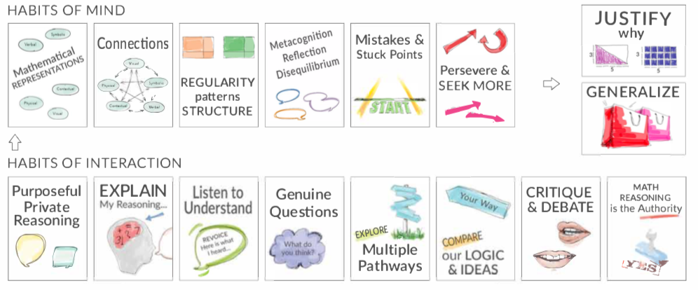
Debrief: Habits, routines and actions
Which of these habits did you notice? What others could have been highlighted? In what ways?
Habits of Mind: Things we do as individual mathematicians when solving problems.
Habits of Interaction: Things that we do when working with others to make sense of the math.
(TDG, 2020)
Notes:
Facilitator Notes:
Option 2: Debrief “Doing Math Together” or “Studying Teaching” through the lens of TDG’s Habits & Routines tool.
If you’re facilitating online, you might offer an opportunity to “stamp” the habits participants notice and discuss trends or questions that emerge.
If you’re facilitating in person, you might offer a turn and talk so participants can discuss what they noticed with a partner/group and then come back to share trends or questions that emerge.
During the discussion, press for examples/evidence from the shared moment of teaching. This might sound like: “Where/when did you see an example of this practice?”

Slide 54
Debriefing Session 13
Reflecting on our work in the activities in the session

Slide 55
Debriefing Session 13: Four cornerstone principles of the OMP
What connections do you see between any of the cornerstones and our work in this session?
Focus: Learning experiences in every grade and course are focused on core mathematical content and practices that progress purposefully across grade levels.
Engagement: Mathematical learning happens in environments that motivate all students to engage with relevant and meaningful issues in the world around them.
Pathways: All students are equipped with the mathematical knowledge and skills necessary to identify and productively pursue any postsecondary paths in their future. Students have agency to choose from a variety of courses, contexts, and applications they find relevant.
Belonging: Participation in mathematical learning builds students’ identities as capable math learners and fosters a positive self-concept. Students’ cultural and linguistic assets are valued in ways that contribute to a sense of belonging to a community of learners.
Any proposed instructional approach, curricular change, or system design element should be evaluated by the degree to which it builds on these four cornerstones. When new approaches are built within the framework of all four-cornerstone principles, we will be on our way to engineering a reimagined system.
(ODE, 2022)
Notes:
Facilitator Notes:
Option 1: Debrief the session through the lens of the four cornerstone principles of the Oregon Mathematics Project.

Slide 56
Debriefing Session 13: Focus of the session
What new insights do you have after analyzing teaching practice and trying out a lesson designed to elicit students’ rough draft thinking and maintain the cognitive demand for students?
Take a couple of minutes to reflect on our work in the session.
Activities in this session:
Setting and maintaining norms: Reconnect with and revise our norms for interacting together
Studying teaching: Trying out a lesson that elicits students’ rough draft thinking and maintains the cognitive demand for students
Notes:
Facilitator Notes:
Option 2: Debrief the session through the lens of the focus of the session.
Module 2 Part 3 especially supports our thinking around both essential questions of this module: What does ambitious math instruction look like at the unit, lesson, and task levels? How do we value and build on the mathematical strengths of students who are often excluded by schooling?
The focus of this session in particular is to try out a lesson designed to elicit students’ rough draft thinking and maintain cognitive demand for students. You might offer participants time to think individually about new insights before sharing aloud.

Slide 57
Debriefing Module 2 Part 3
Reflecting on our work in Sessions 12 & 13

Slide 58
Debriefing Module 2 Part 3: Important moments
Record important moments that impacted your thinking about what ambitious math teaching looks like at the lesson level.
Examples of important moments:
AHA! moments you experienced
Changes in your thinking
WOW! ideas that you hadn’t considered before
Contradictions to or affirmations of prior understandings

Slide 59
Debriefing Module 2 Part 3: Important moments
Take 5 minutes to refine the ideas you jotted.
Synthesize your important moments from Module 2 Part 3.
Based on the work and discussions in these sessions, what ideas do you have for how you’ll implement your learning?
What else, if anything, would you like to share with the facilitator?
Notes:
Facilitator Notes:
You might pose these questions in the form of a survey or exit card.

Slide 60
Acknowledgements
These Ambitious Teaching Modules exist because of the vision and hard work of a team led by the creative vision, development, and design offered by Kathy Pfaendler and Julie Fredericks, Math Professional Learning Specialists, Teachers Development Group, Cathy Martin, Denver, CO, Taylor Stafford, University of Washington, and Hannah Nieman, University of Washington. Their efforts were supported by the ongoing input and feedback of the entire staff of Teachers Development Group (TDG). These Modules, like all professional learning materials produced by our organization, are based on the collective knowledge, expertise, and ongoing learning of TDG’S Math Professional Learning Specialists and the teachers and leaders with whom we work. Thanks also go to Mark Freed, and Kama Almasi, Oregon Department of Education, and Rebekah Elliott, Oregon State University, who offered vision and feedback throughout the development and design process. Special thanks go to Sophia Vazquez, University of Washington, who did the accessibility formatting of these Modules.
Ruth Heaton, CEO, Teachers Development Group

Slide 61
Resource Partners
Thank you for joining us!

