Slide 1
Module 2
Part 1: What ambitious math teaching looks like
at the task level

Slide 2
Facilitator Guide: Welcome to Module 2, Part 1!
In Module 1, we will work to understand the foundations of high school math teaching, including what ambitious math teaching is and how a 2 + 1 model can support ambitious math teaching.
In Module 2, we will dig deeper into ambitious math instruction and our day-to-day work as teachers. We will explore:
What does ambitious math instruction look like at the unit, lesson, and task levels?
How do we value and build on the mathematical strengths of students who are often excluded by schooling?
In Module 2, Part 1, we focus especially on deepening our understanding of what ambitious math instruction looks like at the task level.
Notes:
Facilitator Notes:
Orange Facilitator Guide slides orient facilitators in making sense of upcoming sections.
These slides are intended to be hidden from the deck during sessions.

Slide 3





Facilitator Guide: Professional learning activity types
Setting and maintaining norms: These activities support participants to establish norms that will guide participation in sessions.
Doing math together: These activities engage participants in a mathematics task.
Studying teaching: These activities involve analysis of video, vignettes, live teaching, or instructional tools.
Connecting to research: These activities involve unpacking and understanding the research in mathematics education underpinning focal ideas and concepts.
Planning for action: These activities involve making links between session content and our own practice and contexts.
Notes:
Facilitator Notes:
Icons appear on section header slides throughout the slide deck, both for facilitators and participants

Slide 4
Facilitator Guide: Table of contents
Module 2 Pre-Session: Introduction to Module 2 (20 minutes)
Session 7: Ambitious instruction at the task level: Ensuring opportunities for students’ reasoning and sensemaking (120 minutes)
Setting and maintaining norms: Reconnect with and revise our norms for interacting together
Connecting to research: Defining reasoning and sensemaking
Doing math together: Reasoning and sensemaking using the Bike and Truck Task
Studying teaching: Analyzing opportunities for reasoning and sensemaking in Ms. Shackelford’s lesson
Planning for action: Adapting a task to ensure opportunities for students’ reasoning and sensemaking
Session 8: Ambitious instruction at the task level: Opportunities for reasoning and sensemaking using technology (90 minutes)
Doing math together: Reasoning and sensemaking in a Desmos lesson
Planning for action: Adapting a Desmos lesson to ensure opportunities for students’ reasoning and sensemaking
Session 9: Ambitious instruction at the task level: Using worked examples to support reasoning and sensemaking (90 minutes)
Connecting to research: The potential of worked examples to support reasoning and sensemaking
Planning for action: Planning a worked example
Notes:
Facilitator Notes:
Each of the sessions is designed to be enacted within a professional learning meeting.
We suggest that the sessions and activities within session be enacted in order if possible, as some of the content and ideas build on one another.

Slide 5
Essential Questions of the Modules
Module 1: Foundations of High School Math Instruction | What is ambitious math teaching? Why is a 2 + 1 model important for equitable outcomes in mathematics?
Module 2: Principles and Practices of Ambitious Math Teaching | What does ambitious math teaching look like at the unit, lesson, and task levels? How do we value and build on the mathematical strengths of students who are often excluded by schooling?
Module 3: Principles and Practices of Sustainability | What planning, teaching, and assessment practices can be used to sustain ambitious math teaching?
Notes:
Facilitator Notes:
You might say: Let’s ground ourselves in the Essential Questions that drive the Ambitious Math Teaching Professional Learning Modules.

Slide 6




Four Cornerstones: Oregon Math Project &
Oregon Educational Goals (ORS 329.015)
Provide students with the skills necessary to pursue learning throughout their lives in an ever-changing world. (ORS 329.015(2)(a))
Provide an environment that motivates students to have experience in applying knowledge and skills and demonstrating achievement. (ORS 329.015(2)(b))
Equip students with the academic and career skills and information necessary to pursue the future of their choice. (ORS 329.015(2)(a))
Provide an environment that motivates students to pursue serious scholarship. (ORS 329.015(2)(b))
Notes:
Facilitator Notes:
You might give participants a minute to read what is on the screen silently, or ask a participant to read it aloud.
You might say: These are the cornerstones of the Oregon Math Project and will ground our work in these modules.

Slide 7





Across the modules we will have opportunities to…
Set and maintain norms: These activities support participants to establish norms that will guide participation in sessions.
Do math together: These activities engage participants in a mathematics task.
Study teaching: These activities involve analysis of video, vignettes, live teaching, or instructional tools.
Connect to research: These activities involve unpacking and understanding the research in mathematics education underpinning focal ideas and concepts.
Plan for action: These activities involve making links between session content and our own practice and contexts.
Notes:
Facilitator Notes:
You might say: These icons will appear throughout the modules and indicate the kind of activity we will engage in together.

Slide 8
Reconnecting
Share a new, since we last met personal piece of information to help us reconnect with you.
Share a new, since we last met professional piece of information in to help us reconnect and get to know you professionally as an educator.
OR
Notes:
Facilitator Notes:
Depending on the history and rhythms of the group you are working with, you might choose to adapt these questions.
In virtual groups, you might ask people to share in the chat. Once they have shared, ask them to read through the chat and respond / say hello to the person who shared after them. (The last person can respond to the first person who shared in the chat.)
You might say, to remind the group of their role in fostering this community of learners: As we have opportunities to get to know each other better and better it allows for us to develop trust and feel more and more comfortable asking questions and asking for and receiving help. It also promotes our being willing to challenge each other's ideas which deepens our understandings. This is an example of the Belonging Cornerstone.

Slide 9
Reconnecting to our thinking from the previous sessions
Notes:
Facilitator Notes:
Optional: Paste excerpts of participants’ reflections from previous sessions to support the group in reconnecting with the work you have done together previously.
You might ask: What learning from our previous sessions are you excited to or hoping to build on today?

Slide 10
Ambitious math instruction at the task level:
Ensuring opportunities for students’ reasoning and sensemaking
Session 7
The focus of this session is to deepen our understandings related to reasoning and sensemaking.
Agenda for this session:
Setting and maintaining norms: Reconnect with and revise our norms for interacting together
Connecting to research: Defining reasoning and sensemaking
Doing math together: Reasoning and sensemaking using the Bike and Truck Task
Studying teaching: Analyzing opportunities for reasoning and sensemaking in Ms. Shackelford’s lesson
Planning for action: Adapting a task to ensure opportunities for students’ reasoning and sensemaking
Time estimate: 2 hours
M2 P1 Table of Contents
Notes:
Facilitator Notes:
This section especially supports our thinking around the first essential question of this module: What does ambitious math instruction look like at the unit, lesson, and task levels?
We estimate this session will take 2 hours. If you need to break the section into smaller pieces, please note the activities listed in the agenda are intended to be enacted in this order.
Resources for this session are in the Module 2 Resources folder with two exceptions. Before the session, make a .pdf or copy of the supplemental resource Transcript from the Bike and Truck task in Shalunda Shackelford's classroom. Also, add the video of Shalunda Shackelford’s classroom to this slide. (Both resources are in the Principles to Actions Toolkit; accessible to NCTM members here).

Slide 11

Setting and maintaining norms
Reconnect with and revise our norms for interacting together

Slide 12
Facilitator Guide: Setting and Maintaining Norms
Rationale for setting and maintaining norms:
  To create spaces where we can vulnerably share about our teaching, learning and mathematics (Elliott et al., 2009; Little, 2002; Horn, 2010)
  To support us in sharing in-process, “rough draft” ideas (Thanheiser & Jansen, 2016)
  To foster a community where all members are valued (Grossman et al., 2001)
Recommendations for setting and maintaining norms:
  Include everyone’s ideas and perspectives when setting norms
  Regularly revisit norms and adjust norms as needed
Notes:
Upholding norms is a responsibility of participants and leaders/facilitators. It may be helpful to come up with a protocol that supports participants in naming and problem solving in the event that norms are breached.
Additional resources: If you are interested in learning more about setting and maintaining norms check out these resources.
TEDD.org: Setting norms for collaborative work
References
Elliott, R. & Lesseig, K., & Kazemi, E.. (2009). Sociomathematical norms in professional development: Examining leaders’ use of justification and its implication for practice. The Montana Mathematics Enthusiast Journal monograph, 7.
Grossman, P., Wineburg, S., & Woolworth, S. (2001). Toward a theory of teacher community. Teachers College Record, 103, 942–1012.
Horn, I. S. (2010). Teaching replays, teaching rehearsals, and re-visions of practice: Learning from colleagues in a mathematics teacher community. Teachers College Record, 112(1), 225–259.
Little, J. W. (2002). Professional community and the problem of high school reform. International Journal of Educational Research, 37(8), 693–714.
Thanheiser, E. & Jansen, A. (2016). Inviting prospective teachers to share rough draft mathematical thinking. Mathematics Teacher Educator, 4(2), 145–163.

Slide 13
Revisiting norms
Rights of a Learner
You have the right to:
Be confused
Make mistakes
Say what makes sense to you
Share unfinished or rough draft thinking and not be judged
[Insert your group norms]
(Kalinec-Craig, C. A., 2017)
Notes:
To reconnect to the rationale for framing norms through the “Rights of a Learner” see Module 1, Part 1

Slide 14
Small Group Activity
Directions: Use the workspace slide to reflect on, reconnect with, and revise our norms.
Notes:
Facilitator Notes:
Aspects of small group directions you might consider:
It may be helpful to specify roles for participants in the small groups. For example, you might:
Specify who will go first and in what order participants will share. For example, in a virtual session, you might say, “The second person who enters the breakout room will share first, and sharing will move counterclockwise until everyone has shared.”
Specify who will record. For example, in a virtual session, you might say, “The first person who enters the breakout room will be the recorder and jot down ideas from the group onto the workspace slide.
Specify who will keep time. For example, in a virtual session, you might say, “The third person will be the time keeper and let each team member know if airtime goes over a minute and how much time is left.”
It may be helpful to specify where participants will record and show them how to access it. As we have suggested, you might have an assigned Google Slide for each group which is a copy of this activity’s workspace slide.
It may be helpful to specify how much time participants will have in their small group.
It may be helpful to preview what their workspace will look like (e.g., share the next slide).

Slide 15
Team names:
Preview of Workspace Slide
our DRAFT norms
Provide space and permission to make mistakes in mathematical thinking and reasoning.
Challenge each other with kindness and give time for everyone’s needs as well as tech needs.
Balance the talking time, center students who are often excluded from rich mathematics in our conversations.
Listen completely to each other and not assume. Withhold judgement while listening when sharing rough draft thinking.
Keep conversations focused. Stay Curious. Ask Questions
Always approach math through an equity lens & honor initial private think time and the ability to ask for more if needed.
Be open-minded about the process. Be transparent!
No spoilers - let others get to an answer/conclusion.
Seek to understand & be open to different ideas and approaches.
Avoid interrupting others & assume best intentions
What do you want to add, delete, or revise in our norms to maximize your learning? What is your reasoning?
How could our norms possibly not result in equitable outcomes?
What understandings and skills would we need in the norms to position each and every student as competent?
Notes:
Facilitator Notes:
Replace the box on the right with norms your group drafted in Module 1. (These norms are the ones drafted in the original iteration of these modules, led by Kathy Pfaendler.)
Label your group’s norms “our DRAFT norms” to indicate that they are always up for revision.
Groups / breakout rooms: Engage with the questions on the workspace slide for 4 - 5 minutes.
Whole group: Ask participants to identify noticings and trends, and call on a couple of people to share.

Slide 16

Connecting to research:
Defining reasoning and sensemaking
Notes:
Facilitator Notes:
The purpose of Session 7 is to deepen our understandings related to reasoning and sensemaking. Here we begin this work by supporting participants in defining what we mean by “reasoning and sensemaking”
Some background on why we are focusing on research on reasoning and sensemaking first:
Reasoning is a critical component of ambitious math instruction and creates opportunities to nurture and appreciate the rich knowledge of students often excluded from mathematics by schooling
If reasoning and sensemaking do not occur, students will rely on procedures and facts. This will hamper their ability to apply ideas to other situations. This also impacts students ability to consider or make sense of other students’ strategies/ideas or the validity of general arguments.
Reasoning and sensemaking allows students to use the resources and understanding they bring to the classroom. Asking for reasoning encourages students to share their unfinished, in-progress ideas, while creating the desire to listen to others so they can revise their thinking (“rough draft thinking,” Jansen, 2017). Asking for reasoning ups the cognitive demand of the task. Students are more motivated to take a risk answering than on questions with only one answer.
If teachers learn to plan tasks, lessons, and units that engage students in reasoning and sensemaking, greater student learning occurs.

Slide 17
Facilitator Guide: Connecting to Research
Rationale for connecting to research:
  To infuse new ideas into our conversations about instruction and challenge or deepen our existing understandings (Cain, 2015).
  To support us in using evidence to inform our professional learning
Recommendations for connecting to research:
  Honor and make space for participants’ existing knowledge and expertise.
  Support participants to collectively grapple with the complexity of what the research offers and carefully consider how the research relates to their own teaching context and work.
  Closely pair opportunities to connect to research with opportunities to plan for action on the basis of what they have read.
Notes:
Additional resources: If you are interested in learning more about these ideas, check out these resources.
Module 0, Resource 1:
References
Cain, T (2015). Teachers’ engagement with research texts: beyond instrumental, conceptual or strategic use. Journal of Education for Teaching, 41(5), 478-492.

Slide 18
Why was reasoning added to the title of every domain of the math content standards?
(ODE, 2022)
Notes:
Facilitator Notes:
Have participants view and/or explore the different grade level domains and generate ideas about why reasoning was added to the title of every domain.
Grade level domains start on p. 24 of the 2021 Oregon Math Standards document.
You might share your screen and flip through some of the elementary pages, and then skip to some of the high school pages.
You might share the link with participants and ask them to take a few minutes to explore.
You might ask: Why is reasoning important?

Slide 19
Reasoning and sensemaking
“Reasoning and sensemaking are the cornerstones of mathematics. Restructuring the high school mathematics program around them enhances students’ development of both the content and process knowledge they need to be successful in their continuing study of mathematics and in their lives.”
(NCTM, 2009)
Notes:
Facilitator Notes:
You might say: This quote most likely captures the thoughts that many of you were thinking, but it is always nice to hear reputable sources say the same thing.
This quote comes from the National Council of Teachers of Mathematics’ Focus in high school mathematics: Reasoning and sensemaking (NCTM, 2009).

Slide 20
What impact does reasoning have on the cognitive demand of a task?
(ODE, 2022)
Notes:
Facilitator Notes:
Have participants explore standards in the algebraic domain by opening 1 High School Algebra Standards HS.AEE and HS.AFN
Give participants time to scan the standards and consider the impact reasoning has on the cognitive demand of a task.
Algebraic Reasoning: Expressions and Equations (HS.AEE)
Algebraic Reasoning: Functions (HS.AFN)

Slide 21
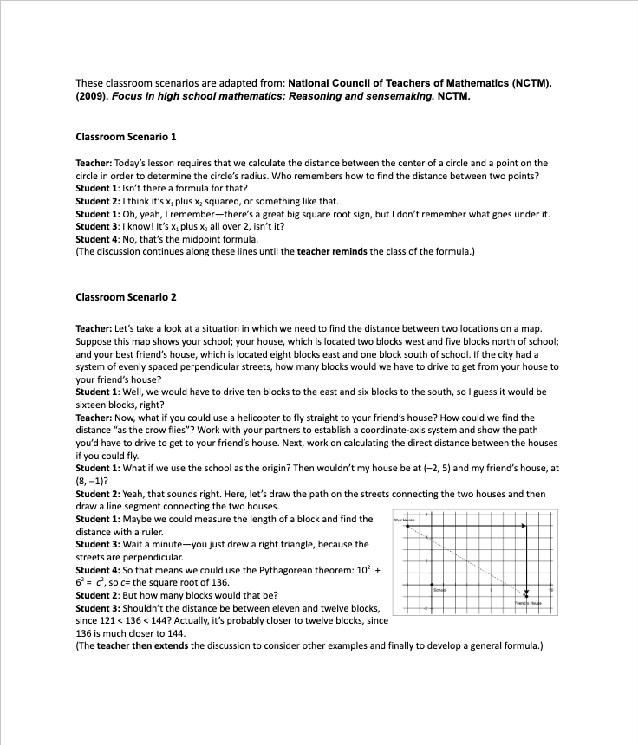
Read the two classroom scenarios.
What do you notice?
What do you wonder?
Scenarios adapted from:
(NCTM, 2009)
Notes:
Facilitator Notes:
Have participants open 2 Classroom Scenarios
Give participants time to read and privately think about what they notice and wonder in the two scenarios.
Support participants to notice that scenario 1 has no reasoning and sensemaking but relies on memorization. Scenario 2 has reasoning and sensemaking embedded into the discussion. Representations and connecting the discussion to the graph allow for more rich discussion. If you know Pythagorean Theorem and can apply it, you can always develop the distance formula. This presses on conceptual understanding. Reasoning increases the cognitive cognitive demand of tasks.
This scenario comes from the National Council of Teachers of Mathematics’ Focus in high school mathematics: Reasoning and sensemaking (NCTM, 2009).

Slide 22
Small Group Activity
Directions: Use the workspace slide to re-envision a classroom scenario with a focus on reasoning and sensemaking.
Notes:
Facilitator Notes:
Aspects of small group directions you might consider:
It may be helpful to specify roles for participants in the small groups. For example, you might:
Specify who will go first and in what order participants will share. For example, in a virtual session, you might say, “The second person who enters the breakout room will share first, and sharing will move counterclockwise until everyone has shared.”
Specify who will record. For example, in a virtual session, you might say, “The first person who enters the breakout room will be the recorder and jot down ideas from the group onto the workspace slide.
Specify who will keep time. For example, in a virtual session, you might say, “The third person will be the time keeper and let each team member know if airtime goes over a minute and how much time is left.”
It may be helpful to specify where participants will record and show them how to access it. As we have suggested, you might have an assigned Google Slide for each group which is a copy of this activity’s workspace slide.
It may be helpful to specify how much time participants will have in their small group.
It may be helpful to preview what their workspace will look like (e.g., share the next slide).

Slide 23
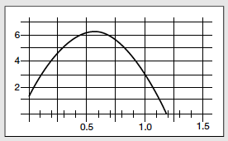
Team names:
Preview of Workspace Slide
Consider the following algebra math standard and the task off to the right. HS.AFN.A.3 Calculate and interpret the average rate of change of a function over a specified interval.
Scenario without explicit focus on reasoning and sensemaking:
The teacher asks, do we have a formula for calculating the rate of change? Students respond with the slope formula. So what is the average rate of change between 1 second and 1.2 seconds? The teacher asks for an answer and what it means. The students respond with a slope calculation using the formula and it means that it is the rise over the run.
Re-envision this scenario with an explicit focus on reasoning and sensemaking.
Feet
Seconds
The height of a thrown horseshoe depends on the time that has elapsed since its release, as shown in the graph.
What is the average rate of change between 1 second and 1.2 seconds?
(Martin & Robinson, 2011)
Notes:
Facilitator Notes:
Give some private reasoning time.
Small groups: Have folks work in small groups for 7 minutes.
In a virtual space, you might ask the second person to enter the breakout room to start the sharing.
In an in-person space, you might suggest that folks rotate clockwise until everyone has shared.
If a group finishes early, they can select a standard from High School Algebra using the 2022 Oregon Mathematics Standards and Guidance document. They can work together to create two different scenarios for that standard, one with reasoning and one without.
Whole-group: Select at least two examples that shows reasoning and sensemaking taking place, and use the next slide to facilitate a discussion about the examples.
Supplemental/additional resources:
For more classroom examples of reasoning and sensemaking see Focus in high school mathematics: Reasoning and sensemaking.

Slide 24
Generalizing to practice
What is the same and different across our examples?
What are generalizable ideas that we can use to always keep reasoning and sensemaking at the center of our lessons?
Notes:
Facilitator Notes:
Select a good example to share that clearly shows reasoning and sensemaking taking place.
You might ask:
What is the same and different across our examples?
What are generalizable ideas that we can use to always keep reasoning and sensemaking at the center of our lessons?
Have a brief discussion of these focal questions. Try to surface: representations and structure (definitions, properties, known facts) to build an argument as to “why” something works or does not work mathematically.

Slide 25

Math Quote
“A high school mathematics program based on reasoning and sensemaking will prepare students for citizenship, for the workplace, and for further study.”
(NCTM, 2009)
Notes:
Facilitator Notes:
This quote comes from the National Council of Teachers of Mathematics’ Focus in high school mathematics: Reasoning and sensemaking (NCTM, 2009).

Slide 26
What do we mean by reasoning and sensemaking?
Reasoning: The process of drawing conclusions on the basis of evidence or stated assumptions
Sensemaking: Developing understanding of a situation, context, or concept by connecting it with existing knowledge
(NCTM, 2009, pp. 4-5)
Notes:
Facilitator Notes:
These definitions are from pages 4 - 5 of the National Council of Teachers of Mathematics’ Focus in high school mathematics: Reasoning and sensemaking (NCTM, 2009).
Further information about the image on this slide from the NCTM book Focus in high school mathematics: Reasoning and sensemaking.
Reasoning and sensemaking are intertwined across the continuum from informal observations to formal deductions
Reasoning in mathematics is often associated with formal reasoning, or proof. However, mathematical reasoning can take many forms and often begins with explorations, conjectures at various levels, false starts, and partial explanations before a result is reached.
Mathematical reasoning and sensemaking are both important outcomes of mathematics instruction, as well as important means by which students come to know mathematics.
Additional resource: A Teacher’s Guide to Reasoning and Sense Making

Slide 27
Small Group Activity
Directions: Use the workspace to record insights about reasoning and sensemaking.
Notes:
Facilitator Notes:
Have participants open 2 FAQs_Focus in High School Mathematics: Reasoning & Sensemaking
Give directions and have participants work in small groups for ~7 minutes.
Aspects of small group directions you might consider:
It may be helpful to specify roles for participants in the small groups. For example, you might:
Specify who will go first and in what order participants will share. For example, in a virtual session, you might say, “The second person who enters the breakout room will share first, and sharing will move counterclockwise until everyone has shared.”
Specify who will record. For example, in a virtual session, you might say, “The first person who enters the breakout room will be the recorder and jot down ideas from the group onto the workspace slide.
Specify who will keep time. For example, in a virtual session, you might say, “The third person will be the time keeper and let each team member know if airtime goes over a minute and how much time is left.”
It may be helpful to specify where participants will record and show them how to access it. As we have suggested, you might have an assigned Google Slide for each group which is a copy of this activity’s workspace slide.
It may be helpful to specify how much time participants will have in their small group.
It may be helpful to preview what their workspace will look like (e.g., share the next slide).

Slide 28
Team names:
Preview of Workspace Slide
Read two of the questions and responses in the FAQ document from NCTM’s Focus in High School Mathematics: Reasoning and Sensemaking.
Record an insight here:
Notes:
Facilitator Notes:
This is an opportunity for participants to synthesize ideas about reasoning and sensemaking
Small groups: Ask folks to select 2 questions in the document, read the response, and discuss any insights. Ask them to be prepared to share an insight with the whole group.
Whole group: Select a couple of groups to share.
You might say: We know giving choice is an important part of the learning process. I wanted to model giving choice while synthesizing ideas about reasoning and sensemaking.

Slide 29
Students can learn mathematical reasoning!
“Mathematical reasoning is something that students can learn to do” (p. 33)
Two important benefits of reasoning:
it aids students’ mathematical understanding and ability to use concepts and procedures in meaningful ways, and
it helps students reconstruct faded knowledge–that is knowledge that is forgotten by students but can be restored through reasoning with the current content.
(Ball & Bass, 2003)
Notes:
Facilitator Notes:
You might say, to summarize and close this section: As we turn to the mathematics, we want to acknowledge that our students come to us with incomplete understandings. We want to avoid the practice of “just in case” meaning that we reteach ideas that students might need “just in case” they did not get it the first time. Rather, we want to turn to the practice of “just in time,” meaning that we provide support for students at the time they need it in order to engage with course-level mathematics. The processes of reasoning and sensemaking provide us with a strategy for “just in time” learning.

Slide 30
Debrief: Principles of ambitious mathematics teaching
Which of these ideas are you thinking about in light of our work? What questions do you have?
“Ambitious teaching is teaching that deliberately aims for all students – across ethnic, racial, class, and gender categories – not only to acquire, but also to understand and use knowledge, and to use it to solve authentic problems.”
(Lampert & Graziani, 2009, p. 492)
Ambitious teaching:
Engages students in making sense of mathematical concepts
Centers students’ thinking and reasoning through discourse
Views students as capable of using their understandings and assets to solve authentic problems
Values students’ thinking, including emergent understanding and errors
Attends to student thinking in an equitable and responsive manner
(Anthony et al., 2015)
Notes:
Facilitator Notes:
Debrief “Connecting to Research” or “Planning for Action” through the lens of this definition from Lampert and Graziani (2009) and the five principles listed.
If you’re facilitating online, you might offer an opportunity to “stamp” the principles that are on participants’ minds and discuss trends or questions that emerge.
If you’re facilitating in person, you might offer a turn and talk so participants can discuss what principles are on their minds with a partner/group and then come back to share trends or questions that emerge.
[written reflection option]
References for these ideas: Anthony et al., 2015; Huinker & Bill, 2017; Lampert et al., 2011; Lampert & Graziani, 2009

Slide 31

Doing math together:
Reasoning and sensemaking
using the Bike and Truck Task
Notes:
Facilitator Notes:
The purpose of Session 7 is to deepen our understandings related to reasoning and sensemaking. Here we continue this work by engaging participants in a task in which they will reason with and make sense of mathematical ideas.
Rationale for this subsection: Engaging in mathematics where there is an emphasis on reasoning and sensemaking, allows for us to experience first hand what ambitious math instruction looks like and feels like. By hearing about reasoning and its rationale previously, then engaging in it personally solidifies the learning and the importance of planning ambitious instruction where it is included on a regular basis.
You might frame this part of the session by saying:
Reasoning is a critical component of ambitious math instruction and creates opportunities for us to nurture and appreciate the rich knowledge of students often excluded from mathematics by schooling
If reasoning does not occur, students will rely on procedures and facts. This will hamper their ability to apply ideas to other situations. This also impacts students ability to consider or make sense of other students strategies/ideas or the validity of general arguments. Reasoning allows students to use the resources and understanding they bring to the classroom. Asking for reasoning encourages students to share their unfinished, in-progress ideas, while creating the desire to listen to others so they can revise their thinking (Rough Draft Thinking). Asking for reasoning ups the cognitive demand of the task. Students are more motivated to take a risk answering than on questions with only one answer.
If teachers learn to plan tasks, lessons, and units that engage students in reasoning and sense making, greater student learning occurs.

Slide 32
Facilitator Guide: Doing Math Together
Rationale for doing math together:
  Deepens our own specialized mathematical content knowledge so we can better support and respond to students (Kazemi & Franke, 2004)
  Gives us a shared context for the study of teaching (Kazemi et al., 2018)
  Helps us think about the experiences of our students
  To foster joy for doing and learning mathematics (Su, 2020)
Recommendations for doing math together:
  Establish norms for doing math together (see slide notes for examples) (Elliott et al., 2009; Yackel & Cobb; 1998).
  Support participants in engaging with the task as learners and as teachers. Be explicit about when/how participants should take up each of these roles.
Notes:
Example norms for doing mathematics together:
Engage with each other’s thinking with curiosity
Support everyone to experience joy for mathematics
Use partial understandings, mistakes, and errors as an opportunity to examine further questions about mathematics
Additional resources: If you’re interested in digging more into ideas about doing math together check out these resources.
TEDD.org: Mathematics Instructional Activities
TEDD.org: Setting norms for collaborative work
Mathematics For Human Flourishing (book)
References
Ball, D. L., & Cohen, D. K. (1999). Developing practice, developing practitioners: Toward a practice-based theory of professional education. In L. Darling-Hammond & G. Sykes (Eds.), Teaching as the learning profession: Handbook of policy and practice (pp. 3–22). Jossey Bass.
Elliott, R., Lesseig, K., & Kazemi, E.. (2009). Sociomathematical norms in professional development: Examining leaders’ use of justification and its implication for practice. The Montana Mathematics Enthusiast Journal monograph, 7.
Kazemi, E., & Franke, M. L. (2004). Teacher learning in mathematics: Using student work to promote collective inquiry. Journal of Mathematics Teacher Education, 7(3), 203–235.
Su, F. (2021). Mathematics for Human Flourishing. Yale University Press.
Yackel E., & Cobb, P. (1998) Sociomathematical norms, argumentation, and autonomy in mathematics. Journal for Research in Mathematics Education, 27(4), 458-477.

Slide 33
The Bike and Truck Task:
Goals for us as math learners:
Mathematical goal: Deepen our understanding of how context is important for interpreting key features of a graph portraying the relationship between time and distance
Equity goal: Elicit diverse perspectives by continually pressing for reasoning and sense making
Goals for us as teachers:
Equity goal: Expand our vision for what mathematical reasoning and sensemaking look like and sound like by recognizing the power of students sharing rough draft ideas
Pedagogical goal: Develop understanding of what instructional moves that elicit reasoning and sensemaking look like and sound like
Notes:
Facilitator Notes:
This slide frames the purpose of math task and orients participants of the goals we have for them as learners and as educators. The slide appears again at the end of this section to support debriefing participants’ experiences doing the task.
Emphasize that there will be times in this activity where participants are asked to consider ideas as a math learner and other times where they are asked to consider ideas from the math teacher perspective.

Slide 34
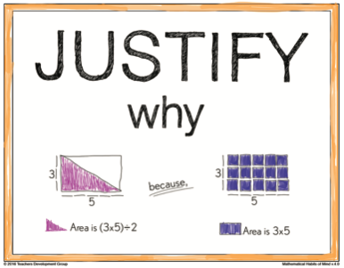
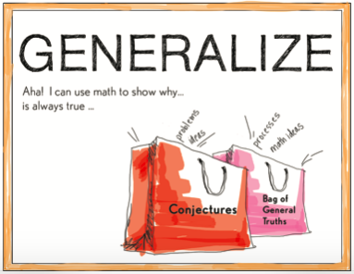
Rich mathematical student discourse
The act of JUSTIFYING may produce an argument that is not mathematically valid, OR it may produce an argument that is a mathematical justification because it is mathematically valid.
The act of GENERALIZING may produce conjectures that
are not yet justified, OR it may produce mathematical
generalizations for which a mathematical justification
can be provided.
How are justifying and generalizing related to reasoning and sensemaking?
Notes:
Facilitator Notes:
Share the definitions of justification and generalization and ask: How are justifying and generalizing related to reasoning and sensemaking?
Press to support connections between justifying, generalizing, reasoning, sensemaking, and students’ opportunities for discourse in the classroom.

Slide 35
Why student discourse?
Student Benefit: Increasing the level of discourse in groups produces greater student learning; explaining to other students is positively related to achievement outcomes even when controlling for prior achievement. However, just getting students to talk was not enough: what they talked about mattered (NCTM Research Journal, 2007).
Teacher Benefit: A powerful way to measure the impact of your implementation of the research on math teaching and learning is to analyze… Student Mathematical Discourse.
Notes:
Facilitator Notes:
Discourse helps us measure / assess what students are learning, and the extent to which they are engaging in reasoning & sensemaking/justification & generalization

Slide 36
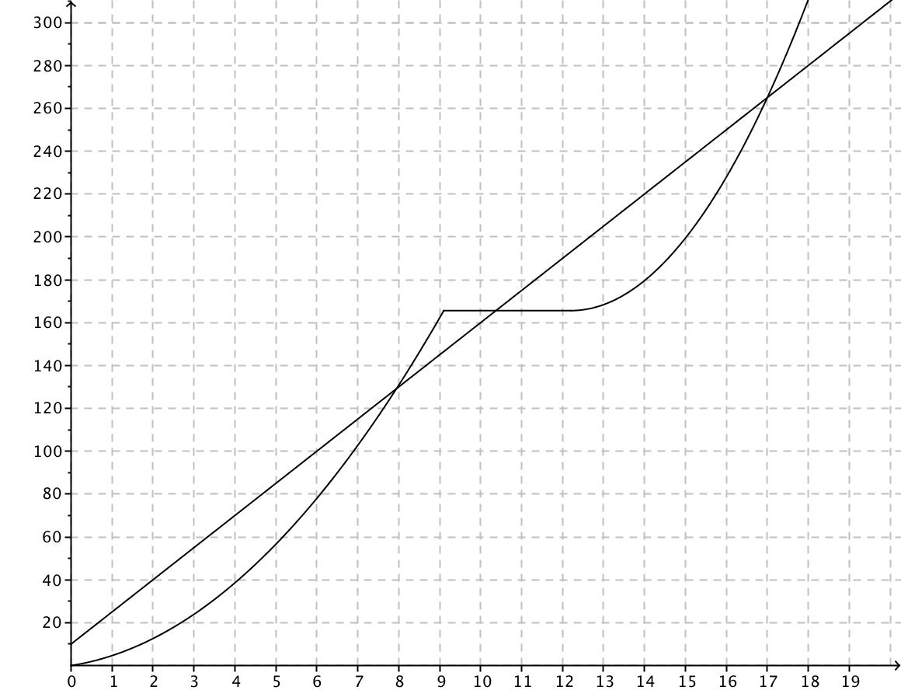
Bike and Truck Task (NCTM, 2014)
What do you notice?
What do you wonder?
Distance from start of road (in feet)
Time (in seconds)
This slide was adapted from:
(Smith, 2014)
Notes:
Facilitator Notes:
The purpose of this activity is twofold: First, to engage participants in a lesson with opportunities for reasoning and sensemaking and second, to orient participants to the “Bike and Truck Task” prior to watching a video of students working on this problem.
Launching the math task:
Pose the Bike and Truck Task.
Give private reasoning time; then move to whole group discussion.
Have participants show on graph what they notice and wonder.

Slide 37
Bike and Truck Task (NCTM, 2014)
A bicycle and a truck are moving along the same road in the same direction.
Discussion questions posed by teacher:
Between what two seconds did the truck drive the fastest? How do you know?
Who was moving faster on the interval from 260 feet to 300 feet?
Distance from start of road (in feet)
Time (in seconds)
This slide was adapted from:
(Smith, 2014)
Notes:
Facilitator Notes:
This is the student task (as we will see in the video). Give private reasoning time and then ask participants to get ready to share with a small group.
Press teachers to “prove” or quantify their ideas about which part of the graph is the steepest. The idea is to prompt teachers to use the ratio of “change in distance” to “change in time” over a specific interval to determine the average rate of change intuitively (or slope of the line connecting the points).
Anticipated Responses: Participants may notice there are some inconsistencies exist in how the graphs model the real life movement of a bike and a truck (e.g. A vehicle would not come to an immediate stop at t = 9 seconds.)
If teachers suggest connecting two points with a line and determining the slope, you might ask: Do you need to know the slope formula to answer this question? How might this question help students make sense of the slope formula?
Video Clip 2 (second half) features students’ discussion of this question and whether the bike or truck was moving faster on the interval from 260 feet to 300 feet.

Slide 38
Small Group Activity
Directions: Use the workspace slide to make sense of and draft a solution to the Bike and Truck Task.
Notes:
Facilitator Notes:
Give directions and have participants work in small groups for 4-5 minutes.
Aspects of small group directions you might consider:
It may be helpful to specify roles for participants in the small groups. For example, you might:
Specify who will go first and in what order participants will share. For example, in a virtual session, you might say, “The second person who enters the breakout room will share first, and sharing will move counterclockwise until everyone has shared.”
Specify who will record. For example, in a virtual session, you might say, “The first person who enters the breakout room will be the recorder and jot down ideas from the group onto the workspace slide.
Specify who will keep time. For example, in a virtual session, you might say, “The third person will be the time keeper and let each team member know if airtime goes over a minute and how much time is left.”
It may be helpful to specify where participants will record and show them how to access it. As we have suggested, you might have an assigned Google Slide for each group which is a copy of this activity’s workspace slide.
It may be helpful to specify how much time participants will have in their small group.
It may be helpful to preview what their workspace will look like (e.g., share the next slide).

Slide 39
Team names:
Preview of Workspace Slide
Between what two seconds did the truck drive the fastest? How do you know?
Who was moving faster on the interval from 260 ft to 300 ft? How do you know?
Distance from start of road (in feet)
Time (in seconds)
This slide was adapted from:
(Smith, 2014)
Notes:
Facilitator Notes:
Groups / breakout rooms: Participants should work in groups on these three workspace slides for ~4-5 minutes.
Whole group: Engage participants in a discussion of the task.
Select a group to share out.
Press for reasoning!
Why does that make sense?
Where do you see that?
Convince us why that works or makes sense to you.
What mathematically allows us to do that?
Also press on Listening to Understand
I heard you say….
I understand ….
I want to add on ….
I wonder….

Slide 40
Debriefing the Bike and Truck Task:
Goals for us as math learners:
Mathematical goal: Deepen our understanding of how context is important for interpreting key features of a graph portraying the relationship between time and distance
Equity goal: Elicit diverse perspectives by continually pressing for reasoning and sense making
How did you see me working on each of these goals during the lesson?
What moves was I making as a teacher of mathematics?
What moves could have been made to support our work on these goals even more?
Notes:
Facilitator Notes:
This slide returns to the purpose of math task and orients participants of the goals we have had for them as learners.
Emphasize that we are now asking them to debrief their experience with the task as learners using the questions on the slide.

Slide 41
Debriefing the Bike and Truck Task:
Goals for us as teachers:
Equity goal: Expand our vision for what mathematical reasoning looks like and sounds like by recognizing the power of students sharing rough draft ideas
Pedagogical goal: Develop understanding of what instructional moves that elicit reasoning and sensemaking look like and sound like
What new ideas do you have about what reasoning and sensemaking look like and sounds like?
What questions do you have about supporting students’ reasoning and sensemaking?
Notes:
Facilitator Notes:
This slide returns to the purpose of math task and orients participants to the goals we have had for them as teachers.
Emphasize that we are now asking them to debrief their experience with the task as teachers using the questions on the slide.

Slide 42
Debrief: Practices of ambitious mathematics teaching
Which of these 8 practices did you notice? What others could have been highlighted? In what ways?
Establish mathematical goals to focus learning
Implement tasks that promote reasoning and problem solving
Use and connect mathematical representations
Facilitate meaningful mathematical discourse
Pose purposeful questions
Build on procedural fluency from conceptual understanding
Support productive struggle in learning mathematics
Elicit and use evidence of student thinking
(NCTM, 2014)
Notes:
Facilitator Notes:
Option 1: Debrief “Doing Math Together” or “Studying Teaching” through the lens of NCTM’s 8 practices of ambitious instruction.
If you’re facilitating online, you might offer an opportunity to “stamp” the practices participants notice and discuss trends or questions that emerge.
If you’re facilitating in person, you might offer a turn and talk so participants can discuss what they noticed with a partner/group and then come back to share trends or questions that emerge.
During the discussion, press for examples/evidence from the shared moment of teaching. This might sound like: “Where/when did you see an example of this practice?”

Slide 43
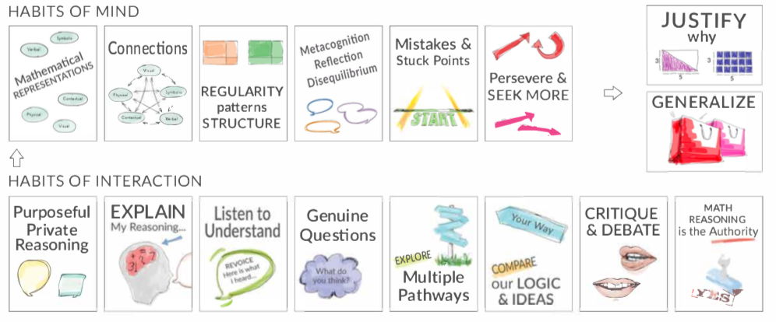
Debrief: Habits, routines, and actions
Which of these habits did you notice? What others could have been highlighted? In what ways?
Habits of Mind: Things we do as individual mathematicians when solving problems.
Habits of Interaction: Things that we do when working with others to make sense of the math.
(TDG, 2020)
Notes:
Facilitator Notes:
Option 2: Debrief “Doing Math Together” or “Studying Teaching” through the lens of TDG’s Habits & Routines tool.
If you’re facilitating online, you might offer an opportunity to “stamp” the habits participants notice and discuss trends or questions that emerge.
If you’re facilitating in person, you might offer a turn and talk so participants can discuss what they noticed with a partner/group and then come back to share trends or questions that emerge.
During the discussion, press for examples/evidence from the shared moment of teaching. This might sound like: “Where/when did you see an example of this practice?”

Slide 44

Studying teaching:
Analyzing opportunities for reasoning and sensemaking in Ms. Shackelford’s lesson
Notes:
Facilitator Notes:
The purpose of Session 7 is to deepen our understandings related to reasoning and sensemaking. Here we continue this work by analyzing opportunities for reasoning and sensemaking in another teacher’s math lesson.

Slide 45
Facilitator Guide: Studying Teaching
Rationale for studying teaching:
  To give us a shared context for thinking deeply about the complex work of teaching (Grossman, 2011)
  To sharpen our ability to notice and enhance our pedagogical judgment (Horn, 2022; van Es & Sherin, 2021)
  To learn about and experiment with new ideas (Grossman et al., 2009)
Recommendations for studying teaching together:
  Focus conversations: It is important to keep conversations focused on connections between learners, mathematical content, and teaching (Cohen et al., 2003; Horn et al. 2018).
  Establish norms: It can be valuable to establish norms that honor the brave work of making practice public
Notes:
Studying teaching involves analysis of video, vignettes, live teaching, or instructional tools to support participants in thinking deeply about the work of teaching.
Examples of how we might engage in studying teaching:
Watching classroom video of our own or another teacher’s practice (Borko et al., 2008; Sherin & van Es, 2009)
Reading transcripts of episodes of teaching
Sharing detailed vignettes of our own classroom experiences (Horn, 2010)
Rehearsing an episode of teaching (Kazemi et al., 2016)
Experiencing live teaching together (Kazemi et al., 2018)
In each example of teaching, specific features of teachers’ work are highlighted / visible, and invisible (Little, 2022).
As you focus conversations, orient participants to specific features of the example or tool at hand. For example, a facilitator might say, “As we watch this video, notice how the teacher elicits students’ reasoning.”
When setting norms, please know that the suggestions in the slides are intended to orient the group toward an inquiry stance toward students, one another, and the work of teaching and orient the group toward making connections between learners, mathematical content, and teaching.
Additional resources: If you are interested in learning more about these ideas, check out these resources.
Module 0, Resource 3: This resource is designed to support leaders preparing to facilitate rehearsals in teachers’ professional learning.
TEDD.org, Teacher Educator Pedagogies: This site includes additional resources for leading rehearsals and teacher time out.
van Es et al., 2014 (full citation below): This article details facilitation moves to support teachers’ analysis of video.
Taking Action (Boston et al., 2017; full citation below): This NCTM-published book includes cases and videos for studying teaching, including the case of Shalunda Shackelford used in Module 2.
References
Borko, H., Jacobs, J., Eiteljorg, E., & Pittman, M. E. (2008). Video as a tool for fostering productive discussions in mathematics professional development. Teaching and Teacher Education, 24, 417–436.
Boston, M., Dillon, F., Smith, M., & Miller, S. (2017). Taking action: Implementing effective mathematics teaching practices in grades 9-12. National Council of Teachers of Mathematics.
Cohen, D. K., Raudenbush, S. W., & Ball, D. L. (2003). Resources, instruction, and research. Educational Evaluation and Policy Analysis, 25(2), 119-142.
Grossman, P. (2011). Framework for teaching practice: A brief history of an idea. Teachers College Record, 113(12), 2836–2843.
Grossman, P., Compton, C., Igra, D., Ronfeldt, M., Shahan, E., & Williamson, P. W. (2009). Teaching practice: A cross-professional perspective. Teachers College Record, 111(9), 2055–2100.
Horn, I. S. (2010). Teaching replays, teaching rehearsals, and re-visions of practice: Learning from colleagues in a mathematics teacher community. Teachers College Record, 112(1), 225–259.
Horn, I. S., Kane, B. D., & Garner, B. (2018). Teacher collaborative time: Helping teachers make sense of ambitious teaching in the context of their schools. In P. Cobb, K. Jackson, E. Henrick, T. Smith, & MIST team (Eds.), Systems for instructional improvement: creating coherence from the classroom to the district central office (pp. 93-112). Harvard Education Press.
Kazemi, E., Gibbons, L., Lewis, B. (2018) Math Labs: Teachers, teacher educators, and school leaders learning together from their own students. Journal of Mathematics Education Leadership, Spring 2018, 23-36.
Little, J. W. (2002). Professional community and the problem of high school reform. International Journal of Educational Research, 37(8), 693–714.
Sherin, M. G., & Van Es, E. A. (2009). Effects of video club participation on teachers’ professional vision. Journal of Teacher Education, 60(1), 20–37.
van Es, E. A., Tunney, J., Goldsmith, L. T., & Seago, N. (2014). A framework for the facilitation of teachers’ analysis of video. Journal of Teacher Education, 65(4), 340–356. (Open access: https://escholarship.org/uc/item/3jj747gv)

Slide 46
Rich mathematical student discourse
The act of JUSTIFYING may produce an argument that is not mathematically valid, OR it may produce an argument that is a mathematical justification because it is mathematically valid.
The act of GENERALIZING may produce conjectures that
are not yet justified, OR it may produce mathematical
generalizations for which a mathematical justification
can be provided.
How are justifying and generalizing related to reasoning and sensemaking?
Notes:
Facilitator Notes:
Remind participants of the definitions of justification and generalization and connections they generated between justification and generalization, and reasoning and sensemaking.

Slide 47
Justify
JUSTIFY | To justify why a solution or mathematical statement makes sense, or is correct/true or incorrect or untrue, students create a logical argument by using: math structures (definitions, properties, meanings), connections between math structures and mathematical representations, previously established generalizations, and/or a counterexample to invalidate a claim The act of justifying may produce an argument that is not mathematically valid, or it may produce a mathematical justification because the argument is mathematically valid. The argument may not be complete but is a start. When working on a problem/task or listening to others' math ideas, students persevere and seek more by: seeking increasingly robust justifications not settling for right answers without understanding It is important for students to use justifications about solutions to specific problems as context for generating conjectures and justifications about the general case. This Habit uses math to "argue why" rather than to "verify that," meaning it is not checking an answer or describing a procedure.
Notes:
Facilitator Notes:
You might share these descriptions from the Teachers Development Group Habits, routines, and actions tool. (3 Habits, routines, and actions_TDG)

Slide 48
Generalize
GENERALIZE | When students generalize, they: GENERATE CONJECTURES about the general case (i.e., what is always, sometimes, or never true) by reasoning with: representations connections contradictions (what is NOT true) regularity in repeated reasoning and/or other patterns structures (definitions, properties, meanings) their justifications of solutions to specific problems Note: When students justify why their own and/or someone else's conjecture is sometimes, always, or never valid, this habit would co-occur with the Justify habit.
Notes:
Facilitator Notes:
You might share these descriptions from the Teachers Development Group Habits, routines, and actions tool. (3 Habits, routines, and actions_TDG)

Slide 49
Shalunda Shackelford’s mathematics learning goals
Students will understand that:
The language of change and rate of change (increasing, decreasing, constant, relative maximum or minimum) can be used to describe how two quantities vary together over a range of possible values.
Context is important for interpreting key features of a graph portraying the relationship between time and distance.
The average rate of change is the ratio of the change in the dependent variable to the change in the independent variable for a specified interval in the domain.
This slide was adapted from:
(Smith, 2014)
Notes:
Facilitator Notes:
Before sharing video, it is helpful to orient participants to the goals the teacher has for the lesson and the mathematics the students are working on (this might include sharing the standards or learning objectives of the lesson, and engaging participants in the math tasks in some way).
Resources for you and your participants:
You can access the video for this lesson and associated resources (transcript, etc.) here: The Case of Shalunda Shackelford and the Bike and Truck Task - National Council of Teachers of Mathematics

Slide 50
Considerations as we engage with teachers’ practice
Useful sentence stems for reflecting on excerpts of teaching:
I noticed when the teacher _____ students _____.
I am curious about why the teacher/students ______. What reasons might they have?
Norms for reflecting on excerpts of teaching:
Approach artifacts of teaching with gratitude: This educator has shared their work to support our learning.
Assume that there are many things we do not know about students, classroom, and the shared history of the teacher and students
Assume good intent on the part of the teacher
Keep focused on what the students are doing and how they are working on the content
Use your noticing/wonderings to raise questions about your own students and your own classroom.
Notes:
Facilitator Notes:
It is critical to establish productive norms when engaging with another teacher’s practice. We hope the suggestions on the slide, and the sentence stems help to create a productive space through which to learn about teaching.

Slide 51
Characterizing students’ mathematical discourse
Identify at least one example of when students are justifying and one example of when students are generalizing. How are the students using the other Habits to justify and generalize?
What does the teacher do to support students’ engagement in and understanding of mathematics, and the effective mathematics teaching practices of facilitating meaningful mathematical discourse and posing purposeful questions?
Be prepared to share:
Specific line numbers from the transcript
Brief justification for your thinking

Slide 52
Shalunda Shackelford’s classroom
Embed Video Here
Notes:
Facilitator Notes:
You might embed video of the classroom excerpt on this slide.
You can access the video for this lesson and associated resources (transcript, etc.) here: The Case of Shalunda Shackelford and the Bike and Truck Task - National Council of Teachers of Mathematics

Slide 53
Small Group Activity
Directions: Use the workspace slide to record students’ justifications and generalizations, and the teachers’ moves.
Notes:
Facilitator Notes:
Before the session, make a .pdf or copy of the supplemental resource Transcript from the Bike and Truck task in Shalunda Shackelford's classroom (in the Principles to Actions Toolkit; accessible to NCTM members here).
Have participants open Transcript from the Bike and Truck task in Shalunda Shackelford's classroom (facilitator-provided resource)
Give directions and have participants work in small groups for 4-5 minutes.
Aspects of small group directions you might consider:
It may be helpful to specify roles for participants in the small groups. For example, you might:
Specify who will go first and in what order participants will share. For example, in a virtual session, you might say, “The second person who enters the breakout room will share first, and sharing will move counterclockwise until everyone has shared.”
Specify who will record. For example, in a virtual session, you might say, “The first person who enters the breakout room will be the recorder and jot down ideas from the group onto the workspace slide.
Specify who will keep time. For example, in a virtual session, you might say, “The third person will be the time keeper and let each team member know if airtime goes over a minute and how much time is left.”
It may be helpful to specify where participants will record and show them how to access it. As we have suggested, you might have an assigned Google Slide for each group which is a copy of this activity’s workspace slide.
It may be helpful to specify how much time participants will have in their small group.
It may be helpful to preview what their workspace will look like (e.g., share the next slide).

Slide 54
Team names:
Preview of Workspace Slide
Use specific line numbers from the transcript, and briefly justify your thinking.
Students’ justifications and generalizations
Teachers’ moves
Notes:
Facilitator Notes:
Groups / breakout rooms: Participants should work in groups on the workspace slide for ~4-5 minutes.
Whole group:
After participants have had time to work in small groups, you might ask them to spend time looking at one another’s slides.
You can bring the whole group back to share, or ask participants to comment on one another’s slides in another format.

Slide 55
Bike and Truck Transcript Student Names
Preview of Workspace Slide
Line 3 & 6 | Valery |  | Line 26 | Chelsea
Line 10 & 13 | Mykel |  | Line 30, 34, 37 | Tony
Line 16 & 19 | Lauren |  | Line 44, 46, 55, 58 | Stephanie
Line 21, 40, 52 | Ne’Kail |  | Line 59, 61 | Tamela

Slide 56

Implementing ambitious math teaching
Ambitious math teaching enables students to develop positive mathematical identities.
Mathematical identity is the way in which people think of themselves in relation to mathematics: Having a positive mathematical identity means that people feel empowered by mathematics and as doers of mathematics, see the multiple purposes for learning mathematics, appreciate why mathematics is important in their lives, and come to believe that they can succeed in mathematics.
The ways in which students experience mathematics have a significant impact on the way in which they identify themselves as doers of mathematics.
(NCTM, 2020)

Slide 57
Small Group Activity
Directions: Use the workspace slide to debrief the Bike and Truck task, identifying practices we saw related to each of the five principles of ambitious math teaching.
Notes:
Facilitator Notes:
Give directions and have participants work in small groups for ~5 minutes.
Aspects of small group directions you might consider:
It may be helpful to specify roles for participants in the small groups. For example, you might:
Specify who will go first and in what order participants will share. For example, in a virtual session, you might say, “The second person who enters the breakout room will share first, and sharing will move counterclockwise until everyone has shared.”
Specify who will record. For example, in a virtual session, you might say, “The first person who enters the breakout room will be the recorder and jot down ideas from the group onto the workspace slide.
Specify who will keep time. For example, in a virtual session, you might say, “The third person will be the time keeper and let each team member know if airtime goes over a minute and how much time is left.”
It may be helpful to specify where participants will record and show them how to access it. As we have suggested, you might have an assigned Google Slide for each group which is a copy of this activity’s workspace slide.
It may be helpful to specify how much time participants will have in their small group.
It may be helpful to preview what their workspace will look like (e.g., share the next slide).

Slide 58
Team names:
Preview of Workspace Slide
“Ambitious teaching is teaching that deliberately aims for all students – across ethnic, racial, class, and gender categories – not only to acquire, but also to understand and use knowledge, and to use it to solve authentic problems.”
(Lampert & Graziani, 2009, p. 492)
From the Bike and Truck Task and Shalunda’s video, cite specific examples of ambitious math teaching:
Engages students in making sense of mathematical concepts
Centers students’ thinking and reasoning through discourse
Views students as capable of using their understandings and assets to solve authentic problems
Values students’ thinking, including emergent understanding and errors
Attends to student thinking in an equitable and responsive manner
Notes:
Facilitator Notes:
Groups / breakout rooms: Participants should work in groups on the workspace slide for ~5 minutes.
Whole group:
After participants have had time to work in small groups, you might ask them to time looking at one another’s slides.
You can bring the whole group back to share, or ask participants to comment on one another’s slides in another format.

Slide 59
Debrief: Practices of ambitious mathematics teaching
Which of these 8 practices did you notice? What others could have been highlighted? In what ways?
Establish mathematical goals to focus learning
Implement tasks that promote reasoning and problem solving
Use and connect mathematical representations
Facilitate meaningful mathematical discourse
Pose purposeful questions
Build on procedural fluency from conceptual understanding
Support productive struggle in learning mathematics
Elicit and use evidence of student thinking
(NCTM, 2014)
Notes:
Facilitator Notes:
Option 1: Debrief “Doing Math Together” or “Studying Teaching” through the lens of NCTM’s 8 practices of ambitious instruction.
If you’re facilitating online, you might offer an opportunity to “stamp” the practices participants notice and discuss trends or questions that emerge.
If you’re facilitating in person, you might offer a turn and talk so participants can discuss what they noticed with a partner/group and then come back to share trends or questions that emerge.
During the discussion, press for examples/evidence from the shared moment of teaching. This might sound like: “Where/when did you see an example of this practice?”

Slide 60
Debrief: Habits, routines, and actions
Which of these habits did you notice? What others could have been highlighted? In what ways?
Habits of Mind: Things we do as individual mathematicians when solving problems.
Habits of Interaction: Things that we do when working with others to make sense of the math.
(TDG, 2020)
Notes:
Facilitator Notes:
Option 2: Debrief “Doing Math Together” or “Studying Teaching” through the lens of TDG’s Habits & Routines tool.
If you’re facilitating online, you might offer an opportunity to “stamp” the habits participants notice and discuss trends or questions that emerge.
If you’re facilitating in person, you might offer a turn and talk so participants can discuss what they noticed with a partner/group and then come back to share trends or questions that emerge.
During the discussion, press for examples/evidence from the shared moment of teaching. This might sound like: “Where/when did you see an example of this practice?”

Slide 61

Planning for action:
Adapting a task to ensure opportunities for reasoning and sensemaking
Notes:
Facilitator Notes:
The purpose of Session 7 is to deepen our understandings related to reasoning and sensemaking. Here we continue this work by adapting a task to ensure opportunities for students’ reasoning and sensemaking.

Slide 62
Facilitator Guide: Planning for Action
Rationale for planning for action:
  To see connections to our contexts and goals (Putnam & Borko, 2000)
  To apply new ideas to upcoming work (Horn & Kane, 2015)
  To surface complexities when taking up new ideas
Recommendations for planning for action:
  Use teachers’ own curricular resources when possible
  Create space to discuss anticipated challenges and strategies for trying new ideas within those challenges
  Follow up on teachers’ plans; return to them to build on and refine ideas
Notes:
Planning for action involves making links between session content and our own practice and contexts.
Additional resources: If you’re interested in digging more into these ideas, check out these resources.
Module 0, Resource 2: Sometimes, planning conversations can surface unproductive ideas about particular students or student groups that circulate in our schools or broader contexts. This resource is designed to support leaders preparing for difficult conversations, especially when unproductive language about students emerges.
References
Horn, I. S., & Kane, B. D. (2015). Opportunities for professional learning in mathematics teacher workgroup conversations: Relationships to instructional expertise. Journal of the Learning Sciences, 24(3), 1–46.
Putnam, R. T., & Borko, H. (2000). What do new views of knowledge and thinking have to say about research on teacher learning? Educational Researcher, 29(1), 4-15.

Slide 63
Applying our learning to our work in the classroom
Work with a partner/group or independently to adapt a task you will use in the near future:
  What new ideas about ambitious math teaching are you excited to try out, that will help ensure opportunities for students’ reasoning and sensemaking?
  How will you work on this new idea?
Make a plan with your colleagues to check-in about how trying this idea out went between now and our next session (i.e., at your next PLC meeting)
Notes:
Facilitator Notes:
Give participants time to work on applying their learning to their work in the classroom (in small groups, pairs or independently).
Invite participants to take out curricular materials and work on specific lessons, units or assessments
To support continued reflection between sessions, be sure to provide an opportunity for participants to set up time to check-in with one another in the near future about their experiences trying out this idea/plan

Slide 64
Debrief: Principles of ambitious mathematics teaching
Which of these ideas are you thinking about in light of our work? What questions do you have?
“Ambitious teaching is teaching that deliberately aims for all students – across ethnic, racial, class, and gender categories – not only to acquire, but also to understand and use knowledge, and to use it to solve authentic problems.”
(Lampert & Graziani, 2009, p. 492)
Ambitious teaching:
Engages students in making sense of mathematical concepts
Centers students’ thinking and reasoning through discourse
Views students as capable of using their understandings and assets to solve authentic problems
Values students’ thinking, including emergent understanding and errors
Attends to student thinking in an equitable and responsive manner
(Anthony et al., 2015)
Notes:
Facilitator Notes:
Debrief “Connecting to Research” or “Planning for Action” through the lens of this definition from Lampert and Graziani (2009) and the five principles listed.
If you’re facilitating online, you might offer an opportunity to “stamp” the principles that are on participants’ minds and discuss trends or questions that emerge.
If you’re facilitating in person, you might offer a turn and talk so participants can discuss what principles are on their minds with a partner/group and then come back to share trends or questions that emerge.
[written reflection option]
References for these ideas: Anthony et al., 2015; Huinker & Bill, 2017; Lampert et al., 2011; Lampert & Graziani, 2009

Slide 65
Debriefing Session 7
Reflecting on our work in the activities in the session

Slide 66




Debriefing Session 7: Four cornerstone principles of the OMP
What connections do you see between any of the cornerstones and our work in this session?
Focus: Learning experiences in every grade and course are focused on core mathematical content and practices that progress purposefully across grade levels.
Engagement: Mathematical learning happens in environments that motivate all students to engage with relevant and meaningful issues in the world around them.
Pathways: All students are equipped with the mathematical knowledge and skills necessary to identify and productively pursue any postsecondary paths in their future. Students have agency to choose from a variety of courses, contexts, and applications they find relevant.
Belonging: Participation in mathematical learning builds students’ identities as capable math learners and fosters a positive self-concept. Students’ cultural and linguistic assets are valued in ways that contribute to a sense of belonging to a community of learners.
Any proposed instructional approach, curricular change, or system design element should be evaluated by the degree to which it builds on these four cornerstones. When new approaches are built within the framework of all four-cornerstone principles, we will be on our way to engineering a reimagined system.
(ODE, 2022)
Notes:
Facilitator Notes:
Option 1: Debrief the session through the lens of the four cornerstone principles of the Oregon Mathematics Project.

Slide 67
Debriefing Session 7: Focus of the session
What new insights do you have about reasoning and sensemaking?
Take a couple of minutes to reflect on our work in the session.
Activities in this session:
Setting and maintaining norms: Reconnect with and revise our norms for interacting together
Connecting to research: Defining reasoning and sensemaking
Doing math together: Reasoning and sensemaking using the Bike and Truck Task
Studying teaching: Analyzing opportunities for reasoning and sensemaking in Ms. Shackelford’s lesson
Planning for action: Adapting a task to ensure opportunities for students’ reasoning and sensemaking
Notes:
Facilitator Notes:
Option 2: Debrief the session through the lens of the focus of the session.
Module 2 Part 1 especially supports our thinking around the first essential question of this module: What does ambitious math instruction look like at the unit, lesson, and task levels?
The focus of this session in particular is to deepen our understandings related to reasoning and sensemaking.
You might offer participants time to think individually about new insights before sharing aloud.

Slide 68
Ambitious math instruction at the task level:
Opportunities for reasoning and sensemaking with technology
Session 8
The focus of this session is to consider how we might support students’ reasoning and sensemaking with technology.
Agenda for this session:
Setting and maintaining norms: Reconnect with and revise our norms for interacting together
Doing math together: Reasoning and sensemaking in a Desmos lesson
Planning for action: Adapting a Desmos lesson to ensure opportunities for students’ reasoning and sensemaking
Time estimate: 90 minutes
M2 P1 Table of Contents
Notes:
Facilitator Notes:
This session especially supports our thinking around the first essential question of this module: What does ambitious math instruction look like at the unit, lesson, and task levels?
We estimate this section will take 90 minutes. If you need to break the section into smaller pieces, please note the activities listed in the agenda are intended to be enacted in this order.

Slide 69

Setting and maintaining norms
Reconnect with and revise our norms for interacting together

Slide 70
Facilitator Guide: Setting and Maintaining Norms
Rationale for setting and maintaining norms:
  To create spaces where we can vulnerably share about our teaching, learning and mathematics (Elliott et al., 2009; Little, 2002; Horn, 2010)
  To support us in sharing in-process, “rough draft” ideas (Thanheiser & Jansen, 2016)
  To foster a community where all members are valued (Grossman et al., 2001)
Recommendations for setting and maintaining norms:
  Include everyone’s ideas and perspectives when setting norms
  Regularly revisit norms and adjust norms as needed
Notes:
Upholding norms is a responsibility of participants and leaders/facilitators. It may be helpful to come up with a protocol that supports participants in naming and problem solving in the event that norms are breached.
Additional resources: If you are interested in learning more and setting and maintaining norms check out these resources.
TEDD.org: Setting norms for collaborative work
References
Elliott, R. & Lesseig, K., & Kazemi, E.. (2009). Sociomathematical norms in professional development: Examining leaders’ use of justification and its implication for practice. The Montana Mathematics Enthusiast Journal monograph, 7.
Grossman, P., Wineburg, S., & Woolworth, S. (2001). Toward a theory of teacher community. Teachers College Record, 103, 942–1012.
Horn, I. S. (2010). Teaching replays, teaching rehearsals, and re-visions of practice: Learning from colleagues in a mathematics teacher community. Teachers College Record, 112(1), 225–259.
Little, J. W. (2002). Professional community and the problem of high school reform. International Journal of Educational Research, 37(8), 693–714.
Thanheiser, E. & Jansen, A. (2016). Inviting prospective teachers to share rough draft mathematical thinking. Mathematics Teacher Educator, 4(2), 145–163.

Slide 71
Revisiting norms
[Insert your group norms]
Rights of a Learner
You have the right to:
Be confused
Make mistakes
Say what makes sense to you
Share unfinished or rough draft thinking and not be judged
(Kalinec-Craig, 2017)
Notes:
Facilitator Notes:
Orient participants to the norms you set in prior sessions and Rights of the Learner
You might ask questions like:
How do the productive norms and Rights of the Learner support our learning together?
Choose one of our norms that you want to focus on in particular. Why does that norm feel important for your learning today?
Invite participants to revise or add onto existing norms as needed
Remind participants of the importance of norms in developing a community of learners.
You might say: As we have opportunities to get to know each other better and better it allows for us to develop trust and feel more and more comfortable asking questions, getting help, revealing our shortcomings with others.

Slide 72

Doing math together:
Reasoning and sensemaking in a Desmos lesson
Notes:
Facilitator Notes:
The purpose of Session 8 is to deepen our understandings related to reasoning and sensemaking by considering how using technology can support students’ reasoning and sensemaking. Here we begin this work by experiencing opportunities to reason and make sense of mathematical ideas through a task with technology.
Some context for why students’ fluency with technology is so critical:
SAT: Students will continue to use calculators on the SAT until 2024 when the test will go online. Whether or not Desmos will be part of the online resources is not known at this time.
ACT: Students may use any 4-function, scientific, or graphing calculator, as long as the calculators do NOT have built-in or downloaded computer algebra system functionality.
Rationale for this section:
This math activity promotes using technology to enhance the reasoning of mathematical ideas.
The technology gives learners access to higher level thinking and reasoning by providing access for students who are still developing procedural skills.
The technology also supports students who are often excluded from rich mathematics by schooling by easing the often times tedious calculations which then gives more time to focus on the reasoning behind ideas.
Technology encourages students to play and investigate more math. Playing with math ideas leads to seeing regularity and patterns emerge which then leads to conjectures and generalizations. This allows you to use your learnings in new situations – which is what mathematicians do.
You might frame this activity by saying:
In this math activity, we will consider how technology can:
Promote students’ reasoning and sensemaking
Give students equitable access to ideas
Create opportunity for experimentation and play

Slide 73
Facilitator Guide: Doing Math Together
Rationale for doing math together:
  Deepens our own specialized mathematical content knowledge so we can better support and respond to students (Kazemi & Franke, 2004)
  Gives us a shared context for the study of teaching (Kazemi et al., 2018)
  Helps us think about the experiences of our students
  To foster joy for doing and learning mathematics (Su, 2020)
Recommendations for doing math together:
  Establish norms for doing math together (see slide notes for examples) (Elliott et al., 2009; Yackel & Cobb; 1998).
  Support participants in engaging with the task as learners and as teachers. Be explicit about when/how participants should take up each of these roles.
Notes:
Example norms for doing mathematics together:
Engage with each other’s thinking with curiosity
Support everyone to experience joy for mathematics
Use partial understandings, mistakes, and errors as an opportunity to examine further questions about mathematics
Additional resources: If you’re interested in digging more into ideas about doing math together check out these resources.
TEDD.org: Mathematics Instructional Activities
TEDD.org: Setting norms for collaborative work
Mathematics For Human Flourishing (book)
References
Ball, D. L., & Cohen, D. K. (1999). Developing practice, developing practitioners: Toward a practice-based theory of professional education. In L. Darling-Hammond & G. Sykes (Eds.), Teaching as the learning profession: Handbook of policy and practice (pp. 3–22). Jossey Bass.
Elliott, R., Lesseig, K., & Kazemi, E.. (2009). Sociomathematical norms in professional development: Examining leaders’ use of justification and its implication for practice. The Montana Mathematics Enthusiast Journal monograph, 7.
Kazemi, E., & Franke, M. L. (2004). Teacher learning in mathematics: Using student work to promote collective inquiry. Journal of Mathematics Teacher Education, 7(3), 203–235.
Su, F. (2021). Mathematics for Human Flourishing. Yale University Press.
Yackel E., & Cobb, P. (1998) Sociomathematical norms, argumentation, and autonomy in mathematics. Journal for Research in Mathematics Education, 27(4), 458-477.

Slide 74
The Desmos lesson
Goals for us as math learners:
Goals for us as teachers and leaders:
Mathematical goal: Notice connections and regularity between graphs and equations that support us in making and justifying conjectures about translations of functions.
Equity goal: Use technology to give learners access to higher level thinking and reasoning by providing access for students who are still developing procedural skills.
Equity goal: Expanding our vision for what mathematical reasoning can look like and sound like by eliciting rough draft ideas.
Pedagogical goal: Demonstrate how technology allows us to maximize reasoning opposed to spending most of your time on calculating.
Notes:
Facilitator Notes:
This slide frames the purpose of the math task and orients participants of the goals we have for them as learners and as educators. The slide appears again at the end of this section to support debriefing participants’ experiences doing the task (see discussion prompts 1-3 on the slide)
Make explicit what we mean by “math learners” and “educators”

Slide 75
Orienting ourselves to the mathematics for this task
Related Oregon Math Standards
HS.AFN.D Model a wide variety of authentic situations using functions through the process of making and changing assumptions, assigning variables, and finding solutions to contextual problems.
HS.AFN.D.9 Identify and interpret the effect on the graph of a function when the equation has been transformed
Notes:
Facilitator Notes:
Have participants open 4a Critical Areas of Focus for HS Algebra and 4b Standards Guidance Document for HS.AFN.D.9 and privately read.
Orient participants to where these documents come from: the Oregon Mathematics Guidance Document, 2021 Oregon Mathematics Standards.
You might preview that there will be more work with the Standards Guidance Documents in Session 11.

Slide 76
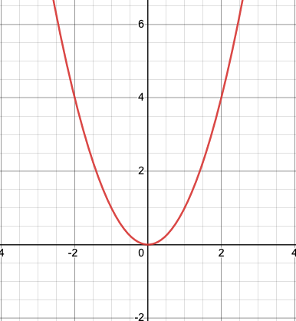

Desmos Desmos | Graphing Calculator
Open Desmos and type in the following equation. Add sliders for h and k.
Investigate what happens as you move h and k to different values. What can you generalize and why does that work (justify)?
What happens to the graph when h is positive and when h is negative? Why does that make sense?
What happens to the graph when k is positive and when k is negative? Why does that make sense?
Notes:
Facilitator Notes:
Give participants time to read the problem and open Desmos.
Give participants private reasoning time to begin to make sense of the task.

Slide 77
Small Group Activity
Directions: Use the workspace slide to draft a solution to the Desmos task.
Notes:
Facilitator Notes:
After giving participants 3 minutes to consider the questions individually, give directions and have them work in small groups for ~5 minutes.
Aspects of small group directions you might consider:
It may be helpful to specify roles for participants in the small groups. For example, you might:
Specify who will go first and in what order participants will share. For example, in a virtual session, you might say, “The second person who enters the breakout room will share first, and sharing will move counterclockwise until everyone has shared.”
Specify who will record. For example, in a virtual session, you might say, “The first person who enters the breakout room will be the recorder and jot down ideas from the group onto the workspace slide.
Specify who will keep time. For example, in a virtual session, you might say, “The third person will be the time keeper and let each team member know if airtime goes over a minute and how much time is left.”
It may be helpful to specify where participants will record and show them how to access it. As we have suggested, you might have an assigned Google Slide for each group which is a copy of this activity’s workspace slide.
It may be helpful to specify how much time participants will have in their small group.
It may be helpful to preview what their workspace will look like (e.g., share the next slide).

Slide 78
Team names:
Preview of Workspace Slide
Open Desmos and type in the following equation. Add sliders for h and k.
Desmos | Graphing Calculator
Investigate what happens as you move h and k to different values. What can you generalize and why does that work (justify)?
What happens to the graph when h is positive and when h is negative? Why does that make sense?
What happens to the graph when k is positive and when k is negative? Why does that make sense?
Notes:
Facilitator Notes:
Groups / breakout rooms: Record what makes sense about each student’s reasoning for ~5 minutes.
Whole group: Engage participants in a discussion of the task.
Select a group to share out.
Press for reasoning!
Why does that make sense?
Where do you see that?
Convince us why that works or makes sense to you.
What mathematically allows us to do that?
Also press on Listening to Understand
I heard you say….
I understand ….
I want to add on ….
I wonder….

Slide 79
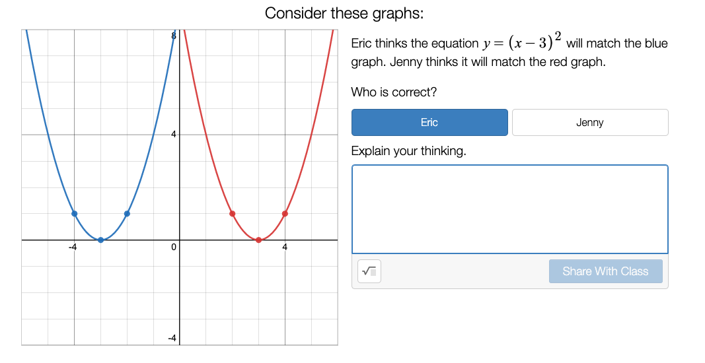
Desmos Desmos | Graphing Calculator
Link to the activity:
Match My Parabola • Activity Builder by Desmos
Notes:
Facilitator Notes:
This next Desmos task allows you to dig a little deeper into mathematical reasoning about translations left and right.
Give participants private reasoning time with the task, and then share the worked example on the next slide.

Slide 80
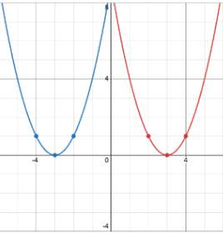

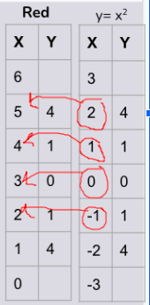
Worked example
Which graph matches y = (x - 3)²? Why?
Eric:
The parent function y= x² has a vertex at (0,0) so y = (x-3)² moves the graph 3 left.
Jenny:
If I plug in x values 4, 3, and 2, I get the 3 points on the red graph.
Student from another group:
I know that when I compare y = (x-3)² to y = x², that for every point on the y = x² graph there is another point on the y = (x-3)² graph whose y value is the same but whose x value is 3 more. So the graph y = (x-3)² is the graph of zero when the x input is 3. So the equation y = (x-3)² is the graph of y = x² with the x values shifted 3 to the right.
Notes:
Facilitator Notes:
Give participants private reasoning time with the worked example.
You might consider making a worksheet version of this worked example.

Slide 81
Small Group Activity
Directions: Use the workspace slide to make sense of the worked example.
Notes:
Facilitator Notes:
After giving participants time to consider the worked example individually, give directions and have them work in small groups for ~5 minutes.
Aspects of small group directions you might consider:
It may be helpful to specify roles for participants in the small groups. For example, you might:
Specify who will go first and in what order participants will share. For example, in a virtual session, you might say, “The second person who enters the breakout room will share first, and sharing will move counterclockwise until everyone has shared.”
Specify who will record. For example, in a virtual session, you might say, “The first person who enters the breakout room will be the recorder and jot down ideas from the group onto the workspace slide.
Specify who will keep time. For example, in a virtual session, you might say, “The third person will be the time keeper and let each team member know if airtime goes over a minute and how much time is left.”
It may be helpful to specify where participants will record and show them how to access it. As we have suggested, you might have an assigned Google Slide for each group which is a copy of this activity’s workspace slide.
It may be helpful to specify how much time participants will have in their small group.
It may be helpful to preview what their workspace will look like (e.g., share the next slide).

Slide 82
Team names:
Preview of Workspace Slide
Which graph matches y = (x - 3)²? Why?
What is convincing about these rough draft justifications? What would strengthen them?
Eric:
The parent function y= x² has a vertex at (0,0) so y = (x-3)² moves the graph 3 left.
Jenny:
If I plug in x values 4, 3, and 2, I get the 3 points on the red graph.
Student from another group:
I know that when I compare y = (x-3)² to y = x², that for every point on the y = x² graph there is another point on the y = (x-3)² graph whose y value is the same but whose x value is 3 more. So the graph y = (x-3)² is the graph of zero when the x input is 3. So the equation y = (x-3)² is the graph of y = x² with the x values shifted 3 to the right.
Notes:
Facilitator Notes:
Groups / breakout rooms: Record what makes sense about the students’ justifications and what would strengthen them for ~5 minutes.
Whole group: Engage participants in a discussion of the task.
Select a group to share out.
Press for reasoning!
Why does that make sense?
Where do you see that?
Convince us why that works or makes sense to you.
What mathematically allows us to do that?
Also press on Listening to Understand
I heard you say….
I understand ….
I want to add on ….
I wonder….

Slide 83
Desmos Desmos | Graphing Calculator
Peter said, “The constant C in the quadratic equation of the form Ax² + By = C tells you where the vertex of the parabola will be on the y-axis”
Do you agree with Peter? Why or why not? If you disagree, what would you want the conjecture to say?
(Dougherty et al, 2021, p. 99)
Notes:
Facilitator Notes:
After debriefing the small group activity with the worked example, build on the conversation using the prompts on this slide.
Give participants private reasoning time and then move into small groups again.

Slide 84
Small Group Activity
Directions: Use the workspace slide to make sense of the worked example.
Notes:
Facilitator Notes:
After giving participants time to consider the worked example individually, give directions and have them work in small groups for ~5 minutes.
Aspects of small group directions you might consider:
It may be helpful to specify roles for participants in the small groups. For example, you might:
Specify who will go first and in what order participants will share. For example, in a virtual session, you might say, “The second person who enters the breakout room will share first, and sharing will move counterclockwise until everyone has shared.”
Specify who will record. For example, in a virtual session, you might say, “The first person who enters the breakout room will be the recorder and jot down ideas from the group onto the workspace slide.
Specify who will keep time. For example, in a virtual session, you might say, “The third person will be the time keeper and let each team member know if airtime goes over a minute and how much time is left.”
It may be helpful to specify where participants will record and show them how to access it. As we have suggested, you might have an assigned Google Slide for each group which is a copy of this activity’s workspace slide.
It may be helpful to specify how much time participants will have in their small group.
It may be helpful to preview what their workspace will look like (e.g., share the next slide).

Slide 85
Team names:
Preview of Workspace Slide
Peter said, “The constant C in the quadratic equation of the form Ax² + By = C tells you where the vertex of the parabola will be on the y-axis”
Is it True/False? Do you agree with Peter? Why or why not? If you disagree what, would you want it to say?
Desmos | Graphing Calculator
(Dougherty et al, 2021, p. 99)
Notes:
Facilitator Notes:
Groups / breakout rooms: Record reactions to Peter’s statement for ~5 minutes.
Whole group: Engage participants in a discussion of the task.
Select a group to share out.
Press for reasoning!
Why does that make sense?
Where do you see that?
Convince us why that works or makes sense to you.
What mathematically allows us to do that?
Also press on Listening to Understand
I heard you say….
I understand ….
I want to add on ….
I wonder….

Slide 86
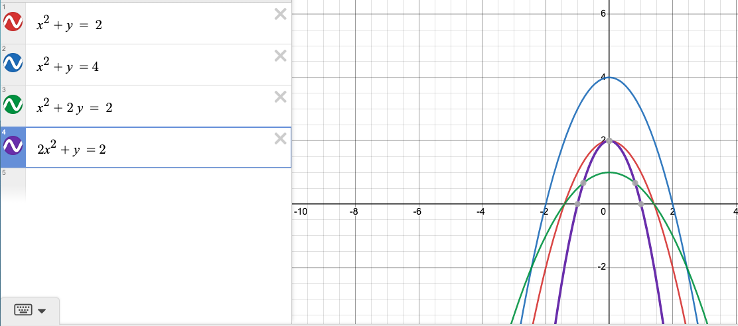
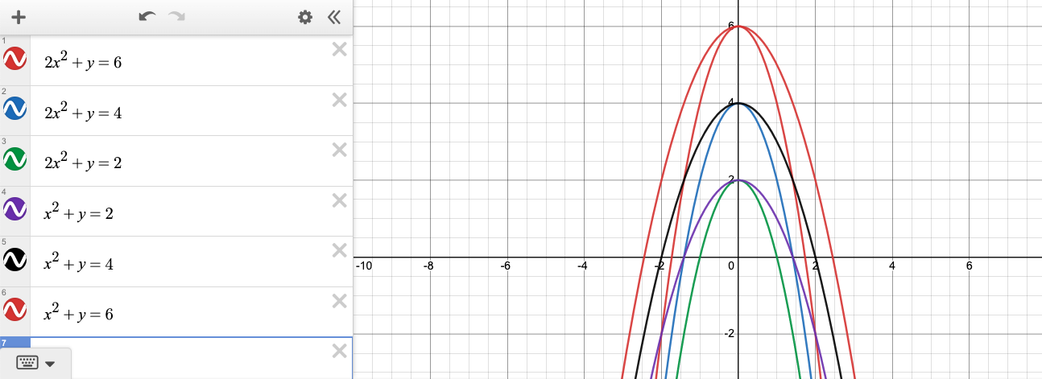
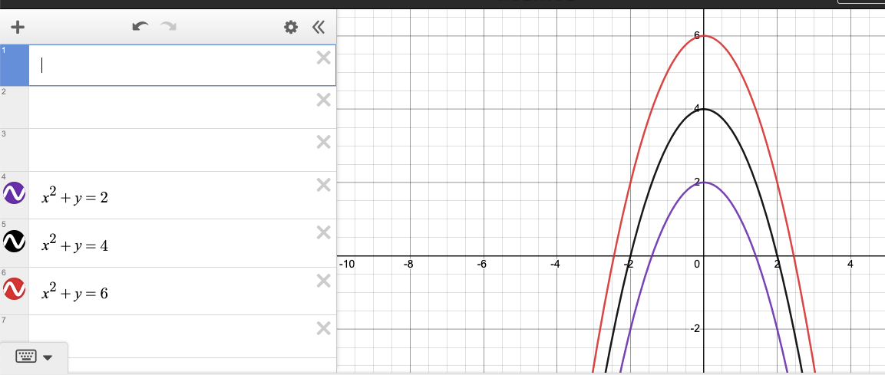
Desmos: Anticipated work Desmos | Graphing Calculator
This problem asks us to generate multiple cases and formalize a pattern or generalization that always works.
Notes:
Facilitator Notes:
This is the anticipated work for the problem we just engaged with.
You might frame the importance of doing the math and anticipating students’ solutions in planning.
You might use this as an opportunity to discuss selecting and sequencing students’ strategies.
Additional resource: Chapter 5: Selecting and Sequencing Student Solutions | Online Resources

Slide 87
Desmos: Problem types Desmos | Graphing Calculator
Opposite thinking of graphing an equation | Promoting relationships across problems (String) | Generate multiple cases and formalize a pattern or generalization
What is the graph of a parabola that intersects the y-axis at (0,4) and the x-axis at (-2,0) and (2,0). What do you think is alway true? Sometimes true? Never true? Why? | Using Desmos graph each of the following on the same coordinate grid: x² + y = 4 2x² + y = 4 4x² + y = 4 What do you notice? What is always true? Build a mathematical argument for why it is true. | Peter said, “The constant C in the quadratic equation of the form Ax² + By = C tells you where the vertex of the parabola will be on the y-axis” Do you agree with Peter? Why or why not? If you disagree, what would you want the conjecture to say?
(Dougherty et al, 2021, p. 99)

Slide 88
Debriefing the Desmos lesson
Goals for us as math learners:
Mathematical goal: Notice connections and regularity between graphs and equations that support us in making and justifying conjectures about translations of functions.
Equity goal: Use technology to give learners access to higher level thinking and reasoning by providing access for students who are still developing procedural skills.
How did you see me working on each of these goals during the lesson?
What moves could have been made to support our work on these goals even more?
Notes:
Facilitator Notes:
This slide returns to the purpose of math task and orients participants to the goals we have had for them as learners.
Emphasize that we are now asking them to debrief their experience with the task as learners using the questions on the slide.

Slide 89
Debriefing the Desmos lesson
Goals for us as teachers:
Equity goal: Expanding our vision for what mathematical reasoning and sensemaking can look like and sound like by eliciting rough draft ideas.
Pedagogical goal: Demonstrate how technology allows us to maximize reasoning and sensemaking as opposed to spending most of the time calculating.
What new ideas do you have about what reasoning and sensemaking look like and sounds like?
What questions do you have about supporting students’ reasoning and sensemaking?
Notes:
Facilitator Notes:
This slide returns to the purpose of math task and orients participants to the goals we have had for them as educators.
Emphasize that we are now asking them to debrief their experience with the task as teachers using the questions on the slide.

Slide 90
Debrief: Practices of ambitious mathematics teaching
Which of these 8 practices did you notice? What others could have been highlighted? In what ways?
Establish mathematical goals to focus learning
Implement tasks that promote reasoning and problem solving
Use and connect mathematical representations
Facilitate meaningful mathematical discourse
Pose purposeful questions
Build on procedural fluency from conceptual understanding
Support productive struggle in learning mathematics
Elicit and use evidence of student thinking
(NCTM, 2014)
Notes:
Facilitator Notes:
Option 1: Debrief “Doing Math Together” or “Studying Teaching” through the lens of NCTM’s 8 practices of ambitious instruction.
If you’re facilitating online, you might offer an opportunity to “stamp” the practices participants notice and discuss trends or questions that emerge.
If you’re facilitating in person, you might offer a turn and talk so participants can discuss what they noticed with a partner/group and then come back to share trends or questions that emerge.
During the discussion, press for examples/evidence from the shared moment of teaching. This might sound like: “Where/when did you see an example of this practice?”

Slide 91
Debrief: Habits, routines, and actions
Which of these habits did you notice? What others could have been highlighted? In what ways?
Habits of Mind: Things we do as individual mathematicians when solving problems.
Habits of Interaction: Things that we do when working with others to make sense of the math.
(TDG, 2020)
Notes:
Facilitator Notes:
Option 2: Debrief “Doing Math Together” or “Studying Teaching” through the lens of TDG’s Habits & Routines tool.
If you’re facilitating online, you might offer an opportunity to “stamp” the habits participants notice and discuss trends or questions that emerge.
If you’re facilitating in person, you might offer a turn and talk so participants can discuss what they noticed with a partner/group and then come back to share trends or questions that emerge.
During the discussion, press for examples/evidence from the shared moment of teaching. This might sound like: “Where/when did you see an example of this practice?”

Slide 92

Planning for action:
Adapting a Desmos lesson to ensure opportunities for reasoning and sensemaking
Notes:
Facilitator Notes:
The purpose of Session 8 is to deepen our understandings related to reasoning and sensemaking by considering how using technology can support students’ reasoning and sensemaking. Here we begin this work by experiencing opportunities to reason and make sense of mathematical ideas through a task with technology.
Some context for why students’ fluency with technology is so critical:
SAT: Students will continue to use calculators on the SAT until 2024 when the test will go online. Whether or not Desmos will be part of the online resources is not known at this time.
ACT: Students may use any 4-function, scientific, or graphing calculator, as long as the calculators do NOT have built-in or downloaded computer algebra system functionality.
Rationale for this section:
This math activity promotes using technology to enhance the reasoning of mathematical ideas.
The technology gives learners access to higher level thinking and reasoning by providing access for students who are still developing procedural skills.
The technology also supports students often excluded from rich mathematics by schooling by easing the often times tedious calculations which then gives more time to focus on the reasoning behind ideas.
Technology encourages students to play and investigate more math. Playing with math ideas leads to seeing regularity and patterns emerge which then leads to conjectures and generalizations. This allows you to use your learnings in new situations – which is what mathematicians do.
You might frame this activity by saying:
In this math activity, we will consider how technology can:
Promote students’ reasoning and sensemaking
Give students equitable access to ideas
Create opportunity for experimentation and play

Slide 93
Facilitator Guide: Planning for Action
Rationale for planning for action:
  To see connections to our contexts and goals (Putnam & Borko, 2000)
  To apply new ideas to upcoming work (Horn & Kane, 2015)
  To surface complexities when taking up new ideas
Recommendations for planning for action:
  Use teachers’ own curricular resources when possible
  Create space to discuss anticipated challenges and strategies for trying new ideas within those challenges
  Follow up on teachers’ plans; return to them to build on and refine ideas
Notes:
Planning for action involves making links between session content and our own practice and contexts.
Additional resources: If you’re interested in digging more into these ideas, check out these resources.
Module 0, Resource 2: Sometimes, planning conversations can surface unproductive ideas about particular students or student groups that circulate in our schools or broader contexts. This resource is designed to support leaders preparing for difficult conversations, especially when unproductive language about students emerges.
References
Horn, I. S., & Kane, B. D. (2015). Opportunities for professional learning in mathematics teacher workgroup conversations: Relationships to instructional expertise. Journal of the Learning Sciences, 24(3), 1–46.
Putnam, R. T., & Borko, H. (2000). What do new views of knowledge and thinking have to say about research on teacher learning? Educational Researcher, 29(1), 4-15.

Slide 94
Adapting a Desmos lesson Desmos | Graphing Calculator
Explore one of the following:
Popular Desmos Activities
Functions • Activities by Desmos
Marbleslides: Parabolas • Activity Builder by Desmos
Then respond to these questions:
How could we make sure reasoning is central to the activity?
What can we do to normalize modern technology tools with the algebra instruction with the goals to increase access for students.
How can technology enhance pencil/paper activities you have used in the past? What can you do with technology that you can’t do otherwise?
Notes:
Facilitator Notes:
Give participants private reasoning time with the tasks and prompt.

Slide 95
Small Group Activity
Directions: Use the workspace slide to consider adaptations to tasks using technology to ensure opportunities for reasoning & sensemaking.
Notes:
Facilitator Notes:
After giving participants time to consider the worked example individually, give directions and have them work in small groups for ~8 minutes.
Aspects of small group directions you might consider:
It may be helpful to specify roles for participants in the small groups. For example, you might:
Specify who will go first and in what order participants will share. For example, in a virtual session, you might say, “The second person who enters the breakout room will share first, and sharing will move counterclockwise until everyone has shared.”
Specify who will record. For example, in a virtual session, you might say, “The first person who enters the breakout room will be the recorder and jot down ideas from the group onto the workspace slide.
Specify who will keep time. For example, in a virtual session, you might say, “The third person will be the time keeper and let each team member know if airtime goes over a minute and how much time is left.”
It may be helpful to specify where participants will record and show them how to access it. As we have suggested, you might have an assigned Google Slide for each group which is a copy of this activity’s workspace slide.
It may be helpful to specify how much time participants will have in their small group.
It may be helpful to preview what their workspace will look like (e.g., share the next slide).

Slide 96
Team names:
Preview of Workspace Slide
What adaptations can we make to make sure reasoning is central to an activity using technology?
What can we do to normalize modern technology tools with algebra instruction with the goals to increase access for student?
In general, how can technology enhance pencil/paper activities we have used in the past? What can we do with technology that we can’t do otherwise?
Notes:
Facilitator Notes:
Groups / breakout rooms: Explore the tasks and respond to the prompts for ~8 minutes.
Whole group: You might have participants share key takeaways.

Slide 97
Debrief: Principles of ambitious mathematics teaching
Which of these ideas are you thinking about in light of our work? What questions do you have?
“Ambitious teaching is teaching that deliberately aims for all students – across ethnic, racial, class, and gender categories – not only to acquire, but also to understand and use knowledge, and to use it to solve authentic problems.”
(Lampert & Graziani, 2009, p. 492)
Ambitious teaching:
Engages students in making sense of mathematical concepts
Centers students’ thinking and reasoning through discourse
Views students as capable of using their understandings and assets to solve authentic problems
Values students’ thinking, including emergent understanding and errors
Attends to student thinking in an equitable and responsive manner
(Anthony et al., 2015)
Notes:
Facilitator Notes:
Debrief “Connecting to Research” or “Planning for Action” through the lens of this definition from Lampert and Graziani (2009) and the five principles listed.
If you’re facilitating online, you might offer an opportunity to “stamp” the principles that are on participants’ minds and discuss trends or questions that emerge.
If you’re facilitating in person, you might offer a turn and talk so participants can discuss what principles are on their minds with a partner/group and then come back to share trends or questions that emerge.
You might also ask participants to write or share examples of something they saw related to each of the principles.
References for these ideas: Anthony et al., 2015; Huinker & Bill, 2017; Lampert et al., 2011; Lampert & Graziani, 2009

Slide 98
Debriefing Session 8
Reflecting on our work in the activities in the session

Slide 99
Debriefing Session 8: Four cornerstone principles of the OMP
What connections do you see between any of the cornerstones and our work in this session?
Focus: Learning experiences in every grade and course are focused on core mathematical content and practices that progress purposefully across grade levels.
Engagement: Mathematical learning happens in environments that motivate all students to engage with relevant and meaningful issues in the world around them.
Pathways: All students are equipped with the mathematical knowledge and skills necessary to identify and productively pursue any postsecondary paths in their future. Students have agency to choose from a variety of courses, contexts, and applications they find relevant.
Belonging: Participation in mathematical learning builds students’ identities as capable math learners and fosters a positive self-concept. Students’ cultural and linguistic assets are valued in ways that contribute to a sense of belonging to a community of learners.
Any proposed instructional approach, curricular change, or system design element should be evaluated by the degree to which it builds on these four cornerstones. When new approaches are built within the framework of all four-cornerstone principles, we will be on our way to engineering a reimagined system.
(ODE, 2022)
Notes:
Facilitator Notes:
Option 1: Debrief the session through the lens of the four cornerstone principles of the Oregon Mathematics Project.

Slide 100
Debriefing Session 8: Focus of the session
What new insights do you have related to how we might support students’ reasoning and sensemaking with technology.?
Take a couple of minutes to reflect on our work in the session.
Activities this session:
Setting and maintaining norms: Reconnect with and revise our norms for interacting together
Doing math together: Reasoning and sensemaking in a Desmos lesson
Planning for action: Adapting a Desmos lesson to ensure opportunities for students’ reasoning and sensemaking
Notes:
Facilitator Notes:
Option 2: Debrief the session through the lens of the focus of the session.
Module 2 Part 1 especially supports our thinking around the first essential question of this module: What does ambitious math instruction look like at the unit, lesson, and task levels?
The focus of this session in particular is to consider how we might support students’ reasoning and sensemaking using technology
You might offer participants time to think individually about new insights before sharing aloud.

Slide 101
Ambitious math instruction at the task level:
Using worked examples to support reasoning and sensemaking
Session 9
The focus of this session is to consider how a task using worked examples can support students’ reasoning and sensemaking.
Agenda for this session:
Setting and maintaining norms: Reconnect with and revise our norms for interacting together
Connecting to research: The potential of worked examples to support reasoning and sensemaking
Planning for action: Planning a worked example
Time estimate: 90 minutes
M2 P1 Table of Contents
Notes:
Facilitator Notes:
This session especially supports our thinking around the first essential question of this module: What does ambitious math instruction look like at the unit, lesson, and task levels?
We estimate this section will take 90 minutes. If you need to break the section into smaller pieces, please note the activities listed in the agenda are intended to be enacted in this order.

Slide 102

Setting and maintaining norms
Reconnect with and revise our norms for interacting together

Slide 103
Facilitator Guide: Setting and Maintaining Norms
Rationale for setting and maintaining norms:
  To create spaces where we can vulnerably share about our teaching, learning and mathematics (Elliott et al., 2009; Little, 2002; Horn, 2010)
  To support us in sharing in-process, “rough draft” ideas (Thanheiser & Jansen, 2016)
  To foster a community where all members are valued (Grossman et al., 2001)
Recommendations for setting and maintaining norms:
  Include everyone’s ideas and perspectives when setting norms
  Regularly revisit norms and adjust norms as needed
Notes:
Upholding norms is a responsibility of participants and leaders/facilitators. It may be helpful to come up with a protocol that supports participants in naming and problem solving in the event that norms are breached.
Additional resources: If you’re interested in digging more into ideas about setting and maintaining norms check out these resources.
TEDD.org: Setting norms for collaborative work
References
Elliott, R. & Lesseig, K., & Kazemi, E.. (2009). Sociomathematical norms in professional development: Examining leaders’ use of justification and its implication for practice. The Montana Mathematics Enthusiast Journal monograph, 7.
Grossman, P., Wineburg, S., & Woolworth, S. (2001). Toward a theory of teacher community. Teachers College Record, 103, 942–1012.
Horn, I. S. (2010). Teaching replays, teaching rehearsals, and re-visions of practice: Learning from colleagues in a mathematics teacher community. Teachers College Record, 112(1), 225–259.
Little, J. W. (2002). Professional community and the problem of high school reform. International Journal of Educational Research, 37(8), 693–714.
Thanheiser, E. & Jansen, A. (2016). Inviting prospective teachers to share rough draft mathematical thinking. Mathematics Teacher Educator, 4(2), 145–163.

Slide 104
Revisiting norms
[Insert your group norms]
Rights of a Learner
You have the right to:
Be confused
Make mistakes
Say what makes sense to you
Share unfinished or rough draft thinking and not be judged
(Kalinec-Craig, 2017)
Notes:
Facilitator Notes:
Orient participants to the norms you set in prior sessions and Rights of the Learner
You might ask questions like:
How do the productive norms and Rights of the Learner support our learning together?
Choose one of our norms that you want to focus on in particular. Why does that norm feel important for your learning today?
Invite participants to revise or add onto existing norms as needed
Remind participants of the importance of norms in developing a community of learners.
You might say: As we have opportunities to get to know each other better and better it allows for us to develop trust and feel more and more comfortable asking questions, getting help, revealing our shortcomings with others.

Slide 105

Connecting to research
The potential of worked examples to support reasoning and sensemaking

Slide 106
Facilitator Guide: Connecting to Research
Rationale for connecting to research:
  To infuse new ideas into our conversations about instruction and challenge or deepen our existing understandings (Cain, 2015).
  To support us in using evidence to inform our professional learning
Recommendations for connecting to research:
  Honor and make space for participants’ existing knowledge and expertise.
  Support participants to collectively grapple with the complexity of what the research offers and carefully consider how the research relates to their own teaching context and work.
  Closely pair opportunities to connect to research with opportunities to plan for action on the basis of what they’ve read.
Notes:
Additional resources: If you are interested in learning more about these ideas, check out these resources.
Module 0, Resource 1:
References
Cain, T (2015). Teachers’ engagement with research texts: beyond instrumental, conceptual or strategic use. Journal of Education for Teaching, 41(5), 478-492.

Slide 107
Habit Activators:
Instructional activities to engage students in reasoning & sensemaking
Worked Examples: Using one or more pieces of student work/thinking with a reasoning prompt to engage students in analyzing the work. | True/False Discussions: What “false” conjecture might be productive for your students to explore? Consider conjectures that are partially true and/or lack precision. How will you engage students in exploring and refining the conjecture?
Why? Let’s Justify (Kazemi & Hintz, 2014): Identify/create a task where students will be asked to create a justification. How will you engage students in comparing their ideas with others, reflecting on their own work and then using those reflections to refine/add on to their thinking? | Connecting Representations (Kelemanik, Lucenta, & Creighton, 2016): Identify 3 pairs of representations (e.g. visual model with story context, symbolic expression with story context, etc). Decide which representation you will omit. Task is to have student match representations, using key structures they notice to justify their connections. Then to create the missing representation.
Notice and Wonder (Fetter, 2011): Find a place in the lesson/activity where students would benefit from recording some noticing and wonderings of a figure or worked problem - that they can use to access the task/activity and make/justify conjectures. | And many, many others!
Notes:
Facilitator Notes:
Orient participants toward worked examples as just one kind of “habit activator,” or instructional activity they can use to support students’ engagement in reasoning and sensemaking.
References for these instructional activities: Danielson, 2016; Fetter, 2011; Kazemi & Hintz, 2014; Kelemanik et al., 2016

Slide 108
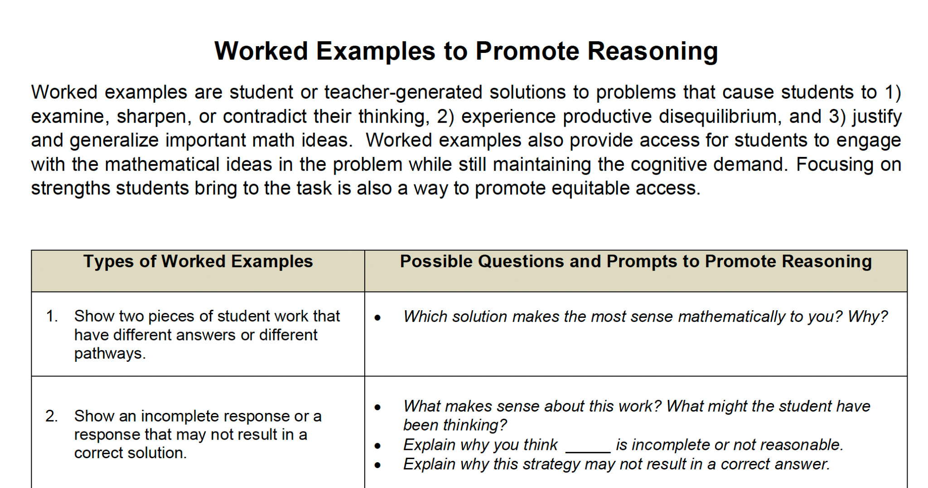
Using worked examples
A worked example involves developing student work for students to analyze that will promote students’ engagement in reasoning and meaningful discourse
A worked example includes:
1 or more pieces of student work/reasoning
A reasoning prompt that engages students in analyzing the work to make and/or justify conjectures related to your core math idea
A reflection prompt
(TDG, 2021)
Notes:
Facilitator Notes:
Orient participants toward what a worked example involves.
Have participants open 5 Worked Examples Reasoning Prompts_TDG

Slide 109
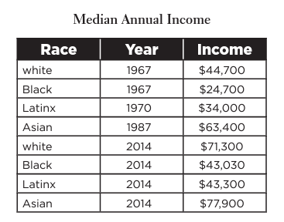
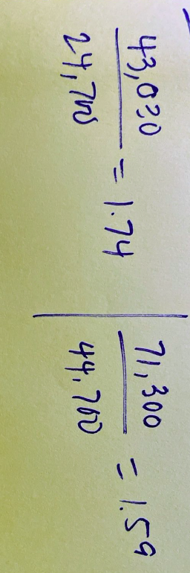
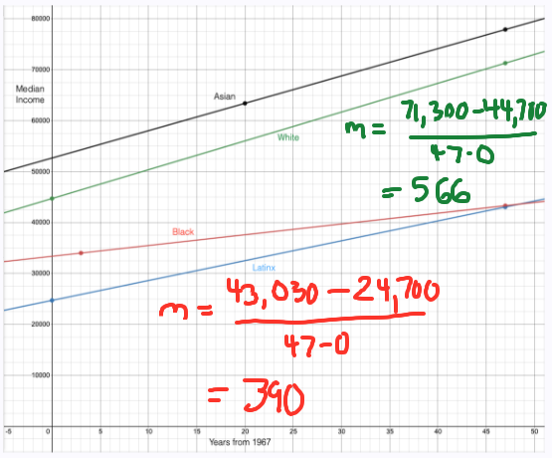
Worked example #1 (Median Annual Income)
What makes sense in each student’s reasoning and why?
Who do you agree with and why?
Determine whether the income gap between white and Black people is increasing, decreasing or staying the same.
Student A said that the gap in median income between white and Black people is decreasing because Black median income increased 74% between 1967 and 2014 and white median income only increased 59%.
Student B said that the gap in median income between white and Black people is increasing because the white median income gains more each year.
Notes:
Facilitator Notes:
Share worked examples participants have engaged in so far in the Ambitious Math Teaching Professional Learning Modules.
Worked example #1 was part of Session 1.

Slide 110
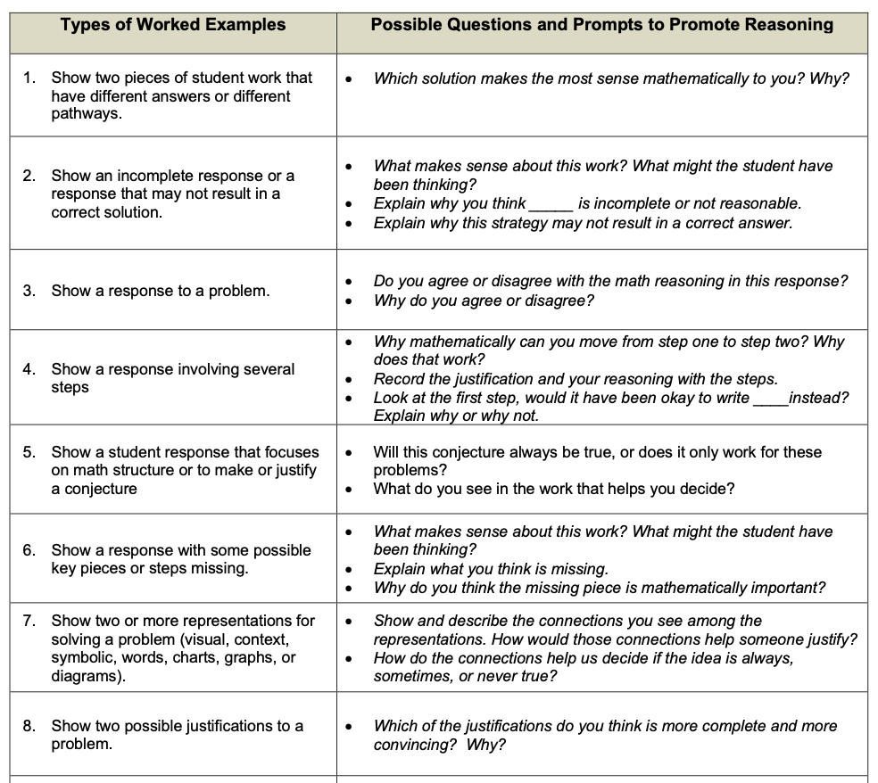
Worked Example (Median Annual Income) & Possible Outcomes
Worked example #1
(Median Annual Income)
(TDG, 2021)
Notes:
Facilitator Notes:
Support participants in making sense of what kind of worked example the Median Annual Income task represents on the 5 Worked Examples Reasoning Prompts_TDG resource.

Slide 111
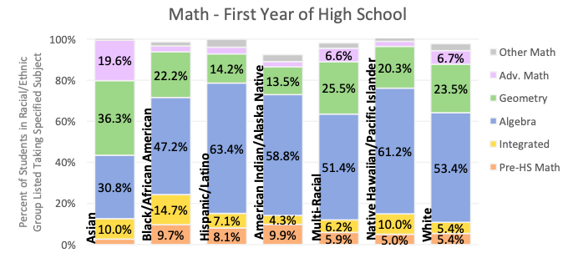
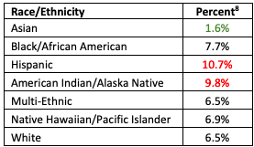
Worked example #2 (Patterns in First Year of HS)
Do you agree or disagree with the following students comments and why?
Student A: Took 6.5% of 53.4% and got 3.5% white students take Alg 1 as a freshman and repeat it. Then did 10.7% of 63.4% and got 6.8% Hispanic/Latino students take Alg 1 as a freshman and repeat it. Claim “If you are a Hispanic/Latino you are twice as likely to have to repeat Alg during their 2nd year of HS.”
Student B: In the second chart, all white sophomores (6.5%) who took algebra 1 as freshman and are now repeating algebra is a part of the 53.4% from the first chart. So 6.5% of the 53.4% of white students who took algebra the first year of high school.
Student C: About 14% more of Pacific Islanders are taking Alg 1 than Black/African Americans
Students in their second year of High School who were repeating Algebra
Notes:
Facilitator Notes:
Share another worked example participants have engaged in so far in the Ambitious Math Teaching Professional Learning Modules.
Worked example #2 was part of Session 3.

Slide 112
Worked Examples and Possible Outcomes
Worked example #1
(Median Annual Income)
Worked example #2
(Patterns in First Year of HS)
(TDG, 2021)
Notes:
Facilitator Notes:
Support participants in making sense of what kind of worked example the Patterns in First Year of HS task represents on the 5 Worked Examples Reasoning Prompts_TDG resource.

Slide 113

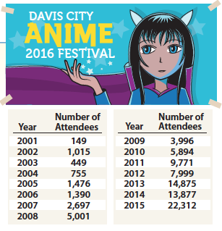
Worked example #3 (Davis City Anime Festival)
What do you notice?
What do you wonder?
Notes:
Facilitator Notes:
Share another worked example participants have engaged in so far in the Ambitious Math Teaching Professional Learning Modules.
Worked example #2 was part of Session 5.

Slide 114
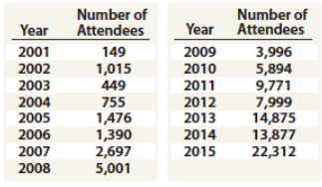
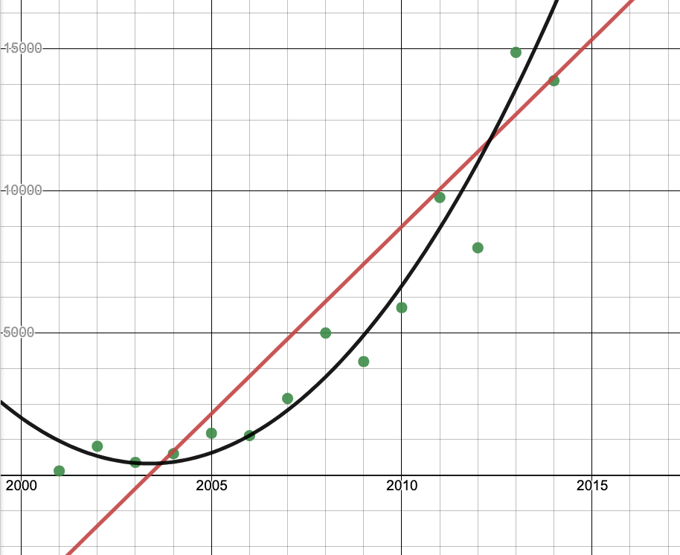
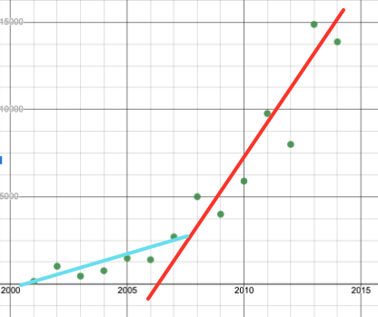
Worked example #3 (Davis City Anime Festival), continued
What makes sense about this work?
What is incomplete or not reasonable about this work?
Use connections to the graphs and the context to justify your claim.
Student A & B
Student C

Slide 115
(3) Worked Examples & Possible Outcomes
Worked example #1
(Median Annual Income)
Worked example #2
(Patterns in First Year of HS)
Worked example #3
(Davis City Anime Festival)
(TDG, 2021)
Notes:
Facilitator Notes:
Support participants in making sense of what kind of worked example this represents on the 5 Worked Examples Reasoning Prompts_TDG resource.

Slide 116
Worked Examples and Possibile Outcomes to Promote Reasoning
Read through the types of worked examples and possible questions and prompts to promote reasoning.
What is a noticing and/or a wondering you have?
Which one are you most interested in trying? Why?
(TDG, 2021)
Notes:
Facilitator Notes:
Give participants time to carefully read 5 Worked Examples Reasoning Prompts_TDG and consider the questions on the screen.
Raise key takeaways whole group.

Slide 117
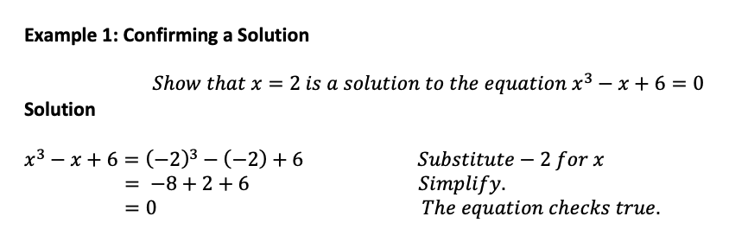
How is a worked example the same/different from the examples in many textbooks?
Notes:
Facilitator Notes:
Clarify the difference between a worked example and the examples of student work in many textbooks, like what we see here.

Slide 118
Benefits of worked examples
Using worked examples can support and improve both conceptual and procedural knowledge by supporting students in integrating new knowledge and ideas into what they already know and supporting students in making their reasoning explicit.
Research has found that the use of both correct and incorrect worked examples can improve student learning. Incorrect examples help students reason about the differences between them and the correct procedures, which can increase students’ conceptual and procedural knowledge
Studying a worked-out example, answering questions that require them to explain the problem to themselves, and then practicing a similar problems supports students in strengthening their understandings
(Mcginn et. al., 2015)
Notes:
Facilitator Notes:
Offer opportunities to engage with the slide, for example:
Asking a participant to read the slide aloud for the group
Asking participants to read the slide privately a second time
Asking participants to identify something that resonates about the ideas

Slide 119
Habit Activators:
Instructional activities to engage students in reasoning & sensemaking
Worked Examples: Using one or more pieces of student work/thinking with a reasoning prompt to engage students in analyzing the work. | True/False Discussions: What “false” conjecture might be productive for your students to explore? Consider conjectures that are partially true and/or lack precision. How will you engage students in exploring and refining the conjecture?
Why? Let’s Justify (Kazemi & Hintz, 2014): Identify/create a task where students will be asked to create a justification. How will you engage students in comparing their ideas with others, reflecting on their own work and then using those reflections to refine/add on to their thinking? | Connecting Representations (Kelemanik, Lucenta, & Creighton, 2016): Identify 3 pairs of representations (e.g. visual model with story context, symbolic expression with story context, etc). Decide which representation you will omit. Task is to have student match representations, using key structures they notice to justify their connections. Then to create the missing representation.
Notice and Wonder (Fetter, 2011): Find a place in the lesson/activity where students would benefit from recording some noticing and wonderings of a figure or worked problem - that they can use to access the task/activity and make/justify conjectures. | And many, many others!
Notes:
Facilitator Notes:
Re-orient participants toward worked examples as just one kind of “habit activator,” or instructional activity they can use to support students’ engagement in reasoning and sensemaking.
References for these instructional activities: Danielson, 2016; Fetter, 2011; Kazemi & Hintz, 2014; Kelemanik et al., 2016

Slide 120
Debrief: Principles of ambitious mathematics teaching
Which of these ideas are you thinking about in light of our work? What questions do you have?
“Ambitious teaching is teaching that deliberately aims for all students – across ethnic, racial, class, and gender categories – not only to acquire, but also to understand and use knowledge, and to use it to solve authentic problems.”
(Lampert & Graziani, 2009, p. 492)
Ambitious teaching:
Engages students in making sense of mathematical concepts
Centers students’ thinking and reasoning through discourse
Views students as capable of using their understandings and assets to solve authentic problems
Values students’ thinking, including emergent understanding and errors
Attends to student thinking in an equitable and responsive manner
(Anthony et al., 2015)
Notes:
Facilitator Notes:
Debrief “Connecting to Research” or “Planning for Action” through the lens of this definition from Lampert and Graziani (2009) and the five principles listed.
If you’re facilitating online, you might offer an opportunity to “stamp” the principles that are on participants’ minds and discuss trends or questions that emerge.
If you’re facilitating in person, you might offer a turn and talk so participants can discuss what principles are on their minds with a partner/group and then come back to share trends or questions that emerge.
[written reflection option]
References for these ideas: Anthony et al., 2015; Huinker & Bill, 2017; Lampert et al., 2011; Lampert & Graziani, 2009

Slide 121

Planning for action
Planning a worked example

Slide 122
Facilitator Guide: Planning for Action
Rationale for planning for action:
  To see connections to our contexts and goals (Putnam & Borko, 2000)
  To apply new ideas to upcoming work (Horn & Kane, 2015)
  To surface complexities when taking up new ideas
Recommendations for planning for action:
  Use teachers’ own curricular resources when possible
  Create space to discuss anticipated challenges and strategies for trying new ideas within those challenges
  Follow up on teachers’ plans; return to them to build on and refine ideas
Notes:
Planning for action involves making links between session content and our own practice and contexts.
Additional resources: If you’re interested in digging more into these ideas, check out these resources.
Module 0, Resource 2: Sometimes, planning conversations can surface unproductive ideas about particular students or student groups that circulate in our schools or broader contexts. This resource is designed to support leaders preparing for difficult conversations, especially when unproductive language about students emerges.
References
Horn, I. S., & Kane, B. D. (2015). Opportunities for professional learning in mathematics teacher workgroup conversations: Relationships to instructional expertise. Journal of the Learning Sciences, 24(3), 1–46.
Putnam, R. T., & Borko, H. (2000). What do new views of knowledge and thinking have to say about research on teacher learning? Educational Researcher, 29(1), 4-15.

Slide 123
Creating a worked example
Choose the problem that you are most interested in building a worked example. (Reminder: Our goals for building a worked example are to raise the cognitive demand of the task and give students access to the mathematics.
Use a representation to solve the system of linear equations: -x – 2y = -20 and y = x²
Use what you know about equations to solve 3 – 3x > 9
Create two examples of student thinking, and choose a prompt (from the worked example sheet) that you would use.

Slide 124
Small Group Activity
Directions: Use the workspace slide to create a worked example.
Notes:
Facilitator Notes:
Give directions and have them work in small groups for ~10 minutes.
Aspects of small group directions you might consider:
It may be helpful to specify roles for participants in the small groups. For example, you might:
Specify who will go first and in what order participants will share. For example, in a virtual session, you might say, “The second person who enters the breakout room will share first, and sharing will move counterclockwise until everyone has shared.”
Specify who will record. For example, in a virtual session, you might say, “The first person who enters the breakout room will be the recorder and jot down ideas from the group onto the workspace slide.
Specify who will keep time. For example, in a virtual session, you might say, “The third person will be the time keeper and let each team member know if airtime goes over a minute and how much time is left.”
It may be helpful to specify where participants will record and show them how to access it. As we have suggested, you might have an assigned Google Slide for each group which is a copy of this activity’s workspace slide.
It may be helpful to specify how much time participants will have in their small group.
It may be helpful to preview what their workspace will look like (e.g., share the next slide).

Slide 125
Preview of Workspace Slide
Select one task and delete the other:
Use a representation to solve the system of linear equations: -x – 2y = -20 and y = x²
Use what you know about equations to solve 3 – 3x > 9
Student A
Student B
Reasoning prompt:

Slide 126
Debrief: Principles of ambitious mathematics teaching
Which of these ideas are you thinking about in light of our work? What questions do you have?
“Ambitious teaching is teaching that deliberately aims for all students – across ethnic, racial, class, and gender categories – not only to acquire, but also to understand and use knowledge, and to use it to solve authentic problems.”
(Lampert & Graziani, 2009, p. 492)
Ambitious teaching:
Engages students in making sense of mathematical concepts
Centers students’ thinking and reasoning through discourse
Views students as capable of using their understandings and assets to solve authentic problems
Values students’ thinking, including emergent understanding and errors
Attends to student thinking in an equitable and responsive manner
(Anthony et al., 2015)
Notes:
Facilitator Notes:
Debrief “Connecting to Research” or “Planning for Action” through the lens of this definition from Lampert and Graziani (2009) and the five principles listed.
If you’re facilitating online, you might offer an opportunity to “stamp” the principles that are on participants’ minds and discuss trends or questions that emerge.
If you’re facilitating in person, you might offer a turn and talk so participants can discuss what principles are on their minds with a partner/group and then come back to share trends or questions that emerge.
[written reflection option]
References for these ideas: Anthony et al., 2015; Huinker & Bill, 2017; Lampert et al., 2011; Lampert & Graziani, 2009

Slide 127
Debriefing Session 9
Reflecting on our work in the activities in the session

Slide 128
Debriefing Session 9: Four cornerstone principles of the OMP
What connections do you see between any of the cornerstones and our work in this session?
Focus: Learning experiences in every grade and course are focused on core mathematical content and practices that progress purposefully across grade levels.
Engagement: Mathematical learning happens in environments that motivate all students to engage with relevant and meaningful issues in the world around them.
Pathways: All students are equipped with the mathematical knowledge and skills necessary to identify and productively pursue any postsecondary paths in their future. Students have agency to choose from a variety of courses, contexts, and applications they find relevant.
Belonging: Participation in mathematical learning builds students’ identities as capable math learners and fosters a positive self-concept. Students’ cultural and linguistic assets are valued in ways that contribute to a sense of belonging to a community of learners.
Any proposed instructional approach, curricular change, or system design element should be evaluated by the degree to which it builds on these four cornerstones. When new approaches are built within the framework of all four-cornerstone principles, we will be on our way to engineering a reimagined system.
(ODE, 2022)
Notes:
Facilitator Notes:
Option 1: Debrief the session through the lens of the four cornerstone principles of the Oregon Mathematics Project.

Slide 129
Debriefing Session 9: Focus of the session
What new insights do you have related to how a task using worked examples can support students’ reasoning and sensemaking?
Take a couple of minutes to reflect on our work in the session.
Activities in this session:
Setting and maintaining norms: Reconnect with and revise our norms for interacting together
Connecting to research: The potential of worked examples to support reasoning and sensemaking
Planning for action: Preparing a worked example to rehearse
Notes:
Facilitator Notes:
Option 2: Debrief the session through the lens of the focus of the session.
Module 2 Part 1 especially supports our thinking around the first essential question of this module: What does ambitious math instruction look like at the unit, lesson, and task levels?
The focus of this session in particular is to consider how a task using worked examples can support students’ reasoning and sensemaking.
You might offer participants time to think individually about new insights before sharing aloud.

Slide 130
Debriefing Module 2 Part 1
Reflecting on our work in Sessions 7 – 9

Slide 131
Debriefing Module 2 Part 1: Important moments
Record important moments that impacted your thinking about what ambitious math teaching looks like at the task level.
Examples of important moments:
AHA! moments you experienced
Changes in your thinking
WOW! ideas that you hadn’t considered before
Contradictions to or affirmations of prior understandings

Slide 132
Debriefing Module 2 Part 1: Important moments
Take 5 minutes to refine the ideas you jotted.
Synthesize your important moments from Module 2 Part 1.
Based on the work and discussions in these sessions, what ideas do you have for how you will implement your learning?
What else, if anything, would you like to share with the facilitator?
Notes:
Facilitator Notes:
You might pose these questions in the form of a survey or exit card.

Slide 133
Acknowledgements
These Ambitious Teaching Modules exist because of the vision and hard work of a team led by the creative vision, development, and design offered by Kathy Pfaendler and Julie Fredericks, Math Professional Learning Specialists, Teachers Development Group, Cathy Martin, Denver, CO, Taylor Stafford, University of Washington, and Hannah Nieman, University of Washington. Their efforts were supported by the ongoing input and feedback of the entire staff of Teachers Development Group (TDG). These Modules, like all professional learning materials produced by our organization, are based on the collective knowledge, expertise, and ongoing learning of TDG’S Math Professional Learning Specialists and the teachers and leaders with whom we work. Thanks also go to Mark Freed, and Kama Almasi, Oregon Department of Education, and Rebekah Elliott, Oregon State University, who offered vision and feedback throughout the development and design process. Special thanks go to Sophia Vazquez, University of Washington, who did the accessibility formatting of these Modules.
Ruth Heaton, CEO, Teachers Development Group

Slide 134
Resources & Partners

