Slide 1




WHY NO PHONES
What Students Across Oregon Are Saying
Fall 2026

Slide 2

THIS ISN'T JUST OUR SCHOOL
Governor Kotek required every Oregon public school to restrict phone use during the school day based on a growing body of research.
Executive Order (EO) 25-09 was issued in July 2025.
Oregon is among 39 U.S. states and countries around the world making this move.
The Personal Electronic Device (PED) policy was designed to support students, not punish them.
The goal is to help reduce the constant pull
of notifications and social media competing for your attention during important learning time.

Slide 3

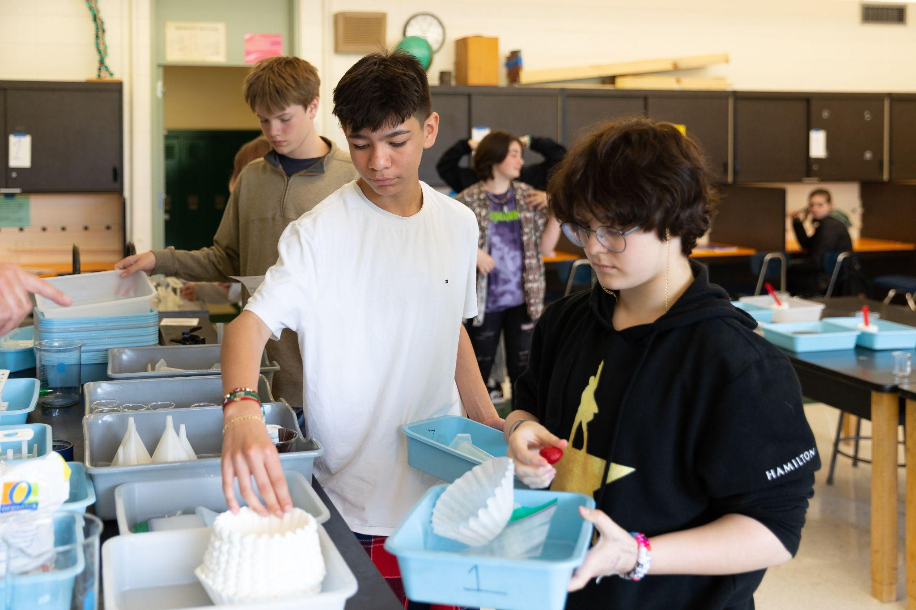

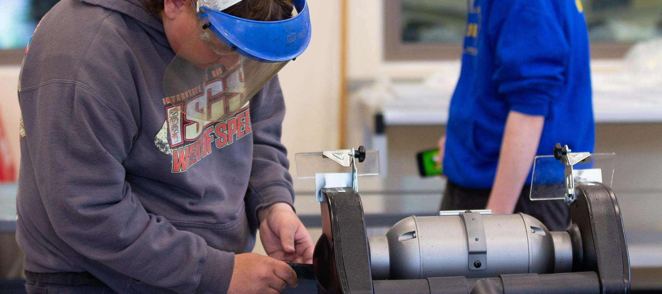
YOUR BRAIN ON YOUR PHONE
Research shows the mere presence of a phone drains cognitive resources.
Social media
can be addicting
Increased risk to
your mental health
Cell phones can limit your capacity for learning
Apps are designed to keep you hooked and social media platforms use the same psychological hooks found in gambling.
Excessive use is linked to anxiety, depression, and
reduced attention.
Even having your phone nearby – without using it – reduces your brain's available capacity for learning.

Slide 4

ODE ASKED
Over 6,000 Oregon students responded
ODE surveyed MS & HS students in spring 2025-26. Results were honest and mixed, and schools are working hard to improve PED policy implementation.
Over 6,000 students across 76 districts told us what's working, what's not, and what needs to change.
ODE also collaborated with Oregon’s Youth Advisory Council (YAC) to get their insight and input into EO and PED policy implementation.
Students recognized real benefits like less harassment and more face-to-face interaction, while also reporting stress, especially high schoolers managing jobs and family communication. Both can be true.

Slide 5

What's Working
Students and teachers both saw a difference early on. ODE heard from school staff and students across Oregon, including:
Less social media harassment and cyberbullying, more real conversations, louder cafeterias and hallways ← In a good way!
56% of educators surveyed confirmed reduced distractions, 52% confirmed improved social interactions among students.
One YAC student noted the increased interaction benefits students who were already social, while quieter students maybe haven't changed much.

Slide 6

What Needs to Improve
The number one finding was that schools communicated rules but never explained the purpose.
Students said: ‘Tell us WHY, not just the rules.’
Students want enforcement to be fair and consistent across every classroom.
They know exactly which teachers enforce the PED policy and which don't.
Students also described enforcement applied more aggressively toward students already on staff radar for behavioral concerns.

Slide 7

Why This Matters For You Right Now
Your brain is still building the skills you'll use forever: focus, communication, emotional regulation. This policy protects that development.
Middle and high school years are critical for developing sustained attention and face-to-face communication skills.
This isn't about adults thinking you can't handle your phone.
It's about creating space where technology designed to capture your attention isn't competing with your personal growth and learning.

Slide 8

It Gets Easier
The transition is the hardest part. Student survey data shows that students in schools with PED policies in place longer expressed the least concern overall.
Students who lived under a phone policy for a full year or longer said it feels normal.
YAC students believe this will benefit future generations of students and expressed genuine long-term optimism.
ODE will survey students again in Years 2 and 3 to track change and keep student voice central.

Slide 9
Let's Talk About It
Your perspective matters!
What questions do you have?
What's working at our school?
What would you change?
Student discussion notes here.
Student discussion notes here.
Student discussion notes here.
Notes:
DISCUSSION NOTES: Leave at least 10 to 15 minutes for open discussion. The brief's central finding is that students want to be part of the conversation, not just told rules. This is where that happens. Listen more than you talk.
Bullets on slide are left empty for you to type in notes on student discussion.

