Slide 1
CTE Revitalization Grant 2023-25
Technical Assistance Webinar #3 – Wednesday, October 25, 2023 | 3:00-4:00 p.m.
Building Your CTE Revitalization Application
CTE and Equity, Reporting, and Budgeting
This session will be recorded.
Notes:
Gabby

Slide 2
Welcome
Please introduce yourself in the chat-
Name, school, and what you are thinking of doing with CTE Revit Funds for 2023-2025

Slide 3
RFA Overview
2023-2025 CTE Revitalization Grant
  CTE Revitalization Grant website
  RFA/Request for Application
  Deadline for submission: Monday, November 6, 2023 | 5:00 p.m. PST
Focus
  Create a new CTE Program of Study or revitalize/evolve an existing program
Eligibility
  public school district; Education Service District (ESD); public school; public charter school or combination (in Oregon)
Support
  Technical Assistance Webinars
  CTE Revit Team email

Slide 4
CTE and Equity

Slide 5
ODE Education Equity Stance
Education equity is the equitable implementation of policy, practices, procedures, and legislation that translates into resource allocation, education rigor, and opportunities for historically and currently marginalized youth, students, and families including civil rights protected classes. This means the restructuring and dismantling of systems and institutions that create the dichotomy of beneficiaries and the oppressed and marginalized.

Slide 6
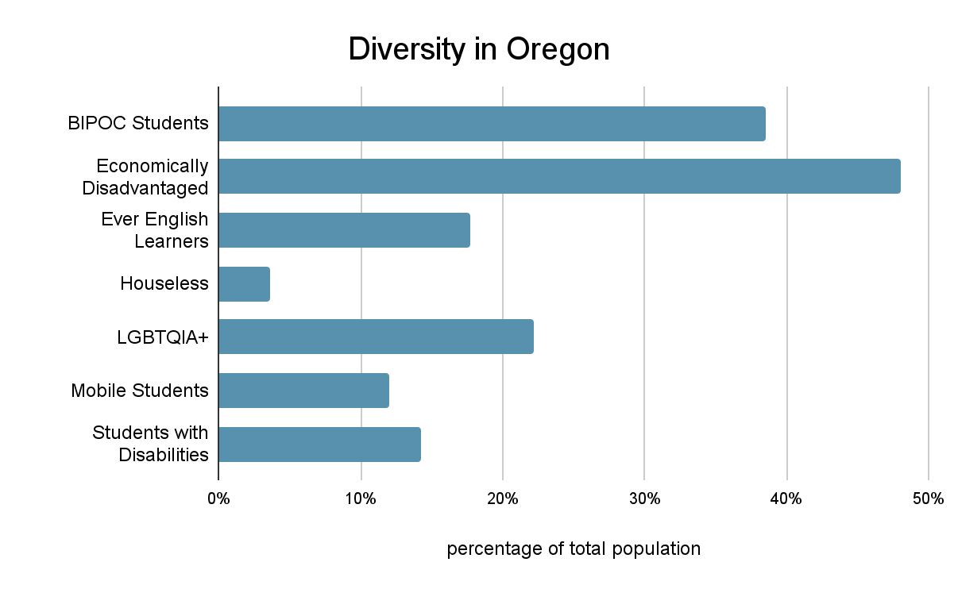
Diversity in Oregon
Notes:
Data from 2021

Slide 7
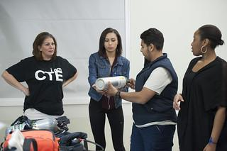
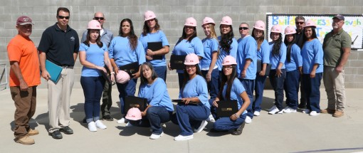
Most Pivotal Question
How will this project increase participation, support, and retention of historically and currently marginalized students in your community?

Slide 8
Matching Demographic Data with Outcomes
Enrollment in CTE compared to Total Population
90% reports
Work-Based Learning reports
Needs Assessments

Slide 9
Measuring Student Impact
Successful applicants will demonstrate their understanding of the local community by aligning demographic data with project outcomes, including a method for measuring and reporting student impact.
Identify the specific activities within this project that are intended to recruit historically and currently marginalized students.
Identify specific activities within this project that are intended to provide support of historically and currently marginalized students.
Identify specific activities within this project that are intended to help retain historically and currently marginalized students.

Slide 10
Examples of Specific Activities for Recruitment
Your district might choose to offer a job fair that highlights employers of color, or employers with disabilities.
Your district includes interpreters for the languages of your community in informational meetings.
Any recruitment materials are offered in languages of the community and feature pictures of diverse populations.

Slide 11
Samples of Specific Activities to Provide Support
Your district seeks information from the community to understand student needs and provide the necessary supports.
  Surveys
  Parent meetings
  Advisories
  Focus groups
School counselors discuss with students any strengths or weaknesses of current CTE programming.

Slide 12
Suggested Retention Strategies
Examine scheduling practices to ensure access for all courses.
Provide culturally responsive training for CTE teachers and counselors.
Examine monetary barriers for access.
Continue to listen to students and community about needs.

Slide 13
Reporting Process
Notes:
Linda

Slide 14
Reporting Timeline
Update #1 due May 24, 2024
Update #2 due September 27, 2024
Update #3 due December 18, 2024
Update #4 due March 31, 2025
Final Update due October 10, 2025
All CTE Revitalization Grant funds must be expended and goods delivered by June 30, 2025.
Notes:
Linda

Slide 15
Reporting Topics
Partnerships
Project Progress
Activities
Successes
Challenges
Student Engagement
Questions for ODE
Photos/Press Clippings/etc.
Notes:
Linda

Slide 16
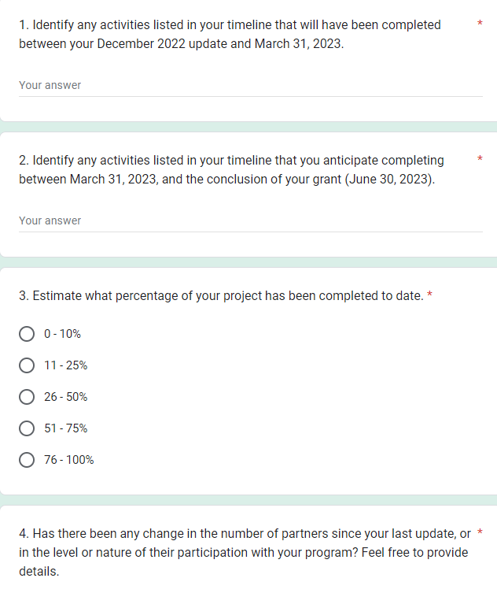
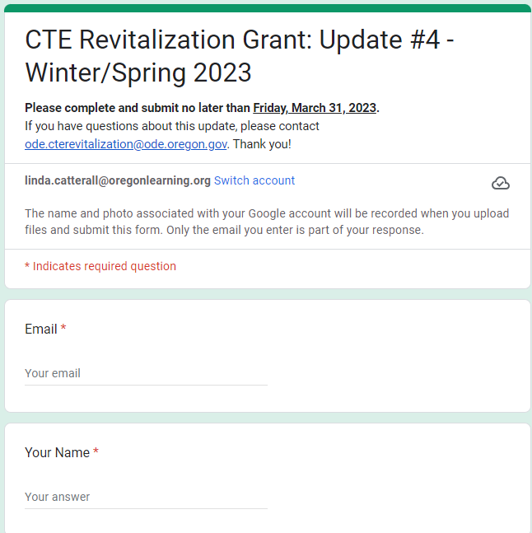
Update Form Sample

Slide 17
Budgeting
Notes:
Linda

Slide 18
Budget Worksheet
Required, but will not be scored separately
Adds context for reviews and aids in understanding
Matching funds not required, but are considered as an indicator of partner support
Braiding funds: Student Success Act, High School Success, other funds
Think about sustainability when building the grant concept

Slide 19
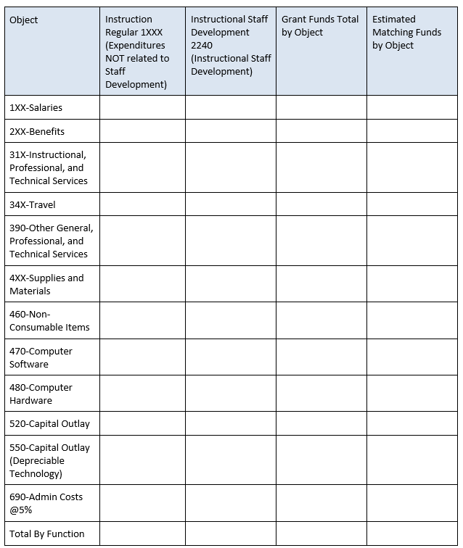
Budget Worksheet Image

Slide 20
Budget Narrative
Literally, the story behind the numbers
Links costs and investments to the proposed activities and outcomes
  Examples: equipment and improvements, professional and technical services, supplies and materials, curricula, staff expenses

Slide 21
Budget: Infrastructure Costs
For infrastructure projects, please provide evidence that the budget narrative has been reviewed by appropriate fiscal staff or contractors
Official bids are not required, BUT do your homework

Slide 22
Budget: Required Meeting
One required meeting: February 7, 2024
  Grant team (minimum of two individuals) must attend
  Currently virtual
  If held in person, Revit funds may be used to defray associated costs

Slide 23
Application Deadline
Application Submission Deadline:
Monday, November 6, 2023
No later than 5:00 p.m. PST
Notes:
Linda

Slide 24
Upcoming Webinar
Wednesday, November 1 3-4pm
Office Hours for Applicants
Notes:
Linda

Slide 25
Contact Information
Contact the CTE Revit Grant Team:
Dan Findley | KC Andrew | Linda Catterall
ode.cterevitalization@ode.oregon.gov
Notes:
Linda

Slide 26

Questions
Notes:
Linda

