Slide 1

Retrospective on Oregon CTE State Plan

Slide 2
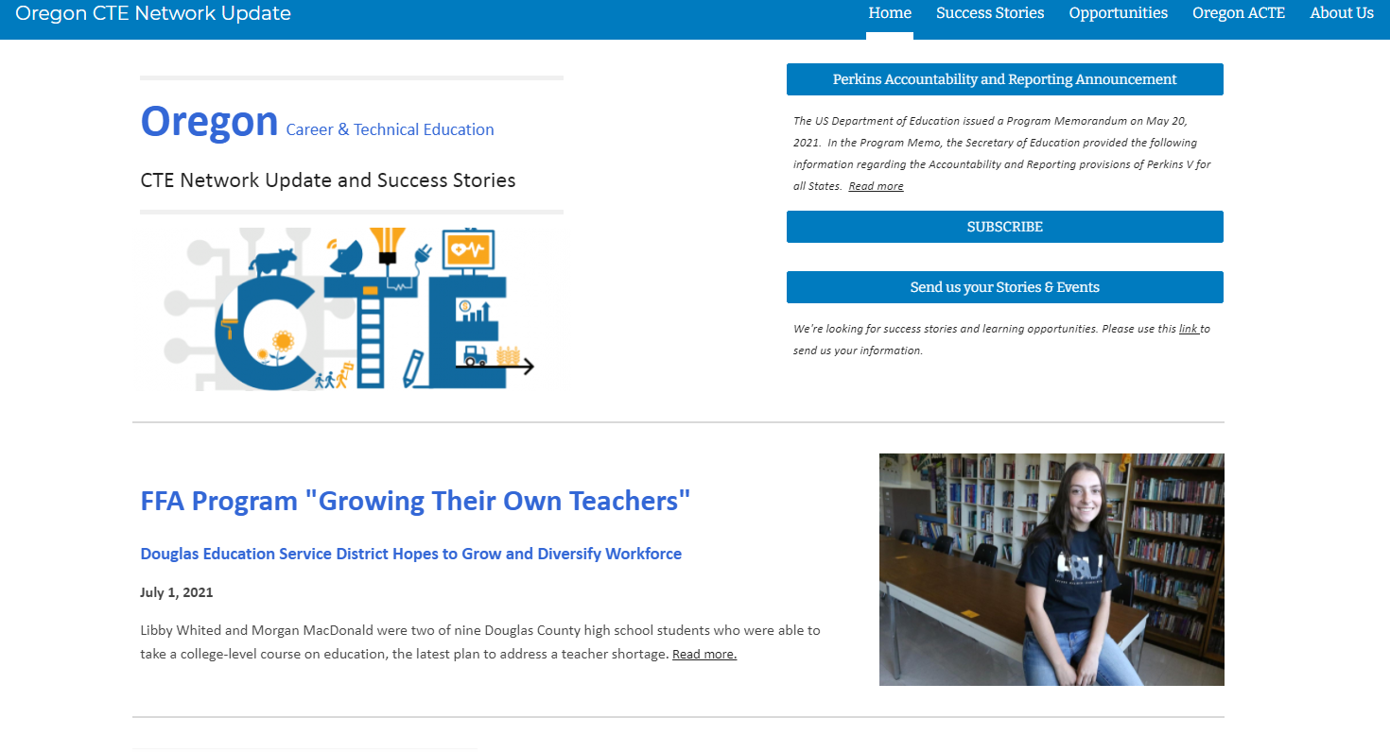
Oregon CTE Network Update
Notes:
https://sites.google.com/oregonlearning.org/cte-network-update/home - landing page to subscribe
https://sites.google.com/oregonlearning.org/cte-network-update/success-stories - success stories tab.

Slide 3





The Power of CTE
25% more likely to graduate
Higher attendance rates
Equally likely to attend college
Earn higher income
Notes:
REL Research on CTE Impacts

Slide 4
ReVision of CTE in Oregon
What role does CTE programs, career exploration and career guidance play in our society?
How are our students prepared for the realities of our Oregon economy and community?
What will career, college, and community readiness mean for students starting middle school this year?
How do we leverage education to build a more just and equitable economy?

Slide 5
ReVision to Vision of CTE In Oregon
Reimagine and transform learner experiences in order to
enhance their future prospects,
empower their communities, and
build equity in an inclusive, sustainable, innovation-based economy.

Slide 6
Oregon’s CTE State Plan
4 YEARS
Expand transparency and the voices contributing to our career preparation system
Increase equitable access and inclusion in high quality CTE and career connected learning activities.
Integrate Career Connected Learning more centrally in Oregon’s schools.

Slide 7
Oregon’s CTE State Plan Priorities
Oregon’s CTE State Plan
Data Literacy and Accountability
Educator Recruitment and Retention
Flexible Learning
Systems
Career Connected Learning
Equity and Civil Rights
High Quality Programs of Study

Slide 8
Equity & Access - Goals
Goal 1: Methods of Administration (MOA) State Plan Implementation
Goal 2: Center on equity in rule-making, budgeting, and resources allocation
Goal 3: Pursue meaningful collaboration with communities and students to provide comprehensive outreach and communication for those who are impacted by decisions regarding Career and Technical Education
Goal 4: Provide professional development and technical assistance on culturally responsive teaching and creating inclusive and welcoming CTE programs

Slide 9
CTE Statewide Advisory/Steering Committee
Building Diverse Inclusive Partnerships:
Twenty-one Standing Members
33% identify other than white
3 members have English as a second language
LGTBQ+ representation
Exofficio members from: BOLI, HECC, Workforce and Talent Development Board,Employment, HSS, STEM Network

Slide 10
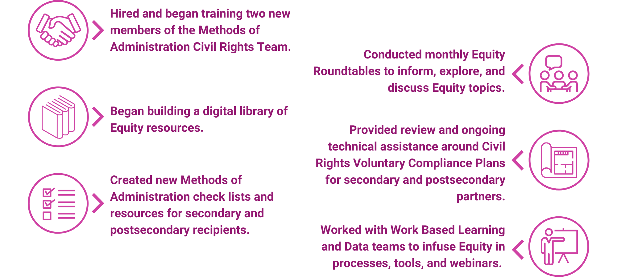
Equity & Access - Highlights

Slide 11
Oregon’s CTE State Plan
4 YEARS
Expand transparency and the voices contributing to our career preparation system
Increase equitable access and inclusion in high quality CTE and career connected learning activities.
Integrate Career Connected Learning more centrally in Oregon’s schools.
Notes:
I have provide a few examples of how we have approached increased access and inclusion as well as expanding transparency of our work. The third big bucket of work involves the integration of career connected learning - this is a big shift and a big lift in our work and has the potential to positively impact all students.

Slide 12
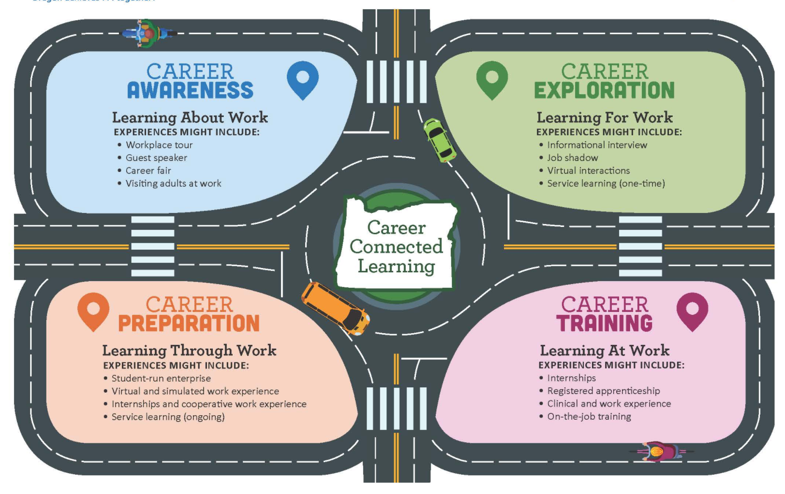
Career Awareness, Exploration, Preparation, Training
Career Awareness, Exploration, Preparation and Training

Slide 13

Career Connected Learning
Career Exploration Expansion - Goals
Goal 1 – Provide learners with career experiences earlier in secondary grades.
Goal 2 – Develop systems and support for Oregon career education for all learners.
Goal 3 – Build a scope and sequence for career exploration and development, map resources and assets, and integrate with comprehensive counseling programs and community college guided pathways.
Goal 4 – Provide all learners with CCL opportunities and supports to enter career pathways

Slide 14
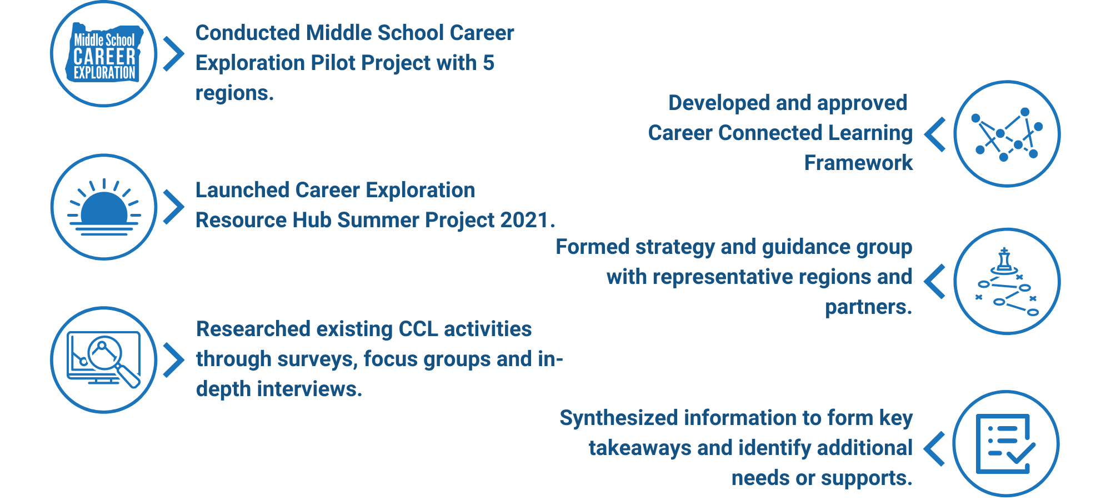
Career Connected Learning
Career Exploration Expansion - Highlights

Slide 15
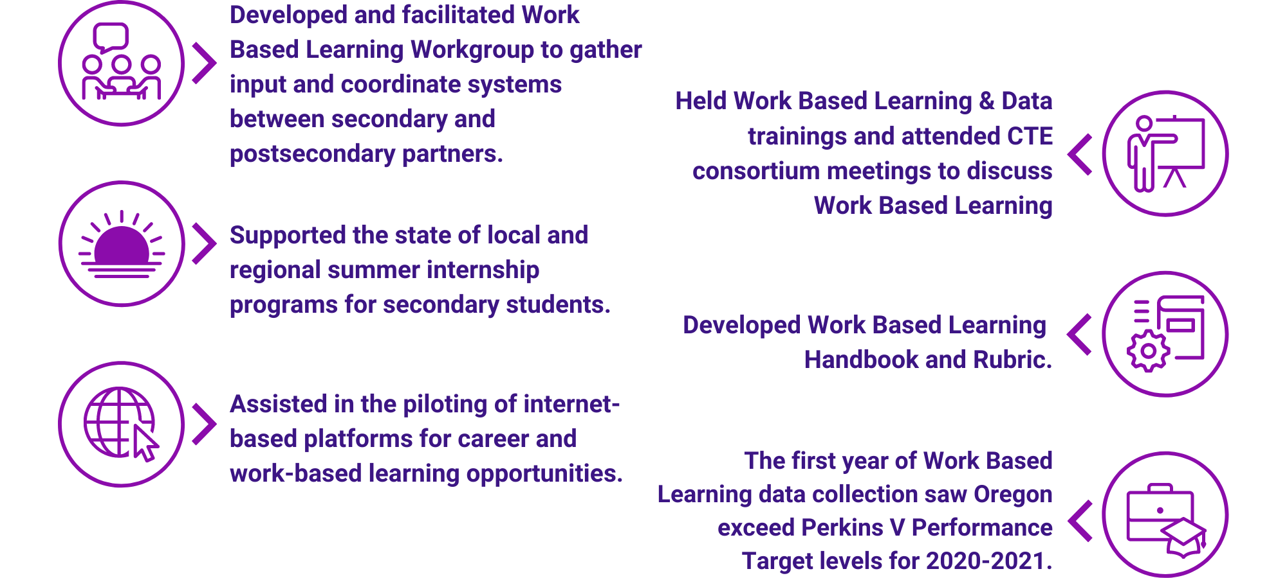
Career Connected Learning
Work Based Learning - Highlights

Slide 16
Oregon’s CTE State Plan (cont.)
4 YEARS
Expand transparency and the voices contributing to our career preparation system
Increase equitable access and inclusion in high quality CTE and career connected learning activities.
Integrate Career Connected Learning more centrally in Oregon’s schools.

Slide 17
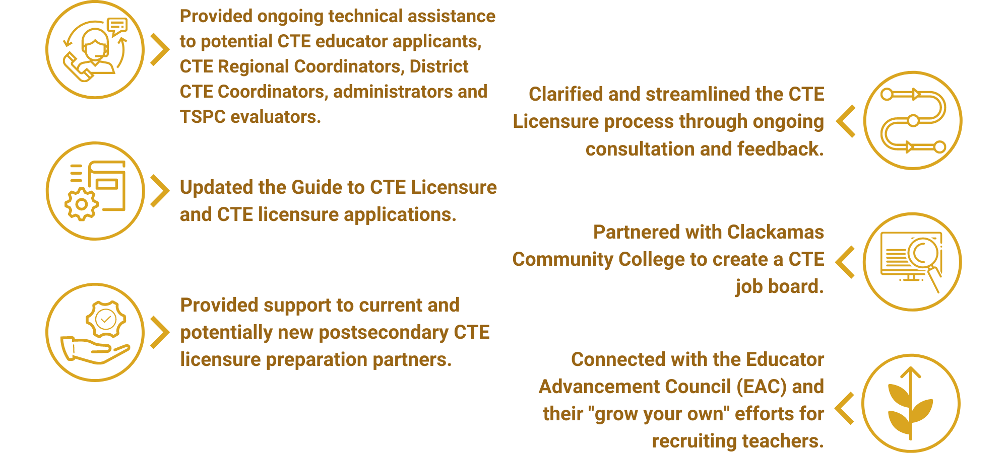
Educator Recruitment, Retention, & Training - Highlights

Slide 18
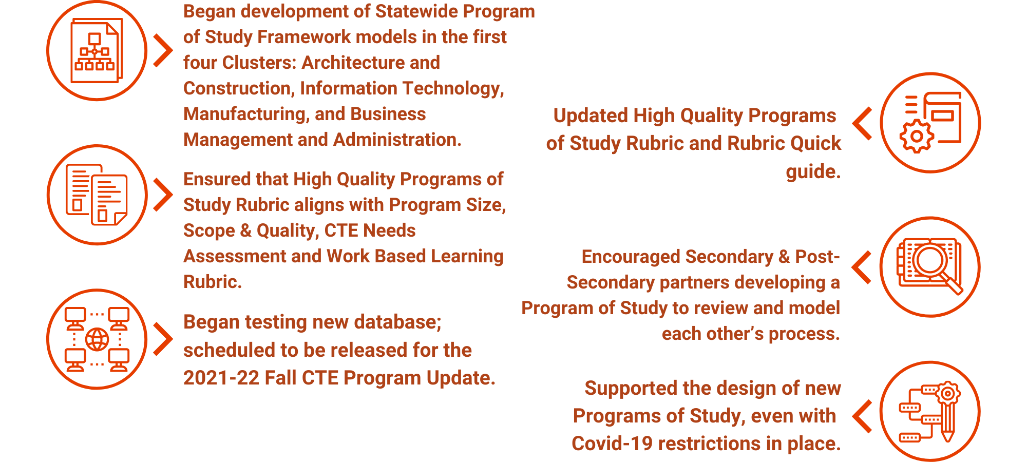
High Quality Programs of Study - Highlights

Slide 19
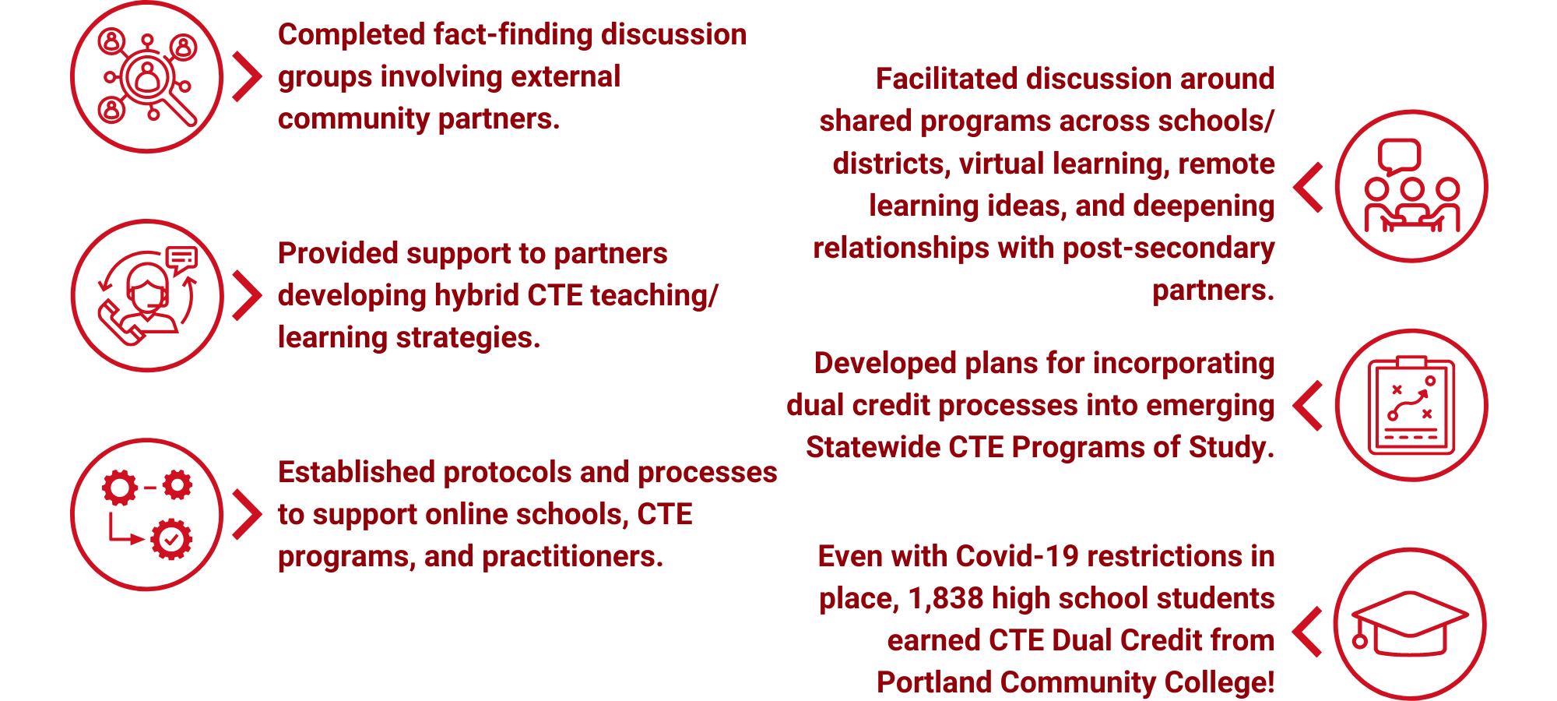
Flexible Learning - Highlights

Slide 20
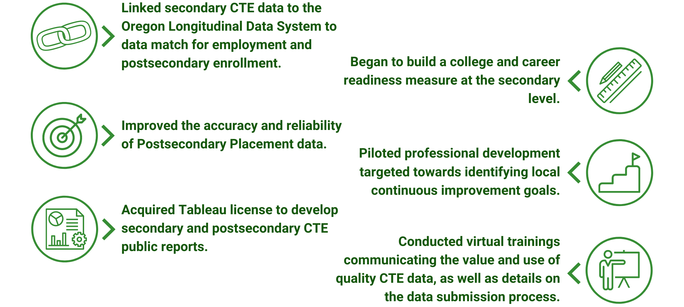
Data Literacy & Accountability - Highlights

Slide 21
Ongoing Structural/Awareness Challenges
Regional Structure and Funding for Regional Leadership
Awareness and understanding of CTE
Integration of CTE/career explorations into schools
Supporting Administrators and Counselors in building/integrating role of CTE in school systems
Creating accessible, welcoming, inclusive, antiracist CTE programs
Integration of CTE/Education in larger workforce development ecosystem

Slide 22
CTE High Impact Strategy
4 YEARS
Expand Transparency and Ownership
Increase Access and Inclusion
Integrate Career Learning

Slide 23


Slide 24
Resources to Learn More About CTE
State Plan Accomplishments: Year One
CTE Policy Guidebook; Everything you need to know and more
Oregon’s CTE State Plan
CTE Data Dashboard
SPST Equity Decision Making Process
CTE State Plan - Year One Highlights State and Local
REL Research on CTE Impacts

