Slide 1
CTE Revitalization Grant - Final Checks and Updates During this webinar…
Please mute any microphones or phones
A copy of the RFP and these slides is available on the CTE Revitalization Webpage: http://www.oregon.gov/ode/learning-options/CTE/statefund/Pages/CTE-Revitalization-Grant.aspx
Submit all questions through the question feature.
We will answer as may questions as possible at the end of the presentation.

Slide 2
CTE Revitalization Grant
Final Checks and Updates
October 4, 2017

Slide 3
During this webinar…
Review Submission Requirements
How to Compress a File
How to Use Secure File Transfer (SFT)
Demo on Using SFT
Final Questions from YOU!

Slide 4

Submission Reminders

Slide 5
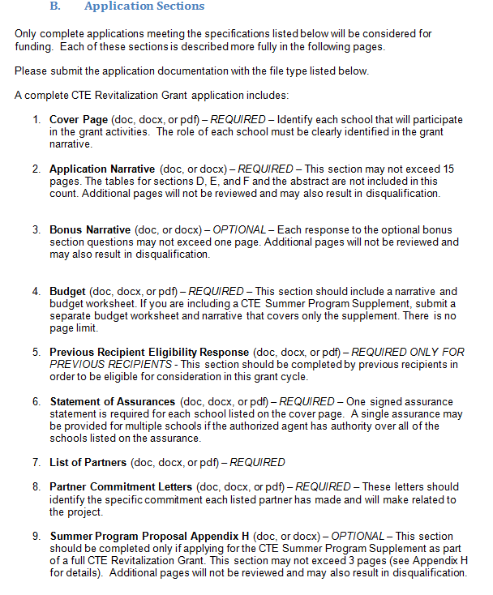
Application Sections
Required Submission
p. 13

Slide 6
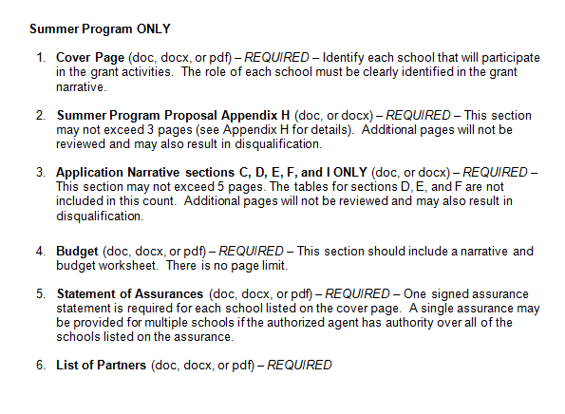
Summer Program Only
Required Submission
p. 14

Slide 7
Format and Submission (p. 15)
Format
12 point font
Double spaced
1 inch margins
Numbered pages
Include the eligible agency in all file names
Submit all documents through Secure File Transfer (SFT) ONLY
Secure File Transfer – REQUIRED
October 15, 2017 by 11:59 pm
Technical Assistance for Upload
October 13, 2017 by 5:00 pm

Slide 8

Compressing Files
Compressing Files

Slide 9
Compressed (ZIP) Files
Take up less storage space
Transfer more quickly
Behave just like uncompressed files/folders
Simplifies transfer – usually in single file
Notes:
Compressed files take up less storage space and can be transferred to other computers more quickly than uncompressed files. You can work with compressed files and folders in the same way that you work with uncompressed files and folders. You can also combine several files into a single compressed folder, making it easier to share a group of files, since you only need to attach one folder to an e‑mail message instead of several files.

Slide 10
How to Zip a File Folder - PC
Move all documents into a single folder “Agency_Grant Name”
AllOregonESD_AgStars
FirstSD_HealthCare
Organize them in the folder – match to submission requirement
Right Click on the folder
Send to
Compressed (Zipped) Folder
Compressed folder
.zip
Notes:
If long grant name, can abreviate but fiscal agent goes first!

Slide 11
How to Zip a File Folder - MAC
Move all documents into a single folder – “Agency_Grant Name”
AllOregonESD_AgStars
FirstSD_HealthCare
Organize them in the folder – match to submission requirement
“Right Click” on the folder
Select Compress “folder name will appear”
Compressed folder appears
.zip

Slide 12
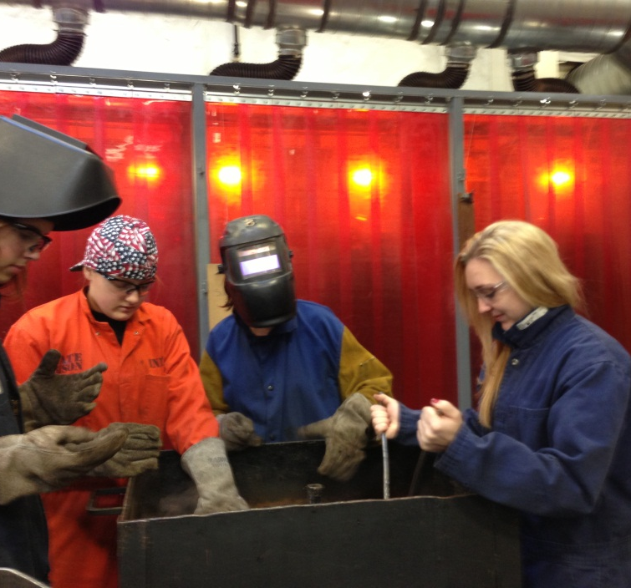
Secure File Trnafer
Secure File Transfer

Slide 13
What is Secure File Transfer (SFT)?
Used to transfer files from one computer to another
Encrypted
Able to move LARGE files

Slide 14
Secure File Transfer (SFT)
Go to “District” website
https://district.ode.state.or.us/home/
Do not need user name/password
Click on Secure File Transfer
(located on right side under Quick Links)

Slide 15
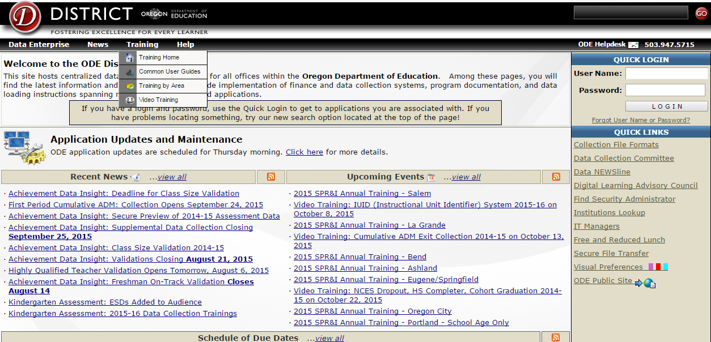
District web page capture
https://district.ode.state.or.us/home/

Slide 16
Secure File Transfer(SFT)
Who Receives the File?
ode.cterevitalization@ode.state.or.us
Who is Sending the File?
Locate your file and SEND
ZIP it!!
Enter message

Slide 17
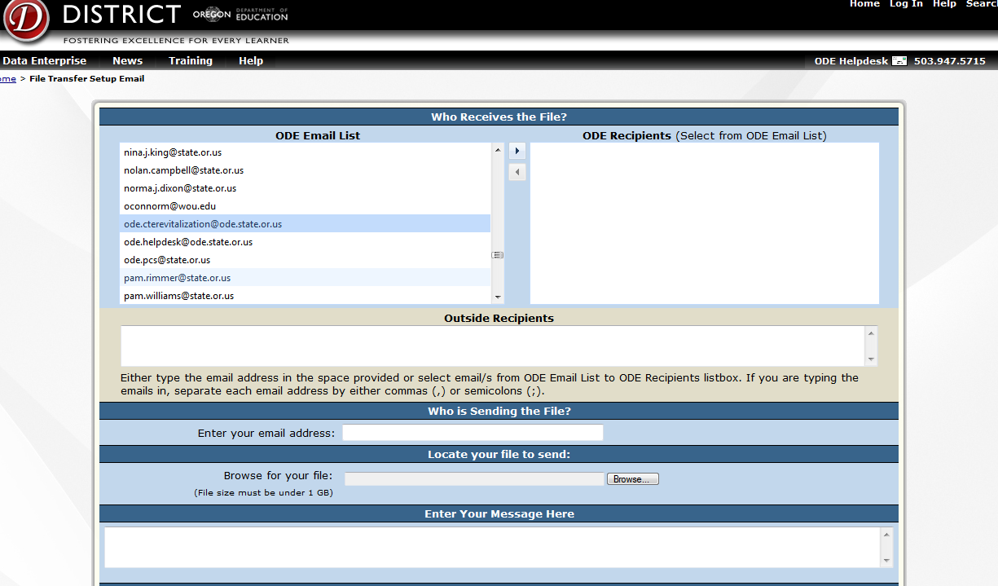
Secure file transfer page capture
Let’s Practice…..

Slide 18
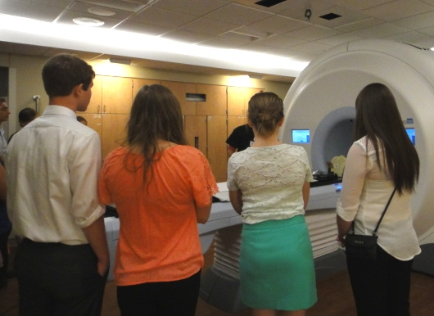
Help with secure file transfer
HELP with Secure File Transfer…
ODE Helpdesk
Mon to Fri
503-947-5715
Ode.helpdesk@ode.state.or.us

Slide 19
One last note…
Keep the receipt!

Slide 20
One more last, last note…
Don’t wait until the last minute to use SFT!
Give yourself time to work out any glitches.

Slide 21
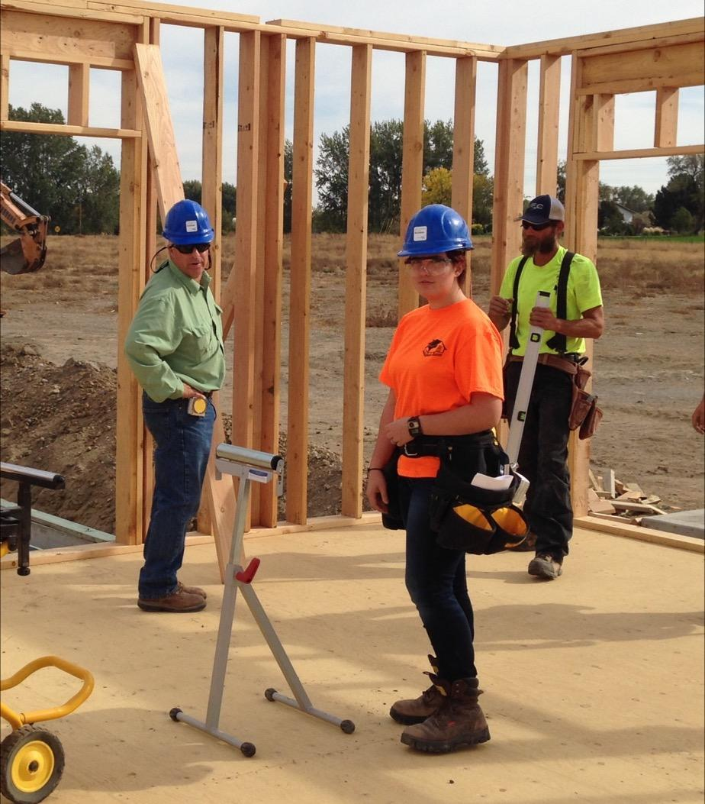
Final Questions

