Slide 1
Change in the Number of Programs by County
(July 2017 – July 2019)

Slide 2
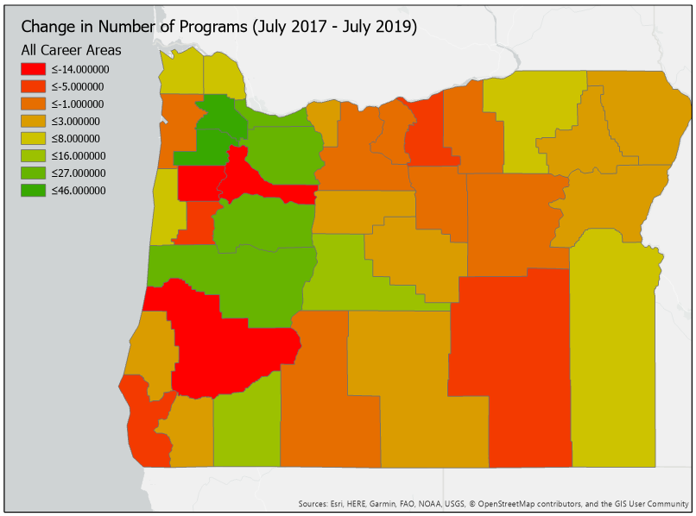
fdsdf
< -14
< -5
< -1
< 3
< 8
< 16
< 27
< 46
CTE Programs

Slide 3
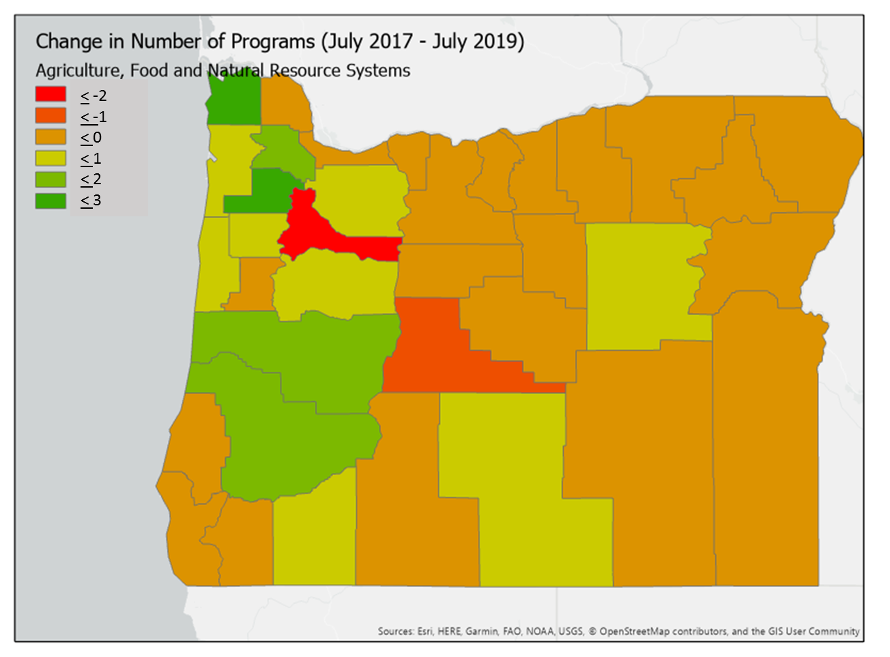
sdf

Slide 4
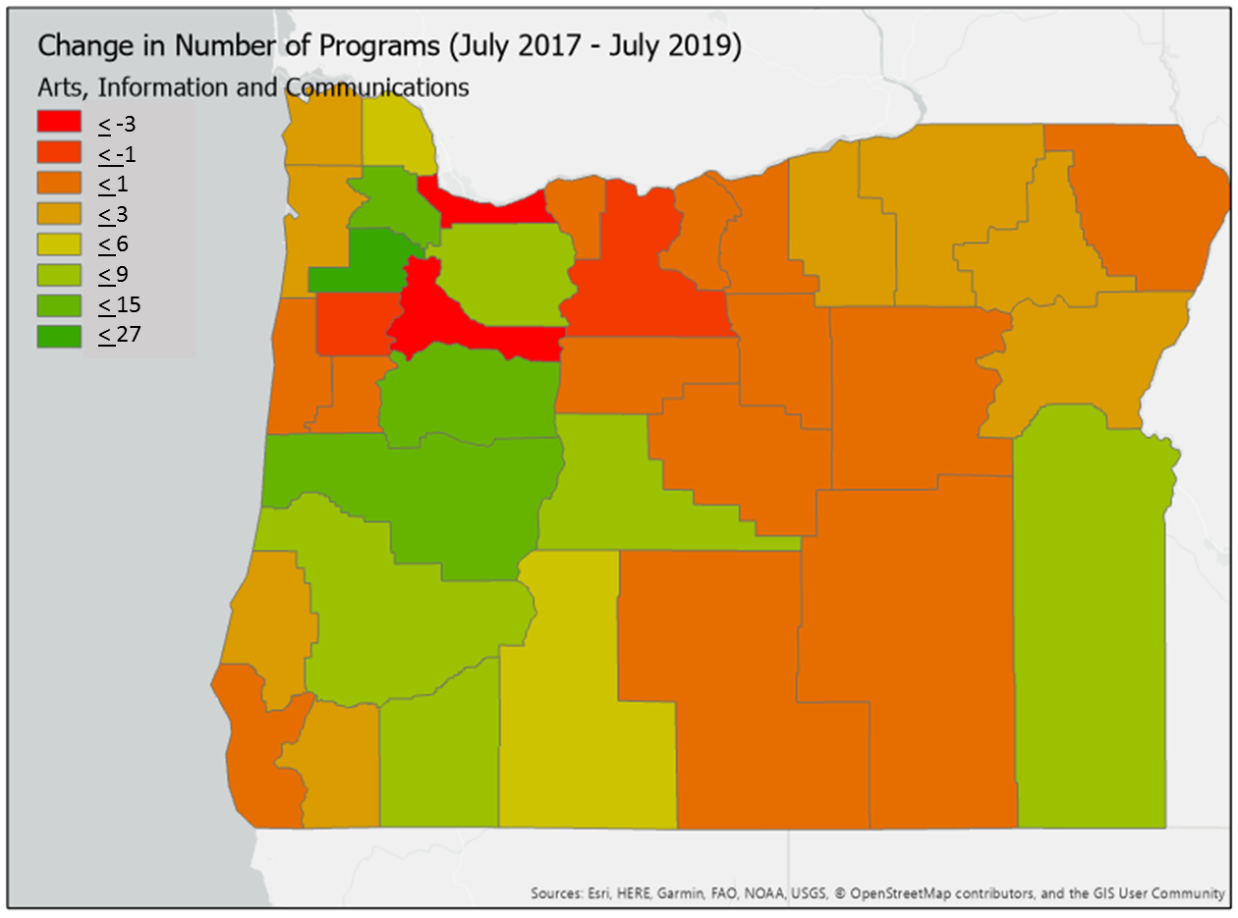
sfd

Slide 5
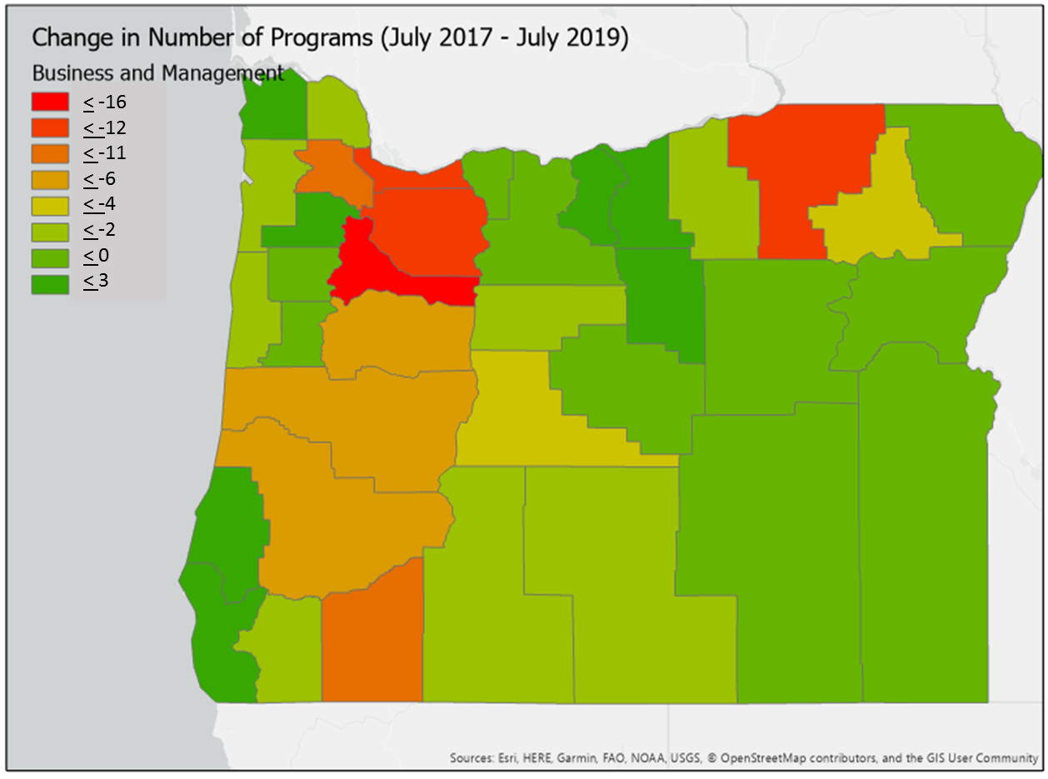
Change in Programs, Business and Management

Slide 6
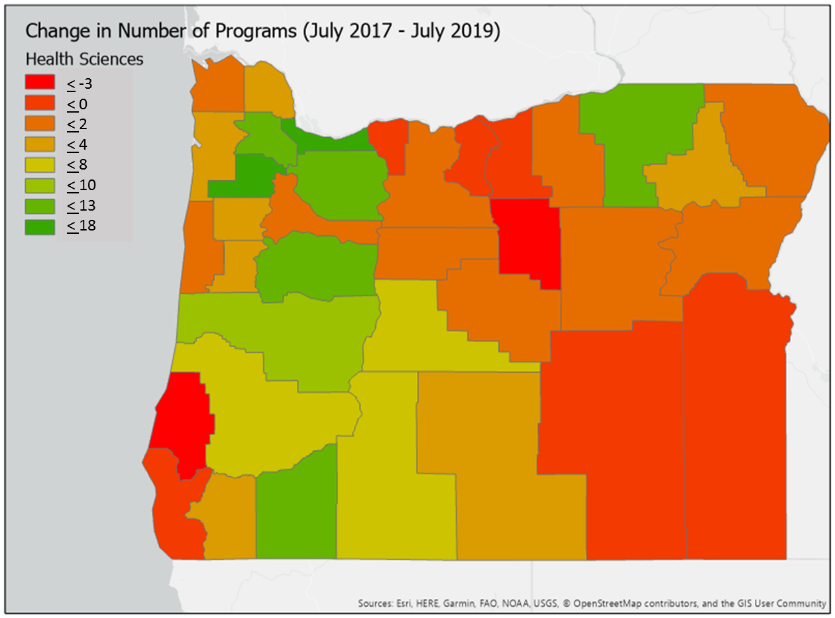
Change in Programs, Health Sciences

Slide 7
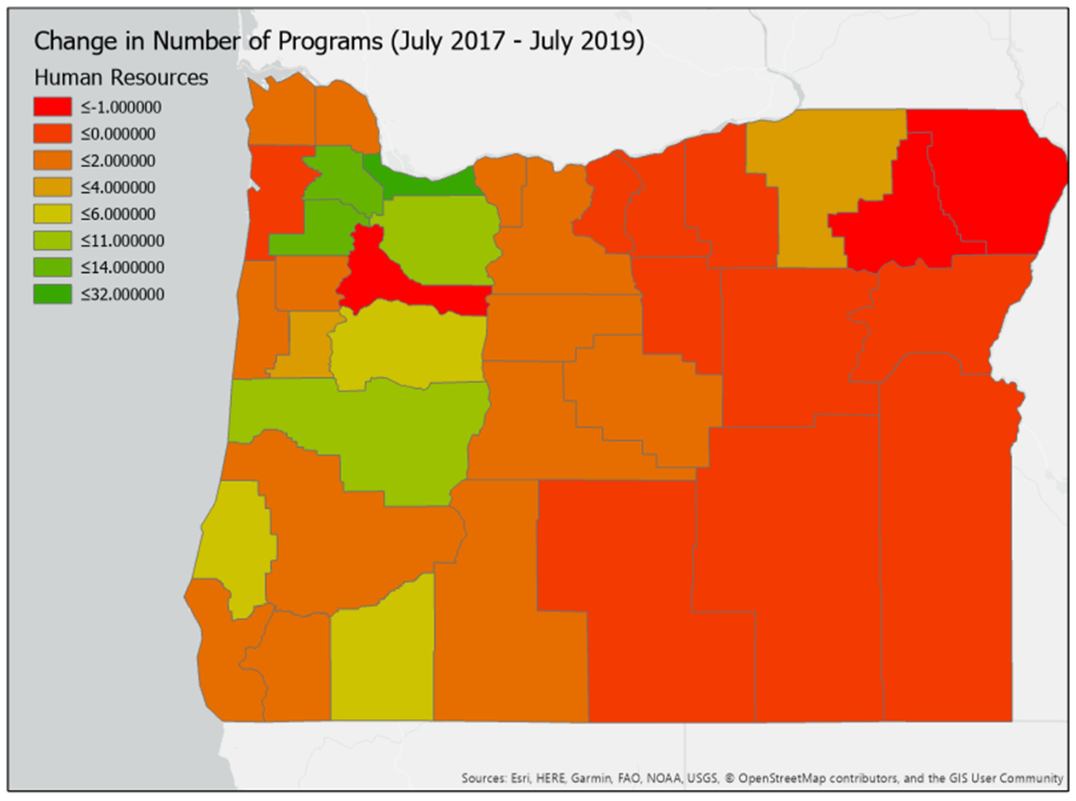
Change in Programs, Human Resources
< -1
< 0
< 2
< 4
< 6
< 11
< 14
< 32

Slide 8
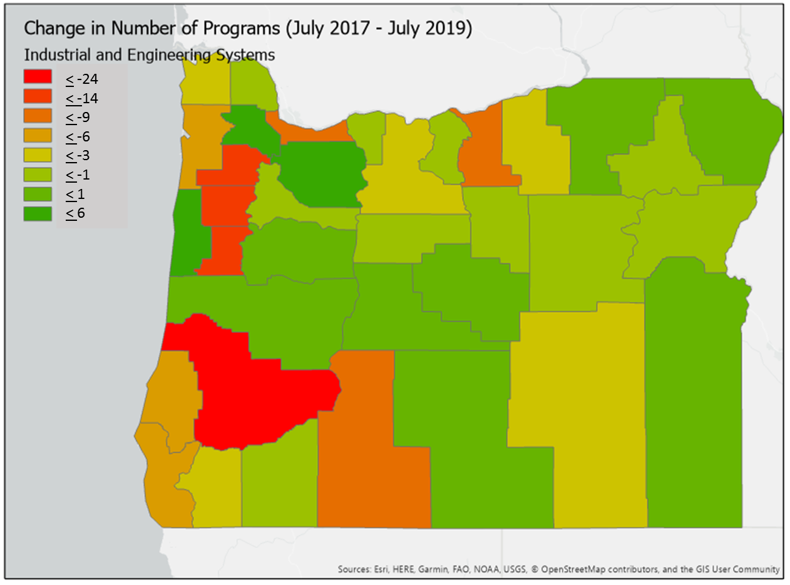
Change in Programs, Industrial and Engineering Systems

