Slide 1
Statewide Natural Resource / Forestry Program of Study Standards & Content Webinar #1
Reynold Gardner
Oregon Department of Education
October 14, 2022
Content will be archived

Slide 2
Long Term Goal
All Natural Resource / Forestry Programs are being renewed June 30, 2023
Regardless of:
Statewide Model Natural Resource / Forestry POS
Locally Developed POS
Annual Statewide Professional Development requirements ONREA Fall Conf (1 day) and OFRI (1.5 day)

Slide 3
Today’s Objective Goal
Required components and expected documentation of Element # 1 Standards and Content
Excel Template (Emailed)
Timeline to June 2023
Professional Development expectations
Homework – Archive location

Slide 4
Program of Study - POS
What is a Program of Study (POS)
Connection to High Wage & High Demand
POS Elements
Standards & Content
Alignment & Articulation Visual
Work Based Learning / Accountability & Assessment
Student Support Services
Professional Development
Equity / Diversity / Inclusion

Slide 5
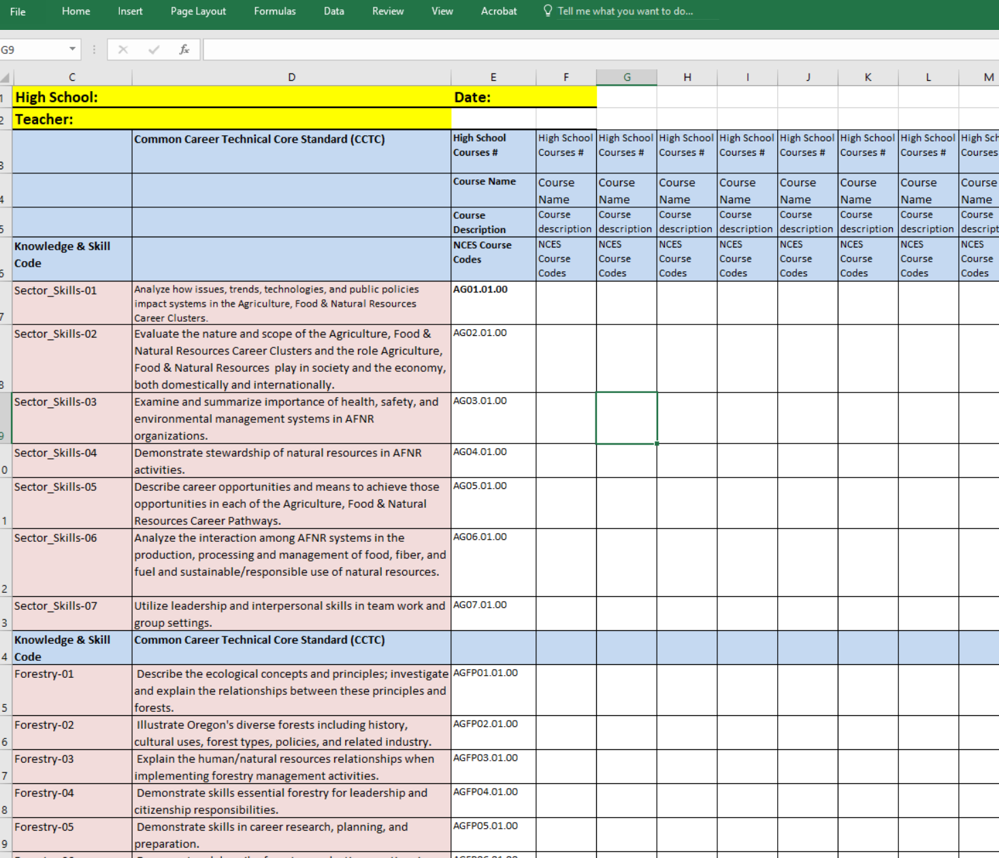
Emailed - CTE Course-to-Standards Crosswalk Templates
Nat_Res_Forestry_POS_Skill_Set_Crosswalk_10-14-2022

Slide 6
Knowledge and Skill Statement vs Performance / Measurement
What vs How
What students need to know and do
VS
How you provide instruction and measure knowledge gained.

Slide 7
June 2023 Timeline
Webinar - Element 1 – Standards & Content (Oct 13 – ONREA)
Webinar - Element 2 - Alignment & Articulation Visual (Dec 14)
OFRI Workshop Dec 14 @ Silverton
Webinar - Element 3 – Accountability, Data, Assessment,
Work Based Learning (March 7)
Webinar - Element 4 - Student Support Services (May 9)
Webinar - Element 5 & 6 - Professional Development &
Diversity Equity & Inclusion (June 6)
Regional Coordinator Approval, Signatures / Submission (June 30)

Slide 8
Professional Development
What is the professional development plan of your program?
ONREA
Annual Fall Conference
Statewide In-service Day 1st week in October
OFRI
Winter workshop
Community College involvement (6 colleges)
Collegial interactions
Annual basis (expectation)
More than just crossing paths with your postsecondary partner…..
Perkins Defined – Program of Study required
Planned long range professional development (PD with a focus)
Regional Coordinator input
Skin in the Game

Slide 9
Homework
Complete the Emailed - CTE Course-to-Standards Crosswalk
Attend the OFRI Workshop on Dec 14, 2022 Oregon Gardens - Silverton

Slide 10
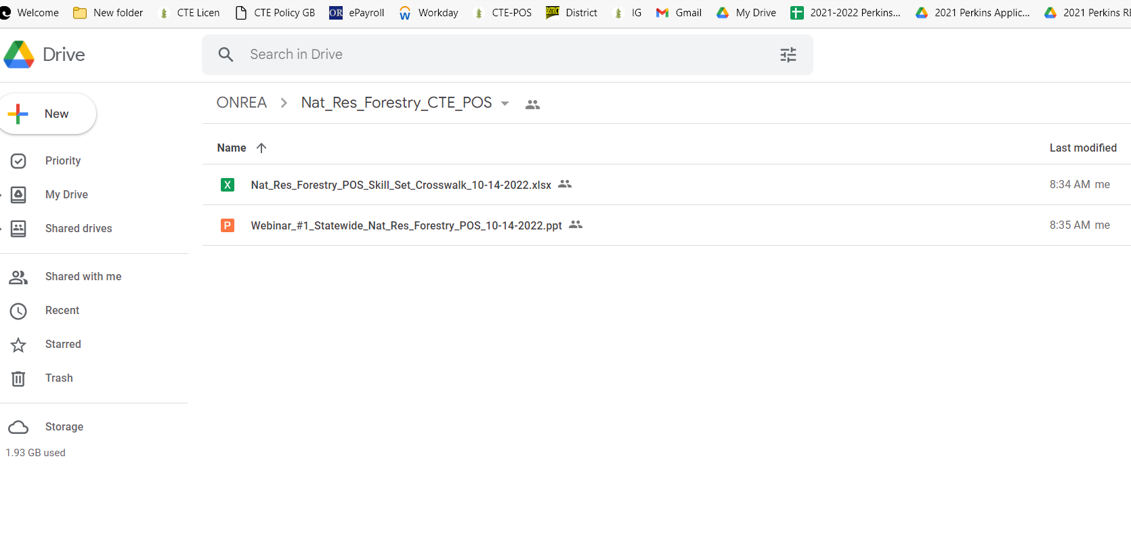
Archive Source / ONREA Google
https://drive.google.com/drive/folders/13X42yRB3Gxxd2p_BJJj2FLHn-L6rfkD2?usp=sharing

Slide 11
Archive Location
Content will be archived
Video of this webinar
Crosswalk Template
PowerPoint
https://drive.google.com/drive/folders/13X42yRB3Gxxd2p_BJJj2FLHn-L6rfkD2?usp=sharing

Slide 12
Today’s Objective Goal
What is a Program of Study (POS)
Required components and expected documentation of Element # 1 Standards and Content
Excel Template (Emailed)
Timeline to June 2023
Professional Development expectations
Homework – Archive location

Slide 13
Thank you
Questions.
Reynold.Gardner@ode.oregon.gov

