Slide 1


Computer Science Education Engagement Session
[Engagement Session Title]
[Date]
Notes:
Hello, and welcome to the Computer Science Education Engagement Session. We are going to spend the next hour and a half together today learning about your experiences with Computer Science Education. Our goal during this time is to gather ideas to help the Oregon Department of Education and the Higher Education Coordinating Commission understand what should be included in the Computer Science Implementation Plan which will aim to ensure that every public school student in Oregon has access to computer science by the 2027-28 School year. We are excited to have you with us today and are hopeful that we can spend the time learning alongside one another.
[Facilitator Introduce Self and Additional Speakers]
Beth
Allie
Tom
Celia
Luis
Eric
Jennell
Alexa
Kama
Lizzy
Deb
Dan
Vanessa
Shannon
Matt

Slide 2






Introductions & Gratitude
Logistics
Video:
Audio:
Recording:
Chat:
Captioning: Available
Interpreters: Available
1. Please update your Zoom Name
First Last (Pronouns) Organization, Title
Example: Jenn Smith (she/they) Oregon Academy, Principal
2. Introduce Yourself
In the chat, share your name and what brought you here today.
Notes:
Thank you! Now that we’ve introduced ourselves, if you are able to access the chat, please take a moment to use the chat and add your name and what brought you here today. While you’re typing in this information, I’m going to go over some basic Zoom Logistics.
First, if you have not done so already, please update your Zoom Name by clicking on the Participants Tab, finding your name, and selecting the three dots next to your name. This will provide you an option to change your name. It is helpful to include your first and last name, your pronouns if you are comfortable sharing them, and if you are here representing an organization, please include your organization and your title as part of your Zoom name.
You should see an icon of a video camera. If there is a red line through this icon, your camera is not displaying. If you would like to display your video, click on the icon and the red line should disappear.
This is a similar process for audio. If you see a red line through your microphone icon, this means you are muted, and we cannot hear you. If you would like to unmute, click on the icon, and the red line should disappear, allowing us to hear you. To ensure that all participants can hear the audio clearly, please be sure to mute yourself when not talking. We will have an opportunity for everyone to unmute and share out during our breakout sessions.
We will be recording this presentation and whole group discussions, but we will not be recording the breakout sessions. Information shared during the recording is subject to public records laws and may be shared with the public if requested.
We will be using the chat feature today. If you are unable to access or add to the chat, we will have an opportunity during breakout sessions to share your feedback verbally.
We have also enabled live captioning today.
To support our presentation and discussion today, we have ASL Interpreters on the call. If they are not already showing up as pinned to the top of your screen, you can pin them by hovering your mouse over their screen and clicking the three dots that display. This will bring up a menu for you to select the Pin option.
During today’s breakout discussion, not every breakout room will have an ASL Interpreter. If you would like to be placed in a room with an ASL Interpreter, please type this request into the chat as a private message to [Technical Support], and we will be sure to include you in a room with an Interpreter.
If you experience any technical difficulties or need technical support during our time today, please message [TA Support] in the chat, and they will be able to help you.
We also have today’s materials available in multiple languages. If you would like a version of these materials in a language other than English, please message [TA Support], and we can get these to you.
Thank you to everyone for taking the time to introduce yourself in the chat! We’ll now move onto our agenda for the day.

Slide 3

Engagement Session Agenda and Flow
Background and Framing
Computer Science Experiences and Goals
  Breakout Rooms: Share Out
Computer Science Hopes and Priorities
  Breakout Rooms: Share Out
Closing and Next Steps
Notes:
During our time today, we will begin with some background and framing information. Then, we will send everyone to breakout rooms to engage in small group discussions around some key questions. We’ll come back together as a whole group to share out key themes that emerged from those breakout sessions, and follow this time by a short break. After the break, we’ll repeat this process with another breakout session and whole group discussion. Last, we’ll share some next steps and information about how to stay informed.

Slide 4
Background and Framing
Notes:
We are going to begin our presentation today with some background and framing information.

Slide 5







Oregon's Timeline and Commitment to Computer Science Implementation (2022-23)
MAY 2022
JULY 2022 – SEPT 2023
DEC 2022 – JAN 2023
FEB 2023 – MAR 2023
APR 2023 –JUNE 2023
JULY 2023 –AUG 2023
SEPT 2023
Governor Brown signs Computer Science Directive
STEM Hubs submit and implement
proposals to increase access and participation in computer science in their regions
ODE and HECC facilitate Phase I Engagement focused on learning from education partners, career connected partners, students, families, and community members about their experience with computer science
ODE and HECC identify a consult team (based on applications) and draft the Computer Science Implementation Plan. Phase I Engagement
summary shared publicly.
ODE and HECC facilitate Phase II Engagement focused on getting feedback on the draft implementation plan. Phase II Engagement
summary shared publicly.
ODE, HECC, and the Consult Group respond to feedback on the implementation plan and write the final implementation
plan
Publish Computer Science Implementation Plan
Notes:
This slide provides a timeline of the computer science work spanning from May 2022 through September 2023.
To provide some background information, in May 2022, Governor Kate Brown signed a Computer Science Directive that began the process for the Oregon Department of Education and the Higher Education Coordinating Commission to start increasing access to computer science education through two methods:
1) The Oregon Department of Education was given authority to distribute $6 Million in GEER Funds to increase Computer Science opportunities for students during this school year. ODE distributed these funds to Oregon’s 13 STEM Hubs to meet this need with regional projects taking place through September 2023 - and the second method;
2) The Oregon Department of Education and the Higher Education Coordinating Commission were given authority to write an Implementation Plan that would provide computer science access to all public school students by the 2027-28 school year. Our engagement today is focused on this second method to hear from you and gather ideas about what should be included in this implementation plan. We are seeking input and advice through several engagement sessions to lay this groundwork before we begin drafting the plan. You will see Phase 1 engagement in the grey box which represents where we are in this timeline. Beginning in December and lasting through January 2023, the Oregon Department of Education and the Higher Education Coordinating Commission will be facilitating engagement with education partners, career connected partners, students, families, and community members. The information gleaned during these sessions will be used to write a draft Computer Science implementation plan between February and March 2023 with the goal of receiving feedback during Phase II engagement sessions in the spring and publishing the finalized plan by September 2023. The implementation plan has three overarching goals:
That Computer Science be made available to public school students on an equitable basis
That it is based on a framework that guides students from computer users to computer literate creators who are proficient in the concepts and practices of computer science, as informed by national frameworks and standards
And last, to identify immediate practical and systemic changes, with a focus on equity and inclusion.
While this timeline provides important dates beginning in May 2022, the work of computer science education in Oregon has been an ongoing effort prior to the spring of 2022 with educators, career connected partners, and community members leading for computer science education across the state.

Slide 6
National Computer Science Education Efforts
Just over half (53%) of high schools in the United States (U.S.) offer a single computer science course.
In states that have adopted at least some policies related to computer science, 68% of their high schools offer foundational computer science.
Notes:
The work we are doing in Oregon is alongside national efforts to broaden participation in computer science – with data showing that there is work to be done across the nation to ensure that all students have equitable access to computer science education. According to the 2022 State of CS report, just over half (53%) of high schools in the United States (U.S.) offer a single computer science course and across the nation students identifying as female, Hispanic/Latina/Latino/Latinx students, multilingual learners, students with disabilities, and economically disadvantaged students are underrepresented in foundational computer science compared to their overall population. Yet, we also know that in states that had policy action focused on broadening participation in computer science there has been growth in access, participation, engagement, and overall equity efforts. For example, for states that have adopted at least some policies, 68% of their high schools offer foundational computer science.
While Oregon falls behind other states with regards to legislation, this is a pivotal moment to lean into the experiences, ideas, and perspectives of those who have been leading for computer science education in Oregon for decades – many of you who are with us today. This is the first time in Oregon's history that direction has been given to the Oregon Department of Education to develop a plan to provide access to computer science to all public school students in the state and both the Oregon Department of Education and the Higher Education Coordinating Commission are looking forward to engaging with you all to learn from and alongside you about your experiences, ideas, and hopes for computer science in Oregon.
2022 State of CS Report: https://advocacy.code.org/2022_state_of_cs.pdf

Slide 7

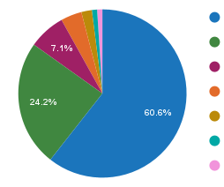
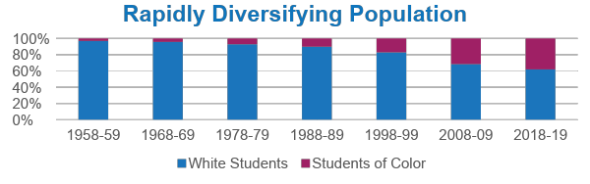
Who We Serve
Student Diversity
560,907 Students
More than 200 languages spoken
Economically Disadvantaged: 53%
Ever English Learners: 18%
Homeless: 3%
Lesbian/Gay /Bisexual: 12.6%
Mobile Students: 11%
Students with Disabilities: 15%
75,807 Educators
Staff of Color
11.4% of Teachers
12.3% of Administrators
16.4% of Counselors
21.1% of Educational Assistants
White (60%)
Hispanic (24%)
Multi-Racial (7%)
Asian (4%)
African American/Black (2%)
American Indian/ Alaska Native (1%)
Native Hawaiian/ Pacific Islander (1%)
197 Districts
1,257 Schools
133 Charter Schools
19 Education Service Districts
Rapidly Diversifying Population
White Students
Students of Color
Notes:
Before we dive into some data, we’d like to provide a little more context about our state. Oregon’s Public K-12 system serves more than 560,000 students, with more than 200 languages spoken. We have approximately 75,000 educators, 197 School Districts, and about 1200 Schools. Our students are diverse and bring a wealth of knowledge and experiences with them into the classroom.
When thinking about these students and the education that we bring to them, the Oregon Department of Education values equitable opportunity for all students and defines education equity as the equitable implementation of policy, practices, procedures, and legislation that translates into resource allocation, education rigor, and opportunities for historically and currently marginalized youth, students, and families including civil rights protected classes. This means the restructuring and dismantling of systems and institutions that create the dichotomy of beneficiaries and the oppressed and marginalized.
Given the impact Computer Science education can have on students, it is important for all students to have the opportunity to learn computer science concepts and skills. However, in Oregon and across the nation, students do not have equitable opportunities to learn these skills. To frame the "why" behind this work, we are going to present data specific to computer science in Oregon. Before we dive in, we want to acknowledge that as we talk about data, we recognize that there are stories of students represented here, not just numbers on a slide. And while these data are important in framing the "why" behind the computer science implementation plan, we are hopeful that our conversations today and moving forward will bring life to these data through the stories, experiences, and perspectives that each of you bring to this space.

Slide 8

Why Do Computer Scientists Do?
Develop ways to keep your emails and phone calls secure.
Develop digital tools that can be used to create realistic 3D animations and images.
Figure out how to link computing devices so you can monitor your home from anywhere in the world.
Make it easier for people to use computers by learning how computers and people interact.
Use artificial intelligence to understand and process video or sound.
Notes:
We want to begin today grounding us in why we are all here – computer science.
Computer science instills creativity, logical reasoning, and critical thinking skills
It supports students in creative, hands-on learning
It helps students to develop resiliency through problem-solving
Computer science strengthens collaboration skills through working with others to solve problems
It supports cross-disciplinary skills needed within and across academic and workforce contexts
It also helps students become active participants in changing their world
While many of these skills are cross-cutting and interdisciplinary, someone doing computer science might...
Develop ways to keep your emails and phone calls secure.
Develop digital tools that can be used to create realistic 3D animations and images.
Figure out how to link computing devices so you can monitor your home from anywhere in the world.
Make it easier for people to use computers by learning how computers and people interact.
And Use artificial intelligence to understand and process video or sound.

Slide 9
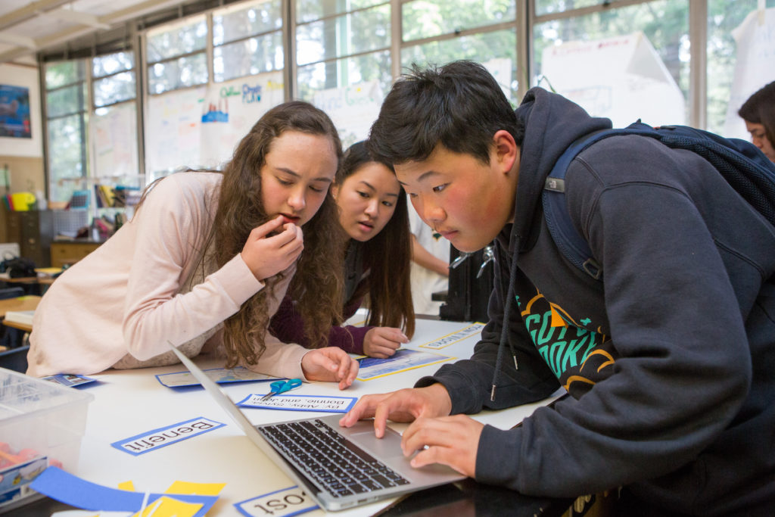
Foundational Computer Science Access and Participation in Oregon
86.6% of Oregon high school students attend a
school that offers foundational computer
science, but only 7.2% of students are
enrolled in a computer science course.
Code.org, CSTA, & ECEP Alliance (2022). 2022
State of Computer Science Education:
Understanding Our National Imperative.
Notes:
In the most recent State of Computer Science Education report, nearly 87% of public Oregon high school students attend a school that offers foundational computer science, but only 7% of students are enrolled in a computer science course.

Slide 10
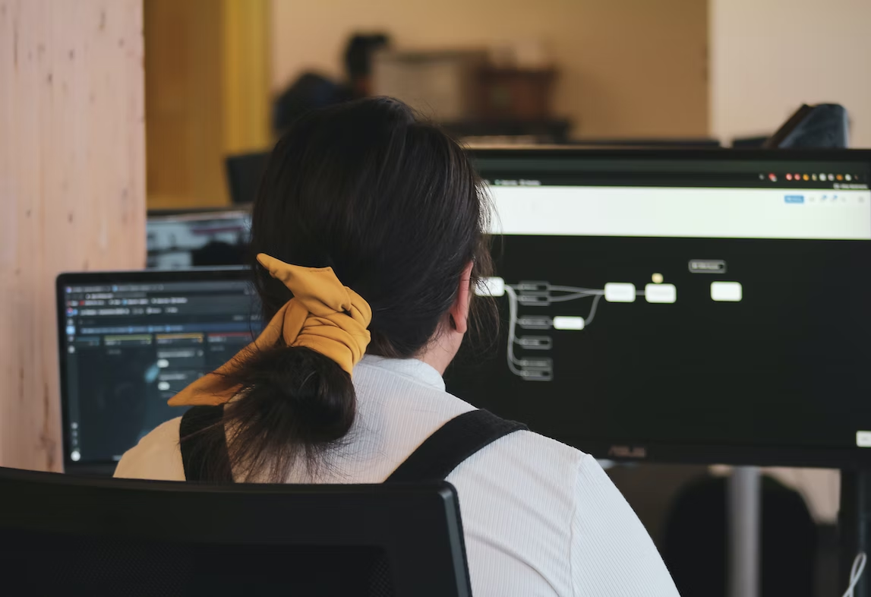
Disparities in Computer Science
Courses in Oregon
Black/African American students, Latino/a/x students, students identifying as female, students with disabilities, and multilingual learners are significantly underrepresented in computer science courses.
Well-Rounded Access Program Needs Assessment (2022)
Notes:
According to the Well-Rounded Access Program Needs Assessment which was published in 2022, Black and African American students, Latino/a/x students, students identifying as female, students with disabilities, and multilingual learners have a statistically significant underrepresentation in Oregon High School computer science enrollment.

Slide 11


Female Student Representation in Computer Science Courses in Oregon
Male-identifying high school students are approximately 2 times more likely to be enrolled in a computer science course than female-identifying students
4 out of 25 male-identifying high school students were enrolled in a computer science course in the 2021-22 school year compared to 2 out of 25 female-identifying high school students.
Oregon Department of Education Administrative Data (2022)
Notes:
Diving further into the data, in Oregon, male-identifying high school students are approximately 2 times more likely to be enrolled in a computer science course than female-identifying students. In the 2021-22 school year, 4 out of 25 male-identifying high school students were enrolled in a computer science course compared to 2 out of 25 female-identifying high school students.
It is important to acknowledge that these data are imperfect as they do not represent the range of gender identities of Oregon students. While the Department has begun collecting data on non-binary students, this gender designation is underreported and contains a much smaller denominator than male or female identifying categories. Acknowledging this, 2022 administrative data does show that only 5 out of 20 non-binary students in high school enrolled in a computer science course in the 2021-22 school year. All of this information points to gender disparities within computer science across Oregon.

Slide 12
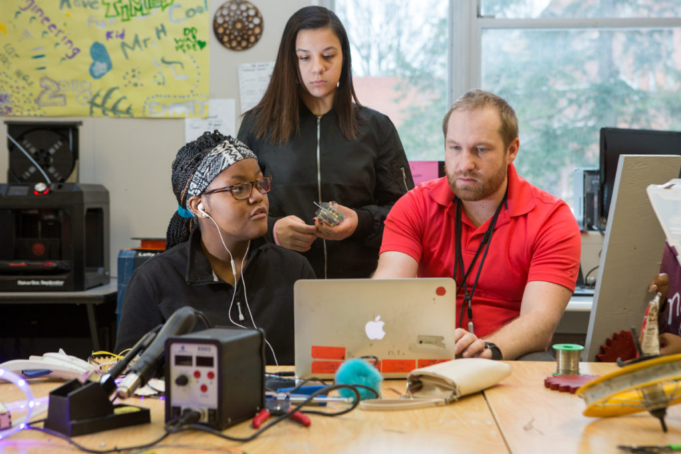
Racial and Gender Disparities in AP Computer Science
In 2019, 369 high school students took the AP Computer Science exam. Of those students:
17% of the students were female
Less than 1% of students were Hispanic/Latino
No Black students took the AP exam.
Notes:
While those numbers represent access to computer science broadly, we see even more vast disparities when looking at enrollment in AP (Advanced Placement) Computer Science courses. As framed in the Governor's Computer Science Directive, in 2019, only 369 high school students took the AP Computer Science exam. Of those students, 17 percent were female, 33 students were Hispanic/Latino, and no Black students took the AP exam.

Slide 13


Geographical Disparities in Advanced Computer Science Courses in Oregon
High school computer science students in urban areas are approximately 4 times more likely to be taking an advanced computer science course compared to high school computer science students in rural areas.
1 in 50 rural high school computer science students were enrolled in an advanced computer science course in the 2021-22 school year compared to 4 out of 50 urban high school computer science students
Oregon Department of Education Administrative Data (2022)
Notes:
In addition, we also see disparities in enrollment in AP (Advanced Placement) computer science courses across geographic regions. For students in Oregon public high schools, those in urban areas are approximately 4 times more likely to be taking an advanced computer science course compared to those living in rural areas. In the 2021-22 school year, 1 in 50 rural high school computer science students were enrolled in an advanced computer science course compared to 4 out of 50 urban area high school computer science students.

Slide 14


Female Student Representation in Postsecondary Computer Science CTE Programs in Oregon
Female-identifying participate in postsecondary Computer Science CTE Programs at a rate slightly more than male-identifying students.
Approximately 2 out of 25 male-identifying CTE Participants were participating in a Computer Science CTE Program in the 2021-22 academic year, compared to almost 3 out of 25 female-identifying CTE Participants.
Source: HECC analysis of community college student-level data.
Notes: CTE Participants must have earned one or more credits in CTE Courses. Computer Science CTE program includes programs with a CIP family of 11, 14, 30, 38, or 52.
Notes:
Another way for us to understand data related to computer science is by looking at representation within CTE, or career technical education. CTE programs use 21st century technology to support students in acquiring technical skills, professional practices, and academic knowledge critical for career success in high-wage, in-demand careers. When looking at data related to postsecondary participation in computer science education, we see that female-identifying students participate in Computer Science CTE programs at a rate slightly higher than males. During the 2021-22 academic year, approximately 2 (or 2.3) out of 25 male-identifying postsecondary students were enrolled in a Computer Science CTE program, compared to almost 3 (or 2.6) out of 25 female-identifying postsecondary students.

Slide 15

Postsecondary Participation in Computer Science in Oregon
Of the 42,599 community college CTE (Career Technical Education) participants enrolled during the 2021-22 academic year, 9.5% participated in a Computer Science CTE program.
Source: HECC analysis of community college student-level data. Notes: CTE Participants must have earned one or more credits in CTE Courses. Computer Science CTE program includes programs with a CIP family of 11, 14, 30, 38, or 52.
Notes:
And finally, during the 2021-22 academic year, there were 42,599 community college students who were CTE Participants, meaning that they earned one or more credits in CTE Courses. Of those, 9.5% were participating in a Computer Science CTE program. It is important to note that all 17 community colleges have students participating in a Computer Science CTE program.
We just presented a lot of data – which can feel overwhelming given the disparities discussed. You do have access to these data to refer to throughout the rest of our session today as well as after the session so that you can have continued processing opportunities. We share these data with you as a way to anchor the conversations you will have in breakout rooms today as well as ground us in the importance and urgency of this work moving forward. Though, as we shared earlier, these data are more than numbers, they are students whose identities, stories, and experiences cannot be represented on a slide. We are hopeful that during the remainder of our time together today, you can give voice to those stories as you share your experiences, ideas, and perspectives about computer science education.

Slide 16
Breakout Room Discussions
Notes:
With this background and framing, we’re now going to transition into a time of breakout room discussions. Before we move into these rooms, there are a few instructions.

Slide 17

Offerings for Today
Stay focused on students
Listen and ask questions
Share the airtime
Respect differences of opinion
Accept that not all questions have clear answers
Notes:
While we are all entering these conversations with differing identities, life experiences, and perspectives, it is important that we are able to have meaningful and generative conversations aimed at ensuring access to computer science education for all students in Oregon. As we do not have time to co-develop agreements today, we have offerings for you that we are hopeful will ground the conversations in your breakout rooms so that everyone feels safe and welcomed in sharing their voice.
First, Stay focused on students and how our recommendations will impact them.
Listen and ask questions. This is a time for open dialogue.
Be mindful of who is and isn’t speaking. Share the airtime with others.
Respect differences of opinion.
And, accept that we may not have answers. Part of this work will be developing answers to the questions that you have for us today.

Slide 18

Breakout Discussion #1: Computer Science Experiences and Goals
What goal(s) for computer science education in Oregon do you think is the most important to attend to in the implementation plan?
What do you see as the central challenge(s) to ensuring equitable opportunities and outcomes in computer science?
What promising practice(s) have you experienced or learned about with regards to broadening participation in computer science?
Notes:
During the remainder of our time together today, you will be in breakout rooms. Each room will have an ODE or HECC facilitator who will provide support and framing as well as provide any needed technical support. Your facilitator will also share the questions for each breakout room as well as ensure that the conversation is grounded in the community offerings.
For the first breakout room, we will be discussing experiences with computer science and goals that you have moving forward with this work. Our hope is to spend this time talking about the following questions:
What goal(s) for computer science education in Oregon do you think is the most important to attend to in the implementation plan?
What do you see as the central challenge(s) to ensuring equitable opportunities and outcomes in computer science?
What promising practice(s) have you experienced or learned about with regards to broadening participation in computer science?
We will be using a Google Doc during the breakout rooms so that there are multiple ways to capture ideas. In just a minute, you will see links to Google Docs in the chat. Before you go to your breakout room, please look at your room number and open the corresponding Google Doc. Once you are moved to your breakout room, your facilitator will be there with guidance on how your time together will work and can support as needed.
This first breakout room will last for 20 minutes. During that time, you will be discussing Computer Science Experiences and Goals. The specific questions you will be discussing are on the Google Doc. After the breakout discussion has finished, you will return to the main room and the facilitator of each room will have the opportunity to share out themes from each breakout room. If time remains, people from each breakout room can also speak into the space.
If you have any technical difficulties during this process, please be sure to send a message to [Technical Support] in the chat or stay in the main room. Thank you, and you’ll be moved to your breakout room momentarily.
_________________________
Welcome back everyone. Now we will have an opportunity for each group to provide a short summary of their conversation.
Is there anything else you would like to add that wasn't yet shared?
[Facilitator: Guide this discussion.]

Slide 19
Breakout Discussion #1: Computer Science Experiences and Goals, cont.
Have you or your child participated in computer science education? What has that looked like/felt like?
If you or your child has participated in computer science, what do you see as the benefits (short-term and long-term)?
If you or your child has not participated in computer science education, what do you see as barriers to participation? What do you see as the impact (short-term and long-term)?
Notes:
During the remainder of our time together today, you will be in breakout rooms. Each room will have an ODE or HECC facilitator who will provide support and framing as well as provide any needed technical support. Your facilitator will also share the questions for each breakout room as well as ensure that the conversation is grounded in the community offerings.
For the first breakout room, we will be discussing experiences with computer science and goals that you have moving forward with this work. Our hope is to spend this time talking about the following questions:
Have you or your child participated in computer science education? What has that looked like/felt like?
If you or your child has participated in computer science, what do you see as the benefits (short-term and long-term)?
If you or your child has not participated in computer science education, what do you see as barriers to participation? What do you see as the impact (short-term and long-term)?
We will be using a Google Doc during the breakout rooms so that there are multiple ways to capture ideas. In just a minute, you will see links to Google Docs in the chat. Before you go to your breakout room, please look at your room number and open the corresponding Google Doc. Once you are moved to your breakout room, your facilitator will be there with guidance on how your time together will work and can support as needed.
This first breakout room will last for 20 minutes. During that time, you will be discussing Computer Science Experiences and Goals. The specific questions you will be discussing are on the Google Doc. After the breakout discussion has finished, you will return to the main room and the facilitator of each room will have the opportunity to share out themes from each breakout room. If time remains, people from each breakout room can also speak into the space.
If you have any technical difficulties during this process, please be sure to send a message to [Technical Support] in the chat or stay in the main room. Thank you, and you’ll be moved to your breakout room momentarily.
_________________________
Welcome back everyone. Now we will have an opportunity for each group to provide a short summary of their conversation.
Is there anything else you would like to add that wasn't yet shared?
[Facilitator: Guide this discussion.]

Slide 20
Break
Notes:
Before we go into our next breakout session, let’s take a 10 minute break. We’ll meet back here at [say the time]. Thank you!

Slide 21

Breakout Discussion #2:
Hopes and Priorities
What do you see as the most important topic to be included in the Computer Science Implementation Plan?
  What immediate actions/next steps do you see as important to implement within Oregon?
  What long-term changes do you see as important to implement within Oregon?
What do you hope that ODE/HECC considers or understands when developing the Computer Science Implementation plan?
Notes:
I hope everyone had a chance to take a short break.
In a minute, you will be automatically moved to the same breakout room for your second breakout session. During breakout discussion #2, the conversation will focus on hopes and priorities for computer science education – both short term and long-term.
Our hope is to spend this time talking about the following questions:
What do you see as most important to be included in the Computer Science Implementation Plan?
What immediate actions/next steps do you see as important to implement within Oregon?
What long-term changes do you see as important to implement within Oregon?
What do you hope that ODE/HECC considers or understands when developing the Computer Science Implementation plan?
As a reminder, each room will have an Oregon Department of Education or Higher Education Coordinating Commission facilitator who will provide support and framing as well as provide any needed technical support. Your facilitator will also share the questions for each breakout room as well as ensure that the conversation is grounded in the community offerings.
You will use the same Google Doc as you used for the first breakout discussion. If you closed that document during the break, you will see links to Google Docs in the chat. Before you go to your breakout room, please look at your room number and open the corresponding Google Doc. Once you are moved to your breakout room, your facilitator will be there with guidance on how your time together will work and can support as needed.
As with the first breakout discussion, we will be in breakout rooms for 20 minutes. After the breakout discussion has finished, you will return to the main room and the facilitator of each room will have the opportunity to share out themes from each breakout room. If time remains, people from each breakout room can also speak into the space.
If you have any technical difficulties during this process, please be sure to send a message to [Technical Support] in the chat or stay in the main room. Thank you, and you’ll be moved to your breakout room momentarily.
_________________________
Welcome back everyone. We will again have an opportunity for each group to provide a short summary of their conversation.
Is there anything else you would like to add that wasn't yet shared?
Are there any questions or prompts you would recommend we incorporate in future engagement sessions?
[Facilitator: Guide this discussion.]

Slide 22
Breakout Discussion #2:
Hopes and Priorities, cont.
What do you hope to see continue in schools next year to support computer science education?
What do you hope to see change in your schools next year to support access to computer science education?
What do you hope to see change with computer science long-term?
Is there anything else you would like us to know when writing the Computer Science Implementation Plan?
Notes:
I hope everyone had a chance to take a short break.
In a minute, you will be automatically moved to the same breakout room for your second breakout session. During breakout discussion #2, the conversation will focus on hopes and priorities for computer science education – both short term and long-term.
Our hope is to spend this time talking about the following questions:
What do you hope to see continue in schools next year to support computer science education?
What do you hope to see change in your schools next year to support access to computer science education?
What do you hope to see change with computer science long-term?
Is there anything else you would like us to know when writing the Computer Science Implementation Plan?
As a reminder, each room will have an Oregon Department of Education or Higher Education Coordinating Commission facilitator who will provide support and framing as well as provide any needed technical support. Your facilitator will also share the questions for each breakout room as well as ensure that the conversation is grounded in the community offerings.
You will use the same Google Doc as you used for the first breakout discussion. If you closed that document during the break, you will see links to Google Docs in the chat. Before you go to your breakout room, please look at your room number and open the corresponding Google Doc. Once you are moved to your breakout room, your facilitator will be there with guidance on how your time together will work and can support as needed.
As with the first breakout discussion, we will be in breakout rooms for 20 minutes. After the breakout discussion has finished, you will return to the main room and the facilitator of each room will have the opportunity to share out themes from each breakout room. If time remains, people from each breakout room can also speak into the space.
If you have any technical difficulties during this process, please be sure to send a message to [Technical Support] in the chat or stay in the main room. Thank you, and you’ll be moved to your breakout room momentarily.
_________________________
Welcome back everyone. We will again have an opportunity for each group to provide a short summary of their conversation.
Is there anything else you would like to add that wasn't yet shared?
Are there any questions or prompts you would recommend we incorporate in future engagement sessions?
[Facilitator: Guide this discussion.]

Slide 23
Closing and Next Steps
Notes:
Thank you all for this engaging discussion and for sharing your thoughts and ideas with us! Your time is valuable and we are appreciative that you were able to be here with us today. Before we leave today, we wanted to provide you with some closing items and next steps.

Slide 24
Next Steps
MAY 2022
JULY 2022 – SEPT 2023
DEC 2022 – JAN 2023
FEB 2023 – MAR 2023
APR 2023 –JUNE 2023
JULY 2023 –AUG 2023
SEPT 2023
Governor Brown signs Computer Science Directive
STEM Hubs submit proposals to increase access and participation in computer science in their regions
ODE and HECC facilitate Phase I Engagement focused on learning from education partners, career connected partners, students, families, and community members about their experience with computer science.
ODE and HECC identify a consult team (based on applications) and work with the consult team to write a draft implementation plan. Phase I Engagement summary shared publicly.
ODE and HECC facilitate Phase II Engagement focused on getting feedback on the draft implementation plan. Phase II Engagement summary shared publicly.
ODE, HECC, and the Consult Group respond to feedback on the implementation plan and write final implementation
plan
Publish Computer Science Implementation Plan
Notes:
You will see in the grey box that the next steps after our initial engagement will include identifying a consult group (which we will share information about in a moment), facilitating another round of engagement – which we hope you all will join us for (anyone who participated in Phase I engagement will receive an invite as will those signed up for our listserv (which we will share the link for in the chat in just a moment), revising the Computer Science Implementation plan, and publishing it in September 2023. After each phase of engagement, we plan to publish an engagement summary and post it on our Computer Science website.

Slide 25

Lend Your Voice: Computer Science Consult Group
Who: Oregon-based partners including teachers, school/district administrators, teacher licensure representatives, instructors, professors, teacher preparatory program representatives, CTE Regional Coordinators, and computer science education experts existing across the P-20 education age range, as well as business/industry representation.
What: The group will review engagement summaries, draft recommendations, and advise ODE and HECC staff.
When: The group will meet virtually on a regular basis from February 2022 through August 2023.
How: Membership on the Consult Group will be by application, and members will be selected by ODE/HECC staff. Applications are due by January 23, 2023.
Notes:
On the previous slide, we mentioned that we will be forming a consult group to help provide advice to the Oregon Department of Education and the Higher Education Coordinating Commission as we write the implementation plan. We are looking for a small group of individuals representing broad and diverse perspectives in Oregon. The consult group will meet monthly for approximately 2 hours with an additional 2-4 hours of outside work each month, including reading, leaving feedback on documents, etc. This group will meet virtually from February through August 2023.
If you are interested in being a part of the computer science consult group, we encourage you to complete the consult group application. You can find a link to the application in chat and this will also be shared out through email after today's session. Applications are due by January 23, 2023.

Slide 26

Closing
Please consider applying for the Computer Science Consult Group.
We will reach out to all of those who participated in Phase I engagement for participation in Phase II engagement in the spring.
If you would like to receive direct notifications about upcoming Computer Science work, please join the Computer Science listserv.
You can find additional information on our Computer Science website.
If you have any questions, please reach out to the ODE Computer Science Inbox ode.csinitiative@ode.oregon.gov
Our gratitude for your time, voice and input today
Notes:
Just a few reminders before we end our session. Again, if you are interested in being a part of the consult group, please consider applying. We will also be reaching out to all of you with an invitation to participate in our next phase of engagement this spring and review a draft of the implementation plan. If you would like to stay informed, please consider subscribing to our Computer Science listserv. We also encourage you to share out this link with others who might be interested. You can also find information on our Computer Science website. If you have specific questions or would like to connect individually, please send our Computer Science team an email at ode.csinitiative@ode.oregon.gov. Thank you so much for your time today! We will stay on the line if you have further questions. Otherwise, we are grateful for your gift of time and the vulnerability it takes to share your stories, experiences, and perspectives within a virtual meeting. Thank you!

