Slide 1

Monthly Alternative Education Community Webinar
February 18, 2020
Annie Marges, ODE Alternative Education Options Specialist
Jeremy A. Wartz, ODE Program Analyst
Notes:
Welcome and introductions. Reminder about newsletter and dates to watch (GED Summit!) Explanation about how we plan to utilize the webinars – present information on topics that matter to / are of concern to the Alt Ed community, and then hear from YOU! We are simply facilitating the conversation, not doing all of the talking (hopefully)
At the end of the discussion we will ask about future topics.

Slide 2
Agenda
Welcome and introductions
YouScience presentation
Alt Ed Summit
Private Alternative Education Program Application
Notes:
Jeremy

Slide 3
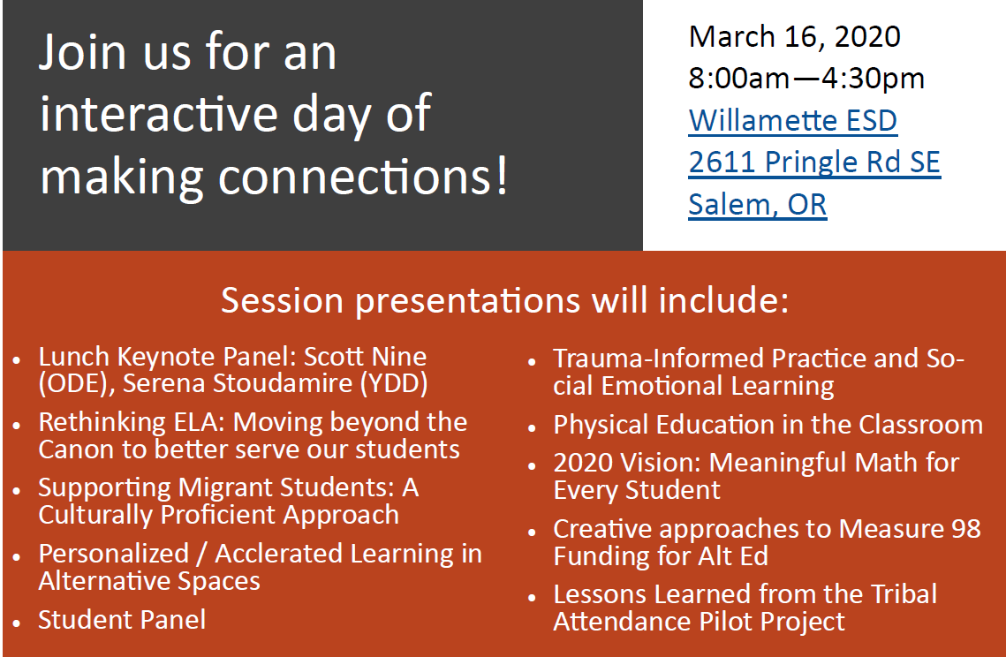
Alt Ed Summer flyer

Slide 4
Thank you!

