Slide 1
2026 Process to Request a Charter School Waiver
January 1, 2026

Slide 2
Overview
Participants will Understand:
Background on Charter School Waivers
Criteria for Approving Charter School Waivers
Requirements in the Waiver Request Process
Timeline for Waiver Requests
Equity Guidance
Data Collection and Review Process
All waiver resources are accessible on the website under Current Charter Schools

Slide 3
Background on Charter School Waivers
What gives the State Board of Education authority to grant waivers?
ORS 338.025
1. The State Board of Education may adopt any rules necessary for the implementation of this chapter. The rules shall follow the intent of this chapter.
2. Upon application by a public charter school, the State Board of Education may grant a waiver of any provision of this chapter if the waiver promotes the development of programs by providers, enhances the equitable access by underserved families to the public education of their choice, extends the equitable access to public support by all students or permits high quality programs of unusual cost. The State Board of Education may not waive any appeal provision in this chapter or any provision under ORS 338.115.

Slide 4
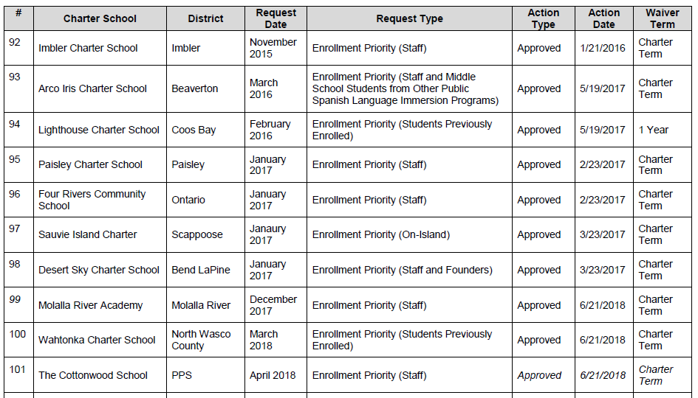
Types of Charter School Waivers Granted

Slide 5
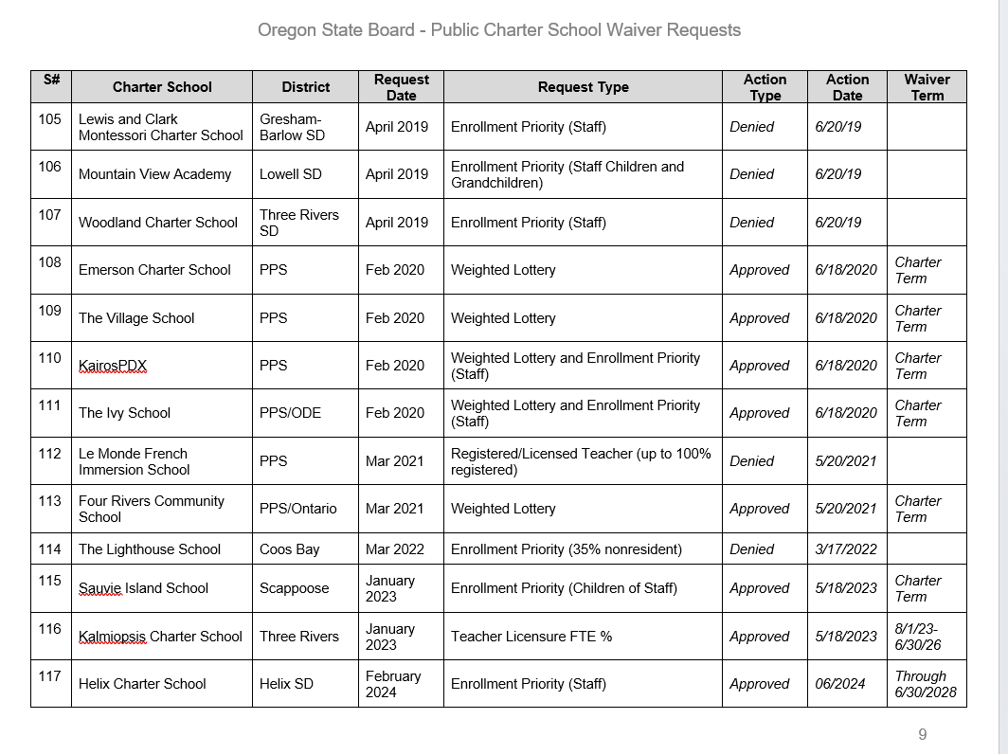
Recent Charter School Waivers

Slide 6
Criteria for Approving Charter School Waivers
Upon application by a public charter school, the State Board of Education may grant a waiver of any provision of this chapter if the waiver:
Promotes the development of programs by providers;
Enhances the equitable access by underserved families to the public education of their choice;
Extends the equitable access to public support by all students; or
Permits high quality programs of unusual cost.

Slide 7
Requirements in the Waiver Request Process
Process Requirements:
Complete the Waiver Request Form
Request a letter of support from sponsor
Identify the specific law to be waived
Answer all of the equity questions
Identify what data the charter will collect and report to the State Board of Education

Slide 8
Timeline for Waiver Requests
Date | Description
Friday, February 27, 2026 | Deadline for submitting waiver requests. No other waivers will be considered in 2026 after this day. Deadline for submitting waiver requests. Waiver requests must be submitted by midnight PST on Friday, February 27, 2026. No other waivers will be considered after this day for 2026. Submit via email to: Christen.Kelly@ode.oregon.gov
Friday, March 13, 2026 10:00AM-12:00PM | The Department will conduct an internal review hearing for all waiver requests prior to drafting recommendations for the State Board of Education. Charter school leaders are invited to attend the virtual hearing to present the waiver request and answer questions.
Friday, March 27, 2026 | Deadline for submitting additional information following the review hearing.
Thursday, April 16, 2026 | The State Board will have a first read on all charter school waiver requests. Charter schools are invited to attend the State Board meeting to respond to the State Board’s questions. State Board agendas and materials are available here.
Friday, May 1, 2026 | Deadline for submitting additional information following the first read at State Board meeting.
Thursday, May 21, 2026 | The State Board will make a final decision on all charter school waiver requests. Charter schools are invited to attend the meeting. State Board agendas and materials are available here.

Slide 9
Equity Guidance
Equity Lens Questions
Who are the racial or ethnic and underserved groups affected? What is the potential impact of the waiver and educational opportunity for these groups?
Does the decision being made ignore or worsen existing disparities or produce other unintended consequences? Does this decision have an impact on eliminating the opportunity gap?
Are there barriers to more equitable access to these groups to the public education of their choice? (e.g. mandated, political, emotional, financial, programmatic, or managerial)
How has the public charter school intentionally involved stakeholders who are also members of these groups within their community?
How will the public charter school modify or enhance its school to ensure each learner and the school’s community’s individual and cultural needs are met?
How is the public charter school collecting data on race, ethnicity, and native language relating to the educational goals for the school and waiver under consideration?
What is the public charter school’s commitment to professional learning for equity? What resources is the public charter school allocating for training in cultural responsive instruction and board governance?

Slide 10
Data Collection and Review Process
All schools requesting waivers will need to include a process for collecting data on how their proposed waiver has impacted the following:
  Equitable access for families
  Teaching style
  Accommodations
  Student outcomes
  Other data

Slide 11
So What’s Next?
Friday, February 27, 2026 – Waiver Requests Due
Email to: Christen.Kelly@ode.oregon.gov
Contact me if you have questions.

