Slide 1
Boot Camp Training
2025-2026 Special Education Data Collections
Notes:
Good Morning and welcome to this virtual Boot Camp for new data submitters.
My name is Jackie McKim. Presenting with me today are Cynthia Garton, Amanda Claycomb and Maxwell Swope. Running technology is Cara McMurry, and Cynthia will monitor chat. We are Research Analysts with the Oregon Department of Education, Office of Enhancing Student Opportunities.
This training is intended for staff who are new to submitting special education data. This training is for you. Please ask questions anytime by raising your hand or typing it in the chat. We will not record this session for confidentiality reasons related to FERPA.
You should have the following handouts in your packet:
Agenda- Times are approximate – there will be two breaks and a lunch around 12:30
PowerPoint
What’s New
Date Range Summary
Data Collection Calendar
Decision Tree for Coding Secondary Federal Placement
How-To-Videos TOC

Slide 2

Before we start…
Notes:
This is an interactive session so feel free to ask questions anytime. Please use the raise hand feature or type your question in the chat.
If you have problems hearing, please let us know.
Please mute yourself unless you are speaking.
Check for access to Consolidated Collections and IDEA Data Manager for the needed collections. If not, email your District Security Administrator for Primary Submitter rights and Modify rights.

Slide 3
ODE Equity Stance
Education equity is the equitable implementation of policy, practices, procedures, and legislation that translates into resource allocation, education rigor, and opportunities for historically and currently marginalized youth, students, and families including civil rights protected classes. This means the restructuring and dismantling of systems and institutions that create the dichotomy of beneficiaries and the oppressed and marginalized.
Notes:
This is a reminder that ODE supports the following equity stance.
Please consult the link for more information about Education Equity.

Slide 4

Agenda
Special Education Data Collections
Submitting Data to ODE
Review Window Processes
IDEA Data Manager Topics
Resources/Getting Assistance
Notes:
This is what we will be going over today.

Slide 5

Who’s in the room?
Notes:
So we can best meet your needs, please type in the chat:
Your district or agency
Data submitting (December Child Count, June Exit and/or Child Find)
Primary submitter or backup

Slide 6
Boot Camp Materials
Posted on ODE public website
URL for SECC Boot Camp Materials is https://www.oregon.gov/ode/reports-and-data/SpEdReports/Pages/BootCampMaterials.aspx
  Manuals
  File Layouts
  Program Forms
  Supplemental Handouts
  Q&A Documents
  SSID/Data Security
  Links to other training pages
Notes:
All materials for the Boot Camp are posted online:
Manuals – The Process and Content Manual for SECC, which covers both December Child Count and June Exit, and also the Child Find Manual
File Layouts – for SECC and Child Find
Program Forms – these are for district use only. They may be helpful in collecting data to be submitted.
Supplemental Handouts – the PowerPoint, etc.
Collections Q&A Documents
SSID/Security – requesting an SSID # and data security
Links to other training pages – e.g., webinar

Slide 7
Information Security & ODE Help Desk
Data is confidential
FERPA
HIPAA (transfer of records)
Email SSID numbers only
ODE Data Team
Always call us first
If necessary, we can refer you to the Help Desk.
Notes:
Before we go over the collections, we need to talk about confidentiality.
Data collected is considered confidential, personally identifiable information is protected by
FERPA (Family Educational Rights and Privacy Act)
Oregon Identity Theft Protection Act
And in some cases, HIPAA (Health Insurance Portability and Accountability Act), mainly the transfer of records from one agency to another.
Loss of protected data can have a financial impact to your school, district, ESD, including fines and cost of remediation! Failure to comply can lead to legal problems, lawsuits, fines, cost of remediation, etc.
Keep in mind that State email is public – be careful when sending information to us, e.g., student name, DOB, grade, etc. It is okay to send SSID only (with zero personal information).
ODE policy – cell sizes less than 6 are suppressed. We follow this policy for all data that is shared publically - whether requested by an individual or entity (such as the media) or posted to the web.
ODE Helpdesk
If you are having technical difficulties with submitting your data, you can call the help desk for:
Technical assistance submitting your data
See if data submitted
Questions about access rights and permissions
However, the ODE Helpdesk:
Can’t answer questions about our collections, December Child Count, June Exit and Child Find
Recommend that you always call a member of Data Team first
If necessary we will send you to HelpDesk

Slide 8
Collection Timelines
July 1, 2025 - June 30, 2026
Date | Collection Information
August/September | Update Staff Contacts in IDEA Data Manager.
September 15 | June Exit, Child Find, Discipline, Restraint/Seclusion and Seclusion Rooms Review Windows closed.
October | Communications with OSD & Regional Programs.
November 17 | CEIS & Private School collections close in IDEA Data Manager.
December 1 | December SECC official count date.
December 15 | December SECC closes. Form due end of day January 5.
February 9 | December SECC Review Window closes. Form due end of day March 2.
July 6 | Child Find & June Exit collections close.
 | Discipline Incidents, Restraint/Seclusion Incidents and Seclusion Rooms collections close.
Notes:
For now we are going to cover when collections close and some related information.
This is just an overview of the deadlines. We will provide more details including when the collections open later.
August and September - Update Staff Contacts in the IDEA Data Manager
September 15 – the Review Windows for June Exit, Child Find, Discipline, Restraint/Seclusion and Seclusion Rooms closed. Agencies have about a three-week window to make corrections to data previously submitted for June Exit and Child Find, as well as Discipline, Restraint/Seclusion and Seclusion Rooms.
October – Districts should be contacting and communicating with their Regional Programs and the Oregon School for the Deaf to gather the data to be reported. Keep in mind, it is a district’s responsibility to gather and report these data.
November 17– Coordinated Early Intervening Services and Private School collections are due.
Links to instructions can be found on the SECC Webpage. These two collections are located in the IDEA Data Manager.
Note that the Private School collection includes the total enrollment at parent placed private schools within your boundaries. This report is important fiscally, since it affects IDEA dollars.
Even if there are no private schools in your district boundaries, you must still submit by verifying the Enrollment screen in the IDEA Data Manager.
Cynthia is the data owner for both of these collections so if you need help with it, please contact her.
December 1 – As always, this is the official count date for the December Child Count.
December 15 – is the close date for December Child Count. The Final Submission Form is due to ODE by end of day January 5.
February 9 – December Child Count Review Window closes. The Final Submission Form is due to ODE by end of day March 2.
July 6 – Child Find & June Exit collections close.
July 6 – Discipline Incidents, Restraint/Seclusion Incidents and Seclusion Rooms collections close.

Slide 9

Collection Timeline – Problem Areas
Please don’t wait for the last week to work on the collection
Please respond to a call or email so we know you are on it
Notes:
Before we delve into the collections, just a few tips to reduce your stress level:
It’s best not to wait for the last week to work on the collection.
The last week before it closes, we send out a listserv and contact all who are not done. Please respond to a call or email so we know you are on it. We don’t want anyone to be late so that is why we call.

Slide 10
Collection Webpages
December Child Count *
June Exit *
Child Find *
CEIS *
Private School *
Restraint/Seclusion Incidents
Seclusion Rooms
Discipline Incidents
Post School Outcomes Follow Up & Exit (Prep)
Schedule of Due Dates (SoDDs)
Notes:
Here are the links to the collections. These are hyperlinked for your convenience. These are the collections that the Data Team, Cynthia, Amanda, Maxwell, Cara and I are responsible for and support.
For this training, we will be going over the ones with asterisks. The others are covered separately in webinars offered later in the school year by us and the data owners, Lisa Bateman and Shava Feinstein.

Slide 11
Manuals & Guides
SECC Process & Content Manual
IDEA Data Manager User Guide
ESO Consolidated Collections User Guide
Child Find Manual
Notes:
Here are our manuals, which are hyperlinked.
Special Education Child Count Process & Content Manual – covers reporting essentials for December Child Count and June Exit. Includes examples, codes and definitions for both collections. There is also P&C Supplement that contains Institution IDs for state programs, county jails and charter schools.
IDEA Data Manager User Guide – covers the IDEA Data Manager tools for SECC and Child Find, Reports available, Utilities, the Agency screen, and the steps for submitting CEIS and Private School Data.
ESO Consolidated Collections User Guide – covers submitting data to ODE, adding, deleting and revising records, clearing errors and audits, and how to verify reports in Status Tracking. This manual also has information on the Discipline collections, including how to verify the submission as that process is different from the special education collections.
Special Education Child Find Manual – covers the reporting essentials for Child Find.

Slide 12
Special Education
December Child Count
Notes:
First collection we’ll cover is December Child Count.

Slide 13
December Child Count Dates
Collection
Opens: 11/20/2025
Closes: 12/15/2025
Review Window
Opens: 1/15/2026
Closes: 2/9/2026
Data Owner: Jackie McKim
Notes:
The collection opens November 20 and closes December 15.
The Review Window will open January 15, 2026 and closes February 9, 2026.
Jackie McKim is the Data Owner.
The Review Window is your opportunity to make corrections to the data and to review audits from the Data Team to help clean up your data.

Slide 14
December Child Count
Description/Purpose:
  Count of special education students as of December 1
Why?
  Required by IDEA Section 618
Notes:
Purpose of December Child Count or SECC as it is otherwise known is to collect the count of special education students as of December 1.
Why do we collect these data? Because it is required by IDEA Section 618.
Section 618 of the Individuals with Disabilities Education Act (IDEA) requires that each state submit data about the infants and toddlers, birth through age 2, who receive early intervention services under Part C of IDEA and children with disabilities, ages 3 through 21, who receive special education and related services under Part B of IDEA.

Slide 15
December Child Count – Who is reported?
Early Intervention
Early Childhood Special Education
School Age
Notes:
For December Child Count, agencies report Early Intervention (EI) children (birth through 2), Early Childhood Special Education (ECSE) children (3 through 4), and School Age students K through 21.

Slide 16
December Child Count – Students reported
All eligible students:
  Valid Oregon Eligibility
  Valid IEP
  Receiving services
    In-Person
    Virtually, or
    Both
Exception: Parent Placed Private School, Not Receiving Services
Notes:
For December Child Count you report students who:
Have current valid Oregon eligibility,
Have a valid IEP, and
Are receiving services as of December 1
Note: Students receiving services in-person, virtually or both (sometimes referred to as hybrid)
With one exception, if it is a parentally placed private school student who is not receiving services. These students should also be reported. The federal government requires states to collect and use these data for use in the IDEA flow through funds distribution to districts and for statewide tracking purposes.

Slide 17
December Child Count – Who is NOT reported?
Students in referral status (Child Find)
Exited students
Students not receiving services, including:
  Parents who have opted to Homeschool with no services
  Students who received a Modified Diploma and are no longer receiving services
Students who received a Regular Diploma
Notes:
Do not report:
Students who are being evaluated for an initial disability
Students who left special education
Students who are not receiving services, including
Students who are being homeschooled with no services
Students who received a Modified Diploma and are no longer receiving special education services
Students who received a regular High School diploma – FAPE ends. You can serve, but can’t report them on the Child Count
Be careful with reporting student’s under age 21 who receive a Modified diploma. If they received a modified diploma and continue to receive services, you report them on Child Count. If they don’t continue to receive services then you wouldn’t report them on the Child Count.

Slide 18
December Child Count
Who is responsible for reporting
Resident district
Except if:
  Parent Placed Private School
  Charter School
  Open Enrollment
  Inter-District Transfer
  Foster Care
Notes:
Generally speaking the resident district (or where the parent or guardian lives) is responsible for reporting. This is the district that is responsible for FAPE (Free and Appropriate Public Education).
However, there are some exceptions:
Parent placed private school students – if the school is within your district boundaries, then you must report them.
A Charter school - if it is within your district’s boundaries, then you must report them.
Open Enrollment – if student accepted in an Open Enrollment slot in your district prior to July 1, 2019 you must report them – as the student became your district’s responsibility. In other words, in an Open Enrollment slot, the attending district becomes responsible for FAPE and for reporting the student.
Inter-District or Inter-Agency transfer agreement - this is a written agreement involving the parent or guardian with another district to serve the student for the your district. The attending district is responsible for FAPE and for reporting inter-district transfer students.
Foster Care – if the student resides in another district but continues to attend the district of origin then the district of origin, which is the attending district reports the record.

Slide 19
December Child Count – Enrollment Type Codes
N - Normal District Enrollment
Y - Private or Parochial School - Parentally Placed
A - Approved Private School - District Placed (with IEP)
H - Home-Schooled
I - Inter-District Agreement/Transfer
C - Charter Schools
J - Jail/ACEP/JDEP/YCEP
T - Parent Paid Tuition
E - Open Enrollment
M - Homeless
R - Recovery School
O - Other
Notes:
The next few slides will show some of the codes used for December Child Count. The full descriptions for these can be found in the Process and Content Manual.
I am not going to go over all of the codes but I do want to highlight a few.
The SECC Enrollment Type Code is the code indicating the type of enrollment setting. Select the code that best describes the student’s setting.
N – Normal - Includes individuals receiving services in a public school within his or her resident district. Please check that student does not fall under any of the other SECC Enrollment Types below. For example, do not include students enrolled in a charter school.
R – Recovery School – This is a new Enrollment Code. Include students with disabilities receiving their education in an ODE approved Recovery High School.
O – Other – is only used if the student’s setting is not described by the other codes, such as foster care, hospital program students or LTCT.

Slide 20
December Child Count
EI/ECSE Agency Serving Codes
EI Codes:
10 - EI Program Only
11 - EI Long Term Care or Treatment
13 - EI with Regional Services
18 - Pediatric Nursing Facility
19 - Pediatric Nursing Facility with Regional Inclusive Services
ECSE Codes:
20 - ECSE Programs Only
21 - ECSE Long Term Care or Treatment
23 - ECSE with Regional Services
28 - Pediatric Nursing Facility
29 - Pediatric Nursing Facility with Regional Inclusive Services
Notes:
The agency serving code indicates the type of agency providing services to the student.
This slide shows the codes used for EI and ECSE students and is fairly straightforward.

Slide 21
December Child Count
School Age Agency Serving Codes
School Age Codes:
30 - School Age District Only
31 - School Age Long Term Care or Treatment
32 - School Age Hospital Program
33 - School Age Regional Services
34 - OSD (School Age only)
35 - Adult Corrections Education Program (ACEP)
36 - Youth Corrections Education Program (YCEP)
37 - Juvenile Detention Education Program (JDEP)
38 - Pediatric Nursing Facility
39 - PNF with Regional Inclusive Services
40 – Recovery School Only
41 - Recovery School with Regional Inclusive Services
80 - Not Claimed (Not used by ODE)
81 - Parent Placed Private School, Eligible Not Receiving Services
90 - Exited
Notes:
These are the agency serving codes for school age.
For normal district reporting, these are the codes that are used:
30 - School Age District Only
33 - School Age Regional Services
34 - OSD (School Age only)
80 - Not Claimed (Not used by ODE)
Agency Serving Code 81 is used for the exception I talked about earlier. Parent placed private school student who is not receiving services should be reported as it is used in the used in the calculation for IDEA flow through funds to districts.
The others, except for 90, are used to report students in state programs, and 90 is used for June Exit which we will be covering later.

Slide 22
December Child Count
EI Federal Placement Codes
EI Codes:
10 - Program Designed for Typically Developing Children
11 - Program Designed for Children with Developmental Delays or Disabilities
12 - Hospital (inpatient)
13 - Service Provider Location
16 - Residential Facility
18 - Other Setting
19 - Home
Notes:
Next we will go over some of the federal placement codes. Again all of this information is in the Process and Content Manual.
These are the codes used for Early Intervention. Federal Placement for EI children are to be counted according to the type of program being received at a location, not the type of location. These are the same if virtual, hybrid or in-person.

Slide 23
December Child Count
ECSE Federal Placement Codes
ECSE Codes:
20 - ECSE – 50% or more of ECSE services received in the Early Childhood Program
22 - Hospital
23 - ECSE – Less than 50% of ECSE services received in the Early Childhood Program
24 - Separate School
25 - Separate Class
26 - Residential Facility
27 - Service Provider Location
28 - Other Setting
29 - Home
Notes:
These are the codes used for Early Childhood Special Education. Federal placement for ECSE takes into consideration time spent in the regular classroom. A regular early childhood program must include at least 50 percent non-disabled children, even if the child receives their special education and related services in other environments.
Virtual learning has added a new twist to determining federal placement codes when considering the regular early childhood program.
For ECSE placements 20 and 23, the regular early childhood program may include online learning environments open to students with and without disabilities when:
Students with and without disabilities independently select where they will access the online learning for all students, and the online learning includes a mix of students with and without disabilities participating. If only students with disabilities are enrolled in and participating, then it is not a regular classroom.
The designated classroom or other location within the school building or campus for the online learning is a mix of students with and without disabilities.
The off-campus location (e.g., public library, community center, local career tech education school, etc.) for the online learning is a mix of students with and without disabilities.
For placement in the Home, if a student’s IFSP/IEP placement is Home, in general, it was still be Home even when special education or related services are provided online or receiving some individualized online learning.
Also if the child is attending neither a regular early childhood program nor a special education program and receiving the majority of hours of special education and related services at Home, or the Service Provider Location or Other Setting then it will be Home or the Service Provider Location or Other Setting, whichever the case may be. This is the same if virtual, hybrid or in-person.

Slide 24
December Child Count
School Age Federal Placement Codes
School Age Placements:
30 - 80% or more of day - Regular Class
31 - 40 to 79% of day - Regular Class
32 - Hospital
33 - Less than 40% of day - Regular Class
34 - Public Separate School
35 - Private Separate School
36 - Public Residential Facility
37 - Private Residential Facility
38 - Correctional Facility
39 - Homebound
40 - Parentally Placed in Private School
41 - Home Schooled
Notes:
For school age placement, report the setting in which the school age student has been placed for educational services.
Federal Placement Codes 30, 31 and 33 are based on the amount of time spent inside the regular classroom. To determine the federal placement codes (e.g., codes 30, 31 or 33), divide the number of minutes in regular class per day by the length of the school day.
Codes 34, 35, 36, and 37 are only for students in schools, facilities and separate (off campus) programs that serve students with disabilities. Examples include:
Oregon School for the Deaf
Long Term Care or Treatment Programs designed to serve students with specific disabilities
Private (including approved private) or public separate schools/programs designed to serve students with specific disabilities
If ALL students served at the separate school or programs are on an IEP. Separate schools or programs where all the students have IEPs can change through the year so it is important to check and report these as of December 1.
Students in LTCT facilities (day or residential) or approved private schools that are educated with students without disabilities would be coded as 30, 31, or 33 depending on the time outside of the regular class. The regular class here would mean the class in the treatment center or approved private school that serves both students with and without IEPs.
Like ECSE, Virtual learning has added a new twist when determining federal placement codes. Same as ECSE, Online Learning environments can be considered a regular classroom when it is open to and includes students with and without disabilities.
Students with and without disabilities independently select where they will access the online learning for all students, and the online learning includes a mix of students with and without disabilities participating. If only students with disabilities are enrolled in and participating then it is not a regular classroom.
The designated classroom or other location within the school building or campus for the online learning is a mix of students with and without disabilities.
The off-campus location (e.g., public library, community center, local career tech education school, etc.) for the online learning is a mix of students with and without disabilities.
Think about the virtual classroom in the same way you think about the in-person classroom; the only difference is that one is being held virtually, the other in-person.
For placement in the Homebound, if a student’s IEP placement is Homebound, in general, it was still be Homebound even when special education or related services are provided online or receiving some individualized online learning.

Slide 25
December Child Count – How are the data used?
Reporting to the U.S. Department of Education
Fiscal
Statistical
At-A-Glance Special Education Profile
SPR&I
SPP/APR
Notes:
Federal Reports - Oregon annually submits multiple reports to the U.S. Department of Education to comply with the Individuals with Disabilities Education Act (IDEA).
The SECC does not drive the federal IDEA Part B flow-through allocations. It does however determine the number of eligible students served by State Programs (YCEP, JDEP, LTCT, PNF and Hospital programs) that receive a portion of district federal funds. The December Child Count is one of many factors that are used to determine the amount flow-through funds distributed to districts.
Data is used in the At-A-Glance Special Education Profile (formerly Special Education Report Card), the Special Education Systems Performance Review & Improvement (SPR&I) reporting system and the State Performance Plan/Annual Performance Report (SPP/APR).

Slide 26
December Child Count – What’s New for 2025-2026
Removing both Related and Supplemental service codes and their business rules.
Revising the Final Submission Form formatting and adding PNF counts to the Programs column.
Notes:
New for December Child Count:
Removing both Related and Supplemental service codes and their business rules.
Revising the Final submission Form formatting and PNF counts to the Programs column.
Formatting change to the form will align the Child Count and June Exit forms.

Slide 27

December Child Count – Problem Areas Miscodes
Common Miscoded Fields:
Homeschool records (Federal Placement 41), Attending District and Attending School ID is the ESD ID
If attending a Charter School, then Enrollment type is “C”
If Enrollment Type N, then Attending District and Attending School IDs should match Resident District and Resident School IDs
If Interdistrict Transfer, then the Special Education Resident District ID cannot be same as the Resident District ID and Attending District ID
If district placed in an Approved Private School,
then Enrollment type is “A”
Notes:
As you work on your submission, here are some thing to watch out for:
For Homeschool records, Federal Placement code 41, the Attending District and Attending School is the ESD ID.
If the attending school is a charter school, then the Enrollment Type should be “C.”
If Enrollment Type is N, then the Attending District and Attending School IDs should match the Resident District and Resident School IDs.
If Interdistrict Transfer student (Enrollment Type I), then the Special Education Resident District ID cannot be same as the Resident District ID and Attending District ID.
If a student is placed by the district in an Approved Private School, then the Enrollment Type is “A.”

Slide 28
December Child Count – Problem Areas Programs
JDEP students:
  Attending District and SECC Resident District
  should be reported as 3476
YCEP students:
  Attending District and SECC Resident District
  should be reported as 3477
LTCT students:
  Attending District and SECC Resident District
  should be reported as 3559
  Agency Serving Code should be reported as 31
  Enrollment Type Code should be reported as Other (O)
Missing Records:
  JDEP
  YCEP
Notes:
Some other things to keep your eye on for Child Count:
For Juvenile Detention Education Program (JDEP) students both the Attending District ID and the SECC Resident District ID should be reported as 3476.
For Youth Corrections Education Program (YCEP), students both the Attending District ID and the SECC Resident District ID should be reported as 3477.
For Long Term Care and Treatment (LTCT) students:
Both the Attending District ID and the SECC Resident District ID should be reported as 3559.
Agency Serving Code should be reported as 31.
Enrollment Type Code should be reported as Other (O)
If you are the contractor and report for JDEP or YCEP, ensure that:
Check for missing records! There are about 20 missing records every year that we have to ask to be added during the Review Window.

Slide 29
December Child Count – Problem Areas Demographics
SSID errors:
  Student Effective Date is Outdated
  Demographic Mismatch
ADM errors:
  Race/Ethnicity not matching ADM
  Grade not matching ADM
  English Learner flag not matching ADM
  Birthdate not matching ADM
Prior Year Child Count errors:
  Birthdate not matching prior year SECC
  Race/Ethnicity not matching prior year SECC
  Grade lower than prior year SECC
Notes:
Secure Student ID (SSID) System errors – there are two common ones that submitters frequently encounter.
Student Effective Date is Outdated – this means that the record has not been touched since prior to September 1. To resolve this, someone needs to open the record in SSID System, make any updates and save even if no updates.
Demographic Mismatch – the error message identifies the fields that are not matching in your record as compared to the SSID system. If your record is accurate, then the SSID System record will need to be revised.
Fall ADM (Annual Daily Membership):
Race/Ethnicity flag should match Child Count or Fall ADM.
Grade level should match Fall ADM.
English Learner Flag should match what was reported in Fall ADM.
Birthdate should match what was reported in Fall ADM.
Prior Year Child Count:
Birthdate not matching what was reported in the prior year Child Count.
Race/Ethnicity not matching what was reported in the prior year Child Count.
Grade is lower than what was reported in the prior year Child Count.

Slide 30
December Child Count – Problem Areas
Contact OSD
  Missing records
  Change to Federal Placement Code
  Over reports
A3 records cannot be PK
Primary Disability reported in Discipline Incidents collection
Be sure to resubmit your Final Submission Form if changes were made to your submission
Notes:
Contact OSD to see if there are students to report and to check on their placement.
Last year there were a fair amount of missing records, records that needed the Federal Placement Code updated, and a few records that needed to be deleted as the student was not attending OSD.
Reminder that A3 records cannot be reported with grade of PK. Even if they are in a PreK program, they must be reported with grade KG (Kindergarten).
We are cross validating the Primary Disability reported in the December Child Count against what is reported in Discipline Incidents. We have noticed the Primary Disability sometimes does not match Child Count, and there have been instances where more than one Primary Disability will be reported for a student. Please collaborate with the Discipline Data Submitter in your district to help them report accurately. We have started to audit Primary Disability in the Discipline collection, so that submitter may ask you questions as we recommended they talk to you.
Final Submission Form, be sure to resubmit if you make changes after emailing it to us. We don’t mind if you have to send it to us again.

Slide 31
December Child Count – Secondary Federal Placement
  Secondary Federal Placement includes Kindergarten students age 5
Secondary Federal Placement
M1 | EC ≥10 Hours & ≥50% Services in EC
M2 | EC ≥10 Hours & <50% Services in EC
L1 | EC <10 Hours & ≥50% Services in EC
L2 | EC <10 Hours & <50% Services in EC
MORE
LESS
Notes:
Secondary Federal Placement sometimes poses a problem. See handout “Decision Tree for Reporting Secondary Federal Placement.”
Last year we got a lot of questions about secondary federal placement for age 5 kindergarten students. Remember that Secondary Federal Placement applies to ECSE and age 5 kindergarteners. This is because the kindergarten classroom in this instance is considered an early childhood classroom.
In deciding which code to use, the easiest way is to first look at the amount of time students spend in the Early Childhood classroom. If greater than 10 hours, it will be an “M” code (think “m” for more) if less than 10 hours, it will be an “L” code (think “l” for less).
Next think about where the student receives their services. If 50% or more of the services are provided in the Early Childhood classroom, then it will be a M1 or L1 code, if less than 50% of services in the Early Childhood classroom, then it will be an M2 or L2 code.

Slide 32

Child Count – Questions?
Notes:
Questions?

Slide 33
June Special Education Exit
Notes:
The next collection we are going to go over is June Exit (also part of SECC).

Slide 34
June Special Education Exit Dates
Closes: 9/28/2026
Opens: 5/28/2026
Closes: 7/6/2026
Collection
Opens: 8/27/2026
Review Window
Data Owner: Jackie McKim
Notes:
The collection opens May 28, 2026 and closes July 6, 2026.
Review Window will open August 27, 2026 and closes September 28, 2026.
Jackie McKim is the data owner.

Slide 35
June Exit
Description/Purpose:
  Students who have exited Special Education
  Students who successfully transitioned from EI to ECSE on their 3rd birthday between July 1 and June 30.
Why?
  Required by IDEA
Notes:
Purpose of June Exit is to collect the count of students who exited special education from July 1 to June 30. In short, you are reporting how a student left special education.
Also EI students transitioning to ECSE (A2).
Why do we collect these data? It is required by IDEA.

Slide 36
June Exit – Who is reported for June Exit?
EI children exiting Part C (E1)
EI children successfully transitioning to ECSE (A2)
ECSE children exiting special education or transitioning to School Age (E2)
School Age students exiting special education (E3)
Notes:
For June Exit, agencies report EI children (birth through 2), ECSE children (3 through 4), and School Age students K through 21 with the date they exited Special Education.
The Record Type code for exited EI children is E1, for ECSE children is E2, and for School Age students is E3.
Additionally, for children transitioning from EI to ECSE, (so EI students not exiting Special Education, just the EI program), these students are reported in the Exit collection as a Record Type of A2 (Active ECSE).
Other types of records are optional, such as code 80 (not claimed).
Not Reported is only used in the IDEA Data Manager or a district’s system to exclude records.
If the IDEA Data Manager is used, record type Not Reported (NR), it will not show up in the Export Submission File, however they will be in the Backup File.
If your district is utilizing their own system, make sure it excludes the code 70 records from the submission file.

Slide 37
June Exit – Who is reported?
We are asking how the student left special education.
If the student has moved and returned within the same year, you will not report an exited record.
Notes:
Again, June Exit is asking how the student left special education.
Transient students are difficult to track because they may have multiple exits. If the student was there the last day of school, don’t exit them.

Slide 38
June Exit – Who is reported for EI?
Codes for Exiting Early Intervention (EI):
10 - IFSP Completed Before Age 3
11 - Part B Eligibility Not Determined
12 - Not Eligible for Part B, Exited w/Referrals to other programs
13 - Not Eligible for Part B, Exited w/No Referrals
15 - Deceased
16 - Moved within Oregon
17 - Moved Out of State
18 - Withdrawal by Parent (or guardian)
19 - Contacts Unsuccessful
Also Report: EI children successfully transitioning to ECSE (A2)
Notes:
The next three slides will show the codes used to describe how a student exited Special Education. The full descriptions for these can be found in the Process and Content Manual which was included in your handouts.
Exit Reason Codes 10-19 are for children exiting EI programs,
Codes 20-29 are for children exiting ECSE programs, and
Codes 30-39 are for students exiting School Age programs.
I am not going to go over all of them, but I do want to highlight a few.
These codes (10-19) are used for exiting EI children. The EI/ECSE programs report these data.
Code 11: These are children who have been referred for Part B services, but the determination has not been made by their 3rd birthday. If the student exited EI by other means, you would of course, use the appropriate exit code.
Also Report: As I mentioned earlier, children transitioning from EI to ECSE, (so EI students not exiting Special Education, just the EI program), these students are reported in the Exit collection as a Record Type of A2 (Active ECSE).

Slide 39
June Exit – Who is reported for ECSE?
Codes for Exiting Early Childhood Special Education (ECSE):
20 - School Age (5+) Part B Eligible
21 - School Age Eligibility Not Determined
22 - Not Eligible for School Age Services, Exited w/Referrals
23 - Not Eligible for School Age Services, Exited w/No Referrals
24 - No Longer Eligible for ECSE Prior to Kindergarten
25 - Deceased
26 - Moved Within Oregon
27 - Moved out of State
28 - Withdrawal by Parent (or guardian)
29 - Contacts Unsuccessful
Notes:
These codes (20-29) are used for exiting ECSE children and are similar to the EI codes.
Code 20: These are children who have exited ECSE and were determined to be eligible for Part B, meaning they are transitioning from ECSE to School Age and not exiting special education. These children will be entering Kindergarten the next school and will continue in special education at the school district. These children will be reported with Record Type Code E2.
Just wanted to point out Code 21: Like EI, these are children who have been referred for Part B services, but the determination has not been made. If the student exited ECSE by other means, you would of course, use the appropriate exit code.

Slide 40
June Exit – Who is reported for School Age?
Codes for Exiting School Age:
30 - Graduation with Regular Diploma
31 - Received a Modified Diploma
32 - Received a Certificate
33 - Returned to Regular Education
34 - Reached Maximum Age
35 - Deceased
36 - Moved, Continuing in Education
37 - Extended Diploma
39 - Dropped Out
Notes:
These codes (30-39) are used to exit School Age students and are different than the EI and ECSE exit codes. The next few slides I will be going over some of the complexities of reporting school age children who exit special education.

Slide 41

June Exit – Diplomas
Students graduating with a regular high school diploma:
  Regular High School Diploma
  Modified Diploma under Age 21
    If expected back = No Exit Record (but…)
    If not expected back = Exit Record (but…)
  Modified Diploma Age 21 or older
    Exit Record
Notes:
For June Exit School Age, you will report records for student who left special education, including:
Students graduating with a regular high school diploma, which includes the regular and the modified diploma.
Regular High School Diploma - When a student receives a regular diploma, FAPE ends. The district can continue to serve, you just can’t report them on Child Count and must submit an exit record.
Modified diploma tends to be the most confusing exit category.
Students awarded the modified diploma are still eligible for FAPE until age 21.
If the student is expected back, do not report an exit record. But when school starts in the fall, and it turns out the student is not returning or expected to not return, add the exit record during the Review Window.
If the student is not expected back, and you are sure they are not returning - for example, you complete the Summary of Performance (SOP), they are set them up for post school employment or attending college, you will report as exiting with a modified diploma. But if the student shows up in the fall, during the Review Window, remove the record and do not exit the student.
If age 21 or older as of September 1, 2026, the district can continue to serve, you just can’t report them on December Child Count and must submit an exit record.
Talk to your special education director, if you are not sure how to report these students. This information is discussed during the annual IEP meeting.
Students need to be exited in the year that they actually leave special education.
Delaying can impact Post School Outcomes as surveys may not being completed for two years due to waiting more than one year after the student left to exit them.
Also, it makes it appear that the student exited a full year later than they actually did.
If there is still confusion, please contact a member of the Data Team to help you determine how to report the record.

Slide 42
June Exit – Certificates and Drop Out
Students exiting with some other type of credential/certificate:
  Extended Diploma, not returning
  Received Certificate, not returning
    Includes student who has a GED when exiting
Students dropping out:
  Dropped Out is the only drop out category
  Always check if exited in some other manner
  June Exit is used for Drop Out Rate
Notes:
You also report students exiting with some other type of credential or certificate:
Extended diploma and Received Certificate, the student is still eligible for FAPE until age 21 and can return, but if they exit and are not returning you will report them on your exit report.
Received Certificate – in addition to receiving a certificate of attendance, if the student has a GED at the time of exit but no other credential, such as a diploma, be sure to report the student as received certificate, not dropped out.
Students dropping out.
Dropped out is the only drop category.
Always check to see if the student exited in some other manner.
Check the SSID system to see if they showed up in another district.
If a student left school to enter either a GED or Job Corps program, they should be considered a drop out. In rare instances, students continue to be jointly enrolled in school and either the GED or Job Corp programs and continue to receive special education services. Assuming special education services continue, these latter students would be reported as receiving a certificate upon completion of their GED or Job Corps program.
Note that Kindergarten students can’t be reported as dropout since they are not generally compulsory attendance age.
June Exit is used for Drop Out Rate for SPP/APR, SPR&I and Special Education Profile.

Slide 43
June Exit – Other Reasons
Students exiting for some other reason:
  Reached Maximum Age
    Will be 21 before September 1, 2026
  Returned to Regular Education, e.g., no longer eligible or revoked
  Moved, Continuing Education
  Deceased
Notes:
You will also report students exiting for some other reason:
Reached Maximum Age - Students who have reached maximum age (21) without receiving a diploma or certificate should be coded as a 34.
Remember that students who turn 21 during a school year may continue to receive services throughout the rest of that school year.
If a student will be turning 21 on or before September 1st (the summer after the school year ends) then you will need to be sure to report them as exiting. An error will result if you try to report this student the next school year.
Returned to Regular Education, such as no longer eligible or revoked
Moved to another district
Deceased

Slide 44
June Exit - Who is NOT reported?
Students in referral status found not eligible
Under age 21 receiving services
Notes:
A student must be eligible to be reported as exited.
If still being evaluated for a disability, do not report them.
If they are under 21 and still receiving services, do not report them as exited.

Slide 45
June Exit – Who is responsible for reporting?
Resident district
Except if:
  Parent Placed Private School
  Charter School
  Open Enrollment
  Inter-District Transfer
  Foster Care
Notes:
Same as December Child Count, generally the Resident district reports, and the same exceptions apply.
However, there are some exceptions:
Parent placed private school students – if the school is within your district boundaries, then you must report them.
A Charter school - if it is within your district’s boundaries, then you must report them.
Open Enrollment – if student accepted in an Open Enrollment slot in your district prior to July 1, 2019 you must report them – as the student became your district’s responsibility. In other words, in an Open Enrollment slot, the attending district becomes responsible for FAPE and for reporting the student.
Inter-District or Inter-Agency transfer agreement - this is a written agreement involving the parent or guardian with another district to serve the student for the your district. The attending district is responsible for FAPE and for reporting inter-district transfer students.
Foster Care – if the student resides in another district but continues to attend the district of origin then the district of origin, which is the attending district reports the record.

Slide 46
June Exit – How are the data used?
Reporting to the U.S. Department of Education
Statistical
Post School Outcomes (Indicator B14)
Grad & Dropout Rates
  SPP/APR
  SPR&I
  At-A-Glance Special Education Profile
Notes:
Oregon is required to complete a federal report to the U.S. Department of Education (USED) on students 14 years or older who exited special education to comply with the Individuals with Disabilities Education Act (IDEA). EI/ECSE Exit data is also submitted and used for federal reporting.
These data are used by USED for State level determinations on graduation and dropout rates.
Data is used for Post School Outcomes. Reminder that what you submit for 2025-2026 June Exit this spring will be on the PSO next year, during the 2026-2027 school year. The Exit Prep is not the submission site for the next year’s Follow-up Survey.
June Exit data used for graduation and dropout rates and on the At-A-Glance Special Education Profile. Office of Special Education programs (OSEP) directed that we have to use June Exit data for these indicators.

Slide 47
June Exit – What’s New for 2025-2026
Removing both Related and Supplemental service codes and their business rules.
Revising the Final Submission Form formatting and adding PNF counts to the Programs column.
Removing A1 and A3 as valid record type codes.
Shifting the Review Window dates.
Notes:
Like with December Child Count:
Removing both Related and Supplemental service codes and their business rules.
Revising the Final Submission Form formatting and PNF counts to the Programs column.
Formatting change to the form will align the Count and Exit forms.
Additionally, removing A1 and A3 as valid record type codes. These will no longer be reportable in the June Exit.
Shifting the Review Window dates.
Now will open last Thursday of August and close last Monday of September.

Slide 48
June Exit – Problem Areas
10-day drop rule
Turning Age 21 During Summer (July 1 to September 1)
Students in grade 10 and 11 exiting with Regular Diploma,
Extended Diploma, Modified Diploma or Certificate
Students reported as Return to Regular Education prior to Dec. 1
Dropped out – Check SSID system
Received Certificate if student has a GED when exit
Missing records
Web Submissions
Resubmit your Final Submission Form if changes were made to your submission
Notes:
For June Exit, here are some things to keep an eye on:
10-day drop rule – must be in seat/attending for ADM. However, this does not apply to June Exit, e.g., medically fragile student still requires FAPE, and are not exiting special education.
If the student will be turning age 21 and exiting between July 1 and September 1, in other words during Extended School Year, be sure to report as exited the preceding regular school year. For example, if the student will turn 21 and exits on July 3, 2026, be sure to report the exit record on the June Exit 2025-2026, using the last day of your school year or June 30, 2026 as the exit date.
Students age 16 or 17, or in grade 10 or 11 exiting with Regular Diploma, Extended Diploma, Modified Diploma or Certificate. You will want to double check the grade level to make sure it’s reported accurately.
There were many records where the student was reported as Return to Regular Education prior to December 1, but they were also reported on the December Child Count. If a student returns to regular education before December 1, they should not be reported on the Child Count. If a student returns to regular education, but then is found eligible and resumes receiving special education services before the end of the school year, they should not be reported on the June Exit.
Dropped out - Always check SSID system to see if showed up somewhere else before reporting as drop out.
If a student has a GED then the exit reason is Received Certificate, not dropped out. There seems to have been a bit of confusion concerning this. If incorrectly reported as dropped out, it will impact your drop out rate.
Missing records for students:
Quite a few records were not reported in 23-24 June Exit, so they had to be added to the PSO Survey for the 2025-2026 collection year. When gathering your data to submit for June Exit this spring, make sure you have all the records you need to report.
Students who come and go affect the survey by not being added, or excluded as they were on it the year before.
Modified diploma are often missed so be sure to add them to your exit submission if they are not returning even if they are under age 21
If records need to be added to PSO, then the district will be considered inaccurate for their June Exit submission.
When adding a record via Web Submission, be sure the student core SSID data is accurate. If a student has moved during the year, the District ID fields, School ID fields, and address and county fields could be different from when the student was attending your district.
Same as December Child Count, be sure to resubmit your Final Submission Form if you make changes to your submission.

Slide 49
June Exit – Problem Areas Coding
ADM/SECC Errors:
  Race/Ethnicity flag not matching SECC or ADM
  Gender not matching SECC or ADM
  EL Flag not matching SECC or ADM
Grade not matching SECC
JDEP students:
  Attending District and SECC Resident District
  should be reported as 3476
YCEP students:
  Attending District and SECC Resident District
  should be reported as 3477
LTCT students:
  Attending District and SECC Resident District
  should be reported as 3559
Program students:
  Attending School ID should be the facility ID
Notes:
Some other things to keep your eye on for June Exit:
Race/Ethnicity flag should match Child Count or Fall ADM.
Gender flag should match Child Count or Fall ADM.
EL flag should match Child Count or Fall ADM.
Grade should match Child Count.
For JDEP students both the Attending District ID and the SECC Resident District ID should be reported as 3476.
For YCEP students both the Attending District ID and the SECC Resident District ID should be reported as 3477.
For LTCT students both the Attending District ID and the SECC Resident District ID should be reported as 3559.
For Program students the Attending School ID should be the facility ID.

Slide 50

June Exit – Questions?
Notes:
Questions?

Slide 51
Special Education Child Find
Notes:
The next collection I want to talk about is Child Find.

Slide 52
Special Education Child Find Dates
Collection
Opens: 5/28/2026
Closes: 7/6/2026
Closes: 9/28/2026
Review Window
Opens: 8/27/2026
Data Owner: Cherisse Gordon
Notes:
The collection opens May 28, 2026 and closes July 6, 2026.
Review Window will open August 27, 2026 and closes September 28, 2026.
Cherisse Gordon is the data owner.

Slide 53
Child Find
Description/Purpose:
  To identify, locate and evaluate children with disabilities in a timely manner
Why?
  Required by IDEA
Notes:
The purpose of Child Find is to identify, locate and evaluate children with disabilities in a timely manner.
Why do we collect these data? IDEA requirement.

Slide 54
Child Find – Key Information
Key to Child Find:
  Timeliness = 60 school days or less
  Count Days ~ Consent Date to Determination Date
  Count only the days school is in session
  Note: Virtual learning counts as school day!
Notes:
The key to Child Find is timeliness. Once you obtain consent, the process should be completed in 60 school days or less.
Consent starts the time clock for the 60 days, i.e., the consent date is day one.
Count only the days school is in session. In other words, don’t count observed holidays, snow days, teacher in-service days, summer, winter break, spring break, etc.
If school was closed due to natural disaster, such as wild fires, it does not count as a school day.
Do not count calendar days or business days, only days school is in session.
If school is in session, whether virtual learning or in a classroom, it counts as a school day.

Slide 55
Child Find – Criteria
Major Criteria to Determine if Reportable Record:
  New or not new but “Returned to Regular Education”
  Consent Required
  Determination date must fall within July 1 and June 30
Notes:
The Child Find Collection has two pieces to keep in mind when trying to decide if you have to report a student.
Is the student new to special education, brand new, no IEP and services, or were they “Returned to Regular Education” because eligibility was terminated by an IEP team or parent revoked consent?
Did you need to get consent to evaluate?
If YES, to both these questions, report the student on Child Find.
3. You collect Child Find data from July 1 though June 30.
The determination date must fall within these dates.
Students whose evaluations were not completed within these dates are reported the following year.
For example: if your consent date is May 16, 2026, and you complete the evaluation process July 1, 2026, the student would be reported in the 2026-2027 Child Find collection, which will be in spring of 2027.

Slide 56
Child Find – Who is reported?
Initial referrals
Students who exited special education
Moved to Oregon
  Consent to do additional testing
IMPORTANT: Report Eligible and Not Eligible Records
Notes:
More on who is reported. Child Find includes:
Initial Referrals: Be sure to report students found eligible for special education as well as those found not eligible.
Students who exited Special Education being evaluated for special education again. This includes when a parent revokes services in writing or the IEP team determined the student is not eligible.
Out of state – if you need consent to test to meet Oregon eligibility.
Report found eligible and not eligible (NOT eligible sometimes missed).

Slide 57
Child Find – Reason Timeline Not Met Codes
Code | Code type
0 | Not Applicable
2 | Parent/guardian did not present child/student for testing (comment required)
3 | Parent/guardian did not attend eligibility meeting
4 | Initial testing results indicated need for additional testing not identified through initial evaluation planning
5 | Delay by doctor/medical personnel (comment required)
6 | Delay by district/program evaluation staff (comment required)
7 | Within extended timeline by written agreement for a transfer student
8 | Within extended timeline by written agreement to determine if a student has a specific learning disability.
Notes:
When you exceed the 60 Day timeline, there are reason codes that must be entered.
If codes 2, 7, and 8 are used, the district is not flagged in SPR&I as it is an allowable exemption.
Codes 2, 5 and 6 require a comment.
There is a committee that gets together to review codes and comments.
We decide if the record needs to be recoded, then during the Review Window we ask you to recode. If a recode is not corrected by changing the comment or code, the district will be marked as inaccurate.
Comment for 6 has been beneficial to help with TA, and to notify districts that they met the timeline or should have used another code, such as Code 2.
Further information about the coding requirement is outlined in the Special Education Child Find Manual.

Slide 58
Child Find – Use of Code 2
Use of Code 2:
  Include explanatory information about inability to test in-person in your comment
  Information in the Child Find Manual
Notes:
When using Code 2:
Be sure to include enough information in your comment to explain why you couldn’t test the student.
The Child Find Manual includes information about the use of Code 2.

Slide 59
Child Find – Who is NOT reported?
Currently eligible for special education
Currently eligible, moved within Oregon
Transitioning from ECSE to Kindergarten
Notes:
Let’s review who is NOT reported:
Students currently eligible for special education.
Students currently eligible who have moved within the state of Oregon.
Students transitioning from ECSE to kindergarten. These students are already eligible for special education and should not be reported on Child Find.

Slide 60
Child Find – Who is responsible for reporting?
Resident district
Except if:
  Parent Placed Private School - District Boundary
  Charter School - District Boundary
  Open Enrollment - Attending District
  Inter-District Transfer – Attending District
  Foster Care
Notes:
Same as December Child Count and June Exit, generally the Resident district reports, and the same exceptions apply.
Note that the district that completes the evaluation and holds the determination meeting reports the Child Find record. So if one district gets consent and starts the process, but the student moves and is completed by another district, it is the district that completes the process who reports the record.
The only exception would be if your district is paying another district or agency to complete the process for you, then you are the submitter of the record.

Slide 61

Child Find – Polling Question 1
A district selects Code 2 for Timeline Not Met and uses this comment: “Sporadic attendance made it difficult to schedule testing.”
Is this an allowable comment?
Notes:
For the next two slides, we will be launching a poll for each of the question scenarios. Once you see the prompt, you can answer the question. It’s okay to guess or be wrong. No one will know!
Is this an allowable comment for use of Code 2 – Parent/guardian did not present child/student for testing?
This comment is not allowable as it does not provide enough information.
The district needs to expand comment to indicate specificity regarding absences, e.g., number of days absent, etc.
If there is insufficient evidence for a Code 2, we would ask the district to recode it during the Review Window to a Code 6 or to change the comment. If you are unsure how to code a situation, please call a member of the Data Team for assistance.
Allowable: “Student was absent 45 days during the 60-day timeline and made it difficult to schedule testing.”

Slide 62
Child Find – Polling Question 2
A district reports 65 days in the Timeline Days field with the following comment: “47 days accounting for winter break (non-school days).”
What Timeline Not Met Code should they use?
Notes:
Which code should they use?
Code 0 – Timeline Met
Code 2 – Parent/guardian did not present child/student for testing
Code 6 – Delay by district/program evaluation staff
Answer: This district counted non-school days and therefore the Timeline Days is 47, not 65. The 60 Day Timeline was met (Code 0).

Slide 63
Child Find – How are the data used?
Reporting to the U.S. Department of Education
  State Performance Plan (SPP) Indicator B11
  Compliance Target is 100%
District: SPR&I Indicator 11
At-A-Glance Special Education Profile
Notes:
Federal Reports - Reporting to the U.S. Department of Education. Oregon annually submits multiple reports to the U.S. Department of Education to comply with the Individuals with Disabilities Education Act (IDEA).
Child Find data is used to meet reporting requirements for Indicator B11 of State Performance Plan (SPP).
The compliance target is 100% of students with parental consent to evaluate will be evaluated and eligibility determined within 60 school days.
Districts must meet this same compliance target in SPR&I. Codes 2, 7 and 8 are counted as compliant and timely in the calculation.
The data are also used for Indicator 11 for the At-A-Glance Special Education Profile, which is used to share district and program progress on SPP indicators with the public.

Slide 64
Child Find - What’s New for 2025-2026
No field changes.
Shifting the Review Window dates.
Notes:
There are no changes to Child Find fields this year.
Like June Exit, the dates for the Review Window will be shifted.
Now will open last Thursday of August and close last Monday of September.

Slide 65
Child Find – Problem Areas
Miscounting Days
  Counting business or calendar days rather than school days
  Counting holidays, winter or spring break
  Relying on SIS to calculate days (spot check to ensure accuracy)
  Timeline days not aligning with Consent and Determination dates
Eligibility date on Child Find differs from Child Count
Web Submissions
Duplicate records
Notes:
For Child Find, some things to look out for:
Counting non-school days can impact the timeline not being met within 60 days
Be sure to count days when school is in session not business or calendar days.
Do no count holidays, winter or spring break
Some Student Information Systems (SIS) miscounted school days last year so we recommend that you spot check records by hand counting
Be careful when counting your school days. Many records last year the school days did not align with the reported Consent and Determination Dates.
Don’t just confirm these audits! If we believe either the Timeline Days, Consent Date or Determination Date is incorrect, we will open the collection for you to correct.
We had quite a few records where the eligibility date was different than December Child Count. Some were just a few days apart. And some we were concerned that they might be re-evaluations rather than Child Find reportable records.
When adding a record via Web Submission, be sure the student core SSID data is accurate. If a student has moved during the year, the District ID fields, School ID fields, and address and county fields could be different from when the student was attending your district.
There were 44 duplicate records audited last year, which is up from the 35 records in 2023-2024. Half were reported by two separate districts, and half were reported by a single district.
These duplicate records were all Yes Eligible and there was a mix of Consent or Determination date being the same or similar, and the dates being different.
In the past four years both duplicate records were deleted, and there were times that both duplicate records were kept and the audit was confirmed. Be sure to delete the duplicate record before confirming the audit. If you get an audit for duplicate record submitted by another agency, please work with that other agency to determine who should report the record. We provide the Institution ID number for the other agency in the audit message. There are instances where both agencies either delete or keep the duplicate record.
We’ve been noticing a trend of SD and EI/ECSE’s reporting the same student in the last couple of years. Between 2023-2024 and 2024-2025 the amount of records doubled.

Slide 66
Child Find – Problem Areas Evaluations
Evaluation completed in one day
ECSE evaluations before third birthday
Start Stops
Re-evaluations submitted as Child Find records
Notes:
There were many records where the evaluation was completed in one day. This can happen, but we audit in case the same or similar date was entered.
EI/ECSE programs evaluating for EI and ECSE at the same time, or evaluating ECSE in advance of third birthday.
If the eligibility determination happens before the student’s third birthday and the primary disability is Developmental Delay ages 3-9 (Code 98), this will cause an error in Consolidated as the record is not reportable because the student was 2 as of September 1. For example, if the evaluation and determination occur in the spring, but the birthday is after September 1, then Consolidated will display a Student Effective Date error. This is because the child was not 3 as of September 1 (the Student Effective Date). These records will not be reportable on Child Find.
The Student Effective Date is used by Consolidated as a validation check to make sure a student is the correct age; for example student must be between ages 3 and 9 for Developmental Delay ages 3-9 (Code 98). There are similar validations for Child Count and June Exit.
Each collection has its own Student Effective Date. Our Collections, this date is September 1.
Start Stops, there were instances where a student had two records reported, where the Evaluation Determination date for one record and Consent date for the second record are the same day or shortly after.
Be careful when submitting Child Find records, if a student is already eligible and team is doing the re-evaluation, then it’s not a Child Find record. In the last several years, there were a lot of students who were currently eligible that were reported on Child Find. We noticed many students were reported in 2022-2023 and/or 2023-2024 that were then reported again in 2024-2025.

Slide 67
Child Find – Problem Areas Coding
Records with Code 2 but comment not sufficient
  Issues scheduling Determination Meeting
  Illness/absences without number of days
  Illness/absences with insufficient number of days
  Absent on testing days
  Transfer student
English Learner Flag not matching Fall ADM
Code 6 comment insufficient
Failure to recode or change comment
Notes:
There were many records with Timeline Not Met Code 2 with comments that were insufficient to justify a Code 2, which is based on not having access to the student. Example comments were about absences/illness without number of days, absences/illness with insufficient number of days, student absent on testing days, issues scheduling meeting, transfer students, etc.
Remember for students transferring into your district, staff can get a written agreement to extend the evaluation for transfer student, and then code 7 is allowable. We saw a lot of records for transfer students that were not coded as 7, but instead coded as a 2 or a 6. We noticed there were comments that indicated the timeline had passed before the student transferred. By asking for a written agreement to extend for transfer student (code 7), this protects the district from being accountable for another districts timeline days.
I also want to point out that when a student moves during the evaluation process and transfers from one Oregon district to another Oregon district, the district the student moves into becomes the attending district. The new district is responsible for completing Child Find, and will report the record on the Special Education Child Find collection. The Special Education Evaluation Timeline School Days will include both the first district’s school days and the new district’s school days.
English Learner Flag not matching what was reported in Fall ADM.
Records with Timeline Not Met Code 6 with a comment that was insufficient in explaining the delay by district.
Failure to change the Reason Timeline Not Met Code or the Comment during the Review Window. Be sure to read the full message and respond to the entire recode audit. For 2023-2024 these are the trends we noted for a few districts:
Some confirmed an audit without changing the Timeline Not Met Code or the Comment
Some did not provide sufficient change to the Comment to substantiate the use of Code 2
Some changed the Timeline Not Met Code to something that was not indicated in the audit message
Remember if an audit message is something like “Based on comment change Timeline Not Met Code to 2 and provide number days student absent” then it is required to put the number of days the student was absent.

Slide 68
Child Find – Comment Guidance
If asked to change the Timeline Not Met Code or Comment, the comment change should have sufficient details to substantiate the exemption
Do not change the comment by one word
Do not reword the comment, but say the same thing
Be careful when using Code 2
Comments Required for Codes 2, 5 and 6
Include an explanatory comment
Must be based on not having access to the student to test
Notes:
If Reason Timeline Not Met Code is codes 2, 5 or 6, then a comment is required.
As we mentioned earlier, be careful when using Code 2. Be sure to explain the reason evaluations could not be completed due to not having access to the student.
Some records submitted in recent years contained the code description. Please add a detailed comment as this helps the team determine if record should be re-coded or not. We do find records that meet exemptions – aka could be a Code 2 or even Meets Timeline.
Reminder that if you are asked to change the Timeline Not Met Code or the Comment, then the comment change should have sufficient details to substantiate the exemptions. ODE cannot accept a comment that is changed by one word, or a comment that is reworded, but says the same thing.
Keep in mind that even if a student is absent, the total Timeline Days minus those absences needs to be 60 or under.

Slide 69
Child Find – Comment Examples
Example what not to do
Audit: Change Reason Timeline Not Met Code to 6 or change comment to include days student was absent. Can only use Code 2 if absent more than 15 days. If no change district will be considered inaccurate.
Original Comment: Student was not available due to excessive absences
Updated Comment: Student had excessive absences.
Example of what to do
Audit: Change Reason Timeline Not Met Code to 6 or change comment to include days student was absent. Can only use Code 2 if absent more than 20 days. If no change district will be considered inaccurate.
Original Comment: lack of attendance kept us from moving forward
Updated Comment: Student absent 25 days during this timeframe.
Notes:
Recodes during Review Window. Here are some examples:
Example of what not to do:
Audit: Change Reason Timeline Not Met Code to 6 or change comment to include days student was absent. Can only use Code 2 if absent more than 15 days. If no change district will be considered inaccurate.
Original Comment: Student was not available due to excessive absences
Updated Comment: Student had excessive absences
This comment was changed but says the same thing and does not include the count of days absent
Result: ODE will change the Timeline Not Met Code to 6 and the district will be dinged for inaccurate data.
Example of what to do:
Audit: Change Reason Timeline Not Met Code to 6 or change comment to include days student was absent. Can only use Code 2 if absent more than 20 days. If no change district will be considered inaccurate.
Original Comment: lack of attendance kept us from moving forward
Updated Comment: Student absent 25 days during this timeframe.
This comment was changed to include the count of days absent which justified the code 2 exemption.
Result: ODE will accept the comment change and agrees with code 2.

Slide 70
Child Find – Recode Example
Timeline Not Met Code: 2
Timeline Days: 135
Comment: Due to absences child not available for assessment for team to complete evaluations in 60 days
Audit: Change Reason Timeline Not Met Code to 6 or change comment. If no change district will be considered inaccurate.
Example what not to do
Timeline Not Met Code: 2
Updated Comment: Excessive absences, was absent for 35 days.
Example of what to do
Updated Timeline Not Met Code: 6
Updated Comment: Due to absences child not available for assessment for team to complete evaluations in 60 days
Notes:
Here is an example of an audit for a district that used Timeline Not Met Code 2:
Example Record and Audit Message:
Timeline Not Met Code: 2
Timeline Days: 135
Comment: Due to absences child not available for assessment for team to complete evaluations in 60 days
Audit message: Change Reason Timeline Not Met Code to 6 or change comment. If no change district will be considered inaccurate.
Example what not to do:
Timeline Not Met Code: 2
Timeline Days: 135
Updated Comment: Excessive absences, was absent for 35 days.
In this example, the district updated the Comment, but the number of days out does not justify the use of Code 2 exemption. Even though the student was absent for 35 days, without those absences the total Timeline Days would have been 100 days. The result is ODE will change the Timeline Not Met Code to 6 and the district will be dinged for inaccurate data.
Example of what to do:
Updated Timeline Not Met Code: 6
Timeline Days: 135
Updated Comment: Due to absences child not available for assessment for team to complete evaluations in 60 days.
In this example, the district updated the Timeline Not Met Code and ODE will accept that change.

Slide 71

Questions?
Notes:
Questions?

Slide 72
Think about…
Where do you get the data to report for each of these three collections?
What processes are in place to ensure the data are accurate when it is time to pull it for reporting?
Who can help you if you run into problems extracting your file or the data appears inaccurate?
If you do not know the answers to these questions, who can help at your district or agency?
Notes:
Here are some things to think about as a new data submitter:
Where do you get the data to report for the collections. Will it be a file download or a list? How and where do you access this file or list?
What processes are in place in your district/agency to ensure the data are accurate for you when you pull it for reporting?
Who can help you if you have problems extracting your file from your SIS, if the data appear inaccurate or it is not working?
If you do not know the answers to any or all of these, who can you turn to for help at your district or agency?

Slide 73
ODE Consolidated Collections
Notes:
Once you have prepared a clean file from your Student Information System, you will need to submit these data to ODE.
If you are a small district, you may also submit individual records to ODE Consolidated Collections as well.

Slide 74
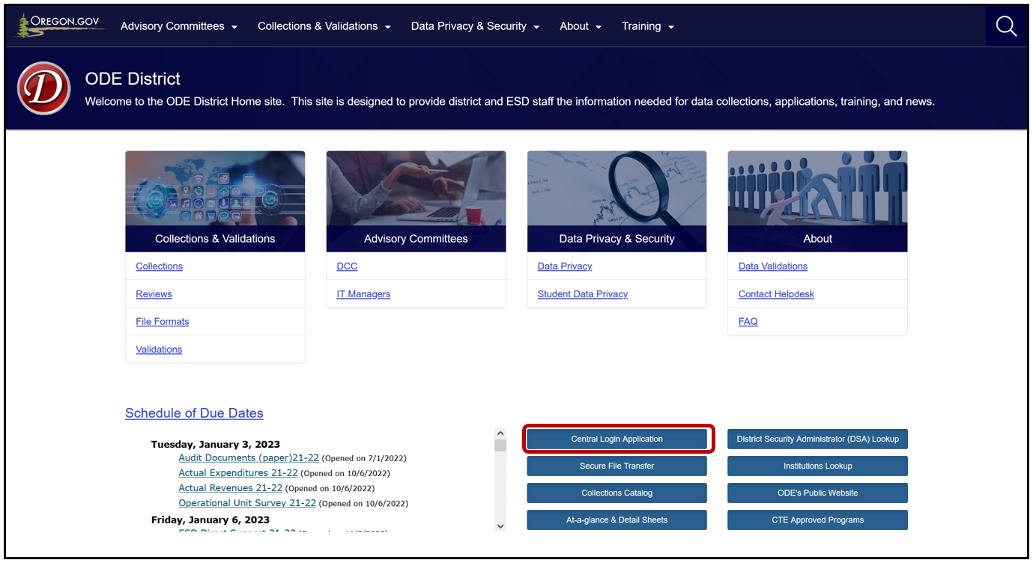
Logging In – District Site
The ODE District site https://odedistrict.oregon.gov/Pages/default.aspx
Notes:
First you need to login. To do this you will access Consolidated Collections from the ODE District site at https://odedistrict.oregon.gov/Pages/default.aspx.
You will only be able to login if your District Security Administrator gave you Primary Submitter rights and Modify rights.
Click on Central Login Application.

Slide 75
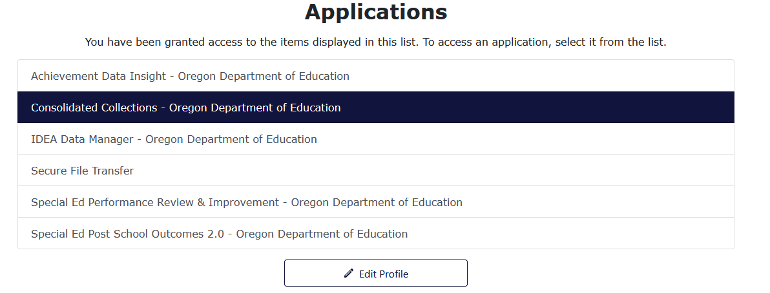
Logging In – Applications List
From the Applications list, click on Consolidated Collections
Notes:
From the Applications list, click on Consolidated Collections.

Slide 76
Logging In – Some Cautions
Districts should always login under their District ID
Consortium managers should always login and submit the same way (ESD or Member District)
Contractors for Programs should always login as the SD or ESD and not the program
Logging in a different way to add/update a record can:
  Display inaccurate counts on Status Tracking verification reports
  Display inaccurate counts on the Final Submission Form
  Lead to inability to see certain error messages
  May lead to inability to see audit messages for contractors
Notes:
Before we talk about submitting data, here are some cautions when logging in.
Districts should always login to December Child Count, June Exit and Child Find under their District
Consortium Managers should always login the same way to submit data. If you login as the ESD and submit data for all your member districts then you should always login under the ESD ID
Contractors for Programs should always login as the SD or ESD and not the program. Logging in a different way to add/update a record can:
Display inaccurate counts on Status Tracking verification reports
Display inaccurate counts on the Final Submission Form
Lead to inability to see certain error messages
May lead to inability to see audit messages for contractors

Slide 77
Submitting Data to ODE
Navigation
Data Submission
Error Management
Record Management
Verification Reports (Status Tracking)
Final Submission Form (Child Count & June Exit)
Production Download
Notes:
This is what we’ll cover in the demonstration for submitting data to ODE:
Navigation
Data Submission
Error Management
Record Management
Verification Reports (Status Tracking)
Final Submission Form (Child Count & June Exit)
Production Download

Slide 78
Review Window
Notes:
Now we’ll cover the Review Window and Data Quality.

Slide 79
Review Window – Purpose and Dates
Purpose is data clean-up
Goal is data quality!
Review Windows:
  Child Find and June Exit – August/September
  December Child Count – After New Year’s (January/February)
Notes:
I wanted to briefly talk about the Review Windows for the collections.
For the regular collection, please don’t submit placeholder data! The purpose of the Review Window is to clean up the data, not for submitting original data to ODE.
During the Review Window, you can make revisions to the data such as adding or deleting records.
In addition, we screen data for errors and provide audits messages or comments to help you with data clean-up.
The respective review windows are as follows:
Child Find and June Exit – In Fall (August/September)
December Child Count – After New Year’s (January/February)
For these, you have about a four weeks to do data clean-up, including reviewing and addressing ODE audits.

Slide 80
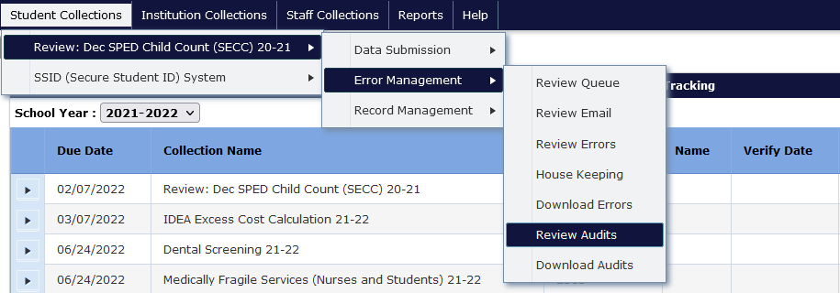
Review Window – Menu Navigation
Notes:
When the Review Window opens, login to Consolidated Collections.
In Consolidated, select the collection (e.g., Review December Child Count 20-21) then from the fly-out menus, select Error Management and then Review Audits.

Slide 81
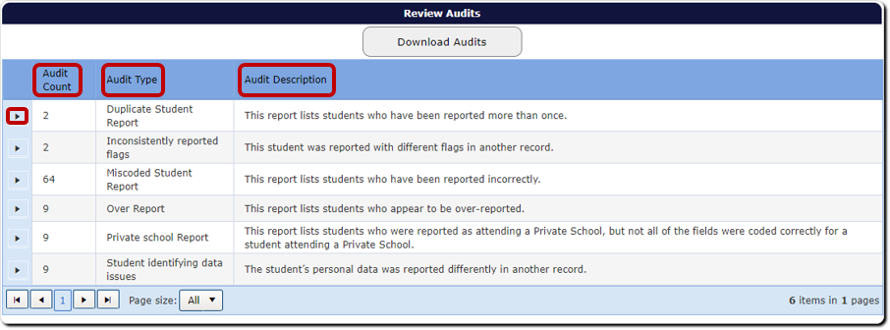
Review Window – Audit Screen
Notes:
In the “Review Audits” screen, you will see:
Audit Count – indicates how many records have the respective audit type.
Audit Type – indicated that type a potential error.
Audit Description – defines the audit type (tip: don’t need to pay a lot of attention to this).
To view audits, click the triangle expand button next to each Audit Type, will reveal a table with details of the records.

Slide 82
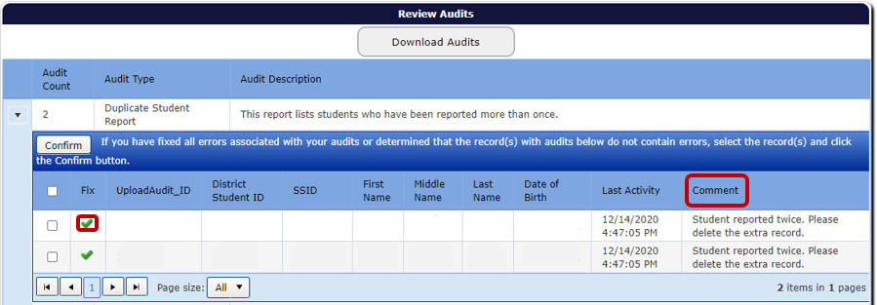
Review Window – Audit Details
Notes:
Under “Audit Details,” pay attention to the audit comment.
The comment is a message from the special education Data Team indicating why the record is being flagged as an error or warning.
If you are not sure what the comment means, call a member of the Data Team for assistance. It’s best not to just confirm it.
Click on the green check mark to review the record.
Once corrected, click “Confirm” (top left). This will save your corrections, and the record will disappear from the audit list.
Users can update records in the Review Audit screen, there is no need to do a Web Submission to add a new record with the corrected information. This will lead to duplicate records. The same is true for the Review Errors screen.
Please note that you cannot delete records from the Review Audit screen. To delete records, go to Record Management, Record Maintenance.

Slide 83
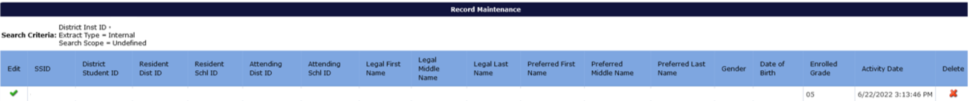
To Delete a Record
Search for the student in Record Management/Record Maintenance
Once you have identified that this is the correct record
Click the red “X” to the far right
Notes:
We get a lot of questions about how to delete a record. These are the steps during the Review Window and the regular collection window.
Search for the student in Record Management/Record Maintenance. SSID is usually the easiest to find the student’s record, but you can also search by name.
Once you have identified that this is the correct record that you want to delete.
Click the red “X” to the far right.
When asked if you want to proceed, indicate yes.
The record is deleted from your submission.
Note while you can delete records from the Review Errors screen, you cannot delete record from the Review Audit screen.

Slide 84
Review Window – Problem Areas
Web Submission vs. Editing a Record:
  Web Submission is to add new records
  To edit records
    Records in Error Management (Audits or Errors), click the green checkmark
    Records not in Error Management, go to Record Management, Record Maintenance
  Final Submission Form is required (Child Count and June Exit)
  The Final Submission Form button is only available when the collection is open
  Approving the verification reports in Status Tracking is required for the Review Window
Notes:
If you need to edit a record, do not use Web Submission. This has resulted in duplicate records being submitted.
If updating a record with an audit in the Review Audit screen, click the green checkmark to edit the record and then click Save and Confirm when done.
If updating a record in the Review Errors screen, click the green checkmark to edit the record and then click Save when done.
If updating a record in general, go to Record Management, Record Maintenance first.
If the record is there, click the green checkmark to edit the record and then click Save when done.
If the record is not there and the record is not in Review Errors, go to Data Submission, then Web Submission to add the record.
Final Submission Form is required (Child Count and June Exit) for both the Main window and the Review Window. In November/December, you will send the Child Count form, and in January/February, you will send the Child Count Review Window form. In June/July, you will send the June Exit form, and in September/October, you will send the June Exit Review Window form.
Reminder! The Final Submission Form button is only available when the collection is open. If you need the download the form after the collection closes, a member of the Data Team can do that for you.
Reminder! Approving the verification reports in Status Tracking is required for the Review Window for Child Count, Child Find and June Exit.

Slide 85

Data Quality
Timely
Accurate
Used for Annual District Determination Status
Collection | Timely | Accurate
December Child Count | Yes | Yes
June Exit | Yes | Yes
Child Find | Yes | Yes
Notes:
Next I want to talk about submitting timely and accurate data and what will happen if you don’t submit on time or submit accurate data.
Timely and accurate data submissions are included as part of each district’s overall determination annually. This is important because data drives decisions and improvement efforts.
Timely means that you submitted your data by the due date. This includes verifying your reports and sending us the Final Submission Form by the due date listed on the form.
If we have to open a collection for you to finish or for you to verify your reports, your submission is considered late. We don’t want anyone to be late, so we send listserv messages and call districts. As always, please call a member of the Data Team if you need help. We are here for you.
Accurate means just that… You submitted accurate data.
We only allow changes to Child Count for fiscal reasons once the Review Window closes. This is generally LTCT, JDEP, YCEP, OSD , PNF, Recovery School and Regional program students. If you feel you need to make a change, please contact a member of the Data Team. If a correction is made to your submission, your district will be considered inaccurate.
We generally do not allow corrections to June Exit or Child Find after the Review Window closes. If we find an error that impacts the federal report that is generated in October, we will contact you.
For Child Find, if you fail to recode or change your comment as requested during Child Find the Review Window, you will be considered inaccurate and ODE will recode the record for you. Ouch!
Consequences:
Timely and accurate is considered for each of the three collections.
The goal is for all three submissions to be timely and accurate.
If late once or inaccurate once during the year, then your district will have to implement improvement efforts. This means that one ‘No’ results in an automatic determination of “Needs Intervention” for your district.

Slide 86
Tips for Submitting Timely and Accurate Data
Keep your data up to date
Submit as early as possible
Train at least one back-up
Make an annual plan
Notes:
Here are some tips for submitting timely and accurate data.
Keep your data up to date at all times as much as possible. The more up to date the data, the less time it will take to prepare data for submission.
Submit data as early as possible. You don’t want to rush but technology, weather, and other factors can suddenly keep a district from being able to submit data on the final day.
Train at least one backup person to submit, validate, and correct data for each data collection. Key people may get sick, injured, or leave without notice. Do not forget to have the District Security Administrator grant appropriate permissions to the backup staff member (Primary Submitter rights and Modify rights).
Make an annual plan with a data submission calendar for submitting your data. What needs to be done when and by whom.

Slide 87
IDEA Data Manager
Notes:
Next, we will go over using the Data Manager.
First we will provide an overview of IDEA Data Manager Tools for cleaning your December Child Count, June Exit or Child Find data.

Slide 88
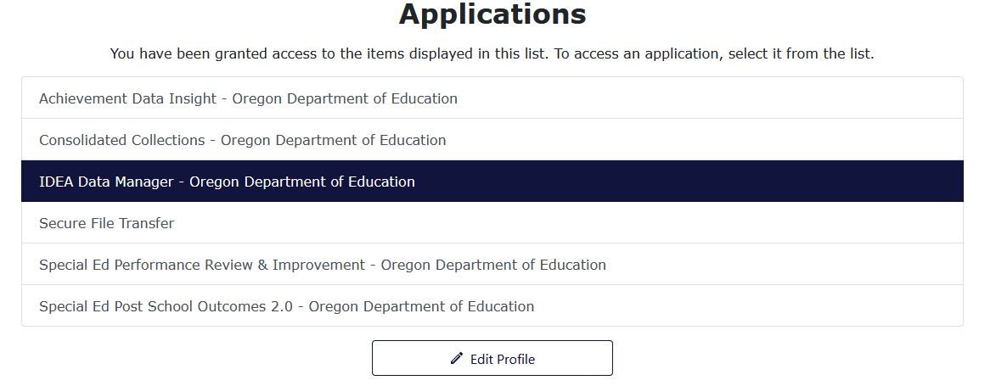
Logging In
From the Applications list, click on IDEA Data Manager
Notes:
Logging in takes Users to their Applications List, (yours might appear differently).
From the Applications list, click on IDEA Data Manager.

Slide 89
Steps for December Child Count
Navigation
Entering and Importing Data
Validating and Fixing Errors
Deleting a Record
Exporting a File
Utilities
Built-In Reports
Notes:
For this part of the training we will demo the steps for December Child Count. These steps are the same for June Exit and Child Find.

Slide 90
IDEA Data Manager Collections
Notes:
Now we will cover the collections within the IDEA Data Manager.

Slide 91
Additional IDEA Data Manager Topics
Agency
  Staff Contacts
  Late and Inaccurate
CEIS Collection (Districts Only)
Private School Collection (Districts Only)
Notes:
In addition to the tools for cleaning your SECC and Child Find data, the IDEA Data Manager also includes:
Agency
Staff Contacts are used to contact and notify agencies regarding data collections.
Late and Inaccurate shows district late and inaccurate status.
CEIS Collection
Unlike the tools for SECC and Child Find, this is the actual collection site.
All districts required to submit even if not using IDEA funds for CEIS.
This is a school district only collection, ESDs and EI/ECSEs do not submit.
Private School Collection
Like with CEIS, this is the collection site.
All districts required to submit even if there are no private schools within the district boundaries.
This is a school district only collection, ESDs and EI/ECSEs do not submit.

Slide 92
Agency – Annual Updates
Listserv sent in August as a reminder to update Agency information
Remember to:
  Update, Save and Click to Verify all tabs
  Add to Listserv flag should be Yes if Staff Contact should be on listserv
  If no applicable Staff Contact field but want on Listserv, email ODE.OSS-DataTeam@ode.oregon.gov.
  Additional Information is to communicate special information
Notes:
We always send a listserv reminder to update Agency information in August.
Some things to remember:
You will want to check each tab and update as needed and as a final step always click on the Click to Verify button. This is the only way we know the information is up to date (Agency, Staff Contacts, SECC Consortium).
To ensure a staff contact will be on the listserv, be sure the Add to Listserv flag is Yes.
If there is no applicable staff contact field but they want or need to be on the Listserv, please email ODE.OSS-DataTeam@ode.oregon.gov.
Use the Additional Information field to communicate special information to us that you want us to know. Some districts use it to add a back up SECC or Child Find data submitter.

Slide 93
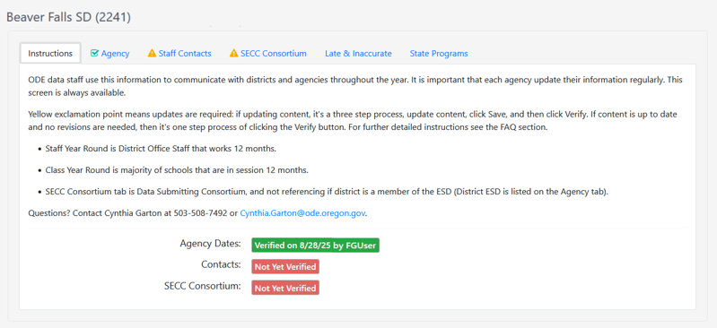
Agency – Instructions Tab
Notes:
First tab for Agency is the Instructions tab, which provides basic information and explanations of what we mean by terms like staff year round and SECC Consortium.
It also contains verification status the three editable tabs: Agency, Contacts and SECC Consortium.
Each tab defaults to display a yellow triangle, indicating action is needed.
When verified, the tab will display a green check box.
Verification status also displays in the boxes in the bottom part of the screen: a red box for Not Yet Verified and a green Verified box with the name of the person who verified and the date.

Slide 94
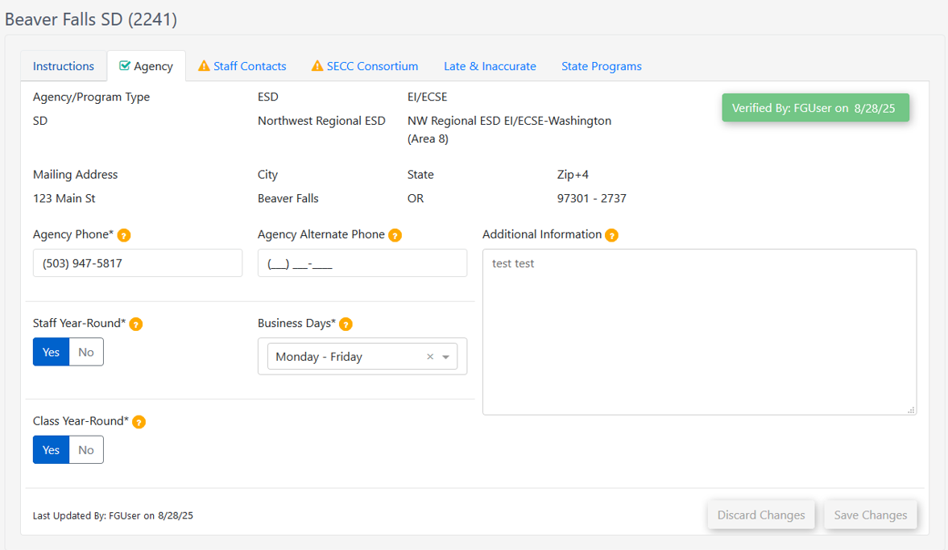
Agency – Agency Tab
Notes:
The Agency tab shows basic agency information, such as address, phone, business days and if staff is in office year-round.
The top portion is not editable and comes from the Institutions database. If there is an error, please let a member of the Data Team know so we can get you an Institutions Update Request form.
Business days is helpful for us, so we know the districts that are Monday though Friday and those that are Monday through Thursday.
Staff Year-Round indicates whether staff who submit data collections work year round or not.
There is a verify button at the top of the screen. When clicked, name and date will appear in a green box.
Note: The most common errors on this tab are for the First and Last Day of School fields. If the year is two digit instead of four digit, then the system will throw an error. Also, if the year is outside the current school year, then it will throw a validation error. Example would be End of Class is June 2024 instead of 2025.

Slide 95
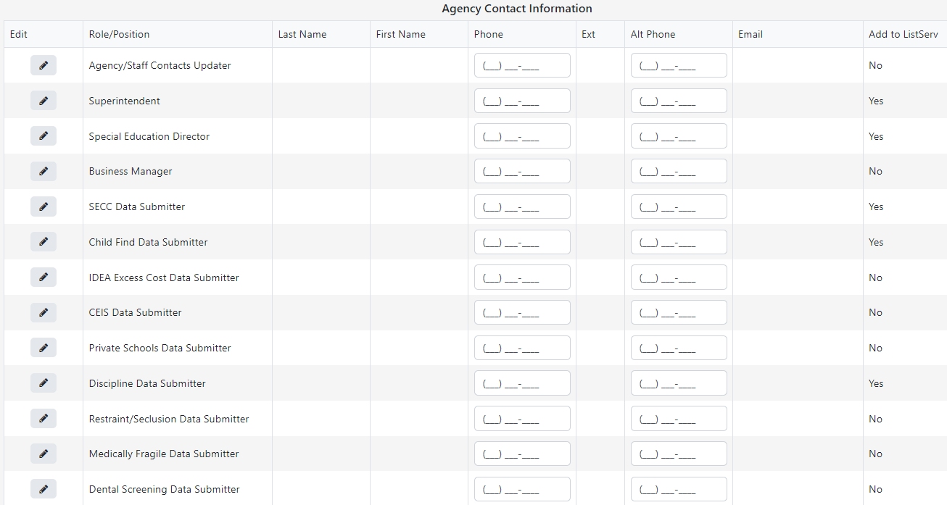
Agency – Staff Contacts Tab
Notes:
The Staff Contacts tab gathers data submitter contact information. When a contact is updated, ODE staff receive an email containing the updated contact information, which allows us to add new staff to our Listserv as soon as possible.
Purpose:
Information is used to contact Data Submitters, Special Education Directors, and Superintendents – if we have questions or need to call in advance of collection closing
Used to populate the Superintendent and Special Education Director on the At A Glance Special Education Profile that is published in late winter/early spring! If these are not updated the profile is published with incorrect names and is out there for many years.
Used to update our Special Education Collections Listserv
Required staff contacts:
Agency/Staff Contacts Updater
Superintendent
Special Education Director
Business Manager
SECC Data Submitter
Child Find Data Submitter
IDEA Excess Cost Data Submitter
CEIS Data Submitter
Private School Data Submitter
Discipline Data Submitter
Restraint/Seclusion Data Submitter
Medically Fragile Data Submitter
Dental Screening Data Submitter
There is a column for Add to Listserv
This tells ODE you want to be on the Listserv
Required, and defaulted to Yes, are Special Education Director, SECC Contact, and Child Find Contact
Other contacts can choose Yes or No
When a contact is updated, a name and date will appear in columns at the far right.
There is a verify button at the top of the screen. When clicked, name and date will appear in a green box.
Problem Areas: Don’t forget to update the staff contact’s email.

Slide 96
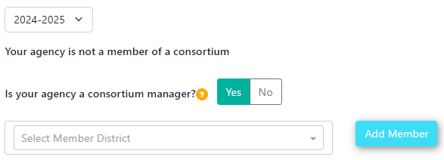
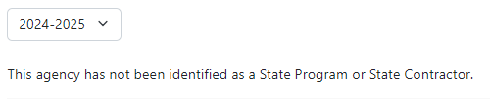
Agency – SECC Consortium and State Programs
Consortiums
State Programs
Notes:
The SECC Consortium tab is where districts and ESDs can indicate if they are consortium managers.
If yes, a list of members will display
In this list, there is a button to remove members
There is a drop menu to add new members
Member districts will see their Consortium manager listed on this page. If it is incorrect, please contact that ESD or School District.
The State Contractors tab is where districts and ESDs can see if they are contract managers.
If yes, a list of programs will display
State Programs tab is updated by ODE
Both tabs have drop menus for collection years, so districts and ESDs can see prior year memberships.

Slide 97
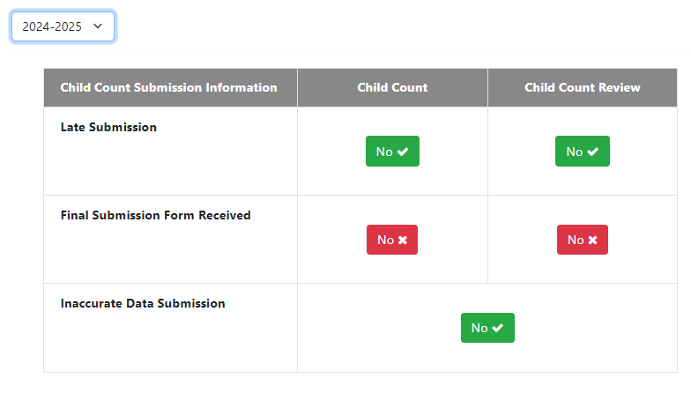
Agency – Late & Inaccurate Tab Start of Year
Notes:
In the IDEA Data Manager, you can review data quality in the Late and Inaccurate tab. This is a view only tab for districts and ESDs to review their data quality to see if they are timely and accurate. This screen indicates No for all fields until ODE updates them. We do not update these until we receive and process your Final Submission Form, or until after the collection is closed. The Main collection window and Review Window have their own columns of Yes/No flags. A problem area is districts seeing No for Final Submission Form Received in the Review column and think we have not received the Main Window form. They reach out to us in a panic asking why the table says No, and will try to resubmit their Main Window form. This is especially common in the summer before the June Exit Review Window opens. If we don’t have your form, we will reach out to you before the due date listed on the form.
This tab contains late and inaccurate information for December Child Count, June Exit and Child Find and their review windows. There is a drop menu for collection years, so districts and ESDs can see prior year late and inaccurate information.
Note that the Child Find table does not show Final Submission Form information because it does not have a Final Submission Form.
Data from this screen is used in SPR&I to indicate whether districts are timely and accurate.

Slide 98
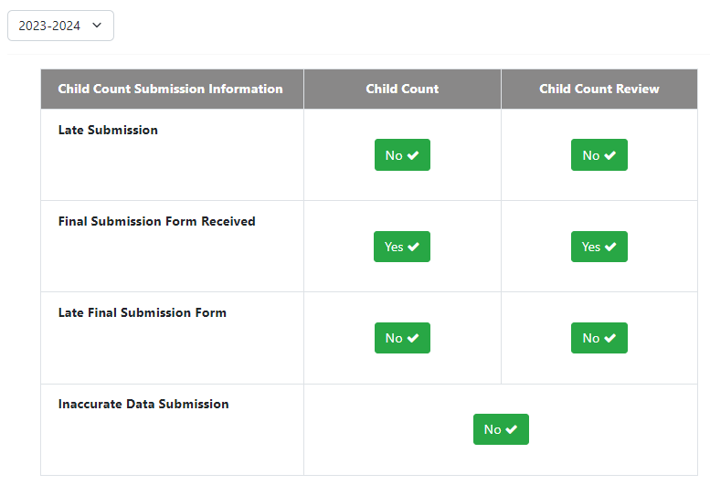
Agency – Late & Inaccurate Tab Example 1
Notes:
After the collection is complete and ODE has processed the forms, green means good:
Late Submission marked No is green, as that means the district was timely.
Final Submission Form Received marked Yes is green, as that means ODE received the form.
Late Final Submission Form marked No is green, as that means ODE received the form by the due date.
Inaccurate Data Submission marked No is green, as the district submitted accurate data.
In this example, the district got all of Child Count in timely and accurately.

Slide 99
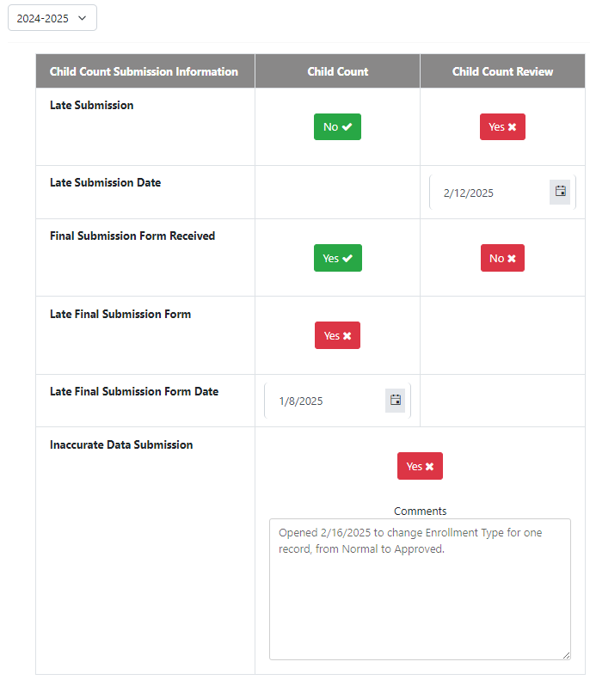
Agency – Late & Inaccurate Tab Example 2
Notes:
After the collection is complete and ODE has processed the forms, red means bad:
Late Submission for Review marked Yes is red, as that means the district was not timely for that collection.
When marked Yes, a field with the date of the late submission will display. In this example the date is February 12, 2025.
Final Submission Form Received for Review marked No is red, as that means ODE has not received the form.
Note that if you see Final Submission Form Received set to No before the due date listed on the form and you know you submitted it, don’t panic, as we may not have processed it yet.
Late Final Submission Form for Child Count marked Yes is red, as that means the district did not submit the form timely for that collection.
When marked Yes, a field with the date of the late submission will display. In this example the date is January 8, 2025.
Inaccurate Data Submission marked Yes is red, as that means the district submitted inaccurate data.
If inaccurate, a comment box will display why the district was inaccurate. In this example the Review Window was opened to fix a record.

Slide 100
CEIS Collection
Tabs
  Overview
  CEIS Data
  Use of IDEA Funds for CEIS
Notes:
CEIS Collection (Districts Only)
It opened September 25 and will close November 17, 2025.
Overview tab – basic steps (refer to link for more information and detailed instructions)
CEIS Data Tab – enter data from previous year which is used for the federal report. “Did your District/Agency use IDEA funds for CEIS or CCEIS in 2024-2025?” is a Yes/No flag and ODE populates the answer based on prior year Use of Funds selection.
If Yes, district enters data into the student count and expenditures fields.
If No, the district will click the Save and Verify buttons.
If a district was required to reserve funds for CCEIS during the prior school year, the flag will be defaulted to Yes and cannot be changed.
Use of IDEA Funds for CEIS Tab – enter the plan for current year. “Will the District/Agency reserve IDEA Funds for CEIS in 2025-2026?” is a drop menu for Yes and No.
If Yes, Voluntary, data entry fields will appear, and the district must enter data into the activity, plan, funding and estimated student count fields.
If the district does not plan to expend funds for CEIS, leave this field as “No, Not Required” and click the Save and Verify buttons.
If a district is required to reserve funds for CCEIS during the current school year, this field is prepopulated and cannot be changed.
All districts must click the Save and Verify buttons for both tabs as this confirms their status of Yes or No, and confirms the data entered.

Slide 101
Private School Collection
Schools rolled from last year
Enrollment
  Counts by school
Proportionate Share
  Check student counts
  Add carryover funds
Notes:
Private School Collection (Districts Only)
It opened September 25 and will close November 17, 2025.
Schools are rolled over from the prior year, and schools marked closed do not roll. You will need to add new schools and indicate those that closed.
Enrollment - “Does your district have private schools located within district boundaries for the 2025-2026 school year?” is a Yes/No flag and we populated this based on prior year selection. If Yes, district enters the enrollment data.
All districts must verify this screen.
Proportionate Share
We populate for districts based on December Child Count and IDEA 611 & 619 Flow Through Allocations.
Districts need to add carryover funds, if any.
Student count fields are locked.
Verification of this screen is optional.

Slide 102
Getting Assistance/Resources
SECC GovDelivery Listserv
  Check your clutter, junk or spam!
  Delivery system sends from ODE
  Be sure to read the Listserv messages
YouTube Videos: https://www.youtube.com/channel/UCaii77lr_Y00qyjL8OMcq2A
Trainings
Resources: https://www.oregon.gov/ode/reports-and-data/SpEdReports/Pages/SEDC-Training-Resources.aspx
Notes:
SECC GovDelivery
Messages sent from email address ode@public.govdelivery.com and sender Oregon Department of Education. We add Special Education Data in the subject line so the messages stand out.
Check your junk or spam!
It is important to be on our listserv if you are a data submitter. We use the listserv to notify when collections open and close, trainings and important updates.
It is important to read the entirety of each email. These messages contain critical information that are must know.
All of you will be added to our listserv. If someone needs to be added be sure to contact a member of the Data Team.
YouTube Videos
These are short, around 5 minute videos for:
All major functions of the IDEA Data Manager tools for SECC and Child Find
Reports and Help functions within IDEA Data Manager
Importing and Exporting Data within IDEA Data Manager
Navigating Consolidated Collections
Uploading a file to Consolidated Collections
Trainings
We provide Boot Camp for new data submitters
We provide one virtual fall webinar. See bottom of agenda for the date.
We provide one virtual spring webinar.
We try to provide a recording of the fall webinar and spring webinar for those who are unable to attend the virtual webinars.
Resources
We have the P&C Manual, P&C Supplement, Consolidated Collections User Guide, IDEA Data Manager User Guide and the Child Find Manual, which are located on the Boot Camp Materials web page.
We also have Q&A documents posted to the public web. These were compiled based on questions asked during trainings and webinars.

Slide 103
Resources
IDEA Data Manager Help features
Institution Lookup: https://www.ode.state.or.us/instID/
Schedule of Due Dates (SODDs):
https://district.ode.state.or.us/apps/info/
Collections and Validations: https://odedistrict.oregon.gov/CollectionsValidations/Pages/default.aspx
File Formats: https://odedistrict.oregon.gov/CollectionsValidations/FileFormats/Pages/default.aspx
ODE Collection Catalog:
https://www.ode.state.or.us/apps/CollectionCatalog
Notes:
IDEA Data Manager Help features
The IDEA Data Manager also has resources in the Help menu
FAQs contains frequently asked questions about Child Count, June Exit and Child Find
Resources contains:
ODE staff contacts
Links to manuals and user guides
Link to YouTube page
Links to collection webpages on District website
Link to training resources on public website
Institution Lookup
This page is where you can look up district IDs and Names.
Schedule of Dues Dates
Schedule of Due Dates, also known as SODDs, is a list of all ODE collections
Contains open and close dates, contact person, email and phone
Collections and Validations
Collections and Validations page has links to all ODE collections
These pages contain:
Open and close dates, contact person, email and phone
Manuals and user guides
Training resources
PowerPoint presentations, video links and upcoming trainings
File Formats
IT has moved all file formats to this centralized webpage, which will contain the most up to date file formats
ODE Collection Catalog
This application can be used to search for information about the data that ODE collects or has collected
Provides basic information on collections, such as purpose, description, collection type, collection audience, and publications (reports that use or show the data)
To search for a collection:
Type in a collection name or select the criteria you are interested in, then click “Search”
The default search is for all collections that match any of the criteria selected
Use the dropdowns to limit the search to only open or discontinued collections, or to require results to match all of your search criteria
Discontinued collections are listed, including those that have been replaced by a new collection - CEIS and Private School will display both the discontinued paper collection and current electronic collection
Contacts – On the next slide - any questions call or email us. We are here to help. Our goal is to provide good customer service to you.

Slide 104
Contact Information
Name | Phone |  | Email
December Child Count, June Exit and Child Find
Jackie McKim |  | 971-240-0234 |  | jackie.mckim@ode.oregon.gov
Cynthia Garton |  | 503-508-7492 |  | cynthia.garton@ode.oregon.gov
Maxwell Swope |  | 971-208-0259 |  | maxwell.swope@ode.oregon.gov
Amanda Claycomb |  | 503-931-8003 |  | amanda.claycomb@ode.oregon.gov
Cara McMurry |  | 503 689-2783 |  | cara.mcmurry@ode.oregon.gov
Child Find Data Owner
Cherisse Gordon |  | 503-428-7080 |  | cherisse.gordon@ode.oregon.gov
Notes:
Customer Service is important to us!
Here is our contact information should you need help with your collections. Please call or email us if you need help.
The Data Team can answer questions for any of the three collections.
Cherisse Gordon is the data owner for Child Find. The special education Data Team can answer technical questions regarding the data to be reported, how to resolve errors and audits, as well as navigation of the IDEA Data Manager and Consolidated Collections. However, compliance questions should always be directed to Cherisse.
We will be sending you an evaluation survey via Survey Monkey tomorrow. Your thoughts are important to us so please fill it out.
Any final questions?
Thank you so much for all that you do. We appreciate you. Have a wonderful afternoon.

Slide 105
Thank you!
Notes:
Thank you!

