Slide 1
Abbreviated School Day Programs
End-of-Year Activities
May 2026

Slide 2

Purpose of this Training
Prepare for the end-of-year activities required for Abbreviated School Day Programs
Avoid having to complete required activities during the summer months.
Review questions around parent choice for ASDP
Review revised charter school flowchart.

Slide 3
Information Security & ODE Help Desk
Data is Confidential​
FERPA​
HIPAA (transfer of records)​
Email SSID numbers only​
​ODE Data Team ​
Always call us first ​
If necessary, we can refer you to the Help Desk
Notes:
Jackie
Data collected is considered confidential, personally identifiable information is​
Protected by FERPA (Family Educational Rights and Privacy Act)​
Oregon Identity Theft Protection Act ​
And in some cases, HIPAA (Health Insurance Portability and Accountability Act), mainly the transfer of records from one agency to another. ​
Loss of protected data can have a financial impact to your school, district, ESD including fines and cost of remediation! Failure to comply can lead to legal problems, lawsuits, fines, cost of remediation, etc.​
Keep in mind that State email is public – be careful when sending information to us, e.g. student name, DOB, grade, etc. It is okay to send SSID only (with zero personal information).​
​
ODE Help Desk​
If you are having technical difficulties with submitting your data, you can call the help desk for:​
Technical assistance submitting your data​
See if data submitted​
Questions about access rights and permissions​
However, the ODE Help Desk:​
Can’t answer questions about Abbreviated School Day
Recommend that you always call a member of Data Team first ​
If necessary we will send you to Help Desk​

Slide 4
End of Year Timeline
Check all 2025-2026 student records for accuracy and make appropriate updates.
Review all student records retained from SY 2025-2026 and make any required changes.
End of Year Verification Form for all SY 2025-2026 ASDP records signed and sent to ODE.
Now until June 30
Starting July 1, 2026
July 17, 2026
May and June
July 1, 2026
July 8, 2026
Create a list of students who will be exiting ASDP by the EOY and add a stop date.
2026-2027 will display in the School Year Drop Menu.
Records for June 2026 must be verified in the ASDP collection.
Notes:
Jackie
Here is an end of year timeline to help you identify what needs to be completed each month.
Now until June 30 check all your 2025-2026 records for accuracy and make any needed updates
May and June - develop a list of students exiting the Abbreviated School Day Program on of before June 30. You will need to login an add stop dates for all of these records so they don’t roll over on July 1 to 2026-2027.
July 1, 2026, the 2026-2027 School Year will appear in the dropdown.
Beginning July 1 review all records that rolled over from 2025-2026 and make any required changes
No later than July 8 verify the month of June. Note that June can be verified as early as June 1 unlike other months.
July 17, 2026, the End of Year Verification for 2025-2026 must be signed and sent to ODE

Slide 5
Check all 2025-2026 Student Records
for Accuracy
Now until June 30
Review records to determine any that may need to be updated/changed for accuracy.
Consider:
Dates of expected return to full day
Student minutes
Reason codes
Latest consent documents uploaded
Latest IEP date
Notes:
Jackie
Review and determine if any records need to be updated by June 30, 2026. You will want to check:
the Expected Date to Return to Full School Day
the Student's Weekly Instruction and Service Minutes as well as the Weekly Minutes for Grade (Bell to Bell)
the Program Reason Code to be sure it is up to date, accurate or should be recoded if code 6 Other was used
Confirm the most recent parent consent form has been uploaded
Check the Latest IEP Date

Slide 6
Create Your Exit List Now
May and June
Start to gather a list of students who will exit ASDP on or before June 30, 2026. Include:
Students graduating with a regular diploma.
Students receiving another type of diploma and NOT moving on to the transition program within a school district.
Students returning to full-time instruction.
Students no longer in special education or have a 504 plan or no longer under evaluation.
Students moving out of the district.
Notes:
Jackie
Prepare your list of students who will exit ASDP on or before June 30. For example:
Students graduating with a regular diploma. FAPE ends so they will exit special education.
Students receiving another type of diploma and NOT moving on to the transition program within a school district unless they are turning 21 on or before September 1.
Students returning to full-time instruction.
Students who are no longer in special education or who no longer have a 504 plan
Students who are no longer under evaluation, including if they were determined not eligible for special education or 504.
Students moving out of the district.

Slide 7
Deadline to Add Student Stop Dates
June 30, 2026
No later than June 30, 2026, enter student stop dates for all students exiting their Abbreviated School Day Program this school year.
If you are unsure if a student is leaving the district or will be returning to a full day of instruction in the fall, keep the student in the application.
Do not enter a stop date for students moving into 18- to 21-year-old transition program who are turning 21 after September 1.
Notes:
Jackie
The deadline to add stop dates to 2025-2026 records is June 30, 2026.
If unsure if the student is leaving or will no longer be on a abbreviated day, do not add a stop date to the record.
Also, you will not enter a stop date for students moving into 18- to 21-year-old transition program who will turn 21 after September 1.

Slide 8
Verify 2025-2026 Data
June
Make sure September 2025 through June 2026 verifications are completed by June 30.
  Re-verify months if any changes were made to records.
Go to the Reports tab, then select the menu option “End of Year Verification”
  Download the End of Year PDF
  Print the report, sign it and send to ODE.
Notes:
Jackie
Makes the months of September 2025 through June 2026 are verified before or no later than June 30. Note that there is a glitch that is causing prior months that were verified to become unverified. The original verification dates are retained in our database so don’t be alarmed. Just be sure to verify them all again if they revert back.
Also, be sure to Re-verify any moths where yo made changes to records
Once you have verified and re-verified september through june, the next step is complete your end of year verification. to do this:
Go to the Reports tab, then select the menu option “End of Year Verification”
Download the End of Year PDF
Print the report, sign it and send it back to ODE.
.

Slide 9

2026-2027 Available in ASDP Application
July 1, 2026
Districts can begin to add new students to the ASDP Application for the 2026-2027 school year as early as July 1, 2026.
Districts cannot retroactively add students who were placed on an ASDP during the 2024-2025 school year.
If Districts need to add a record for 2025-2026 then this can be done until June 30, 2027.
  Caution: This is for data cleanup only and not normal practice.
  Reminder: Best practice - add the record as soon as possible.
Notes:
Jackie
2026-2027 will be available on July 1, so you can add new students who will start their ASDP program in 2026-2027 on or after July 1
2024-2025 records cannot be added on or after July 1. The ability to add records for students placed on ASDP in 2024-2025 is closed as of July 1.
2025-2026 records - you can add a 2025-2026 records until June 30, 2027. This should be for clean-up only, not normal practice. Ideally, your 2025-2026 submission should be complete and accurate as of June 30, 2026.

Slide 10
Start the 2026-2027 SY by Updating Open Records
July 1 - September 30
Review all students whose program records continued from 2025-2026.
By September 30, complete any necessary edits to student records carried over from 2025-2026.
Examples of Changes:
Updated minutes of instruction and educational services
Updated reason code
Student now eligible for an IEP or 504 Plan who was previously under evaluation, etc.
Student has left the district over the summer
Student is no longer on an ASDP
Notes:
Jackie
Start 2026-2027 on the right track by updating all open records that rolled over from 2025-2026.
These updates should be completed on and by Spetember 30. Some examples of changes might be:
Updating the minutes of instruction and educational services
Updating the reason code
Changing the disability status selection for students who are now eligible for an IEP or 504 Plan who was previously under evaluation.
Be sure to add a program stop reason code and program stop date to students who moved out of or left the district over the summer OR who are no longer on an ASDP

Slide 11

Verify September 2026 Records
October 8, 2026
Records entered in July and August will be verified with September.
  These must be verified by October 8, 2026.
REMINDER: Always upload the most recent parent consent into the application each time you hold a review meeting.
Notes:
Jackie
Records rolled over from 2025-2026 that are still active and records entered in July and August will be verified for the month of September. This will be the first moth to be verified for 2025-2026.
September must be verified by October 8
Also, you will also need to upload the most recent parent consent form into the application each time you hold a review meeting.

Slide 12

Other Reminders
The count for meeting days and the Superintendent’s Review stops over the summer.
  Pick up the count on the first day of the 2026-2027 school year.
Although not required, best practice would be to hold IEP and 504 meetings at the beginning of the new school year for students with open records.
Do not simply assume an ASDP needs to continue. Deeply analyze the new situation (new teachers, supports, etc.)!
Notes:
Elizabeth

Slide 13
Problem Areas for ASDP Records
Common ASDP Data Errors
Wrong Program Start Date
Wrong Date of Initial Parent Consent
Daily minutes entered instead of weekly minutes
Number of hours entered instead of weekly minutes
Reason Code 06 “Other” selected when there is an available reason code that fits
Logging in as a school to submit and/or verify
  Must be done at the school district level
  Exception: state sponsored charter schools
When in doubt, reach out to ODE, we are here to help!
Notes:
Jackie
Some common ASDP errors the data team has encountered include records with:
The wrong program start date. This fix for this is not easy. The record has to be deleted by ODE and then the district has to reenter it.
The wrong date of initial parent consent,
the student is SpED but the last IEP date is blank,
The daily number of minutes was entered in lieu of the weekly minutes, or the number of hours were entered instead of the weekly minutes.
When selecting the reason code, check the list of available reason codes for a more appropriate code before selecting code 06, “Other.” the OESO recode team will have you recode the record if they fit under another reason code. For example, if the student attends a special program that has a school day that is shorter, use code 10, “Special School or Program.”
Logging in as a school to submit and/or verify
Must be done at the school district level
Exception: state sponsored charter schools
When in doubt, don’t hesitate to reach out to ODE. Our contact information has been included at the end of this presentation.

Slide 14
Review of Parent Requests for ASDP

Slide 15
Flow Chart Steps
1. Is parent choice the sole reason the student currently does not receive a full-day of instruction? Yes or No. If No, student continues to remain in the ASDP application.
2. If Yes, is the parent choice reason linked to attending a charter school, a virtual public charter school or other school of choice whose instructional time may be less than the resident district?
3. If Yes, the student should remain in the application.
4. If No, has the district communicated with the parent that they can provide meaningful access to instruction on a full-time schedule despite the parent request for an abbreviated school day?
5. If No, the school has agreed with the parent request to provide an abbreviated school day program. The student is therefore on an abbreviated school day program and should remain in the ASDP application.
6. If Yes, the district has shared it is ready and able to provide a full-time schedule and therefore the student does not belong in the ASDP application.

Slide 16
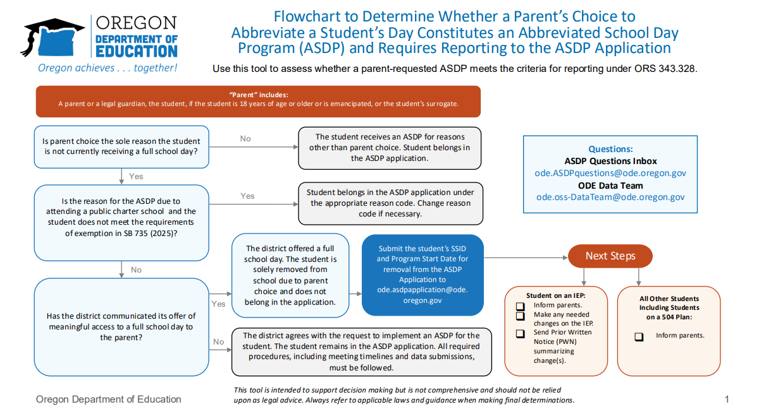
Flowchart to Determine if a Parent’s Choice to Abbreviate a Student’s Day is reportable in the application
Notes:
Will put the flow chart in the chat.

Slide 17
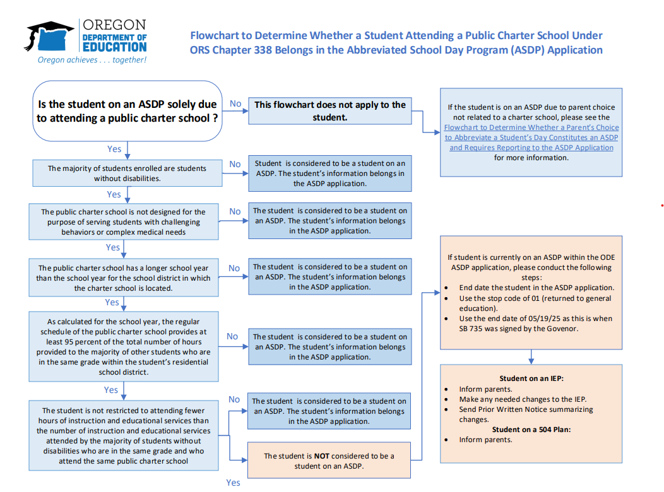
Flowchart to Determine if a Student Attending a Charter School is reportable in the application
Notes:
Will put the flow chart in the chat.

Slide 18

What questions do you have?

Slide 19

We Are Here to Help
Policies and Procedures
ode.ASDPquestions@ode.Oregon.gov
Data Application Support
ode.ASDPapplication@ode.oregon.gov

Slide 20

Oregon Department of Education
for the incredible work you do throughout the entire school year to keep our ASDP records up to date. It is appreciated!

