Slide 1
Abbreviated School Day Program
Data Collection Training
2026-2027
September 17, 2026

Slide 2
About this Training
Commonly used acronyms
ODE – Oregon Department of Education
OESO – Office of Enhancing Student Opportunities
ASDP – Abbreviated School Day Program
DSA – District Security Administrator
How to get the most out of this training:
Mute your mic when you are not speaking
Ask questions

Slide 3

Agenda
Collection Background
Getting Started
Data Entry and Record Management
Verification
Demonstration:
  Logging in and Navigation
  Submitting & Editing Records
  Verification
  Production Downloads
Common Issues and Troubleshooting
Resources and Closing

Slide 4
Upcoming Trainings & Office Hours
Upcoming Trainings:
ASDPs for Charter Schools
  October 14, 2026, from 10 - 11 a.m. Registration Link
Conducting Compliant Meetings – Lunch & Learn
  October 14, 2026, from 12 - 1 p.m. Registration Link
Exemptions & Exceptions – Lunch & Learn
  October 20, 2026, from 10 - 11 a.m. Registration Link
2026 Virtual Office Hours:
Wednesday, October 7, 2026, from 10 - 11 a.m. Registration Link
Monday, October 19, 2026, from 10 - 11 a.m. Registration Link
Thursday, November 12, 2026, from 2 - 3 p.m. Registration Link

Slide 5
Recorded Webinars
Available Recordings:
ASDP Essentials Part 1 2026-2027
  Recording Link; Passcode: vdXtA6z.
ASDP Essentials Part 2 2026-2027
  Recording Link; Passcode: q6*Z^pGY
ASDP Refresher Training 2026-27
  Recording Link; Passcode: i%0VK1$X

Slide 6
Information Security
Data is confidential
HIPAA (transfer of records)
Email SSID numbers only
FERPA
Use the “Notes” function in the application

Slide 7
Collection Background

Slide 8

Abbreviated School Day Programs (ORS 343.322)
Ensuring Equitable Access to Instruction for Students with Disabilities
The Legislative Assembly finds that:
(a) Students with disabilities have a right to meaningful access to the same number of hours of instruction and educational services as the majority of students without disabilities who are in the same grade within the student’s resident school district.
(b) Removal from school is neither a service nor support for students with disabilities.
(c) Use of an abbreviated school day program for students with disabilities should be infrequent and, under most circumstances, should be used for a limited duration.

Slide 9
What is an Abbreviated School Day Program?
An Abbreviated School Day Program (ASDP)
Is an education program:
In which a school district restricts a student’s access to hours of instruction or educational services to less than the number of hours of instruction or educational services that are provided to the majority of other students who are in the same grade within the student’s resident school district.
That results in a student having an abbreviated school day for more than 10 cumulative school days per school year.

Slide 10
Which Students Does ASDP Apply To?
A student who is eligible for special education and related services, as provided by ORS chapter 343;
A student who has a disability under Section 504 of the Rehabilitation Act of 1973, 29 U.S.C. 794, and is eligible for a 504 Plan including students eligible without a plan; or
A student who has not been determined to be eligible for special education and related services, as provided by ORS chapter 343, or to be eligible for a 504 Plan, but for whom a request or referral for evaluation for eligibility determination has been made but not yet completed.

Slide 11

How Do We Determine if a Student is on an ASDP?
To identify if a student with a disability is receiving fewer hours of instruction or educational services, compare the student's “bell-to-bell” schedule by day to their same grade level peers in their resident school district.*
If the student is receiving fewer minutes on any day of the week than their comparison group, after 10 such days in a school year, the student is on an ASDP.
*Please review differing comparison groups
Instruction + Educational Services = Bell-to-Bell Services

Slide 12
Criteria for Reporting a Record
Eligible students must be reported when they receive an "Abbreviated School Day" as defined by ORS 343.321 for more than 10 school days per school year.
  Record(s) become reportable on day 11
  Days are cumulative!

Slide 13
Reporting Consecutive versus Cumulative Days
If Count of Days is 11 Consecutive Days:
Report the record
  Day 1, not Day 11, is the Abbreviated School Day Program Start Date
If Count of Days is 11 Cumulative Days:
  Report multiple records, one for each instance leading up to a count of 11 days total

Slide 14
Example: If Count of Days are Cumulative
  Polly receives an Abbreviated School Day for 4 school days in September, returns to full time and then receives an additional 7 Abbreviated School Days in December. This totals 11 cumulative Abbreviated School Days, which is then a reportable Abbreviated School Day Program. In this scenario you would enter two records for the student
First Record, 4 ASDP Days in September:
Enter Day 1, not Day 11, as the Abbreviated School Day Program Start Date.
Enter Abbreviated School Day Program Stop Date
Second Record, 7 ASDP Days in December:
Enter the date in December Polly was placed back on an Abbreviated School Day Program

Slide 15
Not Reportable Situations and Student Groups
Registered Home School Students
Parent Placed Private Schools
Excluded from or limited access due to court order
Disciplinary consequences in compliance with state and federal law
Exposure to communicable disease as defined by OHA
Public health emergency
NEW: Students with attendance or truancy concerns where the district stands ready to provide a full school day

Slide 16
Who Submits
Resident Districts
ODE Contractors/Partners responsible for reporting for ODE or Districts:
  JDEP
  YCEP
  Hospital Programs
  LTCT
  Pediatric Nursing Facilities
  Recovery Schools

Slide 17
When to Report
    Throughout the year AND
    As soon as possible (the same day or next day is best)
    Data collection is on-going. No open or close dates.
    Delayed data entry can result in challenges or extra work

Slide 18
Getting Started

Slide 19
Guiding Questions
Identify the “Who”
  Who will enter the Abbreviated School Day records?
  Who will verify the records on a monthly and annual basis?
  Who can serve as a backup if that person is out of the office?
  Who needs access to the Abbreviated Day Application?

Slide 20
Abbreviated School Day Application Access
Work with your District Security Administrator (DSA) to confirm everyone who needs access to the Abbreviated Day Application has it.
Unsure who your DSA is? Use the DSA Search tool: https://district.ode.state.or.us/CentralLogin/DSASearch
How to grant user access to the Abbreviated Day Application PDF: https://odedistrict.oregon.gov/Applications/Documents/AddingPermissionsforAbbreviatedDayApplication.pdf

Slide 21
Data Entry and Record Management

Slide 22
What’s New?
Notes Feature
Section 504 Disability Code
Additional Program Stop Reason Codes
End of Year Verification Form

Slide 23
Data Entry Fields – Dates
Program Start Date (Required)
  Enter the date the student started on an abbreviated school day
  This is Day 1, not Day 11 for each instance
  Warning – this field cannot be edited
Date Expected to Return to Full Day (Required)
Date student is expected to not be on an Abbreviated Day Program

Slide 24
Data Entry Fields – Weekly Minutes
Student’s Weekly Instruction and Service Minutes (Required)
The weekly instructional and educational service minutes provided to the student
Weekly minutes for grade (Bell to Bell) (Required)
Weekly minutes available to other students in the same grade at the Resident District

Slide 25
Data Entry Fields – Program Reason
Program Reason Code (Required)
The code indicating the reason the student is on an Abbreviated School Day Program
Program Reason Comment
  Required if Code 06 is selected
  Be complete but concise (50 characters)

Slide 26
Program Start Reason Codes
Code | Name | Description
01 | Social/Emotional/Behavioral Needs | To help the student meet their IEP or 504 goals related to behavior
02 | Medical Needs | To help students meet their medically related needs
06 | Other | Student is on an abbreviated school day program for other reason detailed in comment (USE ONLY WHEN OTHER CODES NOT APPLICABLE!)
07 | Adult Transition Needs | Student’s transition plan does not include a full-day schedule
08 | Charter School | Parental choice for child to attend charter school whose instructional minutes are less than sponsoring district
09 | Virtual Asynchronous Instruction | Child attends instructional model with components of asynchronous instruction
10 | Special School or Program | Team decision for child to attend special school or program where meaningful access is less than the comparison group
11 | Virtual Public Charter School | Virtual Public Charter School / Parental choice for child to attend a Virtual Public Charter School as recognized by ORS # 338

Slide 27
Data Entry Fields – Notice to Parent
Notice Provided to Parent (Required)
Required information provided in writing
(ORS 343.321 to 343.333)
Date Notice Signed by Parent (Required)
The date the district/agency obtained required parental signature of acknowledgement

Slide 28
Data Entry Fields – Parent Consent
Date of Initial Parent Consent (Required)
Date parent signed consent
Latest Parent Consent Form (PDF file)
Upload field for Signed Consent and Acknowledgement of receipt of program information
Steps to uploading:
  Browse and select file to be uploaded
    Once selected the file uploads
  Click “Reset” if wrong file selected
  CAUTION! When clicking the Save button at bottom of record
    If wrong PDF uploaded, it cannot be deleted without ODE’s assistance
    To fix, immediately use “Select File” and upload the correct file, then click “Save”

Slide 29
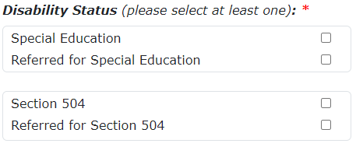
Data Entry Fields – Disability Status
These fields must be accurate. Check them every time a new record is entered!
Disability Status (Required)
Responses let the ODE know if the student is on an IEP, 504 plan, or both, or if the student has been referred for either

Slide 30
Data Entry Fields – Special Education Details
Special Education Primary Disability
  Select the primary special education disability from the drop-down list if the Special Education box is checked. If the Special Education box is not checked, select 00-Not Applicable.
Last IEP Date
  The date that the student’s most recent Individual Education Plan was completed. This field is required if the Special Education box is checked.

Slide 31
Data Entry Fields – Program Stop
Program Stop Date
The date the student was last on an Abbreviated School Day Program. Leave blank if student is still on an Abbreviated School Day Program.
Program Stop Reason
The reason for which the student’s Abbreviated School Day Program was stopped. Leave blank if student is still on an Abbreviated School Day Program.

Slide 32
Stop Reason Codes - Part 1 (Codes 01 -09)
Code | Name
01 | Returned to full-time instruction and educational services
02 | Moved out of District
03 | Dropped out of school
04 | No longer in Special Education
05 | No longer on a 504 Plan
06 | No longer in referral status (not eligible for IEP)
07 | No longer in referral status (not eligible for 504)
08 | Graduated with Regular Diploma
09 | Received Modified Diploma, no longer in school

Slide 33
Stop Reason Codes - Part 2 (Codes 10 -15)
Code | Name
10 | Obtained GED
11 | On Track to Graduate, No Longer Reportable
12 | Suspension
13 | Removal to an Interim Alternate Setting (IAS)
14 | Expelled
15 | Deceased

Slide 34
Data Entry Fields – Section 504 Information
Section 504 Code (Required, if Section 504 box is checked)
Select the primary Section 504 disability
Select 00-Not Applicable for students who are not on a 504
If the student is on a 504 but their disability is not listed, select “99 Other - Non listed Section 504 Category Code.”
Section 504 Code Comment
This field is required if the Section 504 code of 99 – Other is selected. Enter the student’s disability in this field.

Slide 35
Multiple Records During the same School Year
Students may only have one open record during the reporting period, or one record without a Program Stop Date
Students can have multiple closed records with a Program Stop Date.

Slide 36
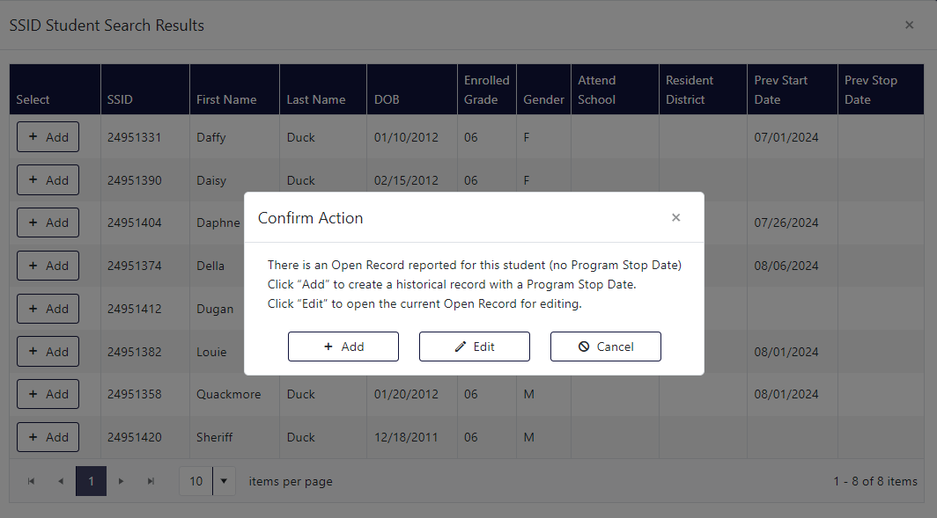
Multiple Records Confirmation

Slide 37
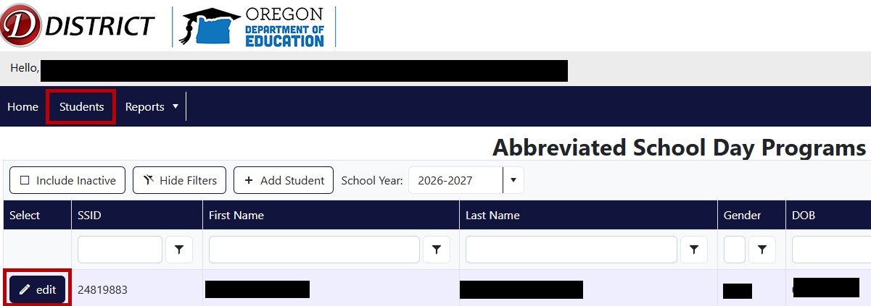
How to Edit or Update a Record
Click on “Students” in the Abbreviated School Day Application
Search for the student
Click the “edit” icon next to the student’s information

Slide 38
Updating the Record - Editable fields
Program Reason Code Notice Provided to Parent Disability Status Attending District ID Resident District ID Attending School ID Resident School ID | Latest IEP Date Special Education Primary Disability Date Notice Signed by Parent Program Reason Comment Weekly Minutes for Grade (Bell to Bell) Date Expected to Return to Full Day

Slide 39
Non-Editable fields
Program Start Date SSID Student information such as Name, DOB, and Gender Date of Initial Parent Consent Submitter Name and Email

Slide 40
Notes
Notes is feature in the ASDP application that allows the submitter to add a note to an open record.
Notes will be visible to anyone with access to the record, including ODE staff.
There is an option to send ODE staff an email notification at: ODE.ASDPApplication@ode.oregon.gov

Slide 41
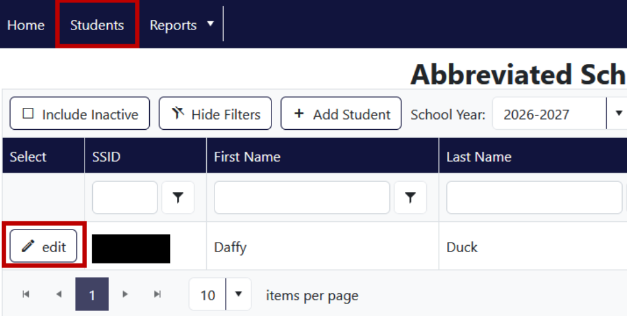
Adding a Note to a Record - Step 1
Pull up the student record under “Students”
Click the “Edit” Icon next to the student’s information.

Slide 42
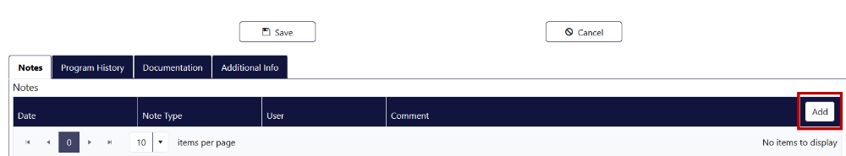
Adding a Note to a Record - Step 2
Scroll down towards the bottom of the record
Click the “Add” button under “Notes”

Slide 43
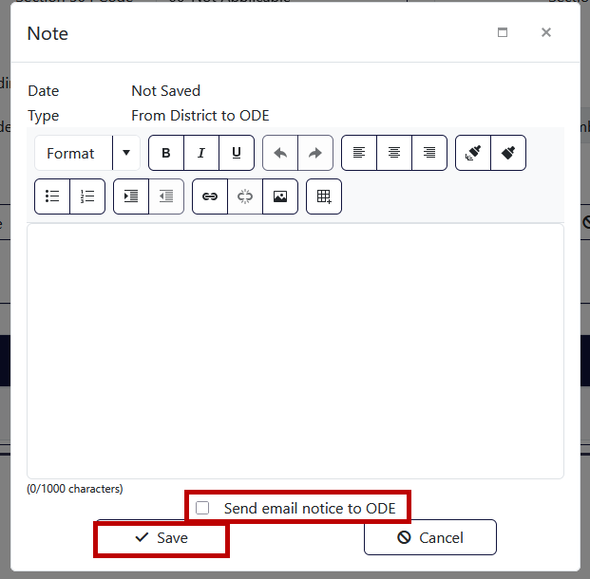
Adding a Note to a Record - Step 3
Enter the Note you would like to add
Click “Send email notice to ODE” if you want to ensure ODE reads the note.
Click “Save” when done.

Slide 44
Verification

Slide 45
ASDP Verification
ASDP reporting requires two types of verification
  Ongoing monthly verification
  End of year submission form
Verification is required even if your district has zero records to report

Slide 46
Monthly Verification
Verification is required at the end of each month. ODE cannot consider the monthly submission complete until the submitting district verifies it as complete. All districts are required to complete the verification process on the Reports tab.
You can expect a communication by email or phone from ODE if your district has not verified their data by the beginning of the month following verification.
For example, we would contact you if you still have not verified by October 8 for September’s data.
Note: You must verify while logged in as your district, not as any schools within your district. Do not verify as a school or other institution.

Slide 47
Verification timeline example
Collect, report, and edit data
In-window for on-time verification. If pending, will receive reminder from ODE.
Verification is considered late. Verify as soon as possible. Re-verify as necessary for updated data.
September 1st-26th
October 1st
October 9th – June 30th
September 27th
October 8th
Review, correct, and verify data
Last date for on-time verification.

Slide 48
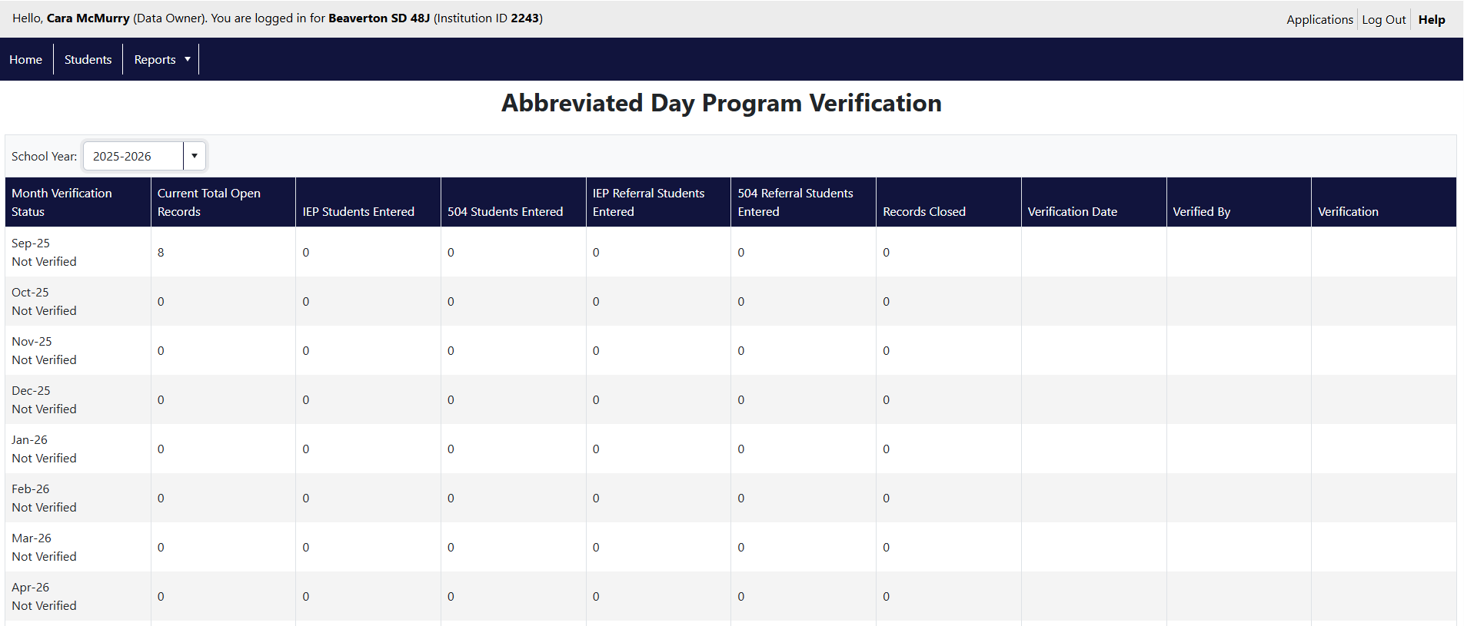
Verification Report

Slide 49
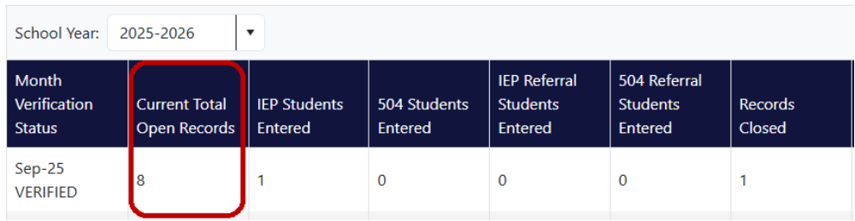
Verification Report Summaries – Open Records
Current Total Open Records
Number of records that were open during the verification month, this includes are Abbreviated Day instances that continued from a prior month, as well as new Abbreviated Day records with a start date in the report month.

Slide 50
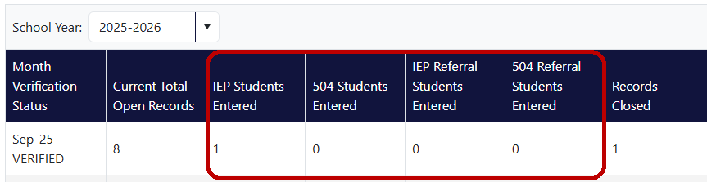
Verification Report Summaries – Students Entered
Students Entered (IEP, 504, IEP Referral, 504 Referral)
These are the counts of records that have a Program Start Date within the verification period. This data is aggregated by the disability status (IEP, 504, referral to IEP/504).
Note, as a student can be both on an IEP and have a 504 plan, a single student may be counted in more than one of these columns if applicable.

Slide 51
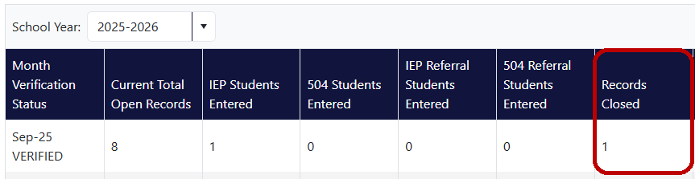
Verification Report Summaries – Records Closed
Record Closed
Number of records where the Program Stop Date is within the verification period.

Slide 52
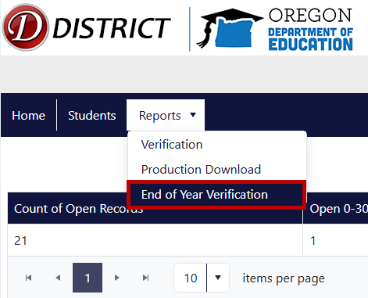
End of Year Submission Form
At the end of the school year, districts need to complete the End of Year Verification
This report will appear under “Reports”

Slide 53
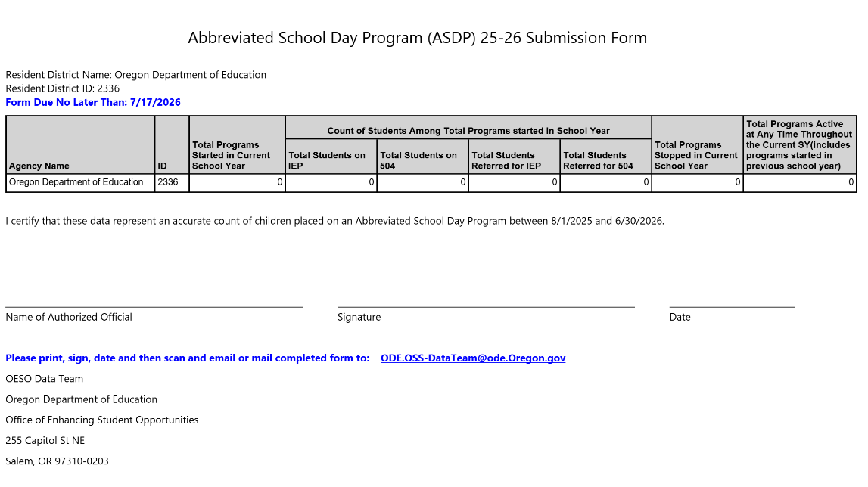
End of Year Submission Form Example

Slide 54
Demonstration

Slide 55
Common Issues and Troubleshooting

Slide 56
ASDP Record Reviews
  Data Accuracy
    The OESO data team performs periodic audits of the data to identify potential errors.
    Districts need to confirm the data or correct erroneous information as needed

Slide 57
Common Errors
  Parent consent date is after the program start date
  Student’s Weekly Instruction and Service Minutes is unusually low
  Weekly minutes for grade (Bell to Bell) minutes is unusually low
  Non-reportable record entered (example: 12th grade on track to graduate)
  Last IEP date missing for a student in Special Education
  “Code 06 – Other” used when an existing code fits
  Entering or verifying records under a school instead of a district

Slide 58
Common Errors Resolved by Editing the Record
  Edit the Record to Add or Update the Missing or Incorrect Information
  Student’s Weekly Minutes or the Weekly Minutes for Grade is incorrect
  “Code 06 – Other” used when a better code fits
  Last IEP Date is missing

Slide 59
Common Errors Requiring Data Team Support
  Contact the OESO Data Team
  Record needs to be removed
  Stop date added in error
  Date of Initial Parent Consent is incorrect

Slide 60
Common Errors That Require Record Reentry
  Remove and Reenter the Record
  Start date is incorrect
  Record entered under a school instead of a district

Slide 61
Removing records – Stop Dated versus Removed
  Removed records versus stop dated records
    Stop dated – the student is no longer on an abbreviated day. The record, however, is reportable and the student should be included in historic counts. District adds the Program Stop Date
    Removed – The record was not valid and never should have been reported. ODE removes the record, so it is excluded from all counts, including historic counts.

Slide 62
Resources and Closing

Slide 63
Abbreviated Day Collection Resources
The Abbreviated Day Collection Page
  https://www.oregon.gov/ode/reports-and-data/spedreports/pages/abbreviatedschooldaycollection.aspx
  Includes the most recent version of the collection manual, presentation and webinar materials, flow charts, and other resources
The Abbreviated School Day Program Page
  https://www.oregon.gov/ode/students-and-family/SpecialEducation/Pages/abbreviatedschoolday.aspx
  Links to Oregon Revised Statutes that pertain to Abbreviated Day, FAQ and other resources regarding the compliance and program side of an Abbreviated Day

Slide 64
Abbreviated Day Support – OESO Data Team
Contact the OESO Data Team for help with the following:
  How to enter or edit an ASDP record
  Help resolving an error
  Removing a record that was entered in error
  Help identifying the correct program reason code
  Application bugs and issues
Reach out to us at one of our shared inboxes:
  ODE.ASDPApplication@ode.oregon.gov (dedicated to ASDP application requests/support)
  ODE.OSS-DataTeam@ode.oregon.gov (general questions, may include non-ASDP questions)

Slide 65
Abbreviated Day Support – Additional Support
Compliance and program-related questions:
  ode.ASDPquestions@ode.oregon.gov
Password resets and general login issues:
ODE Helpdesk (503) 947-5715 ODE.Helpdesk@ode.oregon.gov
Access to the application: Contact you DSA

Slide 66
Thank You for All That You Do!
Please reach out to any of us with further questions:
ASDP requests/support:
ODE.ASDPApplication@ode.oregon.gov
ODE.OSS-DataTeam@ode.oregon.gov
Compliance and program-related questions:
ODE.ASDPquestions@ode.oregon.gov
Password resets and general login issues:
ODE Helpdesk (503) 947-5715 ODE.Helpdesk@ode.oregon.gov

