Slide 1
2022-23 Division 22 Standards Assurances Process
September 2023
Susan Payne
Education Standards and Systems Specialist
Office of Teaching, Learning, and Assessment
Notes:
Hi. My name is Susan Payne. I’m the Education Standards and Systems Specialist in the Office of Teaching, Learning and Assessment at ODE, which means that I am the point of contact for the Division 22 Standards and assurances. In this webinar, we will walk through the process for completing Division 22 Standards assurances for the 2022-23 school year. First, I want to thank you for taking the time to watch this webinar. We know districts are juggling many competing priorities and we appreciate you carving out this time to focus on the Division 22 Standards.

Slide 2
Oregon Department of Education
Education Equity Stance
Education equity is the equitable implementation of policy, practices, procedures, and legislation that translates into resource allocation, education rigor, and opportunities for historically and currently marginalized youth, students, and families including civil rights protected classes. This means the restructuring and dismantling of systems and institutions that create the dichotomy of beneficiaries and the oppressed and marginalized.
Notes:
Before we get into the technical pieces of how to complete your assurances, I want to touch on the “why” behind the Division 22 standards and the positive implications of upholding Oregon’s Standards for Public Elementary and Secondary Schools. It can be easy to fall into the mindset of considering Division 22 Standards Assurances merely as an exercise in compliance, when in fact, the process is directly aligned with ODE’s Education Equity Stance and the vision for creating equitable policies with the intent to close the opportunity gap, especially for our historically and currently underserved youth, students and families.

Slide 3
Division 22 Standards & Assurances of Compliance
“Our Why”
Signals our commitment to providing a high quality educational experience and equitable opportunities for all students.
Division 22 standards articulate the floor of the education to be provided to students, not the ceiling.
Assurances process offers an opportunity for districts not in compliance to reflect on areas in need of attention and receive technical assistance.
Notes:
ODE is charged with assisting districts to provide a high quality educational experience and equitable opportunities for all students. The Division 22 standards outline the baseline expectations, and the assurance process offers an opportunity for school districts to not only demonstrate compliance, but also to reflect on areas in need of attention and alignment, and to plan for how to address them, thus acting as a lever for improvement and innovation. As part of our shared responsibility to provide quality service for our students and communities, this system promotes reciprocal accountability between school districts and the Oregon Department of Education (ODE). Our goal as an agency is to maintain these standards by partnering with you and providing technical assistance throughout the process as needed.

Slide 4
Helpful Resources
Consult the following resources for information on specific rules:
Resources | Rules
ODE’s Rules at a Glance Summary | Provides a high level summary of each rule
Secretary of State’s Oregon Administrative Rules Database | Consult the text of the OAR for all of the specific details
ODE’s Division 22 Standards Newsletter | Biannual publication that highlights new/revised rules, clarifies existing rules; provides insights on how the standards intersect with current issues and trends in K-12 education, as well as resources and promising practices
Notes:
As you are preparing your assurances, you may have questions about what the requirements are for specific rules. We’ve linked here to some helpful resources:
The Rules at a Glance document provides a high-level summary. For all of the specific details, you’ll want to consult the text of the actual rule which you can find in the Secretary of State’s OAR Database. And finally, the Division 22 standards newsletter highlights specific rules that are new, have recently been revised, or where there has been some confusion about requirements. In addition to the August 2023 issue, you’ll also find archived issues on the Division 22 standards professional learning webpage.

Slide 5
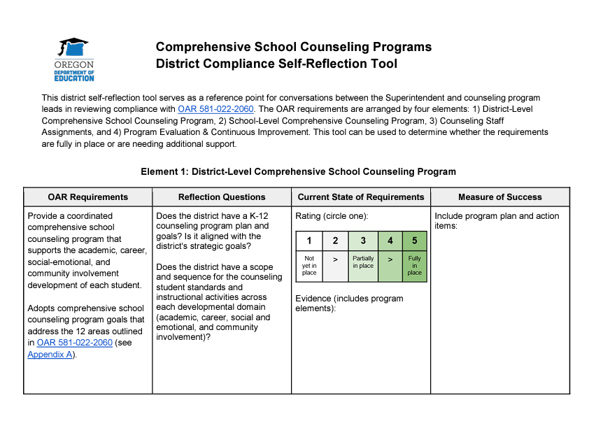
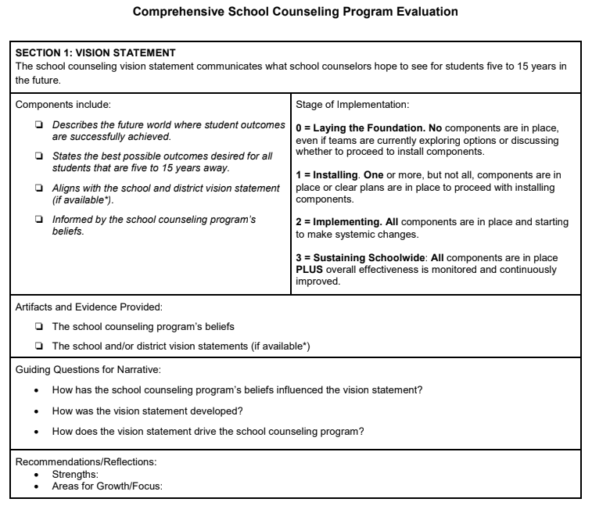
Resources for Comprehensive School Counseling
Notes:
There are two additional resources you should be aware of that have been developed to support districts’ understanding and implementation of the Division 22 requirements for Comprehensive School Counseling Programs. They are linked in this slide, as well as in the ODE online submission form. The first is the District Compliance Self-Reflection Tool which was created to support districts in determining compliance with the OAR. ODE recommends that Superintendents partner with the district counseling leadership team to review the district and school programs and determine areas of strength and need. Alternatively, districts may use the program evaluation tool to determine areas of strength and need.
If it is determined that a district is out of compliance with this rule, the district may choose to share a link to one or both of these documents with ODE staff via the ODE assurances form. This information will help us evaluate the proposed corrective action and provide appropriate support/resources.

Slide 6
Waivers for 2022-23
581-022-2115(3) Assessment of Essential Skills:
Essential Skills Graduation Requirements were waived for students graduating in the 2022-2023 and 2023-2024 school years.
Note: Local Performance Assessment requirement in Section (2) remains in effect.
OAR 581-022-2265 Report on PE Data
PE Data collections were suspended last year. Districts will be required to submit data for the upcoming 2023-24 SY.
Notes:
As a reminder, there were two requirements waived for last year.
First is section 3 of the Assessment of Essential Skills rule; these are the assessment requirements for graduation. This was waived for graduates beginning in 2020; this waiver is still in effect for the class of 2024, and is likely to be extended further when the State Board meets in September. Section 2 of the Essential Skills rule, which is the local performance assessment requirement, remains in effect and districts must report on compliance with this section.
Also, the requirement to submit data to the PE collection was suspended last year for just one year. This is a different rule than the PE Requirements rule, which requires a certain number of instructional minutes in PE for grades K-8. That rule has not been waived.

Slide 7
New/Revised Rules & Requirements
OAR 581-022-2308 Agreements Entered Into with Voluntary Organizations
Requires adoption of a policy governing participation in a voluntary organization that administers interscholastic activities. Voluntary organization must adopt and implement policies prohibiting discrimination, maintain a complaint process with sanctions, and administer an annual survey.
OAR 581-022-0107 Operational Plans for the 2022-23 School Year
School districts and public charter schools must periodically submit to the Department a plan for operation during the 2022-23 school year. The plan must be submitted on a form and on a timeline to be determined by the Department.
Notes:
There are two rules that districts will be reporting on for the first time. The first rule listed on this slide, Agreements Entered Into with Voluntary Organizations, was a new policy requirement related to organizations that administer interscholastic activities. The second, Operational Plans, was not a new requirement, just a new rule, which was needed because the previous one was temporary. This rule is also just for one year, but moving forward, the operational plan requirement has been incorporated into the Health Services rule.

Slide 8
Assurance Process Requirements
School district superintendents report to their local School Board the district’s compliance with all Division 22 Standards for the 2022-23 school year by November 1, 2023.
School districts post the Community Report on Compliance with Public School Standards to their websites by November 1, 2023.
School districts complete and submit the annual Division 22 Standards Assurances Form to ODE by November 15, 2023.
Notes:
The assurances process consists of three distinct steps: reporting to the local School Board and posting the Community Report on Compliance with Public School Standards to the district website by November 1st, and submitting the Assurances Form to ODE by November 15th.
A question we sometimes get is: What if my board won’t meet again between now and Nov 1?
If you find yourself in that position, we ask that you share the report with the board as soon as possible after Nov 1 and then let us know when that is done by sending a copy of the minutes from that board meeting and the link to where the report is posted on the district website. You may still submit your report to ODE to meet the November 15 deadline, but you will need to submit a Placeholder document in place of the minutes. This document should include either the agenda for the board meeting or a statement that includes the date of the board meeting at which the report will be presented. We are providing this information to you now with the recommendation that you plan to include this item on your School Board’s October agenda in order to meet the Nov. 1 deadline.

Slide 9
Confirmation of Completed Corrective Action
Any corrective action from prior years should be complete by the beginning of the 2023-24 school year.
This applies to districts that reported out of compliance last year on their 2021-22 assurances and to any district that had an approved extension in place for corrective action on the 2020-21 assurances.
Districts should provide an update on implementation of the corrective action, including when it was completed, on the community report and when submitting to ODE.
If needed, submit your request for extension via the form located at http://bit.ly/Division22Extension
Notes:
A final reminder about completing any corrective action from the prior year: If your district reported out of compliance for the 2021-22 school year (on last year’s assurances), your corrective action should have been completed prior to the start of the current school year. When you submit this year’s assurances, you will be prompted to provide confirmation that any previously approved corrective action has been completed. If the district was unable to complete the plan according to the original timeline, you may request an extension. Please contact us as soon as possible, either via the Division 22 email or by submitting your request through the form, which can be accessed at the link shown at the bottom of the slide.

Slide 10
ODE Provided Materials
Instructions
Internal Tracking Tool
Community Report Template – Required
Status Determination Flowchart
School Board Presentation Template
Online Submission Form – Required
Exemplar District Reports
* All materials can be found on the Division 22 Webpage *
http://bit.ly/Division22
Notes:
OK. Let’s dive into the details on how to complete your assurances. These are the resources linked on the Division 22 Standards Webpage that should be useful to you in completing your assurances. We’ve provided step by step written instructions, the required Community Report Template and district exemplars, a link to the form to use for submission to ODE, a status determination flowchart, and two templates that are optional for you to use: an internal tracking sheet and an editable slide deck you can use when reporting to your local school board. I’ll show you where to find these on ODE’s Division 22 Standards webpage. I’ll head back to the slides now to provide more details about each of the resources.

Slide 11
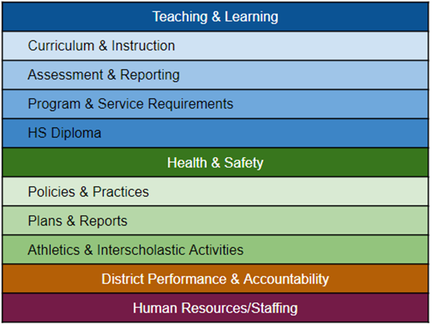
Organizational Structure
All districts are required to use the same report template for reporting to the community.
The report template and ODE’s online form are organized by categories.
Goal: increase understanding of what the standards are and what role they play in the state's delivery of educational services
Notes:
You will notice on these various documents that the rules are now organized by categories (instead of simply in order by rule number, which is how they had been organized in the past). They are divided into 4 four large buckets: Teaching and Learning, Health and Safety, District Performance and Accountability, and Human Resources/Staffing. Within Teaching and Learning and Health and Safety, there are several sub-categories. ODE first introduced this new organizational structure last year with the goal to increase understanding of what the standards are and what role they play in the state's delivery of educational services for school board members, district staff, parents, and students.

Slide 12
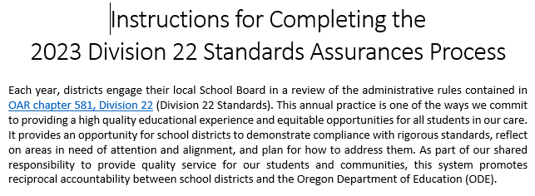
Instructions
Instructions for Completing the Division 22 Standards Assurances Process can be found on the Division 22 webpage.
This document will walk you through how to complete both the Division 22 Standards Community Report Template and the ODE Submission Form.
Notes:
When preparing your district’s assurances, a good place to start is with the instructions. That document provides step by step instructions for how to complete the Division 22 Community Report template and how to fill out the ODE submission form. The same information is covered in this webinar, so you have access to it in multiple formats.

Slide 13
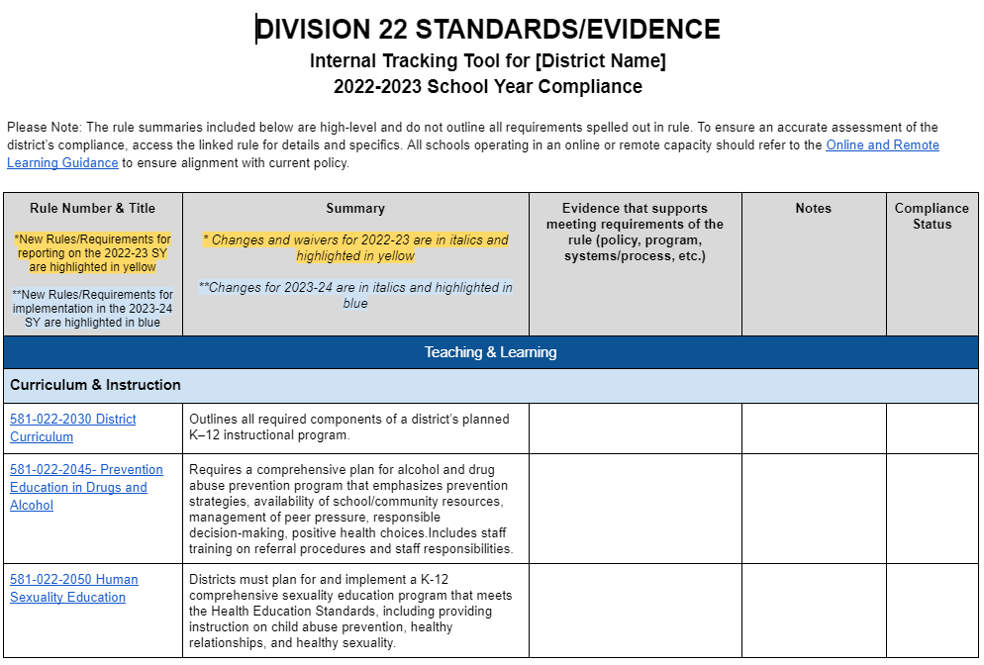
Internal Tracking Tool
Template for districts to use to gather and record information on compliance with each rule for internal use.
Links to full text of each rule
Summary column includes modifications and waivers for 2022-23 and 2023-24 (in italics)
New rules for 2022-23 and 2023-24 are highlighted
Track compliance from year to year & maintain historical context
Notes:
The internal tracking tool is designed to support districts in gathering evidence and recording information on compliance with each rule as part of their internal process. The document includes links to the full text of each rule and highlights all new rules for both the reporting year (22-23) and the current year (23-24). The summary column provides a brief description of each rule, as well as information on any modifications and waivers. This resource is intended to provide a useful way for districts to track compliance from year to year and to maintain continuity and historical context as there are changes in personnel. Districts are not required to use it.

Slide 14
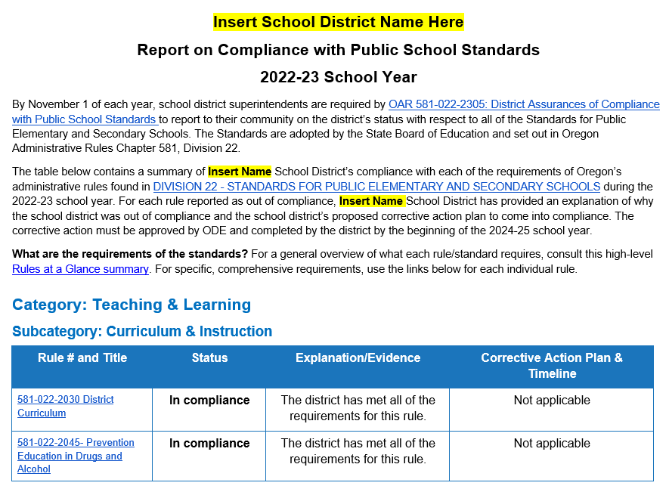
Community Report Template - REQUIRED
For each of the Division 22 standards, the template includes three columns:
1. Compliance Status
2. Explanation/Evidence
3. Corrective Action Plan &
Timeline
Notes:
As mentioned earlier, all districts are required to use the same community report template. ODE provides the Report on Compliance with Public School Standards template as a Microsoft Word document in order to ensure that the posted report will meet web accessibility standards. Also, this format provides the option to include dropdown menus. The first column includes links to all of the rules and then each of the additional columns has a dropdown menu embedded in the cell. The default setting for the status dropdown for each rule is “In compliance,” and the default dropdown choices in the other columns correspond with the “In compliance” status.
The community report provides a summary of the school district’s compliance with each of the Division 22 Standards and includes the same information that is submitted to ODE via the required online submission form, so you can easily copy and paste your responses. The reason for having two different reporting mechanisms is that the Community Report is designed for public consumption, while the ODE submission form enables our staff to more easily manipulate the data and track outreach efforts and compliance.

Slide 15
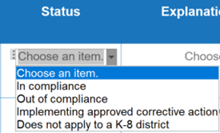
Compliance Status
For each standard, the template provides a section for the school district to enter the compliance status for the 2022-23 school year.
Focus on transparency: Districts that were in the process of implementing corrective action during the previous school year should indicate that on the report, as well as provide an update and date of completion for the corrective action.
Notes:
In the status column of the community report, the district will indicate the compliance status for the 2022-23 school year on each rule. “In compliance” is pre-populated as the default status for each rule. Alternatively, a district may choose “out of compliance” or “implementing approved corrective action.” This third status choice enables districts that reported out of compliance in the prior year to provide an update on implementation, as well as the date of completion for the corrective action, both to their community and board, and to ODE. There is also a fourth option included on rules that do not apply to a K-8 district.

Slide 16
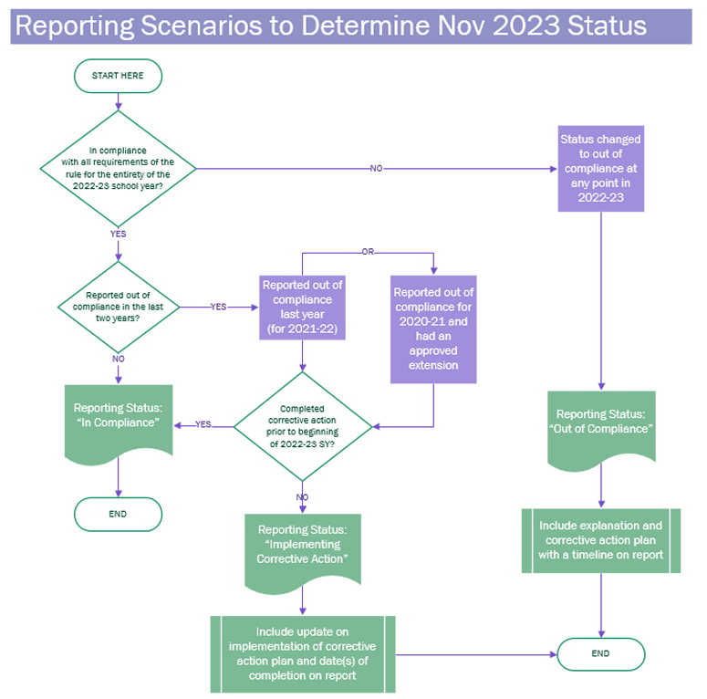
Determining Compliance Status
Not sure which status is appropriate for your district’s situation? Use the Status Determination Flowchart as a guide. This tool is helpful for districts that:
Reported out of compliance on any rule(s) in the last two years
Had an approved extension in place during the 2022-23 school year
Notes:
In order to help school districts in determining the appropriate status for their individual situation, we have provided the Status Determination Flowchart as a guide. This tool will be especially helpful for districts that reported out of compliance on any rule in the last two years or that had an approved extension in place. The flowchart is linked on ODE’s Division 22 Standards webpage.

Slide 17
Reporting on PE Requirements - Middle Grades
OAR 581-022-2263 Physical Education Requirements
In 2022-23 the instructional time requirements for grades 6-8 increased to 225 minutes per week (or 180 minutes/week for a 4 day week).
In June 2023, the legislature passed HB 3199, which reduces the total number of physical education instructional minutes required in grades 6-8 to 150 minutes per week, averaged throughout the year. This provision went into effect on July 1, 2023.
Notes:
This year, reporting on the PE Requirements rule for middle grades is a bit different than other rules due to the passage of HB 3199 in June.This bill revises ORS 329.496 to include two significant changes to the physical education instructional minutes requirement in grades 6-8. First, the weekly time requirement was reduced from 225 to 150 minutes. Second, the new weekly minimum of 150 minutes is calculated as an average over the duration of the school year. This provision went into effect on July 1, 2023 and as a result, some districts that were out of compliance with the old requirements in the 2022-23 school year, are now in compliance with the new requirements. The Compliance Status choices for this rule have been adjusted so districts can accurately report their status for the previous year, as well as the current year.

Slide 18
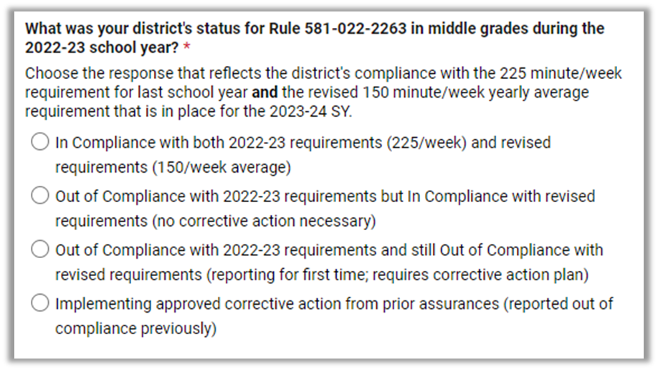
Status Choices for MS PE Requirements
Notes:
The compliance status choices for this rule are the same on both the community report and the ODE form, and there is a PE specific reporting instructions document linked on the web page to help if you’re not sure which status applies to your district. The key thing to know is that if the district was out of compliance with the old requirements, but in compliance with the new ones, you need to choose status two. So you would be reporting out of compliance for last year, but you do not need a corrective action plan. ODE does recommend that you include an explanation in the third column of the community report to provide some context about the district’s specific situation.
If the district was out of compliance with the 225 minute requirement last year and remains out of compliance with the new requirements, you should choose status 3, which will require both an explanation and corrective action plan. And finally, if the district reported out of compliance on this rule on a previous assurances and was implementing a corrective action plan, the district should choose status option 4.

Slide 19
Explanation/Evidence
The dropdown menu in the Explanation/Evidence column provides the school district with four choices:
Notes:
The third column in the table is the Explanation/Evidence column. If a district is in compliance with the rule, the first choice in the dropdown is the standard explanation and it is the default setting. If the district chooses to provide more detail, the fourth choice in the dropdown prompts you to enter an individualized explanation and/or to include specific evidence. For districts that were out of compliance or implementing corrective action, the second choice in the dropdown menu prompts you to enter the explanation for why the district is/was out of compliance.
The “not applicable” option is only appropriate for a K-8 district that selected “Does not apply to a K-8 district” as the status in column 2.
Many districts are including or linking to evidence for rules with which they are in compliance as shown in the district exemplars that are linked on the webpage. The easiest way to do that is to delete the dropdown menu and type directly into the cell.

Slide 20
Proposed Corrective Action Plan & Timeline
The dropdown menu in the Corrective Action Plan & Timeline column provides the school district with three choices:
Notes:
The fourth column is where the district outlines a new corrective action plan and timeline or provides an update on a plan that was already in place. Districts that are in compliance with a rule should use the default setting of “Not applicable” in this column. Districts that are out of compliance should choose option 2 in the dropdown and type in the proposed corrective action plan and timeline for completion. Districts that were implementing corrective action in the previous year should type in a brief update and include the date(s) of completion. To include a link to a plan or other document, you will need to delete the dropdown menu and just type directly into the cell.

Slide 21
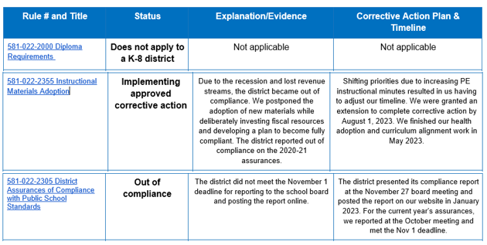
Sample Responses
Notes:
This table shows some sample responses for different reporting scenarios. The example in the first row illustrates how a K-8 district would fill in each cell for any of the rules that do not apply to them.
The sample response in row 2 illustrates how to complete the Report to Community Template in cases where the school district was implementing approved corrective action during the previous year. The sample text included in the Explanation (column 3) and Plan & Timeline (column 4) columns provides an example of how a district that had an approved extension in place would complete each field.
The sample response in row 3 on this slide provides an example of how to complete the report for a standard with which the district was out of compliance.
School districts should consult the Status Determination Flowchart for guidance on which status is appropriate for the district’s individual circumstances.

Slide 22
School Board Presentation Template (Optional)
Notes:
Another resource we are providing is a customizable slide deck that you can use when you share your report with the local school board. The presentation includes some of the slides from the beginning of this presentation that speak to the what and why of Division 22 as well as any changes to the requirements for this year and what happens after you report to ODE. In addition, there are slides for you to fill in regarding your district’s compliance status, and corrective action plans if necessary. You can either download a copy of the Powerpoint version of the slides, or you can make a copy of the Google Slides. Feel free to customize the slides and slide background with district specific information and/or themes.

Slide 23
Posting the Community Report Online
File Format Considerations
PDF: Posting the report as a PDF is the best option to ensure both ease of access and accessibility for people with disabilities.
Microsoft Word: ODE provides the report template as a Microsoft Word file to ensure it meets WCAG 2.0 accessibility criteria; accessibility will also be maintained after it is converted to a PDF.
If viewers do not have Microsoft Word, they will be unable to open a file in that format. To convert a Word document to a PDF, simply choose “Save As a PDF” or reach out to Division22@ode.oregon.gov for support.
Google: ODE does not provide the template as a Google Doc because the drop-down feature is not available in that format. Districts may upload and post the document as a Word.docx file in Google Drive.
Notes:
Districts are required to post the Community Report on Compliance with Public School Standards on their website by November 1st. When deciding what file format to use, there are a variety of factors to consider.
ODE recommends posting the report as a PDF (converted from the original Word file). This ensures both ease of access and accessibility for people with disabilities. ODE provides the report template as a Microsoft Word file to ensure it meets WCAG 2.0 accessibility criteria; accessibility will also be maintained after it is converted to a PDF. Keep in mind that if you post a Microsoft Word version of the report, people who do not have that software will be unable to open or view the report.
Using Google to post the report is an option, but there are a couple of caveats. ODE does not provide the template as a Google Doc because the drop-down feature is not available. After modifying the Word template, districts may upload and post it as a Word.docx file in Google Drive. Google does not have a built-in accessibility checker; however, accessibility of the Word template should be maintained after uploading to Google Drive, as long as it is not converted to a Google Doc.
If your district decides to post the slides from the board meeting to provide additional context, be aware that the PPT version of those slides is the one that is fully accessible.

Slide 24
Additional Considerations
• How easy is it to locate the report?
Is it linked from the main page? Is it searchable?
• How is the report labeled/titled?
The title “Report on Compliance with Public School Standards” provides a clearer description of the content and purpose of the report than the title “Division 22 Report.”
• Are there other languages that the report should be posted in?
Translated versions of the template are available in Spanish, Russian, Chinese, Vietnamese, Somali and Arabic.
Notes:
Other important things to consider are the location of the report on the website and how easy it is to find it. ODE recommends using a descriptive title that clearly communicates the content and purpose of the report, and we remind districts that schools must communicate information to limited English proficient parents in a language they can understand about any program, service, or activity that is called to the attention of parents who are proficient in English. ODE has provided translated versions of the template in six languages.

Slide 25
Demonstrate Transparency & Build Trust
Are there other communication channels the district can use to increase awareness in the school community about the standards and the district’s report? Possibilities include an item in the news section of the website, a monthly newsletter, blog or vlog, weekly bulletin, social media post, etc.
How might the report be strengthened by including a district specific explanation or evidence of compliance? Consider that this report offers an opportunity to demonstrate transparency and build trust with the community.
These Exemplar District Reports from Previous Assurances include Community Reports and School Board engagement artifacts.
Notes:
Finally, the Division 22 Standards assurances process provides an opportunity for districts to demonstrate transparency and build trust. Consider strategies you might use to increase awareness and educate the school community about the standards and the district’s report. Also consider how you might strengthen the report by including district specific information and evidence, as mentioned previously.

Slide 26
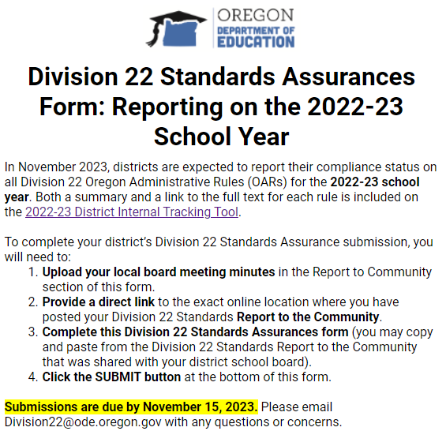
ODE Division 22 Submission Form - REQUIRED
The Online Submission Form includes three sections:
1. Contact Information
2. Report to the Community
3. Compliance Review
Notes:
Once the district has made the report to the local school board and posted it online, they must then submit their annual Division 22 Standards Assurances to ODE using the online form.
The Form includes three sections:
Contact Information
Report to the Community
Compliance Review

Slide 27
Contact Information
At the top of the screen, the Division 22 Assurances Form asks the submitter to provide the following information:
Note: All of these
fields are required
Notes:
All of the fields in the Contact Information section are required. We use this information to follow up on any questions regarding the school district’s submission.

Slide 28
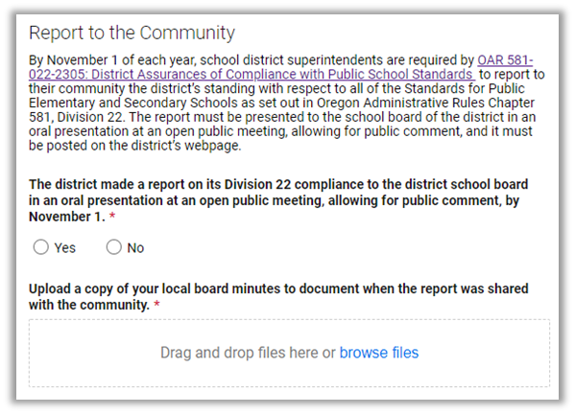
Report to the Community
Step 1: The Report to the Community section of the Division 22 Standards Assurances Form asks the school district to certify that:
The school district made a report on its Division 22 Standards compliance to the district school board in an oral presentation at an open public meeting, allowing for public comment, by November 1, 2023;
Question 2 requires the school district to upload a copy of the local board meeting minutes where the Division 22 Standards Assurances Report was shared.
Notes:
The first step in the Report to Community section is a certification that the district has made a report to the school board in an oral presentation at an open public meeting by November 1st. The second step in this section is to upload a copy of the board meeting minutes where the sharing of the report is documented. An agenda is not sufficient, but may be used as a placeholder if the district does not yet have minutes to submit. If a district will need to submit minutes following submission of the form, they should be emailed to Division22@ode.oregon.gov.

Slide 29
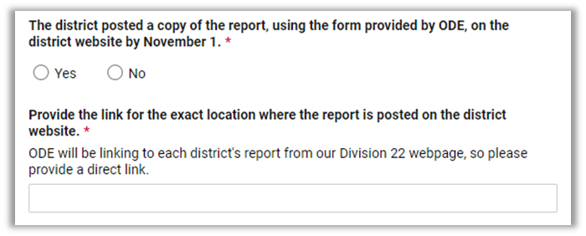
Report to the Community (Continued)
Step 2: The Report to the Community section asks the school district to certify that:
The school district posted a copy of the report, using the form provided by ODE, on the school district’s website by November 1, 2023;
Question 2 requires the school district to enter a link to the exact location on the district website where the school district has posted its Division 22 Standards Assurances Report.
Notes:
Next, the district must certify that a copy of the Community Report has been posted online and provide the link to its exact location on the district website. ODE will be linking to each district's report from the agency’s Division 22 Standards webpage, so it is important to provide a direct link.

Slide 30
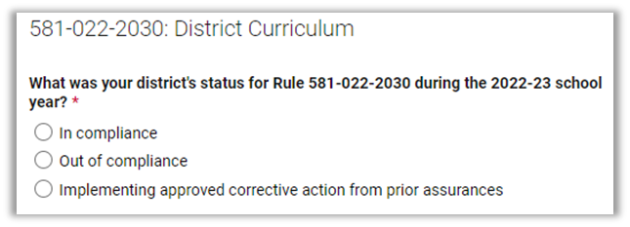
Compliance Review
Step 1: The Compliance Review section asks what the school district’s compliance status was for the rule during the 2022-23 school year and requires the school district to click “In compliance,” “Out of compliance,” or “Implementing approved corrective action.” Some rules also have the additional option of “Does not apply to a K-8 district.”
Notes:
The Compliance Review section of the Division 22 Standards Assurances Form mirrors the Report to Community Template both in terms of how the standards are organized and the information the district will need to provide. For each standard, the Compliance Review section requires the school district to enter the district’s compliance status during the 2022-23 school year.

Slide 31
Compliance Review (Out of Compliance a)
Steps 2 and 3 are only required for those standards with which the school district reports “Out of compliance” or “Implementing approved corrective action.” The additional fields will not populate for districts that report “In compliance” or “Does not apply to a K-8 district.”
Step 2a: “Out of Compliance” For standards with which the school district was out of compliance during the 2022-23 school year, the Compliance Review section prompts the school district to provide an explanation of why the school district was out of compliance.
Notes:
When a district selects “Out of compliance” or “Implementing approved corrective action” as its status on a rule, additional fields will populate on the form.
If the district chooses “Out of compliance,” two additional fields are populated. The first prompts the district to provide an explanation for why the district was out of compliance. This can be copied from the third column of the district’s Community Report.

Slide 32
Compliance Review (Out of Compliance b)
Step 2b: For standards with which the school district was out of compliance during the 2022-23 school year, the Compliance Review section prompts the school district to provide a description of the school district’s proposed corrective action plan to come into compliance by the beginning of the 2024-25 school year.
Notes:
The second field prompts the district to provide a description and a timeline for the proposed corrective action plan to come into compliance by the beginning of the 2024-25 school year. This question corresponds with the Corrective Action Plan & Timeline column in the Community Report.

Slide 33
Compliance Review (Implementing corrective action)
Step 3: “Implementing approved corrective action from prior assurances”
For standards with which the district reported out of compliance on a previous assurances, the district must confirm completion of corrective action.
Notes:
If the district chooses “implementing approved corrective action,” one additional field is populated. It prompts the district to provide a brief update on implementation of the district’s corrective action plan, including the date(s) of completion. This can be copied from the fourth column of the district’s Community Report. ODE does not require the district to provide an explanation, as that should have already been submitted in the original assurances report or in the district’s request for an extension. If the school district has already provided ODE with an update and confirmation of completion of the corrective action by email, the district may reference that communication in this field, as shown in the example on the slide, which reads…

Slide 34
Considerations for Completing the Form
The online submission form must be completed in one session.
ODE encourages copying and pasting responses from the “Explanation/Evidence” and “Corrective Action Plan & Timeline” fields of the Division 22 Standards Community Report Template.
Be sure to carefully review each rule to avoid cut/paste errors!
Notes:
A few final points before we wrap up:
The form must be completed in one session. You cannot save it, close it, and come back to it.
There are a few links in the form, which when tested, opened in a new tab; to be safe, right click on any links or use the control/command key to open them in a new tab; if you navigate away from the form, you will lose any information already entered.
We recommend that you gather all of the information ahead of time. You will need the Community Report if you plan to cut and paste from it, the board minutes, and the link to the exact location where the report is posted online.
Once submitted, you cannot revise. If there is something you need to change after you’ve submitted, please email Division22@ode.state.or.us.

Slide 35
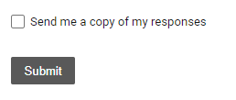
Request a Copy of Your Submission
When you submit, check this box to have a copy of your submission emailed to you!
Notes:
When you are ready to submit the form to ODE, click the SUBMIT button at the bottom of the form. If any required fields are blank, the form will identify incomplete sections and prompt you to go back and complete them.
Before clicking SUBMIT, I highly recommend that you check the “send me a copy” box so you will have a copy of your submission. Do not post this copy online as the district’s report; you must use the community report template on your website. If you have any problems with submitting your form, you can give me a call and I am happy to help.

Slide 36
Questions? Concerns? Feedback?
If you have questions about the Division 22 Standards Assurances submission process, please contact Susan Payne – Education Standards and Systems Specialist.
Email: Division22@ode.oregon.gov or Susan.Payne@ode.oregon.gov
Phone: 503-580-6814 (cell)
Notes:
Thank you for your time and for your continued efforts to honor and uphold the Division 22 standards. Please let me know if you have any questions or issues as you are going through the process.

