Slide 1


2019-20 Division 22 Assurances Process
Oregon Department of Education
September, 2020
Susan Payne
Educational Standards & Systems Specialist
Office of Teaching, Learning, and Assessment

Slide 2
Oregon Department of Education
Education Equity Stance
Education equity is the equitable implementation of policy, practices, procedures, and legislation that translates into resource allocation, education rigor, and opportunities for historically and currently marginalized youth, students, and families including civil rights protected classes. This means the restructuring and dismantling of systems and institutions that create the dichotomy of beneficiaries and the oppressed and marginalized.
Notes:
Link the submission of Assurances to larger ODE “Why”

Slide 3

Division 22 Oregon Administrative Rules Assurances
“Our Why”
Signals commitment to providing a high quality educational experience and equitable opportunities for all students.
Division 22 standards articulate the floor of the education to be provided to students, not the ceiling.
Assurances process offers an opportunity for districts not in compliance to reflect on areas in need of attention and receive technical assistance.
Notes:
Signals school districts’ and ODE’s joint commitment to providing a high quality educational experience and equitable opportunities for all students in our care.
As part of our shared responsibility to provide quality service for our students and communities, this system promotes reciprocal accountability between school districts and the Oregon Department of Education (ODE).
Assurances articulate the floor of the education to be provided to students, not the ceiling. Compliance with the Division 22 Oregon Administrative Rules ensures a basic level of service across the state.
The Division 22 Assurances process offers an opportunity for districts not in compliance to reflect on areas in need of attention and alignment, plan for how to address them, and receive technical assistance.

Slide 4

Division 22 Oregon Administrative Rules Assurances
“Our Why”
Any corrective action should be complete by the beginning of the 2020-21 school year.
Send confirmation of completion to Division22@ode.state.or.us
If needed, submit your request for extension via the form located at http://bit.ly/Division22Extension
Notes:
Signals school districts’ and ODE’s joint commitment to providing a high quality educational experience and equitable opportunities for all students in our care.
As part of our shared responsibility to provide quality service for our students and communities, this system promotes reciprocal accountability between school districts and the Oregon Department of Education (ODE).
Assurances articulate the floor of the education to be provided to students, not the ceiling. Compliance with the Division 22 Oregon Administrative Rules ensures a basic level of service across the state.
The Division 22 Assurances process offers an opportunity for districts not in compliance to reflect on areas in need of attention and alignment, plan for how to address them, and receive technical assistance.

Slide 5

Changes for Division 22 Assurances Process for the 2019-20 School Year
Streamlined Set of Standards
OAR 581-022-0103: State Standards for the 2019-20 School Year defines the standards with which districts were required to comply for the 20219-20 school year
The streamlined standards reflect the need for flexibility during Distance Learning for All in Spring 2020.
Notes:
On April 16, 2020 the State Board adopted a new administrative rule, OAR 581-022-0103: State Standards for the 2019-20 School Year. This rule establishes the Division 22 standards in effect for the 2019-20 school year, accommodating for the school closures and providing appropriate flexibility to districts during this unprecedented time. School districts will be required to report on the Division 22 standards included in this new rule; any standard not included in the new rule is waived for the 2019-2020 school year.

Slide 6
Streamlined Standards for 2019-20 School Year
(defined in OAR 581-022-0103, Sections 2 – 18)
  Diploma requirements
  Credit options
  Distance learning for all
  Special education for children with disabilities
  Emergent bilinguals
  Talented and gifted
  Alternative education programs
  Equal educational opportunities
  School counseling
  Student safety
  Personnel
  Fingerprinting of subject individuals in positions not requiring licensure as teachers, administrators, personnel specialists, school nurses
  Individual student assessment and reporting
  Student education records
  Records and reports
  Complaint procedures
  Assurances
Notes:
Seventeen standards in the new rule. These specific standards were chosen in order to define the floor for Distance Learning in the spring, to help ensure a basic level of service across the state .

Slide 7

Changes to Division 22 Assurances Process
Revised Timeline
The assurances process will occur in November instead of February
This change goes into effect for the 2019-20 school year and will apply for future years as well
Notes:
OAR 581-022-0103 also implements a new timeline for districts to complete the assurances process that will go into effect starting with the 2019-20 school year. In previous years, the assurance process occurred in February, reporting on the previous school year. Moving forward, the assurance process will occur in November. This means that, for the 2019-20 Assurances process, districts will report to their local school board and post their report to their webpage no later than November 1, 2020. Districts will then report assurances to ODE no later than November 15, 2020. Shifting the Division 22 Assurances timeline to the fall will allow ODE to review district submissions and provide districts with actionable feedback on their corrective action plans earlier in the school year, giving districts additional time to implement corrective actions in order to achieve compliance by the start of the next school year. The November 15 submission deadline will permanently replace the February 15 submission deadline going forward.

Slide 8
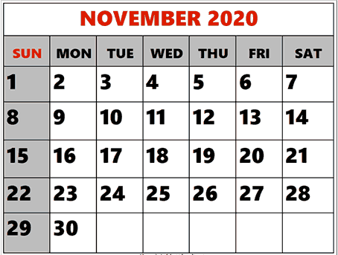
Timeline & Process
By November 1, 2020:
School district superintendents report to their local School Board the district’s compliance with all Division 22 Standards in effect for the 2019-20 school year.
School districts post the report to their websites.
By November 15, 2020:
School districts complete and submit the annual Division 22 Assurance Form to ODE.
Notes:
This means that, for the 2019-20 Assurances process, districts will report to their local school board and post their report to their webpage no later than November 1, 2020. Districts will then report assurances to ODE no later than November 15, 2020. Shifting the Division 22 Assurances timeline to the fall will allow ODE to review district submissions and provide districts with actionable feedback on their corrective action plans earlier in the school year, giving districts additional time to implement corrective actions in order to achieve compliance by the start of the next school year. The November 15 submission deadline will permanently replace the February 15 submission deadline going forward.

Slide 9
Three Steps in Div. 22 Assurances Process and Key Dates
School district superintendents report to their local School Board the district’s compliance with all Division 22 Standards for the 2019-20 school year by November 1, 2020.
School districts post the report to their websites
by November 1, 2020.
School districts complete and submit the annual Division 22 Assurances Form to ODE by November 15, 2020
Notes:
Frequent question:
What if my board won’t meet again between now and Nov 1?
Accomplish as soon as possible after Nov 1 and let us know when done including where posted on website and send copy of minutes of that board meeting

Slide 10
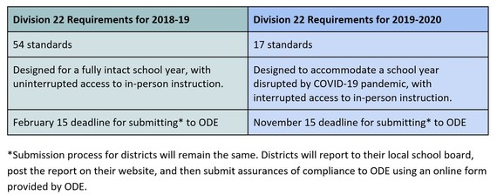
Changes for Division 22 Assurances Process for the 2019-20 School Year
Notes:
Summary and Side-by-Side Comparison of Requirements

Slide 11
ODE Provided Materials
ODE Provided Materials
Instructions
School Board Report Template – Optional
School Board Presentation Template - Optional
Online Submission Form – Required
* All materials can be found on the Division 22 Webpage *
http://bit.ly/Division22

Slide 12

Instructions
Instructions
Instructions for Completing the Division 22 Assurances Process can be found on the Division 22 webpage
It will walk you through the Division 22 Report Template and the Submission Form
Notes:
The instructions include live links to the Division 22 Oregon Administrative Rules (OARs) (Open link to show it’s live and show page)

Slide 13
Division 22 Report Template (Optional)
For each of the Division 22 standards, the template includes three sections:
Compliance Status
Explanation (applies only to standards for which the district reports out of compliance)
Proposed Corrective Action (applies only to standards for which the district reports out of compliance)
Notes:
ODE has developed a template in Word format that meets web accessibility standards.
Use of this template is optional, and districts are welcome to modify the template to meet their needs.
Districts may also elect to use a different format to communicate to their local boards and community.
The template provides a summary of the school district’s compliance with each of the Division 22 Standards and includes the same information that is submitted to ODE via the required online submission form.
If using the template, we suggest copying and pasting responses into the submission form

Slide 14
Compliance Status
For each standard, the template provides a section for the school district to enter the compliance status for the 2019-20 school year:
Notes:
School districts should first carefully review the standard as defined in OAR 581-022-0103, and then enter either “In compliance” or “Out of compliance” in this section.

Slide 15

Explanation (for “out of compliance” standards only)
For each standard the school district reports as out of compliance, the template provides a section for the school district to enter an explanation of why the school district was out of compliance:
Notes:
Note: the Explanation section only applies for those standards with which the school district reports out of compliance. For all standards with which the school district is in compliance, the school district should delete the Explanation section.

Slide 16

Proposed Corrective Action (for “out of compliance” standards only)
For each standard the school district reports as out of compliance, the template provides a section for the school district to enter the school district’s proposed corrective action plan to come into compliance by the beginning of the 2021-22 school year:
Notes:
Note: the Corrective Action section only applies for those standards with which the school district reports out of compliance. For all standards with which the school district is in compliance, the school district should delete the Corrective Action section.

Slide 17
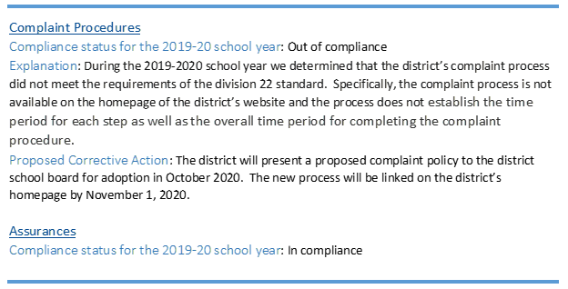
Sample Responses
Notes:
Here are sample responses to illustrate how to complete the Report to Community Template for both standards with which the school district is in compliance and standards with which the school district is out of compliance.
Note that the Explanation and Corrective Action sections have been deleted for the Assurances standard, which is reported as “In compliance.”

Slide 18
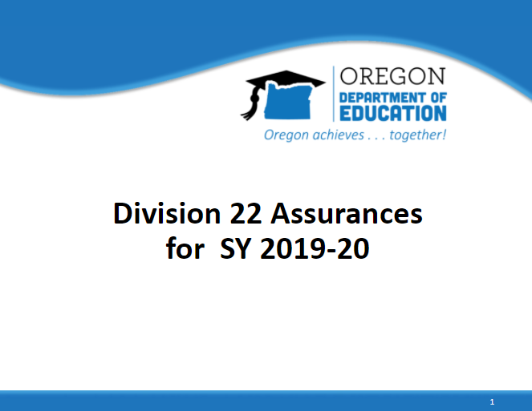
School Board Presentation Template (Optional)
Notes:
Customize slides/slide background with district specific information/slide template.
Includes slides from the beginning of this presentation, as well as placeholders for you to fill in regarding your district’s compliance status, and corrective action plans if necessary.
Also includes update on the Division 22 requirements for the current school year.

Slide 19
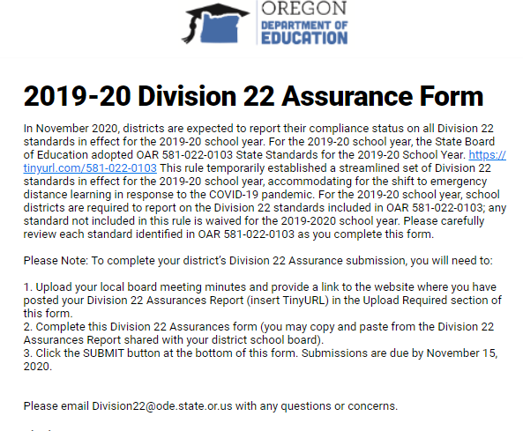
ODE Division 22 Submission Form (Required)
The Online Submission Form includes three sections:
1. Submitter Information
2. School Board Report
3. Compliance Review
Notes:
After making a report to the local school board, school districts must submit their annual Division 22 Assurances to ODE using the online Division 22 Assurances Form.
The Form includes three sections:
Submitter Information
School Board Report
Compliance Review

Slide 20
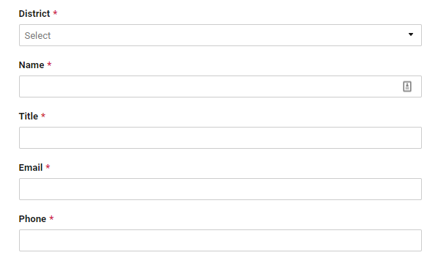
Submitter Information
At the top of the screen, the Division 22 Assurances Form asks the submitter to provide the following information:
Note: All of these fields are required
Notes:
The district field has a drop-down menu from which to select the applicable school district.
The remaining fields (name, title, email, and phone) are fillable fields for the submitter to provide their contact information.
ODE will use this information to send email confirmation once the form has been successfully submitted ??? and to follow up on any questions regarding the school district’s submission.

Slide 21
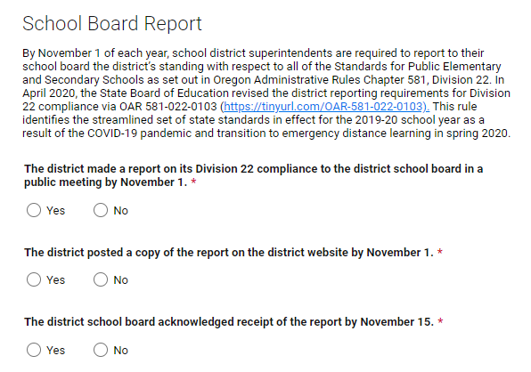
School Board Report
Step one: The Report to the Community section of the Division 22 Assurances Form asks the school district to certify that:
The school district made a report on its Division 22 compliance to the district school board in a public meeting by November 1, 2020;
The school district posted a copy of the Division 22 Report on the school district’s website by November 1, 2020; and
The district school board acknowledged receipt of the report by November 15, 2020
Notes:
For each of these statements, the school district must click either “yes” or “no”.

Slide 22
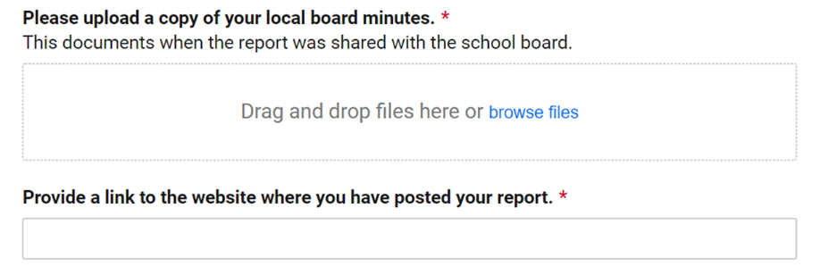
School Board Report (Continued)
Step two: Next, the School Board Report section requires the school district to upload a copy of the local board meeting minutes where the Division 22 Report was shared.
Step three: Finally, the School Board Report section provides a fillable field that requires the school district to enter a link to the website where the school district has posted its Division 22 Report.

Slide 23
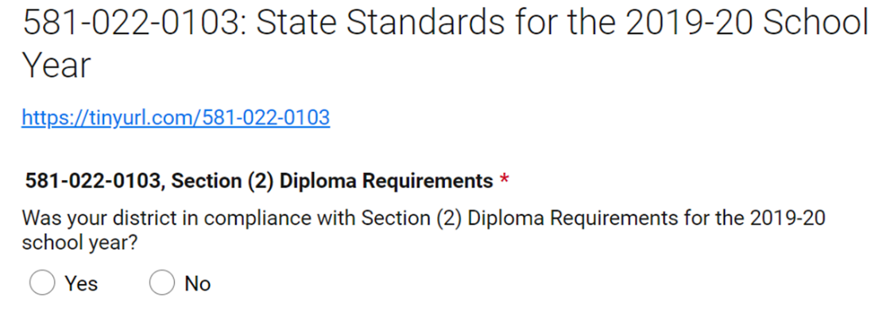
Compliance Review
Step one: The Compliance Review section asks whether the school district was in compliance during the 2019-20 school year and requires the school district to click either “yes” or “no”.
Notes:
The Compliance Review section of the Division 22 Assurances Form mirrors the structure of the Report to Community Template in that, for each standard, the Compliance Review section requires the school district to enter whether the school district was in compliance or out of compliance during the 2019-20 school year.
As with the Report to Community Template, the Compliance Review section then requires the school district to enter both an explanation and proposed corrective action for each standard with which the school district reports as out of compliance. The Compliance Review section consists of three steps for each standard.

Slide 24
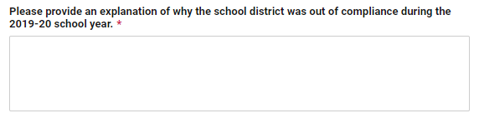
Compliance Review (Continued)
Step two: For standards with which the school district was out of compliance during the 2019-20 school year, the Compliance Review section prompts the school district to provide an explanation of why the school district was out of compliance.
Notes:
This question corresponds with the Explanation section in the Report to Community Template.
Step two is only required for those standards with which the school district reports out of compliance.
The school district may skip this step for all standards reported as in compliance.

Slide 25
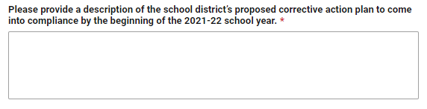
Compliance Review (Continued)
Step three: For standards with which the school district was out of compliance during the 2019-20 school year, the Compliance Review section prompts the school district to provide a description of the school district’s proposed corrective action plan to come into compliance by the beginning of the 2021-22 school year.
Notes:
This question corresponds with the Proposed Corrective Action section in the Report to Community Template.
Step three is only required for those standards with which the school district reports out of compliance.
The school district may skip this step for all standards reported as in compliance.

Slide 26
Considerations for Completing the Form
The online submission form must be completed in one session
  You can leave it open on your desktop and take breaks and return to it. But…
    That may be risky, it can time out when your screen saver turns on!
    You cannot save it, close it, and come back to it!
    Once submitted, you cannot revise!
ODE encourages copying and pasting responses from the “Explanation” and “Proposed Corrective Action” fields of the Division 22 Report Template
  Be sure to carefully review each rule to avoid cut/paste errors!
Notes:
School districts must complete their online submission in a single session; the online form does not allow for saving responses across multiple sessions.
ODE recommends that school districts complete all of their information gathering ahead of time; the Report to Community Template may be used for this purpose, although it is not required.
ODE also recommends setting aside sufficient time to enter information for all Division 22 standards during a single session.
If using the optional Report to Community template, ODE suggests copying and pasting responses into the online form. However, ODE cautions that the school district should carefully review each standard as it completes the form to avoid transcription errors (e.g., entering information on the wrong standard). Spell check is also functional in the form.
Once the school district has completed the entire Division 22 Assurances Form, the school district is ready to submit the form to ODE by clicking the SUBMIT button at the bottom of the form. If any required fields are blank, the form will identify incomplete sections and prompt the school district to go back and complete all required fields.

Slide 27
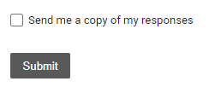
Request a Copy of Your Submission
When you submit, check this box to have a copy of your response emailed to you
Notes:
Before clicking SUBMIT, the school district may also check a box to send a copy of the school district’s responses. Doing so will generate an email sent to the submitter’s email account that includes the full submission embedded in the body of the email.

Slide 28
Questions/Concerns/Feedback?
If you have questions about the Division 22 Assurances submission process, please contact Susan Payne – Standards and Systems Specialist
  Email: division22@state.or.us or susan.payne@state.or.us
  Phone: 503-947-5730 (desk), 503-580-6814 (cell)
  If you have questions about the upcoming Division 22 rule revision process, please contact Emily Nazarov, Director of Government and Legal Affairs Management
  Email: emily.nazarov@state.or.us
  Phone: 503-947-5637
If you have questions about Division 22 Assurances instructional programs and processes, please contact Alexa Pearson–Director of Standards and Instructional Support
  Email: alexa.pearson@state.or.us
  Phone: 503-947-5713 (desk), 503-428-6898 (cell)
Notes:
Emily

