Slide 1
SUMMER LEARNING BEST PRACTICE GUIDE
Session 5 - Elevating Relationships and Enrichment & Ensuring Mental Health and Well-Being
January 28, 2022

Slide 2
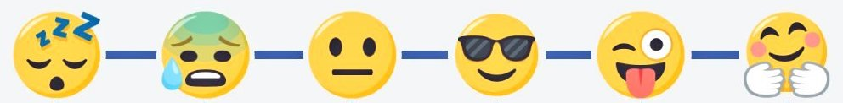
How Are You Today?
Enter and emoji into the chat to indicate how you are feeling today.

Slide 3
Today’s Goals
Upon the conclusion of today’s presentation, participants will be able to:
Dream, conceptualize and remain curious about the possibilities of equity-driven summer programming.
Explore the Integrated Model of Mental Health and practical tools for creating care and connection.
Collaborate with practitioners around planning summer programming for Summer 2022.

Slide 4
Agenda
10:00 - Welcome & Introductions
10:05 - Equity-Driven Summer Learning Programs
10:10 - Integrated Model of Mental Health
Care and Connection Campaign
Resources & Discussion
11:00- Thank you!

Slide 5
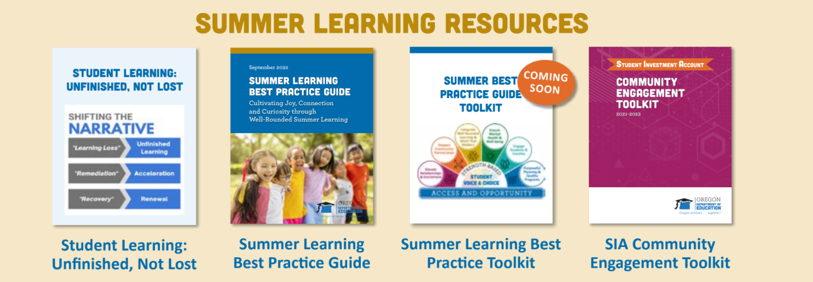

Summer Learning Resources

Slide 6
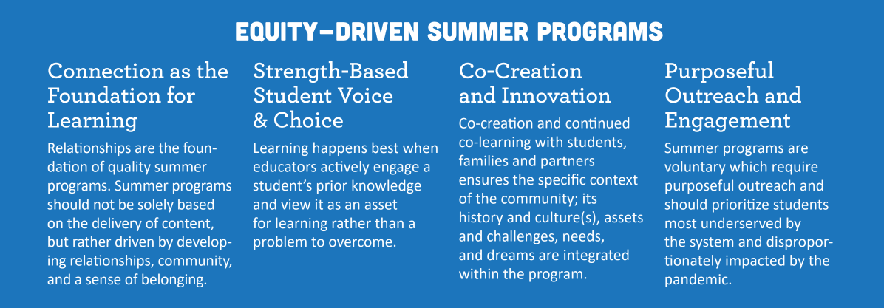
Equity-Driven Summer Programs

Slide 7
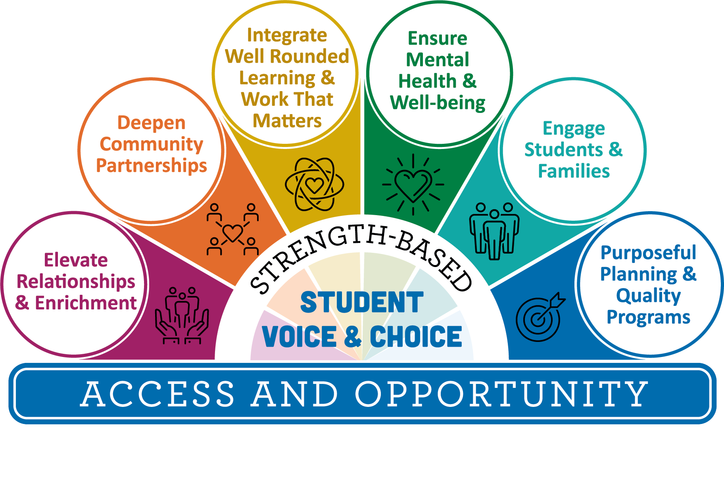
Where We Are
…and here!
We are here…

Slide 8
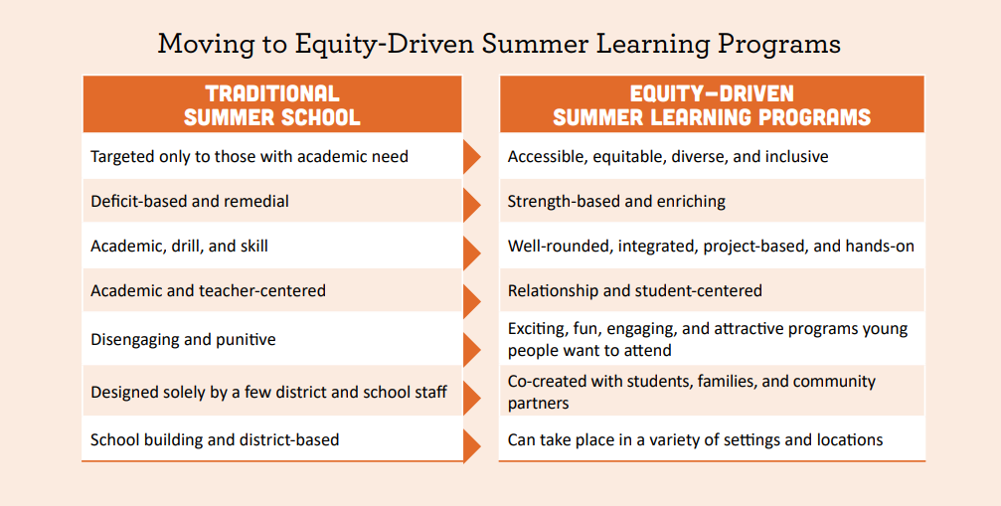
Centering Equity

Slide 9


Hands-On Enriching Learning
Academic Enrichment - Place-based Science, STEM, CTE, Math, Literature aligned to Oregon Standards
AND
Youth Development - SEL, Dance, Identity Affirming Cultural Programs, Art, Music, Etc.
Academics
&
Enrichment

Slide 10
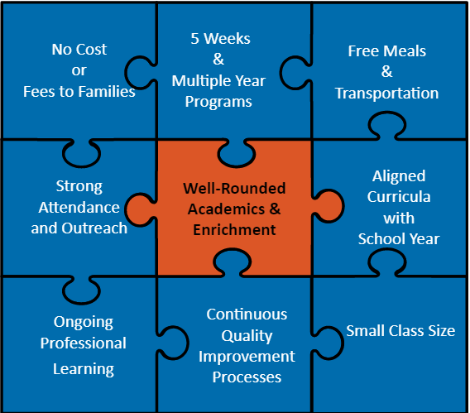
Core Elements of Quality Summer Programs
The Wallace Foundation, in partnership with the RAND Corporation and others, has published a wealth of research, evaluations and tools that delve deeply into core elements of effective summer programming.
Over the last decade, they have found the strongest results from these conditions of programming

Slide 11
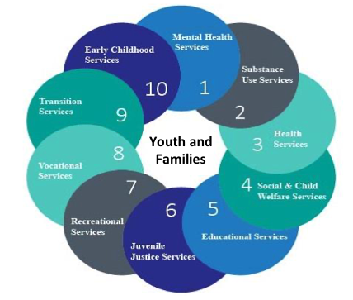
Partners in a System of Care

Slide 12
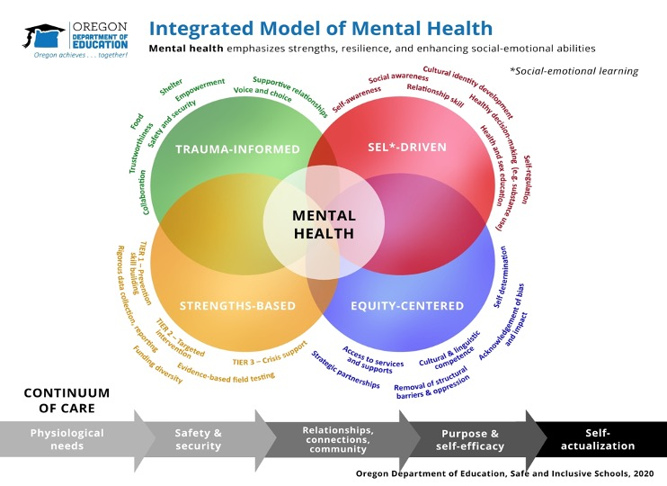
Values
Mental health is a cornerstone of education.
Health occurs along a continuum of care.
Schools are primary providers of mental health services.
Strengths-based health promotion.
Celebrates ways of being and knowing.
Meets people where they are.

Slide 13
Tools
ODE has a number of mental and behavioral health-focused initiatives that focus on the prevention, intervention and response to the mental health needs of school communities. These include:
Mental Health Toolkit
An Integrated Model for Mental and Emotional Health
Mental Health Guidance & Resources
Strengthening Mental Health in Education Initiatives
Suicide Prevention (Adi's Act)
School Safety & Prevention System (SSPS)
Every Student Belongs
For more information please see link below:
Resources from ODE Mental Health and Well-Being Website

Slide 14

Care and Connection Campaign
ODE Care & Connection Webpage

Slide 15
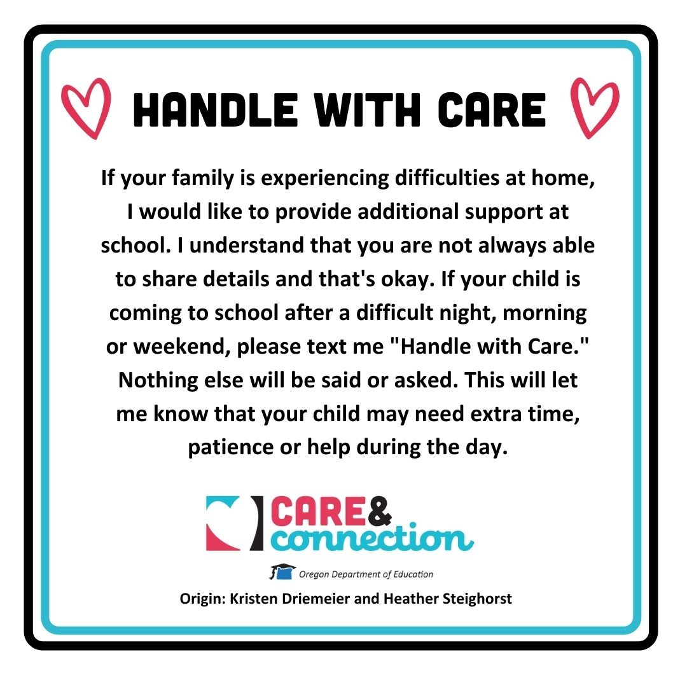
Handle with Care Tool
There are graphic resources available such as the Handle with Care printable for download on the Care and Connection Webpage.

Slide 16

Check Out These Resources!
Please take the next five minutes to silently review the Care and Connection Participant Resource Page

Slide 17


Small Group Discussion
Break Out Room Discussion Questions:
How might you embody the values of the Integrated Model of Mental Health and incorporate the Care and Connection Campaign resources to promote safe, supportive school climates and mental health and well-being for students and staff in your summer school programs?

Slide 18

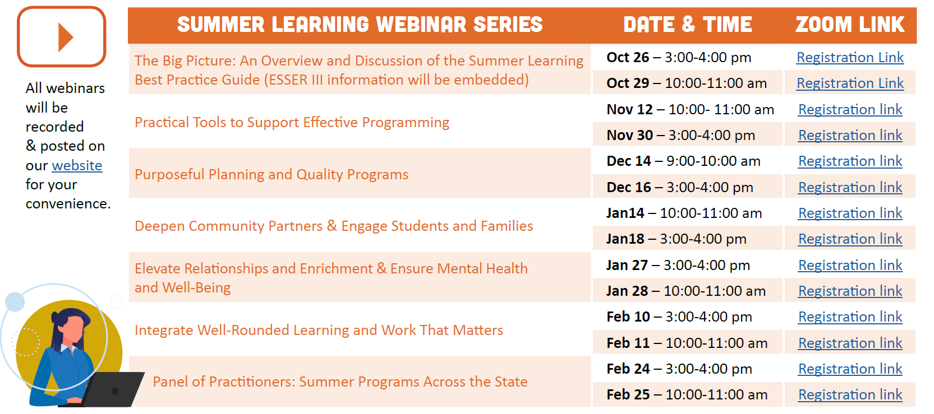
Summer Learning Webinar Series
Coming Soon!
Notes:
Framing the series, discourse,

Slide 19

Thank you!
Raquel Gwynn, Education Specialist
Office of Teaching, Learning and Assessment
raquel.gwynn@state.or.us
Sophie Hilton, Program Analyst
Office of Teaching, Learning and Assessment
sophie.hilton@state.or.us

