Slide 1
SUMMER LEARNING BEST PRACTICE GUIDE
Session 4 - Deepening Community Partnerships
& Engaging Students and Families

Slide 2
Today’s Goals
Upon the conclusion of today’s presentation, participants will be able to:
Dream, conceptualize and remain curious about the possibilities of equity-driven summer programming.
Explore practical tools for planning quality summer learning opportunities.
Collaborate with practitioners around planning summer programming for Summer 2022.

Slide 3
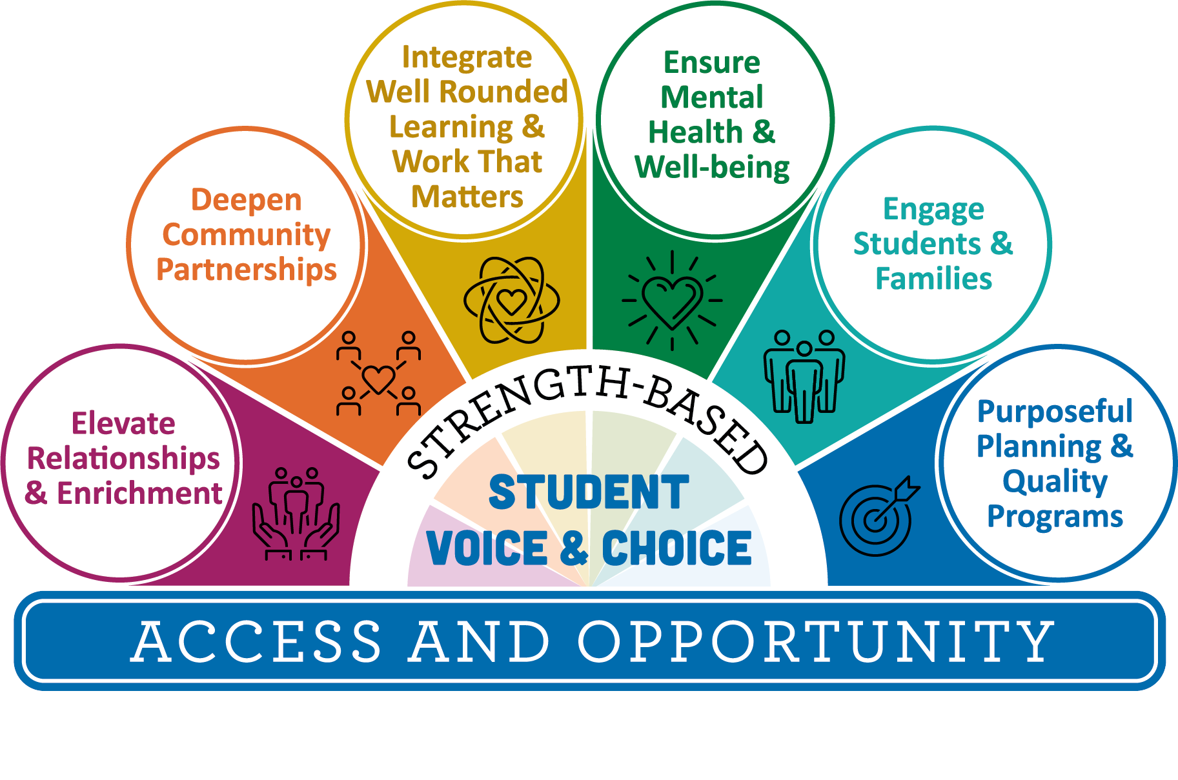
Agenda
10:00 Welcome
10:05 Equity-Driven Summer Learning - Webinar & Overview
10:10 Community Partner Tools/Resources
10:20 Examples from Districts
10:30 Outreach Tools/Resources
10:40 Small Group Discourse
10:55 Debrief, Next Steps, Questions
11:00 Thank you!

Slide 4
Which movie do you identify with most right now?
If there is another movie that resonates more, please share that!
Notes:
Framing the series, discourse,

Slide 5
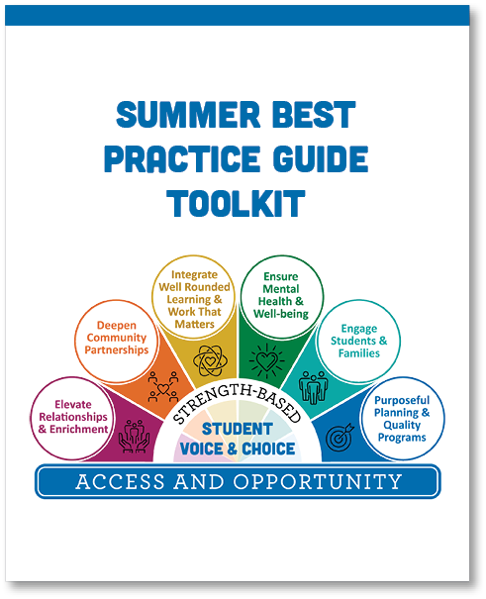
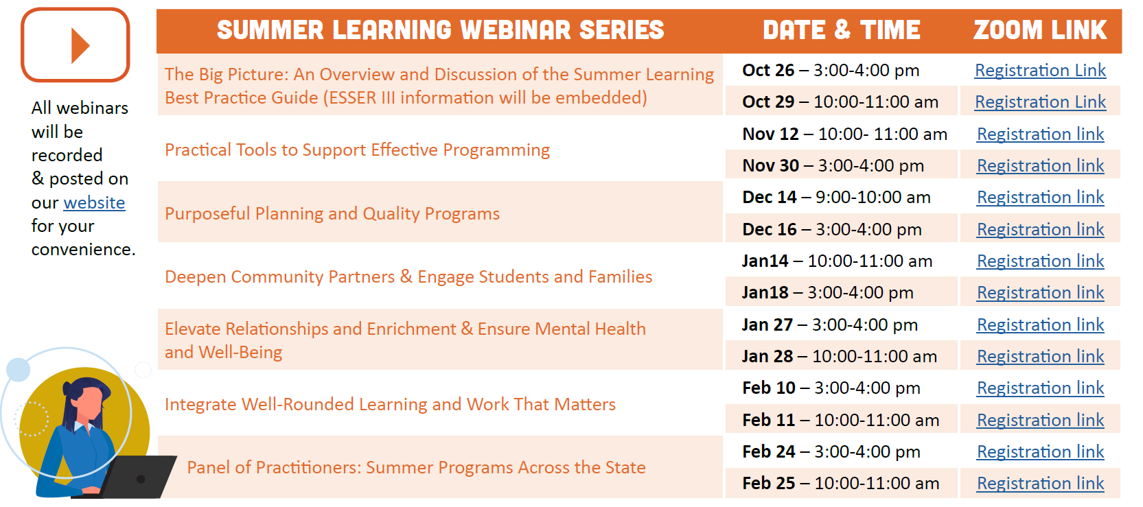
Summer Learning Webinar Series
Coming Soon!
Notes:
Framing the series, discourse,

Slide 6
Summer Learning Resources

Slide 7
Equity-Driven Summer Programs

Slide 8
Where We Are
We are here…
…and here!

Slide 9
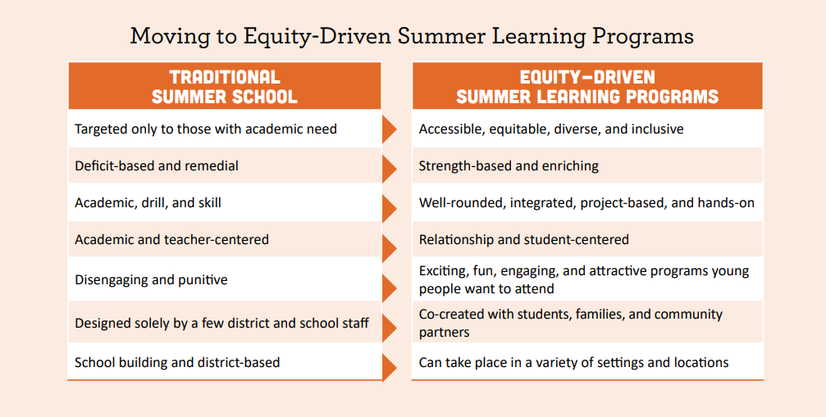
Centering Equity

Slide 10
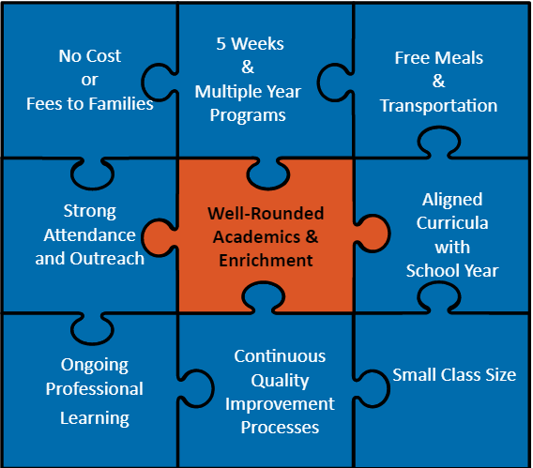
Core Elements of Quality Summer Programs
The Wallace Foundation, in partnership with the RAND Corporation and others, has published a wealth of research, evaluations and tools that delve deeply into core elements of effective summer programming.
Over the last decade, they have found the strongest results from these conditions of programming

Slide 11
Hands-On Enriching Learning
Academic Enrichment - Place-based Science, STEM, CTE, Math, Literature aligned to Oregon Standards
AND
Youth Development - SEL, Dance, Identity Affirming Cultural Programs, Art, Music, Etc.
Academics
&
Enrichment

Slide 12
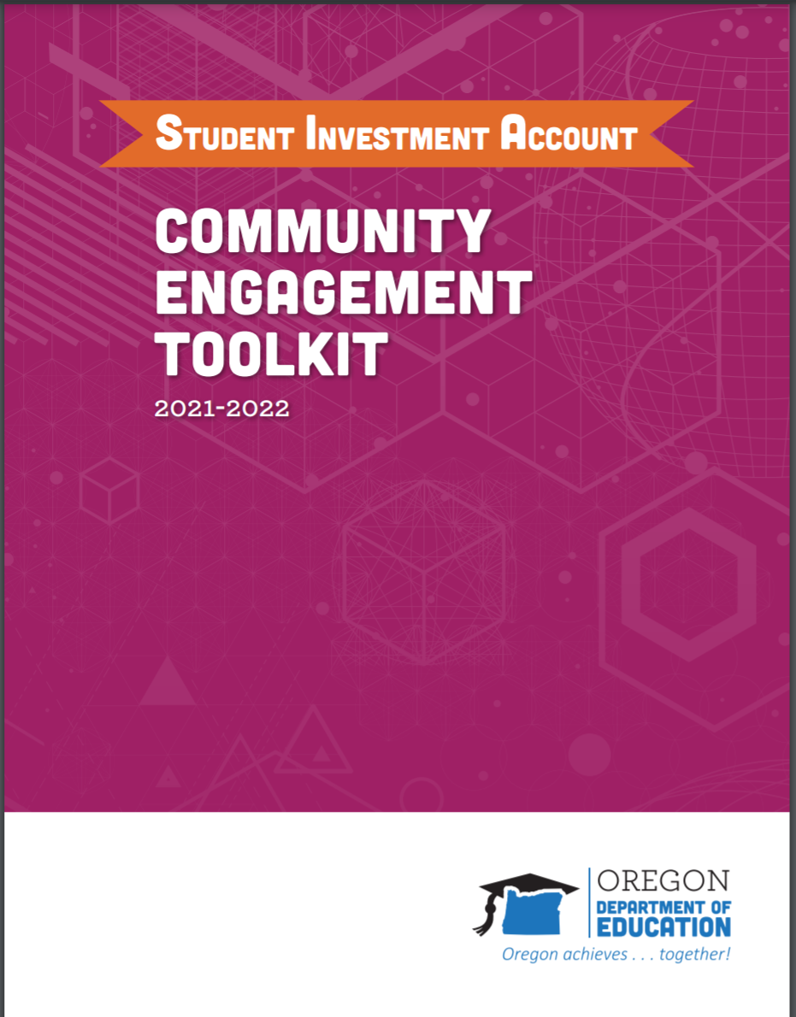
Deepening Community Partnerships
Levels of Community Engagement
0 | 1 | 2 | 3 | 4 | 5
Example Engagement Methods
Ignore | Inform | Consult | Involve | Collaborate | Defer
Closed door meeting Misinformation Systematic effort to avoid engagement | Fact sheets Open houses Presentations Billboards or school electronic boards Videos Social media posts | Input sessions Focus groups Empathy interviews Surveys | Collaboration or engagement with community organizing and community voices House meetings Interactive workshops & forums with accessibility and safety considerations Student & Parent/Family Advisory Committees | MOUs with Community-based organizations Leadership Development Resources & funding allocated for community organizing Collaborative design and facilitations of community forums to ensure voice, safety & accessibility | Community-driven planning Student or Parent/Family led community forums to assess challenges and develop solutions Consensus building Participatory Action Research and community-driven initiatives Participatory budgeting Community schools

Slide 13
Key Strategies
Key Strategy 1: Identify Needs
Key Strategy 2: Use Community Asset Mapping
Key Strategy 3: Implement an Outreach Plan
Key Strategy 4: Execute Your Partnership
Key Strategy 5: Preserve Your Partnerships

Slide 14
Strategic Partnerships
Y4Y Summer Learning Initiative
The United States Department of Education contracted with Y4Y to create this resource for 21st CCLC Out-of-School Time programs. All tools are in Word or Excel formats with permission to use, change, and make work for your specific needs.

Slide 15
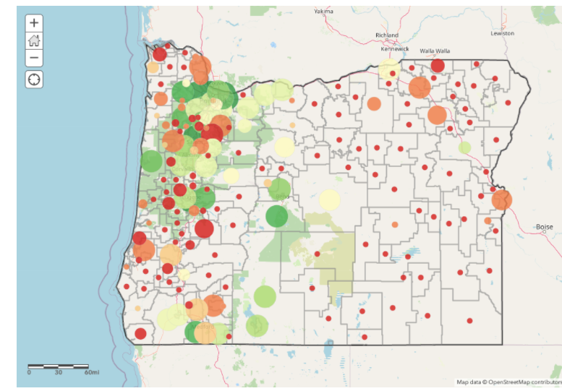
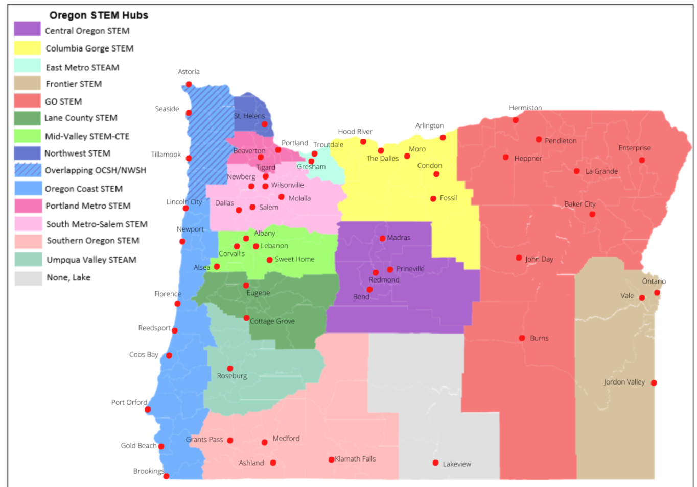
Oregon Resources
Notes:
https://stemoregon.org/regional-stem-hubs/
https://oregonask.org/

Slide 16
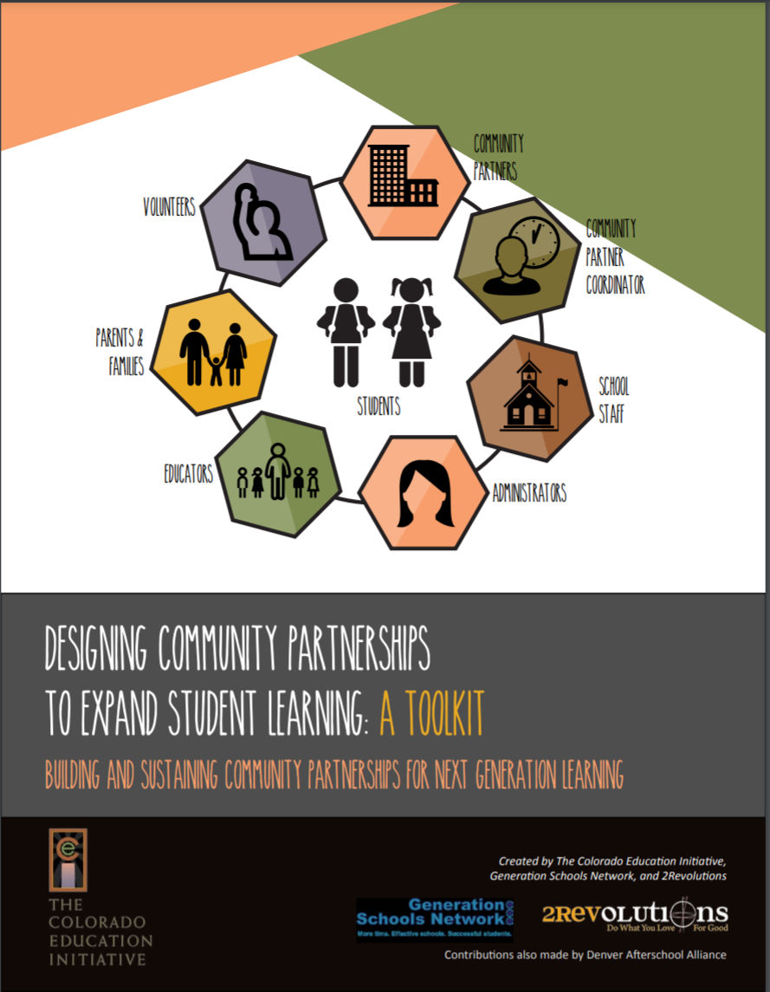
Building Strong Community Partnerships
The Colorado Education Initiative
Designing Community Partnerships To Expand Student Learning: A Toolkit
Building and Sustaining Community Partnerships for Next Generation Learning
Pre-Screening Questions for Potential Community Partners
Community Partnership Agreements
MOU examples
Student and Family Surveys
Shared Learning Space Agreement
Professional Development
“Education can no longer be the sole responsibility of our schools.”
– Katie Salen, educator, game designer, and animator

Slide 17
Supporting Capacity for Community Partnerships
Community Partner Coordinator
Example - Job Description
Family Coordinator
Example - Job Description
Connecting with:
McKinney-Vento
Migrant Education
Title VI Coordinators
Oregon Example
Morrow County CARE Coordinators are one arm of our multidisciplinary CARE program. The CARE coordinators are bilingual staff that are dedicated to working with buildings and families and addressing any barriers that are preventing students from attending school and learning. They build relationships with families and work in partnership with our other wrap-around partners to get families the services they may need. On an average day they will be assisting with families with attendance; helping families through the OHP application process; assisting with scheduling medical/counseling appointment; helping with housing searches; and making connections with students at lunch and recesses.

Slide 18
Summer Learning and Enrichment Collaborative
The Hillsboro school district has worked for many years to create parent leadership and collaborative opportunities for BIIPOC parent groups and built strong parent Advisory Councils that are actively engaged in consultation on education planning.
Please watch the following video to learn more:
Developing Partnerships in High-Needs Communities
Hillsboro SD - July 8, 2021

Slide 19
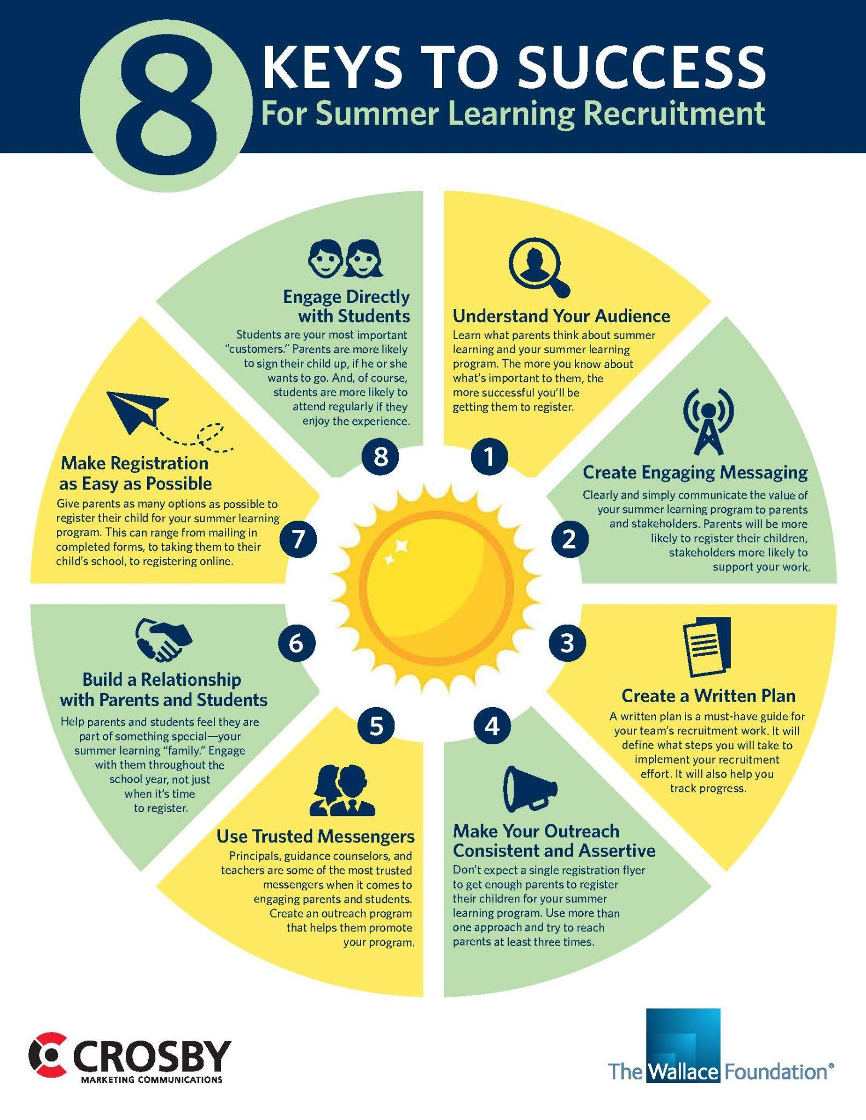
Purposeful Outreach

Slide 20
Purposeful Outreach & Attendance
Coordinated outreach materials and communication about key meetings, dates, registration and activities.
At least three times for enrollment using multiple communication methods, including but not limited to, phone calls, flyers, social media and email.
Personalizing the recruitment of students and their families in home language
Incentivizing student attendance with field trips, college tours, STEM / STEAM content and other fun and engaging activities based on student interests.
Calling and/or texting families on the first day of the program who did not show up to encourage them to participate.
Providing virtual family orientations at multiple times to meet needs of working families; use this time to co-create expectations for summer programming and to build relationships.
Creating inclusive community space in the school for families and students to access technology, laundry facilities, library services, parent education, and childcare.

Slide 21
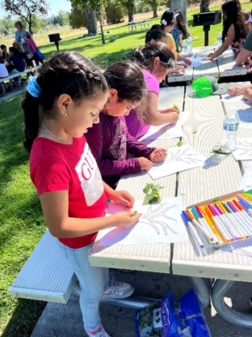
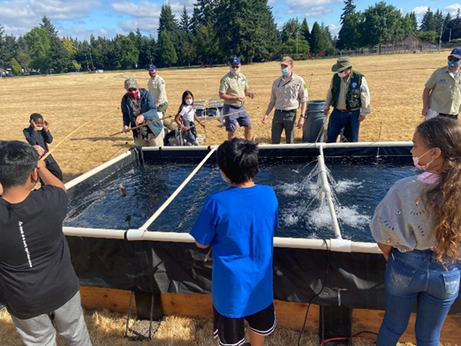
Highlighting District/School Programs
David Douglas School District
Reynolds School District

Slide 22
Check Out These Resources!
Please take the next five minutes to silently review the planning tools on the Google Resource Page and in your Participant Folder

Slide 23
Small Group Discussion
Break Out Room Discussion Questions:
What does equity-driven student, family and community outreach look like?
How are you enriching your summer program by enhancing existing relationships in the community?
What has been helpful in establishing strong community partnerships?

Slide 24
Summer Learning Webinar Series
Coming Soon!
Notes:
Framing the series, discourse,

Slide 25
Thank you!
Raquel Gwynn, Education Specialist
Office of Teaching, Learning and Assessment
raquel.gwynn@state.or.us
Sophie Hilton, Program Analyst
Office of Teaching, Learning and Assessment
sophie.hilton@state.or.us

