Slide 1
SUMMER LEARNING BEST PRACTICE GUIDE
Session 6 - Integrating Well Rounded Learning and
Work that Matters

Slide 2
Today’s Goals
Upon the conclusion of today’s presentation, participants will be able to:
Dream, conceptualize and remain curious about the possibilities of equity-driven summer programming.
Explore Well-Rounded Learning and Work that Matters.
Collaborate with practitioners around planning summer programming for Summer 2022.

Slide 3

Who’s in the space today?
We are excited to have Shannon Johnson, ODE’s arts education specialist, presenting today.
Please put in the chat your role, how you are connected to summer learning, and what you hope to take away from today’s session?

Slide 4
Agenda
10:00 Welcome & Introductions
10:05 Equity-Driven Summer Learning Programs
10:15 Well-Rounded Definitions
10:20 Individualized, Intentional, and Integrated Planning Ideas and Resources
10:35 Resource Dive
10:40 Small Group Discussions
10:55 Debrief, Next Steps, Questions
11:00 Thank you!

Slide 5
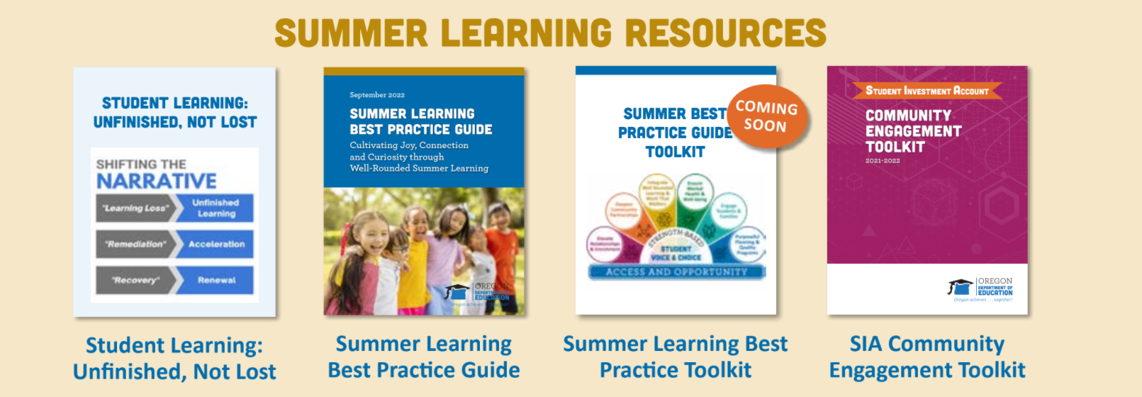

Summer Learning Resources

Slide 6

Shared Responsibility
Providing equitable access to an excellent education to each and every child is a moral imperative and, as educators, it is a responsibility we must own and embrace. It calls for professionals, leaders of all walks of life, families, and communities to find shared understanding, time, and the will to mobilize on a daily basis and to surround young people with the love, care, nourishment, intellectual challenges, and connection they need to thrive.
Director Colt Gill, Letter Written 2-8-22

Slide 7
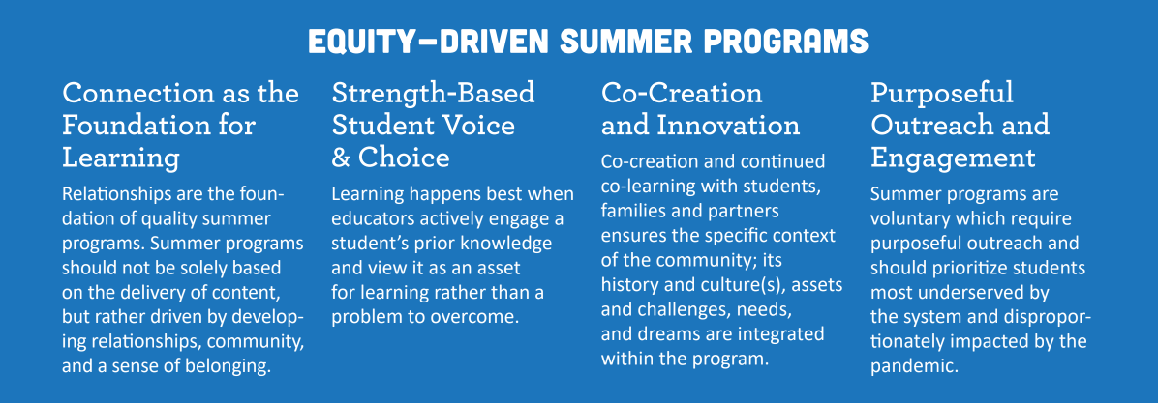
Equity-Driven Summer Programs

Slide 8
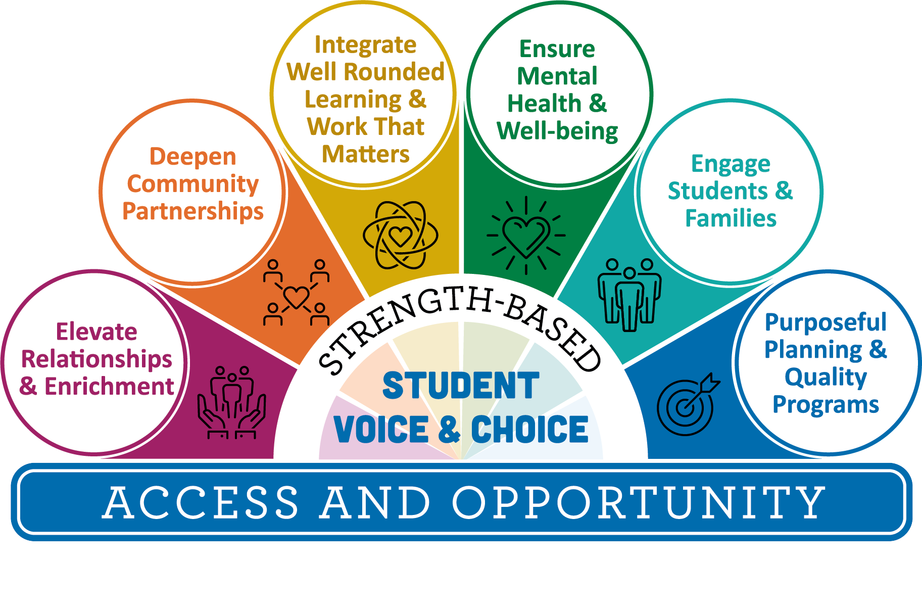
Where We Are
We are here

Slide 9
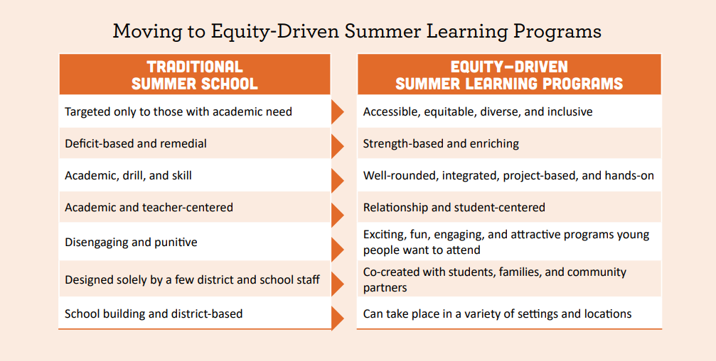
Centering Equity

Slide 10
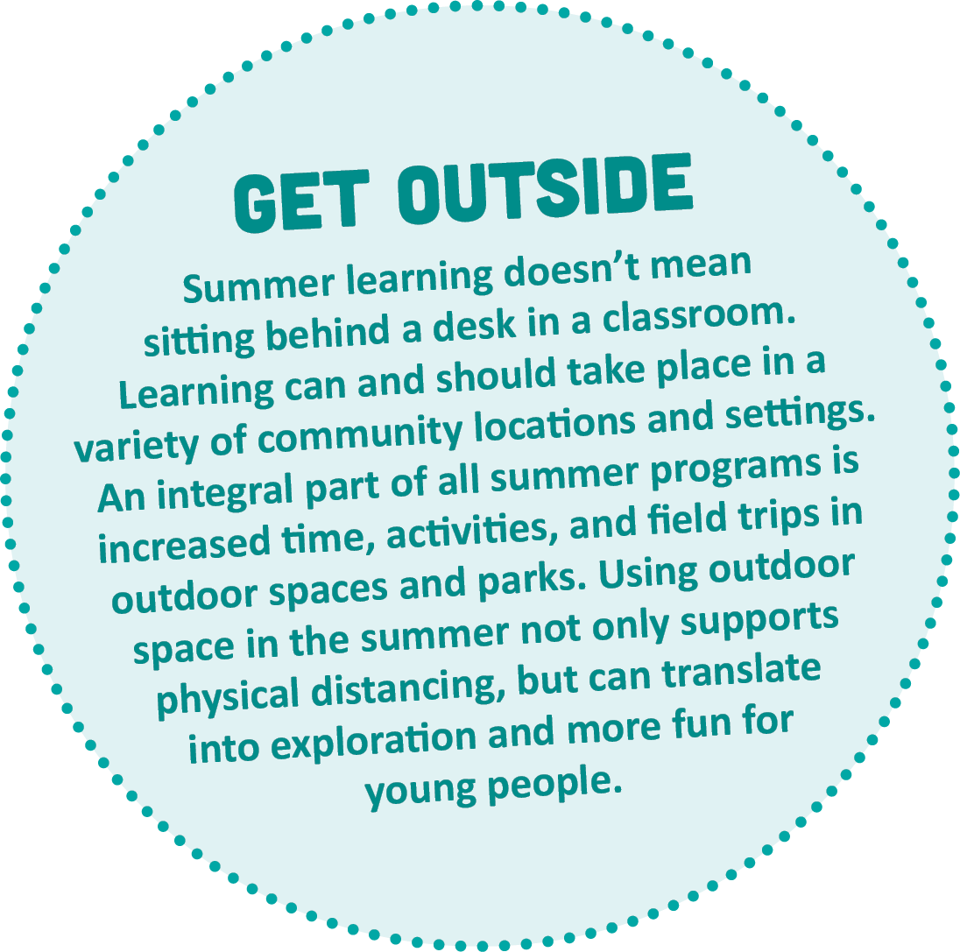

Hands-On Enriching Learning
Academic Enrichment - Place-based Science, STEM, CTE, Math, Literature aligned to Oregon Standards
AND
Youth Development - SEL, Dance, Identity Affirming Cultural Programs, Art, Music, Etc.
Academics
&
Enrichment

Slide 11

Well-Rounded Education in Oregon
In the Chat: What comes to mind when you think about “well-rounded learning” and “work that matters”?
Well-rounded education:
Moves beyond the course subjects that students take
Teaches essential knowledge and skills to live, learn, work, create, and contribute
Each and every student is known, heard, and supported
Focuses on the whole student
Focuses on developing a hands-on, collaborative, and integrated educational environment rooted in inquiry and discovery
Notes:
Pose Activity
In the Chat: What comes to mind when you think about “well rounded learning” and work that matters?
Developing a shared understanding of what “well-rounded” means can be helpful, so we will take a minute to run through it here.
In Oregon, well-rounded education moves beyond the course subjects that students take - which in the federal definition are programs such as arts, STEAM, languages, etc.
Well-rounded programs teach students essential skills that cut across disciplines - such as critical thinking and teamwork skills
In a well-rounded learning environment, students are known, heard, and supported - teachers know their students strengths and needs, allow them to share their voice and ideas, and support them in owning their learning and growth
Focuses on the whole student … so that students can show up in a space where they feel safe sharing about their life, ideas, interests, and beliefs, and can take risks to grow
Focuses on developing a hands-on, collaborative, integrated…this is where work that matters comes in. Activities in well rounded learning are meaningful, so that students are curious and engaged in the work
Examples:
Art and Literacy
Makerspace Exploration
STEAM camps
Music and culture
In this presentation, I try to present a balance of programmatic supports to consider for hosting community partners who specialize in well-rounded learning, and tips for designing instruction for well-rounded learning.

Slide 12



Individualized, Intentional, and Integrated
Students are Known, Heard, and Supported
Successful Experiences with Well-Rounded Learning
Meaningful Work Focused on Cross-Cutting Skills
Notes:
There are three areas highlighted in the Summer Learning Best Practice Guide that focus on well rounded learning.
Individualized programming ensures that students are Known, Heard, and Supported.
Intentional programming involves setting teachers and students up for success with well-rounded learning experiences.
Integrated programming creates opportunities for students to engage with meaningful work that focuses on cross-cutting skills.

Slide 13
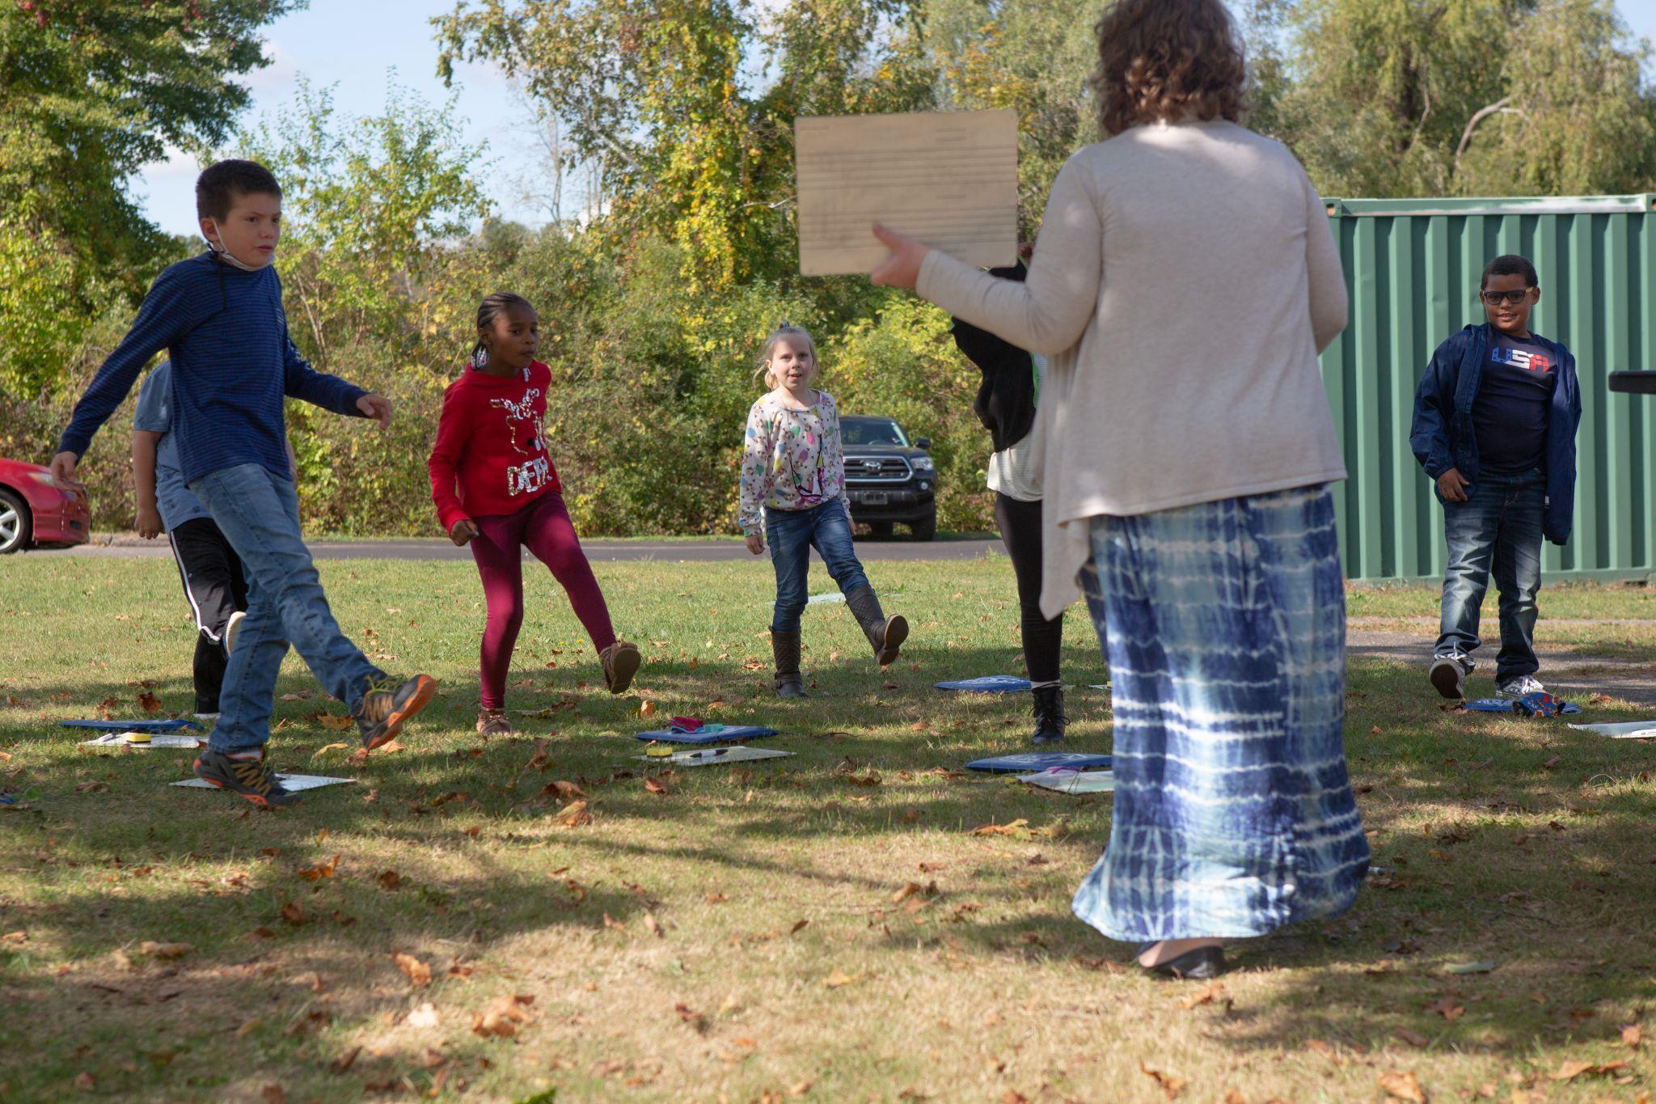
Individualized: Students are Known, Heard, and Supported
Clear information systems and structure for teachers and program contacts
Student interests, choice, and voice are represented
Students need time to build relationships, and support in offering each other formative feedback and encouragement
Photo by Allison Shelley for EDUimages
Notes:
Key components of individualized Well-Rounded programming for students no matter what:
Students are known and respected as individuals, and are able to lead their own learning
Students have entry points into the material and content that work for them
Students feel supported by the teacher and their peers in creating high-quality work they are proud of
What has to be paid attention to in summer programming?
-Sometimes, everyone is new: the teachers AND the students - and need to be familiar with the systems
Studio/Classroom Expectations are still essential and tie students to their structure from the school year: Provide somewhere to start, or encourage class to create their own
Ensure that teachers know the systems (e.g. safety, custodial)
Learning targets are helpful
Student Interests, Choice and Voice are included:
-Summer programs are opt in, so can have the benefit of being individualized to student interests if there is community engagement
Connect to student/family interests, engage community before planning summer programs - and design around ideas and needs
Plan open ended products where students can make connections and choices
Build in Time for Relationships and Formative Feedback:
-Summer programs have the option of flexible scheduling and timing, which can allow space for connection and building an academic community
Formative assessment and feedback is a great way to make ties to learning during the school year, and to bring academic and enrichment learning together. Some examples are Circle shares, Self and Peer Feedback (Tools below), Artist’s Chair, Sketchbooks/Journals to track learning
Some tools I’ve included:
ODE Formative Assessment Page
56 Different Ways to Gather Evidence of Student Achievement
Sentence Stems for Kind, Helpful, and Specific Feedback

Slide 14
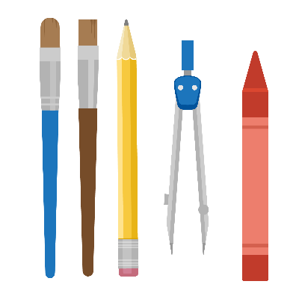
Formative Assessment Tools: Arts Integration
Read a page of the story not allowing students to see the illustration. Have each student create a visualization (illustration) for that page. - Kim Huey
56 different examples of formative assessment powerpoint
Curated by David Wees
Notes:
56 Formative assessment tools gives general prompts for teachers to build in formative assessment

Slide 15
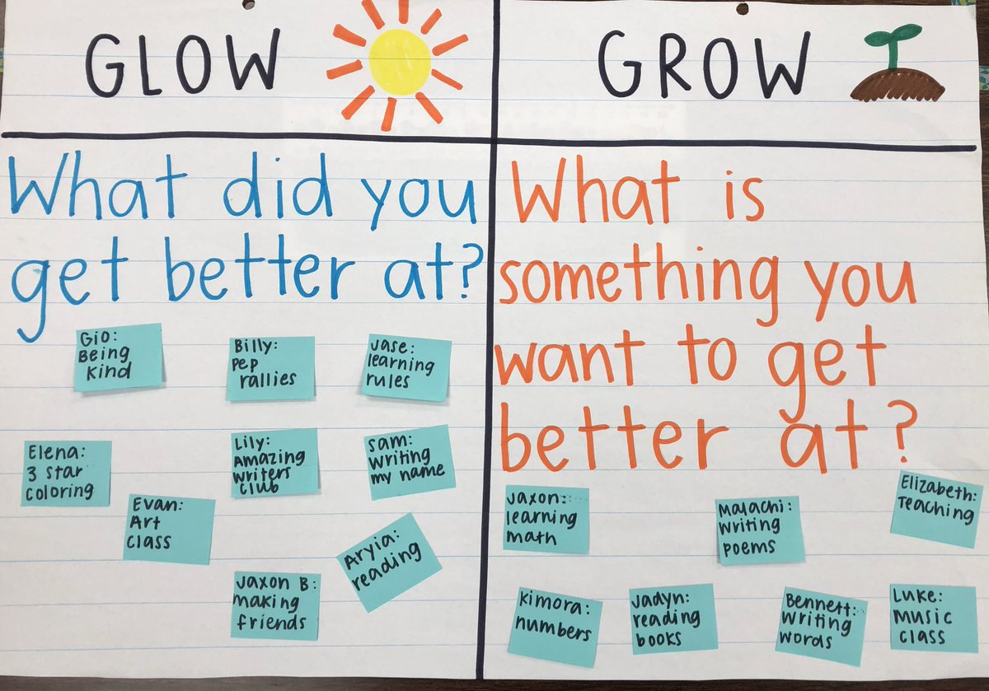
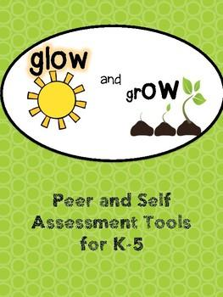
Protocols for Self and Peer Formative Assessment
Notes:
Glow and Grow is an elementary self assessment protocol; students assess what went well in their learning and what they can improve on, and it can be used at different places throughout the making process
Critique protocol language can help students use Kind, Helpful, and Specific feedback when helping a peer improve their work
How does this play out? In the chat or share out - In what ways have you worked to individualize your programs to support well-rounded learning?

Slide 16
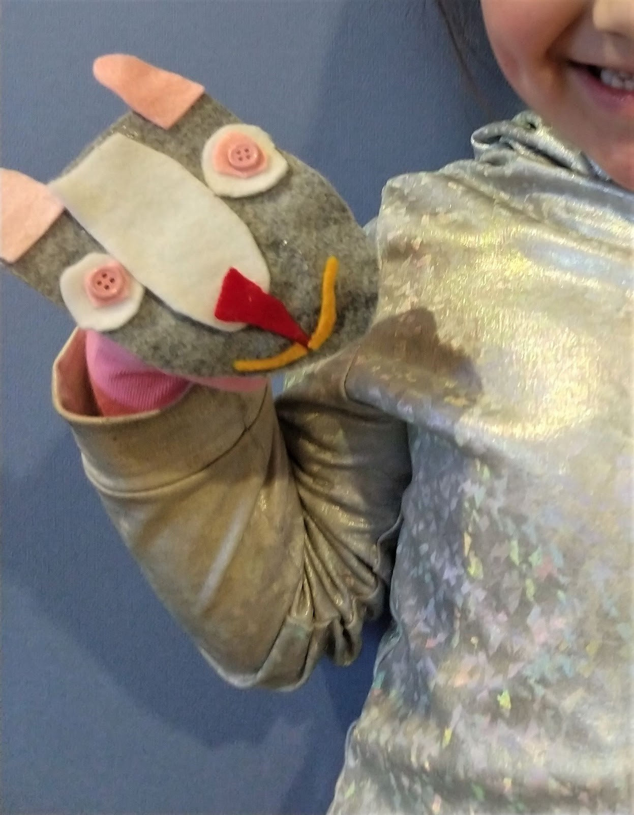
Intentional: Successful Experiences with Well-Rounded Learning
Communicate about space and materials use far ahead of time, including display tech
Materials - secure early and get creative with community resources and donations
Budget time for individual and collective planning with Universal Design for Learning
Notes:
Key components of intentional Well-Rounded programming for students no matter what:
There are the right amount and quality of materials and the right space to do the job (e.g. stage lighting for theatre, instruments for music)
Teachers are supported with both individual and collaborative planning time to create cross-content connections
Students have multiple entries to engagement, representation and expression of content (UDL)
What has to be paid attention to in summer programming?
-Summer educators may be unfamiliar with the space and materials available/shared (scissors, writing utensils, or specialized equipment such as instruments, etc.)
How will teachers display information? Cleaning, storage, and labeling systems - trays and tarps!
If you are managing materials order early and get the exact materials requested - different brands sometimes can make or break a process
Create an “always useful” supply list for families, share at school events and fundraisers to gather needed supplies
-Planning time is different for various teachers/educators
Budget for individual and collective planning time; this will differ depending on program
Encourage communication and learning between summer teachers and school year teachers - classroom visits could be great learning experiences
-Summer educators may or may not be familiar with the supports students will need
Provide supports for integrating Universal Design for Learning into projects
Make sure and connect and introduce any supports for summer educators; e.g. time to collaborate with aides, or learn an accessibility tool
What does this look like? UDL Example: Kindergarten Puppet Project
Multiple points of access in design -
Engagement - can introduce with a model puppet
-students can select from pre-made shapes or cut their own
Representation -
-connect to music/puppet artists for auditory and movement input
-basic color and shape vocabulary, and models of work for students to analyze for high-quality components
Expression - lots of choice in how to express through puppets; and you can use them with any content
Sample Lesson Plan Template from Oregon Open Learning
Universal Design for Learning Guidelines

Slide 17

Tools & Resources for Integrated Learning
STEAM Project Planning Worksheet
Creative: Tackles a Real-World Challenge or Creates Something that Has Value or Meaning
Interdisciplinary: Includes Content and Skills from More than One Domain of Knowledge
Experiential: Provides Opportunities for Active Exploration (for example, through a makerspace)
Inquiry Based: Follows the Design Thinking Process (empathize, define, ideate, prototype, test).
Y4Y STEAM Course
The United States Department of Education contracted with Y4Y to create this resource for 21st CCLC Out-of-School Time programs. All tools are in Word or Excel formats with permission to use, change, and make work for your specific needs.
Notes:
Now we move on to the subject of integrated summer learning. STEAM Pedagogy is one example of a framework for subject integration. There are four areas that define whether a project encompasses STEAM pedagogy; creative, interdisciplinary, experiential, and inquiry based. This tool could be used to evaluate program lessons to determine which program to bring in to your summer learning, or share with teachers from school sites to evaluate and revise lesson ideas.
You 4 Youth has a whole section of STEAM and Project Based Learning resources that may be helpful to your program. And for teachers with little familiarity with STEAM, they offer a basic STEAM course to introduce the topic and provide examples.
The institute for Arts Integration and STEAM has also created a helpful manual for planning makerspaces, if your program is considering creating a makerspace for design and experimentation.
STEAM Project Planning Worksheet - Y4Y (pull up in full screen to share)
STEAM PD Course - Y4Y - for those new to STEAM/interdisciplinary planning
Makerspace Manual - The Institute for Arts Integration and STEAM

Slide 18
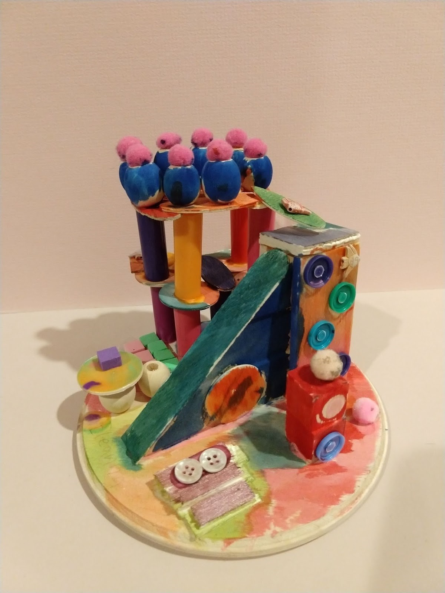
Integrated: Meaningful Work Focused on Cross-Cutting Skills
Inquiry Based:
Big Questions and Themes - KWL Charts, Knowledge Mapping
Creative:
Students see themselves in their work and make creative choices
Interdisciplinary:
Solve Real World Problems - tie into place based learning and service learning, tap into student funds of knowledge and interests using skills from multiple disciplines
Experiential:
Encourage hands on experimenting, editing, and refining of work
Notes:
Key components of integrated, meaningful work in programming for students no matter what:
Students are excited and engaged in the content and activities
Students develop skills that apply in any discipline through the work
Students express themselves and their ideas through the work
Students solve problems as they would in real life situations - and are given opportunities to use their work to help others
Students are given opportunities to edit and refine their work to make it the best representation of their skills
What has to be paid attention to in summer programming?
-There may not be communication structures in place to encourage these relationships with place based and service learning opportunities before summer starts
If you do not yet have this, consider a site liaison system that can help answer questions and make connections between school staff, outside programs, and other school initiatives that could be informed by the student work for your summer program
Example:
Inclusive Playground Designs
-What do we want to know? What do we already know?
-Building Background Knowledge/Research - gather student experience and stories
-Students built a rubric
-Sketch, design, feedback - “Would you Consider?”, and refine
-Where can the project go? e.g. inclusive playground mural, project to fund new playground equipment - students decide if possible

Slide 19

Check Out These Resources!
Please take the next five minutes to silently review the planning tools on the Google Resource Page and in your Participant Folder
Notes:
Resource page with links: https://docs.google.com/document/d/1uP8sS74Oxt3eo5nkksQCzGl-osLJ7mjAdqFOcj3uFUE/edit
Participant Folder: https://drive.google.com/drive/folders/12QW83iCnihI3BbdgYIpDVSXlDkRrg8rf?usp=sharing
I’ve included the tools I mentioned, as well as sections with many well-rounded lesson resources and well-rounded program resources that could be useful

Slide 20


Small Group Discussion
Break Out Room Discussion Questions:
What could you do to support and encourage student and staff communication and relationship-building in your program?
What are your next steps in establishing your plans for well-rounded, meaningful summer learning? What is going well that you could share with your group?
Who are some partners to work with to develop and offer authentic, place-based and inquiry-based lessons for your program?

Slide 21
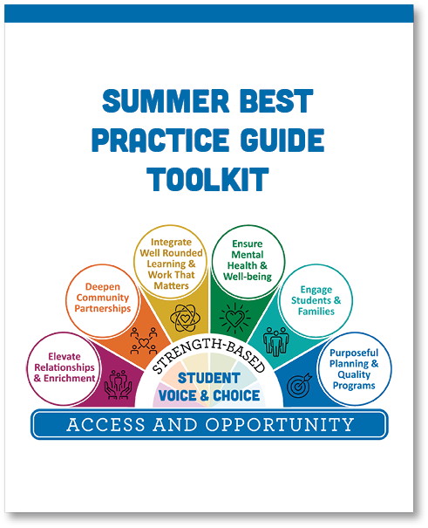
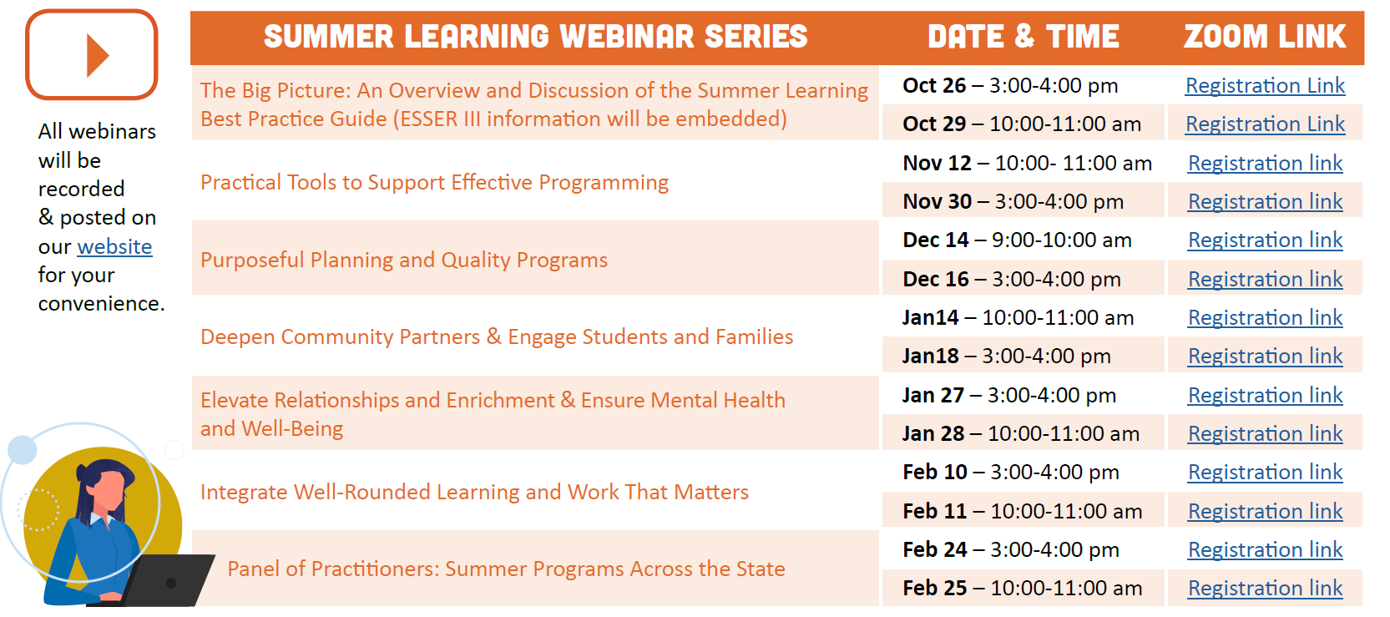
Summer Learning Webinar Series
Coming Soon!
Notes:
Framing the series, discourse,

Slide 22

Thank you!
Raquel Gwynn, Education Specialist
Office of Teaching, Learning and Assessment
raquel.gwynn@state.or.us
Sophie Hilton, Program Analyst
Office of Teaching, Learning and Assessment
sophie.hilton@state.or.us
Shannon Johnson, Arts Education Specialist
Office of Teaching, Learning and Assessment
shannon.johnson@ode.oregon.gov

