Slide 1
SUMMER LEARNING BEST PRACTICE GUIDE
Session 7 - Panel of Practitioners

Slide 2
Today’s Goals
Upon the conclusion of today’s presentation, participants will be able to:
Dream, conceptualize and remain curious about the possibilities of equity-driven summer programming.
Hear from exemplar summer learning programs & best practices across Oregon
Collaborate with practitioners around planning summer programming for Summer 2022

Slide 3
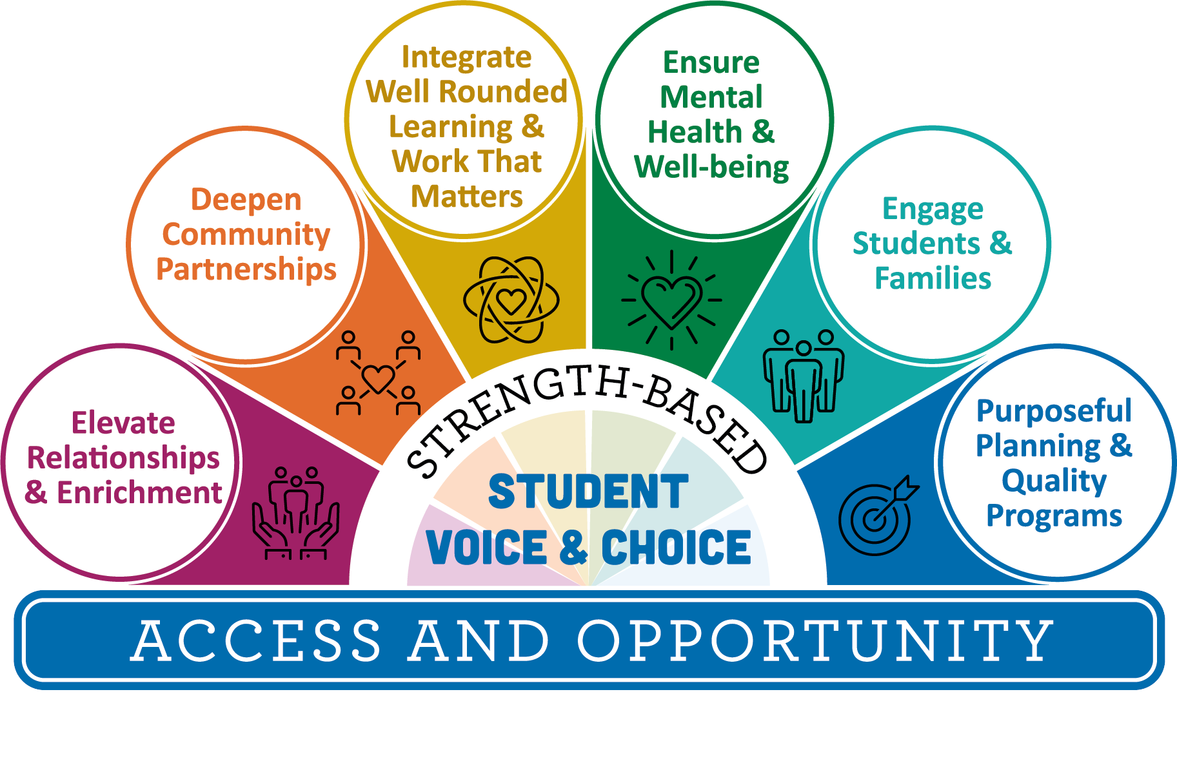
Agenda
9:00 Welcome
10:05 Introduce Panel members
10:35 Questions for Panel members
10:50 Whole group share out and debrief
10:55 Webinar Resources
11:00 Thank you!
Please feel free to use the chat throughout the Webinar to include questions for our panel members

Slide 4
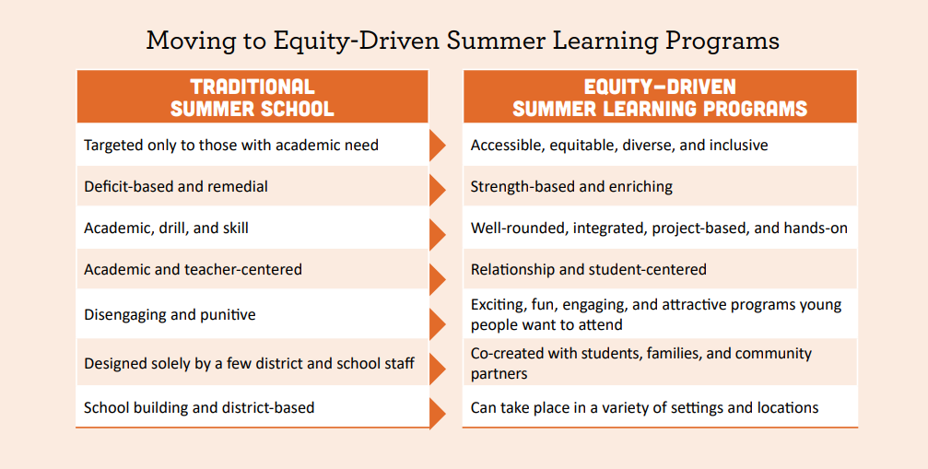
Centering Equity

Slide 5
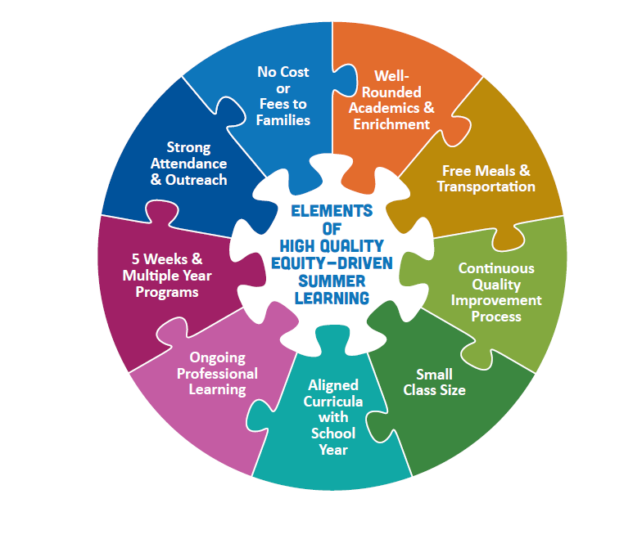




A Vision of Summer Learning
Connection as the Foundation of Learning
Strength-Based Student Voice & Choice
Co-Creation and Innovation
Purposeful Outreach & Engagement

Slide 6
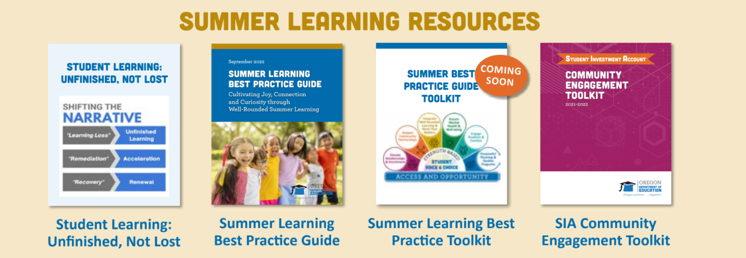

Summer Learning Resources

Slide 7
Panel Members - February 25th
Michael Carter - Superintendent, Lakeview Schools
Andrew Haley & Pau Thang - Youth Programs Supervisor & Youth Advocate, Immigrant and Refugee Community Organization (IRCO)
Stephanie Williams - Program Director, Umatilla School District, 21st CCLC (Title IV-B)
Justin Thibedeau - Project Coordinator, Connected Lane County (SparkLab, Lane STEM, Digital Literacy)
Ana Quintero-Arias - Federal Program Administrator, Lane ESD (Migrant Education and Title III)

Slide 8

Thank you!
Raquel Gwynn, Education Specialist
Office of Teaching, Learning and Assessment
raquel.gwynn@state.or.us
Sophie Hilton, Program Analyst
Office of Teaching, Learning and Assessment
sophie.hilton@state.or.us

