Slide 1
“”
ESSER III District Plan
Overview Module
September 2021
Notes:
The disruption of typical schooling over the last year provides an opportunity for all educators to reimagine schools in ways that can transform learning for students and teachers. We have important work ahead as we:
bring students back to full time in person learning
plan for historic federal investments, carefully tending to unfinished learning and mental health
center racial equity
continue meaningful engagement
innovate and integrate new technology and blended learning practices

Slide 2
About This Learning Module
Designed to be self-paced
Can be copied and customized by districts and ESDs as needed
This module provides an overview of ESSER III funds to assist districts in meeting ESSER III requirements.
  Comparison of ESSER I, II, and III funds
  USED requirements specific to ESSER III
  Intersections between ESSER III District Plan, Student Investment Account (SIA) Plan, and Continuity of Services Plan
Notes:
Modules work together
For information on specific steps to complete the ESSER III District Plan, including community engagement, please refer to the ESSER III District Plan Steps to Complete and Submit Module

Slide 3
I understand:
The basics of ESSER Funding
Unique requirements for ESSER III, outlined by USED
The intersection of the ESSER III District Plan, the Student Investment Account (SIA) Plan, and the Continuity of Services Plan
Learning Targets

Slide 4
I understand:
The basics of ESSER Funding
Unique requirements for ESSER III, outlined by USED
The intersection of the ESSER III District Plan, the Student Investment Account (SIA) Plan, and the Continuity of Services Plan
Learning Targets

Slide 5
What Are ESSER Funds?
The Elementary and Secondary School Emergency Relief (ESSER) fund is a COVID-19 relief program for states and school districts. ESSER was funded through three separate laws:
March 2020 — $13.23 billion through CARES (Coronavirus Aid, Relief, and Economic Security Act), often referred to as “ESSER I”
December 2020 — $54.3 billion through CRRSA (Coronavirus Response and Relief Supplemental Appropriations Act), often referred to as “ESSER II,”
March 2021 —$121.975 billion through ARP (American Rescue Plan), often referred to as “ESSER III” or “ARP ESSER.”
Notes:
The Elem. Sec. School Emergency Relief Fund was created in March 2020 under the CARES Act. It was reauthorized under the CRRSA Act in December and reauthorized a third time in March 2021 under the American Rescue Plan. This is referred to as ESSER III or sometimes ARP-ESSER. Both terms are interchangeable.
A main distinction between ESSER I & II with ESSER III is that ESSER III has more requirements for how to receive, and spend, the funds, though the allowable uses are largely the same.
For each iteration, states must allocate at least 90% of the funds to school districts based on the Title I-A formula, though it does not follow I-A rules. The remaining 10% of funds are reserved for state level activities. For ESSER I and II, ODE chose to award the set aside to districts who do not receive I-A funds, our youth centers, and other centers. Our ESSER III set-aside dollars will be used for activities to address unfinished learning, SEL, and others at the state level.
The Final ARP ESSER Fact Sheet from the US Department of Education includes a comparison of allowables uses across the three laws.

Slide 6
ESSER Timing & Allocations
ESSER Funding Stream | Funding Deadline (Obligated by...) | Oregon District Allocations
ESSER I (CARES Act) - $13.23 billion total - $121.1 million to Oregon | September 30 2022 | ESSER I District Allocations ODE ESSER I website No district plan requirements
ESSER II (CRRSA Act) - $54.3 billion total - $499.1 million to Oregon | September 30 2023 | ESSER II District Allocations ODE ESSER II website No district plan requirements
ESSER III/ARP ESSER (ARP Act) - $121.975 billion total - $1.1 billion to Oregon | September 30 2024 | ESSER III District Allocations ODE ESSER III website District plan requirements
All ESSER funding can be used for costs allowable under ESSER I, II & III dating back to March 13, 2020.
Notes:
ESSER III grant funds can be used to reimburse eligible expenses incurred between March 13, 2020 and September 30, 2024.
The funding deadline is for when funds are obligated, which means that the money is spent (i.e., it’s a line item in the books) or committed (i.e., encumbered through a contract or purchase order).
See ODE’s ESSER Fund FAQs #10 for additional information.
This chart reflects the timing and links to district allocations for each ESSER program. These are one time appropriated funds which you have access to now and you can draw on them throughout the obligation periods stated in the chart. Additionally, the funds can pay for allowable expenditures made beginning March 13, 2020.
While these are one-time funds, the funding arc is long-- the money can be spent over time as districts learn more about where needs may be, especially related to unfinished learning and student mental health.

Slide 7
What’s the Same? What’s New?
What stayed the same (ESSER I,II, & III)
Almost identical allowable uses
Not subject to “supplement, not supplant” rules
Equitable services for private schools do not apply for ESSER II or III
Maintenance of Effort (MOE)
What’s new (Just for ESSER III)
Must submit two district plans - ESSER III District Plan and Continuity of Services Plan
Intentional community engagement is a hallmark of the ESSER III requirements
  focuses on engagement with those disproportionately impacted
  requirements mostly met through the SIA planning process
At least 20% of funds must be used to address unfinished learning
Maintenance of Equity provision
The ARP ESSER Fact Sheet includes a comparison of allowables uses across the three laws.
Notes:
The allowable uses for all three programs are almost identical with a focus on supporting unfinished learning and addressing student needs arising from the pandemic. All three funds are not subject to supplement no supplant, however, other federal funds are. Additionally, equitable services/share requirements do not apply for the ESSER funds. Instead, Congress created the Emergency Assistance to Non-public Schools I & II programs to provide services and supports for private schools.
Important differences for ESSER III
Districts must submit a district plan and continuity of services plan.
ESSER III has a focus on intentional community engagement, from all members of your community with a specific focus on efforts to ensure inclusive and equitable input. This requirement is mostly met through the SIA planning process. We will address this in more detail later in this presentation.
20% of the funds that districts receive must be allocated to address unfinished learning.
Lastly, ESSER III introduces a new Maintenance of Equity MOEquity requirement which reiterates that if funding cuts are taken, that it is not done in a way that disproportionately reduces funding, on a per-pupil basis, for districts and schools with higher percentages of students experiencing poverty.

Slide 8
ESSER III MOEq vs MOE Requirements
Maintenance of Equity
Maintenance of Effort
MOEq (new)
The state and districts are required to ensure that low-income students are not subject to funding or programming reductions.
Do not disproportionately reduce per-pupil funding for schools with the highest percentages of students from low-income families.
Maintenance of Equity FAQ
MOE (same as other fed grants)
Maintain overall financial support for elementary and secondary education
Meet the local level of effort requirements
If you’re going to supplant local funds with ESSER funds, be very careful/thoughtful about it.
Notes:
Maintenance of Equity link is the USED MOEquity FAQ: The MOE requirements ensure that a State maintains overall financial support for elementary and secondary education and for higher education. The MOEquity requirements ensure that, if funding reductions are necessary, each SEA and LEA does not disproportionately reduce per-pupil funding for education in those LEAs and schools in the State with the highest percentages of students from low-income families.
Other federal entitlement grants (IDEA in particular) still require maintenance of effort
o Make sure to maintain your state/local level of effort requirements
o Bottom line: if you’re going to supplant state/local funds with ESSER funds, be very careful/thoughtful about it.
Maintenance of Effort (same) Maintenance of Equity (new)

Slide 9
I understand:
The basics of ESSER Funding
Unique requirements for ESSER III, outlined by USED
The intersection of the ESSER III District Plan, the Student Investment Account (SIA) Plan, and the Continuity of Services Plan
Learning Targets

Slide 10
Values Guiding ESSER III Planning Process
Values Guiding ESSER III Planning Process:
EQUITY - Bring students at the margins to the center
ADAPTABILITY - making the most of available resources to support students
EFFICIENCY - a plan that draws from work already done
Notes:
The main reason we have ESSER III funding is pandemic response - the pandemic is both the catalyst for these funds and a continued factor introducing complexity and requiring us to make quick pivots.
Underneath every quick pivot there is reasoning based on values we all hold:
Bring students at the margins to the center
Use this resource in this moment to support students in the most holistic way possible
Create efficiencies based on work already done
As we provide information and answer your questions, know that these are what we’ve been focusing on.

Slide 11
ESSER III District Plan
USED requires a District plan that outlines:
Meaningful community engagement to inform the use of funds. Includes a focus on supporting students disproportionately impacted by the pandemic.
District use of funds to address the impact. At least 20% of funds used for evidence-based interventions to address unfinished learning.
ODE expects that plans will continue to evolve over time
Questions to address through the plan development.
What are your student needs?
How are you incorporating new information with students returning and conditions changing?
How are you investing to meet student needs?
How will your investments evolve with new information?

Slide 12
ESSER III Overarching Outcomes
USED establishes overarching outcomes for ESSER III investment.
USED requires that each district develop a high-quality plan for the use of ESSER III funds to:
Provide a safe return to in-person instruction and
Focus on meeting student’s academic, social, emotional, and mental health needs.
ESSER III Overarching Outcomes
Address student needs arising from the COVID-19 pandemic and/or to emerge stronger post-pandemic, which may include reopening schools safely, sustaining their safe operation, and addressing students’ academic, social, emotional, and mental health.
Address unfinished learning through the implementation of evidence-based interventions and ensure that those interventions respond to students’ social, emotional, and academic needs and address the disproportionate impact of COVID-19 on underrepresented student subgroups (each major racial and ethnic group, children from low-income families, children with disabilities, English learners, gender, migrant students, students experiencing homelessness, and children and youth in foster care).
ESSER III Districts Plans must be designed to support the overarching outcomes. District may also choose to add additional outcomes to meet their local context.

Slide 13
Unfinished Learning: 20% +
While the uses of funds are broad, each district is required to allocate at least 20% of its total ESSER III funds to address unfinished learning and implement evidence-based interventions related to instruction.
The 20%+ is a minimum amount to be spent over the life of ESSER III. It does not have to be proportionately spent each year.
Evidence-based interventions are defined in four tiers by USED. They are practices or programs that yield evidence of student results and improved learning outcomes.
Notes:
Evidence-based Interventions are practices or programs that yield evidence of student results and improved learning outcomes. The intent of grounding in evidence-based interventions is to ensure formal research and studies undergird the actions districts and schools take to support student learning and well-being. They are defined in four tiers.
Tier 1 – Strong Evidence: the effectiveness of the practices or programs is supported by one or more well-designed and well-implemented randomized control experimental studies.
Tier 2 – Moderate Evidence: the effectiveness of the practices or programs is supported by one or more well-designed and well-implemented quasi-experimental studies.
Tier 3 – Promising Evidence: the effectiveness of the practices or programs is supported by one or more well-designed and well-implemented correlational studies (with statistical controls for selection bias).
Tier 4 – Demonstrates a Rationale: practices that have a well-defined logic model or theory of action, are supported by research, and have some effort underway by a State Educational Agency, LEA, or outside research organization to determine their effectiveness.
Referenced from USED’s ESSER and GEER FAQ, pg 16, A-10 May 2021

Slide 14
Timeline
ODE submits Oregon’s ESSER III State Plan to USED
USED approves Oregon’s ESSER III State Plan
Districts Submit
Continuity of Services Plan
Jun 7
Jun 30
Jul 15
Jul 22
Aug 27
Oct 20
Districts submit SIA Year 2 Plan Update
ODE releases ESSER III district materials and update to districts
District Submission Deadline: ESSER III District Plan
ESSER III District Plan due October 20, 2021
ODE will provide information for data collections and reporting after the release of federal regulations.
Notes:
More information will be forthcoming regarding district updates and reporting. Federal comment period open until Aug 31. ODE is waiting on the release of federal regulations, including data collection requirements, prior to determining district updates and reports.

Slide 15
I understand:
The basics of ESSER Funding
Unique requirements for ESSER III, outlined by USED
The intersection of the ESSER III District Plan, the Student Investment Account (SIA) Plan, and the Continuity of Services Plan
Learning Targets

Slide 16
Plan Alignment
There are 3 parts that make up the district planning requirements for ESSER III.
The parts are connected to create efficiency by leveraging, not duplicating, existing work.
ESSER III District Funding Requirements
Oct 20
SIA Community Engagement to Inform Investments
ESSER III District Plan
Oct 20
Aug 27
ESSER III Safe Return to In-Person & Continuity of Services Plan
Notes:
Overview slide and visual to see how all three parts work together.
SIA
ESSER III - federal requirements
Continuity of Services Plan
The District plans are designed to maximize existing work that districts have been engaged in and coordinate efforts as much as possible.

Slide 17

Continuity of Services Plan
Continuity of Services Plan
Prioritize health, safety, wellness, and connections for all communities.
Notes:
The Safe Return to In-Person Instruction and Continuity of Services Plan, also shorted to “Continuity of Services Plan” is required to prioritize health, safety, wellness, and connections for all communities.

Slide 18
The Parts: ESSER III District Safe Return
& Continuity of Services Plan
Submitted August 27
RSSL Resiliency Framework for 2021-2022 School Year
ESSER III Federal Requirements
State Board of Education Plan Requirement (OAR 581-022-0105)
ESSER III District Plan
ESSER III Safe Return to In-Person & Continuity of Services Plan
Notes:
The Continuity of Services Plan meets requirements for ESSER III and State Board of Education OAR 581-022-0105. It is supported by the RSSL Resiliency Framework and replaces the district’s RSSL Operational Blueprint for the 2021-2022 school-year.

Slide 19
ARP Federal Funding
ARP Federal Funding
Addressing unfinished learning through evidence-based acceleration strategies.
Notes:
ARP ESSER also referred to as ESSER III is designed to migite the impact of COVID-19 with a specific focus on addressing unfinished learning through evidence-based acceleration strategies.

Slide 20
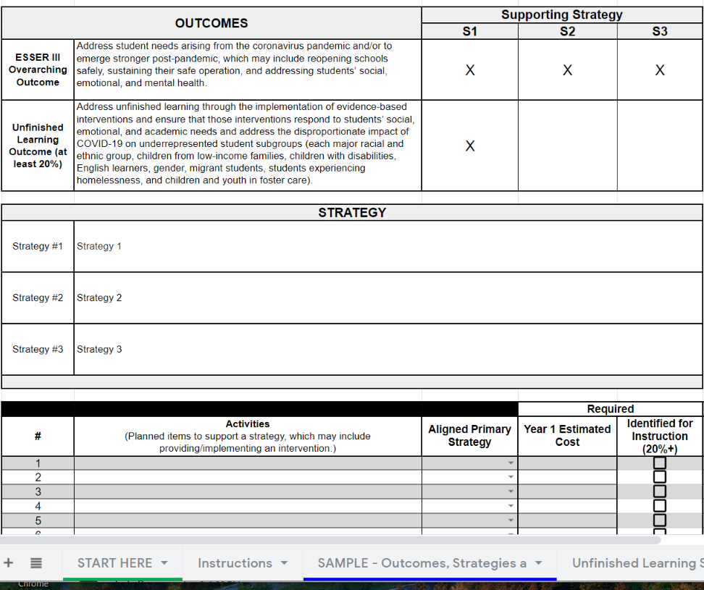
Overview of ESSER III District Plan
The Parts: ARP Federal Funding
ARP ESSER III
ARP HCY
ARP IDEA
ESSER III District Funding Requirements
Integrated Planning Tool provides details about district outcomes, strategies, activities, and estimated investments
ESSER III District Plan
Notes:
The ESSER III District Plan is only related to the funds allocated under the Elementary and Secondary School Emergency Relief Fund (ESSER) provision in the American Rescue Plan (ARP) Act. It does not address other ARP funding streams, such as ARP Homeless Children and Youth (HCY) or ARP Individuals with Disabilities Education Act (IDEA).
The overarching outcome of ESSER III is to address student needs arising from the COVID-19 pandemic and/or to emerge stronger post-pandemic. An additional federal requirement is for at least 20% of the funds to address unfinished learning through the implementation of evidence-based interventions and ensure those interventions respond to students’ social, emotional, and academic needs and address the disproportionate impact of COVID-19 on underrepresented student subgroups.
The Integrated Planning Tool is designed to walk districts through requirements to outline their investments in line with ESSER III requirements.
The ARP Act does not directly address allocation of district ESSER III funds to district-sponsored public charter schools. The clear legislative intent, however, is to benefit all public schools and students regardless of school type. ODE asks that districts include their charter schools on equal footing with other district schools, when determining the most important educational needs as a result of COVID-19, consistent with the intent of the ARP Act. Districts must meaningfully engage all school leaders, including charter school leaders, in determining their plans for using ESSER III funds. Districts that sponsor public charter schools may also plan to pass through a proportionate share of the ESSER III funds. Public charter schools that receive ESSER III funds must comply with the same allowable uses and 20% fund designation requirements as districts. A separate Outcomes, Strategies and Activities tab can be created in the Integrated Planning Tool for the district and any charter schools.

Slide 21

SIA Ongoing Learning and Engagement
SIA Ongoing Learning & Engagement
Strengthen high-quality, culturally-sustaining and revitalizing instruction, leadership, and pathways to graduation and post-secondary transitions.
Notes:
We have learned so much together around how to strengthen community and family engagement as we plan for and invest in ways to strengthen our schools from the inside out. We know that districts conducted some of the most extensive and authentic engagement in 2019-2020 as part of the SIA plan development and in preparation for the first SIA application submission in Spring 2020. Equity transformation, as we know, starts with deep listening. As we continue to listen and engage our students, families, educators and community, we seek to listen to the voices often ignored or silenced by the system. Building from the engagement work on the SIA efforts, districts can continue partnering closely with families and communities to build a more empowering and equitable educational future.

Slide 22
Plan Alignment
The Parts: SIA Ongoing Learning & Engagement
SIA Community Engagement to Inform Investments
ESSER III District Plan
Oct 20
Districts with current SIA Plans have met most of this requirement. Only supplemental information for Migrant Students and Incarcerated Youth are collected through the Smartsheet.
Notes:
Depending on your student needs and budgets, you may want to think about ESSER III as an extension of your SIA plans. How can the funding streams work together to address disproportionate impact of the pandemic on student academic and social, emotional, and mental health? A key difference is that SIA funds are ongoing where are ESSER III funds must be obligated by September 30, 2024.
Most of districts’ ESSER III planning requirements for engagement are met through the ongoing community engagement in the SIA Plan process. ODE is only collecting supplementary information for Migrant Students and students who are incarcerated as those two student groups are not currently part of the SIA planning process. ODE recognizes that some districts will not have students served in these focal groups. Note that ESSER III activities are not required to mirror SIA activities, but in many districts they may mirror or coordinate with SIA investments.

Slide 23
I understand:
The basics of ESSER Funding
Unique requirements for ESSER III, outlined by USED
The intersection of the ESSER III District Plan, the Student Investment Account (SIA) Plan, and the Continuity of Services Plan
Learning Targets

Slide 24



Support and Resources
Drop in ESSER III District Plan Virtual Q&A Sessions
Dates (Zoom Link)
Wed Sept 1, 10-11 (Zoom)
Wed Sept 8, 3-4 (Zoom)
Tues Sept 14, 11-12 (Zoom)
Friday, Sept 24, 11-12 (Zoom)
ESSER III District Plan Q&A Sessions
ESSER III Self-Paced Support Modules
Reach out with questions via email
  ODECOVID19@ode.state.or.us
  ODE.ESSER@ode.state.or.us
Cynthia Stinson Kati Moseley Senior Manager of Federal Investment & RSSL Manager, Contact for Continuity of Service Plan
Pandemic Renewal 971-255-6732
503-881-3992

Slide 25
Appendix - Additional Resources
APPENDIX - Additional Resources

Slide 26
Just the Essentials
If you’re ready to get into the nuts and bolts of building your ESSER III District Plan for the October 20, 2021 deadline, use these links.
Smartsheet to submit plan
Integrated Planning Tool (IPT) to be completed and uploaded in the Smartsheet
For quick reference on requirements, links, and steps, keep this presentation or the District Plan Guide handy.
Notes:
District Plan Guide,
Smartsheet to submit plan
Integrated Planning Tool (IPT)

Slide 27
ODE ESSER III Website
The ODE's Federal COVID-19 Stimulus Resources site includes links to ESSER I, II, and III websites
What you’ll find...
Tools and resources for both the ESSER III District Plan and Continuity of Services Plan
Funding allocations
District assurances
Programs updates, announcements, and presentations
Key federal resources, including FAQs, fact sheets, and eligible use comparisons

Slide 28
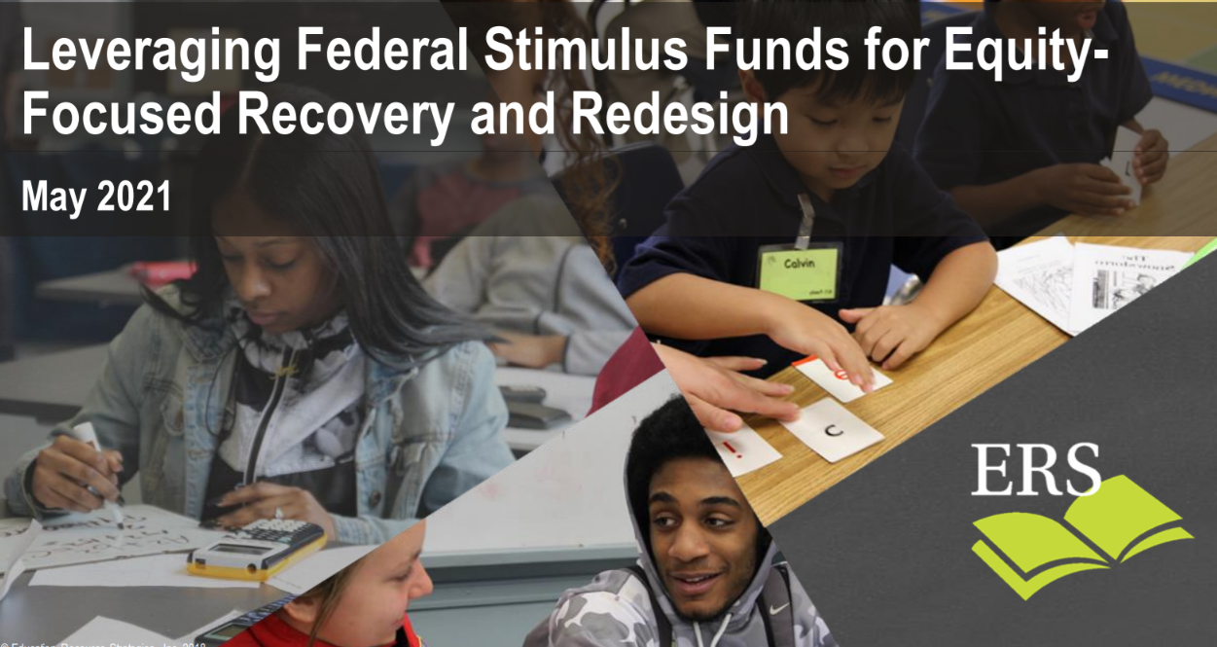
Spotlight Leadership Resource
Spotlight Leadership Resource
“How can district leaders use stimulus funds to center equity, accelerate student learning and create a sustainable foundation for long-term improvement?”
Leveraging Federal Stimulus Funds for Equity-Focused Recovery and Redesign
Meeting the moment
Power Strategies for equity-focused recovery and redesign
“Do Now, Build Toward” for strategic and sustainable change
Creating the conditions for transformative improvement in K-12 education

Slide 29
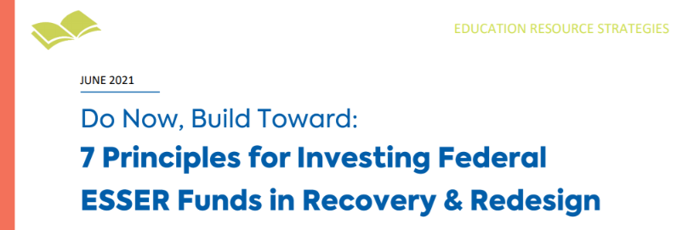
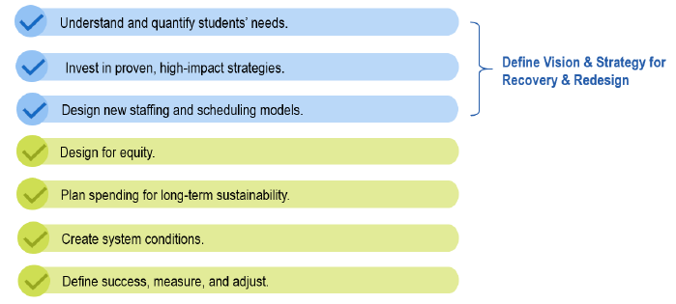
Spotlight Leadership Resource
Navigating these challenges and opportunities is best approached with a “do now, build toward" mindset. This means addressing critical student needs now and laying a sustainable foundation for lasting improvement.
Education Resource Strategies (ERS) - Do Now, Build Towards
Seven crucial principles for investing ESSER funds with a “do now, build toward” approach
Key considerations for each
Resources to help your district realize its vision.

Slide 30
Planning & Leadership Resources
Here are some additional ones with strategies, frameworks, and learning
ERS, Investing in Sustainability (How Hartford Public Schools is planning strategically to use their ESSER funds)
Investing American Rescue Plan (ESSER III) Funds Strategically and Effectively, CGCS
Five Ways To Get on Top of the Education Recovery (A brief summary of “K-Shaped Education Recovery” by Anthony Kim, Education Elements, and Joseph South, Chief Learning Officer at ISTE.)
First look at ESSER priorities: Districts are placing their bets on what they know, CRPE
Student Learning: Unfinished, Not Lost, ODE
Education Resource Strategies (ERS)’s five research-backed overarching “Power Strategies”
SIA: Guidance for Eligible Applicants, Part 3 (community engagement for the SIA Application for SY 2020-21)
SIA Community Engagement Toolkit
Tribal Consultation Toolkit
OESO ESSER Fund FAQs
ODE Care and Connection resources
RESTART & RECOVERY: Leveraging Federal COVID Relief Funding & Medicaid to Support Student & Staff Wellbeing & Connection
More resources are also available in the District Plan Guide.

