Slide 1

ESSER III District Plan
ESSER III District Plan
Q&A Session
September 8, 2021
Thanks for joining us.
Please mute yourself.
We will start in just a few minutes…

Slide 2
Agenda
Welcome and introductions
Charter school specifics
Key topics from Google Form
  Engagement and SIA
  Allowable costs timeline
Open time for questions
Agenda

Slide 3
Introductions & Check-In
Please enter your name, email and organization in the Google sheet
In the chat…
Enter the number that best represents how far along you are you in developing your ESSER III District Plan.
1-We have not started our plan yet
2-We just got started with our plan
3-We are actively developing our plan
4-We are almost done and fine tuning our plan
Indicate if you attended last week’s Q&A session or if this is your first one
Notes:
https://docs.google.com/spreadsheets/d/1xG8BoI0nY4caX0bVtoR9nBLie7m581IQcYoYIlL7jTg/edit?usp=sharing

Slide 4
Charter Schools
Kate Pattison - ODE Charter School Specialist
ODE’s message regarding charter schools and ESSER III funds:
ESSER III and Public Charter Schools
The ARP Act does not directly address allocation of district ESSER III funds to district-sponsored public charter schools that are not standalone LEAs. The clear legislative intent, however, is to benefit all public schools and students regardless of school type. ODE asks that districts include their charter schools on equal footing with other district schools, when determining the most important educational needs as a result of COVID-19, consistent with the intent of the ARP Act. LEAs must meaningfully engage all school leaders, including charter school leaders, in determining their plans for using ESSER III funds. Districts that sponsor public charter schools may also plan to pass through a proportionate share of the ESSER III funds. Public charter schools that receive ESSER III funds must comply with the same allowable uses and 20% fund designation requirements as districts.

Slide 5
Charter Schools
Districts must include district-sponsored charter schools as part of their district plan.
If charter schools are deploying different strategies than the district, they must identify those strategies separately. To do this:
  Charter school strategies can be identified separately in the district’s ESSER III Integrated Planning Tool (IPT), or
  Charter schools can complete their own IPT, which would be included as part of the larger district submission.
Notes:
Districts must include all public schools within the district boundaries that the district operates or sponsors including district-sponsored charter schools as part of their plan submission.

Slide 6

Questions?

Slide 7
ESSER III District Plan Links
If you’re ready to get into the nuts and bolts of building your ESSER III District Plan for the October 20, 2021 deadline, use these links.
Smartsheet to submit plan
Integrated Planning Tool (IPT) to be completed and uploaded in the Smartsheet
For quick reference on requirements, links, and steps, keep this presentation or the District Plan Guide handy.

Slide 8
Community Engagement
Smartsheet Section 2. District Community Engagement to Inform Use of ESSER III Funds
USED Requirements
To inform the plan, districts must:
  Conduct community engagement with stakeholders, including those disproportionately impacted by the pandemic
  Provide the public the opportunity for input on the district’s use of ESSER III funds
Most of districts’ planning requirements for engagement are met through the ongoing community engagement in the SIA Plan process.
  ODE is only collecting supplementary information for Migrant Students and students who are incarcerated as those two student groups are not currently part of the SIA planning process.
Notes:
Focal groups for community engagement
USED requires meaningful consultation with stakeholders including, but not limited to students, families, and educators (school and district administrators, teachers, and their unions). To the extent they are present in the district, meaningful consultation is also required with Tribes, civil rights organizations (including disability rights organizations), and stakeholders representing the interests of children with disabilities, English learners, children experiencing homelessness, children and youth in foster care, migratory students, children who are incarcerated, and other underserved students.

Slide 9
ESSER III District Plan &
Continuity of Services Plan Guide
Community Engagement
The intent of engagement for both SIA and ESSER III is to:
Understand student needs
Improve access and opportunities for students who have been historically underserved and disproportionately impacted
There is deep alignment between the community engagement requirements
Use of an equity lens
Focal groups are mostly the same; ESSER III includes Migrant Students and Incarcerated Youth as focal groups
The SIA plan fulfills most of the ESSER III engagement requirements
Learning about student needs can/should
Be connected to other engagements (e.g., HS Success, strategic planning, RSSL). It does not have to be a stand alone process.
Inform student needs and ESSER III investments. (This may include SIA activities you planned but weren’t able to do given the reduction in SIA funding.)
Represent your community of students. Whether you have a couple of students in a focal group or a large community, consider how your local plan represents their unique needs.
Notes:
Guidance around authentic engagement for high-impact investment strategies to meet student needs.
SIA Community Engagement Toolkit
Tribal Consultation Toolkit
The intent of the engagement is to understand student needs in order to improve access and opportunities for students who have been historically underserved and disproportionately impacted. These do not have to be stand-alone or ESSER III-specific engagements, but rather engagements through a variety of approaches and with disproportionately impacted communities to understand students needs. Examples of other engagements may include the SIA process, RSSL, community and family meetings for returning to school, student surveys, or strategic planning.

Slide 10
Community Engagement :
Focal Groups
Meaningful consultation with stakeholders for both ESSER III and SIA include:
Students
Families
Educators, including school and district administrators, teachers, and their unions
Tribes
Civil rights organizations, including disability rights organizations
Stakeholders representing the interests of children with disabilities, English learners, children experiencing homelessness, children and youth in foster care, and other underserved students.
ESSER III focal student groups, NOT formally included in SIA:
Migrant Students
Incarcerated Youth
Migrant Students and Incarcerated Youth are served through regional partnerships that vary by district. The information collected will inform how we plan to serve the students across the state.
Logic is built into the questions and will vary based on students enrolled in your district and how services are provided.

Slide 11
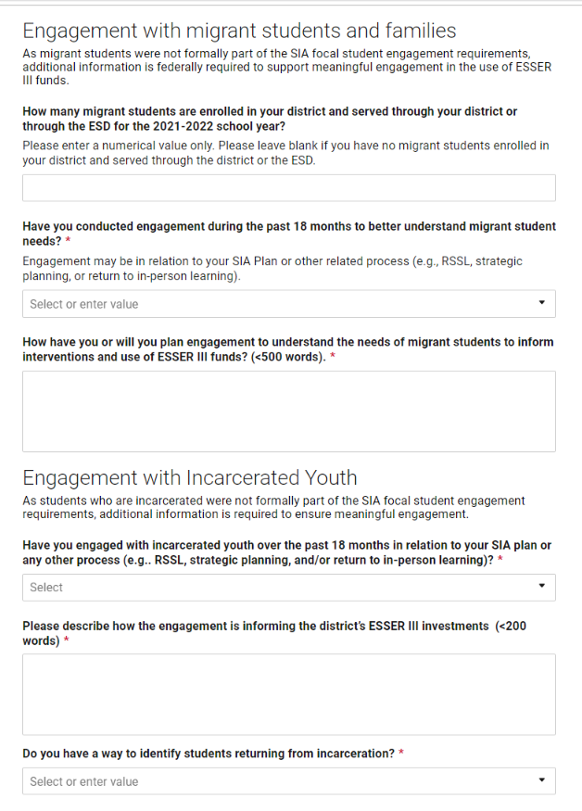
Community Engagement:
Steps to Complete Section 2
Confirm whether your district’s SIA Plan is current
Follow the prompts to share information about Migrant Students and Incarcerated Youth
There is no one right answer. The information being collected across the state will:
  Likely reflect a large range of student enrollment scenarios, service contracts, and partnerships
  Inform statewide plans to better support the students going forward
  Help identify where work is underway to build on and share learning
Note: the Smartsheet includes logic that may prompt for additional questions based on your responses.

Slide 12
ESSER Timing & Allocations
ESSER Funding Stream | Funding Deadline (Obligated by...) | Oregon District Allocations
ESSER I (CARES Act) - $13.23 billion total - $ to Oregon | September 30 2022 | ESSER I District Allocations ODE ESSER I website No district plan requirements
ESSER II (CRRSA Act) - $54.3 billion total - $ to Oregon | September 30 2023 | ESSER II District Allocations ODE ESSER II website No district plan requirements
ESSER III/ARP ESSER (ARP Act) - $121.975 billion total - $1.1 billion to Oregon | September 30 2024 | ESSER III District Allocations ODE ESSER III website District plan requirements
All ESSER funding can be used for costs allowable under ESSER I, II & III dating back to March 13, 2020.
Notes:
ESSER III grant funds can be used to reimburse eligible expenses incurred between March 13, 2020 and September 30, 2024.
The funding deadline is for when funds are obligated, which means that the money is spent (i.e., it’s a line item in the books) or committed (i.e., encumbered through a contract or purchase order).
See ODE’s ESSER Fund FAQs #10 for additional information.
This chart reflects the timing and links to district allocations for each ESSER program. These are one time appropriated funds which you have access to now and you can draw on them throughout the obligation periods stated in the chart. Additionally, the funds can pay for allowable expenditures made beginning March 13, 2020.
While these are one-time funds, the funding arc is long-- the money can be spent over time as districts learn more about where needs may be, especially related to unfinished learning and student mental health.

Slide 13



Supports and Resources
Drop in ESSER III District Plan Virtual Q&A Sessions
Dates (Zoom Link)
Tues Sept 14, 11-12 (Zoom)
Friday, Sept 24, 11-12 (Zoom)
ESSER III District Plan Q&A Sessions
ESSER III Self-Paced Support Modules
Reach out with questions via email
  ODECOVID19@ode.state.or.us
  ODE.ESSER@ode.state.or.us
Cynthia Stinson Kate Pattison
Senior Manager of Federal Investments Charter School Specialist
& Pandemic Renewal kate.pattison@state.or.us
503-881-3992

