Slide 1

ESSER III District Plan
ESSER III District Plan
Q&A Session
September 24, 2021
Thanks for joining us.
Please mute yourself.
We will start in just a few minutes…

Slide 2
Agenda
Welcome and introductions
Review of ESSER III District Plan elements
Open time for questions
Notes:
Jennifer

Slide 3


ODE ESSER Q & A Team Today
Jennifer Patterson,
Assistant Superintendent
Office of Teaching, Learning, and Assessment
Cynthia Stinson,
Senior Manager of Federal
Investment and Pandemic Renewal
Office of Teaching, Learning, and Assessment
Notes:
Jennifer

Slide 4
Purpose
The ESSER III Q&A Sessions are designed for District Leaders in an effort to...
Provide clarity around the ESSER III requirements as districts plan for their ESSER III investments.
Review & unpack the ESSER III District Plan.
Create a space where questions and ideas from other practitioners may inspire new thinking or solidify current planning.
Offer two-way communication and create a space to engage in conversation and sense making.

Slide 5
Structure for Today
Today’s Facilitators: Cynthia Stinson, Jennifer Patterson
Today’s Chat Navigators: Sarah, Haedon, Joanne, Susan, Cheng Fei, Stephanie, Mike, and Jill
Welcome
ESSER III Overview
Please use the chat for specific questions and sharing.
We will record these and post them so they are available for others to view as well.
Notes:
Jennifer

Slide 6
Acknowledgements
ODE acknowledges many districts are in early stages of ESSER III planning. Flexibility and scaffolds are built into the ESSER III District Plan template to support districts in meeting the federal deadline (10/20/21).
Thank you for your ongoing leadership and partnership as we continue to navigate a complex environment!
Notes:
Jennifer

Slide 7
About This Learning Module
Designed to be self-paced
Can be copied and customized by districts and ESDs as needed
This module provides technical assistance to develop and submit the ESSER III District Plan.
Checklists for deliverables
Navigating key tools & resources
Key steps for developing the various components of the plan
Note: ESSER III and ARP ESSER are used interchangeably. ODE more consistently uses ESSER III in order to more easily distinguish it from ESSER I and II.

Slide 8
I know:
ESSER III District Plan Deliverables
I can:
Navigate planning resources
Complete the technical steps to submit the ESSER III District Plan
Section 1: Smartsheet form
Section 2: Community Engagement
Section 3: Integrated Planning Tool
Learning Targets

Slide 9
I know:
ESSER III District Plan Deliverables
I can:
Navigate planning resources
Complete the technical steps to submit the ESSER III District Plan
Section 1: Smartsheet form
Section 2: Community Engagement
Section 3: Integrated Planning Tool
Learning Targets

Slide 10
Plan Alignment
There are 3 parts that make up the district planning requirements for ESSERIII.
The parts are connected to create efficiency by leveraging, not duplicating, existing work.
ESSER III District Funding Requirements
Oct 20
SIA Community Engagement
ESSER III District Plan
Oct 20
Aug 27
Districts with current SIA Plans have met most of this requirement. Only supplemental information for Migrant Student and Incarcerated Youth is collected through the ESSER III District Plan Smartsheet.
ESSER III Safe Return to In-Person & Continuity of Services Plan
This plan is completed and submitted through the Continuity of Services Plan process. (See instructions here for more information.
Notes:
Overview slide and visual to see how all three parts work together.
SIA
ESSER III - federal requirements
Continuity of Services Plan
The District plan process is designed to maximize existing work that districts have been engaged in and coordinate efforts as much as possible.

Slide 11
Checklist to Complete and Submit Plan
Review the information and instructions in the District Plan Guide
The guide includes context, key federal requirements, technical information, and resources to aid in the planning process.
Complete and submit the ESSER III District Plan Smartsheet by October 20, 2021.
To complete the form, you will need:
District contact information
Prioritized strategies with supporting interventions and progress measurements for addressing unfinished learning (20%+)
Student needs the districts has prioritized for ESSER III investment
Initial information on current and planned engagement activities to inform the use of ESSER III funds to support Migrant Students and students who are incarcerated.
A completed ESSER III Integrated Planning Tool (IPT)
Post your accessible district plan on a public website (Note: The IPT can act as foundation of your district plan.)
Notes:
The checklist includes the required information to complete each Section of the Smartsheet:
Section 1: District Use of ESSER III Funds to Address Unfinished Learning
Section 2: District Community Engagement to Inform the Use of ESSER III Funds
Section 3: ESSER III Integrated Planning Tool
Complete and upload the ESSER III Integrated Planning Tool(IPT)
Paste the accessible public link for the ESSER III District Plan. (The IPT can serve as the plan.)

Slide 12
Charter Schools
Districts must include district-sponsored charter schools as part of their district plan.
If charter schools are deploying different strategies than the district, they must identify those strategies separately. To do this:
  Charter school strategies can be identified separately in the district’s ESSER III Integrated Planning Tool (IPT), or
  Charter schools can complete their own IPT, which would be included as part of the larger district submission.
Notes:
Districts must include all public schools within the district boundaries that the district operates or sponsors including district-sponsored charter schools as part of their plan submission.

Slide 13
I can:
I know:
ESSER III District Plan Deliverables
I can:
Navigate planning resources
Complete the technical steps to submit the ESSER III District Plan
Section 1: Smartsheet form
Section 2: Community Engagement
Section 3: Integrated Planning Tool
Learning Targets

Slide 14
ODE ESSER III Website
The ODE ESSER III website includes key ESSER III information for districts.
What you’ll find...
Tools and resources for both the ESSER III District Plan and Continuity of Services Plan
Funding allocations
District assurances
Programs updates, announcements, and presentations
Key federal resources, including FAQs, fact sheets, and eligible use comparisons

Slide 15
Just the Essentials
If you’re ready to get into the nuts and bolts of building your ESSER III District Plan for the October 20, 2021 deadline, use these links.
Smartsheet to submit plan
Integrated Planning Tool (IPT) to be completed and uploaded in the Smartsheet
For quick reference on requirements, links, and steps, keep this presentation or the District Plan Guide handy.

Slide 16
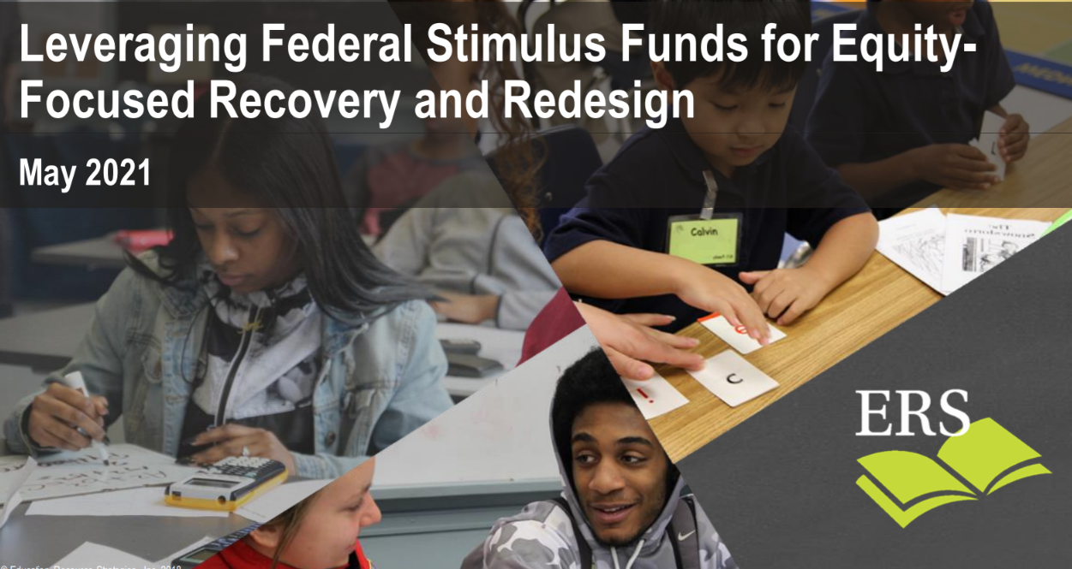
Spotlight Leadership Resource
“How can district leaders use stimulus funds to center equity, accelerate student learning and create a sustainable foundation for long-term improvement?”
Leveraging Federal Stimulus Funds for Equity-Focused Recovery and Redesign
Meeting the moment
Power Strategies for equity-focused recovery and redesign
“Do Now, Build Toward” for strategic and sustainable change
Creating the conditions for transformative improvement in K-12 education
Notes:
The disruption of typical schooling over the last year provides an opportunity for all educators to reimagine schools in ways that can transform learning for students and teachers. We have important work ahead as we:
bring students back to full time in person learning
plan for historic federal investments, carefully tending to unfinished learning and mental health
center racial equity
continue meaningful engagement
innovate and integrate new technology and blended learning practices
The next few slides have resources with strategies, frameworks, and national insights on investing for sustainable growth.

Slide 17
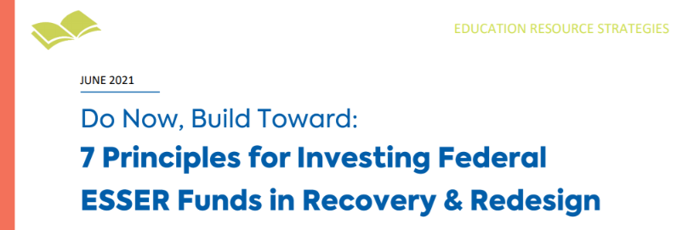
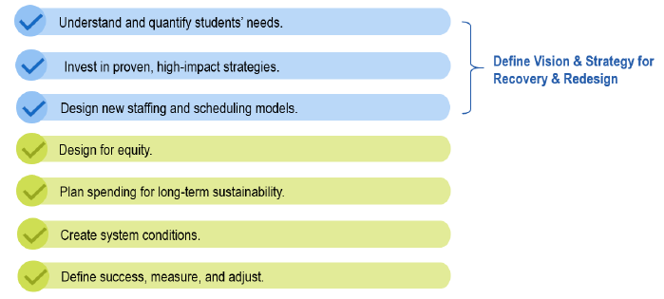
Spotlight Leadership Resource
Navigating these challenges and opportunities is best approached with a “do now, build toward" mindset. This means addressing critical student needs now and laying a sustainable foundation for lasting improvement.
Education Resource Strategies (ERS) - Do Now, Build Towards
Seven crucial principles for investing ESSER funds with a “do now, build toward” approach
Key considerations for each
Resources to help your district realize its vision.

Slide 18
Planning & Leadership Resources
Here are some additional resources with strategies, frameworks, and learning
ERS, Investing in Sustainability (How Hartford Public Schools is planning strategically to use their ESSER funds)
Investing American Rescue Plan (ESSER III) Funds Strategically and Effectively, CGCS
Five Ways To Get on Top of the Education Recovery (A brief summary of “K-Shaped Education Recovery” by Anthony Kim, Education Elements, and Joseph South, Chief Learning Officer at ISTE.)
First look at ESSER priorities: Districts are placing their bets on what they know, CRPE
Student Learning: Unfinished, Not Lost, ODE
Education Resource Strategies (ERS)’s five research-backed overarching “Power Strategies”
SIA: Guidance for Eligible Applicants, Part 3 (community engagement for the SIA Application for SY 2020-21)
SIA Community Engagement Toolkit
Tribal Consultation Toolkit
OESO ESSER Fund FAQs
ODE Care and Connection resources
RESTART & RECOVERY: Leveraging Federal COVID Relief Funding & Medicaid to Support Student & Staff Wellbeing & Connection
More resources are also available in the District Plan Guide.

Slide 19
I can:
I know:
ESSER III District Plan Deliverables
I can:
Navigate planning resources
Complete the technical steps to submit the ESSER III District Plan
Section 1: Smartsheet form
Section 2: Community Engagement
Section 3: Integrated Planning Tool
Learning Targets

Slide 20
ESSER III Overarching Outcomes
USED establishes overarching outcomes for ESSER III investment. The District Plan must be designed in support of them.*
ESSER III Outcomes
ESSER III Overarching Outcome | Address student needs arising from the COVID-19 pandemic and/or to emerge stronger post-pandemic, which may include reopening schools safely, sustaining their safe operation, and addressing students’ academic, social, emotional, and mental health.
Unfinished Learning Outcome (at least 20%) | Address unfinished learning through the implementation of evidence-based interventions and ensure that those interventions respond to students’ social, emotional, and academic needs and address the disproportionate impact of COVID-19 on underrepresented student subgroups (each major racial and ethnic group, children from low-income families, children with disabilities, English learners, gender, migrant students, students experiencing homelessness, and children and youth in foster care).
*The outcomes are already built into the Integrated Planning Tool. Districts may choose to add more specific or targeted outcomes in addition to these larger, overarching ones provided.

Slide 21
Addressing Unfinished Learning
Smartsheet Section 1: District Use of ESSER III Funds to Address Unfinished Learning
USED Requirements
The safe return to in-person instruction must be accompanied by a focus on meeting students’ academic, social, emotional, and mental health needs, and by addressing the opportunity gaps that existed before – and were exacerbated by – the pandemic.
Districts must use at least 20 percent (20%+) of ESSER III funding to address unfinished learning, or expenditures related to addressing the academic impact of lost instructional time through the implementation of evidence-based interventions.
USED defines evidence-based Interventions as practices or programs that yield evidence of student results and improved learning outcomes. They are defined in four tiers.
Notes:
Federal definition of Evidence-based Interventions
Practices or programs that yield evidence of student results and improved learning outcomes. The intent of grounding in evidence-based interventions is to ensure formal research and studies undergird the actions districts and schools take to support student learning and well-being. They are defined in four tiers.
Tier 1 – Strong Evidence: the effectiveness of the practices or programs is supported by one or more well-designed and well-implemented randomized control experimental studies.
Tier 2 – Moderate Evidence: the effectiveness of the practices or programs is supported by one or more well-designed and well-implemented quasi-experimental studies.
Tier 3 – Promising Evidence: the effectiveness of the practices or programs is supported by one or more well-designed and well-implemented correlational studies (with statistical controls for selection bias).
Tier 4 – Demonstrates a Rationale: practices that have a well-defined logic model or theory of action, are supported by research, and have some effort underway by a State Educational Agency, LEA, or outside research organization to determine their effectiveness.
Referenced from USED’s ESSER and GEER FAQ, p 16, May 2021

Slide 22
ESSER III District Plan &
Continuity of Services Plan Guide
Unfinished Learning (20%+)
About the Strategies
To support planning for unfinished learning, ODE adapted Education Resource Strategies (ERS)’s five research-backed overarching “Power Strategies”.
You may choose to use one or more of these strategies or use your own.
They are broad evidence-based strategies provided as an optional scaffold to support planning
Each strategy includes a description with examples of supporting evidence-based interventions.
A focus on deep investment in a small number of high-impact areas with cohesive and aligned strategies can provide a tremendous opportunity for significant growth.
Notes:
Power Strategies: in the context of this guide, the term is based on ERS’ 5 “power strategies” (and real-life examples) to accelerate equity-focused recovery and redesign. ERS describes “power strategies” as strategies that address critical student needs and lay a sustainable foundation for lasting improvement. They are grounded in years of research on how to best support students’ academic and social-emotional development.
Note: the strategies for your plan may include strategies identified through your SIA process. You may also choose to invest in different ones, based on your student needs.

Slide 23
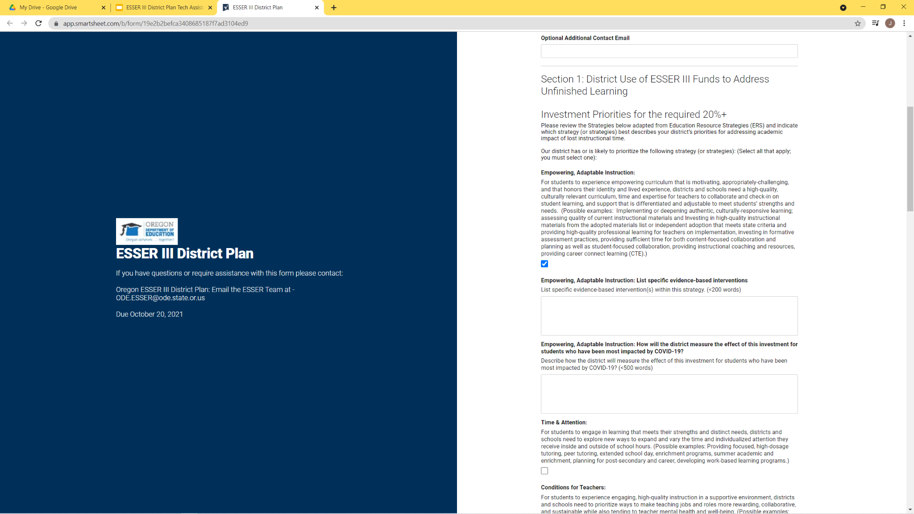
Unfinished Learning (20%+)
Unfinished Learning (20%+)
Steps to Complete Section 1
In the Smartsheet, indicate which strategy (or strategies) best describes your district’s priorities for addressing academic impact of lost instructional time. (Select all that apply.)
Broad evidence-based strategies provided as an optional scaffold to support planning
Empowering, Adaptable Instruction
Time & Attention
Conditions for Teachers
Relationships & Mental Health
Supports
Family & Community Partnerships
Does your district have other prioritized strategies? Use this option:
Other prioritized strategy (ies), please describe
Notes:
Smartsheet link: https://app.smartsheet.com/b/form/19e2b2befca3408685187f7ad3104ed9
The strategies you invest in should reflect your students needs. These may include a power strategy, a strategy you identified through your SIA process, or a different one that has recently emerged.
The strategies in this section focus on the unfinished learning requirement. You may have additional strategies as part of your overall plan. You will have an opportunity to provide those in the Integrated Planning Tool.
Full language in the Smartsheet for the adapted ERS Strategies
Empowering, Adaptable Instruction: For students to experience empowering curriculum that is motivating, appropriately-challenging, and that honors their identity and lived experience, districts and schools need a high-quality, culturally relevant curriculum, time and expertise for teachers to collaborate and check-in on student learning, and support that is differentiated and adjustable to meet students’ strengths and needs. (Possible examples: Implementing or deepening authentic, culturally-responsive learning; assessing quality of current instructional materials and Investing in high-quality instructional materials from the adopted materials list or independent adoption that meets state criteria and providing high-quality professional learning for teachers on implementation, investing in formative assessment practices, providing sufficient time for both content-focused collaboration and planning as well as student-focused collaboration, providing instructional coaching and resources, providing career connect learning (CTE).)
Time & Attention: For students to engage in learning that meets their strengths and distinct needs, districts and schools need to explore new ways to expand and vary the time and individualized attention they receive inside and outside of school hours. (Possible examples: Providing focused, high-dosage tutoring, peer tutoring, extended school day, enrichment programs, summer academic and enrichment, planning for post-secondary and career, developing work-based learning programs.)
Conditions for Teachers: For students to experience engaging, high-quality instruction in a supportive environment, districts and schools need to prioritize ways to make teaching jobs and roles more rewarding, collaborative, and sustainable while also tending to teacher mental health and well-being. (Possible examples: providing mentors and/or at least one team member that has an instructional content expert to help with planning, providing stipends and/or release time for selected teacher leadership roles, investing in wellness supports, providing highly effective teachers with opportunities to share their strengths and expand their impact).
Relationships & Mental Health Support: For students to feel safe, welcome and supported in school, districts and schools need to develop structures and enact policies and practices that cultivate positive, supportive relationships, and provide for staff and student mental and emotional health needs. (Possible examples: create time and space in the school day for relationship building, provide opportunities for staff and students to make meaning of their experience through creative outlets [art, music, writing, movement etc.], regularly engage with staff, students and families to assess their relational and emotional support needs, and build robust relationships with linguistically and culturally responsive community health and mental health providers and local systems of care.
Family & Community Partnerships: To increase academic, health, mental health and emotional support for students, districts and schools need to engage families as partners and leverage the local community and its system of care to provide integrated, wrap-around services and supports. (Possible examples: Implementing or deepening community- based organization’s support to provide authentic, culturally-responsive academic enrichment and learning supports, strengthening connections with local systems of care, communicating in home languages, culturally-specific liaisons, business and college partnerships.)
Other prioritized strategies, please describe.

Slide 24
Unfinished Learning (20%+)
Continuity of Services Plan Guide
Unfinished Learning (20%+)
For each strategy you select, there are two follow up items:
List Specific evidence-based intervention or activities within this Strategy. (<200 words)
Describe how the district will measure the effect of this investment for students who have been most impacted by COVID-19? (<500 words)

Slide 25
Community Engagement
Smartsheet Section 2. District Community Engagement to Inform Use of ESSER III Funds
USED Requirements
To inform the plan, districts must:
  Conduct community engagement with stakeholders, including those disproportionately impacted by the pandemic
  Provide the public the opportunity for input on the district’s use of ESSER III funds
Most of districts’ planning requirements for engagement are met through the ongoing community engagement in the SIA Plan process.
  ODE is only collecting supplementary information for Migrant Students and students who are incarcerated as those two student groups are not currently part of the SIA planning process.
Notes:
Focal groups for community engagement
USED requires meaningful consultation with stakeholders including, but not limited to students, families, and educators (school and district administrators, teachers, and their unions). To the extent they are present in the district, meaningful consultation is also required with Tribes, civil rights organizations (including disability rights organizations), and stakeholders representing the interests of children with disabilities, English learners, children experiencing homelessness, children and youth in foster care, migratory students, children who are incarcerated, and other underserved students.

Slide 26
Community Engagement
Community Engagement
The intent of engagement for both SIA and ESSER III is to:
Understand student needs
Improve access and opportunities for students who have been historically underserved and disproportionately impacted
There is deep alignment between the community engagement requirements
Use of an equity lens
Focal groups are mostly the same; ESSER III includes Migrant Students and Incarcerated Youth as focal groups
The SIA plan fulfills most of the ESSER III engagement requirements
Learning about student needs can/should
Be connected to other engagements (e.g., HS Success, strategic planning, RSSL). It does not have to be a stand alone process.
Inform student needs and ESSER III investments. (This may include SIA activities you planned but weren’t able to do given the reduction in SIA funding.)
Represent your community of students. Whether you have a couple of students in a focal group or a large community, consider how your local plan represents their unique needs.
Notes:
Guidance around authentic engagement for high-impact investment strategies to meet student needs.
SIA Community Engagement Toolkit
Tribal Consultation Toolkit
The intent of the engagement is to understand student needs in order to improve access and opportunities for students who have been historically underserved and disproportionately impacted. These do not have to be stand-alone or ESSER III-specific engagements, but rather engagements through a variety of approaches and with disproportionately impacted communities to understand students needs. Examples of other engagements may include the SIA process, RSSL, community and family meetings for returning to school, student surveys, or strategic planning.

Slide 27
Community engagement
Community Engagement
Focal Groups
Meaningful consultation with stakeholders for both ESSER III and SIA include:
Students
Families
Educators, including school and district administrators, teachers, and their unions
Tribes
Civil rights organizations, including disability rights organizations
Stakeholders representing the interests of children with disabilities, English learners, children experiencing homelessness, children and youth in foster care, and other underserved students.
ESSER III focal student groups, NOT formally included in SIA:
Migrant Students
Incarcerated Youth
Migrant Students and Incarcerated Youth are served through regional partnerships that vary by district. The information collected will inform how we plan to serve the students across the state.
Logic is built into the questions and will vary based on students enrolled in your district and how services are provided.

Slide 28

Community Engagement
Community Engagement
Steps to Complete Section 2
Confirm whether your district’s SIA Plan is current
Follow the prompts to share information about Migrant Students and Incarcerated Youth
There is no one right answer. The information being collected across the state will:
  Likely reflect a large range of student enrollment scenarios, service contracts, and partnerships
  Inform statewide plans to better support the students going forward
  Help identify where work is underway to build on and share learning
Note: the Smartsheet includes logic that may prompt for additional questions based on your responses.

Slide 29
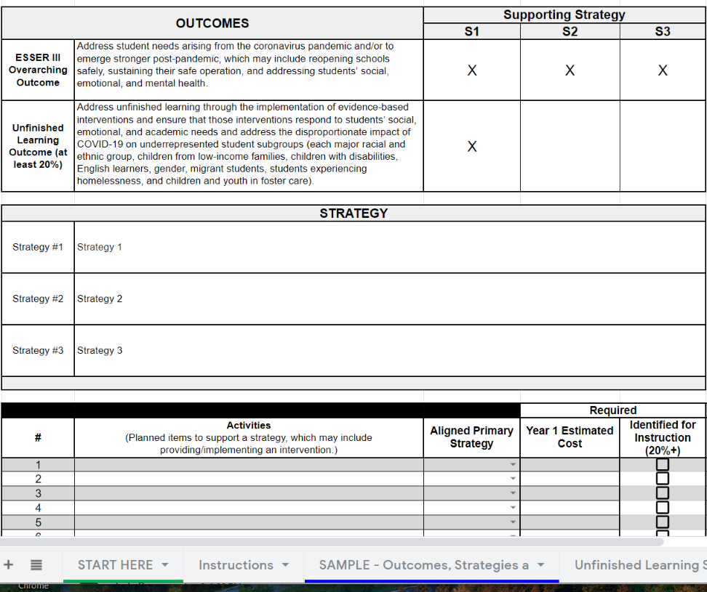
Integrated Planning Tool (IPT)
Smartsheet Section 3 - Integrated Planning Tool (IPT)
USED Requirements
Districts must use ESSER III funds in accordance with the ARP Act
The IPT is designed to show how the money is being invested to support outcomes and strategies in accordance with the ARP Act
Districts must make the plans available to the public.
The information in the IPT “Outcomes, Strategies, and Activities” may be adapted for accessibility and act as your public facing district plan.
Integrated Planning Tool (IPT)
This is an adapted (and simplified) version of the SIA IPT.
ODE is only requiring year 1 (2021-2022) estimates at this point. We understand many districts are in early stages of ESSER III planning. ODE will provide more information on submitting updates.
Notes:
The ESSER III District Plan is only related to the funds allocated under the Elementary and Secondary School Emergency Relief Fund (ESSER) provision in the American Rescue Plan (ARP) Act. It does not address other ARP funding streams, such as ARP Homeless Children and Youth (HCY) or ARP Individuals with Disabilities Education Act (IDEA).
The overarching outcome of ESSER III is to address student needs arising from the COVID-19 pandemic and/or to emerge stronger post-pandemic. An additional federal requirement is for at least 20% of the funds to address unfinished learning through the implementation of evidence-based interventions and ensure those interventions respond to students’ social, emotional, and academic needs and address the disproportionate impact of COVID-19 on underrepresented student subgroups.
The Integrated Planning Tool is designed to walk districts through requirements to outline their investments in line with ESSER III requirements.
The ARP Act does not directly address allocation of district ESSER III funds to district-sponsored public charter schools. The clear legislative intent, however, is to benefit all public schools and students regardless of school type. ODE asks that districts include their charter schools on equal footing with other district schools, when determining the most important educational needs as a result of COVID-19, consistent with the intent of the ARP Act. Districts must meaningfully engage all school leaders, including charter school leaders, in determining their plans for using ESSER III funds. Districts that sponsor public charter schools may also plan to pass through a proportionate share of the ESSER III funds. Public charter schools that receive ESSER III funds must comply with the same allowable uses and 20% fund designation requirements as districts. A separate Outcomes, Strategies and Activities tab can be created in the Integrated Planning Tool for the district and any charter schools.

Slide 30
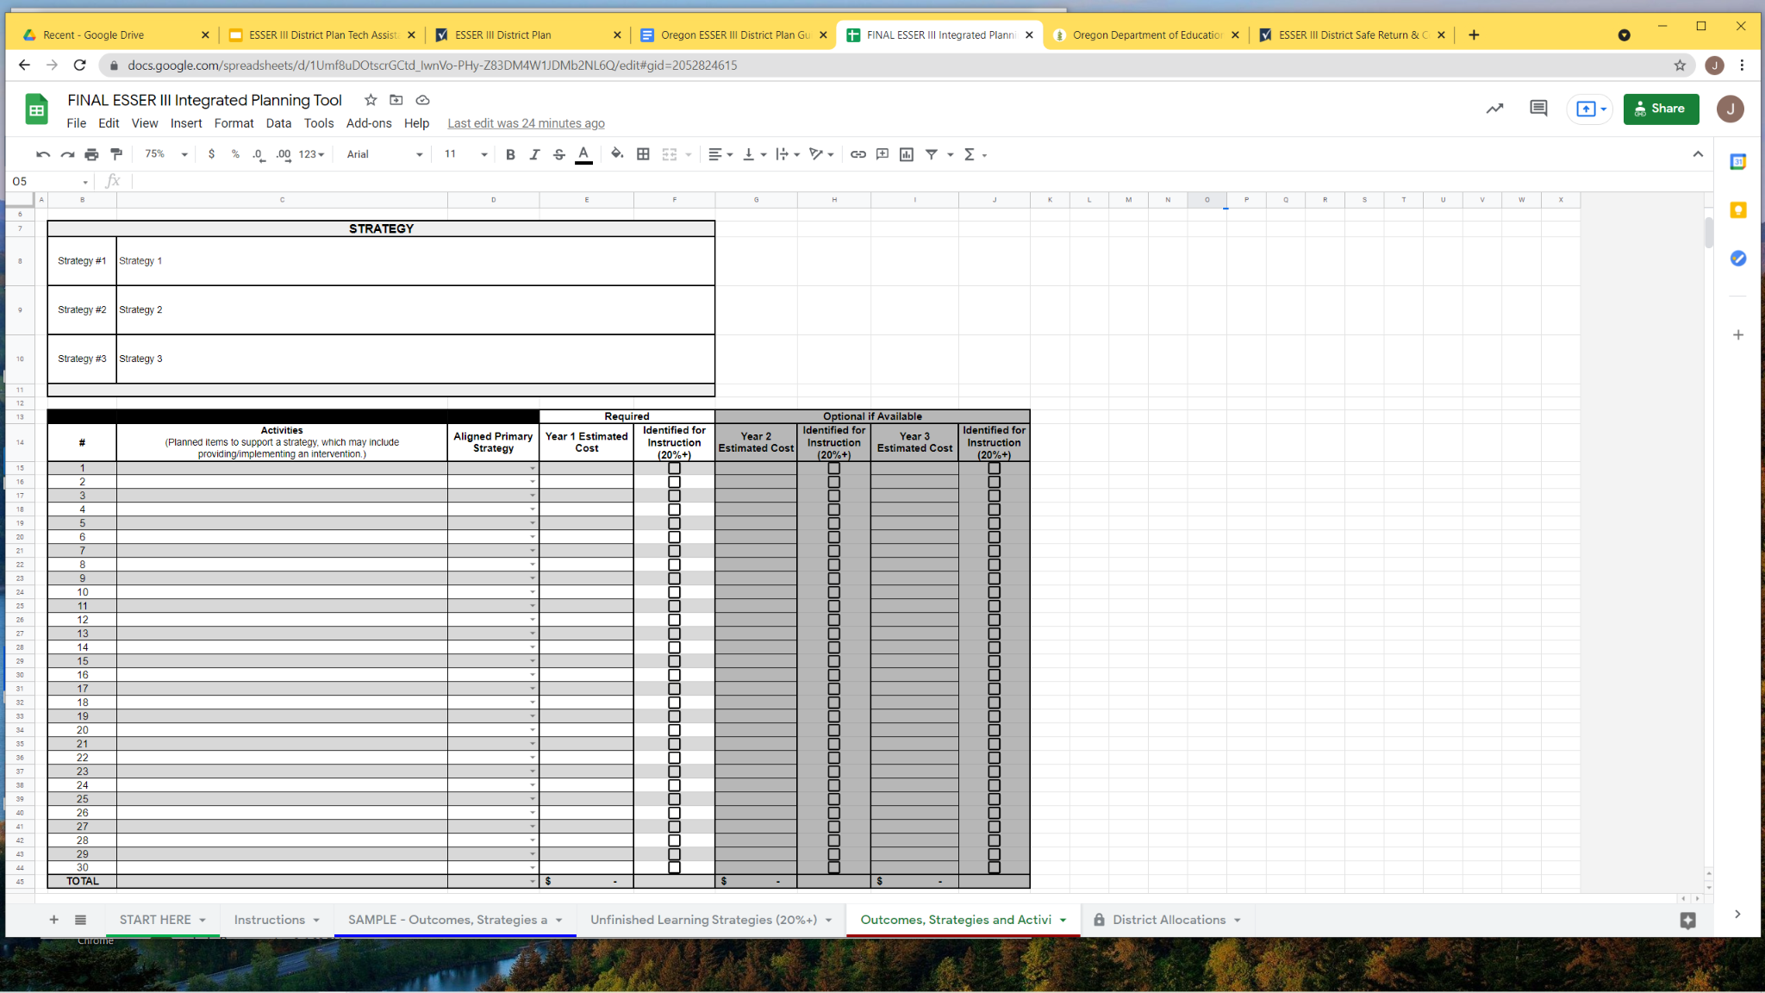
Integrated planning tool
Integrated Planning Tool (IPT)
Review all the tabs from left to right. They include detailed instructions, examples, funding allocations, and other supporting information for completing the IPT.
The IPT template includes outcomes and sections for the essential information. District may choose to add sections, columns, or layer-in information relevant to their district and community.
Outcomes are the changes you are trying to cause. Strategies inform long-term goals, have a theory of action or impact, and consider resources, context, people and timelines. Activities are concrete and oriented to smaller steps or shorter time frames within the arc of a given strategy or set of strategies. Activities generally have specific resource allocations and might also be called initiatives, tactics, investments or work plans. (In the case of the ESSER III District Plan, an activity may be an intervention or a set of investments in support of an intervention.) Adapted from SIA Guidance, December 2019

Slide 31
Learning Targets
I know:
ESSER III District Plan Deliverables
I can:
Navigate planning resources
Complete the technical steps to submit the ESSER III District Plan
Section 1: Smartsheet form
Section 2: Community Engagement
Section 3: Integrated Planning Tool
Learning Targets
Notes:
Timeline
check list of deliverables

Slide 32
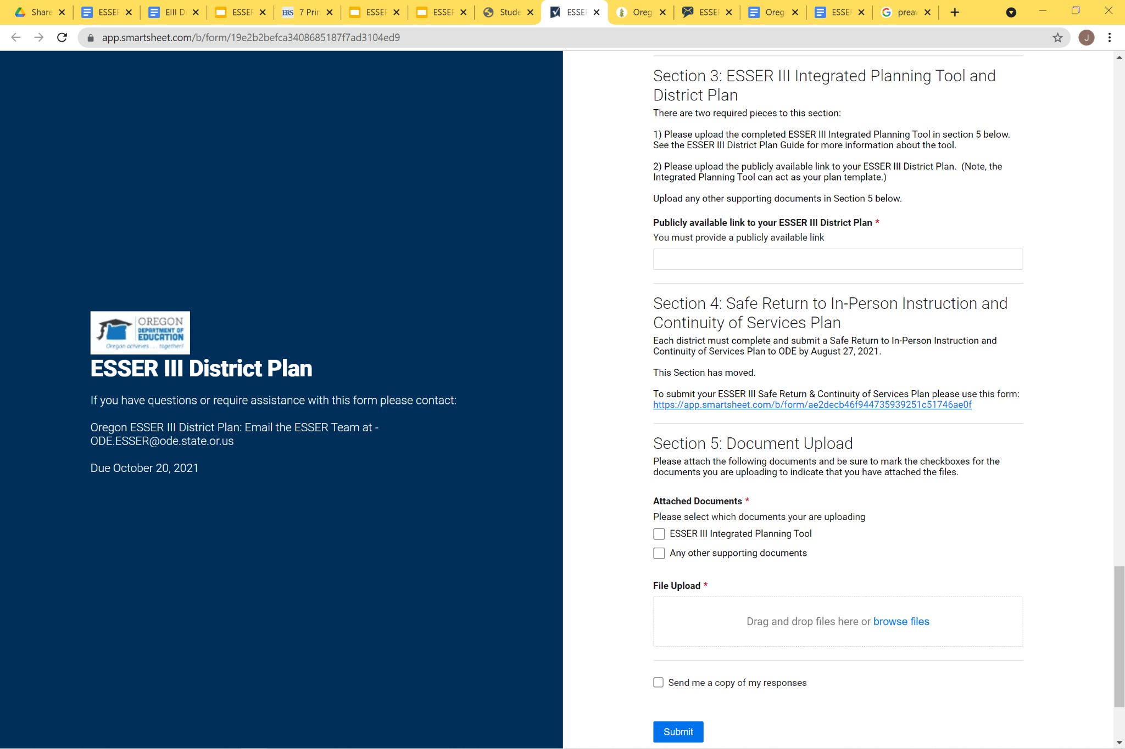
Integrated Planning Tool (IPT)
In Section 3 of the Smartsheet, upload the publicly available link to your ESSER III District Plan. (Note: The “Outcomes, Strategies, and Activities” tab of the IPT can be adapted for accessibility and act as your district plan.)
(Section 4 has moved and no longer applicable.)
In Section 5 of the Smartsheet, upload the completed ESSER III Integrated Planning Tool.
Select to receive a copy of your responses

Slide 33

Supports and Resources
ESSER III Self-Paced Support Modules
Reach out with questions via email
  ODECOVID19@ode.state.or.us – RSSL questions
  ODE.ESSER@ode.state.or.us – ESSER in box
ESSER III District Plans Q & A Sessions
ESSER Contact: Cynthia Stinson
503-881-3992 or
ESSER in box: ODE.ESSER@ode.state.or.us
Drop in ESSER III District Plan Virtual Q&A Sessions
Dates (Zoom Link)
Friday, Sept 24, 11-12 (Zoom)
Wednesday, September 29, 3-4 pm (Zoom link)
Tuesday, October 5, 3-4 pm (Zoom link)
Wednesday, October 13, 3-4 pm (Zoom link)
Monday, October 18, 11 am-12 pm (Zoom link)

