Slide 1
ESSER III District Plan
ESSER III District Plan
In Depth Session
October 7, 2021
Thanks for joining us.
Please mute yourself.
We will start in just a few minutes…

Slide 2
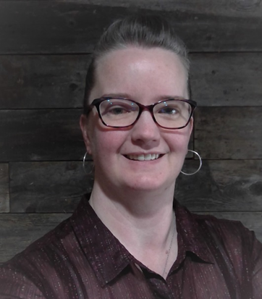
ESSER Facilitator Team Today
Mike Wiltfong
ODE Director of School Finance and School Facilities
Stephanie Tyrer
ODE Senior Business Operations & Policy Analyst
Jennifer Patterson
ODE Assistant Superintendent, Office of Teaching Learning and Assessment
Cynthia Stinson
Senior Manager of Federal Investments and Pandemic Renewal
Notes:
Jennifer

Slide 3
Structure for Today
Today’s Facilitators: Cynthia Stinson, Jennifer Patterson, Mike Wiltfong, Stephanie Tyrer
Today’s Chat Navigators: Sarah, Haedon, Joanne, Susan, Cheng Fei, Mary
1. Welcome
2. ESSER Allowable Costs
3. Capital Expenditures
Please use the chat for specific questions and sharing.
We will record these and post them so they are available for others to view as well.
Notes:
Jennifer

Slide 4
Purpose
The ESSER III In Depth Sessions are designed for District Leaders in an effort to...
Provide clarity around the ESSER III requirements as districts plan for their ESSER III investments.
Create a space where questions and ideas from other practitioners may inspire new thinking or solidify current planning.
Offer two-way communication and create a space to engage in conversation and sense making.
Notes:
Jennifer

Slide 5
Acknowledgements
ODE acknowledges many districts are in early stages of ESSER III planning. Flexibility and scaffolds are built into the ESSER III District Plan template to support districts in meeting the federal deadline (10/20/21).
Thank you for your ongoing leadership and partnership as we continue to navigate a complex environment!
Notes:
Jennifer

Slide 6
ESSER Finance Update
ESSER Finance Update
Mike Wiltfong
Director of School Finance and School Facilities
Email: Michael.Wiltfong@state.or.us
Phone: (503) 947-5914

Slide 7
As of October 2021: What’s ESSER? Everyone in this room is at a different place in their work and understanding of this opportunity and meaning – and that’s okay. This is a multi-year grant and we are still developing the rules as we speak. In fact, there is a lot we are still developing and that’s also okay.

Slide 8
ESSER Programs
Mar. 2020: CARES Act - ESSER I: $121.1 million Effective Mar. 13, 2020 to Sep. 30, 2022 Dec. 2020: CRRSA Act - ESSER II: $499.1 million Effective Mar. 13, 2020 to Sep. 30, 2023 Mar. 2021: ARP Act - ESSER III: $1.1 billion Effective Mar. 13, 2020 to Sep. 30, 2024

Slide 9
ESSER Eligible Uses
A lot of money and a lot of eligible uses – what could go wrong, right?
What qualifies:
“If it is education related and is in response to the pandemic, it will most likely qualify, as long as it is reasonable.” – Mike Wiltfong ca. 2020
However, the priorities did change under ESSER III

Slide 10
ESSER Eligible Uses
Most notable change is where they removed the following eligible use under ESSER III:
Providing resources for principals and others school leaders to address school-specific needs. CRRSA Act Section 313(d)(3)
This is what I referred to as the “catch-all”
More emphasis has been placed on addressing learning loss, especially for historically marginalized students. We saw a significant impact to resources for these students across the country during the last recession.

Slide 11
ESSER Spending as of 10/1/21
ESSER I: Approximately 86% (~$104M) has been claimed and top three uses are for teachers, student supports, and technology - no surprise there
ESSER II: Approximately 16% (~$76M) has been claimed and top three uses are similar to ESSER I, with capital acquisition/construction/improvement making an impressive showing
ESSER III: Less 1% ($10M) has been claimed so far

Slide 12
ESSER Spending
Lots of challenges with spending:
Difficulty finding staff to hire right now
Fear of the anticipated funding cliff if we do find staff to hire
Uncertainty of needs right now and in future
Lots of creative ideas being reviewed
“We weren’t impacted by COVID like other districts and communities”
Concern with anticipated capital spending

Slide 13
Capital Projects
There are concerns with capital requests for ESSER:
This is also true for many other states
There is concern with the types of requests
There is concern with amount of requests
There are a variety of opinions on this topic
This issue continues to evolve and so does our process and understanding
We ask for patience and grace moving forward

Slide 14
ARP ESSER III Plans
This is why your ESSER III plans are so valuable:
They help facilitate and share creative thinking
They help us respond to conversations with other SEAs and federal partners
They help in our review to check for alignment with other strategic initiatives/investments
With competing priorities, it will be tempting to look to immediate goals and returns - capital
I believe our federal partners are monitoring how we respond with this opportunity – please keep that in mind
If you do have capital needs, Stephanie has some helpful information to share

Slide 15
Capital Assets and Expenditures with ESSER
Stephanie Tyrer
Senior Business Operations & Policy Analyst
Email: stephanie.tyrer@ode.state.or.us
Phone: (503) 947-5619

Slide 16
Capital Expenditures under ESSER

Slide 17
Federal Definitions
How does the government define “capital asset” and “capital expenditures”?
§200.1 Definitions
Capital Assets
Tangible or intangible assets used in operations having a useful life of more than one year which are capitalized in accordance with GAAP.
Capital Expenditures
Expenditures to acquire capital assets or expenditures to make additions, improvements, modifications, replacements, rearrangements, reinstallations, renovations, or alterations to capital assets that materially increase their value or useful life.
Notes:
Capital assets means:
(1) Tangible or intangible assets used in operations having a useful life of more than one year which are capitalized in accordance with GAAP. Capital assets include:
(i) Land, buildings (facilities), equipment, and intellectual property (including software) whether acquired by purchase, construction, manufacture, exchange, or through a lease accounted for as financed purchase under Government Accounting Standards Board (GASB) standards or a finance lease under Financial Accounting Standards Board (FASB) standards; and
(ii) Additions, improvements, modifications, replacements, rearrangements, reinstallations, renovations or alterations to capital assets that materially increase their value or useful life (not ordinary repairs and maintenance).
(2) For purpose of this part, capital assets do not include intangible right-to-use assets (per GASB) and right-to-use operating lease assets (per FASB). For example, assets capitalized that recognize a lessee's right to control the use of property and/or equipment for a period of time under a lease contract. See also §200.465.
Capital expenditures means expenditures to acquire capital assets or expenditures to make additions, improvements, modifications, replacements, rearrangements, reinstallations, renovations, or alterations to capital assets that materially increase their value or useful life.

Slide 18
Capital Expenses under ESSER: Are they allowed?
Are capital assets or expenditures allowed under ESSER I, II, and III?
Are construction and renovation costs allowed under ESSER I, II, and III?
Yes!
But, the purchase and tracking of a capital asset or capital expenditures must consider:
Federal Uniform Grant Guidance (UGG) (citations will follow)
EDGAR construction rules, 34 CFR § 76.660, 34 CFR §§ 75.600-75.617
Davis-Bacon prevailing wage rules, 20 U.S. Code § 1232b
Americans with Disabilities Act (ADA), 28 CFR Part 36
CARES Act, CRRSA Act, and ARP Act laws
ODE guidance and procedures
Local purchasing policies
Notes:
Capital asset: SD ESSER funds can be used to purchase a capital asset (real property) or modular classrooms because this is an allowable activity under the ESEA’s Impact Aid program, subject to ODE’s written approval. See section 18003(d)(1) of the CARES Act, Title VII of the ESEA, and 2 CFR § 200.439(b)(1).
Construction/renovation: Because ESSER funds may be used for “any activity authorized by the ESEA,” and construction is an allowable activity under the ESEA’s Impact Aid program, SDs may use ESSER funds for construction, subject to ODE’s written approval. See section 18003(d)(1) of the CARES Act, Title VII of the ESEA, and 2 CFR § 200.439(b)(1).
As it is with all activities charged to ESSER, capital purchases and construction costs must be reasonable and necessary to meet the overall ESSER purpose, which is “to prevent, prepare for, and respond to” COVID-19. You can see this in the CARES Act ESF heading and 2 CFR §§ 200.403-200.405 (factors for allowable and reasonable costs). This means that any construction activities, including renovations or remodeling, that would be necessary for SDs to prevent, prepare for, and respond to COVID-19 would be permissible.
Construction projects are also subject to the Americans with Disabilities Act
E.g. renovations to replace old carpeting with tile to make sanitizing more efficient and effective, or modifying existing space to more adequately meet CDC and ODE guidance for physical distancing.

Slide 19
Guidance: Federal Sources
Key Uniform Grant Guidance Citations:
§200.303 Internal controls
§200.311 Real property
§200.317 - §200.327 Procurement Standards
§200.403 - §200.404 Allowable and Reasonable Costs
§200.407 Prior written approval (from ODE)
§200.436 Depreciation
§200.439 Equipment and other capital expenditures
§200.449 Interest (Finance costs)
§200.452 Maintenance and repair costs
§200.465 Rental costs of real property and equipment
Notes:
What are the recipient’s responsibilities when purchasing a capital asset or capital expenditure with federal grant money?
Prior Approval (from ODE): SDs are required under this law to receive prior approval from ODE before making their purchase.
Internal controls: ensure that federal funding is being used for the intended purpose.
Procurement standards: ensure local procurement policies comply with federal UGG; local can be more stringent, just not less.
Real Property: Use and disposition – basically, any real property (capital asset) purchased with federal funds must be used only for the originally authorized purpose and if that purpose changes, or the property is no longer needed, the SD must obtain disposition instructions from ODE.
Interest: You’ll want to read this section carefully as interest and other finance costs are either allowable or disallowed based on circumstances. Generally speaking, financing costs (including interest) for capital assets are allowable, subject to the conditions in that section.
Rental costs: Consider rentals or leasing during your decision process, especially if you think you won’t need the capital asset for its full “life”.

Slide 20
Requesting Approval for Asset Purchases
SDs are required by federal law to submit for written approval on any capital purchase using ESSER funds.
When to request written approval to purchase a Capital Asset or Expenditure:
When the purchase exceeds $5,000 per unit, and
If the item’s useful life exceeds one year.
How to request written approval from ODE:
ODE Capital Expenditure Approval Form
Complete the form as completely as possible and be sure to tie the purchase back to the ESSER purpose.
Submit the Excel form to ode.esser@ode.state.or.us
Notes:
The ODE Capital Expenditure Approval Form link above will take you to the form to download, but it is also located on the ESSER II and ESSER III webpages under ODE’s site for COVID Resources.

Slide 21
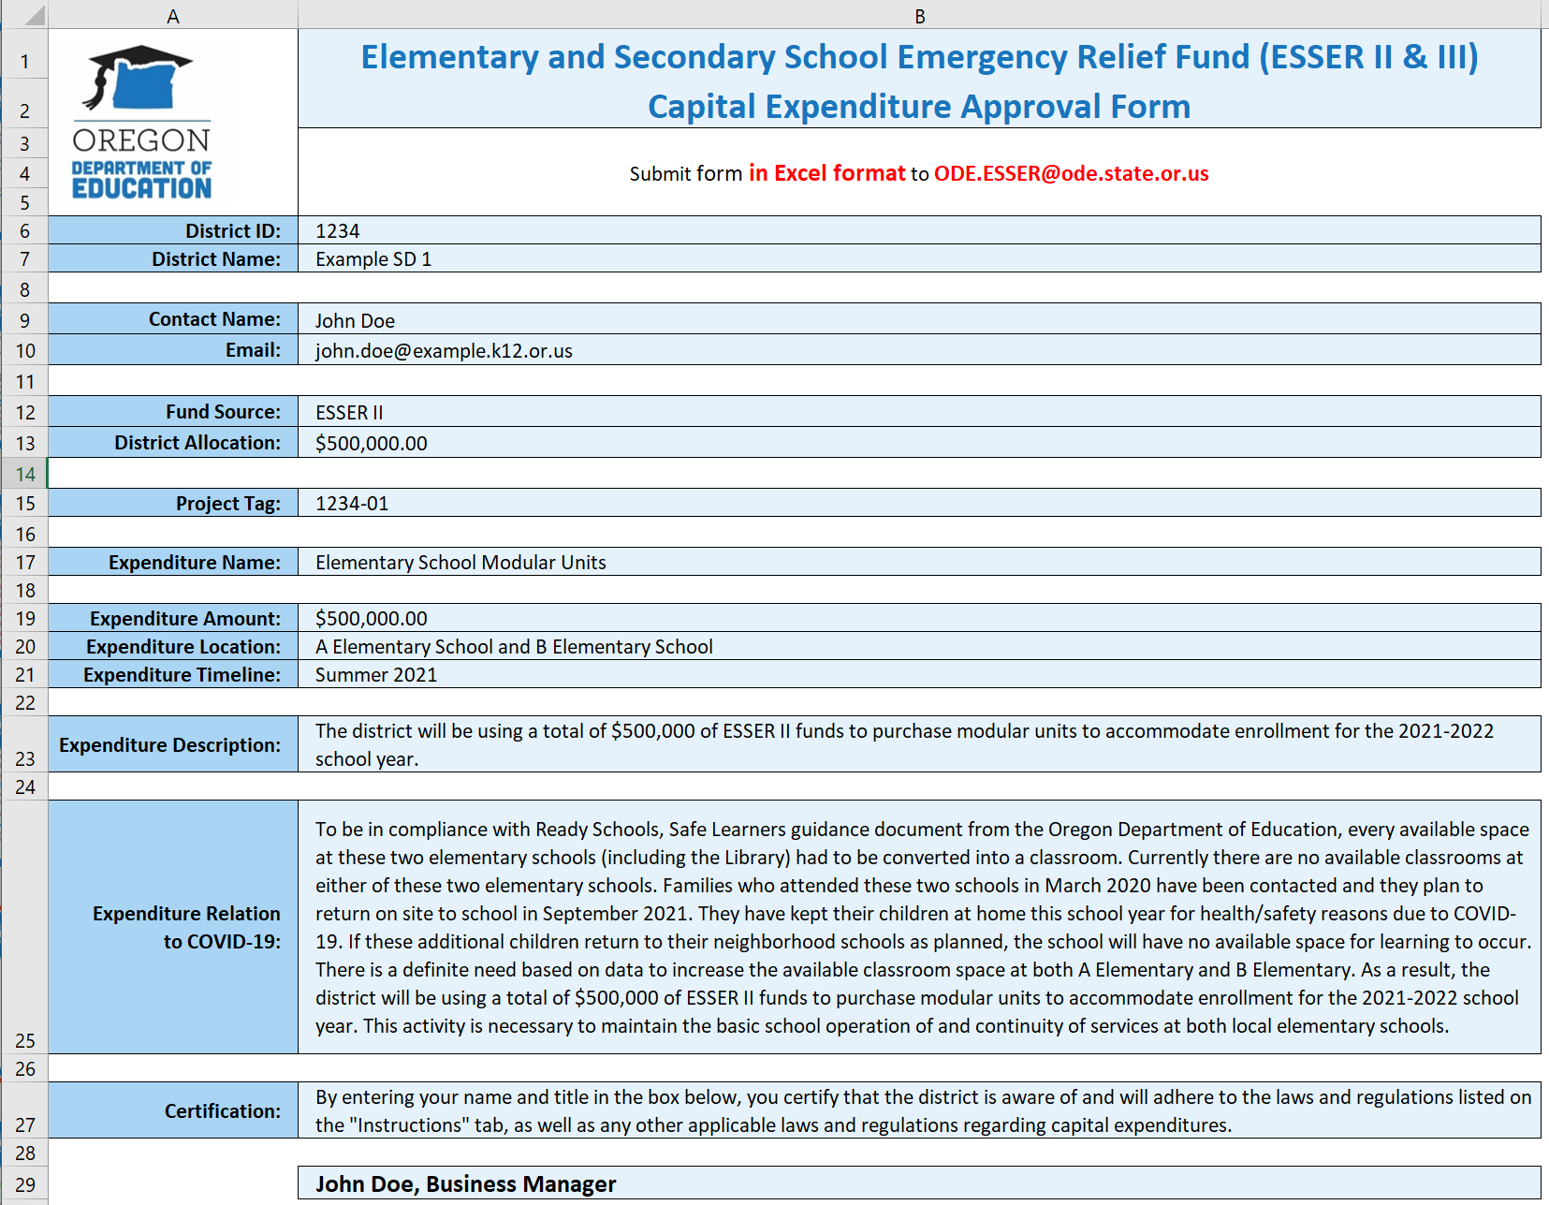
Capital Expenditure Approval Form

Slide 22
After Receiving Approval for Asset Purchases
Tracking your capital purchase is important!
The Excel request form describes a project tag process where the SD will identify each single capital purchase separately.
Depreciate your asset annually.
Set up internal controls to ensure the asset is used for the original purpose.
As soon as the purpose changes, notify ODE for instructions on disposition of the asset.
Be prepared for audit. ☺

Slide 23
USED Use of Funds FAQs Capital Expenditures

Slide 24
Use of Funds: Section A
A-16. Do the requirements in the Uniform Guidance apply to ESSER and GEER Funds?
Construction. Approved construction projects must comply with applicable Uniform Guidance requirements, as well as the Department’s regulations regarding construction at 34 CFR § 76.600. As is the case with all remodeling or construction contracts using laborers and mechanics financed by Federal education funds, an LEA that ues ESSER or GEER funds for minor remodeling, renovation, repair, or construction contracts over $2,000 must meet all Davis-Bacon prevailing wage requirements and include language in the contracts that all contractors or subcontractors must pay wages that are not less than those established for the locality of the project (prevailing wage rates). (See 20 U.S.C. 1232b Labor Standards.) (See also FAQ B-6.)
Prior Approval. In addition to pre-award costs discussed above, the Uniform Guidance at 2 CFR § 200.407 requires prior written approval from either the Department or the State (Governor or SEA, as applicable) for certain costs, such as the purchase of real property; equipment and other capital expenditures; entertainment costs; and travel costs.s

Slide 25
Use of Funds FAQ: Section B
B-6. May ESSER and GEER funds be used for construction?
Yes. Construction is authorized under Title VII of the ESEA (Impact Aid) and therefore is an allowable use of GEER and ESSER funds under sections 18002(c)(3) and 18003(d)(1) of the CARES Act, sections 312(c)(3) and 313(d)(1) of the CRRSA Act, and section 2001(e)(2) of the ARP Act. The broad Impact Aid definition of “construction” includes new construction as well as remodeling, alterations, renovations, and repairs under which many activities related to COVID-19 would likely fall.13 However, the Department discourages LEAs from using ESSER and GEER funds for new construction because this use of funds may limit an LEA’s ability to support other essential needs or initiatives. Remodeling, renovation, and new construction are often time-consuming, which may not be workable under the shorter timelines associated with ESSER and GEER funds. These types of activities are also subject to a number of additional Federal requirements…
Comply with 2 CFR Part 200, subpart E (2 CFR §200.403 - §200.404)
Meet overall purpose of CARES Act, CRRSA Act, or ARP Act programs, which is “to prevent, prepare for, and respond to” COVID-19
Consistent with the proper and efficient administration of those programs
Notes:
As we’ve discussed, there are a lot of federal regulations that must also be considered for construction. Please review this FAQ in full when considering construction, remodeling, alterations, renovations, and repairs using the ESSER funds.

Slide 26
Use of Funds FAQ: Section B Continued
B-7. May ESSER and GEER funds be used for renovation, including for such projects as making improvements to a school facility to improve indoor air quality (such as heating, ventilation, and air conditioning (HVAC) systems), and projects that would promote social distancing and safe in-person instruction?
Yes. ESSER and GEER funds may be used to make necessary improvements, for example to improve air quality and support social distancing, so that teachers and students may safely return to and continue in person instruction. As is the case with all activities charged to ESSER or GEER, costs must be reasonable and necessary to meet the overall purpose of the program, which is “to prevent, prepare for, and respond to” COVID-19. (See 2 CFR §§ 200.403-200.404.) Therefore, renovation or remodeling activities that are necessary for an LEA to prevent, prepare for, and respond to COVID-19 would be permissible. This might include renovations that would permit an LEA to clean effectively (e.g., replacing old carpet with tile that could be cleaned more easily) or create a learning environment that could better sustain social distancing (e.g., bringing an unused wing of a school into compliance with fire and safety codes in order to reopen it to create more space for students to maintain appropriate social distancing).
Notes:
Again, please review this FAQ in full when considering construction, remodeling, alterations, renovations, and repairs using the ESSER funds.

Slide 27
Section B
B-8. May an LEA use ESSER and GEER funds to purchase trailers or modular units?
Yes. Under 2 CFR § 200.33, “equipment” means “tangible personal property (including information technology systems) having a useful life of more than one year and a per-unit acquisition cost which equals or exceeds the lesser of the capitalization level established by the non-Federal entity for financial statement purposes, or $5,000.” Generally, a trailer or modular unit meets this definition. Accordingly, an LEA may use ESSER and GEER funds to purchase trailers or modular units if such purchases are necessary to create additional safe learning spaces due to the COVID-19 pandemic (e.g., for more effective social distancing consistent with CDC guidance) (see section 2001(e)(2)(Q) of the ARP Act).
Notes:
Reminder: all capital expenditures must be pre-approved by ODE as outlined in 2 CFR 200.439(b)

Slide 28
USED Resources for Capital Expenditures
ESSER Office Hours Q&A (see page 5)
ESSER / GEER Use of Funds Guide and FAQs
USED Presentation 6.3.21: USED State Plan Requirements and Use of Funds
See slide 28: purchase of land and applicable regulations
USED Presentation 9.2.21: Using COVID-Relief Funds for Facility Upgrades, Renovations, and Construction
Presentation recording (mp3)
USED Factsheet 9.2.21: Supporting School Districts in Timely Investment of ARP Act Funds

Slide 29
Other Capital Expenditure Resources
CCSSO Common Use of Funds Questions for ESSER and GEER (see page 4)
Uniform Grant Guidance, Subpart E – Cost Principles
2020 Compliance Supplement Addendum, 2 CFR Part 200, Appendix X (starting on page 57; Equipment/Real Property Management on page 63)
Federal COVID-19 Stimulus Resources (ODE site)
ODE ESSER Team: ode.esser@ode.state.or.us

Slide 30
Supports and Resources
ESSER III Self-Paced Support Modules
Reach out with questions via email
ODECOVID19@ode.state.or.us – RSSL questions
ODE.ESSER@ode.state.or.us – ESSER in box
ESSER III District Plans Q & A Sessions
Drop in ESSER III District Plan Virtual Q&A Sessions
Dates (Zoom Link)
Wednesday, October 13, 3-4 pm (Zoom link)
Monday, October 18, 11 am-12 pm (Zoom link)
In-Depth Session:
Thursday, October 14, 3 pm-4 pm (Zoom link)
ESSER Contact: Cynthia Stinson
503-881-3992 or
ESSER in box: ODE.ESSER@ode.state.or.us

