Slide 1

Access and Functional Needs Planning
Ensuring the safety of every student
Presenter info:

Slide 2
Today’s Agenda
School Emergency Preparedness Basics
  Planning and drill requirements: school and local partners
  Emergency Operation Plans and their core components
Access and Functional Needs Planning:
  Common terminology
  Why and how
Deep dive into the PEAP
Practicing the PEAP
Additional resources

Slide 3

SSEM Mission
Task and Purpose:
Ensure every community has the knowledge to respond to any disaster or other event that threatens the safety of the community and access available resources to aid in mitigation, response and recovery.
We do this in order to maintain a safe and welcoming environment for our schools and the communities they learn in so every person can thrive.

Slide 4
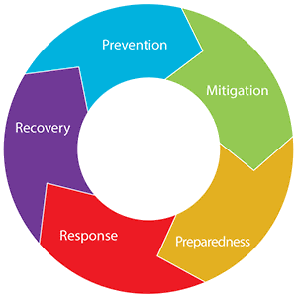
What is School Safety and Emergency Management?
Keeping your school community safe!
What makes a school safe?
You! Your staff, students, families and community supports!
Notes:
Each school day, our nation’s schools are entrusted to provide a safe and healthy learning environment for approximately 55 million elementary and secondary school students in public and nonpublic schools. Families and communities expect schools to keep their children and youths safe from threats (human-caused emergencies such as crime and violence) and hazards (natural disasters, disease outbreaks, and accidents).
Lessons learned from school emergencies highlight the importance of preparing school officials and first responders to implement school emergency operations plans. By having plans in place to keep students and staff safe, schools play a key role in taking preventative and protective measures to stop an emergency from occurring or reduce the impact of an incident.
Schools are not traditional response organizations, but when a school-based emergency occurs, school personnel respond immediately. They provide first aid, notify response partners, and provide instructions before first responders arrive. They also work with their community partners (i.e., governmental organizations) that have a responsibility in the school emergency operations plan to provide a cohesive, coordinated response. Community partners include first responders (law enforcement officers, fire officials, and emergency medical services personnel) as well as public and mental health entities.

Slide 5
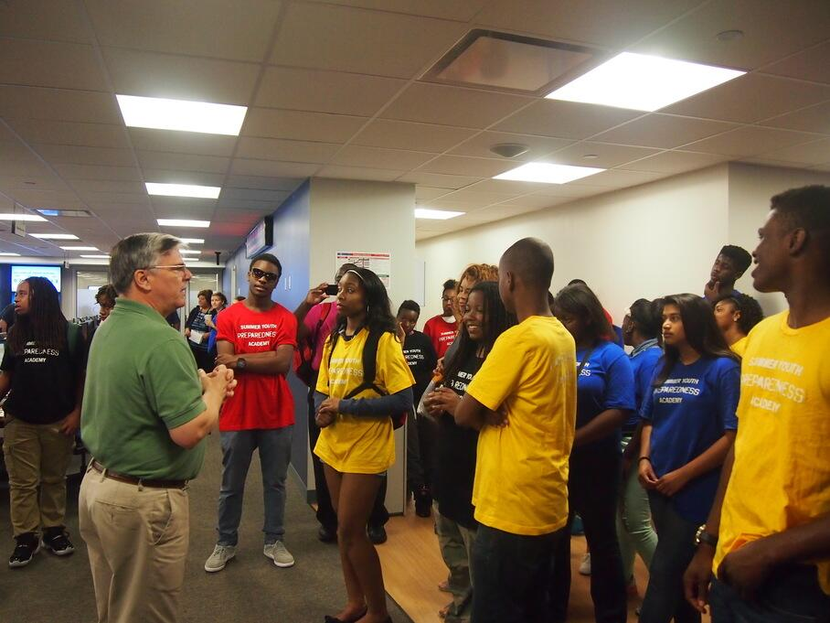
School Drill Requirements (current yr.)
Schools are required to:
Instruct and drill students on emergency procedures (at least 30 minutes per month):
  Fire emergencies (Evacuate monthly).
  Earthquakes (2x per year)
  Earthquake/Tsunamis (only in zone; 3x per year)
  Safety threats (2x per year): Lockdown, Lockout (Secure), Shelter and Evacuate.

Slide 6
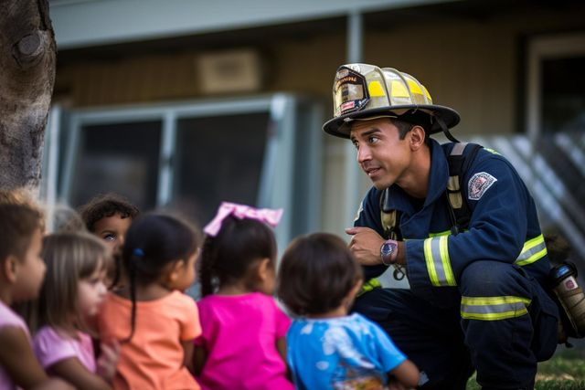
School Drill Requirements (next yr.)
Schools will be required to:
Instruct and drill students on emergency procedures (at least 30 minutes per month):
  Fire emergencies (Evacuate monthly).
  Earthquakes (2x per year)
  Earthquake/Tsunamis (only in zone; 3x per year)
  Safety threats (1x per year): Lockdown, Secure, Shelter, Hold and Evacuate.

Slide 7

Local Govt. Requirements
Units of local government and state agencies associated with EM shall:
Review emergency procedures proposed by schools.
Assist in instruction and drilling.
Why is this important for Access and Functional needs planning?

Slide 8
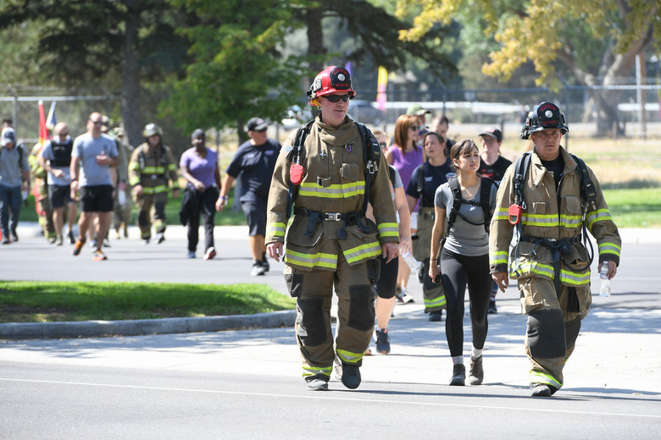
Real-World Requirements
If disaster strikes tomorrow, are you ready?
Establish response priorities that protect life, health and safety.
Establish protocols that prevent or mitigate death or injury.
Practice, exercise and drill.

Slide 9
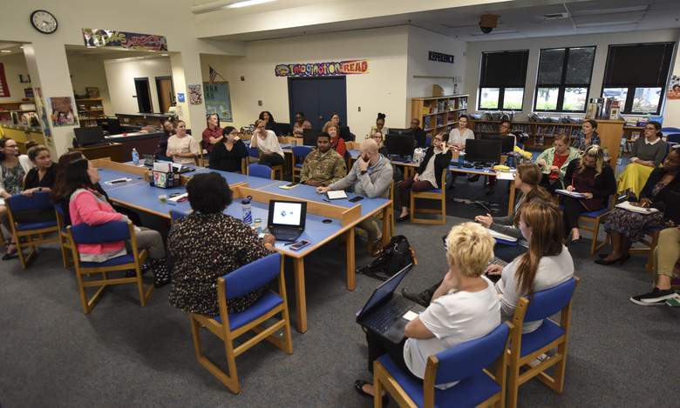
Expectations: a High-Quality School Emergency Operations Plan (EOP)
Schools:
  Provide safe and healthy learning environments.
  Keep students safe from all threats and hazards.
We help schools:
  Identify threats and hazards to plan for.
  Create or improve School Emergency Operations Plans (EOP).
  Exercise those plans.

Slide 10







The Six Pillars of Emergency Preparedness
Incident Command System
Functional Annexes (Emergency Drills)
Community Collaboration
Access and Functional Needs
Assessments for Schools
Incident- Specific
Plans
Notes:
Components that the SSEM program coordinators will look for when engaging districts in Oregon. Guidance documents align with these assessed areas and explain the expectations of each.
Community Collab- Do they have MOU/MOA's in place? Do they know who there EM partners are in the community? Does the Fire Dept. Come to drills and give feedback?
Access & Func. Needs- Are the special ed. Classrooms on the 2nd floor with only elevator access to exit? Do they have paper copies(or access to) medical records for students during a power outage? Do they have flashing lights on their alarms to include students who are deaf?
ICS – Do they use an ICS Structure during an emergency? Do they know what it is? Is there span of control, really in control?
Threat & Hazard Assessments – Site safety assessments: Are there staff members trained in CPR/AED? Are all of there fire alarms still working? How do schools signal people on the outside, NOT to come in? Does the front office have a line of site to the parking lot?
Functional Annexes – Do they use the Standard Response Protocol? If not, do they understand the benefits of using it? What areas may they be forgetting to think about?
Threat & Hazard Specific – Are all regional specific threat/hazards being taken into account? Do they drill/train on them?

Slide 11

Who are We Planning For?
Have you identified students or staff in your school who may need additional help during an emergency?
Notes:
AFN considerations should include, but are not limited to:
• People with physical disabilities or injuries.
• People with developmental, cognitive or mental disabilities.
• People with acute or chronic health conditions.
• People who are blind, low vision, deaf or hard-of-hearing.
• People with limited English proficiency.

Slide 12
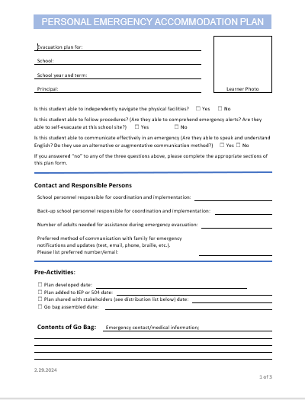
PEAPs: Identify People and Needs
The Personal Emergency Accommodation Plan (PEAP) is a form used to help identify the needs of a student with a disability during an emergency.
These Students may already have an Individualized Education Plan (IEP) or 504 plan.
Including the PEAP in the IEP or 504 planning process will ensure that their emergency needs are considered alongside their educational needs.
Notes:
Link to Guidance Document: https://www.oregon.gov/ode/schools-and-districts/grants/Documents/Office%20of%20School%20Facilities/SSEM/Guidance/Emergency%20Plans%20and%20Drills-Access%20and%20Functional%20Needs.pdf
Link to fillable PEAP: https://www.oregon.gov/ode/schools-and-districts/grants/Documents/Office%20of%20School%20Facilities/SSEM/Training/PEAP_Template.docx

Slide 13

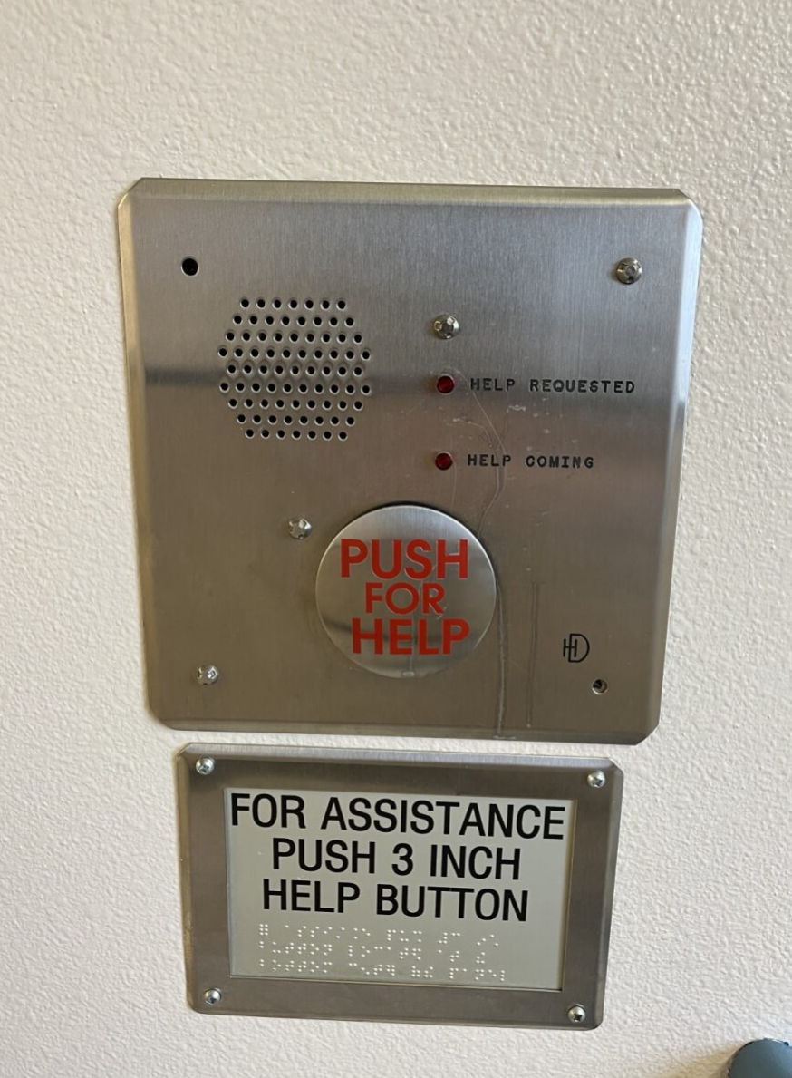
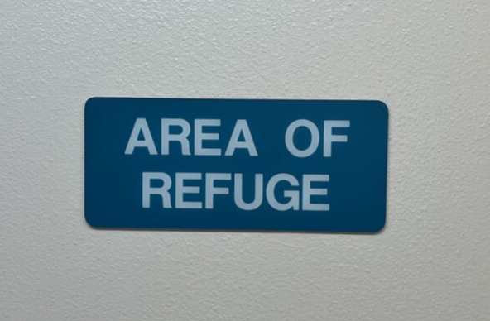
Access & Functional Needs in Emergencies
"I went to the spot and waited for someone to come, but no one ever did."
Evacuation waiting areas (area of refuge) can easily be forgotten.
Notes:
Imagine yourself with access & functional needs in an emergency. Historically, the plan has been, to leave them and someone will come for them. Sometimes the plan was to leave then in a designated "Area of Refuge" but sometimes it was just outside of an elevator or at the top of a stairwell.
Just image yourself in a wheel chair and having limited mobility or having communication challenges with no way to make your needs known and the sheer terror of just being left in a spot. Hoping someone won't forget to come back and get you.

Slide 14
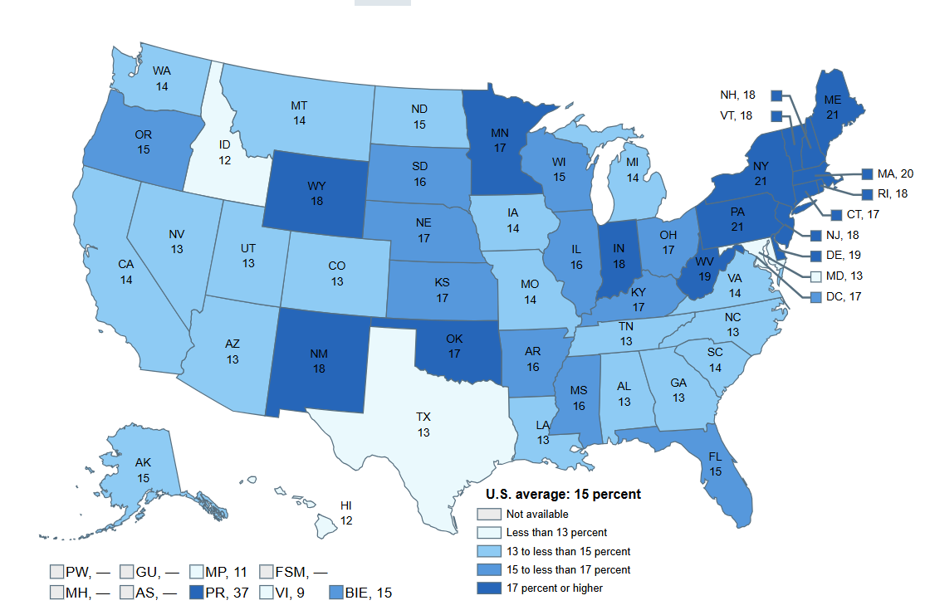
Why use the PEAP?
More than 43 million Americans have a disability.
15% of K-12 students in public education in Oregon have a documented disability.
At any moment, we ourselves or our students, can become part of this group!
% of students in public school with a documented disability – by state
Notes:
Map and data collected from: https://nces.ed.gov/programs/coe/indicator/cgg/students-with-disabilities
This goes across all demographics. It could be something that has been diagnosed for a long time but could also be something that happens suddenly. Like a temporary disability. Think about football player who broke one of their legs last Friday night, maybe staff member who had a 911 surgery.

Slide 15
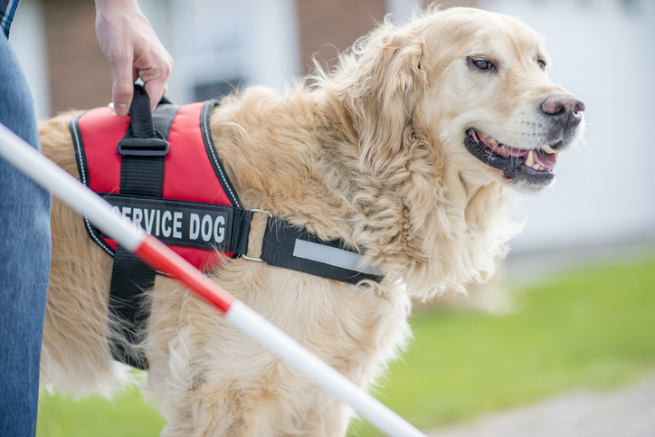
Students have the right to:
"Equal egress" during an emergency.
Know that school districts have an obligation to be prepared and take the proper action during an emergency and to assume responsibility for student safety.
Civil rights/ADA.
Service animal/communication device/ sensory needs, will be taken care of during an emergency.
Notes:
We know that students have the right to legal egress during an emergency. They need to feel good about school districts having a plan for them. All things that we ASSUME are part of the conversation but how deep are we exploring them in the planning process and ensuring we are asking all the right questions.
What about the service animals? What if they are using communication device? Have sensory needs and have to leave their room with all their typical accommodations?

Slide 16
Obligation for Schools
Individuals with Disabilities Education Act (IDEA):
This act mandates that public schools provide individualized education programs (IEPs) for students with disabilities, which includes provisions for emergency planning to ensure their safety and proper accommodations during emergencies.
Americans with Disabilities Act (ADA):
Under the ADA, schools are required to ensure that students with disabilities are not discriminated against in emergency situations. This includes making appropriate accommodations in emergency plans and ensuring access to safe evacuation procedures.

Slide 17

Who is on the planning team?
Notes:
We don't know all the things we need to consider until we start talking about them. You can't have the reunification bus on the other side of the baseball field in the rain. A student or staff member, in the wheelchair is not going to be able to navigate. Again, you may not have someone in the building in a wheelchair now, but it could so easily be any of us at any moment.
Reinforcing the importance of having all the right people in the planning process and all voices are heard.
A PEAP isn't just a document—it’s a collaborative ecosystem. We use this 'Circles of Support' model to show that while the student is always the center of our focus, their safety depends on layers of expertise working in sync.
Layer 1: The Inner Circle (The Experts)
The Student & Family: We start at the core. The student and their parents are the ultimate experts. They know the nuances of the student's mobility, their communication style under stress, and their specific medical history. Without their input, the plan is just a guess.
Layer 2: The Daily Circle (The Classroom Team)
The 'Boots on the Ground': This ring represents the people who are physically with the student every day.
Special Ed Teachers ensure the PEAP doesn't conflict with educational goals.
Paraeducators are often the primary 'implementers' who will physically guide or move the student during a drill or actual emergency.
Layer 3: The Clinical Circle (The Specialists)
Technical Guidance: This layer provides the 'how-to' for complex needs.
The Nurse plans for life-sustaining equipment or meds.
OTs and PTs provide the biomechanical expertise—teaching staff how to perform a safe 'two-person lift' or operate an evacuation chair without causing injury. PT often times owns and writes the plan for those in wheel chairs
Layer 4: The Building Circle (Operations & Safety)
The Structural Safety Net: The outermost ring connects the individual student to the entire facility.
Administrators provide the authority and staffing. Also the ones who should decide who OWNS and WRITES the plans
Facilities Managers identify 'Areas of Refuge' (smoke-protected zones) and harder to see obstacles
First Responders need to know exactly where these students are located so they don't waste precious seconds searching during a high-stakes rescue.
Closing Thought
Notice the gradient on the slide: the colors soften as we move out, but the rings get larger. This reminds us that while the 'inner circle' has the most intimate knowledge, the 'outer circle' provides the massive structural support needed to keep everyone safe.

Slide 18
Training and Implementation
Mandate Comprehensive Training: Clarity from the administration is necessary that staff must be trained to use the evacuation equipment. Training should not be limited to special education staff; all teachers whose rooms are close to the equipment should be invited to attend.
Restrict Equipment Use: Equipment is only to be used in the event of an actual emergency, not during drills.
Encourage Fire Department Collaboration: Staff involved in drafting evacuation plans should attend fire department inspections to learn about the buildings. This is particularly helpful for understanding building codes, safety features like sprinkler systems, and new building construction details, such as hardened entryways designed to prevent school shootings, which make access more difficult for the fire department.
Notes:
Additional resources for administrative responsibilities: https://docs.google.com/document/d/1gp098UUmaQrIxMhjYEbtvGMkZJIXJNJ7d4EvMI76auA/edit?tab=t.0
Don't forget the substitutes and staff that are located near evacuation equipment, stairs or identified areas of refuge. Also, your roaming staff, admin, security, SRO, etc.
What about new staff that come in mid-year? Or an ambitious, new nurse who made their own plans since they weren't part of the beginning of year staff training. Are PEAPs in your substitute training checklist?
Who owns the training and where are the plans located? Are they only accessible to special education teacher in Synergy? Can a sub access them? Does everyone know they are even available in Synergy or the like?

Slide 19

Personal Emergency Accommodation Plans
PEAPs provide a quick-reference checklist of individualized needs during all response types.
Scan the QR code for a downloadable and fillable PEAP template.
Notes:
Link to Guidance Document: https://www.oregon.gov/ode/schools-and-districts/grants/Documents/Office%20of%20School%20Facilities/SSEM/Guidance/Emergency%20Plans%20and%20Drills-Access%20and%20Functional%20Needs.pdf
Link to fillable PEAP: https://www.oregon.gov/ode/schools-and-districts/grants/Documents/Office%20of%20School%20Facilities/SSEM/Training/PEAP_Template.docx

Slide 20
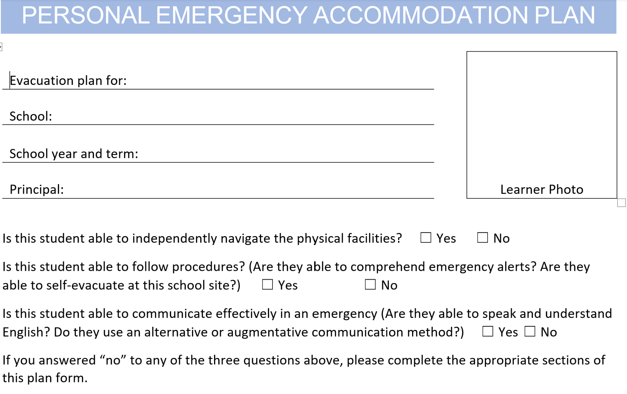
A Dive into the PEAP
Important to know what the person looks like who we are helping in an emergency!
Notes:
Thinking of someone in your school that would be a candidate for the PEAP as we walk through this. Taking special note to things that often get overlooked.
Needs updated when student is in a different classroom, building or working with a new teacher/EA. This is focusing on the situations where students have difficulty in navigating and can't get out on their own.
We know that so often, students with disabilities get some kind of a "bye" for emergency drills because of the sensory issues. But what happens then is they have nothing in their memory bank and the staff too has no idea how that student is going to behave in an actual emergency.
Thinking about the question – Is this student able to communicate effectively in an emergency? This isn't only for students who use a communication device but also those who use English as a second language.

Slide 21
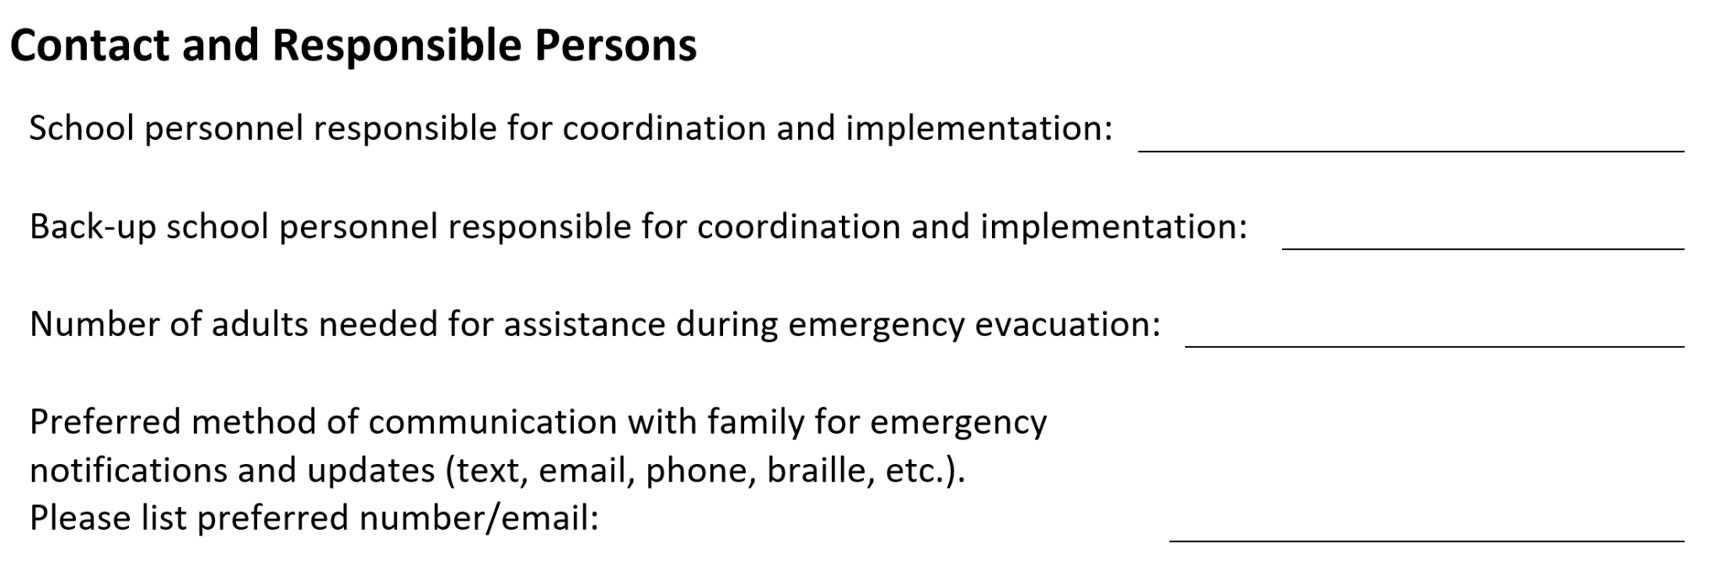
Contact and Responsible Persons
Notes:
Think about the back to the back up!
Communication planning – think about the family communication during reunification for example.

Slide 22
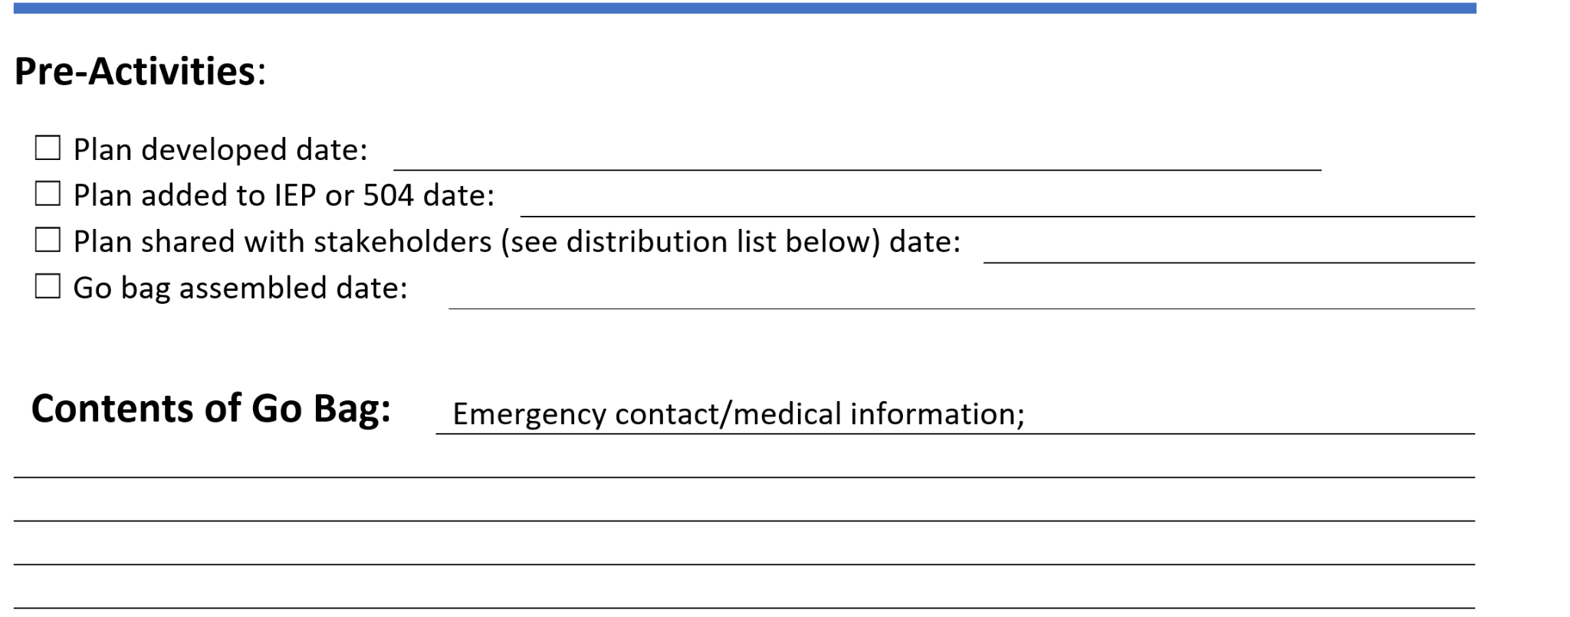
Pre-Activities & Go Bag
Notes:
How are we going to be ready to execute the PEAP. What do we need to get ready.
Building your team, coming up with procedures, having oversight from the administrators – are all pre-activities. The foundation.
Especially thinking about the stakeholders – again – who has access, where does it live, who is responsible for maintaining? What about the community partners, like first responders, how are they going to access this information?
Go Bag could be, extra medication, back up batteries for a communication device, a print out of their communication in the event that their device gets seperated – like a cummunication passport. And where does the bag live? Always to be riding on the back of the wheelchair? Is it placed in a locker area?

Slide 23

Training
Notes:
EVERYONE needs to trained. It needs to be documented and on going.

Slide 24
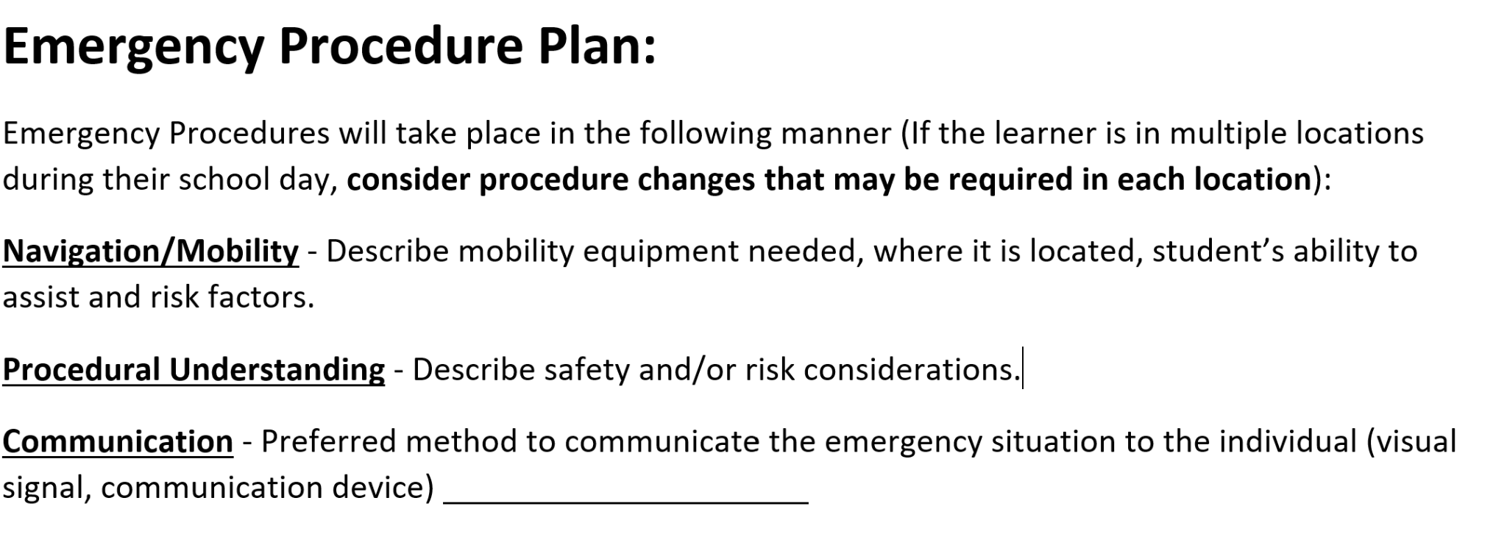
Emergency Procedure Plan
Notes:
The Emergency Plan page is where we dive into that really needs to happen.
Thinking about ALL the buildings the student will be in. What are the contingency plans. What about the cafeteria or play area outside?
Is the student completely reliant on someone to help them – this needs to be noted!
Think about communication with folks outside of the school. Emergency personal – do they know how to bridge the gap with students who have difficulty communicating? Should we look at bringing in these folks for part of the training for working with alternative devices? This can even be extended to people like the bus driver – maybe there are special straps needed and training is necessary?

Slide 25
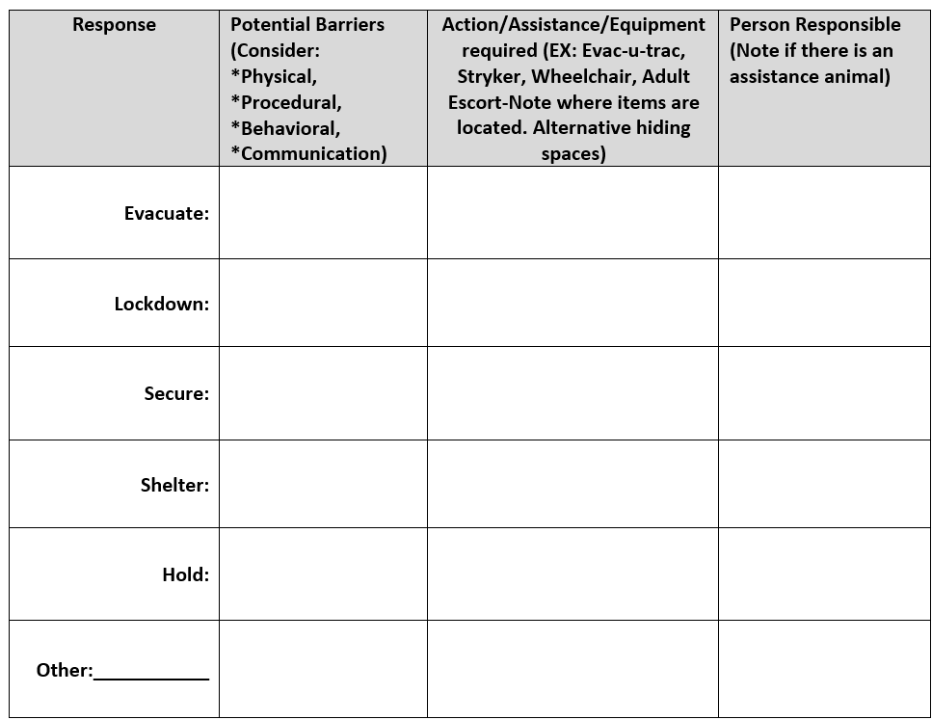
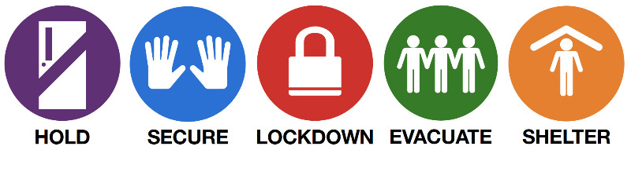

Standard Response Protocol
Notes:
What are the potential barriers, what needs to happen, and who is responsible?

Slide 26

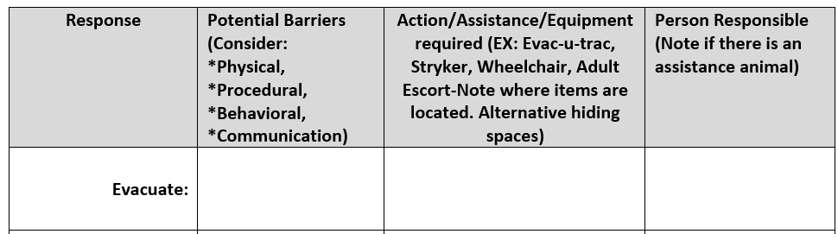
“Evacuate!”
Inside Hazard
The Evacuate protocol, sometimes called a fire drill, and may be followed by a location.
It is used to move people from one location to a different location in or out of the building.
Evacuate! (A location may be specified)

Slide 27

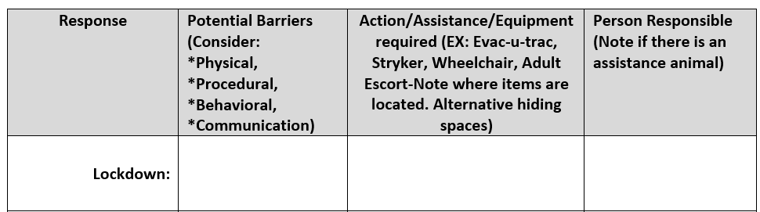
“Lockdown!”
Threat is Inside
Lockdown is followed by "Locks, Lights, Out of Sight" and is the protocol used to secure individual rooms and keep occupants quiet and in place.
Lockdown! Locks, lights, out of sight

Slide 28

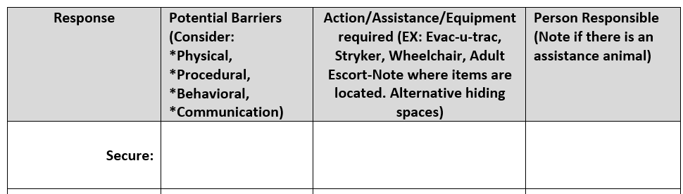
“Secure!”
The Secure protocol—previously called a “lockout”.
Secure is followed by the Directive: "Get Inside. Lock Outside Doors" and is the protocol used to safeguard people within the building.
External Threat or Hazard
Secure! Get inside. Lock outside doors.

Slide 29

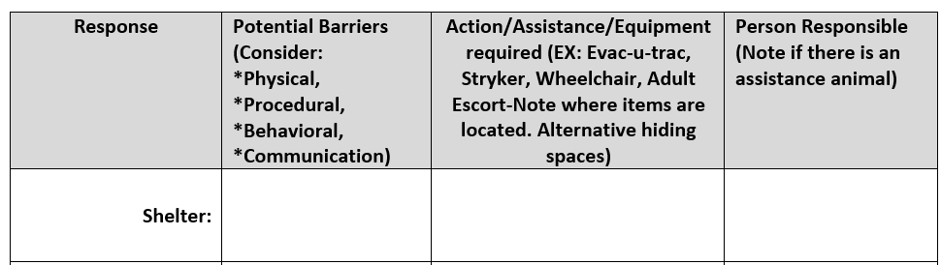
“Shelter!”
Outside Hazard
The Shelter protocol is a common response in an earthquake drill—another required drill.
Shelter: State the Hazard and Safety Strategy for group and self-protection.
Shelter! Hazard and safety strategy.

Slide 30

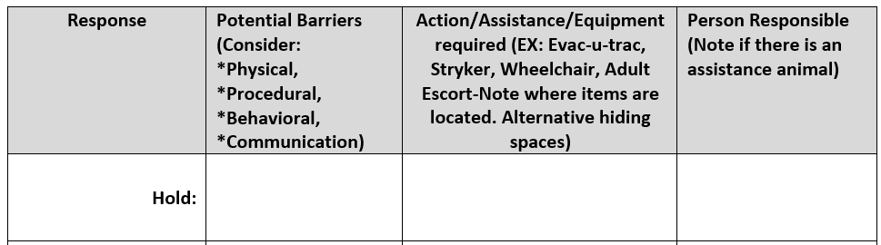
“Hold!”
“Hold!”
Minimize Disruption
Hold is followed by the Directive: "In Your Room or Area" and is the protocol used when hallways need to be kept clear of occupants.
Hold! in your room or area. Clear the halls.

Slide 31
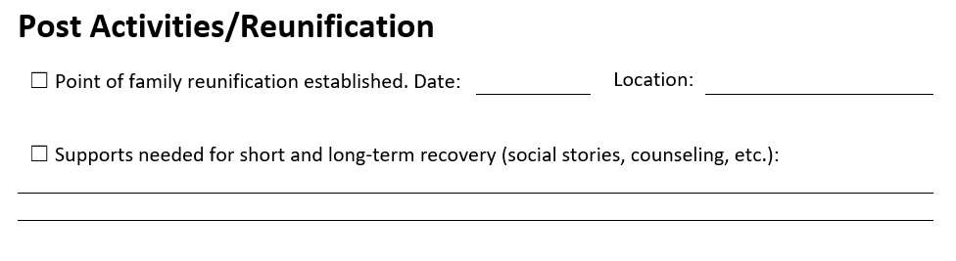
Reunification
Notes:
One piece of the plan that is often not thoroughly thought through. Did you talk to the family about where to meet? When did this conversation happen? What about supports for students with sensory needs?

Slide 32
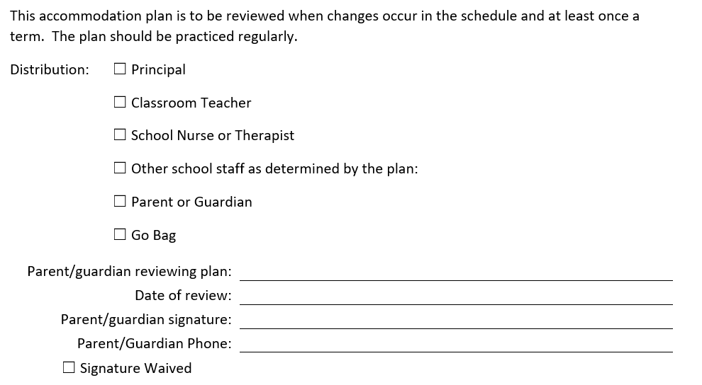
Plan Review
Notes:
The plan is to be reviewed any time there is a change. Not only that the plan itself gets updated but that the right people have a copy of it!

Slide 33
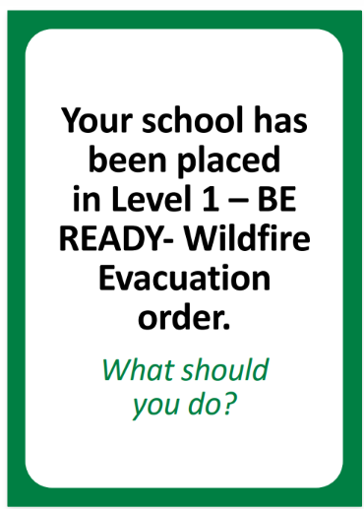
Scenario Discussion #1
Why is a PEAP important for your Access and Functional needs students in a scenario like this?
What would need to be included in their PEAP?

Slide 34
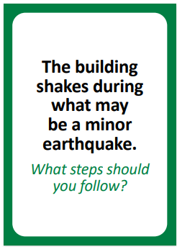
Scenario Discussion #2
Why is a PEAP important for your Access and Functional needs students in a scenario like this?
What would need to be included in their PEAP?

Slide 35
Scenario Discussion #3
Jana is a 1st grader who is an English Language Learner (ELL) and has selective mutism. During a Lockdown drill, she becomes terrified and starts hyperventilating loudly. She cannot follow the verbal 'quiet' commands being whispered by the teacher.
What should be included in Jana's PEAP?

Slide 36
Scenario Discussion – #4
Marcus is a 5th grader with Type 1 Diabetes who uses Continuous Glucose Monitor (CGM) that alerts when his blood sugar is low. During a "Hold in your area", for an emergency in the hallway, the classroom is locked and no one is allowed in or out. Marcus’s monitor starts vibrating—his blood sugar is dropping fast and he is becoming disoriented. His emergency glucose tabs and backup supplies are locked in the Nurse’s Office at the other end of the building.
What should be included in Marcus's PEAP?
What about if this were a lockdown?

Slide 37
Additional Resources
Link to our YouTube video on PEAPs
Link to Access and Functional Needs guidance document.
Link to fillable PEAP
Standard Response Protocol - FREE RESOURCES
OHSU – Health Emergency Ready Oregon Program (HERO)
(FEMA): Responding to the Disabilities and Access and Functional Needs Community Webinar
Americans with Disabilities Act: Laws, Regulations and Standards
Notes:
Grant opportunities to help fund evacuation equipment:
https://oregoncf.org/grants-and-scholarships/grants/community-grant-program
Request an invite for a specific project: https://www.statefarm.com/about-us/corporate-responsibility/community-grants

Slide 38
How We Can Help
Training and technical assistance to Districts, Schools, Charters and Education Service Districts.
Site Safety Assessments.
Threat and Hazard Assessments.
Emergency Operations Plan (EOP) Development.
Table-top exercises.
Connecting districts with other resources—locally and regionally.
Training Opportunities and Webinars.
  Routinely offered twice a month on topical preparedness subjects.
Monthly newsletters and communications with resources.

Slide 39
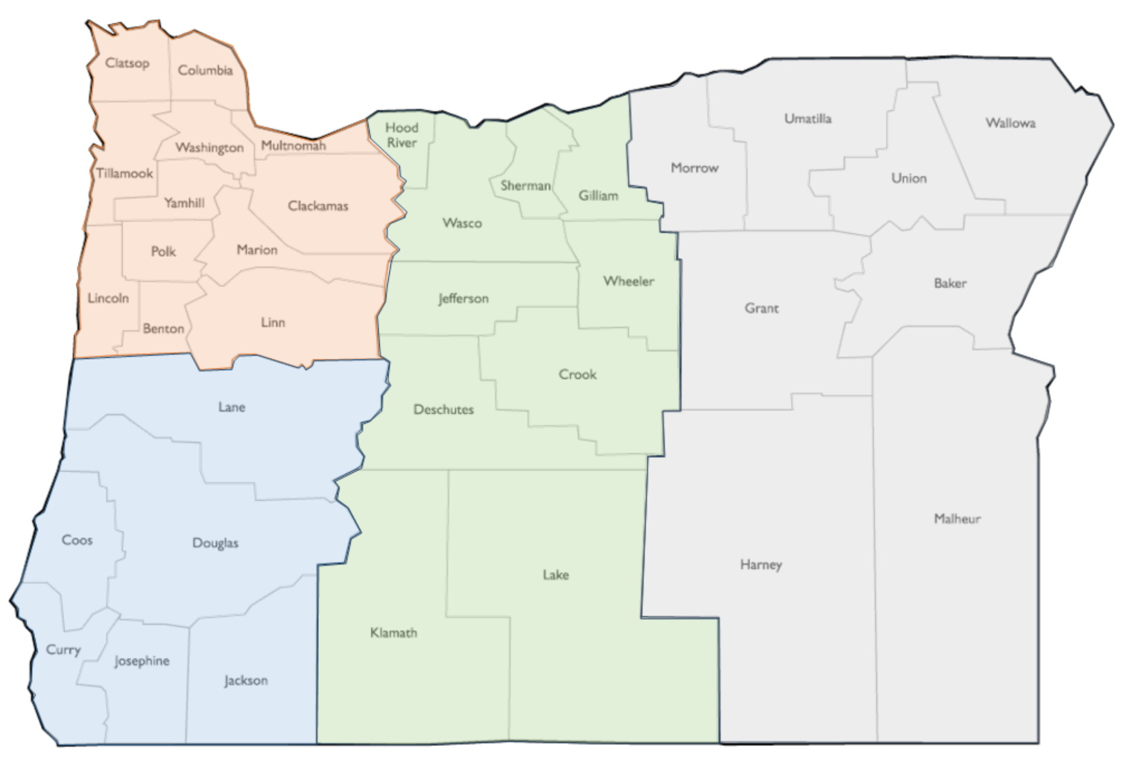


School Safety & Emergency Management (SSEM)
Regional Contact Page:
39
Notes:
Link to regional coordinator contacts page:
https://www.oregon.gov/ode/schools-and-districts/grants/Pages/School-Safety-and-Emergency-Management-Contacts.aspx

Slide 40


We’re Available
School Safety and Emergency Management:
  Provide support to the schools and school districts in Oregon on the development and implementation of high-quality emergency operations plans.
Contact:
  Visit our home page to connect with us and find additional school emergency preparedness resources!
Notes:
Link to SSEM Home Page:
https://www.oregon.gov/ode/schools-and-districts/grants/Pages/School-Safety-and-Emergency-Management-Contacts.aspx

Slide 41
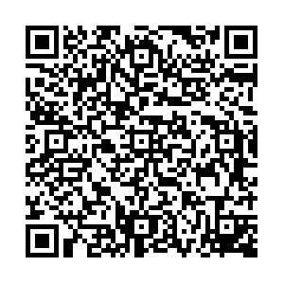
Closing
If disaster strikes tomorrow, are you ready?
Response priorities that protect life, health and safety?
Protocols that prevent or mitigate death or injury?
Scheduled training, exercises and drills?
Please let us know how we did with a link to a survey above.
Notes:
Link to survey:
https://forms.office.com/Pages/DesignPageV2.aspx?prevorigin=shell&origin=NeoPortalPage&subpage=design&id=GBT1tGmyokmTWvpUv1hPyLuHyNzd0jpOjxhLrp29NVtUNU84TEgwQlVRT1FVTzZWNDBSNzlKNERKTyQlQCN0PWcu&topview=Preview

