Slide 1

Emergency Operations Plans for Schools (EOP-101)
Providing training and technical assistance for school EOP development
Presenter info:

Slide 2
Today’s Agenda
What is School Safety and Emergency Management?
What is required?
School Emergency Preparedness Basics.
Emergency Operations Plan Outline:
  Who is involved?
  What are we planning for?
  Who are we planning for?
  Who is responsible?
  How do we do it?
  Standard Response Protocols.
  Incident-specific plans.
For example: thinking through the steps.
How it all fits together: plan maintenance and improvement.

Slide 3

SSEM Mission
Task and Purpose:
Ensure every community has the knowledge to respond to any disaster or other event that threatens the safety of the community and access available resources to aid in mitigation, response and recovery.
We do this in order to maintain a safe and welcoming environment for our schools and the communities they learn in so every person can thrive.

Slide 4
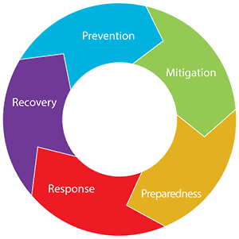
What is School Safety and Emergency Management?
Keeping your school community safe!
What makes a school safe?
You! Your staff, students, families and community supports!
Notes:
Each school day, our nation’s schools are entrusted to provide a safe and healthy learning environment for approximately 55 million elementary and secondary school students in public and nonpublic schools. Families and communities expect schools to keep their children and youths safe from threats (human-caused emergencies such as crime and violence) and hazards (natural disasters, disease outbreaks, and accidents).
Lessons learned from school emergencies highlight the importance of preparing school officials and first responders to implement school emergency operations plans. By having plans in place to keep students and staff safe, schools play a key role in taking preventative and protective measures to stop an emergency from occurring or reduce the impact of an incident.
Schools are not traditional response organizations, but when a school-based emergency occurs, school personnel respond immediately. They provide first aid, notify response partners, and provide instructions before first responders arrive. They also work with their community partners (i.e., governmental organizations) that have a responsibility in the school emergency operations plan to provide a cohesive, coordinated response. Community partners include first responders (law enforcement officers, fire officials, and emergency medical services personnel) as well as public and mental health entities.

Slide 5
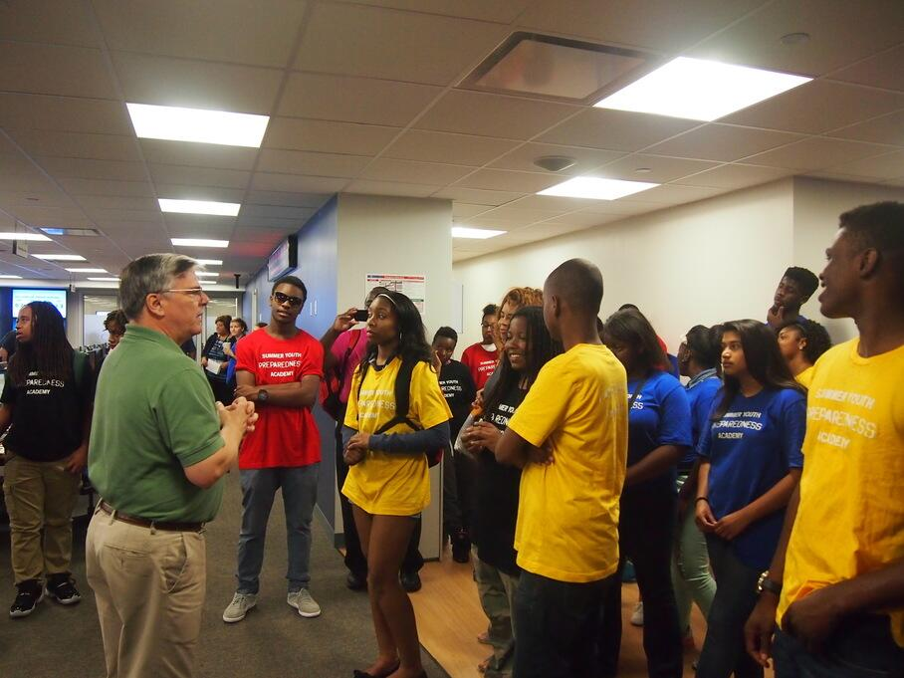
School Requirements
Schools are required to:
Instruct and drill students on emergency procedures (at least 30 minutes per month):
  Fire emergencies (evacuate).
  Earthquakes (2x per year)
  Earthquake/Tsunamis (only in zone; 3x per year)
  Safety threats (2x per year): Lockdown, Lockout (Secure), Shelter and Evacuate.
Exit doors capable of opening from inside without a key.

Slide 6
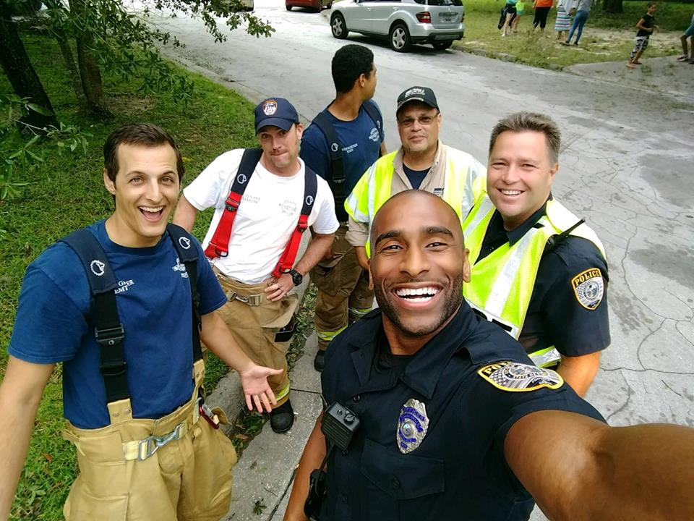
Local Govt. Requirements
Units of local government and state agencies associated with EM shall:
Review emergency procedures proposed by schools.
Assist in instruction and drilling.

Slide 7

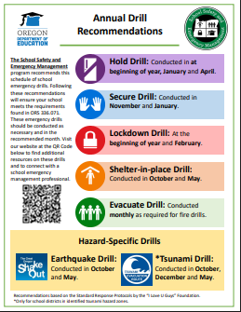
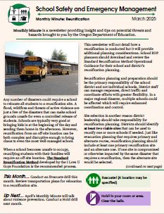
ODE Requirements
The Department of Education shall:
Develop, in consultation with the Oregon Department of Emergency Management, guidance that may be used for the instruction and make the guidance available to school districts; and
Provide, when requested, professional development to teachers and administrators relating to the guidance.

Slide 8
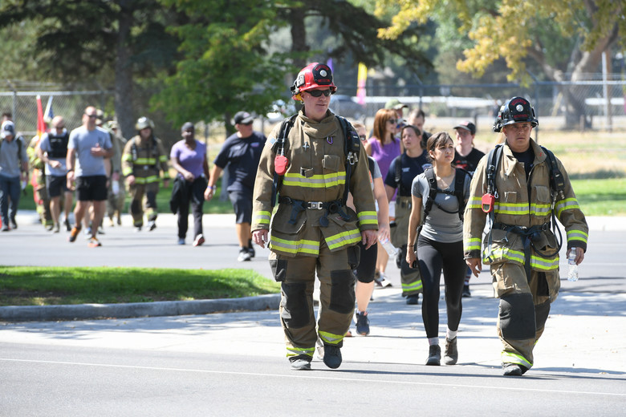
Real-World Requirements
If disaster strikes tomorrow, are you ready?
Establish response priorities that protect life, health and safety.
Establish protocols that prevent or mitigate death or injury.
Practice, exercise and drill.

Slide 9
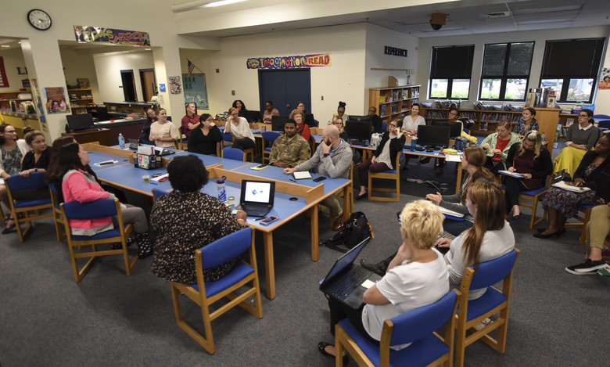
Expectations: a High-Quality School Emergency Operations Plan (EOP)
Schools:
  Provide safe and healthy learning environments.
  Keep students safe from all threats and hazards.
We help schools:
  Identify threats and hazards to plan for.
  Create or improve School Emergency Operations Plans (EOP).
  Exercise those plans.

Slide 10




EOP Workbook
Follow along with the EOP Workbook.
SCAN ME!

Slide 11







Components of an EOP
Incident Command System
Functional Annexes (Emergency Drills)
Community Collaboration
Access and Functional Needs
Assessments for Schools
Incident- Specific
Plans
Notes:
Components that the SSEM program coordinators will look for when engaging districts in Oregon. Guidance documents align with these assessed areas and explain the expectations of each.
Community Collab- Do they have MOU/MOA's in place? Do they know who there EM partners are in the community? Does the Fire Dept. Come to drills and give feedback?
Access & Func. Needs- Are the special ed. Classrooms on the 2nd floor with only elevator access to exit? Do they have paper copies(or access to) medical records for students during a power outage? Do they have flashing lights on their alarms to include students who are deaf?
ICS – Do they use an ICS Structure during an emergency? Do they know what it is? Is there span of control, really in control?
Threat & Hazard Assessments – Site safety assessments: Are there staff members trained in CPR/AED? Are all of there fire alarms still working? How do schools signal people on the outside, NOT to come in? Does the front office have a line of site to the parking lot?
Functional Annexes – Do they use the Standard Response Protocol? If not, do they understand the benefits of using it? What areas may they be forgetting to think about?
Threat & Hazard Specific – Are all regional specific threat/hazards being taken into account? Do they drill/train on them?

Slide 12
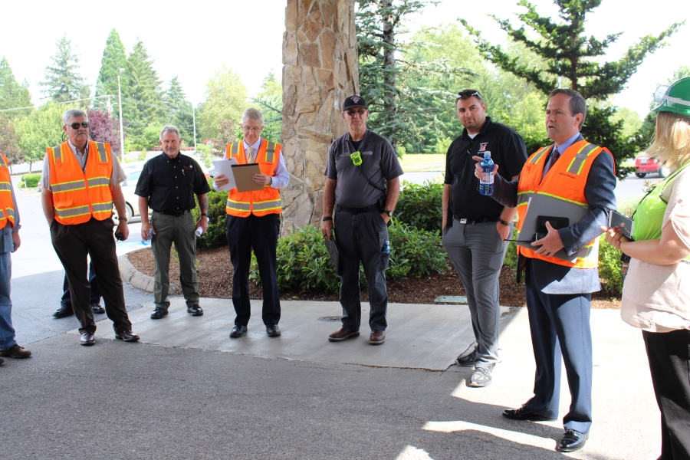
Who is Involved?
Who are you bringing to the table?
Schools own the students, police own the crime, fire owns the fire/medical.
Notes:
So the key to all of this is about building partnerships. As emergency managers what do schools bring to the table to help you out and how can you help schools out. Do we all need to drive around at 4:00 in the morning seeing what roads are closed? But you don’t just connect two pieces of the puzzle together and see the whole picture.

Slide 13


Community Collaboration
The Oregon Department of Education recommends strong community collaboration!
Guidance covers:
Planning team: whole community approach.
Collaboration on drills and exercises: plan together and act together!
Introductory guidance document because this capacity supports all others.
QR Code for the Community Collaboration Guidance document.
Notes:
Planning team
-Internal Partners: Facilities manager, nurse, transportation, counselors, teachers, etc.
-Community Partners: Emergency responders, red cross, religious institutions, CERTs, county fair grounds, parks or rec centers, etc.
Drill collaboration
TEMPLATE for introduction

Slide 14
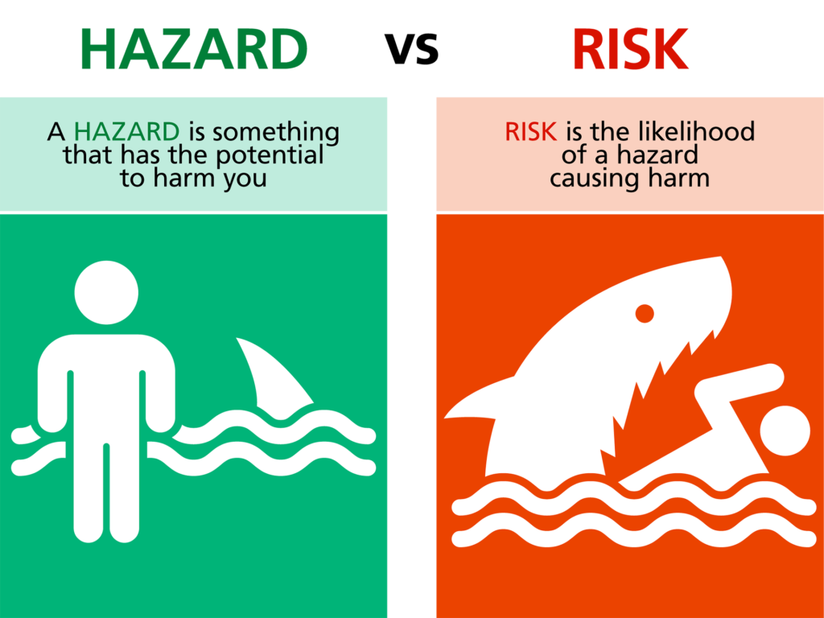
What are We Planning For?
Know your specific threats and hazards based on your environment and location:
What are the threats and hazards specific to you?
Know the risks and vulnerabilities you need to mitigate and plan for.

Slide 15





Threat and Hazard Assessments
What do we need to prepare for?
What level of capability do we need to be prepared?
What are our current capabilities?
What gaps exist between what we need and what we have?
How can we address our capability gaps?
Notes:
So the key to all of this is about building partnerships. As emergency managers what do schools bring to the table to help you out and how can you help schools out. Do we all need to drive around at 4:00 in the morning seeing what roads are closed? But you don’t just connect two pieces of the puzzle together and see the whole picture.

Slide 16

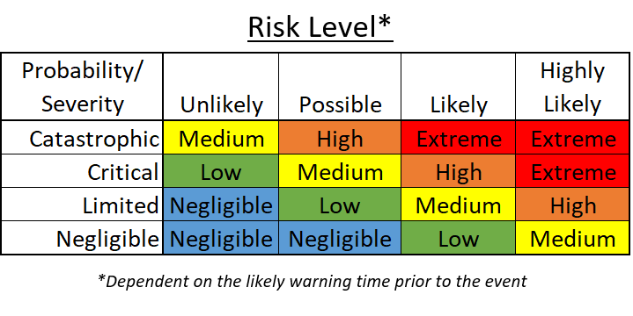
Assessments
Identify known threats and hazards.
Contact your local or county emergency manager to learn about common threats and hazards.
Conduct a risk assessment of identified risks and hazards.
High-risk incidents that are local but not included in recommended guidance should be included in your plan!
Notes:
Refer to the workbook table.

Slide 17

Who are We Planning For?
Have you identified students or staff in your school who may need additional help during an emergency?
Notes:
PEAP

Slide 18
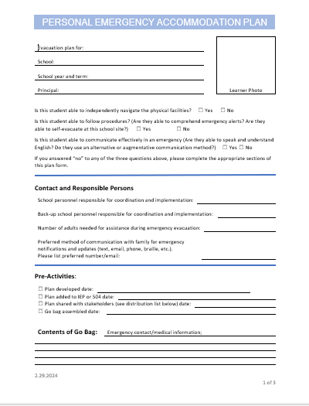

Personal Emergency Accommodation Plans (PEAPs)
PEAPs provide a quick-reference checklist of individualized needs during all response types.
These can be updated and incorporated in the 504 or IEP process.
Notes:
PEAP

Slide 19
Traditional ICS Structure
Who is in charge of what?
Incident Commander is in charge of the overall response.
Command staff includes the Public Information Officer, the Safety Officer and the Liaison Officer.
Operations conducts the response.
Planning plans the response.
Logistics supports the response.
Finance/admin tracks the response.
Incident Commander
PIO
Safety
Liaison
Operations
Planning
Logistics
Finance/ Admin
The Incident Command System helps organize emergency response to complex incidents.
Notes:
Keep in mind that this is adaptable and flexible.

Slide 20

ICS: Key Concepts for Schools
Common Terminology
Use plain English and avoid jargon.
Unity of Command
Each person should only report to one supervisor to avoid confusion.
Span of Control
A concept that describes the appropriate ratio of people supervised per supervisor. Between 1:3 and 1:7.
Unified Command
When multiple organizations work together with independent commands, they should work together to avoid conflicts of command.
Notes:
There are a number of key concepts that are embedded into the Incident Command System. These four are particularly important for schools and should be considered at every stage of the process: before, during and after an incident.

Slide 21
Who is Responsible? School-Based ICS
Identify Necessary Roles
Primary responsibility for the school or district response.
Communication with staff, students and families.
Transportation to a safe location.
Reunification following a disruptive event.
Accountability for students and staff.
Superintendent
Communication
Transportation
Reunification
Elem. Principal
Mid. Principal
HS Principal

Slide 22
Who is Responsible?
Identify Necessary Roles
Roles should be identified by position first and then name.
Identify backups for roles to ensure coverage during an absence.
Third-level backups should be identified, when available.
ICS Role | Who? (Job Title and Name) | Backup?
Incident Commander
Communication Manager
Transportation Manager
Reunification Manager

Slide 23
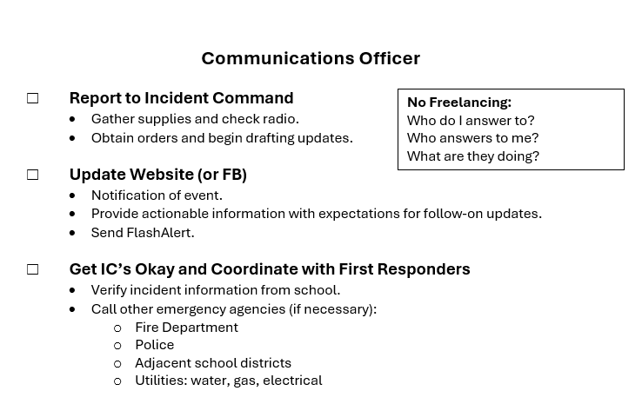
What Are They Responsible For?
Checklists – Consider listing necessary actions for key roles.
What is each role responsible for before, during and after an emergency?
What are common steps that should be taken for that role?
Ensure necessary actions adhere to ICS fundamentals.

Slide 24
Communication
Building the communication checklist:
  Well informed students, staff and families can better navigate a crisis.
Communicate early and communicate often:
  During a crisis, keep communication simple and to the point for ease of following direction.
Consider:
  What messages and modes of communication are necessary inside the building?
  What messages and modes of communication are necessary for school community members outside the building?
  What is the approval process during a complex disaster (who needs to sign-off)?
Do you have templates drafted and ready?
Notes:
How and to whom do you need to quickly and effectively communicate with. Communicate within building – radios, intercom, desktop notifications, bells and strobes, wireless panic alarm. What about outside agencies? How do they communicate with you?
Communicating within district to families– Flash alert, push notifications, PIO, Do you have messages ready to go? Are they translated? Are you consistently using these platforms to communicate with your families already? Are they automatically signed up during registration? Is emergency contact info updated?

Slide 25
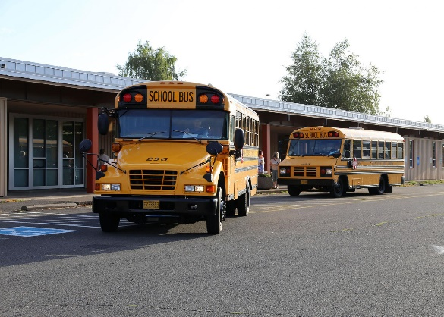
Transportation
Building the transportation checklist:
  Transportation is necessary daily.
  Transportation managers need to be able to respond to contingencies.
Consider:
  How are they contacted off hours?
  How do they re-route deployed buses?
  How do they re-call buses in an emergency?
  How do they maintain awareness of route conditions?
Do you have key locations and staging areas identified?

Slide 26

Reunification
Building the reunification checklist:
Reunification can be on-site, nearby or at a remote location (dependent on level of disruption).
Primary and alternate reunification sites should be identified with agreements in place.
Consider:
  What is the determining factor for on-site vs. off-site reunification—and who makes that call?
  Who is responsible for securing the off-site location?
Do you have reunification roles identified?

Slide 27
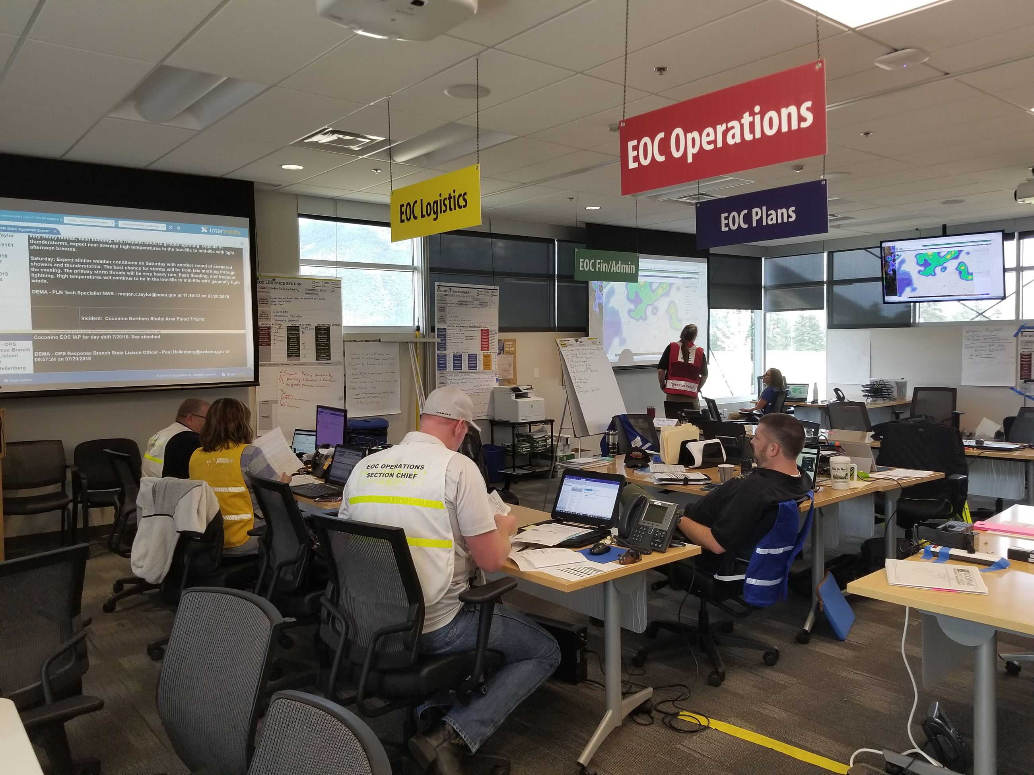
Supporting Roles
Building the checklists for supporting roles:
Focus on the necessary tasks that support the goals and objectives of the response.
Roles should be assigned based on position with a clear identification of who reports to that role and who that role reports to.
Consider:
  Accountability: front office staff for the initiation of the alarm/alert and tracking whole-school accountability.
  Security: SRO to check on security of outer doors and response to criminal activity.
What other supporting roles may be necessary in your school or district?

Slide 28
Table Talk
Small Group Collaboration Time
Who does what? Is there a backup person (who knows they’re the backup?)
What is a real-life incident that your school has experienced that could have turned out better with more planning?
What are a few threats and hazards that you need to have a plan for?
Who is your communications lead? What’s your go-to method for pushing out notifications?

Slide 29


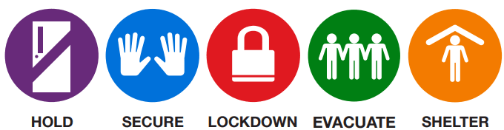
How Do We Do It?
Common Terminology Explained
Guidance covers:
Explains the what and why of:
  Functional annexes of an Emergency Operations Plan (EOP).
  The Standard Response Protocol (SRP).
  Required drills and their frequency.
QR Code for the Functional Annexes and Emergency Drills Guidance document.
Notes:
Guidance document on functional annexes and emergency drills.

Slide 30
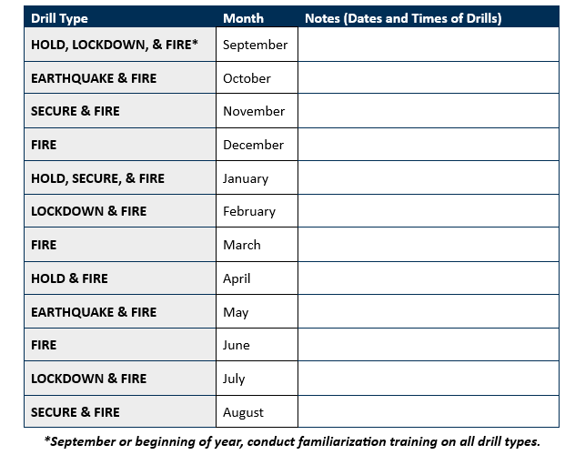
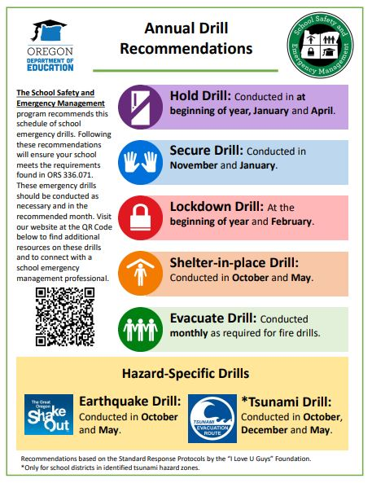
Drill Calendar
Emergency Drill Recommendations:
Not always announced.
Mix it up.
Communicate with parents.
Seek feedback from staff.
Practical practice.
After Action Report (AAR): review the action and schedule improvement.

Slide 31
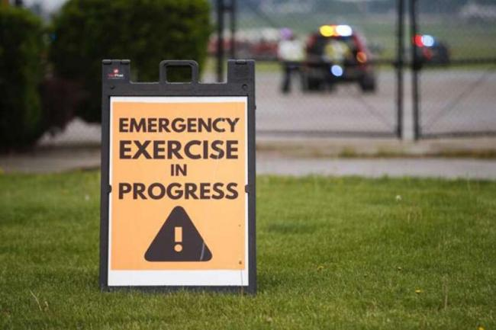
Improve Through Repetition!
Following every incident or drill, conduct an AAR:
What happened
What was supposed to happen?
What did happen?
Why?
What practices should be sustained?
What practices should be improved?
Who is responsible for implementing the improvements and when?

Slide 32

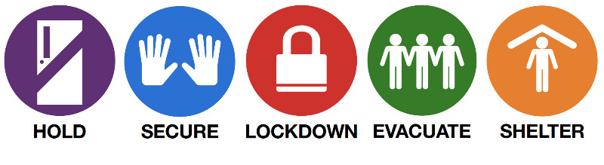
Standard Response Protocol
Notes:
The Standard Response Protocol includes actions necessary for the safe and effective response to any emergency.

Slide 33

“Hold!”
“Hold!”
Hold! in your room or area. Clear the halls.
Minimize Disruption
The Hold protocol is not required but is recommended.
Hold is followed by the Directive: "In Your Room or Area" and is the protocol used when hallways need to be kept clear of occupants.

Slide 34

“Secure!”
Secure! Get inside. Lock outside doors.
External Threat or Hazard
The Secure protocol—previously called a “lockout”—is required.
Secure is followed by the Directive: "Get Inside. Lock Outside Doors" and is the protocol used to safeguard people within the building.

Slide 35

“Lockdown!”
Lockdown! Locks, lights, out of sight
Threat is Inside
The Lockdown protocol is required.
Lockdown is followed by "Locks, Lights, Out of Sight" and is the protocol used to secure individual rooms and keep occupants quiet and in place.

Slide 36

“Evacuate!”
Evacuate! (A location may be specified)
Inside Hazard
The Evacuate protocol, sometimes called a fire drill, is required.
Evacuate and may be followed by a location and is used to move people from one location to a different location in or out of the building.

Slide 37

“Shelter!”
Shelter! Hazard and safety strategy.
Outside Hazard
The Shelter protocol is required. A common Shelter response is an earthquake drill—another required drill.
Shelter: State the Hazard and Safety Strategy for group and self protection.

Slide 38
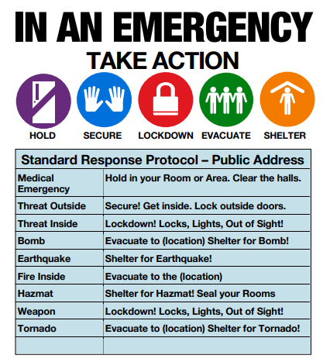
Standard Response Protocol
Putting it all together:
“What do you do if…” game:
  Medical emergency?
  Threat outside?
  Threat inside?
  Bomb threat?
  Earthquake?
  Wildfire?

Slide 39
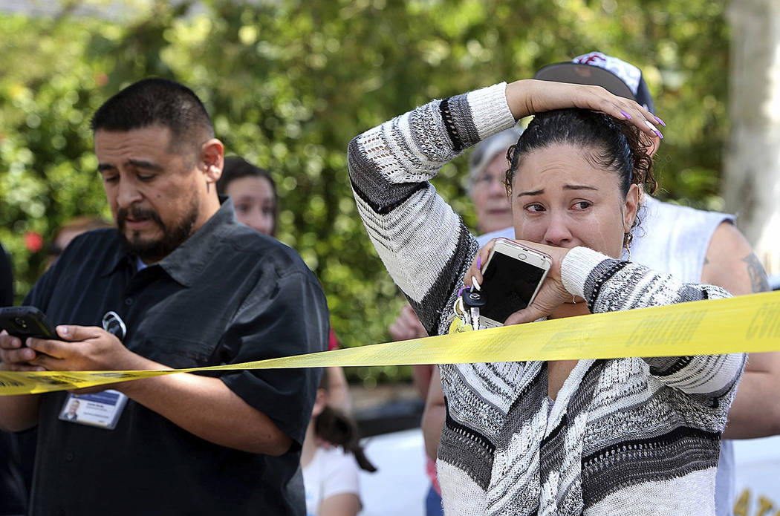

Reunification
Implement what works (SRM).
Train it.
Communicate it.
Collaborate.
Notes:
In loco parenthis- door to door. We do this everyday. Get kids back to their parents. Student records- flood gates.

Slide 40
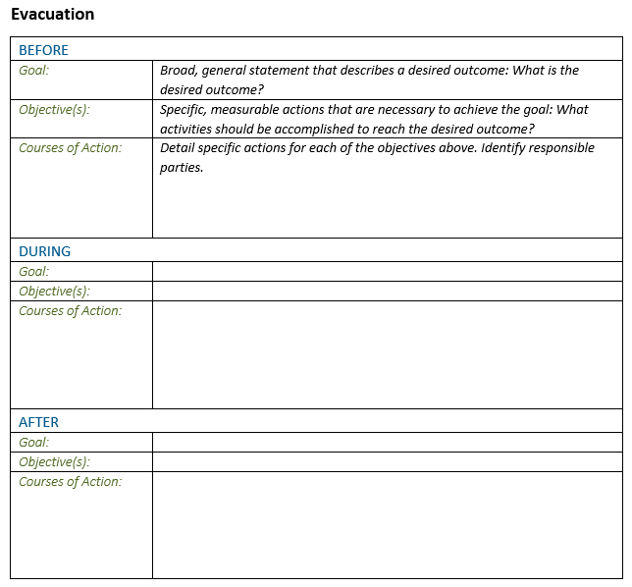
Filling out the Annexes
Each annex should address required actions taken before, during and after an incident.
Before: what we do to make ready with drills and staging.
During: what steps are needed to complete the action or protocol?
After: how do we return the school to normal operation and learn from the action for improved response?

Slide 41
Goals, Objectives and Courses of Action
Be specific with language here. These pages may be referenced during a real emergency and should not be overly cumbersome to navigate.
Goal(s): A broad general statement.
  “Complete a safe evacuation of the facility.”
Objective(s): Specific, measurable actions.
  “Initiate and complete a school-wide response.”
  “Maintain accountability.”
Courses of Action: Specific actions for the objective(s).
  “Front office staff will initiate the alarm from the alarm panel.”
What specific actions would support this objective?

Slide 42
Table Talk (Courses of Action)
Evacuation Procedures
  Primary and secondary routes:
  Assembly points:
  Off-Site Reunification locations:
Hold (in classroom or place) Procedures
  Steps to follow:
  Communication protocols:
Shelter-in-Place Procedures
  Designated locations:
5. Secure (Lockout) Procedures
  Signal for initiating lockdown:
  Communication method:
  After-Action communication plan to parents/guardians:
6. Lockdown Procedures
  Signal for initiating lockdown:
  Communication method:
  After-Action communication plan to parents/guardians:

Slide 43

Incident-Specific Plans
Incident-specific plans will incorporate one, or all of the previously developed functional annexes. The following are recommended for all Oregon schools:
Earthquake (required)
Wildfire
Active Shooter
Bomb-Threat
Cybersecurity
Schools in a tsunami-inundation zone are required to plan and drill for tsunamis. Schools in locations susceptible to landslides or floods should include plans for those hazards.

Slide 44
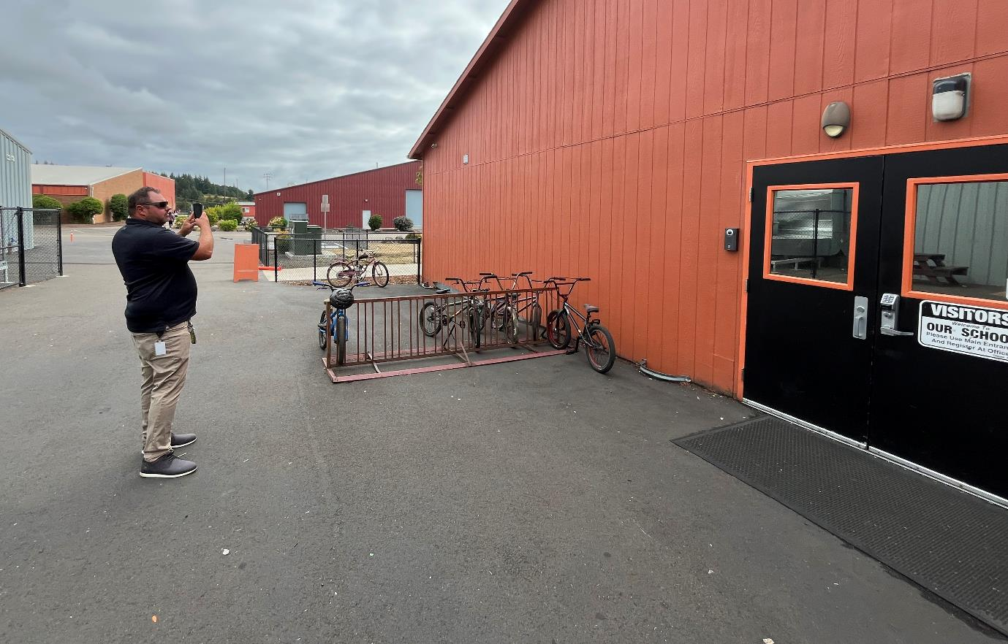
Stranger on Campus (School-Level)
A teacher notices an unfamiliar adult walking around school grounds. The individual looks suspicious, is peering into windows with sunglasses on during an overcast day.
What other environmental conditions or factors could increase the threat level of this scenario?
Which conditions could decrease the threat level of this scenario?

Slide 45
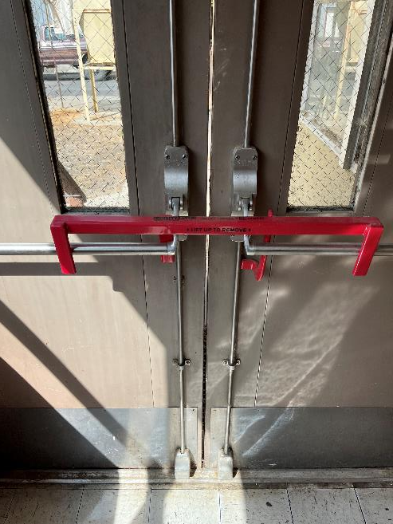
First Actions
Assuming the identified person is a reliable or reasonable threat, what should the school do first?
Hint: see below.
Secure! Get inside. Lock outside doors.
*Illustrative purposes only.
Notes:
Why do we call the response first? What does a well trained and coordinated response (drill) do for us?

Slide 46

Setting Conditions for Safety
The Standard Response Protocol helps set the conditions for the rest of the response.
Schools do not put out the fires or arrest the bad guy. But they can set the conditions that will keep students safe while responders respond.
Notes:
If we were dressing a wound or helping someone who is injured, we would first render first aid and then call 911. This is because some injuries could be made worse if we delay first aid. Same kind of principles apply for school emergency response: respond to the situation and then immediately call for assistance.

Slide 47

Call for Help
The longer we wait to call for help, the longer help will take to get to us.
Respond
Call for help
Continue response.
Notes:
Every minute spent waiting to call for help is another minute that could leave someone without lifesaving care or a minute wasted that could have prevented an escalated event.

Slide 48
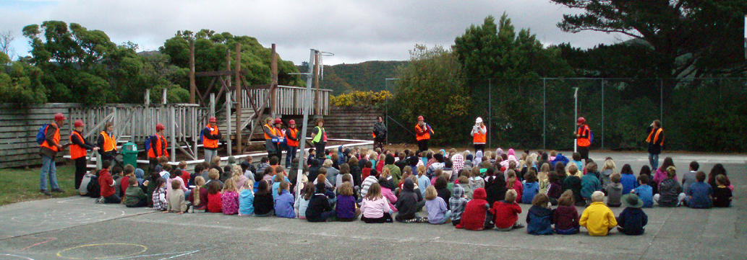
Who else needs to know?
When the conditions are set and help is on the way, then we start the notification process. Contact:
District leadership for accountability and to assist with:
  Communication.
  Coordination with responders.
  Transportation and reunification.
Parents and guardians:
  For awareness and to know what to do and where to go.
Notes:
Another decision point where we must prioritize our actions and communication. Who needs to know first and what do we need to prioritize?

Slide 49

Communications
Be honest and forthright with your school community.
Timely and honest communication will reduce confusion and build trust within your community.
Review and practice plans before they are needed.
Notes:
https://www.oregon.gov/ode/schools-and-districts/grants/Documents/Office%20of%20School%20Facilities/SSEM/Training/Communications_Annex_(Example_Template).docx
https://www.oregon.gov/ode/schools-and-districts/grants/Documents/Office%20of%20School%20Facilities/SSEM/Training/Emergency%20Communication%20Plan%20HB3584.pdf

Slide 50
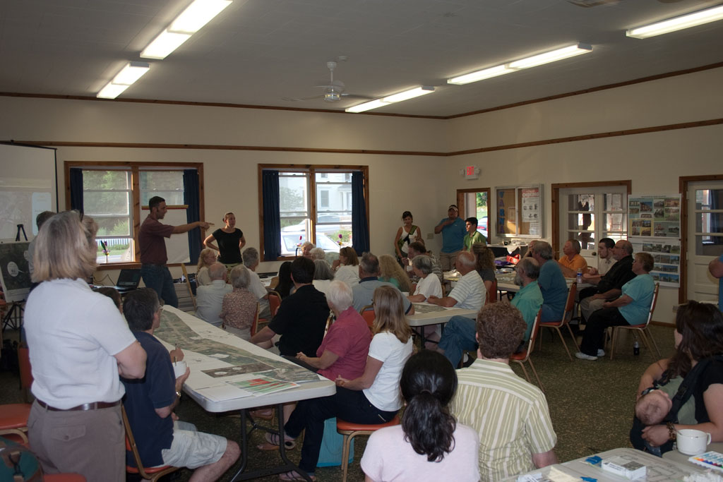
Continue Response
Take accountability as feasible.
Assess and take necessary action to maintain safety of students and staff.
What comes next?
  Evacuation.
  Relocation and reunification.
Notes:
Follow procedures but expect to be thrown curveballs that will necessarily make you consider alternative actions.

Slide 51
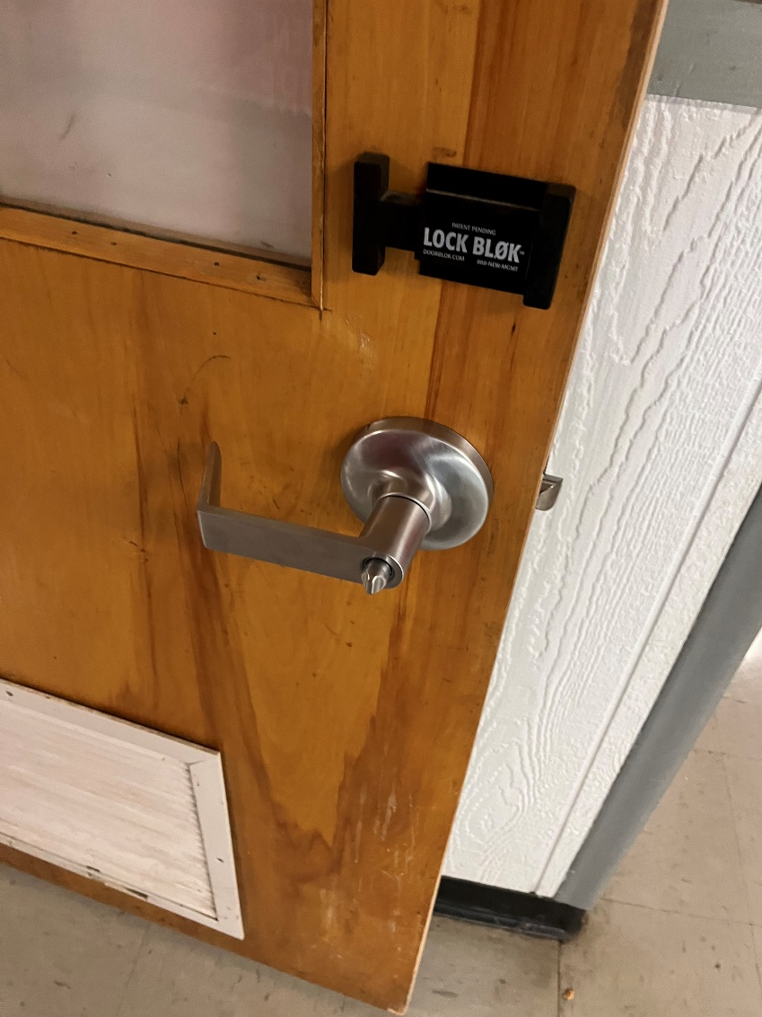
When things escalate…
That suspicious person peering in windows found an unlocked external door and made their way into the building. What do we do now?
Hint: see below.
Lockdown! Locks, lights, out of sight
Notes:
Why do we call the response first? What does a well trained and coordinated response (drill) do for us?

Slide 52
Continue Response
Response can occur consecutively…
Secure
Lockdown
…or concurrently
Evacuation
Accounting for Students, Staff, and Visitors
Notes:
While these functions should be described separately, it is important to remember that many functions will occur consecutively. For example, a shelter-in-place during an emergency may be implemented, but if a building is damaged, the school may then initiate an evacuation of that building.
Often, multiple functions will also be performed concurrently. For example, during an evacuation, once all individuals are safely out of the building, the accounting for students, staff, and visitors function will begin. The evacuation function, however, will still be in effect as school personnel or first responders work to locate and evacuate any persons that are not accounted.
While functions build upon one another and overlap, it is not necessary to repeat a course of action in one functional annex if it appears in a second Functional Annex. For example, though an evacuation may lead to reunification, it is not necessary to list a course of action for reunification within the Evacuation Annex.

Slide 53

When things de-escalate…
The suspicious person has left school grounds or maybe the police spoke with and cleared the individual. How do we respond?
Communication is key for de-escalation!
Lift the secure and return to normal operations.
Notes:
Let parents and guardians know as soon as possible what has happened and why. Especially if they were initially notified of a secure or lockdown. Letting them know everyone is safe—and why—will increase the trust between administration and the school community.

Slide 54
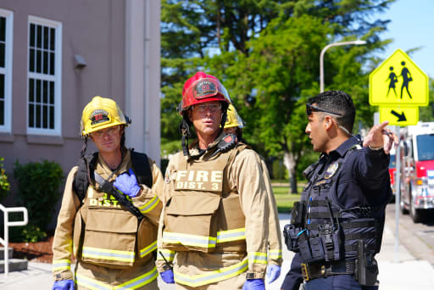
Safety First
The purpose is to keep a safety focus that:
  Involves the entire community.
  Includes ALL members of the school:
    Accounting for and accommodating disabled students and staff.
    Accounting for and accommodating people with other access and functional needs.
Notes:
Once a plan is written, it can be reviewed based on the following criteria to determine the extent of its quality.
Is the plan…adequate? A plan is adequate if it identifies and addresses critical courses of action effectively, it can accomplish the assigned function, and its assumptions are valid and reasonable.
Is the plan…feasible? A plan is feasible if the school can accomplish the assigned function and critical tasks by using available resources within the time contemplated by the plan.
Is the plan…acceptable? A plan is acceptable if it meets the requirements driven by a threat or hazard, meets cost and time limitations, and is consistent with the law.
Is the plan…complete? A plan is complete if it:
Incorporates all courses of action to be accomplished for all selected threats and hazards and identified functions.
Integrates the needs of the whole school community.
Provides a complete picture of what should happen, when, and at whose direction.
Estimates time for achieving objectives, with safety remaining as the utmost priority.
Identifies success criteria and a desired end state.
Conforms with the planning principles outlined in this guide.
Does the plan…comply? A plan must comply with applicable state and local requirements because these provide a baseline that facilitates both planning and execution.

Slide 55
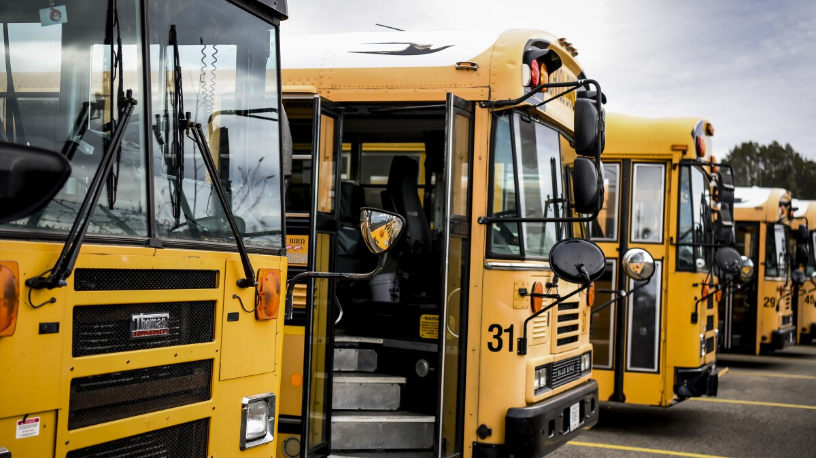
District-Level Response Priorities
In the above scenario, how is the district staff activated for response?
Is the communication manager monitoring the situation and preparing messaging?
Is the transportation manager notified?

Slide 56
Review
Announce the necessary Standard Response Protocol (hold, secure, lockdown, evacuate, or shelter).
Call 911.
Continue the necessary response and notify the district office of the event.
Take accountability of all students and staff.
Decide on further action necessary to maintain the safety of the school.
Follow the district communications plan and notify parents and guardians on what is happening and what they should do.
Notes:
Having a simple checklist like this in the front office can help guide a new or anxious staff member through a response.

Slide 57
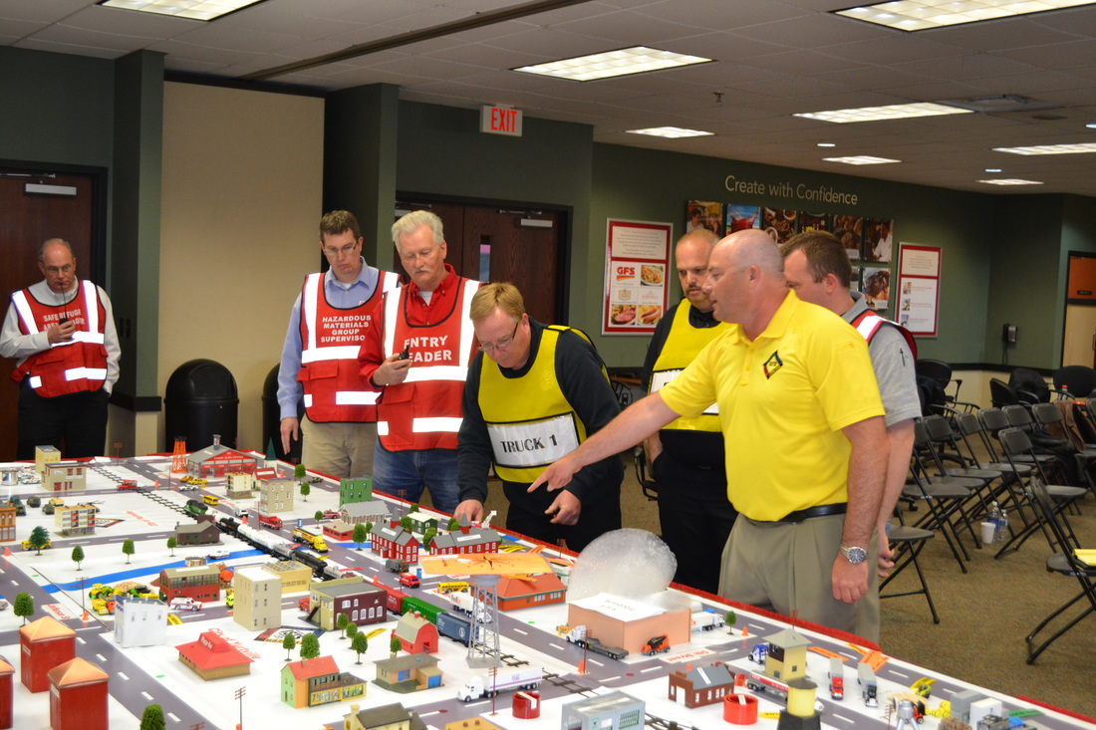
Table-Top Exercises
Work with your school’s leadership on Table-Top Exercises.
Complete plans require all participants to develop familiarity.
Use these to instill confidence in school leadership—keep an open mind.
Revisit past events that are familiar or frequent.
Be deliberate about implementing improvements following a drill or exercise!
Notes:
Scenario based exercises.

Slide 58

Wrap-Up
What’s next?
  Create your planning team.
  Make your plan.
  Teach your plan.
  Exercise your plan.
  Review and adjust your plan.

Slide 59
How We Can Help
Training and technical assistance to Districts, Schools, Charters and Education Service Districts.
Site Safety Assessments.
Threat and Hazard Assessments.
Emergency Operations Plan (EOP) Development.
Table-top exercises.
Connecting districts with other resources—locally and regionally.
Training Opportunities and Webinars.
  Routinely offered twice a month on topical preparedness subjects.
Monthly newsletters and communications with resources.
Notes:
Drop link in chat to sign up for monthly newsletter

Slide 60
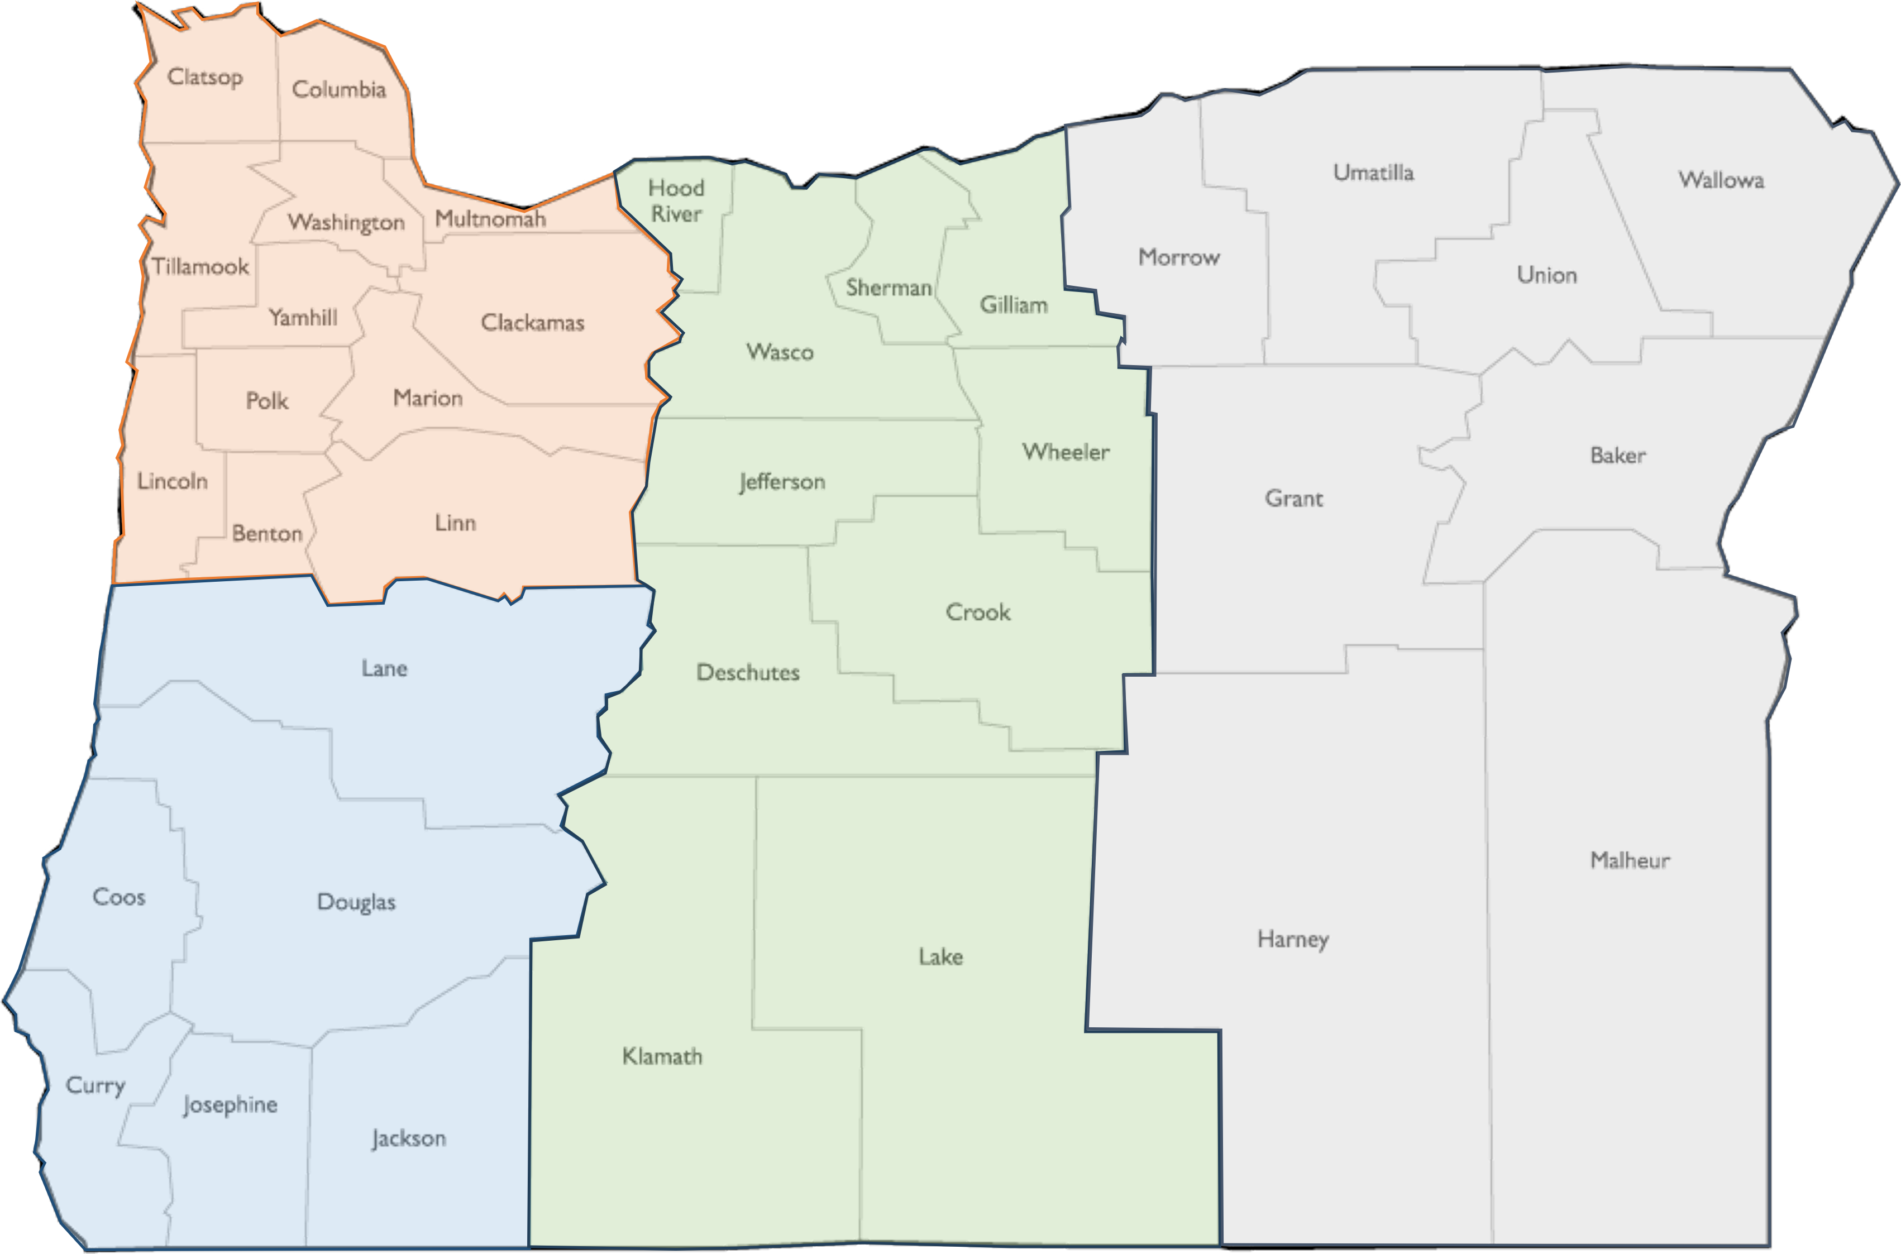

SSEM Regional Coordinator Map:
Regional Contact Page:
Notes:
Regions established to align with OEM’s mitigation and recovery coordinators—with minor changes. Coordinators live in and work in the regions they are assigned so they have some familiarity with regional threats and hazards and culture.
Drop link in chat for contact page

