Slide 1

Site Assessments
Alex Haislip - Mitch Sechler
School Safety and Emergency Management

Slide 2



Training Goals
Explore what site assessments are and how they can help YOU with overall preparedness.
Review the site assessment checklist.
Equip YOU and your site assessment team with information that can be used in your kickoff meeting.
Notes:
The goal of this training is to
Help K-12 schools and school districts develop a greater understanding of site assessments;
Introduce the site assessment checklist.
Support site assessment teams with their kickoff meetings.

Slide 3



What is a Site Assessment?
Examines the safety, security, accessibility, and emergency preparedness of buildings and grounds.
Notes:
Assessments help the planning team to gather data and customize the EOP to a school's specific circumstances and location. Site assessments are just one type of assessment that the planning team may use; other assessments include culture and climate assessments, behavioral threat assessments, and capacity assessments. Site assessments are part of a comprehensive, ongoing assessment process to support the development and revision of the EOP. This ongoing assessment process includes other assessment types, such as culture and climate assessments, behavioral threat assessments, and capacity assessments.
A site assessment examines the safety, security, accessibility, and emergency preparedness of the school buildings and grounds. They are vehicles for the continual collection of information, may be conducted while walking around school grounds and facilities, and are a part of ongoing assessments at an education agency. Site assessments should be conducted on at least an annual basis due to facility, personnel, and hazard/threat changes, although they may be completed at different times.
​
The purpose and results of a site assessment include ​
An increased understanding of risks and vulnerabilities of the school buildings and grounds when developing a customized EOP; ​
An increased understanding of the potential impact of threats and hazards on the school buildings and grounds; and ​
Knowledge of which facilities are physically accessible to students, staff, teachers, administrators, parents, volunteers, visitors, emergency response personnel, and individuals with disabilities and access and functional needs. ​
​
The information generated from site assessments may provide critical information about threats and hazards in a school’s community. School planning teams should share sections of the assessment with first responders in their community. Information from the assessment will be used by school planning teams as they develop their school EOP. ​

Slide 4
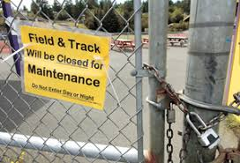

Why Conduct a Site Assessment?
Risks and Vulnerabilities​
Impact of Hazards and Threats
Accessibility​
Gaps and Areas of Improvement​
Notes:
School buildings and grounds provide a physical environment for teaching and learning. A safe school environment is crucial to the healthy academic and social development of students. The safety, security, accessibility, and emergency preparedness of the school buildings and grounds are a critical component of a safe school environment — not just for students, but for administrators, teachers, staff, families, and visitors, too.
Site assessments will prompt you to look at your school site through the lens of school safety, security, accessibility, and emergency preparedness. By participating in this training, you are illustrating your dedication to school safety.
Site assessments identify risks and vulnerabilities of buildings and grounds, bring attention to potential impacts of hazards and threats on the buildings and grounds, identify gaps and areas of improvement, and find which facilities are physically accessible to the whole school community. This information is critical so that planning teams can prepare for emergencies. Furthermore, site assessments highlight gaps/areas of improvement in the safety of your campus.
Information from site assessments will be used by school planning teams as they develop their school EOP, which should include a comprehensive list of possible threats and hazards, as recommended in Step 2 of the federally recommended planning process for developing an EOP. Site assessment data will not only illuminate the potential threats and hazards that a school may face, but will also aid planning teams in evaluating and comparing the risks and vulnerabilities associated with each threat or hazard. In turn, the school planning team will be able to prioritize threats and hazards to address directly in the school EOP and enhance the school’s overall safety and emergency preparedness.
Many school facilities are older and have deferred maintenance projects. Some schools have portable buildings, which can create a new set of access control and security challenges for school officials. A site assessment is important because it is necessary for school officials to prioritize enhancements and projects related to safety and security; a site assessment is a good method to document and share a list of priorities when funds are available or projects are approved.
[Prompt for kickoff meetings: Who has conducted a site assessment before?]

Slide 5
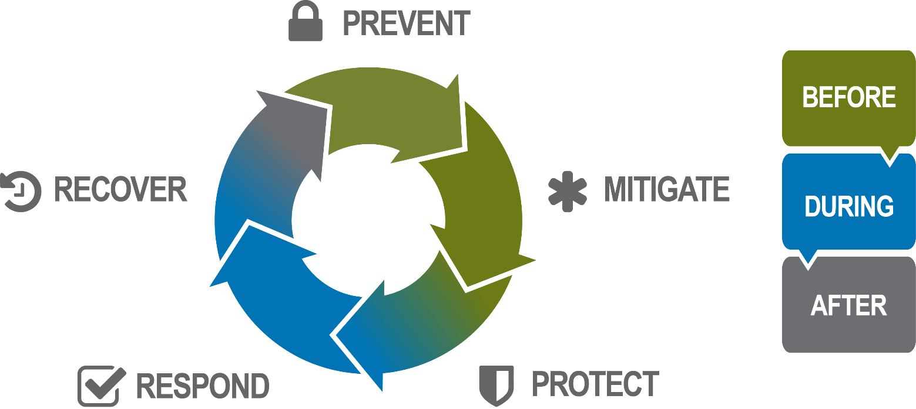
A Component of School Safety
Notes:
Education agencies can use the Site Assessment Checklist them to create new plans, as well as to revise and update existing plans, and align their emergency planning practices with those at the national, state, and local levels. Site assessments are included as an important emergency management planning activity.
National Preparedness System, which describes an organized, whole-community approach to national preparedness activities. The National Preparedness Goal, at the heart of this approach, outlines how the whole community can prepare for all types of threats and hazards, including earthquakes. The National Preparedness System highlights five mission areas — prevention, mitigation, protection, response, and recovery — to help achieve elements of the goal. ​School safety, security, emergency management, and preparedness work to continually build capacity in each of the five preparedness missions, using the paradigm Before, During, and After. For example, we want to identify protection activities that can be carried out before, during, and after a possible emergency.​
Prevention is defined as the action schools and school districts take to prevent a threatened or actual incident from occurring. Later in this section, this training will discuss Crime Prevention Through Environmental Design and its relation to site assessments.
Protection is the ongoing actions schools and school districts take to safeguard the school, students, and staff from an emergency event. School buildings and grounds can be used to provide protection to the school community.
Mitigation focuses on actions schools and school districts take to eliminate or reduce the loss of life, injuries, and property damage from an emergency event.
Response is putting the school’s and school district’s plans into place to effectively respond to an emergency event and provide for the immediate needs of students and staff. By examining the emergency preparedness and accessibility of buildings and grounds, site assessments provide schools with the opportunity to enhance their response capabilities during an emergency.
Recovery is teaming with community partners to restore educational programming; the physical environment; business operations; and social, emotional, and behavioral health. Site assessments can help document any damage and help schools recover from an emergency.
Of the five mission areas, prevention and mitigation may be the most important in the context of site assessments. The more we can do in each specific area, the more prepared we will be. ​
​
Remember that assessment, including site assessments, is just one component of school safety. Other components include policies, procedures, and programs; partnerships; training and exercises; and other types of assessments.
[Prompt for kickoff meetings: Is everyone familiar with these terms, principles, and guidance documents?]

Slide 6
Process
Create an Assessment Team.
Review School Policies and Procedures.
Walk Through the Facilities and Conduct the Site Assessment.
Finalize a report with findings and areas of improvement.
Share with stakeholders so they can create an improvement plan.
Notes:
This specialized training focuses on the process or site walk-through using the SITE ASSESS tool, which is a part of the overall school assessment process. In order to do a comprehensive assessment for strategic planning, consider climate surveys, review of emergency plans/procedures, and other items specifically mentioned on the slide and below.
Form a site assessment team. The next slide suggests members of that team. Teams should host an initial entrance conference with the site administrator to discuss roles, responsibilities, concerns, issues, and the process.
Review documents, policies, and procedures (current EOPs; past site assessments; culture and climate surveys; and specific policies regarding safety, security, and emergency preparedness).
Use culture and climate assessments — it is important to find out what your teachers, staff, and students feel about safety, security, and emergency preparedness. Themes may emerge where you may wish to invest more resources/equipment/supervision. Specific and targeted interviews will help fine-tune issues as well as what the school does well.
Walk through using the SITE ASSESSMENT CHECKLIST— The walk-through is typically conducted in a team fashion utilizing a checklist or a specific note-taker. This should be completed during normal operations and when students are present, after dark, and during off-peak hours.
Finalize the report. It should contain positive points of what the school does well and recommendations for improvement, listed by priority. A final report should be created.
Share data with leadership at the school and/or district level, the core planning team, and community partners.
Develop a facility improvement plan and execute this plan in the short term and long term.
[Prompt for kickoff meetings: Develop a timeline for these activities as a group.]

Slide 7




Crime Prevention Through Environmental Design
Natural Surveillance
Territorial Reinforcement
Natural Access Control
Management and Maintenance
Target Hardening
Notes:
Crime Prevention Through Environmental Design — or CPTED — is a low-cost, effective mitigation approach to deter crime and prevent violence at school, and these concepts should be incorporated into a site assessment. CPTED is applied to a built environment. In other words, if a site is laid out effectively, it can deter crime. CPTED focuses on the physical structure and design components of the school grounds and includes the principles of natural surveillance, territorial reinforcement, natural access control, management and maintenance, and target hardening. Information on how to make sure that the building is physically secure and how to implement CPTED may be found in a Security Annex in a school EOP.
The five principles of CPTED include
Natural Surveillance — maximize visibility through design features to allow authorized adults to monitor and observe a particular setting, such as parking areas or building entrances. Keep areas well lit, increase presence in high-traffic areas, and eliminate hiding places.
Territorial Reinforcement — Clearly define your school boundaries with fencing, landscaping, and signs; express pride and ownership; and create a welcoming environment through art, pavement designs, and other amenities. The objective is to communicate to others that an area is claimed and cared for, and, therefore, unacceptable behavior will not be tolerated.
Natural Access Control — Guide people with signage, well-marked entrances and exits, and landscaping while limiting access to certain areas by using real or symbolic barriers. Arrange streets, sidewalks, building entrances, and neighborhood gateways to clearly indicate public routes and help ensure that only authorized persons may be on the grounds and in school buildings.
Maintenance and Management — Ensure that building services function properly and that the exterior, landscaping, and plantings are properly maintained. This strategy demonstrates ownership and respect for property through the timely repair, replacement, and general upkeep of spaces, so that grounds are clean and free of graffiti, litter, damage, and vandalism.
Target Hardening — Deny entry or access to an area using deterrent devices (e.g., locks, deadbolts, bars, sensors, security systems, alarms, cameras, monitoring equipment) and methods (e.g., patrols, gates, partitions). This strategy may utilize School Resource Officers, law enforcement officers, and/or security officers for patrolling and monitoring.
[Prompt for kickoff meetings: Who is familiar with and/or has received training on CPTED?]

Slide 8

Access and Functional Needs
Notes:
It is important to provide for the access and functional needs of the whole school community, including those with disabilities; people with limited English proficiency; and those from religiously, racially, and ethnically diverse backgrounds. Universal Design is a strategy for making products, environments, operational systems, and services available, accessible, and identifiable to people of all ages, sizes, and abilities — without the need for special assistance or adaptation. Universal Design includes the following principles: equitable use, flexibility in use, simple and intuitive use, perceptible information, tolerance for error, low physical effort, and appropriate size and space for approach and use.
More information about Universal Design is available in the app, and the concept is integrated throughout the app.
[Prompt for kickoff meetings: Who is familiar with Universal Design? Who will represent those with access or functional needs?]

Slide 9
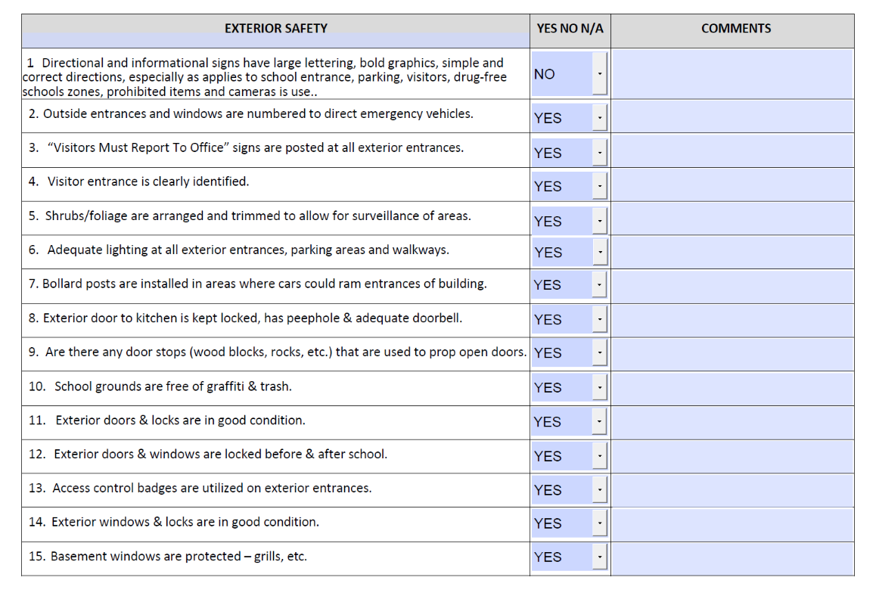

Site Assessment Checklist
INSERT QR ODE
QR Code for the Site Assessment
Notes:
Provide link for finalized Site Assessment checklist

Slide 10
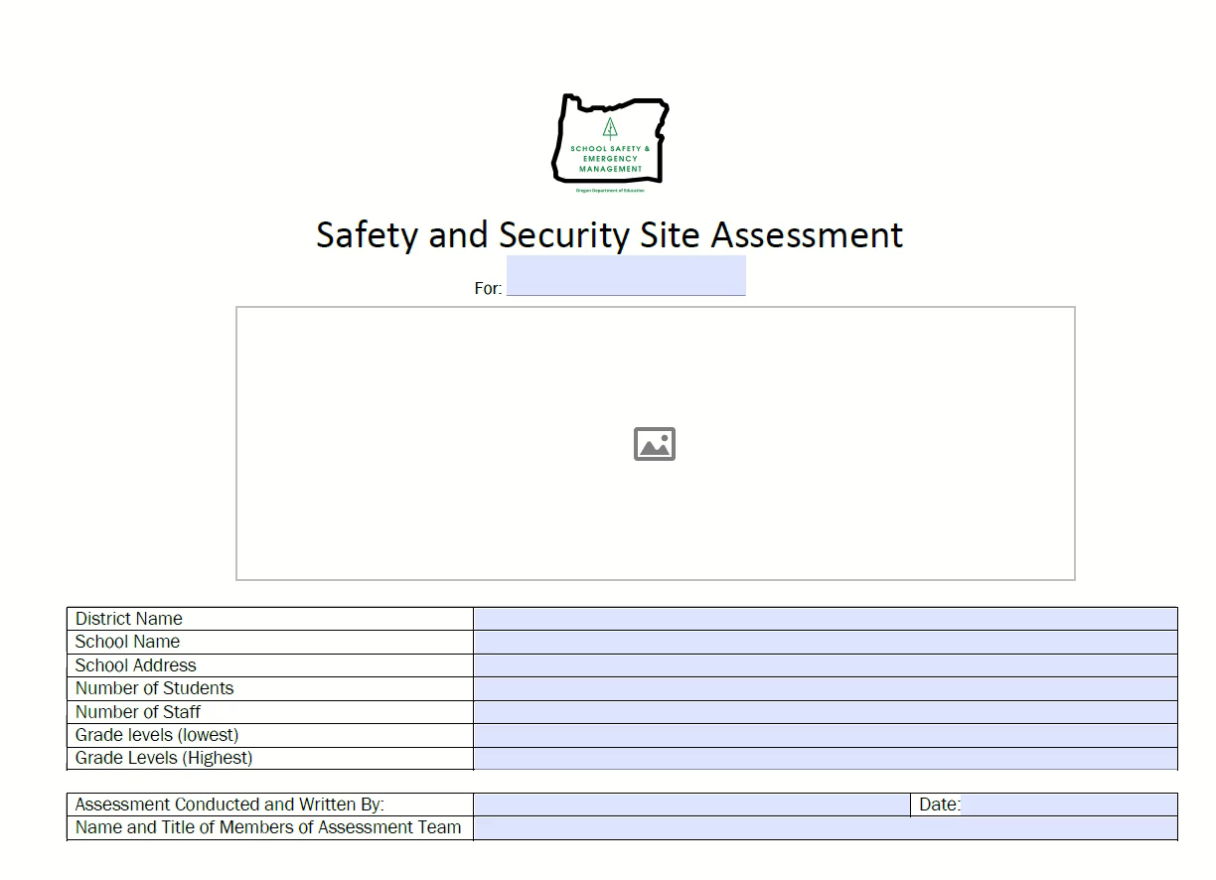
Site Assessment Checklist
Notes:
Provide link for finalized Site Assessment checklist

Slide 11



Data Results
Identify threats and hazards​
Evaluate risks and vulnerabilities​
Address in school EOP​
Improve facilities​
Create a plan​
Execute in short and long term​
Collect important information​
Share with stake holders
Serve as documentation
Notes:
The data that are collected in site assessments help schools to
Identify threats and hazards that they may face. Based on the information collected, EOP planning teams can evaluate the risks and vulnerabilities associated with each threat or hazard, and prioritize which ones are to be addressed in the school EOP.
Improve facilities. Site assessment teams can create a plan for facility improvements for both the short term and the long term, and then complete those projects based on the timeline the team identified.
Collect important information to share with first responders. Site assessments can also serve as documentation of your education agency preparedness activities. It provides proof that you are actively committed to safety and security during conversations with concerned parents or legal guardians, community members, local governments, and/or insurance agencies.
Information from the assessment will be used by school planning teams as they develop your school EOP, which should include a comprehensive list of possible threats and hazards. Site assessment data will not only illuminate the potential threats and hazards that your school may face, but will also aid you in evaluating and comparing the risks and vulnerabilities associated with each threat or hazard. In turn, your school planning team will be able to prioritize threats and hazards to address directly in the school EOP and enhance the school’s overall safety and emergency preparedness.
Furthermore, it is important to make an up-to-date and well-documented site assessment available to first responders, as well as any additional information that would assist them in rapidly moving through your school during an emergency, ensuring that areas are safe and tending to people in need.
[Prompt for kickoff meetings: Discuss how the data will be used post-completion and who will be responsible for managing it.]

Slide 12

Next Steps
What are three things I learned from this presentation?
How can I implement them at my school or school district?
What steps will I take to implement these changes?
Notes:
[Encourage participants to think through the three main ideas that were most relevant or impactful for them, such as things they learned that revealed a need they have, or a way they can enhance the planning efforts already in place.]
[Then encourage participants to think through the steps they will take upon returning to their school/district to set these changes into motion, and to consider how to see them through to completion/implementation.]
Whom will they need to bring on board?
What is needed to put these changes into place — training, equipment, manpower?
How will these changes be maintained?

Slide 13
Questions?

Slide 14

Here to Help
Mitch Sechler
Mitch.Sechler@ode.Oregon.gov
QR Code for the SSEM web page.

