Slide 1


Developing Emergency Operations Plans (EOPs)
K-12 101 Training
Presented by:

Slide 2

Purpose
The purpose of this presentation is to:
Provide an introduction to emergency planning for Oregon’s K-12 schools.
Introduce best practices for continued emergency preparedness.
Present resources for enduring school safety through preparedness.

Slide 3
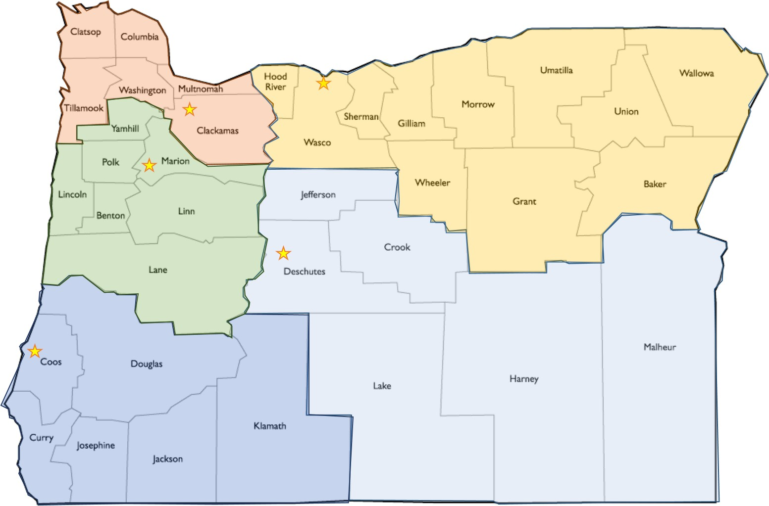
Program Introduction
The SSSEM Program provides training and technical assistance to develop and exercise school emergency operations plans.
Visit us online to find your regional emergency preparedness consultant for help with:
Writing your EOP.
Updating your EOP.
Exercising your EOP.

Slide 4
Prerequisites
The following coursework is recommended to be completed before engaging in emergency operations planning activities:
IS-362.A: Multi-hazard Emergency Planning For Schools; 3hrs.
IS-100.C: Introduction to the Incident Command System, ICS 100; 2hrs.
IS-700.B: An Introduction to the National Incident Management System; 3.5hrs.
IS-800.D: National Response Framework, An Introduction; 3hrs.

Slide 5

Agenda
Expectations, policy and law.
What is an EOP?
EOP101 development: a how-to.
Functional Annexes.
Threat and Hazard -specific annexes.
Notes:
This presentation has been adapted from the same self-titled presentation by Readiness and Emergency Management for Schools. It has been formatted for accessibility per the Oregon Department of Education accessibility requirements. Some content has been pared down for brevity and other points have been emphasized in order to focus this training session toward productivity. Where applicable, links have been included so as to provide additional information to participants as needed. A workbook in the style of the REMS Emergency Operations Plan handbook is meant to accompany this presentation so that participants can follow along and fill in sections that they can use to build their own EOPs.

Slide 6
Expectations
Schools:
  Provide safe and healthy learning environments.
  Keep students safe from threats and hazards.
  Plan for the safety and security of all students and staff (consider people with disabilities, access or functional needs).
Community Partners Collaboration:
  Advise in development of the school’s EOP.
  Provide resources for the implementation of the EOP.
  Provide input and support for diverse populations.
Notes:
Each school day, our nation’s schools are entrusted to provide a safe and healthy learning environment for approximately 55 million elementary and secondary school students in public and nonpublic schools. Families and communities expect schools to keep their children and youths safe from threats (human-caused emergencies such as crime and violence) and hazards (natural disasters, disease outbreaks, and accidents).
Lessons learned from school emergencies highlight the importance of preparing school officials and first responders to implement school emergency operations plans. By having plans in place to keep students and staff safe, schools play a key role in taking preventative and protective measures to stop an emergency from occurring or reduce the impact of an incident.
Schools are not traditional response organizations, but when a school-based emergency occurs, school personnel respond immediately. They provide first aid, notify response partners, and provide instructions before first responders arrive. They also work with their community partners (i.e., governmental organizations) that have a responsibility in the school emergency operations plan to provide a cohesive, coordinated response. Community partners include first responders (law enforcement officers, fire officials, and emergency medical services personnel) as well as public and mental health entities.

Slide 7
Presidential Policy Directive (PPD-*)
National Preparedness Directive
Describes the nation’s approach to preparedness
Aims to facilitate an integrated approach and align planning at all levels and with all sectors
Link to PPD-8: https://www.fema.gov/learn-about-presidential-policy-directive-8
Notes:
Reinforce message that this approach works to have all planning efforts align from the building level, to the district-, state-, and Federal-levels.
More, the approach helps to ensure planning efforts are aligned among school and district officials and their partners (e.g., first responders).
The guidance and this training work to support schools as they strengthen their planning efforts and their EOPs with their community partners. The outcome will be integrated plans that increase effectiveness.
In January 2013, President Obama put forward his “Now is the Time” plan to reduce gun violence. One of the executive actions put forth in his plan was the development of this new guide by the Departments of Education (ED); Justice (DOJ), led by the Federal Bureau of Investigation (FBI); Homeland Security (DHS), led by the Federal Emergency Management Agency (FEMA); and Health and Human Services (HHS) . This training directly supports districts and schools as they work to implement the guidance.
NIMS, the National Incident Management System, is another approach that schools should integrate as they develop their EOPs with partners. These activities support an integrated response. NIMS:
Is the single system for managing all domestic incidents.
Is suitable for all schools and educational institutions to implement throughout all phases of school emergency management.
Enables a coordinated response among various jurisdictions and functional agencies, both public and private.
Establishes common processes for planning and managing resources.
A key component of NIMS is its Incident Command System (ICS).
This is a standardized, on-scene, all-hazards incident management approach that allows for the integration of facilities, equipment, personnel, procedures, and communications operating within a common organizational structure.
As FEMA explains:
“Consistent implementation of NIMS provides a solid foundation across jurisdictions and disciplines to ensure effective and integrated preparedness, planning, and response. NIMS empowers the components of the National Preparedness System, a requirement of Presidential Policy Directive (PPD)-8, to guide activities within the public and private sector and describes the planning, organizing, equipping, training, and exercising needed to build and sustain the core capabilities in support of the National Preparedness Goal.”
http://www.fema.gov/national-incident-management-system

Slide 8
Oregon Legal Requirements
Under OAR 581-022-2225 school districts must ensure that students are instructed and have drills on emergency procedures (responses) to the following:
  Fires.
  Earthquakes (and tsunamis in applicable zones).
  Safety threats including procedures related to lockdown, lockout, shelter in place, evacuation and other appropriate actions.
This supports ORS 336.071.
Notes:
OAR 581-022-2225
The school district shall maintain a comprehensive safety program for all employees and students which shall:
(1) Include plans for responding to emergency situations.
(2) Specify general safety and accident prevention procedures with specific instruction for each type of classroom and laboratory.
(3) Provide instruction in basic emergency procedures for each laboratory, shop and studio, including identification of common physical, chemical, and electrical hazards.
(4) Require necessary safety devices and instruction for their use.
(5) Require that an accident prevention in service program for all employees be conducted periodically and documented.
(6) Provide assurance that each student has received appropriate safety instruction.
(7) Provide for regularly scheduled and documented safety inspections which will assure that facilities and programs are maintained and operated in a manner which protects the safety of all students and employees.
(8) Require reports of accidents involving school district property, or involving employees, students or visiting public, as well as prompt investigation of all accidents, application of appropriate corrective measures, and monthly and annual analyses of accident data and trends.
(9) In schools operated by the district that are occupied by students, the district must ensure that all students are instructed and have drills on emergency procedures in compliance with ORS 336.071. The emergency procedures shall include drills and instruction on:
(a) Fires;
(b) Earthquakes, which shall include tsunami drills and instruction in schools in a tsunami hazard zone; and
(c) Safety threats including procedures related to lockdown, lockout, shelter in place and evacuation and other appropriate actions to take when there is a threat to safety.

Slide 9
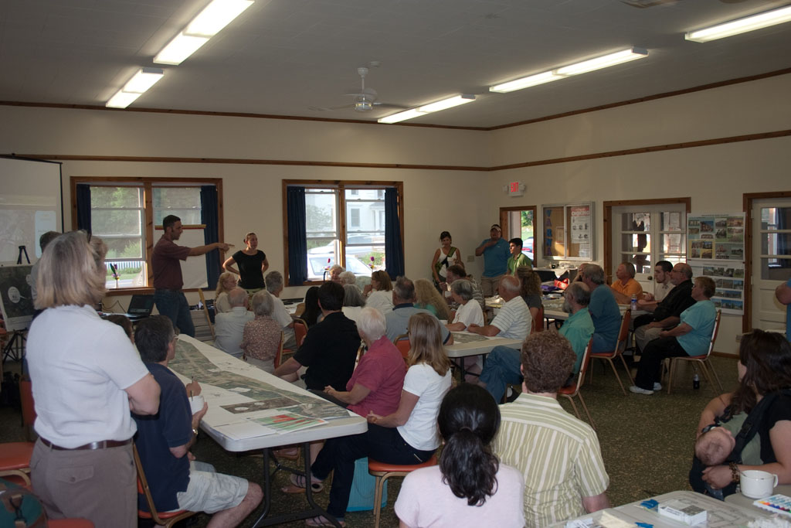
Local Requirements
County and city requirements.
School Board requirements.

Slide 10

Incident Command System (ICS) Key Concepts
Unity of Command
Each person should only report to one supervisor to avoid confusion.
Chain of Command
There should be a clear line of responsibility to avoid command overlap.
Unified Command
When multiple organizations work together with independent commands they should work together to avoid conflicts of command.

Slide 11
Incorporating NIMS and ICS
Incident Commander
PIO
Safety
Liaison
Operations
Planning
Logistics
Finance/ Admin
*This will be covered in more detail in a follow-on presentation.
Notes:
NOTE TO TRAINER: Explain in plain language what is meant by this slide. There is need for practical detail as to what NIMS and the ICS are, and how they are connected/utilized in the EOPs.
NIMS is one example of a strategy and tool that works to form a common framework. It:
Allows for the integration of facilities, equipment, personnel, procedures, and communications operating within a common organizational structure.
Establishes common processes for planning and managing resources.
Enables a coordinated response among various jurisdictions and functional agencies, both public and private.
One component of NIMS is the ICS, which provides a standardized approach for incident management, regardless of cause, size, location, or complexity. By using ICS during an incident, schools are able to more effectively work with the responders in their communities.
By implementing the NIMS activities for K-12 schools, students, staff, and parents will ultimately receive more efficient and effective response support and services, placing them right alongside and on the same page as their community partners—local government officials, fire and rescue officials, emergency medical service providers, law enforcement, and public and mental health personnel.

Slide 12
Incorporating NIMS and ICS
One Common Framework:
National Incident Management System (NIMS) and Incident Command System (ICS)
Single system for managing domestic incidents across the United States
Suitable for all schools and educational institutions to implement throughout all phases of school emergency management
A core set of comprehensive procedures that allow schools to manage emergencies and coordinate with first responders
Connects these institutions to their community partners
*This will be covered in more detail in a follow-on presentation.
Notes:
NOTE TO TRAINER: Explain in plain language what is meant by this slide. There is need for practical detail as to what NIMS and the ICS are, and how they are connected/utilized in the EOPs.
NIMS is one example of a strategy and tool that works to form a common framework. It:
Allows for the integration of facilities, equipment, personnel, procedures, and communications operating within a common organizational structure.
Establishes common processes for planning and managing resources.
Enables a coordinated response among various jurisdictions and functional agencies, both public and private.
One component of NIMS is the ICS, which provides a standardized approach for incident management, regardless of cause, size, location, or complexity. By using ICS during an incident, schools are able to more effectively work with the responders in their communities.
By implementing the NIMS activities for K-12 schools, students, staff, and parents will ultimately receive more efficient and effective response support and services, placing them right alongside and on the same page as their community partners—local government officials, fire and rescue officials, emergency medical service providers, law enforcement, and public and mental health personnel.

Slide 13
Traditional EOP Format
SCHOOL EMERGENCY OPERATIONS PLAN
BASIC PLAN
FUNCTIONAL ANNEXES
THREAT AND HAZARD-SPECIFIC ANNEXES
Notes:
NOTE TO PRESENTER: This is an opportunity to give the participants a little bit of a road map, or a placeholder, for the structure of the school EOP. We are just doing a basic introduction of it on this slide and will go into more details about each section later.
This guide presents a traditional format that can be tailored to meet individual school needs.
The traditional format has three major sections: the Basic Plan, Functional Annexes, and Threat- and Hazard-Specific Annexes.
The Basic Plan section of the school EOP provides an overview of the school’s approach to emergency operations.
The Functional Annexes section details the goals, objectives, and courses of action of essential functions (e.g., evacuation, lockdown, communications, accounting for students) that apply across multiple threats or hazards.
The Threat- and Hazard-Specific Annexes section specifies the goals, objectives, and courses of action that a school will follow before, during, and after a particular type of threat or hazard (e.g., hurricane, active shooter, fire).

Slide 14
Five Preparedness Missions
Prevention
Recovery
Mitigation
Response
Protection
Before
During
After
an incident or emergency
Notes:
PPD-8 (a Presidential Directive) describes the nation’s approach to preparedness and defines preparedness around five mission areas:
Prevention, Mitigation, Protection, Response, and Recovery.
It represents an evolution in our collective understanding of national preparedness and is based on the lessons learned from terrorist attacks, hurricanes, school incidents, and other experiences.
Prevention means the capabilities necessary to avoid, deter, or stop an imminent crime or threatened or actual mass casualty incident.
Mitigation means the capabilities necessary to eliminate or reduce the loss of life and property damage by lessening the impact of an event or emergency.
Protection means the capabilities to secure schools against acts of violence and manmade or natural disasters.
Response means the capabilities necessary to stabilize an emergency once it has already happened or is certain to happen in an unpreventable way.
Recovery means the capabilities necessary to assist schools affected by an event or emergency in restoring the learning environment.
These mission areas generally align with the three timeframes associated with an incident: before, during, and after.
Before: The majority of Prevention, Mitigation, and Protection activities generally occur before an incident, although these three mission areas do have ongoing activities that can occur throughout an incident.
During: Response activities occur during an incident.
After: Recovery activities can begin during an incident and occur after an incident.
To help avoid confusion over terms and allow for ease of reference, we will generally use the terms: “before,” “during,” and “after.”

Slide 15



How does this look? – why does it look like this?
What kinds of things do you need to do today to prepare for tomorrow?
How do you get out of the building when it is on fire?
How do you reopen after a disaster?

Slide 16
Planning Principles
Supported by Leadership
Collaborative Process
Uses Assessments to Customize
Considers All Settings and All Times
Takes an All-Hazards Approach
Provides for Whole School Community
Notes:
The following principles are key to developing a comprehensive school EOP that addresses a range of threats and hazards.
Planning
Must be supported by leadership.
Uses assessments to customize plans to the building level.
Considers all threats and hazards.
Provides for the access and functional needs of the whole school community.
Considers all settings and all times.
Follows a collaborative process.
Let’s consider these in detail.

Slide 17
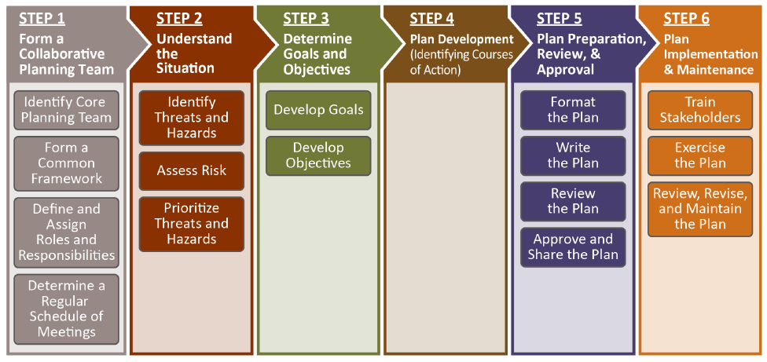
Steps in the Planning Process
Notes:
The TEAM should work through these six steps to create and implement their school’s EOP.
Schools and school districts can use this process to:
Develop a plan.
Do a comprehensive review of their existing plan.
Conduct reviews of their plan’s component parts.
Each step will improve the school’s response to ongoing school and emergency activities, as well as the training, drills, equipment, and resources that are currently in use.
These steps are sequenced to support a collaborative process, which invites multiple perspectives for information gathering, prioritizing, goal-setting, execution of specific activities, and evaluation. The process is intended to be cyclical and ongoing.
Although there are three timeframes, they are generally interconnected and schools can take steps to build capacity for Response and Recovery before an incident occurs.
These steps are supported by applying the planning principles.
NOTE TO TRAINER: As applicable, accentuate a planning principle throughout the steps.

Slide 18

Step 1: Form a Collaborative Planning Team
The most comprehensive
and effective school EOP
is developed by a
PLANNING TEAM.
Notes:
The EOP should not be produced in isolation. Today’s modern schools are too diverse and complex for one or two people to represent the needs of all stakeholders. Buy-in by everyone on campus requires that all concerns be addressed.
A multi-disciplinary team approach:
Ensures all aspects of safety and security are considered from multiple professional perspectives.
Allows for greater input and expertise.
This adds value to the breadth, depth, and scope of the plan.

Slide 19
Form a Collaborative Planning Team
School Stakeholders
Consider community partners who could provide input for any language barriers or other access or functional needs.
Community Partners
District Representative
Identify Core Planning Team
Notes:
Identify a Core Planning Team that will collaborate to analyze and prioritize the threats and hazards facing the school and use their collective expertise to inform the development, implementation, and refinement of the school EOP. The Core Planning Team should include representatives from both the school and larger community.
School Personnel
Include, but are not limited to, administrators, educators, school psychologists, nurses, facilities managers, transportation managers, food personnel, and family services representatives. They also include student and parent representatives; individuals and organizations that serve and represent the interests of students, staff, and parents with disabilities; and others with access and functional needs such as English language learners, as well as racial minorities and religious organizations, so that specific concerns are included in the early stages of planning.
Each member of the Core Planning Team is not only an “ambassador” from their specific group, but they also carry the safety and training messages from the Core Planning Team back to their constituent group.
Community Partners
Those who have roles and responsibilities in school emergency management before, during, and after an incident such as first responders.
Include local law enforcement and school resource officers, emergency medical services (EMS) personnel, fire officials, public and mental health practitioners, and local emergency managers.
District Representative
In order to promote coordination with the district as well as with local, state, tribal, and Federal agencies, the planning team is strongly encouraged to include a district representative.
The local school district’s emergency planning policies, procedures, and training activities will inform and enhance the school’s planning to a significant degree. In addition, from the onset, the planning team should be aware of any local or state requirements that may apply to the school EOP.
Community Partners and District Representatives will provide critical information on the capacity of the district and local municipality to provide support for the school. These representatives can answer questions about how much support the school can expect to receive from the outside agencies and how long it will take that support to arrive.
Size and Membership
The planning team should be small enough to permit close collaboration with first responders and other community partners, yet large enough to be representative of the school, its families, and its community.
It should also be large enough as to not place an undue burden on any single person.
NOTE: The team developing the EOP plan could vary in size as the team works on various aspects of putting the EOP together. Aside from the core group, there will be some members that come and go on an as-needed basis.

Slide 20
Thought Exercise
*Page 2 in the workbook
Who can YOU include?
Who on your own staff (teachers or admin) could provide valuable input for a high-quality EOP?
Who, at the district level, should be included in coordinating your EOP planning process?
Who are your emergency response partners?
What community groups could you call on for planning input or aid during an emergency?
Notes:
Elicit information and successful strategies from audiences
Facilitating Scheduling
How can we make it easier to bring all of the partners together?
How can schools work together with the district to make it easier for community partners to work with each of the schools?
How can we support the partnership and individual activities such as scheduling?
Facilitating Bridging the Culture Gap
Discuss school culture and the culture of community partners.
What strategies can we employ to help bridge the culture gap?
What strategies have you used to form a common framework?

Slide 21
Step 2: Understanding the Situation
The planning team must
Understand the Situation.
Notes:
Step 2: Understand the Situation
In Step 2, the planning team will use a consistent process to collect and analyze data, as well as subsequently prioritize and address hazards and threats the school faces. This will inform the school EOP development process.
Identify the threats and hazards faced by the school.
Assess the risk and vulnerability.
Prioritize the threats and hazards.
Identify Threats and Hazards:
The planning team first needs to understand the threats and hazards faced by the school and the surrounding community.
Team members’ and school knowledge
Federal, state, and local data about historical threats and hazards
Local community partners’ data
Local organization and community groups (e.g., American Red Cross, Community Emergency Response Teams [CERT], utility providers, business)
Assess the Risk Posed by the Identified Threats and Hazards:
Once an initial set of threats and hazards has been identified, the planning team should select suitable assessment tools to evaluate the risk posed by the identified threats and hazards.
Assessments will be used not only to develop the initial plan but also to inform updates and revisions to the plan on an ongoing basis.

Slide 22




Identify Threats and Hazards
Identify Threats and Hazards
The planning team first needs to understand the threats and hazards faced by the school and the surrounding community.
Notes:
School and the surrounding community
Team members’ and school knowledge
Federal, state, and local data about historical threats and hazards
Local community partners’ data
Local organization and community groups (e.g., American Red Cross, CERTs, utility providers, business)

Slide 23
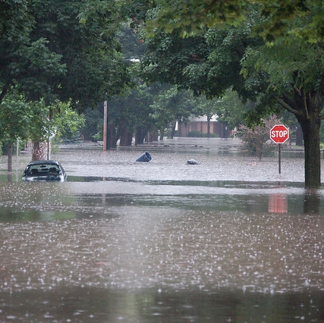
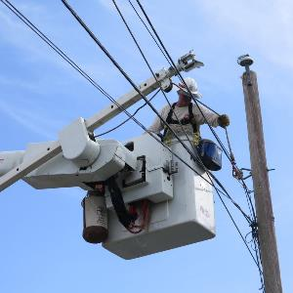
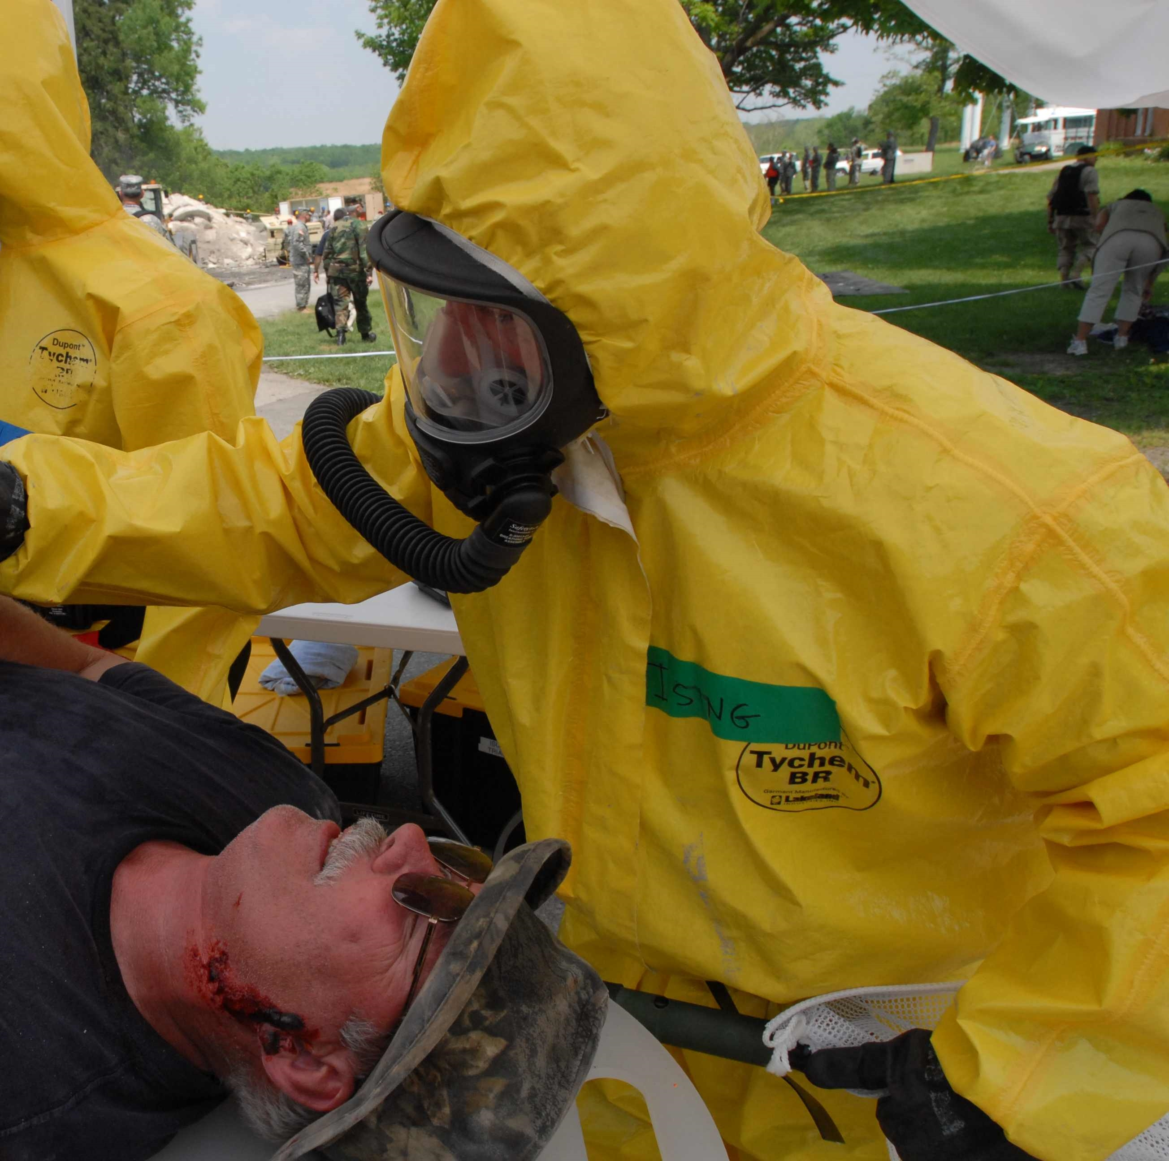
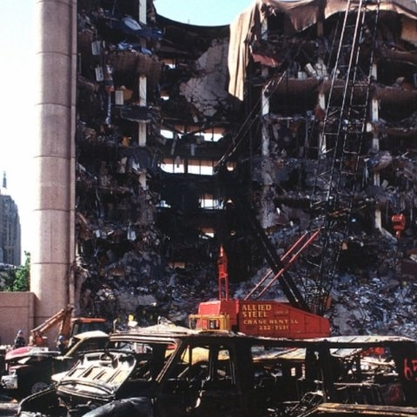
Threats and Hazards: Identification
What are they and how do you identify them?
Threats and hazards are typically broken down into four different categories:
Natural
Technological
Biological
Human-Caused
Notes:
This was not in the original REMS training slide deck. However, this is directly from the FEMA guidelines and best practices for threat and hazard identification and risk assessment. This information is presented in the Threat and Hazard Identification and Risk Assessment (THIRA) and Stakeholder Preparedness Review (SPR) Guide. Located here: https://www.fema.gov/media-library-data/1527613746699-fa31d9ade55988da1293192f1b18f4e3/CPG201Final20180525_508c.pdf

Slide 24
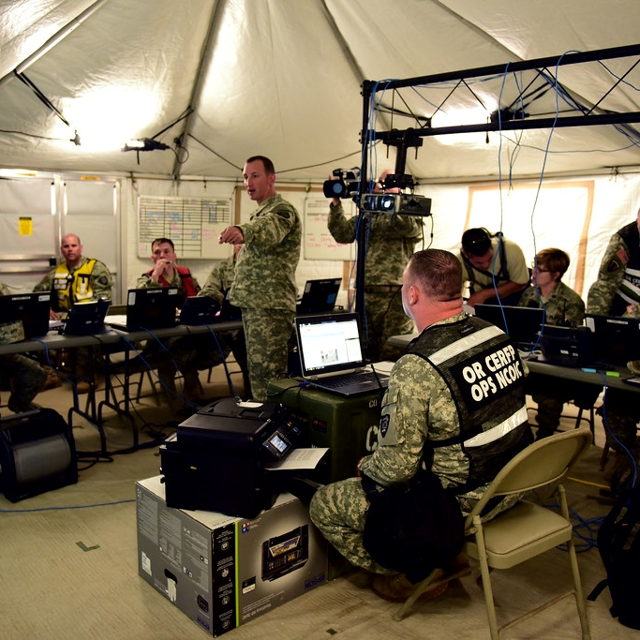
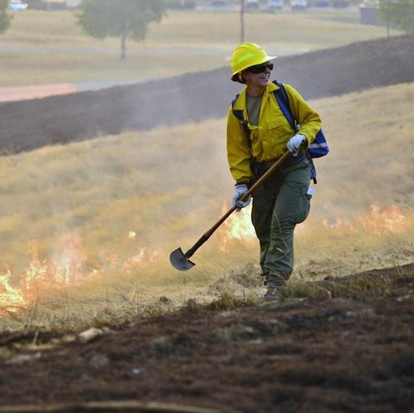
Threats and Hazards: What to Do?
Threat and Hazard Identification and Risk Assessment (things to think about):
Check with your emergency management contacts in your community to aid in identifying potential threats and hazards.
What kinds of disruptions does your school or community encounter regularly or even seasonally?
Notes:
Things to consider here: What events have occurred within a local region that a school might need to plan for? In addition to checking with emergency management contacts in the area, schools and districts should also consider looking in historical records for information about past hazards. For example: a flood that happened 100 years ago may still be a concern if mitigation measures have not been maintained.
This was not in the original REMS training slide deck. However, this is directly from the FEMA guidelines and best practices for threat and hazard identification and risk assessment. This information is presented in the Threat and Hazard Identification and Risk Assessment (THIRA) and Stakeholder Preparedness Review (SPR) Guide. Located here https://www.fema.gov/media-library-data/1527613746699-fa31d9ade55988da1293192f1b18f4e3/CPG201Final20180525_508c.pdf

Slide 25
Assessment Types
There are numerous assessments that the planning team may use to identify threats and hazards, including:
  Site Assessment
  Culture and Climate Assessment
  Behavioral Threat Assessment
  Capacity Assessment
Assessments help the planning team to customize the EOP.
The Readiness and Emergency Management for Schools (REMS) website has some good resources for site and planning assessments. LINK!
Notes:
There are numerous assessments that the planning team may use, including site assessments, culture and climate assessments, behavioral threat assessments, and capacity assessments. These assessments will help the planning team not only assess risk but also identify resources and issues that the plan may need to address. It will also help the planning team to customize the EOP.
But note: there may be restrictions (either legal or practical) on utilization of information gathered by the planning team for customizing the EOP (e.g., with information gathered by the Behavioral Threat Assessment team—information may be restricted by FERPA/HIPAA). The REMS slideshow that this was taken from includes a slide for each of the assessments detailed above with some brief information about each one. They have been removed in this presentation because detailed explanations about the scope of these assessments is beyond the scope of this presentation which is focused on the broader process of constructing an EOP. Supplemental information about additional assessments or assessment types can be found at the REMS link in this slide.
Assessments will be used not only to develop the initial plan but also to inform updates and revisions to the plan on an ongoing basis.

Slide 26
Threats and Hazards: Planning
Prioritize your planning efforts.
Set goals for high-risk threats you plan for.
Incorporate those goals into the plans you create.
There is nothing wrong with planning for every risk you can identify. However, we recommend that you have plans in place to respond to your extreme and high risk hazards and threats first.
Notes:
This was not in the original REMS training slide deck. However, this is directly from the FEMA guidelines and best practices for threat and hazard identification and risk assessment. This information is presented in the Threat and Hazard Identification and Risk Assessment (THIRA) and Stakeholder Preparedness Review (SPR) Guide. Located here: https://www.fema.gov/media-library-data/1527613746699-fa31d9ade55988da1293192f1b18f4e3/CPG201Final20180525_508c.pdf
This slide was included in order to start the discussion of planning priorities and actionable planning activities. In a district or school with limited resources we should recommend that the limited planning resources should be spent on the highest risk threats and responses first. Use this slide to talk about some of those potential threats facing the school or district and how they can prioritize their efforts so they are most effectively prepared.

Slide 27
Risk Assessment
Risk Level*
Probability/ Severity | Unlikely | Possible | Likely | Highly Likely
Catastrophic | Medium | High | Extreme | Extreme
Critical | Low | Medium | High | Extreme
Limited | Negligible | Low | Medium | High
Negligible | Negligible | Negligible | Low | Medium
*Dependent on the likely warning time prior to the event.
Notes:
After conducting these assessments, the planning team should organize and consolidate all of the information it has obtained into a format that is usable for comparing the risks posed by the identified threats and hazards. This information will then be used to assess and compare the threats and hazards and their likely consequences. This is referred to as a “risk and vulnerability assessment.”
One effective method for organizing information is to create a table with a range of information about each possible threat and hazard, including any new threats or hazards identified through the assessment process. The table should include:
Probability or frequency of occurrence (i.e., how often a threat or hazard may occur)
Magnitude (i.e., the extent of expected damage)
Time available to warn staff, students, and visitors
Duration (i.e., how long the hazard or threat will be occurring)
Follow-on and cascading effects of threat or hazard
While some of the information collected will directly feed into this table, other information, for example details on school climate challenges, will have to be organized differently. The most important outcome is that information is clearly presented so that it can be easily used to inform the plan’s development.
Once the list is complete, the TEAM should reach consensus on the Risk Priority for each one.

Slide 28
Risk Assessment
Emergency Incident Risk Assessment Scoring
Potential Event | Warning Preceding Event | Consequence or Significance | Likeliness/ Probability | Risk Level
Cascadia earthquake | None | Catastrophic | Possible | High
Building Fire | 10 minutes | Critical | Possible | Medium
HAZMAT Spill | 30 minutes | Limited | Unlikely | Negligible
Snowstorm | 1 day | Negligible | Highly Likely | Medium
* We will distribute a spreadsheet you can use to aid in determining your own risk levels.
Notes:
This table is an example from the spreadsheet that we will distribute. The spreadsheet differs from the REMS model in that it doesn’t include a column for the duration of hazard or threat. However, it does include a calculation that will provide an appropriate risk level based on the warning time, the significance, and the probability of an event. These conditions and their explanations are also included in the spreadsheet we will distribute.
Risk assessments are an important function in any planning activity, regardless the intent or desired outcome. And risk assessments that are generated from well informed and objective criteria are important enough that without these conditions planners may not have the correct information with which to make effective decisions. An undervalued risk could mean that it doesn’t received the appropriate resources or planning considerations. Conversely, an overvalued risk may draw resources and considerations from other risks that require those resources or considerations. Duration, while an important variable for planning considerations, may not be as impactful as severity, warning time or probability of a risk or hazard, in assessing immediate risk. Because the very nature of a threat or hazard could determine its duration, preparation for long-duration events should be included in the planning phase of that event. And because the risk assessment category of consequence or significance is used as a proxy to determine the severity of loss, the duration of an event--if it becomes unduly burdensome--would likely constitute a loss that should be considered within the context of the event’s consequence or severity.
The below notes are included from the REMS presentation:
After conducting these assessments, the planning team should organize and consolidate all of the information it has obtained into a format that is usable for comparing the risks posed by the identified threats and hazards. This information will then be used to assess and compare the threats and hazards and their likely consequences. This is referred to as a “risk and vulnerability assessment.”
One effective method for organizing information is to create a table with a range of information about each possible threat and hazard, including any new threats or hazards identified through the assessment process. The table should include:
Probability or frequency of occurrence (i.e., how often a threat or hazard may occur)
Magnitude (i.e., the extent of expected damage)
Time available to warn staff, students, and visitors
Duration (i.e., how long the hazard or threat will be occurring)
Follow-on and cascading effects of threat or hazard
While some of the information collected will directly feed into this table, other information, for example details on school climate challenges, will have to be organized differently. The most important outcome is that information is clearly presented so that it can be easily used to inform the plan’s development.
Once the list is complete, the TEAM should reach consensus on the Risk Priority for each one.

Slide 29
Thought Exercise
What are your hazards and threats?
What hazards and threats have disrupted your school before?
What hazards or threats are you aware of that you may need to plan for?
What are the risks associated with the hazards and threats you have identified?
Notes:
Use the workbook (page 3) and the applicable spreadsheet for risk assessment if possible. Go through a couple of different risks as identified by the audience based on the questions on this slide.

Slide 30
Step 3 in the Planning Process
The planning team develops
Goals and Objectives.
Notes:
Step 3: Determine Goals and Objectives
The planning team:
Decides which of the threats and hazards identified in Step 2 will be addressed in the school EOP.
The planning team may decide to address only those threats and hazards that rank “high” in risk priority, or they may decide to also address some of the threats and hazards that rank “medium.”
This is a critical decision point in the planning process that is left up to the planning team. It is recommended that the team address more than just the “high” risk priority threats and hazards.
Develops goals and objectives for each.

Slide 31
Determine the Goals and Objectives
Goals are broad, general statements that indicate the desired outcome in response to a threat or hazard.
The planning team will develop at least three goals indicating desired outcome for:
  (1) Before
  (2) During
  (3) After the threat or hazard
Objectives are specific, measurable actions that are necessary to achieve the goals.
Notes:
Goals are broad, general statements that indicate the desired outcome in response to the threat or hazard identified by planners in the previous step.
Goals are what personnel and other resources are supposed to achieve. They also help identify when major activities are complete and what defines a successful outcome.
Goals are the team’s broad vision of what the school wants to accomplish in response to each emergency, hazard, or threat.
Objectives are specific, measurable actions that are necessary to achieve the goals. Often, planners will need to identify multiple objectives in support of a single goal.
These goals and objectives provide the “roadmap” for the school’s emergency planning and lay the ground work for the courses of action.
A school will have multiple goals and numerous objectives supporting each goal.

Slide 32
Goals and Objectives (another look)
Outcomes
Desired outcome (goals): What you want your school to look like after the event.
  During a fire we want everyone to evacuate the building safely and we want to account for every single student and staff member.
Chain of dependency (objectives): What actions or resources are needed to achieve your desired outcome.
  We will need unobstructed and clearly marked exits.
  We need to communicate evacuation routes and procedures to all students and staff.
Notes:
Another way to look at this is to determine the desired outcome of a given emergency response scenario. What do you want your students, teachers, staff and school to look like when the dust has settled and everyone is back at work? If you can figure that out, then you need to determine necessary actions or resources that are needed to accomplish that desired outcome.

Slide 33
Participant Activity
Goals should support the safety of all.
Goals will address before, during and after.
Goals will be attainable.
Consider a threat
Lockdown.
Shelter in Place.
Evacuate.
Consider a response
How will you communicate your response?
How will you organize your response?
What materials or assets do you need?
Consider supporting activities/resources
Notes:
Notes below are original to the REMS presentation and this slide. The follow-on slide is added for the purposes of this amended presentation.
Review goals and objectives.
Instruct participants to work in small groups to write goals and objectives to support a Shelter-in-Place. Note to Facilitator/Presenter: Inform participants to save their work. This will be the foundation for two more activities.
Provide a definition of Shelter-in-Place (provided in slide and handout). Lead the development of one goal and objective.
What might you set as a goal for Before? And supporting objectives?
Direct participants to write at least three goals: Before, during, and after and numerous objectives to support them.
Have representatives share with large group. As facilitator, trainer should identify common critical functions identified by participants.

Slide 34
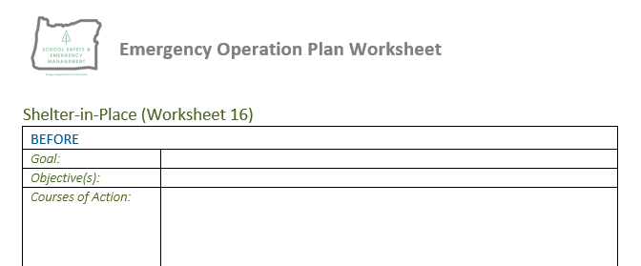
Participant Activity
Based on the process we’ve outlined thus far, go through your worksheets and work together to complete the goals and objectives for a shelter-in-place annex.
Notes:
Stress that the “Shelter-in-place” functional annex worksheet is not the only one the participants need to look at. Encourage the participants to use any functional annex worksheet that they would prefer to work on that would best suit their response to a hazard or threat they had previously identified. However, because the example scenario is based on a shelter-in-place response, it is recommended the participants use this worksheet if they are new enough to emergency response planning and if it is a response procedure they do not currently have in place.
Key words: specifically reference what you are doing in your goals and objectives:
Goal: We will shelter in place in order to prevent environmental contaminants from entering the facility.
Objective: Each designated shelter room will seal all external windows and doors with plastic sheeting and duck tape to keep environmental contaminates out.

Slide 35
Step 4: Plan Development
The planning team identifies
Courses of Action
for each objective.
Notes:
The goal of Step 4 is to assign “action” for accomplishing planning objectives.
Courses of action address the who, what, and how for response to each hazard, threat, and function and include criteria for determining how and when each response will be implemented under a variety of circumstances.
The planning team develops courses of action and subsequently related response protocols and procedures to support the Step 3 efforts—goals and objectives. To more clearly define an appropriate course of action, specific questions must be addressed. Answering primary questions such as who, what, when, where, and how for each threat, hazard, and function brings specificity to the process and helps develop courses of action that will help to achieve the goals and objectives. This depth of planning will assist in writing the response procedures and protocol.
The goals, objectives, and courses of action form the annexes.
The planning team must determine whether the course of action:
Meets financial needs—planners must weigh the cost benefit of each decision. The balance between “best practice” and “practical response” must be measured based on many factors (i.e., capacity, capability, training, resources).
Is feasible.
Is acceptable to all necessary community partners with roles and responsibilities in operationalizing the action.

Slide 36
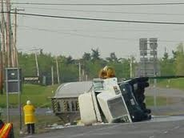
Develop Courses of Action
Four-step process to develop a course of action.
Step 1: Describe possible scenarios.
Step 2: Determine the amount of
time available to respond.
Step 3: Identify decision points.
Step 4: Develop Courses of Action.
Notes:
Describe possible scenarios:
Create a possible scenario based on data collected in Step 2. Planners can use the scenarios to help predict and determine possible impacts and needs.
Scenarios should be developed with widespread input from the school and community network. The broader and more varied the input, the more realistic the scenario will likely be.
Depict the scenario:
Create a possible scenario based on data collected in Step 2. Planners can use the scenarios to help predict and determine possible impacts and needs.
Determine the amount of time available to respond:
Response time will vary based on the threat or hazard. For example, a school may have days or hours to respond before a hurricane makes landfall as compared to minutes when confronted with an active shooter.
Identify decision points:
Decision points are the place in time as the threat or hazard unfolds, when leaders anticipate making decisions about a course of action.
The team can walk through a potential scenario and possible characteristics to identify relevant decision points such as whether or not to evacuate or lockdown, or at which point.
Develop courses of action:
Courses of action will answer critical question and help achieve goals and objectives. (Brief review.)
What is the action?
Who is responsible for the action?
When does the action take place?
How long does the action take, and how much time is actually available?
What has to happen before?
What happens after?
What resources are needed to perform the action?
How will this affect specific populations?
Note to Presenter: Inform participants that we will go into detail on courses of action after we practice Steps 1 through 3. Also, NEXT SLIDE IS AN ANIMATION.

Slide 37
One Possible Scenario…
Setting
  It is 10:05 Wednesday morning and school is in session. The temperature is 40 degrees Fahrenheit outside, the sky is overcast, and there is a light breeze from the west.
Incident
  A tanker truck carrying hazardous materials crashes into another vehicle on a road a few blocks from the school. The truck is leaking a yellowish gas that is hovering close to the ground.
+ 2 minutes
  A motorist comes upon the crash and calls 9-1-1. First responders are immediately dispatched to respond to the incident.
Notes:
“Let’s see one possible scenario and how it unfolds.”
NOTE TO PRESENTER: Following this scenario, participants will be asked to depict their own possible scenarios, etc. This brief presentation depicts one possible scenario, which is intended to help the participants since they will subsequently go through the four-step process independently and develop their own scenario.
There are many variables, and therefore, many possible ways a scenario could unfold. Planning takes into consideration many possible scenarios when developing goals, objectives, and courses of action.
Based on the flow, the presenter will elicit the following for the injects.
Depict the scenario:
Perhaps ask participant for additional injects or alternative possible scenarios.
Determine the amount of time available to respond:
As issues are identified, ask participants to estimate the time available.
Identify decision points:
As the scenario unfolds and response actions are discussed, identify the key decision points.

Slide 38
Scenario (continued)
+ 8 min
  Media has begun reporting on the tanker truck crash. Family members begin to call the school office to check on the status of their children. This is the first the school has heard of the incident.
+ 10 min
  The principal calls police dispatch to get first-hand information. Dispatch verifies the crash and that they’re still gathering information, but they don’t tell the school how to respond.
+ 12 min
  The principal assembles the school incident response team to assess the situation and determine an initial course of action: evacuate, shelter-in-place, or continue school as normal and wait for further instructions from 9-1-1. DECISION POINT!
Notes:
Note to Presenter: At the “Decision Point,” talk through these possible courses of action with the participants.
Continue School as Normal—A lot is still unknown in terms of the hazardous substance and if it will affect the school, but since the crash happened so close to the school, the principal determines that some sort of protective action should be taken as a precaution.
Evacuation—Due to the proximity of the crash to the school, the principal doesn’t think he can get enough bus drivers and buses to the school quick enough to do an off-campus evacuation without putting students, staff, and bus drivers at risk.
Shelter-in-Place—Due to the proximity of the crash, the school decides to take precautionary measures and implements a shelter-in-place to seal off the school from the possible contaminant.

Slide 39
Scenario (continued)
+ 13 min
  The school principal uses the intercom system to instruct staff to immediately implement a “Shelter-in-Place” procedure and seal their rooms.
+ 15 min
  The custodian who knows how to turn off the HVAC system is out sick for the day. Thankfully, two other staff members were cross-trained to turn off the HVAC system and immediately begin that process.
+ 18 min
  As classroom windows are being sealed, a teacher notices students outside on a field with their teacher who are seemingly unaware of the incident. From a distance, it looks like some students might be coughing. The teacher immediately calls the office.
Notes:
The school implements its EOP, and specific courses of action are completed.

Slide 40
Scenario (continued)
+ 20 min
  In the office, phones are ringing non-stop, office staff are sealing their windows and doors, and plans are being made to deliver inhalers and other needed medications to students.
+ 20 min
  The principal needs to decide what to do about the classes meeting outside.
+ 20 min
  Have they been contaminated? Do they need medical attention?
  Are other classes meeting outside?
  How will outside classes be given instructions?
  Should they be returned to the building?
  Do a walking “off-campus” evacuation?
  Call 9-1-1 for assistance/advise?
Based on a scenario developed by the Missouri Center for Safe Schools. Available in the REMS TA Center Resource Repository.
Notes:
Medical Needs: Who is responsible for delivering medical supplies to students who are in need? How is this done once rooms are sealed? Is there a mechanism in place to accomplish this before rooms are sealed? Is this practiced/drilled?
Students/Staff Outside: The school forgot to notify students outside. Does this school have a mechanism for notifying those meeting outside? Does the intercom system reach to the field? Do teachers carry two-way radios when meeting outside? Who is in charge of notifying those outside? Does someone have to risk their life to go and notify them? If they are brought into the school, will they contaminate the school environment and make others sick?
NOTE TO PRESENTER: These questions will give the participants a lot to consider and hopefully will open their eyes to the need of making comprehensive plans so that quick decisions can be made to save lives and reduce injuries.

Slide 41

Scenario Reflection
Things to consider:
Does this example event demonstrate an effective implementation to a plan?
What events or challenges may not have been planned for?
What resources or actions may be needed?
Notes:
Participant Activity: Direct participants to work in small groups to discuss the questions on the screen.
As facilitator:
Lead debrief—highlight the different ways the scenario has the potential to unfold as envisioned by the variety of participants.
Reinforce the value of using scenarios to help identify different courses of action and the resources (people and/or things) needed to carry them out.
Identify and summarize common critical functions cited by participants.
Common Functions:
Communications (internal and external)
Shelter-in-Place protocol
Evacuation (off-campus)
Medical
Accounting for students

Slide 42
Exercise Time
Considering the scenario just presented…
Go through your own worksheet and complete the courses of action sections.
Notes:
This can be a discussion point for the participants:
Consider the scenario just presented. If they chose to go with a different worksheet from earlier, we should still at least visit the scenario just presented. Compare what happened in the scenario to our own shelter-in-place procedures:
Are there things that were done in the scenario that we have not considered in our own planning?
If this event happened locally how would it impact our own building(s)?
After doing a quick brief-back on the previous scenario, give the participants time to go over at least one of their worksheets. The list of common functions they may want to focus on are below.
Common Functions:
Communications (internal and external)
Shelter-in-Place protocol
Lockdown/lockout
Evacuation (off-campus)
Medical
Accounting for students

Slide 43
Step 5: Plan Prep and Review
The planning team
PREPARES A DRAFT
…of the school EOP.
Notes:
In Step 5, the planning team develops a draft of the school EOP using the courses of action developed in Step 4. In addition, the team reviews the plan, obtains official approval, and shares the plan with community partners—first responders, local emergency management officials, staff, and stakeholders.
This is where the plan takes shape and is finalized. After completing Step 5, the planning team will have a final school EOP.

Slide 44
The Plan
FUNCTIONAL ANNEXES
BASIC PLAN
THREAT AND HAZARD-SPECIFIC ANNEXES
SCHOOL EMERGENCY OPERATIONS PLAN
Notes:
At the beginning of the presentation, we introduced the traditional format of an emergency operations plan that can be tailored to meet individual school needs. Let’s once again consider the format:
The Basic Plan section of the school EOP provides an overview of the school’s approach to emergency operations.
The Functional Annexes section details the goals, objectives, and courses of action of essential functions (e.g., evacuation, lockdown, communications, accounting for students) that apply across multiple threats or hazards. Functional annexes set forth how the school manages COMMON function before, during, and after an emergency. Functional annexes address common functions such as communication, which will take place in connection with any emergency.
The Threat- and Hazard-Specific Annexes section specifies the goals, objectives, and courses of action that a school will follow before, during, and after a particular type of threat or hazard (e.g., hurricane, active shooter, fire).
Reinforce the differences between Functional Annexes and Threat and Hazard-Specific Annexes.
REFER to SCHOOL EOP FORMAT from page 18 of the K-12 Guide—This will be an appendix in the participant handbook.

Slide 45
Elements of the Plan
Introductory Material
Purpose and Situation Overview
Concept of Operations
Organization and Assignment of Responsibilities
Direction, Control, and Coordination
Information Collection, Analysis, and Dissemination
Training and Exercises
Administration, Finance, and Logistics
Plan Development and Maintenance
Authorities and References
Elements of the Plan
Notes:
Use this opportunity to briefly talk about what is listed here and in the handout. We can spend some time going over some of the specific paragraphs that are contained in the body of the EOP. However, since there are no additional slides in this presentation or in the REMS presentation addressing the body of the plan, be sure to stress that the priority should be on the functional annexes before the body of the plan. The basic plan should exist as an enduring document for continuity whereas the annexes should be the result of a thorough risk assessment and planning process that best prepares the school for responses to multiple hazards and threats.
The notes in the original REMS presentation are below.
The Basic Plan section includes:
Introductory Material
Purpose and Situation Overview
Concept of Operations
Organization and Assignment of Responsibilities
Direction, Control, and Coordination
Information Collection, Analysis, and Dissemination
Training and Exercises
Administration, Finance, and Logistics
Plan Development and Maintenance
Authorities and References
IMPORTANT NOTE: Remember that planners have to be careful not to share every part of the plan. The planning team needs to determine what should and should not be shared and with whom it could/could not be shared.

Slide 46
Functional Annexes
Functional Response Annexes
Lockout/Secure
Shelter-in-Place
Hold
Continuity of Operations
Communication and Warning
Family Reunification
Evacuation
Lockdown
Health: Public, Medical and Mental
These are your action procedures
Notes:
Some important Functional Annexes may include:
Communications and Warning
General Responses, such as Evacuation, Lockdown, and Shelter-in-Place
Accounting for All Persons
Family Reunification
Security
Continuity of Operations
Recovery
Public, Medical, and Mental Health
These are some of the most important functions and are not meant to constitute an exhaustive list. As the annexes are formed, there are critical considerations. These should influence the development of goals, objectives, and courses of action.

Slide 47
Threat- and Hazard-Specific Annexes
Threat Annexes Requiring Response
Natural Hazards
Technological Hazards
Biological Hazards
Adversarial, Incidental, and Human-Caused Threats
These plans use your action procedures
Notes:
Threats and hazards are referenced into four different categories:
Natural Hazards
Technological Hazards
Biological Hazards
Adversarial, Incidental, and Human-caused Threats
As planning teams develop courses of action for threats and hazards, they should consider the federal, state, and local regulations or mandates that often apply to specific hazards.
The Basic Plan, Functional Annexes, and Threat- and Hazard-Specific Annexes will be discussed in greater detail in the next section of the presentation.

Slide 48
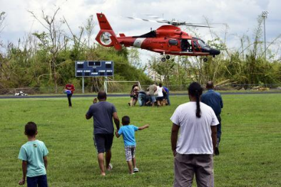
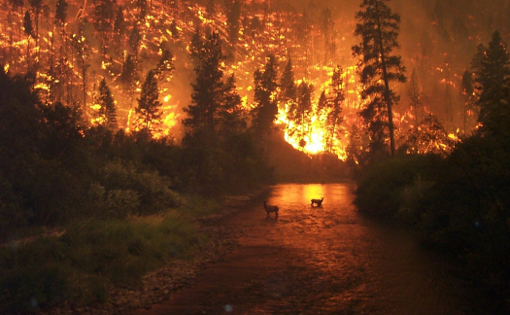
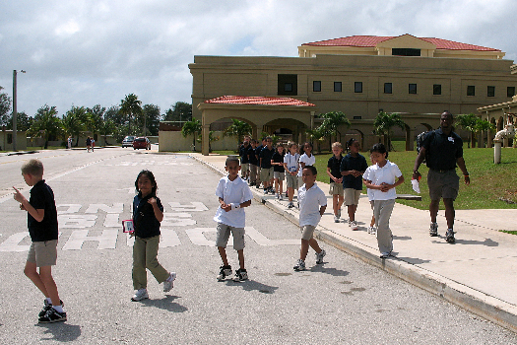
Oregon’s Recommended Threat Annexes
First and Foremost, check with your county emergency management office.
Earthquake.
Tsunami (in specific zones)
Wildfire.
Flooding.
Dust storms.

Slide 49
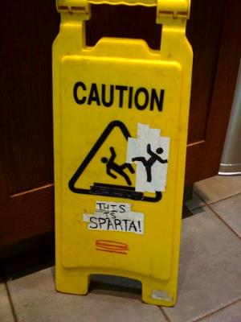
This is ANNEX!
Remember! Functional annexes are:
  The real activities you conduct in response to an emergency.
Threat and hazard specific annexes:
  Use functional annexes to support their execution.
Notes:
This may be a simplified explanation of the function of these two annex types. However, it is important to stress just what these annexes are supposed to accomplish. Similar to battle drills for an army, if you know how to do the simple things (in this case, evacuate, lockdown or shelter-in-place) then you should be able to apply those same drills to a variety of threats and hazards.
For example, a lockdown procedure is useful for a number of situations that may not have to do with a threat of human violence. Maybe you want to limit student and staff movement during construction or when searching for contraband. Maybe a student has gone missing from class and you want to limit movement to ease your search efforts. Same applies to a shelter-in-place. Dust storms or other severe weather might prompt you to conduct a complete or modified shelter-in-place drill. So to with an evacuation.
You will improve your resiliency in any given situation when these drills are properly planned for and the students and staff know what to do when they are called.

Slide 50
Step 6: Plan Maintenance
The planning team implements a
TRAINING, EXERCISE, AND MAINTENANCE
plan.
Notes:
Step 6 involves training stakeholders on the plan. Everyone involved in the plan needs to know their roles and responsibilities before, during, and after an emergency. Step 6 also explains how the plan should be exercised regularly through tabletop exercises, drills, functional exercises, and full-scale exercises. Then, the plan should be reviewed and revised based on lessons learned from exercises and actual emergencies and changing conditions.
The outcome of Step 6 is a living, tested, school EOP that remains familiar to all parties involved in or protected by the plan.

Slide 51
Cool Graphics That Address Training
Visit Key Locations
Distribute Materials
Teach Roles and Responsibilities
Train Stakeholders on Plan and Roles
Hold a Meeting
Include Community Partners
Notes:
Everyone involved in the plan needs to know their roles and responsibilities before, during, and after an emergency. Key training components include the following:
Hold a Meeting: At least annually, hold a meeting to educate all parties on the plan. These meetings should include:
School Leadership (important for obtaining buy-in on the plan)
Community Partners (e.g., first responders, emergency managers, and public and mental health officials)
Additional Stakeholders (e.g., relevant district, local, regional, and/or state agencies)
Other organizations who may use the school building(s)
Distribute Materials: Give appropriate and relevant literature on the plan, policies, and procedures. It may also be helpful to provide all parties with quick reference guides that remind them of key courses of action. Post key information, such as evacuation routes, throughout the building for easy access.
Visit Key Locations: Show appropriate stakeholders the location of evacuation routes and sites, reunification areas, media areas, triage areas, shelter-in-place areas, and the location emergency supplies. Check to affirm that access permissions, contacts, and keys have not changed.
Teach Roles and Responsibilities: Staff will be assigned specific roles in the plan and positions supporting the ICS that will require special skills, such as first aid; threat assessment; and provision of personal assistance services for English language learners, students with disabilities, and others with access and functional needs. Also, substitute teachers must be trained on the plan and their roles in the plan.
Bringing community partners (e.g., law enforcement officers, fire officials, EMS personnel, emergency managers, public and mental health officials) into the school to talk about the plan will make students and staff feel more comfortable working with these partners.

Slide 52
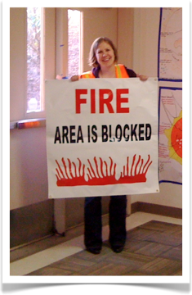
Ways to Implement and Maintain Plan
Tabletop Exercises
Drills
Functional Exercises
Full-Scale Exercises
Notes:
Ultimately you will perform how you practice. The more a plan is practiced and stakeholders are trained on the plan, the more effectively they will be able to act before, during, and after an emergency to lessen the impact on life and property. Exercises provide opportunities to practice with community partners (e.g., first responders, local emergency management personnel), as well as to identify gaps and weaknesses in the plan.
And, if the planning team does not commit to this step, the plan will not work.
Deciding on Frequency, Type of Exercise, and Design: Before making any decisions, school should consider:
Resources of school, district, and partners
Costs and benefits of each
Any state or local requirements
Age of the student population, if they will be involved
Parent involvement and possible roles, if they are included
Cultural diversity of their populations and particular needs
It is up to the planning team to decide how often exercises should be conducted. While frequent exercise is important, it is imperative that exercises are of high quality. Now, we will discuss each of these types in more detail.

Slide 53
Functions Can Occur…
Consecutively
Shelter-in-Place
Evacuation
Concurrently
Evacuation
Accounting for Students, Staff, and Visitors
Notes:
While these functions should be described separately, it is important to remember that many functions will occur consecutively. For example, a shelter-in-place during an emergency may be implemented, but if a building is damaged, the school may then initiate an evacuation of that building.
Often, multiple functions will also be performed concurrently. For example, during an evacuation, once all individuals are safely out of the building, the accounting for students, staff, and visitors function will begin. The evacuation function, however, will still be in effect as school personnel or first responders work to locate and evacuate any persons that are not accounted.
While functions build upon one another and overlap, it is not necessary to repeat a course of action in one functional annex if it appears in a second Functional Annex. For example, though an evacuation may lead to reunification, it is not necessary to list a course of action for reunification within the Evacuation Annex.

Slide 54
Five General Response Annexes
Evacuation
All
Settings All
Times
Lockdown
Lockout/Secure
Shelter-in-Place
Hold
Notes:
During emergencies a critical and immediate decision point is determining whether it is safest to stay or go. Or, in other words, which Functional Annex will be activated—an evacuation, lockdown, or shelter-in-place?
Assessing the situation at hand determines which annexes will be activated—lockdown, evacuation, or shelter-in-place. Each response decision will depend on the specific hazard or threat, specifics of the incident, and the severity of the situation.
Reinforce Planning Principles:
Consider all hazards and threats.
Consider all settings and times (e.g., before, during, after school; classroom and non-classroom; athletic fields, playgrounds, and school buses).
Developing courses of action, procedures, and policies with community partners to support the general functions is critical. The planning team likely will develop variations of these to meet the specific needs of a wide variety of hazards and threats.
The actual terminology used may vary nationwide; however, it is critical the planning team and the school community share a common understanding of words and provide clear directives using plain English. And, for each annex, the planning team will need to take into consideration numerous circumstances and create variations to address them.
Variations will consider the specific threat or hazard and what is needed to keep the school community safe:
The time of school day (before, during, or after)
The time within the school day (e.g., class time, lunch time)
The location of students (e.g., outside at athletic fields, outside at recess, off campus on a field trip)

Slide 55

Evacuation Annex
Key Considerations:
Courses of Action to safely evacuate school buildings and grounds.
Have primary and alternate evacuation routes for every room/section in your building.
Have multiple designated assembly points away from fire lanes.
Have alternate assembly areas away from school grounds.
Various Locations
Secondary Routes
Self-Evacuation
Access and Functional Needs
Notes:
This annex focuses on developing courses of action for leaving the building or grounds when conditions prevent safe occupancy. The planning team should consider the following when developing its goals, objectives, and courses of action:
Bullet 1: Under what conditions would you need to evacuate specific sections of your building or grounds? If such conditions arise, how will you organize movement within your building?
Bullet 2: In the event the school structure is no longer safe to occupy, plan for a controlled egress from the building and identify staging points for students and staff. Student and staff accountability should be considered throughout.
Bullet 3: When evacuation of the school property in its entirety is required, consider alternate assembly sites and transportation options.
Key Considerations: Be sure to include primary and alternate routes and assembly areas. An emergency that requires an evacuation may not permit you to take your preferred exit. And likewise, some designated assembly areas may become obstructed requiring an alternate location.
Always consider your entire population. Don’t wait until it’s too late to identify the unique needs of a particular student or staff member. Have plans in place for people with physical disabilities and ensure you have an effective communication plan so that those with communication difficulties will still be able to understand what is happening and what they should do. This would include people with vision problems, hearing problems, language barriers, or even cognitive impairments that may prevent them from understanding or communicating during an emergency situation.
Specific family reunification procedures should be considered under the “Family Reunification Annex” that will be discussed later in the presentation.

Slide 56

Lockdown Annex (Threat is Inside)
Courses of Action to lock individual classroom doors, offices and other secure spaces when the threat is inside.
Key Considerations:
Interior Doors.
Building Characteristics.
Threats Inside the Building.
Students/Staff Meeting Outside.
Communication with law enforcement.
Locks, lights, out of sight.
No unnecessary movements.
Only unlock or evacuate following an “all-clear” or designated law enforcement response.
Notes:
Who can issue a lockdown order, and how do they do it?
This annex focuses on the courses of action schools will execute to secure the school grounds, buildings, sections of a building, or individual classrooms during incidents that pose an immediate threat of violence in or around the school.
Procedures need to be in place to allow any teacher or staff member who may detect a threat the ability to quickly issue a lockdown.
The primary objective of a lockdown is to quickly secure all school staff, students, and visitors away from immediate danger. The planning team should consider the following when developing its goals, objectives, and courses of action:
Considerations: Exterior Doors and Building Characteristics
How and when to lock all exterior doors, and when it may or may not be safe to do so (e.g., some schools may or may not have the functional ability to lock down all their exterior doors, or the urgency of the situation may not allow for this to safely occur).
How and when interior doors are locked.
How particular classroom and building characteristics (i.e., windows, doors) impact possible lockdown courses of action. Some classroom/office/lab doors in schools may not be able to be locked or require an extra action to lock the door—planning considerations should consider special situations or areas where secondary exits are not available or door securing is not possible.
The circumstances when teaching and learning should stop and students take cover.
Variations: Threats Inside And Outside The School Building
A lockdown is general and actions taken will vary to meet the needs of the specific hazard or threat.
What to do when a threat materializes inside the school. Procedures should include all staff, visitors, students, etc. in all of the various areas within the school and throughout the school day.
Classrooms and non-classroom settings: Classes, media centers, cafeteria, gymnasium, auditorium, administrative offices, etc.
Class time, before and after school, class change times, lunch and recess times, etc.
Procedures should address those students outside of the building using other facilities, such as playgrounds and athletic fields.
What to do when a threat materializes outside the school.
Situations that may prompt outside activities to be immediately halted and direct students and staff to re-enter the building may include a thunderstorm, severe weather event, a wild or threatening animal, a suspicious or dangerous person, and hazardous material situations nearby.
These situations may be concurrent to activation of additional annexes such as a tornado annex.
Common variations of a lockdown.
Outside activities are curtailed, doors are locked, and visitors are closely monitored, but all other school activities continue as normal. Basically, this portion of the plan would consider procedures to be used when the threat or perceived threat is located outside the building (e.g., dangerous animal, swarm of bees, police activity in the area, traffic collision near by).
A lockdown where teaching and learning is stopped and students take cover is generally initiated when there is an imminent threat located inside the school.

Slide 57
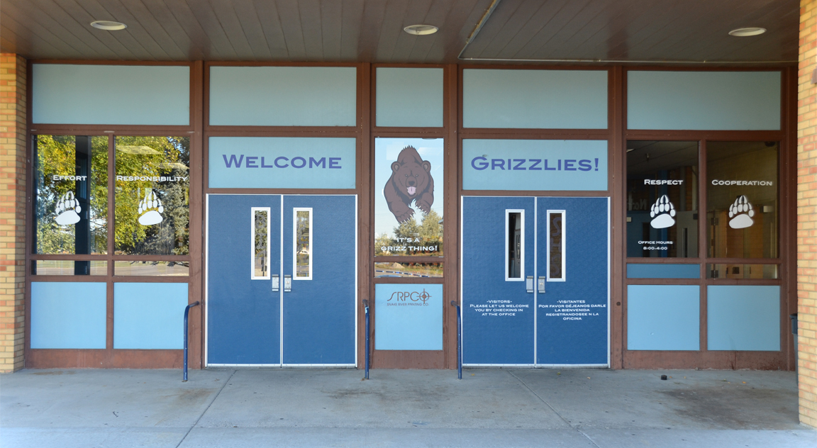
Lockout/Secure Annex (Threat is Outside)
Courses of Action to secure school buildings, facilities, and grounds when the threat is outside.
All students and staff inside.
Lock outer doors.
Continue as normal inside until given all clear by law enforcement.
Key Considerations:
Exterior Doors.
Threats Outside the Building.
Students/Staff Meeting Outside.
Communication with law enforcement.

Slide 58

Hold Annex (Disruption Inside)
Courses of Action to prevent unnecessary movement inside or in specific areas.
Remain in place.
Avoid movement—even during class change periods.
Continue as normal inside classroom until given all clear.
Key Considerations:
Class change periods.
Supervision in transition areas.
Students/Staff Meeting Outside.

Slide 59
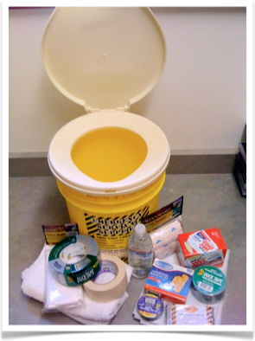
Shelter in Place
Courses of Action when students and staff must remain indoors because it is safer than outside (e.g., Hazardous Materials Shelter; Weather-Related Shelter).
Key Considerations:
Supplies
Accommodations
Designated Safe Rooms
Plan for Moving Students
Notes:
This annex focuses on courses of action when students and staff are required to remain indoors, perhaps for an extended period of time, because it is safer inside the building or a room than outside. Depending on the threat or hazard, students and staff may be required to move to rooms that can be sealed (such as in the event of a chemical or biological hazard) or without windows, or to a weather shelter (such as in the event of a tornado).
The planning team should consider the following when developing its goals, objectives, and courses of action:
Bullet 1: What supplies will be needed to seal the room and to provide for the needs of students and staff (e.g., water). Identification of the required items, where to store them in the classroom or other areas in the building, and training on how to implement the procedure should be a part of this plan.
Bullet 2: How a shelter-in-place can affect individuals with disabilities and others with access and functional needs, such as students who require the regular administration of medication, durable medical equipment, and personal assistant services. Consider how resources will be provided to individuals with disabilities, the personnel required to assist, and training requirements.
Bullet 3: Consider the need for and integration of “safe rooms” for protection against extreme wind hazards (such as a tornado or hurricane) in order to provide immediate life-safety protection when evacuation is not an option.
Bullet 4: Plan for how to move students when the primary route is unusable. This requires the identification of alternate routes and shelter areas. Also plan for how to locate and move students who are not with a teacher or staff member—students who are located in hallways, restrooms, or outdoors when the warning notification is activated for the shelter-in-place emergency.
Remember, planning should consider emergencies that may require sheltering-in-place for several hours. As a result, adequate support resources (water, portable restroom, etc.) should be considered for classrooms and other areas within the building.

Slide 60
Communications and Warning Annex
Includes communication and coordination
before, during, and after emergencies.
Internal
Staff and students.
Language Barriers
Accommodations
External
First Responders
Family
Media
Key Considerations:
Technology
Equipment
Training
Challenges
Notes:
This annex includes communication and coordination before, during, and after emergencies. The planning team should consider the following when developing its goals, objectives, and courses of action:
Internal:
Staff and Students: How students and staff will be notified of emergencies whether at school, on activity trips, or on the school bus (i.e., intercom systems, two-way radios)
Language Barriers: How to effectively address language access barriers. Be sure that your planning includes the provision for emergency information in languages consistent with your student, staff, and community populations.
Accommodations: How the school will provide effective communication with individuals with disabilities and others with access and functional needs before, during, and after the emergency.
External:
First Responders: How the school’s communications system integrates into local first responders (police, fire, etc.) communication networks. This is important because school officials need back-up communication capability with local first responders for notification as well as on-scene communication capabilities.
Families: How the school will communicate with families and the broader community before, during, and after an emergency. Including:
Emergency notification systems that connect with parents during an emergency via text, phone calls, website updates, desktop alerts, and via social networks
The roles and responsibilities of parents and guardians during an emergency
Community updates regarding the possible cancellation of school and other activities such as an athletic event
Community updates describing the impacts on students, including the impact on activities related to the school but not necessarily at the school or during regular school hours (i.e., church use of school property and athletic events)
Additional updates to stakeholders: For example, many outside groups often use schools in the evenings for meetings or church, so notification provisions (and emergency contacts) need to be included in the plan that allows for quick notification of possible cancellation or rescheduling of these events.
Media:
How the school will handle the media (e.g., district or school Public Information Officer [PIO]).
Media planning includes identifying staging areas, school PIOs (and back-ups), pre-scripted media templates with school background information, frequency of media updates, and considerations for coordinating for a multiagency media briefings.
Technology:
Equipment: Planning contingencies for back-ups should utility outages interrupt phone, Internet, or power connections should be considered.
Training: A system for relevant staff members to learn to operate communications equipment. Training is always an important component when acquiring any piece of equipment, particularly communications equipment that will need to be operated properly during an emergency. Be sure to include procedures in your plan for regular familiarization and training on communications equipment.
Challenges: How to account for technology barriers faced by students, staff, parents, and guardians. Remember, not everyone has a computer or access to a smart phone. Traditional media outreach methods may need to be included in your plan, such as local radio, television, or other appropriate methods. Conversely, students are often over-connected and may use social networks to provide additional information about the emergency that may not be factual (e.g., building closures, number of victims, severity of the emergency). A plan needs to be in place to monitor social networks (Facebook and Twitter) in order to provide correct and factual information regarding the emergency.

Slide 61

Accounting for All Persons
Courses of Action for accounting for whereabouts and well-being of students, staff, and visitors.
Key Considerations:
Verification of Attendance
Missing People
Reporting
Release
Notes:
This annex focuses on developing courses of action for accounting for the whereabouts and well-being of students, staff, and visitors, and identifying those who may be missing. The planning team should consider the following when developing its goals, objectives, and courses of action:
Bullet 1: How staff will determine who is in attendance at the assembly area. How will the evacuation area be organized to allow for assembly supervisors or others to implement accountability procedures? Although some emergency situations may not allow for an orderly evacuation, it is always best to attempt to keep classes together to help in the overall accountability process.
Bullet 2: What to do when a student, staff member, or guest cannot be located. Procedures should be in place to quickly alert the assembly supervisor or incident commander when a student, staff member ,or visitor cannot be located during an emergency. Once this happens and considering on-scene safety, staff should be in place to check potential areas, log books, rolls, or other lists for the missing individual(s).
Bullet 3: How staff will report to the assembly supervisor. Generally, this deals with how teachers and staff check in that all their students are accounted for or someone is missing. This may be accomplished through the use of two-way radios, runners, status color cards, etc. Use the method that works best for your school situation.
Bullet 4: How and when students will be dismissed or released. This will likely be determined by the nature of the incident, the weather, the availability of buses, parental notification methods, etc.
Specific family reunification procedures should be considered under the “Family Reunification Annex” that will be discussed later in the presentation.

Slide 62

Family Reunification
Courses of Action for reuniting students with their
families or guardians.
Key Considerations:
Communications
Logistics
Student Security and Release
Missing, Injured, Unaccounted For.
Notes:
This annex details actions to take before, during, and after an emergency in order to reunite students with their families or guardians when there is an emergency situation that prevents a normal school dismissal. The planning team should consider the following when developing its goals, objectives, and courses of action:
Communications: Considerations for communicating with parents before, during, and after the emergency. How to inform families about the reunification process in advance, and how to clearly describe their roles and responsibilities in reunification (e.g., include information at the start of the school year in publications like a participant handbook, on the school’s website, or mention during student/parent orientations.) How frequently families will be updated. Draw upon the Communication and Warning Annex to meet the needs of an effective family reunification.
Logistics: On and off-campus locations; how to move students; floor plans of the off-site family reunification site that clearly map out parent areas, media areas, student areas, etc. How to facilitate communication between the parent check-in and the student assembly and reunion areas.
Student Security and Release Procedures: How to prevent students from leaving on their own. Establish protocols or policies that indicate that students are required to be checked out by a parent during emergencies that necessitate the use of the school’s family reunification procedures. How to verify that an adult is authorized to take custody of a student. This involves including procedures that student emergency contact cards are updated several times a year to eliminate any possible custodial issues; also, clearly explaining that a government issued photo identification is required by individuals picking up students that aligns with the school’s emergency contact card information. How to protect the privacy of students and parents from the media. Procedures that include security and/or law enforcement and a public information officer on site to assist with media relations.
Missing, Injured, or Worse: The plan will include how and when to share information with families when reunification is not possible because a child is missing, injured, or killed. Law enforcement typically takes the lead on death notifications, but all parties must understand their roles and responsibilities so that parents and loved ones receive accurate and timely information in a compassionate manner.

Slide 63

Continuity of Operations (COOP)
Describes how a school will help ensure essential functions continue during an emergency and its aftermath.
Essential Functions
Essential Personnel
Activation
Prolonged Closure
Key Considerations:
Notes:
This annex describes how a school and district will help ensure that essential functions continue during an emergency and its immediate aftermath. For example, continuity of operations (COOP) might be activated following a hurricane that prompted an extended school closure or a pandemic (e.g., H1N1) that caused extended school closure. The COOP includes:
Identifying essential services/functions and set priorities for reestablishing essential functions:
Business services (payroll and purchasing)
Communication (internal and external)
Computer and systems support
Facilities maintenance
Provision of safety and security
Continuity of teaching and learning
Part of this planning includes identifying non-essential functions so that you know which services can cease in an emergency situation and which cannot.
Identifying essential personnel to carry out those essential services. Plan for backup personnel in case the primary person is not available due to the emergency situation. Identify positions “3-deep.” that is, the primary and two backups.
Identify procedures for how the COOP can be activated at any time and sustained for up to 30 days. This involves the collaboration of many internal school departments (administration, district office, facilities, maintenance, transportation, curriculum, IT, etc.) as well as external partners, like local public safety agencies, mental health, and public health.
How the COOP annex will ensure students receive applicable related services in the event of a prolonged closure. Planning considerations should include distance learning strategies and alternate locations and methods to continue the learning process if the building or campus is out of service for an extended period of time. This relates to the recovery annex in the next section.

Slide 64
Public, Medical and Mental Health Annexes
Courses of Action schools should implement to address emergency medical, public health, and mental health counseling issues.
Public Health
  Outbreaks
  Information Sharing
Medical
  Staff Roles and Training
  Resource Management
Mental Health
  Counselors
  Threat Assessment Team
Notes:
This annex describes the courses of action that the school will implement to address emergency medical (e.g., first aid), public health, and mental health counseling issues. Schools should coordinate these efforts with the appropriate emergency medical services, public health, mental health, law enforcement, fire department, and emergency management representatives. Mental health needs after an emergency will be addressed in the Recovery annex.
Medical: What the role of staff members is in providing first aid during an emergency; Where emergency medical supplies (e.g., first aid kits, AEDs) will be located, and who is responsible for purchasing and maintaining those materials; and Which staff have relevant training or experience, such as in first aid or CPR.
Public Health: How the school will promptly share and report information about outbreaks or epidemics or other unusual medical situations to the local health department. This portion of the plan should highlight coordination with local public health agencies, who will report (and receive information from PH) outbreak/epidemic information occurring at the school, and how this information will then be presented to the school community in order to provide sufficient precautions.
Mental Health: How will the school secure a sufficient number of counselors in the event of an emergency. This ties in uniquely with the Recovery Annex, but information needs to be listed on counselor resources and contacts. How will the school support the needs of students identified by the threat assessment team (TAT). This section should highlight the resources available (mental health, etc.) available to students who are identified by the TAT as needing mental health assistance and the procedures for notification and coordination to assist the student.

Slide 65


Public, Medical and Mental Health Annexes cont.
A suicide intervention, prevention and postvention plan (before, during and after) is also not just a good idea to have, but required by law.
Visit ODE’s page on Suicide Intervention, Prevention and Postvention to get more information on requirements as well as sample plans.
Notes:
This annex describes the courses of action that the school will implement to address emergency medical (e.g., first aid), public health, and mental health counseling issues. Schools should coordinate these efforts with the appropriate emergency medical services, public health, mental health, law enforcement, fire department, and emergency management representatives. Mental health needs after an emergency will be addressed in the Recovery annex.
Medical: What the role of staff members is in providing first aid during an emergency; Where emergency medical supplies (e.g., first aid kits, AEDs) will be located, and who is responsible for purchasing and maintaining those materials; and Which staff have relevant training or experience, such as in first aid or CPR.
Public Health: How the school will promptly share and report information about outbreaks or epidemics or other unusual medical situations to the local health department. This portion of the plan should highlight coordination with local public health agencies, who will report (and receive information from PH) outbreak/epidemic information occurring at the school, and how this information will then be presented to the school community in order to provide sufficient precautions.
Mental Health: How will the school secure a sufficient number of counselors in the event of an emergency. This ties in uniquely with the Recovery Annex, but information needs to be listed on counselor resources and contacts. How will the school support the needs of students identified by the threat assessment team (TAT). This section should highlight the resources available (mental health, etc.) available to students who are identified by the TAT as needing mental health assistance and the procedures for notification and coordination to assist the student.

Slide 66

Participant Activity
Identify which of the preceding Functional Annexes you already have in place.
Identify the Functional Annexes that are not currently in place and consider which ones might hold the highest priority.
*Go through page 4 in the workbook and conduct a needs assessment for your school.
Notes:
Participant Activity:
Invite participants to review the 10 Functional Annexes. Have the participants check page 4 in their workbook and conduct an inventory of their current plans or procedures.
Invite participants to consider the prompts on this slide. After individual reflection, invite them to discuss their findings with others in a small group. Finally, invite individuals within the whole group to share their thinking.
Adult learning principles: Integration of new learning, activation of previous knowledge, application of new tools, assessment and evaluation, prioritization, and peer-to-peer learning.

Slide 67
Describe Courses of Action Unique to
Particular threats and hazards
Before, During, and After an Emergency
SCHOOL EMERGENCY OPERATIONS PLAN
BASIC PLAN
FUNCTIONAL ANNEXES
THREAT AND HAZARD-SPECIFIC ANNEXES
Notes:
Threat- and Hazard-Specific Annexes describe the courses of action unique to particular threats and hazards.
Refer to the participants guide for a detailed list of contents for this section of the plan.

Slide 68
Threat and Hazard Specific Annexes
Natural Hazards
Technological Hazards
Biological Hazards
Adversarial, Incidental, and Human-caused Threats
Notes:
Threats and hazards are referenced into four different categories:
Natural Hazards
Technological Hazards
Biological Hazards
Adversarial, Incidental, and Human-caused Threats
The difference between hazards and threats is that a threat includes an adversary.
Courses of action already outlined in a Functional Annex need not be repeated in a Hazard-Specific annex. Schools will develop these based on the prioritized list of hazards determined in the assessment process. As planning teams develop courses of action for threats and hazards, they should consider the Federal, state, and local regulations or mandates that often apply to specific hazards.
If there is a Functional Annex that applies to one of the threat or hazard annexes, the latter will include it by reference. For example, if a “during” course of action for a fire hazard involves evacuation and there is an evacuation annex, the Fire annex would indicate “see Evacuation annex” in the “during” course of action section rather than repeat the evacuation courses of action in the Fire annex.

Slide 69

Threat and Hazard Specific
What threats or hazards have you identified already?
Remember, we should plan for responses to:
Fires.
Earthquakes (and tsunamis in applicable zones).
Safety threats including procedures related to lockdown, lockout, shelter in place, evacuation and other appropriate actions.
Notes:
Emphasize that this is a reference to OAR 581-022-2225 regarding school safety and emergency response. Also, they can use this time to conduct an inventory of which functional annexes they currently have and determine which ones they will still need. Refer to page 4 in the workbook for this activity. Allow time to conduct the inventory and to also go over a couple functional annex worksheets as needed.
Threats and hazards are referenced into four different categories:
Natural Hazards
Technological Hazards
Biological Hazards
Adversarial, Incidental, and Human-caused Threats
The difference between hazards and threats is that a threat includes an adversary.

Slide 70
Program Information
The SSSEM Program provides training and technical assistance to develop and exercise school emergency operations plans.
Visit us online to find your regional emergency preparedness consultant for help with:
Writing your EOP.
Updating your EOP.
Exercising your EOP.

