Slide 1
Federal Systems Team
Title I-A
Fall 2019 Regional Training

Slide 2

Oregon Department of Education
“Our Why”
Equity and Excellence for Every Learner
The Oregon Department of Education works in partnership with school districts, education service districts and community partners;
Together, we serve over 580,000 K-12 students;
We believe every student should have access to a high-quality, well-rounded learning experience;
We work to achieve the Governor’s vision that every student in Oregon graduates with a plan for their future.

Slide 3
Oregon Department of Education
Education Equity Stance
Education equity is the equitable implementation of policy, practices, procedures, and legislation that translates into resource allocation, education rigor, and opportunities for historically and currently marginalized youth, students, and families including civil rights protected classes. This means the restructuring and dismantling of systems and institutions that create the dichotomy of beneficiaries and the oppressed and marginalized.

Slide 4
Who We Serve
Our Customers
Early Childhood
232,168 children under age five;
Approximately 4,000 licensed child care facilities.
Districts & Schools
197 school districts;
19 education service districts;
1,335 schools.
Students & Youth
580,690 students in K-12 (2017-18); and 11,939 at-risk youth ages 6-24.
Educators
Approximately 77,899 teachers, administrators and other local employees.
Oregon Tribes, Stakeholders, & the Public
Families, business community partners, education advocacy groups, the Legislature, other state agencies;
Oregon tribes, non-profits and the general public.

Slide 5
Who We Serve
2017-18 Student Demographics
Student Groups by Race & Ethnicity

Slide 6

Who We Serve
Additional 2017-18 Student Demographics
Other Student Groups
Economically Disadvantaged: 52.1%
Ever English Learners: 18.3%
Homeless: 3.8%
Lesbian/Gay (11th grade): 9.1%
Mobile Students: 12.0%
Students with Disabilities: 13.6%

Slide 7
Agenda
Updates
Program Updates
Title I-A, I-D,IV-A, MV & REAP/RLIS
ESEA Monitoring
Risk Assessment Tool
Continuous Improvement Plan (CIP)
Title I-A School Level Plans
CIP Budget Narrative

Slide 8
Handouts for Today’s Session
  Agenda
  Continuous Improvement Plan (CIP) Information
  Title I-A and Community Eligibility Provision (CEP)
  Title I-A Methodology Statement Reference
  Title I-A Program Calendar
  Title I-A Plan Information
  Title I-A Private School Proportionate Share Flowchart
  Title I-A McKinney-Vento Set-Aside Calculation

Slide 9
Continuous Improvements Plans & Budget Narratives
Continuous Improvement Plan & Budget Narratives
Notes:
Questions for audience: Who was at COSA? Who is new to Title?

Slide 10
Essential Question
How do we anchor in the Continuous Improvement Process so that we have a clear Continuous Improvement Plan that guides and influences our investments to increase student learning and honors federal requirements ?

Slide 11
Objectives
Establish a common understanding of the continuous improvement plan components.
Clarify where the budget narrative lives within the continuous improvement process.
Clarify how to access federal funds in the budget narrative.
Clarify specific Title I-A program components.

Slide 12
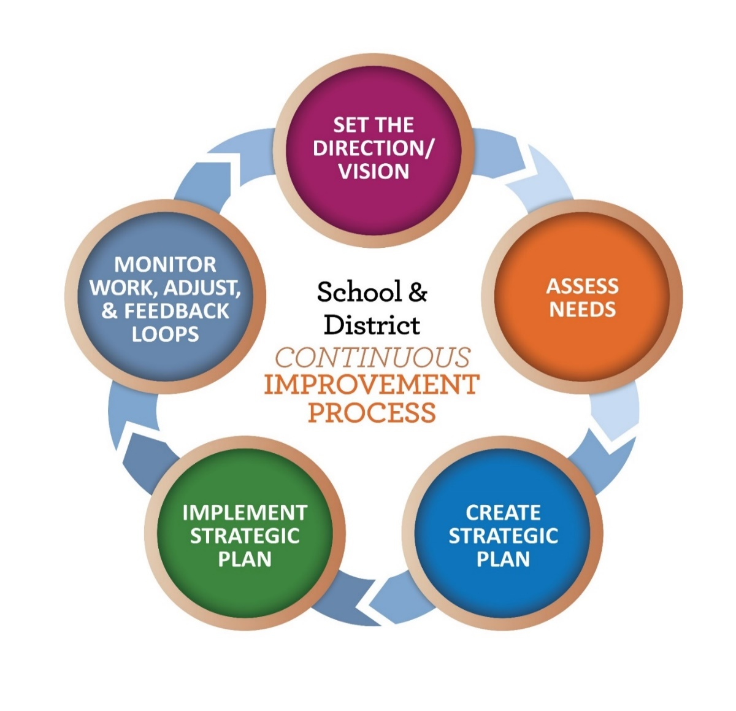
Continuous Improvement Process
CC BY-SA

Slide 13
Continuous Improvement Plan
District Level Continuous Improvement Plan
Big 5
Supplemental 10
CC BY-SA

Slide 14
Continuous Improvement Plan
The Big Five
I. District Vision
II. District Mission
III. Strategic Goals/Priorities: (3-5)
IV. District Implementation Plan
V. Review / Monitoring of the Plan
CC BY-SA

Slide 15
Continuous Improvement Plan
The Supplemental Ten
1. Standards-aligned Curriculum
2. High Quality Instruction
3. Talent Management, Professional Development
4. Safe & Inclusive Climate
5. Family, Community & Stakeholder Engagement
6. Leadership Development
7. High Quality Data Systems
8. Continuous Improvement Planning
9. Supports and Interventions for Students
10. Library Program
CC BY-SA

Slide 16
Access to the Continuous Improvement Plan
Smartsheets
for Big Five and Supplemental Ten
ODE Continuous Improvement Page
CC BY-SA

Slide 17
Where does the Budget Narrative fit?
CC BY-SA

Slide 18
ESSA FEDERAL PROGRAMS included in the CIP Budget Narrative
  Title I, Part A (Improving Basic Programs)
  Title I, Part C (Migrant Education)
  Title I, Part D (Neglected and Delinquent)
  Title II, Part A (Supporting Effective Instruction)
  Title III, Part A (English Learner and Immigrant Youth)
  Title IV, Part A (Student Support & Academic Enrichment)
  Title V (REAP and RLIS)

Slide 19
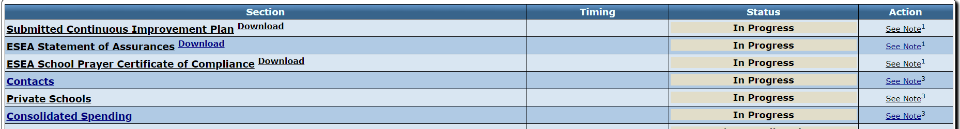
Continuous Improvement Process
BUDGET NARRATIVE

Slide 20
ACCESS TO FUNDS and SUBMISSION
ACCESS TO 20 % Funding
ACCESS TO 100 % FUNDING
Submission of FOUR pre-requisites:
ESEA Statement of Assurances
ESEA School Prayer Certificate
Contacts
Private Schools
All four pre-requisites located in first section of Budget Narrative (opens August 8)
Submission and approval of:
CIP Planning Template
Ten ESSA/State Supplemental Questions
Program Budget Narrative
Smartsheets for Big Plan and Supplemental Ten ODE Continuous Improvement Page

Slide 21
Key Dates
KEY DATES Continuous Improvement Plan (CIP) and Budget Narrative opens in August 2019 | 20 % of funds may be released for each program once the four pre-requisites have been submitted: ESEA Statement of Assurances School Prayer Certificate of Compliance Budget Narrative Contacts Private Schools 100 % of funds may be released for each program once the programs CIP Plan and CIP Budget Narrative have been approved.
November 1, 2019 | Continuous Improvement Plan (CIP) (Big Five and Supplemental Ten responses) Due Extension can be granted until December 6
March 20, 2020 | FINAL date for submission of Federal Program CIP Budget Narratives
March 21, 2020 | Funds will be frozen for those districts that have not submitted the CIP Plan and Budget Narratives
June 1, 2020 | Liquidation of funds if district level CIP (Big Five and Supplemental Ten responses) and CIP Budget Narrative are not submitted and approved

Slide 22

IMPACT ON YOUR DISTRICT?
Guiding Questions:
Clarifications?
Resources/TA needed?
Strategies to share?

Slide 23
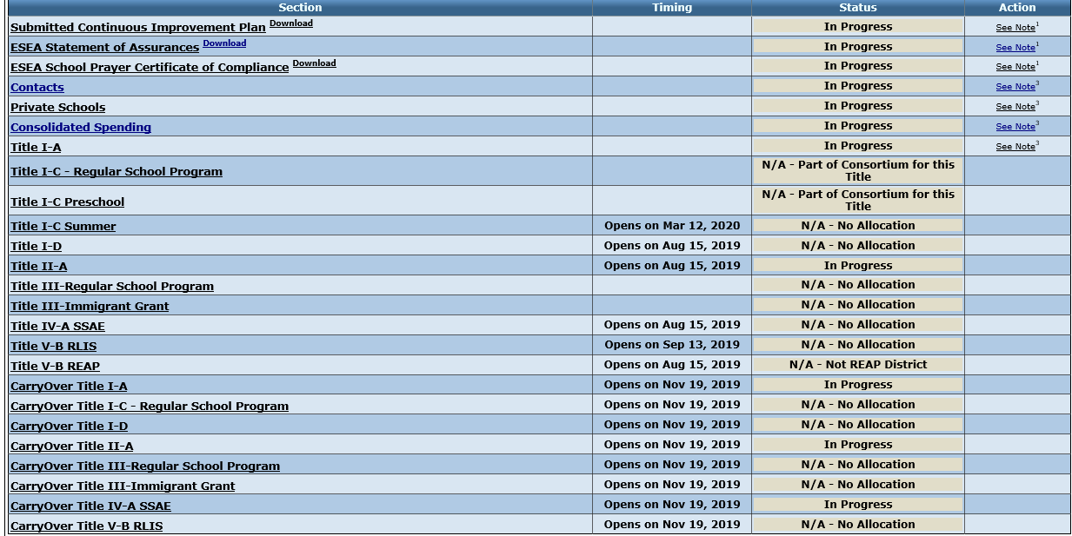
BUDGET NARRATIVE OVERVIEW

Slide 24
Transferring Funds Rules
Needs Assessment with stakeholder engagement, including private schools
Transfer only from Title II-A and Title IV-A
No limits on the amounts of funds to transfer
Once funds are transferred, they take on the identity of that Title AND must be spent under rules applicable to that Title
Notes:
Transferring Funds
To provide districts the flexibility to use federal funds received under ESSA on those programs and services that would most effectively meet identified student and staff needs, the law allows for districts to transfer some of their federal formula grant funds from one Title to another.2 A few general rules apply to transfers of funds:
• A district may transfer funds only from Title II-A and Title IV-A.
• There are no limits on the amount of funds a district may transfer from those Titles.
• If applicable, a district must consult with the appropriate nonpublic school officials before transferring funds.
• Once funds are transferred, they take on the identity of the Title to which they were transferred and must be spent under rules applicable to that Title.

Slide 25
Transferring Funds
Districts May Transfer All or Some Funds From: | Districts May Transfer Funds Into:
Title II-A, Supporting Effective Instruction Title IV-A, Student Support and Academic Enrichment | Title I-A, Improving Basic Programs Title I-C, Migrant Education Title I-D, Prevention and Intervention Programs for Children and Youth who are Neglected, Delinquent, or At-Risk Title II-A, Supporting Effective Instruction Title III-A, English Language Acquisition, Language Enhancement, and Academic Achievement Title IV-A, Student Support and Academic Enrichment Title V-B, Rural Education Initiative

Slide 26
Title I-A Budget Narrative

Slide 27
Title I-A Budget Narrative OVERVIEW Page
Title I-A Budget Narrative
OVERVIEW Page
Notes:
Questions for audience: Who was at COSA? Who is new to Title?

Slide 28
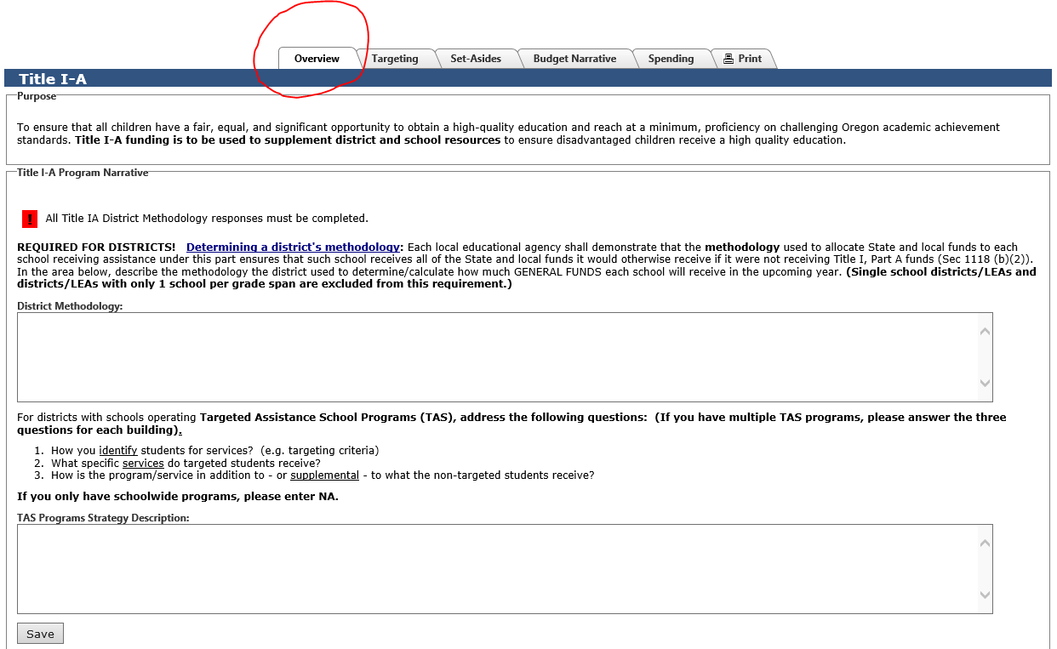
Title I-A Overview Page

Slide 29
Methodology
An LEA must show that its methodology to allocate State and local funds to schools results in each Title I-A school receiving all of the State and local funds it would otherwise receive if it were not receiving Title I-A funds.
In other words, an LEA’s methodology must be “Title I neutral” in that it allocates State and local funds to schools without regard for Title I-A status.
Notes:
Transferring Funds
To provide districts the flexibility to use federal funds received under ESSA on those programs and services that would most effectively meet identified student and staff needs, the law allows for districts to transfer some of their federal formula grant funds from one Title to another.2 A few general rules apply to transfers of funds:
• A district may transfer funds only from Title II-A and Title IV-A.
• There are no limits on the amount of funds a district may transfer from those Titles.
• If applicable, a district must consult with the appropriate nonpublic school officials before transferring funds.
• Once funds are transferred, they take on the identity of the Title to which they were transferred and must be spent under rules applicable to that Title.

Slide 30
Methodology
Methodology statement considerations:
Public charter schools
Different grade spans
Notes:
Transferring Funds
To provide districts the flexibility to use federal funds received under ESSA on those programs and services that would most effectively meet identified student and staff needs, the law allows for districts to transfer some of their federal formula grant funds from one Title to another.2 A few general rules apply to transfers of funds:
• A district may transfer funds only from Title II-A and Title IV-A.
• There are no limits on the amount of funds a district may transfer from those Titles.
• If applicable, a district must consult with the appropriate nonpublic school officials before transferring funds.
• Once funds are transferred, they take on the identity of the Title to which they were transferred and must be spent under rules applicable to that Title.

Slide 31
Title I-A Budget Narrative
SET ASIDES Page
Title I-A Budget Narrative
SET ASIDES Page
Notes:
Questions for audience: Who was at COSA? Who is new to Title?

Slide 32
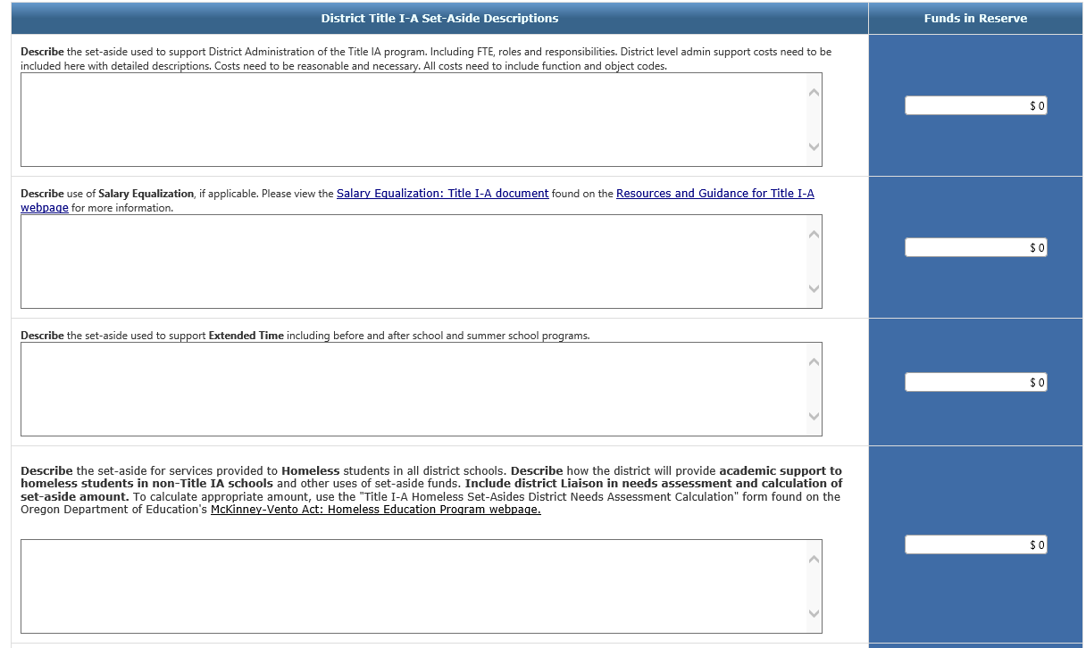
Title I-A Set-aside Page

Slide 33
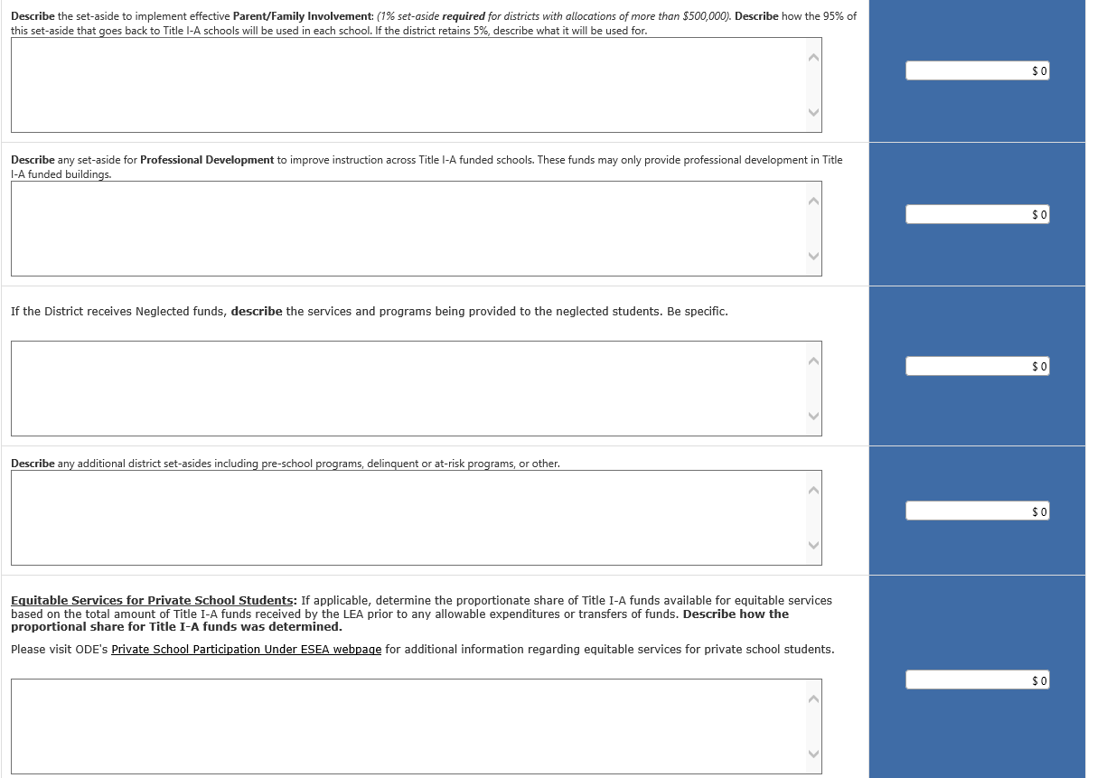
Title I-A Set-aside Page

Slide 34
Title I-A Budget Narrative
TARGETING Page
Title I-A Budget Narrative
TARGETING Page
Notes:
Questions for audience: Who was at COSA? Who is new to Title?

Slide 35
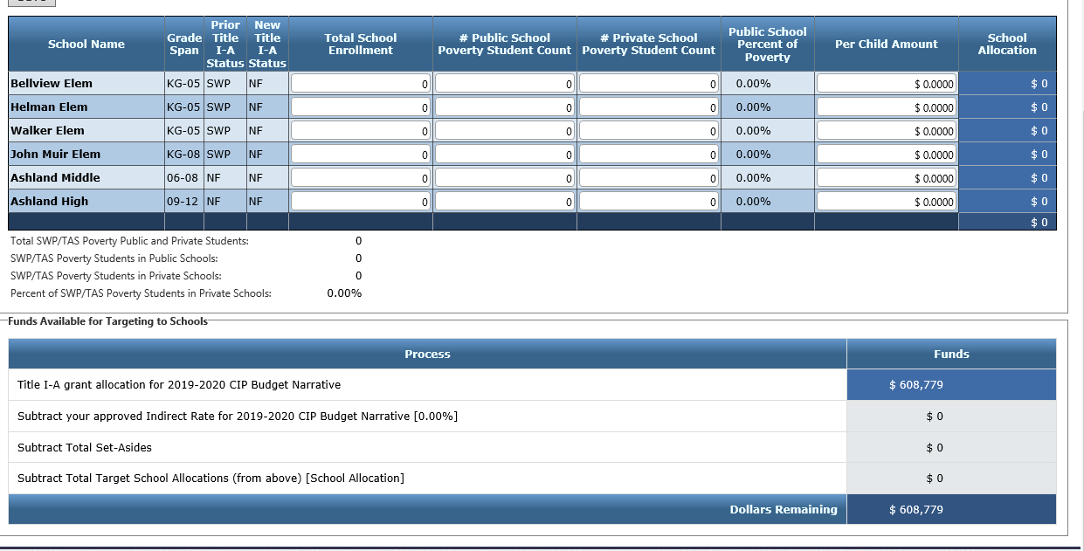
Title I-A Targeting Page

Slide 36
Community Eligibility Provision
Community Eligibility Provision (CEP)
https://www.oregon.gov/ode/students-and-family/childnutrition/SNP/Pages/CEP.aspx

Slide 37
Determining Poverty Count
(Option #1)
CEP School
Composite of the sum of any or all of the following Identified Students:
Non-CEP School
Same composite sum as used in CEP schools
Direct certification count
Foster student count
Homeless/Runaway count
Migrant count
Headstart/Even Start count (if eligible)
Notes:
A consideration here is that the same method of determining poverty is used for all schools.
This option will result in a lower poverty percentage for all schools.

Slide 38
Determining Poverty Count
(Option #2)
CEP School
Using the CEP Multiplier:
Non-CEP School
Using the CEP Multiplier:
The sum of all identified students will be multiplied by the CEP Multiplier (currently 1.6)
The sum of all identified students will be multiplied by the CEP Multiplier (currently 1.6)
Notes:
A consideration here is again, the same method of determining poverty is used for all schools.
This option will result in a higher poverty percentage for all schools.
Title I rank would be the same with Options 1 and 2.

Slide 39
Determining Poverty Count
(Option #3)
CEP School
Using the CEP Multiplier:
Non-CEP School
Determine the same as previous year’s (ie Free & Reduced Lunch applications)
The sum of all identified students will be multiplied by the CEP Multiplier (currently 1.6)
Notes:
With this option, CEP schools may rank higher as compared to non-CEP schools than they would have using Options 1 or 2.

Slide 40
Title I-A Budget Narrative
BUDGET NARRATIVE Page
Title I-A Budget Narrative
BUDGET NARRATIVE Page
Notes:
Questions for audience: Who was at COSA? Who is new to Title?

Slide 41
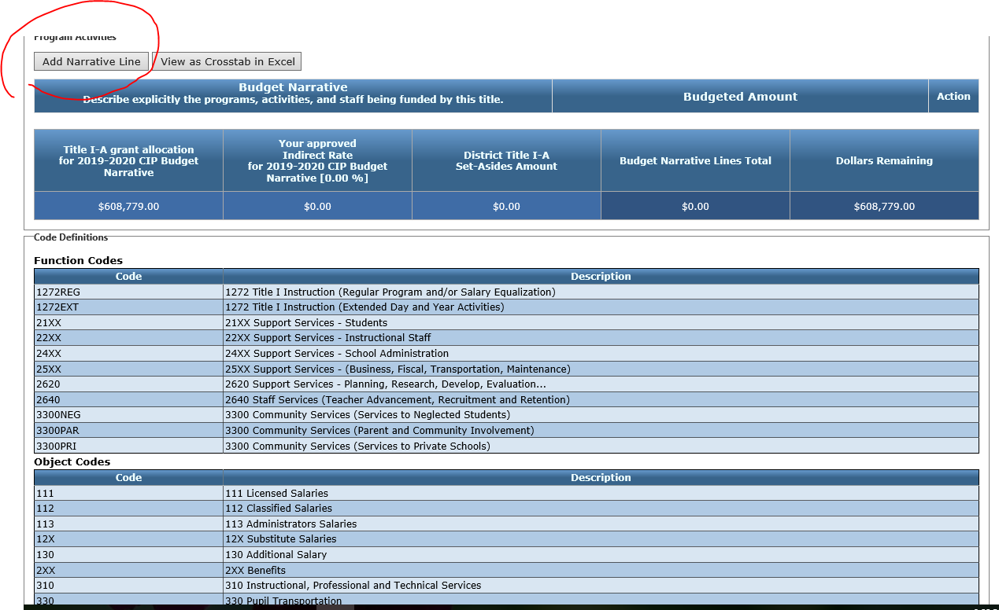
Title I-A Budget Narrative Page

Slide 42
Title I-A Spending Page
  Reminders:
  The allocation for each school on the Targeting Page must equal each school’s allocation on the Budget Narrative Page.
  The Dollars Remaining on both pages must be zero.

Slide 43
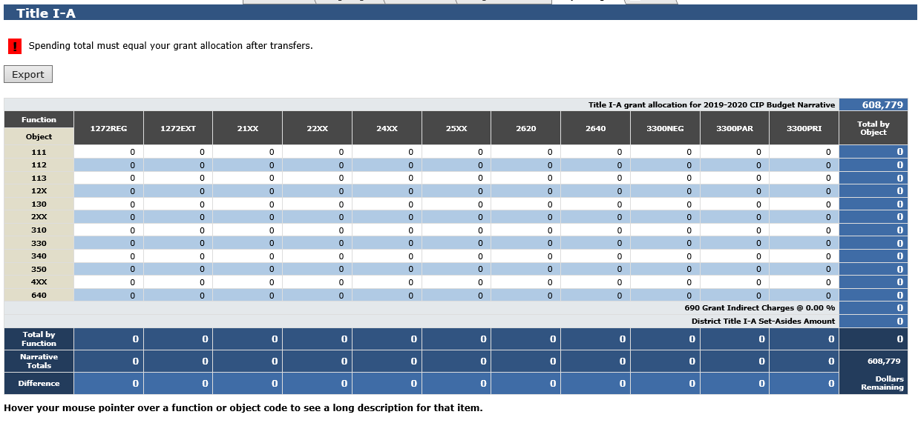
Title I-A Spending Page

Slide 44
Title I-A Carryover
Cannot exceed 15%
Once every 3 years
No current ED Flex Waiver

Slide 45
Title I-A School Level Plans
No longer in Indistar
Now in Smartsheets
Title I-A SchoolWide Plan Submission
Title I-A Targeted Assistance School Plan Submission

Slide 46
Title I-A School Level Plans
Review and revision of the plans and documents is an annual process.
The district can choose each year when the plan and documents are updated.
ODE will check by the end of March each year that the plans and documents have been submitted.

Slide 47
Title I-D Neglected & Delinquent

Slide 48
Title I-D: Subpart 2
Purpose:
  to improve educational services for students in locally operated facilities for neglected or delinquent students.
Eligibility:
  An LEA is eligible to receive funds if there is a locally operated facility within its geographical boundaries.
Funding:
  Determined by annual October Caseload Count
  Neglected funds flow through Title I-A
  Funds can be use at facility, district, and school levels.

Slide 49
Title I-D: Subpart 2
Important Changes
LEA Transition Contact
  Districts will be required to identify a point of contact to assist with enrollment, withdrawal, and records.

Slide 50
Title IV-A
Student Success and Academic Achievement

Slide 51
Title IV-A: Program Requirements
Under ESSA, a block grant for:
  Well-rounded education;
  Improving school conditions for learning; and
  Use of technology to improve academic achievement and digital literacy of all students
Formula grant to all districts based on Title I-A formula--relevant only to districts receiving Title I-A
No district may receive less than $10,000

Slide 52
Needs Assessment
Districts that receive $30,000 or more must complete a comprehensive needs assessment.
The needs assessment must be completed even if the district plans to transfer Title IVA funds into other programs.

Slide 53
Needs Assessment Tools
The Oregon Integrated Systems (ORIS) framework needs assessment can be used for Title IV-A.
USDE also has a needs assessment tool specific to Title IV-A that can be used.

Slide 54
Prioritizing High-Need Schools
LEAs must prioritize SSAE funds to schools that:
Have the greatest needs as determined by the LEA
Have the highest percentages or numbers of low-income children
Are identified for comprehensive support and improvement under Title I
Are implementing targeted support and improvement plans under Title I
Are identified as a persistently dangerous school under Section 8532

Slide 55
Stakeholder Engagement
LEAs must meaningfully consult with a wide array of stakeholders when designing their SSAE programs and before transferring funds.
They must also engage in continuing consultation with stakeholders to improve SSAE activities and to coordinate SSAE activities with other activities conducted in the community.

Slide 56
Title IV-A: Funding Parameters
Districts that receive $30,000 or more must spend:
  At least 20% to support well-rounded education;
  At least 20% to support safe and healthy students; and
  At least “some funds” to support the effective use of technology.
     May not spend more than 15% on technology infrastructure
Districts that receive less than $30,000 must meet at least one of the above requirements.

Slide 57
Title IV-A: Allowable Uses
Well-Rounded Education | Safe & Healthy Students | Use of Technology
College & career guidance Music & Arts STEM Accelerated learning History, civics, economics, geography, government education Foreign language Environmental education Volunteerism & community involvement Integrating multiple disciplines | Drug & violence prevention School-based mental health services Health & safety programs Addressing trauma Addressing sexual abuse Reducing exclusionary discipline practices Positive behavioral interventions Resource coordinator Pay for success | Professional learning Technological capacity & infrastructure Delivering courses through technology Blended learning PD on use of technology in STEM areas Access to digital learning

Slide 58
Equitable Services
SSAE funds are subject to an equitable services requirement to private schools.
LEAs must reserve funds to provide SSAE services to eligible private school children, teachers, and other educational personnel in private schools.

Slide 59
Resources for Title IV-A
Non-Regulatory Guidance: ESSA Title IV, Part A Guidance – Student Support And Academic Enrichment Program
Humanities Education
STEM and CTE
Title I-A Schoolwide Guidance

Slide 60
Title V-B
REAP, RLIS, and SRSA

Slide 61
Differences
REAP/SRSA
Small & Rural
Three sources of funds
Title I-A
Title II-A/REAP Flex
SRSA (from USDE)
RLIS
Rural & Low-Income
Three sources of funds
Title I-A
Title II-A
Title V-B RLIS
Non-REAP/RLIS
Two sources of funds
Title I-A
Title II-A
Does not meet state definition of RURAL

Slide 62
REAP Eligibility
To be eligible, a LEA must be both “rural” and “small”
To be RURAL, an LEA must;
Have 600 or fewer students in the district as determined by state ADA data
All schools served by the LEA have a school locale code of 6, 7, or 8
To be SMALL, an LEA must:
Notes:
Local Codes:
What is the definition of locale codes 7 & 8? Schools receive locale code of “7” if according to the US Census Bureau it is located in a place that is outside the metropolitan statistical area (MSA) and has fewer than 2,500 persons. • A locale code of “8” indicates a school is located inside a MSA with a population fewer than 2,500 persons.

Slide 63
RLIS Eligibility
To be eligible, a LEA must be both “rural” and “low-income”
To be RURAL, an LEA must;
20% or more of the children ages 5 to 17 served by the LEA are from families with incomes below the poverty line
All schools served by the LEA have a school locale code of 6, 7, or 8
To be LOW-INCOME, an LEA must:
Notes:
Local Codes:
What is the definition of locale codes 7 & 8? Schools receive locale code of “7” if according to the US Census Bureau it is located in a place that is outside the metropolitan statistical area (MSA) and has fewer than 2,500 persons. • A locale code of “8” indicates a school is located inside a MSA with a population fewer than 2,500 persons.

Slide 64
Equitable Services for Private Schools

Slide 65
ESSA: Equitable Services for Private Schools
Ombudsman
Attends consultations upon request
Affirmation of Consultation
Please send to Joni Gilles joni.gilles@state.or.us 30 days after consultation with private schools
Allocating funds for
Title IIA and IVA
Based on needs assessments
Responsibilities of Private Schools
Attend consultation meetings
Ensures compliance with ESSA
Handles complaints for private schools
Timely and meaningful consultation with private schools BEFORE transferring funds
Migrant Ed Programs (Title I-C)
Provide poverty and resident information
Provide reports/documentation when requested

Slide 66

Equitable Services
Consultation that is timely, meaningful and ongoing is at the of Equitable Services
ALLOCATION is based on residence AND poverty
SERVICE is based on residence AND need
Targeted assistance (for those eligible students) NOT school wide
Coming soon
    FAQ’s for Equitable Services and General Private School Questions
    List of private schools
    Ombudsman Updates (from me to you with most current state and national information and information)
What is missing? How can we assist?

Slide 67
Oregon Foster Care: Educational Stability (2016-2017)
Student Outcome | Foster Care | Non-Foster Care
Graduates | 35% | 77%
Other Completers | 11% | 3%
Continuing Enrollment | 18% | 6%
Non-completers/dropouts | 37% | 13%
* Data represents unverified 2016-17 school year data; based on 10,800 students in public schools in foster care between January 1, 2012 and December 31, 2017.

Slide 68
Foster Care: Providing Educational Stability
Point of Contact in each district
School/district of Origin
Best Interest Finding
Each district must develop and implement procedures on how transportation will be provided to maintain school of origin
Stay Tuned for dates of Fall and Spring Trainings

Slide 69
McKinney- Vento (MV)
Homeless Children & Youth
ODE McKinney-Vento Website

Slide 70
MV: District Requirements
(examples)
Adopt OSBA Homeless Student Policy (sample)
Designate District Liaison to fulfill MV duties and maintain compliance
Liaison must be trained and provide awareness training to district staff
Provide annual count data, including on homeless children in Head Start
Co-arrange inter-district transportation when required
Collaborate with community service providers

Slide 71
Set-Asides for Homeless Students
All districts that receive Title I-A funds must reserve a portion to serve homeless students
Amount of set-aside must be based on a needs assessment and include consultation with the Liaison
Broad use of funds: school transportation, Liaison FTE, student supplies, emergency medical/dental needs, clothing, shoes, tutoring, etc. May not be used for housing or lodging expenses.
Calculation sheet posted on ODE MV Program Website

Slide 72
McKinney-Vento Program
State Coordinator: Dona Bolt
dona.bolt@state.or.us 503-947-5781
Program Assistant: Stacie Ankrum
stacie.ankrum@state.or.us 503-947-5633

Slide 73
ESEA Monitoring

Slide 74
Which programs are included?
Title I-A – Improving Basic Programs
Title II-A – Supporting Effective Instruction
Title IV-A Student Support and Academic Enrichment
McKinney-Vento Homeless Education
Equitable Services to Private Schools

Slide 75
Risk Assessment for Monitoring
Last Monitoring Cycle
Student Achievement
District Specific Metrics
Unresolved Findings

Slide 76

A new look for Monitoring
Goal: Less paperwork submission for districts.
Student Achievement takes a larger role.
Federal Systems Team will partner with school improvement efforts to support districts.
Title I-A items will now be submitted annually through the Smartsheet process.
District Notification by October 15, 2019

Slide 77

Questions and Discussion

Slide 78
Future Training Opportunities
Ideas and options to consider:
  All day session for new Title I-A colleagues
  Two day conference for all of federal programs

Slide 79
Resources
Informational Materials
ODE website: www.oregon.gov/ode
Budgets & Data Collections
ODE District Website: www.district.ode.state.or.us
Continuous Improvement Plan: https://www.oregon.gov/ode/schools-and-districts/Pages/CIP.aspx
ODE Federal Programs: http://www.oregon.gov/ode/schools-and-districts/grants/ESEA/Pages/default.aspx
Federal Funds Guide
CIP Budget Narrative User Guide

Slide 80

Thank you!

