Slide 1
Title I, Part A:
Title I, Part A:
Improving Basic Programs

Slide 2
Title I-A
2020-2021
Continuous Improvement Process (CIP)
Budget Narrative
Notes:
Hello, and welcome to the Oregon Department of Education’s presentation on completing the 2020-2021 Title I-A Continuous Improvement Process (CIP) Budget Narrative.
I’m Lisa Plumb, an Education Specialist with ODE’s Federal Systems Team, in the Office of Enhancing Student Opportunities.

Slide 3


Grace & Patience
Grace & Patience
We are learning together to move powerfully on behalf of children and communities.

Slide 4

Oregon Department of Education
“Our Why”
Equity and Excellence for Every Learner
The Oregon Department of Education works in partnership with school districts, education service districts and community partners;
Together, we serve over 580,000 K-12 students;
We believe every student should have access to a high-quality, well-rounded learning experience;
We work to achieve the Governor’s vision that every student in Oregon graduates with a plan for their future.
Notes:
At the forefront of our work, The Oregon Department of Education, ODE, is committed to equity and excellence for every learner.
We work in partnership with school districts, education service districts, and community partners to best meet the educational needs of over 580,000 students.

Slide 5
Oregon Department of Education
Education Equity Stance
Education equity is the equitable implementation of policy, practices, procedures, and legislation that translates into resource allocation, education rigor, and opportunities for historically and currently marginalized youth, students, and families including civil rights protected classes. This means the restructuring and dismantling of systems and institutions that create the dichotomy of beneficiaries and the oppressed and marginalized.
Notes:
Our Education Equity Stance notes that:
Education equity is the equitable implementation of policy, practices, procedures, and legislation that translates into resource allocation, education rigor, and opportunities for historically and currently marginalized youth, students, and families including civil rights protected classes.
This means the restructuring and dismantling of systems and institutions that create the dichotomy of beneficiaries and the oppressed and marginalized.

Slide 6
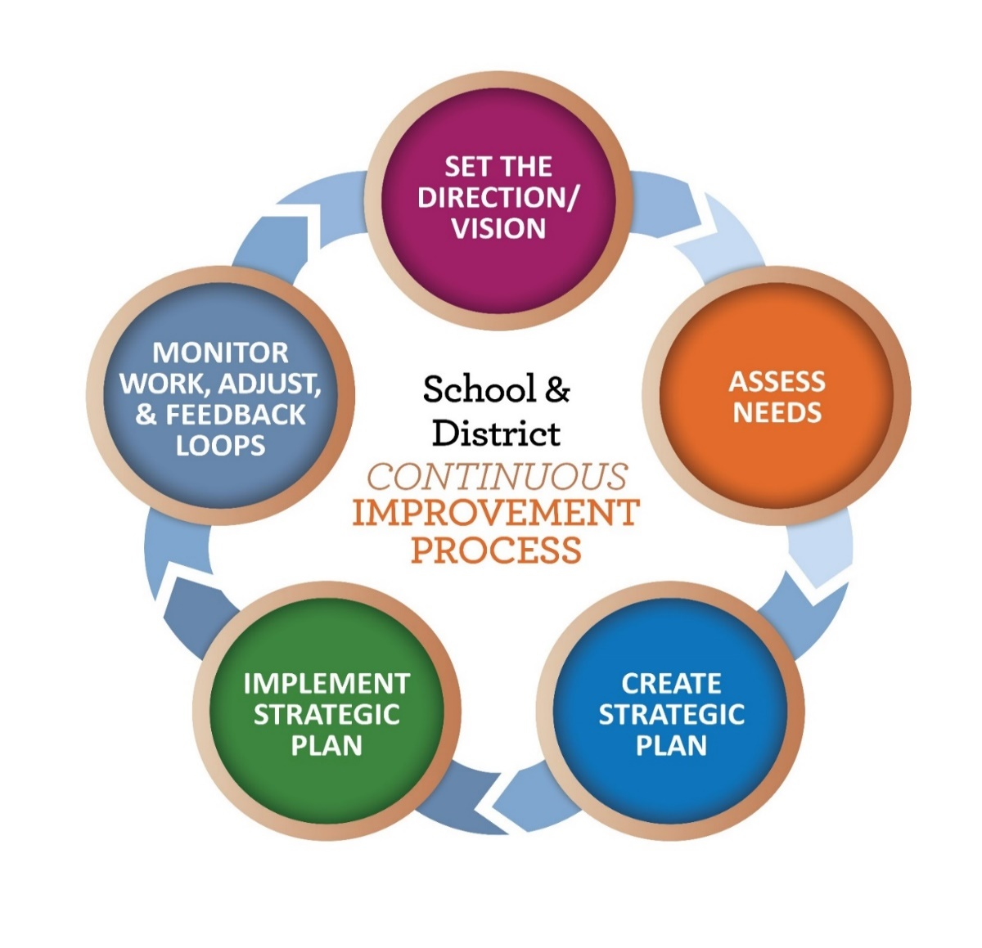
Continuous Improvement Process
Notes:
As we consider how we’re ensuring equity for all students, completing the budget narrative for the district’s Title I-A allocation is part of the entire Continuous Improvement Process.

Slide 7
ESSA FEDERAL PROGRAMS included in the CIP Budget Narrative
  Title I, Part A (Improving Basic Programs)
  Title I, Part C (Migrant Education)
  Title I, Part D (Neglected and Delinquent)
  Title II, Part A (Supporting Effective Instruction)
  Title III, Part A (English Learner and Immigrant Youth)
  Title IV, Part A (Student Support & Academic Enrichment)
  Title V (REAP and RLIS)
Notes:
As we consider the entire CIP Budget Narrative process we’re looking at numerous federal programs, each with a specific focus on student support and opportunity.

Slide 8
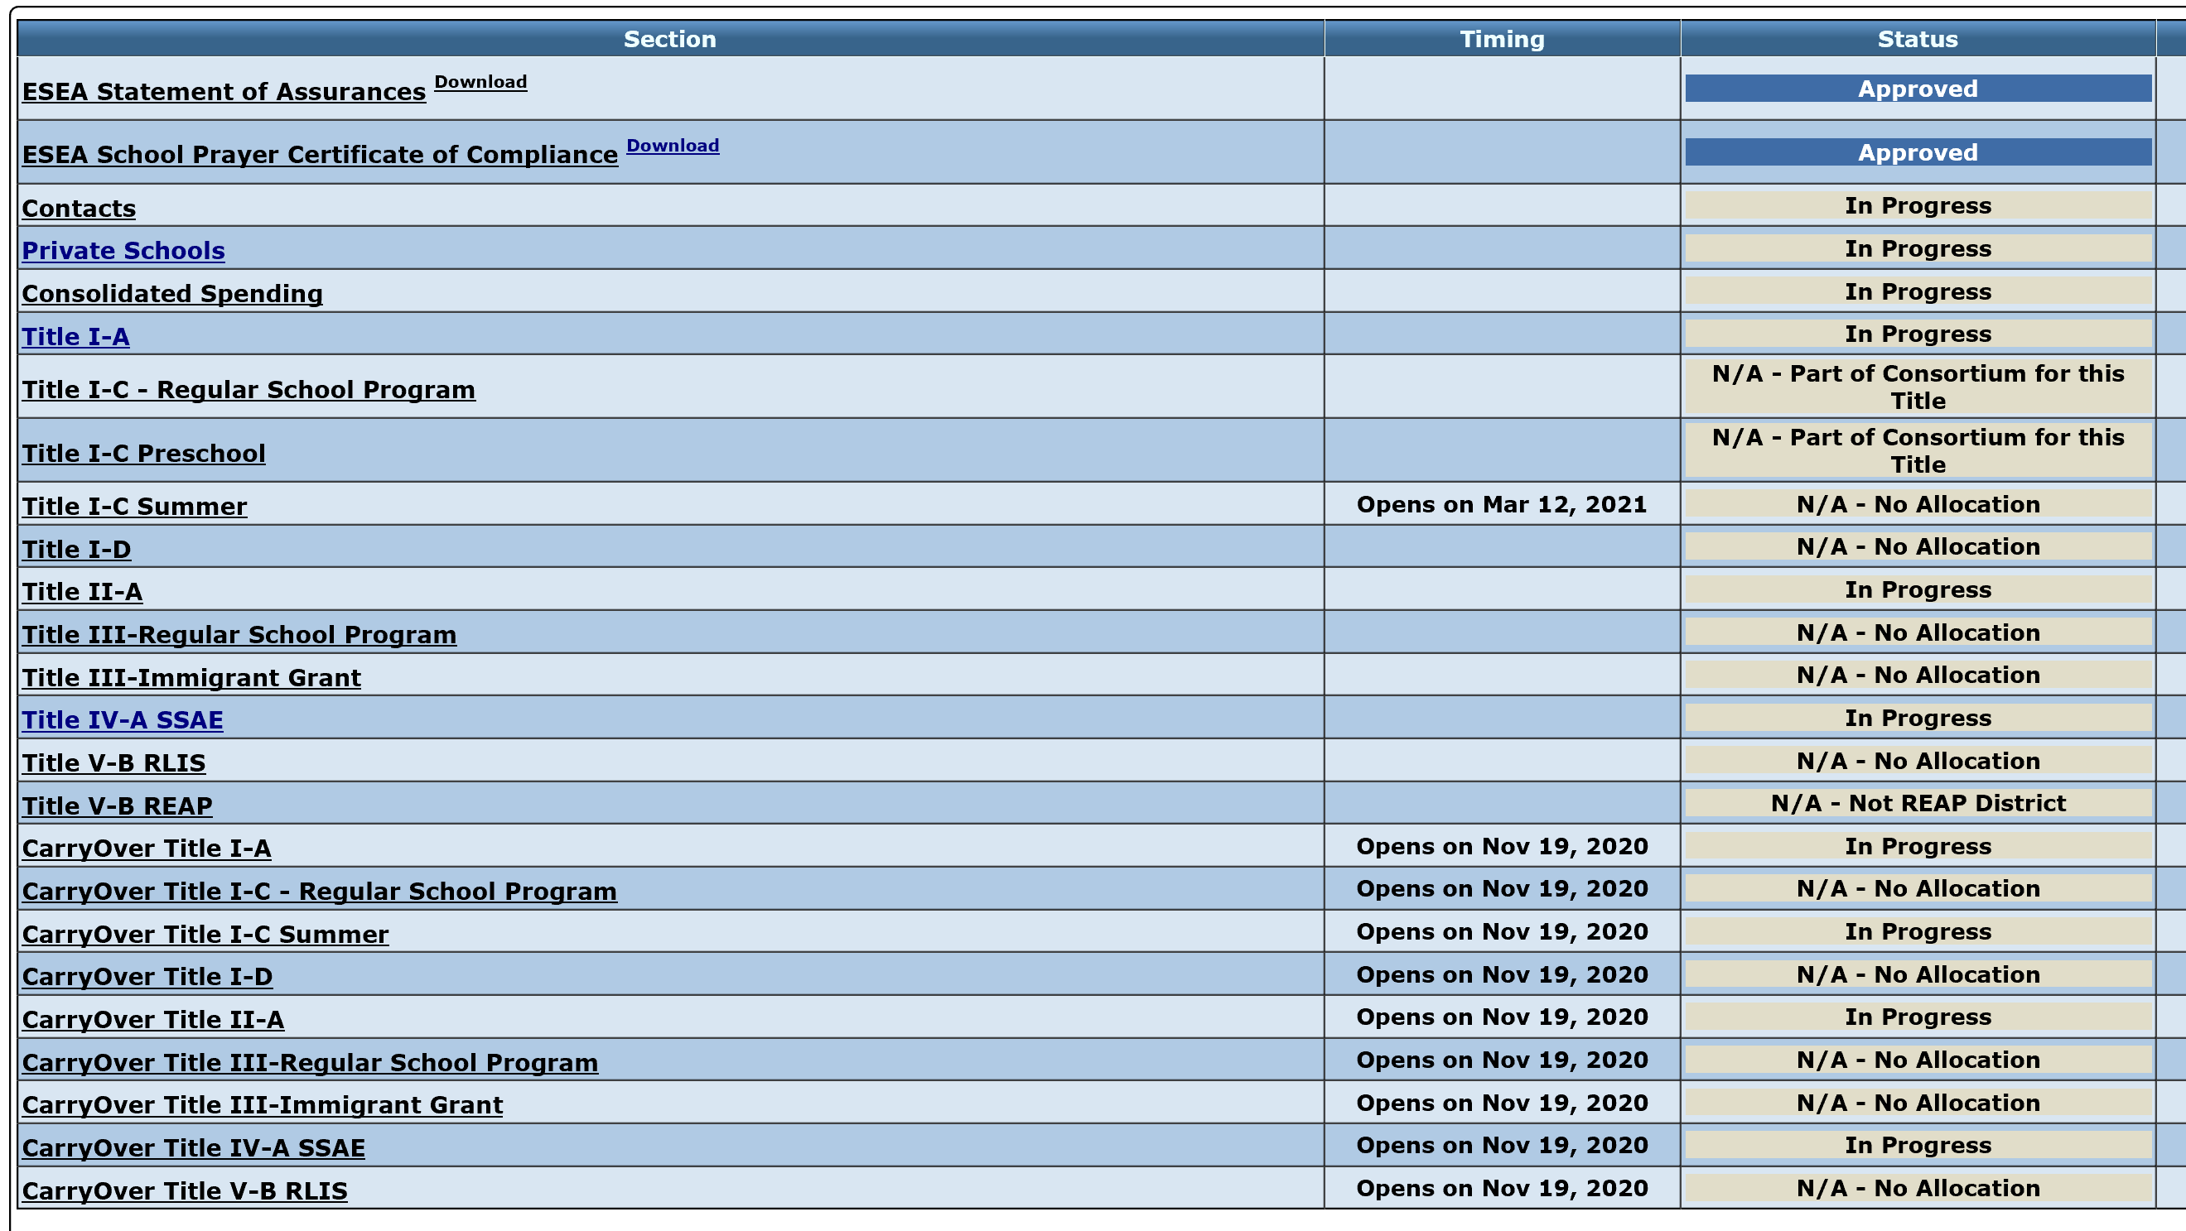
BUDGET NARRATIVE OVERVIEW
Notes:
This slide indicates the contents of the entire CIP budget narrative.

Slide 9
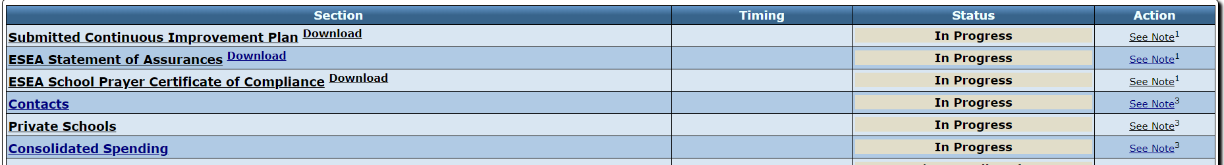
Continuous Improvement Process
BUDGET NARRATIVE
Notes:
At the start of the CIP Budget Narrative, there are annual requirements to be submitted to ODE prior to completing the Title budget narratives.

Slide 10
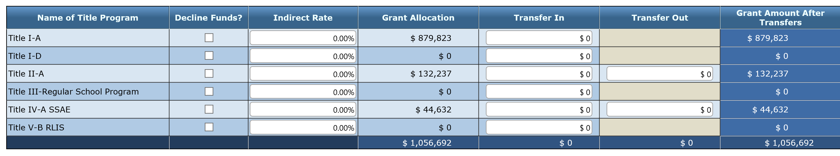
Consolidated Spending Page
Notes:
On the Consolidated Spending Page we have the area to enter in the Indirect Rates that are then submitted to ODE for approval.
In addition, on this page the district may choose to transfer Title II-A and/or Title IV-A allocation into other programs.

Slide 11
Transferring Funds
Districts May Transfer All or Some Funds From: | Districts May Transfer Funds Into:
Title II-A, Supporting Effective Instruction Title IV-A, Student Support and Academic Enrichment | Title I-A, Improving Basic Programs Title I-C, Migrant Education Title I-D, Prevention and Intervention Programs for Children and Youth who are Neglected, Delinquent, or At-Risk Title II-A, Supporting Effective Instruction Title III-A, English Language Acquisition, Language Enhancement, and Academic Achievement Title IV-A, Student Support and Academic Enrichment Title V-B, Rural Education Initiative
Notes:
As the district is considering all federal funds allocated, and, based on a needs assessment, the district may determine that transferring allocations from Title II-A or Title IV-A into other Title programs would best meet the needs of students and staff.
If the district determines this to be the case, relevant information would be provided to participating private schools during the consultation process.

Slide 12
Transferring Funds Rules
Needs Assessment with stakeholder engagement, including private schools
Transfer only from Title II-A and Title IV-A
No limits on the amounts of funds to transfer
Once funds are transferred, they take on the identity of that Title AND must be spent under rules applicable to that Title
Notes:
Transferring Funds
To provide districts the flexibility to use federal funds received under ESSA on those programs and services that would most effectively meet identified student and staff needs, the law allows for districts to transfer some of their federal formula grant funds from one Title to another.2 A few general rules apply to transfers of funds:
• A district may transfer funds only from Title II-A and Title IV-A.
• There are no limits on the amount of funds a district may transfer from those Titles.
• If applicable, a district must consult with the appropriate nonpublic school officials before transferring funds.
• Once funds are transferred, they take on the identity of the Title to which they were transferred and must be spent under rules applicable to that Title.

Slide 13
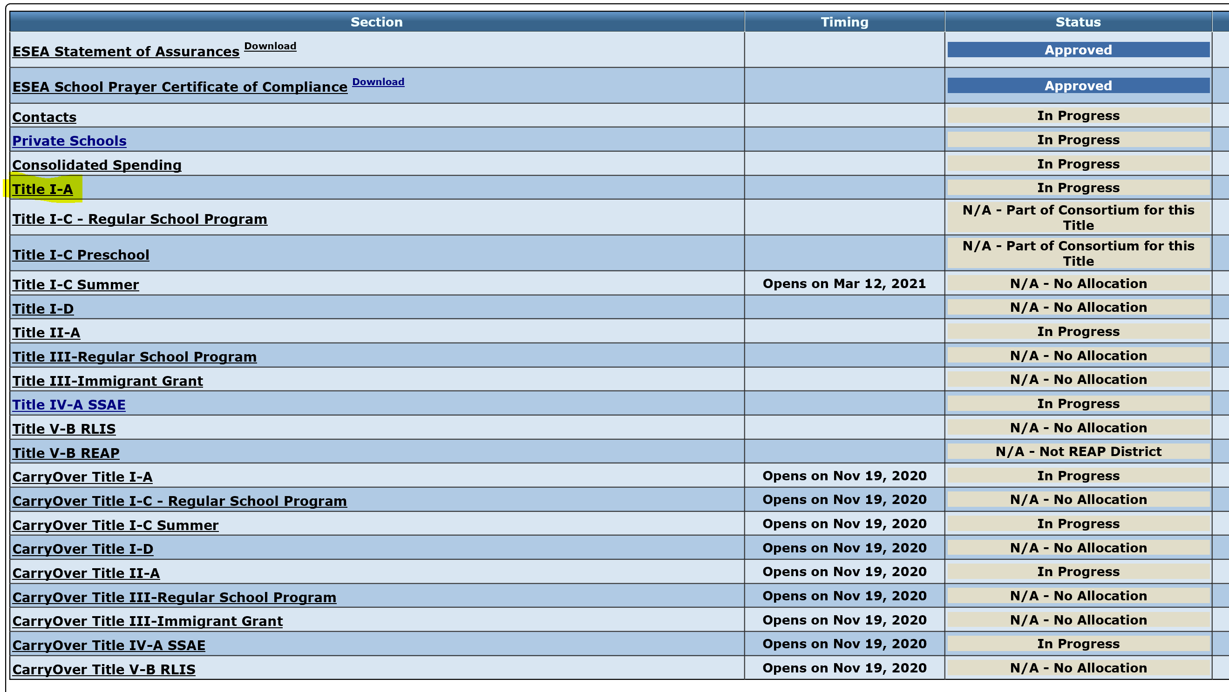
BUDGET NARRATIVE OVERVIEW

Slide 14
Title I-A Purpose:
Title I-A provides federal dollars to supplement educational opportunities for students who live in high poverty areas and are most at risk of failing to meet the state’s challenging academic achievement standards.

Slide 15
Title I-A Budget Narrative
Notes:
There are five sections to completing the Title I-A budget narrative.

Slide 16
Title I-A Budget Narrative OVERVIEW Page
Title I-A Budget Narrative
OVERVIEW Page

Slide 17
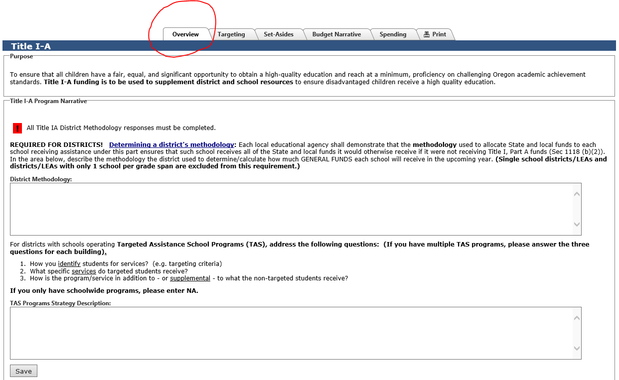
Title I-A Overview Page
Notes:
On the Overview Page, the district’s methodology for allocating State and local funds to each school, regardless of Title I-A status, is provided.
Title I, Part A of ESSA changes the way supplement not supplant (SNS) compliance is tested for LEAs and schools that receive Title I-A funds. ESSA’s revised SNS test does not look at how LEAs and schools spend Title I funds but instead looks at how LEAs distribute state and local funds to Title I schools. The goal of the revised SNS test is to ensure that Title I schools receive all of the state and local funding they would have received if they did not participate in the Title I program, and that LEAs do not reduce state and local funding to Title I schools because they get Title I funds.
In designing a process for evaluating LEA compliance with ESSA’s revised Title I SNS test, it is important to consider that SNS is one of three fiscal tests in Title I: 1) maintenance of effort, 2) comparability, and 3) supplement not supplant.
Each of these tests requires different things, in short:
Maintenance of effort requires LEAs to maintain a consistent floor of state and local funding for free public education from year-to-year.
Comparability requires that state and local funds are used to provide services that, taken as a whole, are comparable between Title I and non-Title I schools.
Supplement not supplant requires LEAs to distribute state and local funds to schools without taking into account a school’s participation in the Title I program.
Also on the Overview Page, districts operating a Title I-A Targeted Assistance Program would enter in the targeting criteria, specific services to be provided and how the services are supplemental.

Slide 18
Methodology
An LEA must show that its methodology to allocate State and local funds to schools results in each Title I-A school receiving all of the State and local funds it would otherwise receive if it were not receiving Title I-A funds.
In other words, an LEA’s methodology must be “Title I neutral” in that it allocates State and local funds to schools without regard for Title I-A status.

Slide 19
Methodology
Single school districts, or districts with one school per grade span, do not need to provide a methodology statement and can enter n/a.
Methodology statement considerations:
  Public charter schools
  Different grade spans

Slide 20
Title I-A Budget Narrative
SET ASIDES Page
Title I-A Budget Narrative
SET-ASIDE Page

Slide 21
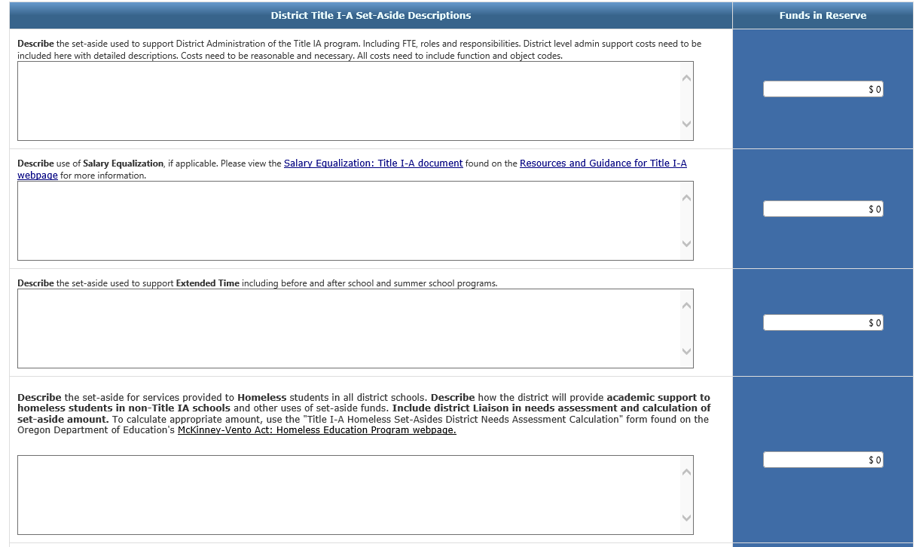
Title I-A Set-aside Page
Notes:
There are required set-asides at the district level under Title I-Part A.
The first required set-aside is for students experiencing homelessness.
The second is for parent engagement if the district’s allocation exceeds $500,000.
The third is the equitable share for participating private schools.

Slide 22
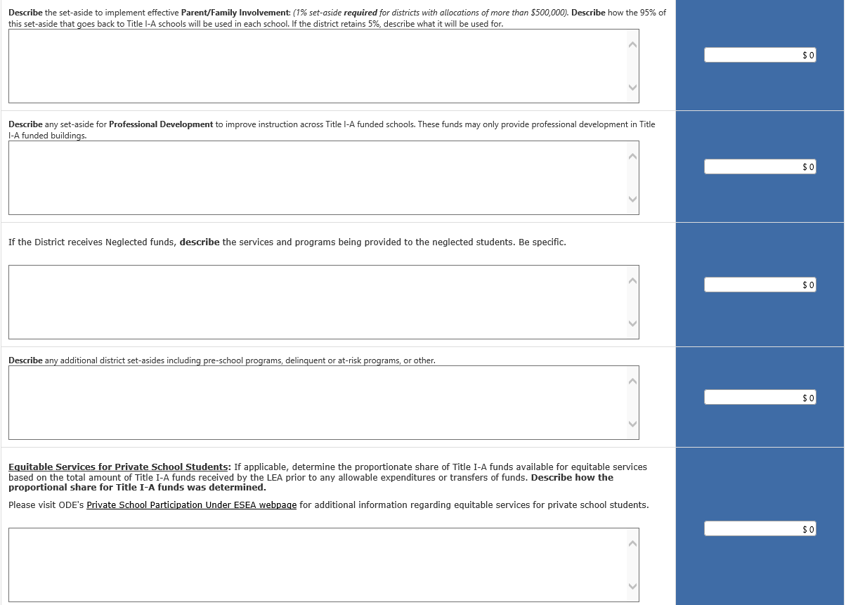
Title I-A Set-aside Page
Notes:
There are required set-asides at the district level under Title I-Part A.
The first required set-aside is for students experiencing homelessness.
The second is for parent engagement if the district’s allocation exceeds $500,000.
The third is the equitable share for participating private schools.

Slide 23
Title I-A Budget Narrative
TARGETING Page
Title I-A Budget Narrative
TARGETING Page

Slide 24
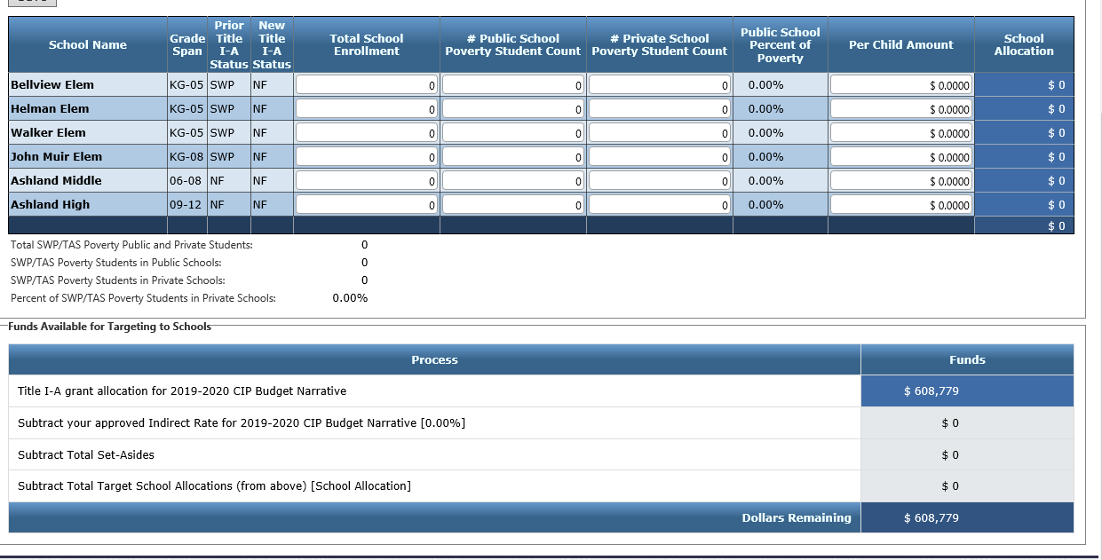
Title I-A Targeting Page
Notes:
On the targeting page the total school enrollment and student poverty count are entered. These counts should be from the same point in time, ie; the last official count in the spring from the previous year, or the first official count in fall from the current year.
The private school poverty count is also entered. This generates a percentage that is taken from the district’s total Title I-A allocation and the amount is entered on the set-aside page for equitable services to private schools.
Schools are then ranked, with those having the highest poverty count (typically over 40%) being served with Title I-A. Any school with 75% poverty count must be served with Title I-A.
A Per Child Amount is then entered in for each school. The school with the highest poverty count must have the same or greater than Per Child Amount than the schools with lower poverty count.

Slide 25
Community Eligibility Provision
Community Eligibility Provision (CEP)
https://www.oregon.gov/ode/students-and-family/childnutrition/SNP/Pages/CEP.aspx
Notes:
If a district is participating in the Community Eligibility Provision through the Office of Child Nutrition, there are options for how the public school student poverty count on the Targeting Page is entered.
The Community Eligibility Provision gives eligible school districts and schools with high percentages of low-income children
the option to offer free school meals to all children in those schools without collecting free and reduced lunch applications.
Therefore, the student poverty percentage entered would be based on data provided to the district by the Office of Child Nutrition.

Slide 26
Determining Poverty Count
(Option #1)
CEP School
Composite of the sum of any or all of the following Identified Students:
Non-CEP School
Same composite sum as used in CEP schools
Direct certification count
Foster student count
Homeless/Runaway count
Migrant count
Headstart/Even Start count (if eligible)
Notes:
With CEP, there are options for deterring the student poverty count for participating schools.
With Option #1, a consideration here is that the same method of determining poverty is used for all schools.
This option will typically result in a lower poverty percentage for all schools.

Slide 27
Determining Poverty Count
(Option #2)
CEP School
Using the CEP Multiplier:
Non-CEP School
Using the CEP Multiplier:
The sum of all identified students will be multiplied by the CEP Multiplier (currently 1.6)
The sum of all identified students will be multiplied by the CEP Multiplier (currently 1.6)
Notes:
With Option #2, a consideration here is again, the same method of determining poverty is used for all schools.
This option will result in a higher poverty percentage for all schools.
Title I rank would be the same with Options 1 and 2.

Slide 28
Determining Poverty Count
(Option #3)
CEP School
Using the CEP Multiplier:
Non-CEP School
Determine the same as previous year’s (ie Free & Reduced Lunch applications)
The sum of all identified students will be multiplied by the CEP Multiplier (currently 1.6)
Notes:
With the third option, CEP schools may rank higher as compared to non-CEP schools than they would have using Options 1 or 2.

Slide 29
Title I-A Budget Narrative
BUDGET NARRATIVE Page
Title I-A Budget Narrative
BUDGET NARRATIVE Page

Slide 30
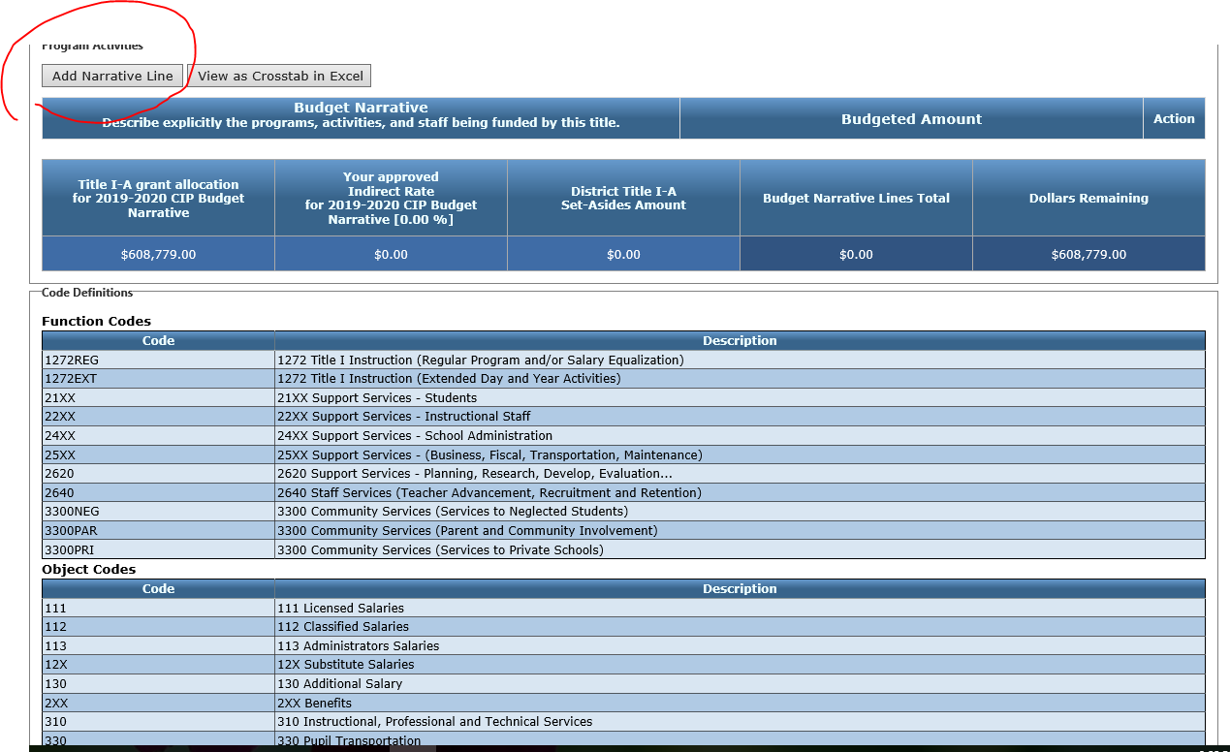
Title I-A Budget Narrative Page

Slide 31
Title I-A Spending Page
  Reminders:
  The allocation for each school on the Targeting Page must equal each school’s allocation on the Budget Narrative Page.
  The Dollars Remaining on both pages must be zero.

Slide 32
Title I-A Budget Narrative
Spending Page
Title I-A Budget Narrative
SPENDING Page

Slide 33
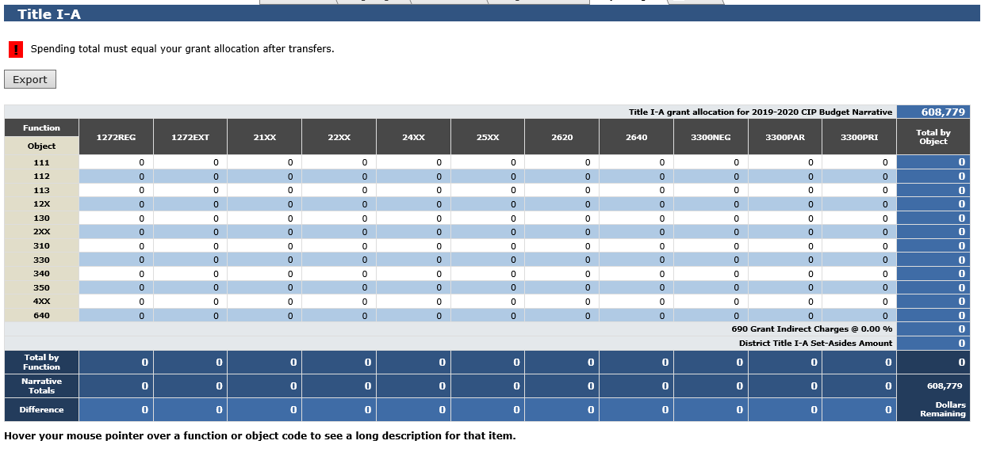
Title I-A Spending Page
Notes:
The Spending Page populates based on information entered on the other pages.

Slide 34
Title I-A Budget Narrative
Timeline Page
Title I-A Budget Narrative
TIMELINE

Slide 35

2019-20 FEDERAL FUNDS TIMELINE
JULY
2019
AUG 2019
DEC 2019
BEGINNING OF 2019-20 GRANT PERIOD
2019-20 BUDGET NARRATIVE APPLICATION OPENS
2019-20 BUDGET NARRATIVES DUE
YOU ARE HERE
NOV 2020
SEPT 2020
FINAL DATE FOR ALL 2019-20 CLAIMS FOR *INITIAL GRANT PERIOD
FINAL DATE FOR OBLIGATION OF 2019-20 FUNDS FOR *INTIAL GRANT PERIOD
NOV 2020
UNCLAIMED FUNDS BECOME “CARRYOVER”
NOV 2020
SEPT 2021
NOV 2021
CARRYOVER APPLICATIONS FOR 2019-20 FUNDS OPEN
FINAL DATE FOR OBLIGATION OF 2019-20 FUNDS
FINAL DATE FOR ALL 2019-20 GRANT CLAIMS
*INITIAL GRANT PERIOD: 7/1/19 – 9/30/20 (15 MONTHS)
Notes:
Federal funds are made available on July 1 of the fiscal year and remain available for obligation for a period of 27 months. This 27-month period includes an initial 15-month period of availability and an automatic 12-month extension permitted under the “Tydings Amendment”. While districts are encouraged to obligate funds in the initial grant year, it is not uncommon for districts to have funds available from two different grant years.
This slide shows the 2019-20 grant year timeline. The checkmarks illustrate milestones in the timeline that have already passed. As you can see, we are approaching the final date for obligation of funds for the initial period. Any funds not claimed by November of this year (called the initial grant period) will become carryover funds.

Slide 36
2020-21 FEDERAL FUNDS TIMELINE
YOU ARE HERE
JULY
2020
AUG 2020
SEPT2020
DEC 2020
BEGINNING OF 2020-21 GRANT PERIOD
2020-21 BUDGET NARRATIVE APPLICATION OPENS
2020-21 BUDGET NARRATIVES DUE
NOV 2021
SEPT 2021
FINAL DATE FOR ALL 2020-21 CLAIMS FOR *INITIAL GRANT PERIOD
FINAL DATE FOR OBLIGATION OF 2020-21 FUNDS FOR *INTIAL GRANT PERIOD
NOV 2021
UNCLAIMED FUNDS BECOME “CARRYOVER”
NOV 2021
SEPT 2022
NOV 2022
CARRYOVER APPLICATIONS FOR 2020-21 FUNDS OPEN
FINAL DATE FOR OBLIGATION OF 2020-21 FUNDS
FINAL DATE FOR ALL 2020-21 GRANT CLAIMS
*INITIAL GRANT PERIOD: 7/1/20 – 9/30/21 (15 MONTHS)
Notes:
This slide shows the timeline for 2020-21 funds. Budget Narrative for 2020 opened on August 13th and all districts should have access to their application.

Slide 37
Resources and Support
Jen Engberg, Title I-A Program Specialist
Jennifer.engberg@state.or.us 503-947-0339
Lisa Plumb, Title I-A Program Specialist
lisa.plumb@state.or.us 503-947-5749

Slide 38

Thank you!

