Slide 1
2020-21 Consolidated District Performance Report (CDPR) ESEA CDPR Title ID: Academic Outcomes 20 – 21 ESEA CDPR Title ID: Programs & Facilities 20 – 21 Materials can be found at: http://www.oregon.gov/ode/schools-and-districts/grants/ESEA/ID/Pages/Reporting.aspx
Notes:
Thank you for joining this webinar. Today’s topic is the 2020-2021 Consolidated District Performance Report for Title I-D for both Academic Outcomes and Programs and Facilities.
It is 20-21 because that is the data we are collecting.
I am Holly Tucker from the Federal Systems Team in the Office of Teaching Learning and Assessment.
The goal is to provide you with the support and guidance you need in order to make this data collection go as smoothly and efficiently as possible.

Slide 2
Agenda
Data Collection Window
Resource Materials
Data Elements
Data Preparation
Title I-D Validations Worksheet Entry
Academic Outcomes
Programs and Facilities
Consolidated Collections Entry
Questions and Discussion
Notes:
Here is our agenda for today:
We’ll look at the
data collection window
the resource materials available to you
Give tips on data preparation
Show you step by step how to use the Title I-D Validations Worksheet
Show you steps on how to submit the data in the Consolidated Collections application
Then give you a chance to ask any questions that have not been answered yet.
There are no data element changes for this year.

Slide 3
Data Collection Window
Opens: August 5, 2021
(approx. 2:00 PM)
Closes: September 17, 2021
(approx. 11:59 PM)
Notes:
The data collection window for both of the ESEA CDPR Title I-D collections opens around 2:00 PM on August 5, 2021, and closes at 11:59 PM on September 17, 2021.
Just a note, that this is the only data window for this data collection. This is the same time frame as the Title I-A CDPR collection. All of this data is then compiled and validated at the state level, then given to the U.S. Department of Education as the Consolidated State Performance Report.
Acknowledging the short data collection window, and knowing this is an incredibly busy time for districts, we want to provide you with the tools you need so you can begin the process in a timely manner.
Thank you ahead of time for your time and effort on this.

Slide 4
Resource Materials
Consolidated District Performance Report (CDPR): Data Collection User Guide
Today’s PowerPoint
CDPR Title I-D Validations Worksheet
CDPR FAQ
Link to all Resource Materials:
http://www.oregon.gov/ode/schools-and-districts/grants/ESEA/ID/Pages/Reporting.aspx
Notes:
Here are the support materials to help you through this process:
CDPR Data Collection User Guide - this has the instructions on how to submit the data collection within the Consolidated Collections application.
Today’s PPT slides and recording
CDPR Title I-D Validations Worksheet – a place to enter data and fix data errors before submission
CDPR FAQ– this document was created to answer common questions and to give clarification on some of the more complex data elements
All of this will be on our website.
This PowerPoint is really meant to be something you can view as you work on the data collection. Please feel free to download this PowerPoint and use as a guide as you work through this data collection process.

Slide 5
CDPR Title I-D Validations Worksheet
The CDPR Title I-D Validations Worksheet provides:
A “savable” place to collect and enter your data
Clarification on the data points you are entering
A place to see your data errors and fix them before submission
The Consolidated Collections web application
Does not allow entering data and coming back to it later
All data must be entered all at once
It will show errors, but not explanations
Notes:
The Title I-D Validations Worksheet can help you gather the data in an efficient and accurate manner prior to entering it into the web-based application. (read slide)
It’s important to note that the web-based application does not allow you to log in, enter some data, log out and enter in more data at a later date. It has to be entered in all at once.
This is why we’re encouraging districts to use the Title I-D Validations Worksheet and have all the data points needed prior to logging in to the web-based application.

Slide 6
Two I-D Data Collections
ESEA CDPR Title ID: Academic Outcomes 20 – 21
ESEA CDPR Title ID: Programs and Facilities 20 – 21
Title I-D Validations within the Consolidated Collections application are internal to the individual data collection
Title I-D Validations within the CDPR Title I-D Validations Worksheet include both internal individual data collection Title I-D Validations and cross-over Title I-D Validations between the data collections.
By utilizing the Title I-D Validations Worksheet prior to entering data into the web-based application, the chance for errors will be greatly reduced.

Slide 7
CDPR FAQ
Document includes for all CDPR data collections:
Reporting Students – Who should be reported?
Access to Data – Who can help me?
Consolidated Collections Web Applications – How do I login?
Common Validation Sheet Errors – What does “this” error really mean?

Slide 8
Types of Title I-D Programs
At-Risk Program
Neglected Program
Juvenile Detention Program
Locally Operated Juvenile Correctional Facility Program
Other Program
Notes:
Let’s start with some Definitions.
There are 5 type of programs to choose from for these collections. We’ll walk through the definition of each in just a moment. There are two key points I want to address before we move on:
1. Remember: You are reporting on the facilities and programs served by Title I-D funds. This may or may not be the same facilities you count for the October Caseload Count. Think about where the funds are going and report on those programs.
2. It’s important to be consistent in how a facility is reported from year to year. For example, a facility should not be reported as “delinquent” one year and “neglected” the next. Many times this happens because there is a drastic population change, etc. The only way the designation can be changed is through state approval and a change in the charter of the facility. If this is something you feel is necessary, please don’t hesitate to contact Jen Engberg.

Slide 9
At-Risk Program Definition
At-Risk Program
Programs operated in local schools that target students who:
are at risk of academic failure,
have a drug or alcohol problem,
are pregnant, or parenting,
have been in contact with the juvenile justice system,
are at least 1 year behind the expected age/grade level,
have limited English proficiency,
are gang members,
have dropped out of school in the past, or
have a high absenteeism rate.
Notes:
Read slide)
District run teen parent education program
Transition programs
Behavioral type programs (not SPED)

Slide 10
Neglected Program Definition
Neglected Program
Public or private residential facilities, other than foster homes, that are operated primarily for the care of children or youth who have been committed to or voluntarily placed in the facility under applicable State law due to:
abandonment,
neglect, or
death of their parents or guardians
These facilities should be reported in the October Caseload Count Data Collection.
Notes:
(Read slide)
These programs are generally funded through Title I-A.
Neglected facilities should be reported in the October Caseload Count Data Collection

Slide 11
Juvenile Detention & Juvenile Correctional Program Definitions
Juvenile Detention Program
Locally operated short-term private or public facilities that provide care to children who require:
secure custody pending court adjudication,
court disposition or execution of a court order, or
care to children after commitment.
Locally Operated Correctional Facility (Juvenile Correctional Program)
A facility in which persons are confined as a result of a conviction for a criminal offense. It can also include a local public or private institution, community day program or school not operated by the State.

Slide 12
“Other” Program Definition
Other Program
Locally operated programs that do not fit the definition of:
At-Risk Program
Neglected Program
Juvenile Detention/Correctional Program
Locally Operated Correctional Facility (Juvenile Corrections) Program
Notes:
(Read slide)
This is rare. If there is a program that falls into the category, reach out to us.
If you have any questions regarding types of facilities, please don’t hesitate to reach out to Jen Engberg whose contact information will be at the end of this PowerPoint

Slide 13
Long Term Student Definition
Long-Term Students:
“Students who spent 90+ consecutive days in the facility”
Notes:
(Read slide, emphasize CONSECUTIVE days).

Slide 14
Getting the Data
Contact the staff at the facilities receiving Title I-D funds to gather the data needed for both the Academic Outcomes and Programs and Facilities collections.
Note: ONLY the students who received Title I-D services, regardless of the program/facility they are in or how it was funded should be included in the counts.
Notes:
Communication between the school district and the Title I-D facilities can be a challenge for some school districts, please be sure to begin this process early.

Slide 15
District Security Administrator
Contact your District Security Administrator for:
Help on preparing and entering the data
Permissions to be able to view and submit the data collection
If you select “Save” and nothing happens, you don’t have the needed permissions.
Find your District Security Administrator: https://district.ode.state.or.us/apps/login/searchSA.aspx

Slide 16
Once you have your data…
Open the CDPR Title I-D Validations Worksheet
Save the worksheet
Read the “Instructions” Tab
Enter data, saving as you go
Note:
Once you have entered all your data (for both collections), BLACK cells indicate errors.
An explanation of what would make a cell BLACK is next to the data point.
Correct all errors before submitting the data collection online.
Notes:
The ODE Title I-D Validations Sheet used to be locked so the conditional formatting that creates the Title I-D Validations and the formulas would hopefully not be deleted. We received requests from school district’s who wanted to control the colors etc. so it is now unlocked.
Districts will need to be careful not to:
delete the conditional formatting
or formulas.
However, if something wrong does happen, you can always download a fresh new worksheet from the website.
(open Title I-D Validations Worksheet and read Instructions Tab)

Slide 17
Data: Academic Outcomes
Documenting the Academic Outcomes data…
Notes:
As we go through these slides you will see “Validation” notations, these explain the Title I-D Validations that are in the CDPR Title I-D Validations Worksheet. We will go back and forth between the powerpoint and the worksheet for these next few slides.

Slide 18
Title I-D Validations Worksheet
Go to the “Title I-D Academic Outcomes” tab in the Title I-D Validations Worksheet
First answer “Yes” or “No” for types of programs that received Title I-D services/funds within your district.
The cells will highlight to reflect your answers
Crossover Validation: you must select the same type of programs for both data collections.
Notes:
Let’s look at the first Title I-D collection, Academic Outcomes.
(Title I-D Validations Worksheet: demonstrate facility types between the collections errors)

Slide 19
Item 1-16: Student Counts
In the Program
Within 90 Days of Exiting the Program
Earned high school credits
Enrolled in a GED program
Enrolled in the local district
Earned a GED
Earned a high school diploma
Accepted/enrolled in post-secondary
Enrolled in job training
Obtained employment
Earned high school credits
Enrolled in a GED program
Enrolled in the local district
Earned a GED
Earned a high school diploma
Accepted/enrolled in post-secondary
Enrolled in job training
Obtained employment
Notes:
Now we start on the data…
For items 1-16 there are 8 questions, each asked twice, once for the time that the students were in the program, and second, within 90 days of exiting the program.
(read slide emphasizing the two timeframes)
Again, these are students who were served using Title I-D funds.
A caveat to note here, is that a student might be counted in both categories, in the program, and within 90 days of exiting the program.
For example, if a student earned high school credits while in the program, and then went on to earn high school credits within 90 days of exiting the program, the student would be counted for both.
(Title I-D Validations Worksheet: Show the screen to enter these items, NOT the error yet)

Slide 20
If You Don’t Track 90 Days After Exit
If your district does not collect student outcomes after exit, please enter zeros (0) for each “Within 90 Days” data element.
For Item #31 “Collect Student Outcomes After Exit” select “NO”
Validation: If you enter counts in the “Within 90 Days” data elements but enter “No” for #31 there will be an error in item #31.
Validation: If you enter “0” for all “Within 90 Days” data elements but answer “Yes” for #31 there will be an error in item #31.
Notes:
Now, tracking students within 90 days of exiting the program may be problematic. There’s a way to note that.
(Read slide emphasizing that if this is the case, the zeros must be manually entered and item 31 must be marked NO).
(Title I-D Validations Worksheet: Demonstrate error for #31)
This is something we struggle with nationwide, so we are hoping in the future to be able to have data in these categories. This will help inform us on how to best reach these students for the long term.

Slide 21
Items 17-30
Items 17-30 only refer to Long-Term Students.
If there are NO long-term students (those who spent 90+ consecutive days) in the facility then enter zero (0) for items 17-30.

Slide 22
Item 17–23: Reading Performance
Item 17: How many long-term students completed a PRE- and POST- test in Reading.
Item 18: In their PRE-test, how many long-term students tested below their grade level (this is referring ONLY to pre-test results, not students who tested below their grade level in the post test).
Items 19–23: In their POST-test, how many long-term students are represented in each category. The sum should match #17’s.
Validation: The total count of Items 19–23 must match the number entered in Item 17.
Notes:
Let’s have a look at items 17-23 for Reading Performance.
(Validation Worksheet: Demonstrate the below grade for PRE test element, and the summing of the other elements)

Slide 23
Items 24-30: Math Performance
Item 24: How many long-term students completed a PRE- and POST- test in Math.
Item 25: In their PRE-test, how many long-term students tested below their grade level (this is referring ONLY to pre-test results, not students who tested below their grade level in the post test).
Items 26–30: In their POST-test, how many long-term students are represented in each category. The sum should match #24’s.
Validation: The total count of Items 26–30 must match the number entered in Item 24.
Notes:
Now we get to Items 24-30 which refer to Math Performance. This is the same process as described for the reading metrics.

Slide 24
Item 31 & 32
As mentioned on slide #20
Item 31: If you do NOT collect student outcomes after exiting the program, answer “No”. If you do, answer “Yes”.
Validation: If you entered counts in the “Within 90 Days” data elements but enter “No” for #31 there will be an error.
Validation: If you entered “0” for all “Within 90 Days” data elements but answer “Yes” for #31 there will be an error.
Item 32: How many students in the facility received transition services that addressed further schooling and/or employment (does NOT only refer to Long-Term Students)
Notes:
Define “transitional services” think outside the box. You are likely servicing these students, but may not be counting them. For example: transition process to school? Career counseling? School counseling? Credit Recovery?
For more information please feel free to contact Jen Engberg

Slide 25
Questions: Academic Outcomes
Any questions so far?

Slide 26
Data: Programs & Facilities
Documenting the Programs and Facilities data…
Notes:
As we go through these slides you will see “Validation” notations, these explain the Title I-D Validations that are in the CDPR Title I-D Validations Worksheet. We will go back and forth between the powerpoint and the worksheet for these next few slides.

Slide 27
Title I-D Validations Worksheet
Go to the “Title I-D Programs & Facilities” tab in the Title I-D Validations Worksheet
First answer “Yes” or “No” for types of programs that received Title I-D services/funds within your district.
The cells will highlight to reflect your answers
Crossover Validation: you must select the same type of programs for both data collections.
Notes:
(Title I-D Validations Worksheet: demonstrate facility types between the collections errors)
Yes and No needs to be the same as for the Academic Outcomes data collection

Slide 28
Item 1: Title I-D Program Count
#1: Title I-D Program Count
This is the number of PROGRAMS that received Title I-D funds, not the number of students.
Validation: If you enter a number over “8” the cell will turn BLACK in order for you to confirm you are entering the PROGRAM count and not the student count. It is not an error, it is just a notification.
Notes:
The first item is about the number of Title I-D programs.
(Read slide emphasizing number of programs, NOT number of students).
(Validations Worksheet: demonstrate Program count in BLACK)

Slide 29
Item 2: Length of Stay Days
#2: Average Stay Days
What is the average length of stay (or number of days) in the facility or program?
The average length of stay days cannot exceed 365
To calculate the average length of stay days:
Divide the combined total of each student’s length of stay by the number of students. The result is the average length of stay.
Validation: You must enter an average length of stay that is 365 or less

Slide 30
Item 3: Unduplicated Student Count
#3: Unduplicated Student Count
How many students in total were served in the program?
This includes all students served in the program, whether it was just for one day, or for 100 days.
Only count each student once (unduplicated)
Validation: The totals for Race, Gender, and Age/Grade must equal the number for Unduplicated Student Count

Slide 31
Item 4: Long-Term Student Count
#4: Long-Term Student Count
Long-Term Student:
“Students who spent 90+ consecutive days in the facility”
A student who has reached Long-Term status should have completed a Pre and Post test in Reading and Math.
Crossover Validation: The number of students who took a Pre and Post Reading/Math test in the Academic Outcomes data collection (Items #17 & #24) must match the number of #4 Long Term Student Count.
Notes:
Item 4 is just for the long term student count, those students who spent 90 or more consecutive days in the facility.
The worksheet’s tabs validate data between them
Number of long-term students MUST MATCH Items 17 and 24 from the Academic Outcomes collection
U.S. Department of Ed will contact me and ask why they do not match.
If these do not match I will need to be contacting your district for the rationale.
(Validations Worksheet: demonstrate Long Term Student Count and Academic Outcomes Reading and Math Pre and Post test numbers)

Slide 32
Crossover Validation
Academic Outcomes
Programs & Facilities
#17: Count of Long-Term Students completed Reading Pre and Post test
#24: Count of Long-Term Students completed Math Pre and Post test
#4: Count of Long-Term Students
Notes:
The count should be the same for all three data fields

Slide 33
Items 5-8: Race/Ethnicity
#5: American Indian/Alaskan Native
Report student if identifies ONLY as American Indian/Alaskan Native
#6: Asian
Report student if identifies ONLY as Asian
#7: Pacific Islander
Report student if identifies ONLY as Pacific Islander
#8: Black
Report student if identifies ONLY as Black/African American
Notes:
Total unduplicated count of students in each category

Slide 34
Items 9-11: Race/Ethnicity
#9: Hispanic Student Count
Report student if identifies as Hispanic/Latino ethnicity regardless of the race they identify.
Report student if identifies as 2+ races/ethnicities if one of them is Hispanic/Latino.
#10: White
Report student if identifies ONLY as White
#11: Multi-Racial
Report student if identifies as two or more races and none of them are Hispanic/Latino.
Validation: The Race/Ethnicity data element (5-11) total must equal the #3 Unduplicated Student Count.
Notes:
Total unduplicated count of students in each category

Slide 35
Items 12-30: Gender and Age
#12-14: Female, Male, Non-Binary
Unduplicated gender count of students within the facility
Validation: The Gender total must equal the #3 Unduplicated Student Count.
#15-30: Age
Unduplicated age count of students within the facility
Validation: The Age/Grade total must equal the #3 Unduplicated Student Count.
Notes:
Total unduplicated count of students in each category
The addition of Non-Binary gender option was added for the 2018-2019 gender data.
This data element is defined as: “Non-Binary people, including intersex and gender-fluid individuals.”
The hyperlink to the official memo regarding the Non-Binary data element that went out to the field is included in the notes of this PowerPoint.
The hyperlink for the memo that went out: https://www.oregon.gov/ode/about-us/Documents/Executive%20Numbered%20Memo%20Gender%20ID%20for%20data%20collections.pdf

Slide 36
Item 31: Students with Disabilities
#31: Students with Disabilities
The number of Students with Disabilities who received Title I-D services. This includes students who have an:
Individualized Education Program (IEP)
Individualized Family Service Plan (IFSP), or a
Services plan.
Validation: This number cannot be greater than #3 Unduplicated Student Count

Slide 37
Item 32: English Learners
#32: English Learners
The number of English Learners who received Title I-D services.
Validation: This number cannot be greater than #3 Unduplicated Student Count
Big one for USED to check, a high number of student count with no students reported here will require a rationale.

Slide 38
Questions: Programs & Facilities
Any questions?

Slide 39
Validations Check
Check both data collections for BLACK highlighted cells.
BLACK highlighted cells indicate a data error and must be corrected before submitting within the Consolidated Collections application.
Resources:
“Validations Explanation & Etc.” column explains the error
“CDPR FAQ” gives more clarification.
Questions? Contact Emily Swope (Emily.Swope@state.or.us)

Slide 40
Submission: Academic Outcomes
Login to the ODE District webpage at https://district.ode.state.or.us/home/
Choose “Consolidated Collections” from the Applications list
Hover over the “Institution Collections” tab
Hover over “ESEA CDPR Title ID: Academic Outcomes 20-21”
Select “Submission/Maintenance”
Select “Insert”

Slide 41
First Screen
Notes:
This view is the same for both Title I-D data collections, this one is for the Programs and Facilities data collection.
On this screen, you’ll see the 5 type of program choices.
When “No” is selected it will give you a message “This will zero out all counts for this program. Are you sure?” Go ahead and select “OK”, if you are sure.

Slide 42
Yes or No for Program Types
Did that program type receive Title I-D services/funds in your district?
Select YES or NO for each program type:
At-Risk
Neglected
Juvenile Detention
Juvenile Corrections
Other Program
(Just as you did in the Title I-D Validations Worksheet)
Notes:
You’ll select either yes or no on each type, just as you did initially on the Validations Worksheet.
When “No” is selected it will give you a message “This will zero out all counts for this program. Are you sure?” Go ahead and select “OK”, if you are sure. This will put the digit “0” in all data fields for that program type.
When you select “yes” it will expand that facility. Just select “collapse” if you want to check all the yes and no’s to begin with. You can then select “Expand” to fill in the data later.

Slide 43
Data Entry Screen

Slide 44
Enter Data
While referring to the Title I-D Validations Worksheet, enter the data for each program.
If there is not a count for a data element, you MUST enter “0” or you won’t be able to submit
Once you have finished entering the data from the CDPR Title I-D Validations Worksheet for all program types that you answered “Yes” for, select “Save”
If you cleared all errors in the Title I-D Validations Worksheet, you should have no errors when submitting in the Consolidated Collections.

Slide 45
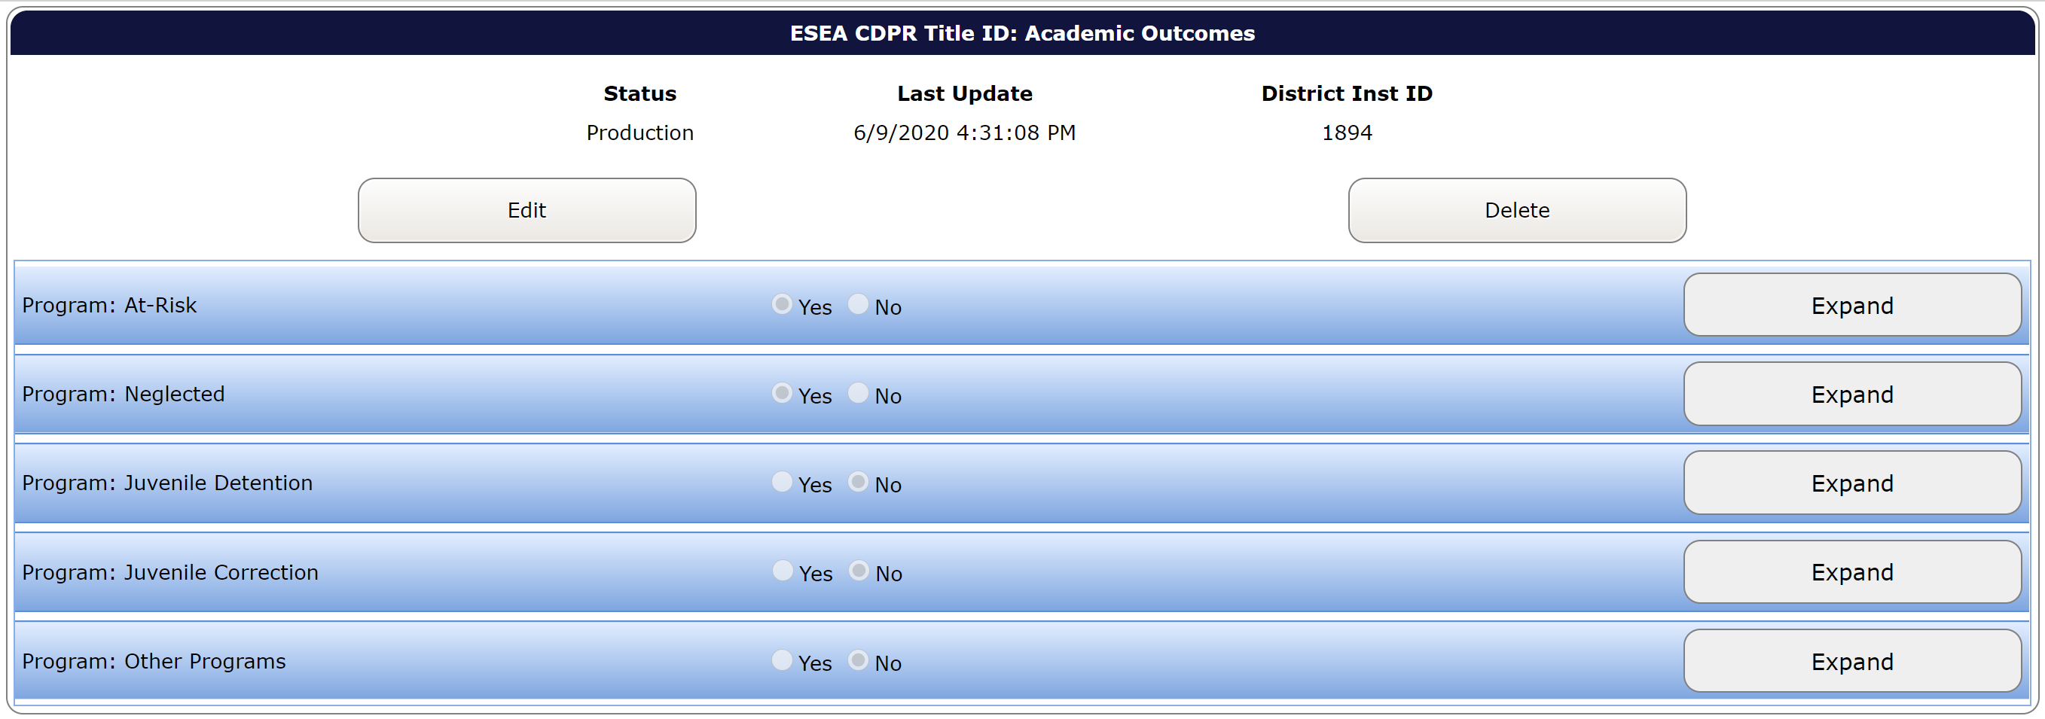
Data Submitted Screen
If you entered the data and there were no errors you should see this screen:
Notes:
If you would like to make changes to the data, select “Edit”, make the changes and select “Save”.
If you would like to delete the record and start over, select “Delete”.

Slide 46
If there are data errors
If there are data errors, when you select “Save”:
You will not see the data submitted screen
Errors will be listed at the top of the screen
Data Fields associated with the error will be framed in red
What you need to do:
Make the needed corrections to the data error(s)
Select “Save”

Slide 47
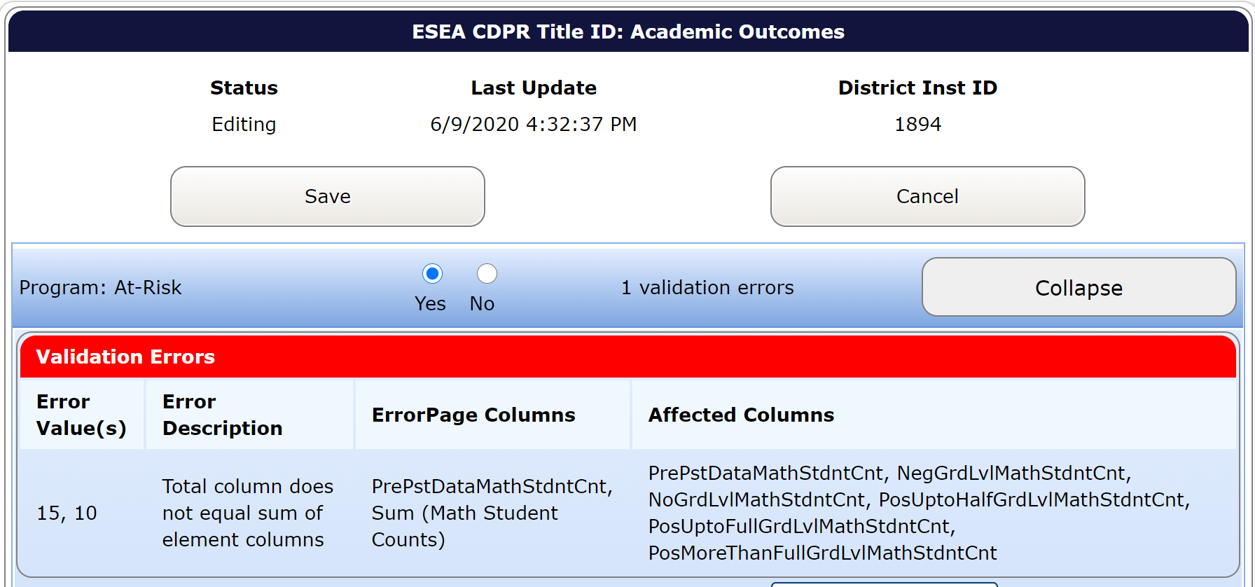
Data Errors Screen

Slide 48
Assistance
If you are still having trouble submitting within the Consolidated Collections application after you have:
Cleared all data errors within the Validations Worksheet
Entered the data correctly from the Title I-D Validations Worksheet into the Consolidated Collections
Checked that there are no data elements without a digit
Contact Holly Tucker (Holly.Tucker@ode.state.or.us)

Slide 49
Submission: Programs & Facilities
Login to the ODE District webpage at https://district.ode.state.or.us/home/
Choose “Consolidated Collections” from the Applications list
Hover over the “Institution Collections” tab
Hover over “ESEA CDPR Title ID: Programs and Facilities 20-21”
Click on “Submission/Maintenance”
Click on “Insert”
Notes:
Choose the other Title I-D data collection

Slide 50
Same Data Entry Process
Follow the same process as for the Title I-D: Academic Outcomes data collection.
Don’t forget to use the Title I-D Validations Worksheet as reference.

Slide 51
Questions
Final Questions?

Slide 52
Contact Information
For program questions:
Jen Engberg, Education Specialist (503) 947-0339
Jennifer.Engberg@ode.state.or.us
For data questions:
Holly Tucker, Administrative Specialist (503) 378-6807
holly.tucker@ode.state.or.us
For questions/problems with the web-based tool:
ODE Helpdesk (503) 947-5715
ode.helpdesk@state.or.us

