Slide 1
Allocations

Slide 2

Agenda for Today’s Session
ESSA Funding Stream/Roadmap
Eligibility and Funding Formulas
Funding Timeline
Questions
Notes:
Goals:
Basic understanding of Census Poverty
How does Census Poverty inform allocations
Basic understanding of how Title IA, II-A, IV-A, etc is allocated to our district

Slide 3
Check your federal funding knowledge!
TRUE OR FALSE:
How districts rank and serve schools impacts how much Title I-A money ODE receives from USED.
Some districts with students experiencing poverty did not receive Title I-A funds last year.
If a district’s free and reduced lunch count increases, the district’s Title I-A funding will also increase.
If the national education budget decreases, my district can expect a drop in Title funding.
Notes:
Before we dive into the material, we have compiled a few quiz questions for you to test you knowledge.
We will discuss the answers to all of these questions in just a few minutes.

Slide 4
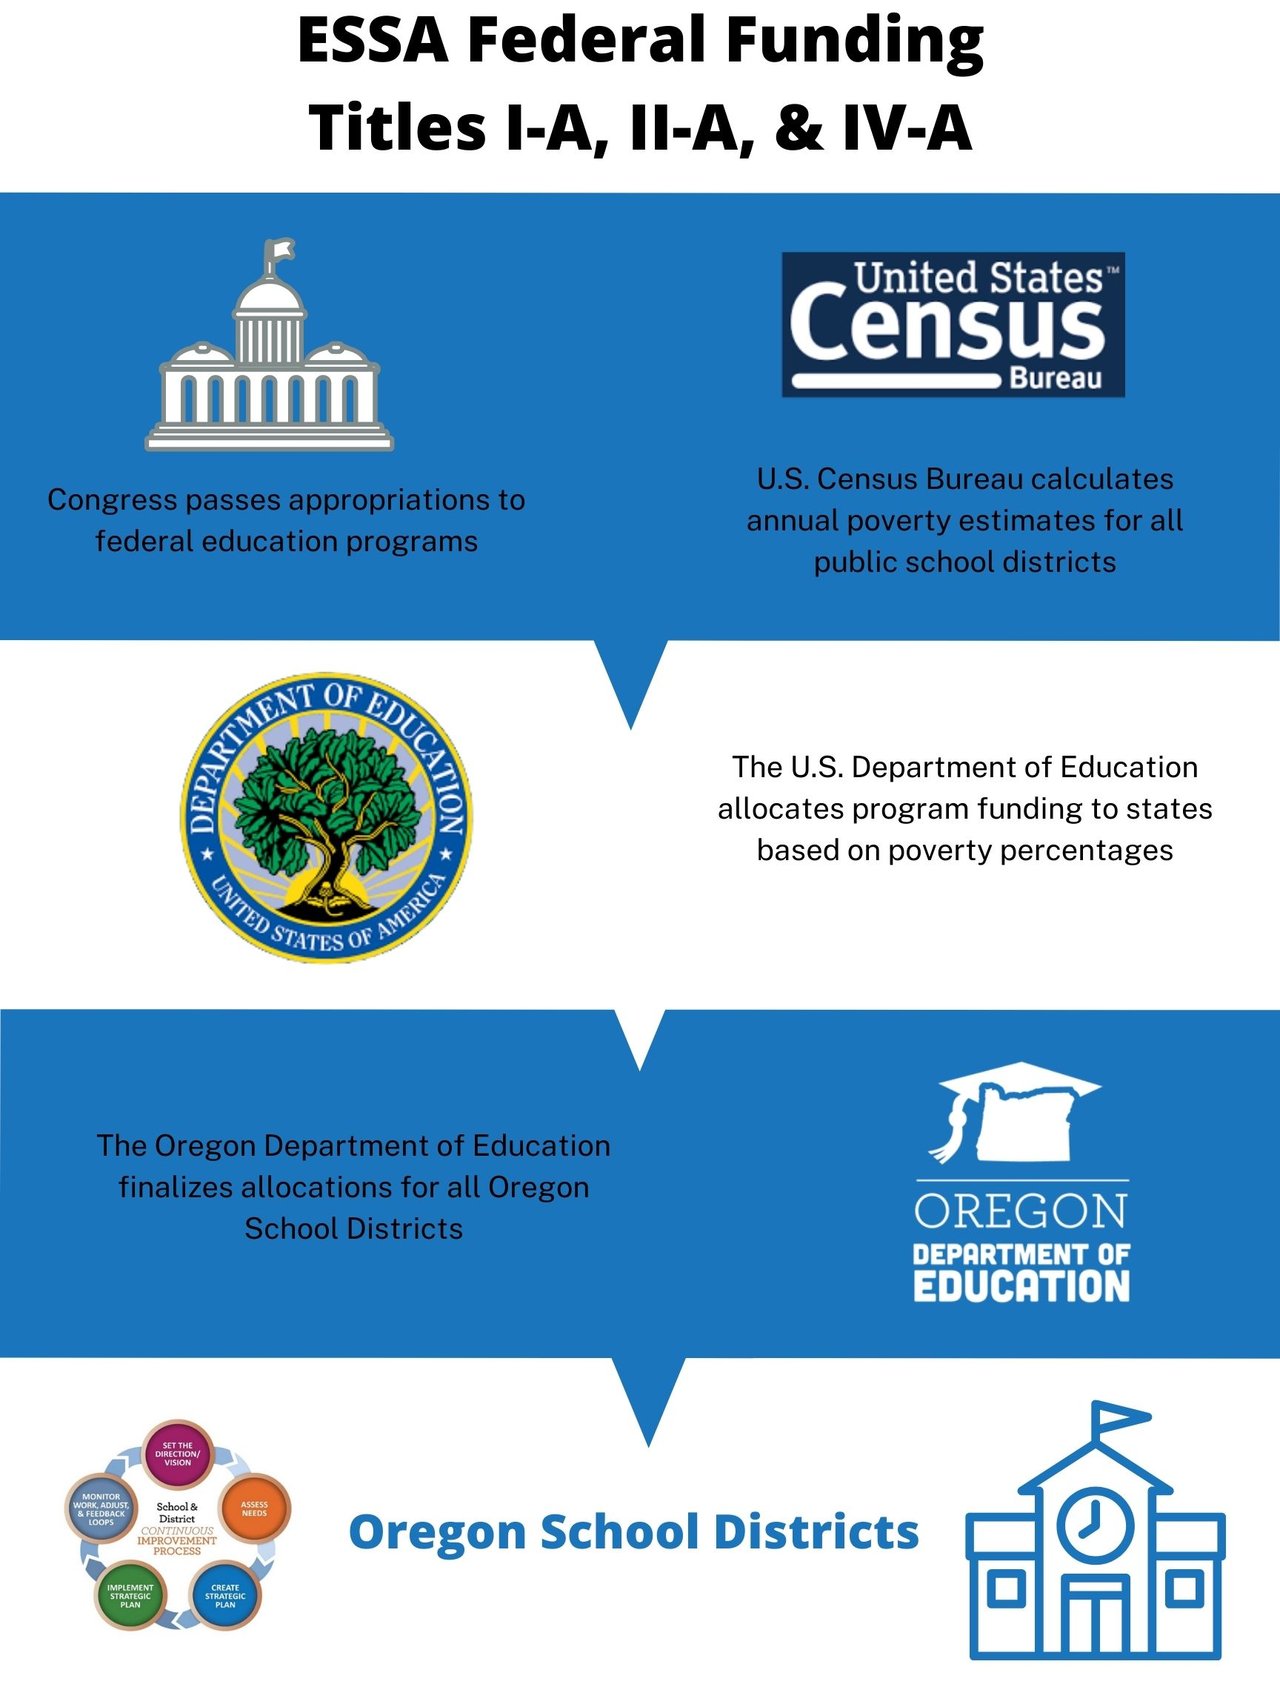
Federal Funding Road Map
First: Federal funds originate in Congress
Second: The U.S. Department of Education calculates state level allocations
Third: ODE calculates each district’s allocation
Notes:
USDE
Census poverty, and overall education budget
To
Oregon
State gets a share based on census poverty in comparison to other states
To
Districts
Districts receive allocations based on census poverty in comparison to district after state level set asides
To
School (if applicable)
Title I-A

Slide 5
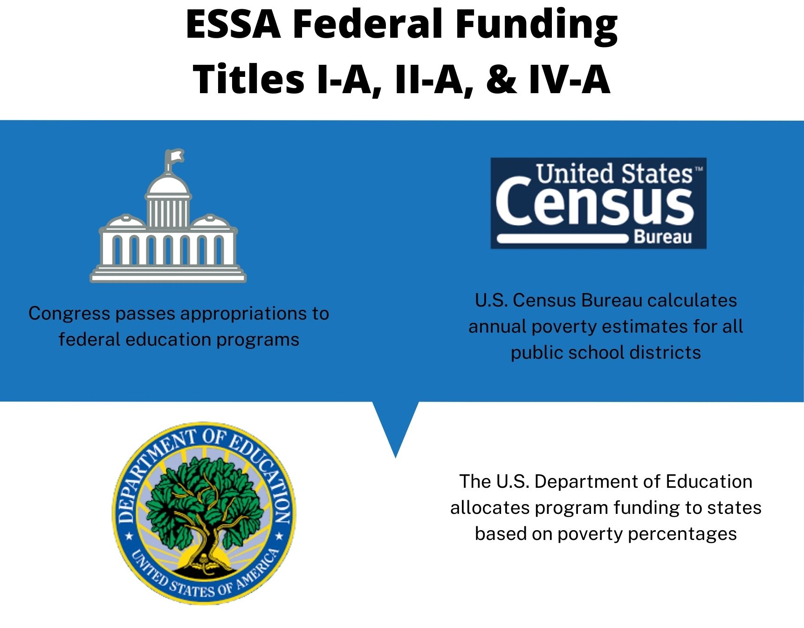
Federal Level Procedures
Notes:
Congress passes appropriations of a budget for all federal education programs (IDEA, Title, CTE, etc).
Meanwhile, the U.S. Census Bureau compiles poverty estimates for all public school districts in the country.
This data is called Small Area Income Poverty Estimates (SAIPE) and can be found on the website. (We will get that website to you at the end).
These estimates are based on the 2010 census, plus information about accessing of government programs. (TANF, Foster Care, Neglected & Delinquent)
2020 Census Data will be used NEXT year.
The U.S. Department of Education takes the money they have been appropriated and awards it to states and programs by census poverty information.

Slide 6

Federal Level Procedures
Congress annually appropriates funds for programs administered by the U.S. Department of Education.
The U.S. Census Bureau annually calculates poverty estimates for every public school district in the country.
The U.S. Department of Education allocates funds for each Title program based on each state’s census poverty information.
Notes:
Congress passes appropriations of a budget for all federal education programs (IDEA, Title, CTE, etc).
Meanwhile, the U.S. Census Bureau compiles poverty estimates for all public school districts in the country.
This data is called Small Area Income Poverty Estimates (SAIPE) and can be found on the website. (We will get that website to you at the end).
These estimates are based on the 2010 census, plus information about accessing of government programs. (TANF, Foster Care, Neglected & Delinquent)
2020 Census Data will be used NEXT year.
The U.S. Department of Education takes the money they have been appropriated and awards it to states and programs by census poverty information.

Slide 7

What is SAIPE Data?
Small Area Income Poverty Estimates (SAIPE)
  Annual estimates of income and poverty for school districts, counties, and states
Things to Remember:
Based on residents in school district boundaries
Lower threshold than Free and Reduced Lunch
Virtual charter schools are not included
Data is two years behind the current school year (2022-23 is based on 2010)
Notes:
SAIPE annually provides the most current school-age poverty estimates available for all school districts and counties in the U.S. regardless of population size.

Slide 8
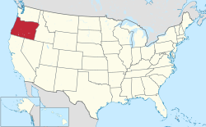
National Poverty & Oregon’s Piece of the Pie
According to the most recent SAIPE Data, there are 8,047,175 students aged 5-17 experiencing poverty. This is a national poverty percentage of 14.91%.
Oregon has 70,179 students aged 5-17 experiencing poverty, representing 0.87% of the nation’s students in this category.
Oregon Stats
2021-22 Poverty Rate: 12.38% (.93)
2022-23 Poverty Rate: 10.97% (.87)
Notes:
We do know that Oregon’s poverty rate has decreased. What we do NOT know

Slide 9
Funding Formulas

Slide 10
Funding Formulas
Title I-A
  Component Funding Formulas & Qualifications
    Basic
      (10 formula students, more than 2% of population)
    Concentration
      (District must meet basic grant and a population of over 6500 formula students OR 15% poverty)
    Education Finance Incentive Grant & Targeted Grants
      (10 formula students, more than 5% of population)
  District allocations based on census poverty of the 5-17 aged children in the district.
Notes:
Overall Education Budget Percentages:
Basic Grant 40%
Concentration Grant 10%
EFIG 25%
Targeted 25%

Slide 11
Funding Formulas
Title II-A
  20% Census Population (ages 5-17)
  80% Census Poverty (ages 5-17)
Title IV-A
  Based on the district’s percentage of Title I-A accepted in the previous school year
  A school district who received 5% of Oregon’s Title I-A allocation in 2021-22 can expect to receive 5% of Oregon’s Title IV-A allocation in 2022-23

Slide 12
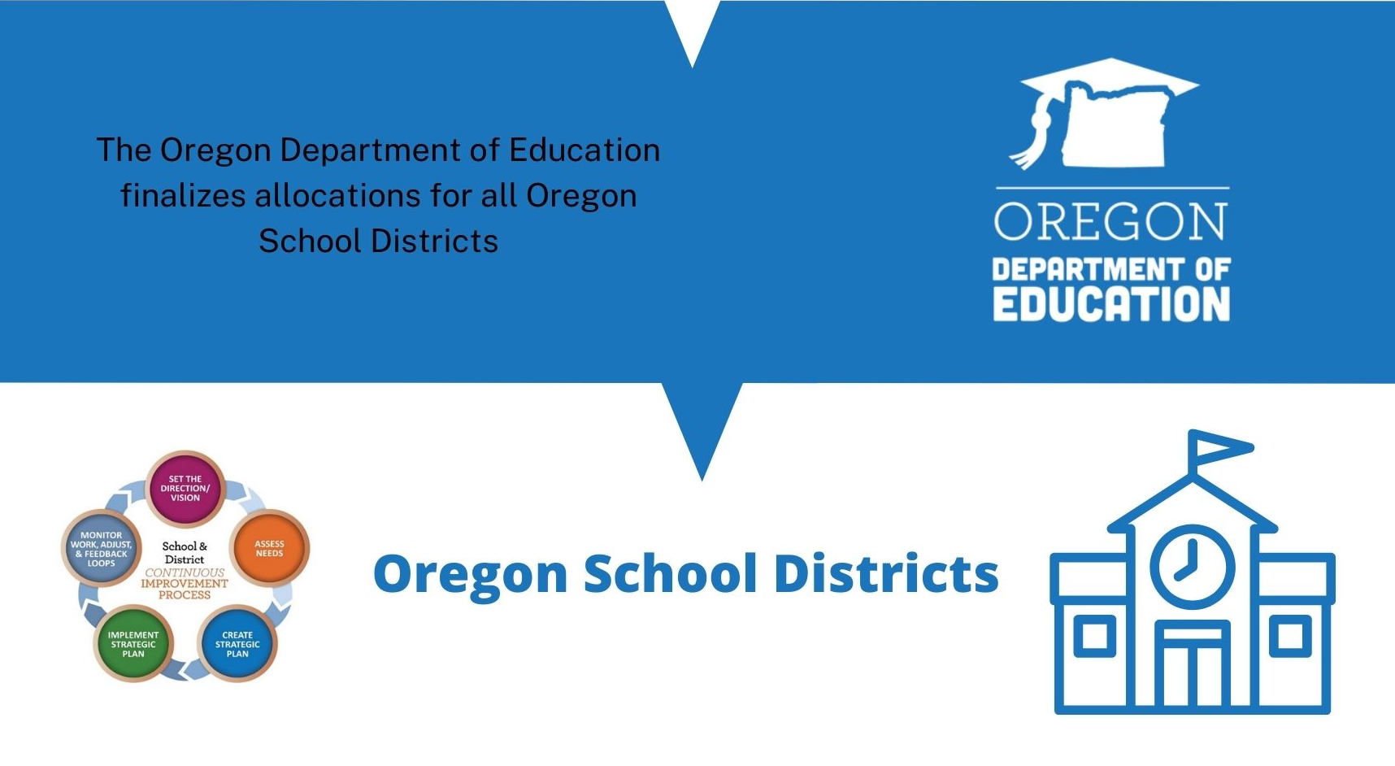
State Level Graphic

Slide 13
Oregon State Level Adjustments
ODE takes out state level set asides.
  Title I-A (school improvement, SEA Admin)
  Title II-A (State activity SEA Admin)
  Title IV-A (State activity, SEA Admin)
Preliminary Allocations (January/February)
Final Allocations (July)
Revisions (September/October
Some programs have a specific hold harmless and eligibility requirements that must be accounted for by ODE
Notes:
Everytime we receive a new allocation or update to an allocation, these calculations are done again.
Hold Harmless, MOE

Slide 14
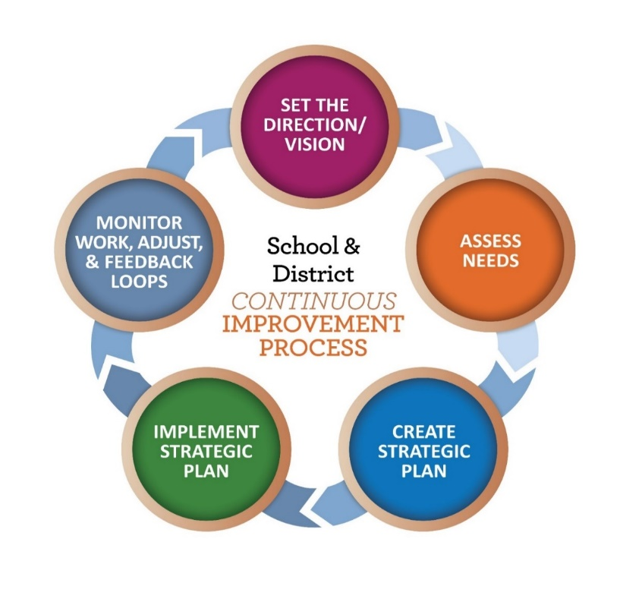
District Level Activities
Title I-A
  Rank & Serve
  School Level Plans
Title II-A
  Activities must be related to an identified need
Title IV-A
  Activities must be related to an identified need

Slide 15
Knowledge Review
1. How a districts rank and serve schools impacts how much Title I-A money ODE receives from USED.
  FALSE
2. Some districts with students experiencing poverty did not receive Title I-A funds last year.
  TRUE
3. If a district’s free and reduced lunch count increases, the district’s Title I-A funding will also increase.
  FALSE
4. If the national education budget decreases, my district can expect a drop in Title funding.
  FALSE
Notes:
How a districts rank and serve schools impacts how much Title I-A money ODE receives from USED.
FALSE (Census poverty determines how much Title I-A money ODE receives)
Some districts with students experiencing poverty did not receive Title I-A funds last year.
TRUE (Some districts very small districts did not meet the criteria for poverty percentage)
If a district’s free and reduced lunch count increases, the district’s Title I-A funding will also increase.
FALSE (Census Poverty and FRL use different thresholds of poverty levels)
If the national education budget decreases, my district can expect a drop in Title funding.
FALSE (Both state and district allocations are determined by poverty as compared to other states and school districts)

Slide 16
Federal Allocations Timeline
USED sends preliminary census poverty estimates to ODE
Districts receive preliminary allocations for the following school year
Districts receive final allocations and CIP Budget Narratives open
ODE reallocates unapplied for funds
December 2021
February 2022
August 2022
June 2023
January 2022
July 2022
Fall 2022
Congress passes the budget and USED sends preliminary allocations to ODE for calculation
Final allocations are sent to ODE for calculation
Revised allocations may be sent to ODE
Notes:
December 2021:
Census poverty estimates are sent to ODE, giving some insight into how allocations may look.
January 2022:
Once Congress approves the final appropriations and sends them to USED, the numbers for each Title program are calculated and sent to states.
February 2022:
ODE publishes preliminary allocations for each district.
July 2022:
By July 1st, “final” allocations are made by USDE. Adjustments are generally small and due to census poverty data adjustments. ODE must take out state level set asides as outlined by law.
August 2022
CIP Budget narrative opens for districts with final allocations.
Federal formula funds are made available on July 1 of the fiscal year and remain available for obligation by the district for a period of 27 months. This 27-month period includes an initial 15-month period of availability and an automatic 12-month extension permitted under the “Tydings Amendment” often referred to as “carry over”. Any funds not obligated by the district in the initial grant period are made available to districts in mid-November through carry over applications.

Slide 17

Resources
SAIPE website
Allocations Brief
U.S Department of Education

Slide 18

Please reach out!
Amy Tidwell
amy.tidwell@ode.oregon.gov
Jen Engberg
jennifer.engberg@ode.oregon.gov
Lisa Plumb
lisa.plumb@ode.oregon.gov
Sarah Martin
sarah.martin@ode.oregon.gov

Slide 19
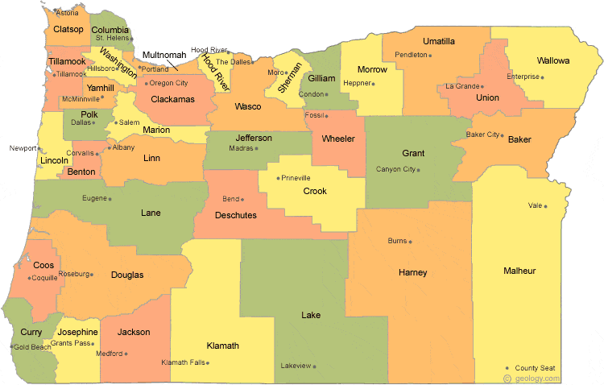
Regional Contacts by ESD
Amy Tidwell
  Grant, Harney, High Desert, InterMountain, Jefferson, North Central and Region 18
Jen Engberg
  Clackamas, Columbia Gorge, Multnomah and Northwest Regional
Lisa Plumb
  Lane, Linn Benton Lincoln and Willamette
Sarah Martin
  Douglas, Lake, Malheur, South Coast and Southern Oregon
Notes:
We have divided up the state into four sections. Each of us serves as the primary contact for the districts in these ESDs

