Slide 1
Welcome to Title II-A Tuesdays!
Diversifying the Educator Workforce
April 2025

Slide 2

Pausing to acknowledge…
The busyness of this time of year
Uncertainty around federal funding and actions
Messaging around diversity, equity, and inclusion
Notes:
We just want to take a moment to acknowledge all that is happening right now. Spring is always a busy time of year with wrapping up the current school year and planning for next year, including budget discussions that sometimes involve hard decisions. The excitement of transitions such as graduation and the difficult budget planning and decisions that need to be made. Not to mention that in the case of federal funds you don’t yet know what your allocation for those grants will be and the discussions around closing the department of education.
There has also been a lot of communication from the current administration around the allowability of activities that promote “diversity, equity, and inclusion” and we expect some of you may be wondering about the timing of this session and whether districts should still be considering these types of activities.

Slide 3
What we know to be true
All the activities we are discussing today are in alignment with the purpose of Title II-A
USDE released this guidance in December, and it is still posted and relevant (as of April 2025)
Oregon supports strong educational practices and pathways for educators
Notes:
The intent of II-A is to strengthen the educator workforce through:
Recruitment
Retention
Professional Learning
Evaluation
Until such time as we hear that the guidance has changed, we will continue to use it as a resource

Slide 4

Our Time Together Today
Diversifying the Educator Workforce
Why a Diverse Workforce Matters
Oregon by the Numbers
Strategies and Title II-A Funding
What Oregon Districts are Doing
Resources
Notes:
The US Department of Education released several pieces of non-regulatory guidance in December that relate directly to Title II-A. Much of what we’ll be discussing today comes from the document titled “Supporting a Diverse Educator Workforce to Strengthen Teaching and Learning”.
This guidance pulls on research and best practice and does not impose any requirements beyond those required under applicable law.

Slide 5

What is Non-Regulatory Guidance (NRG)?
Reflect ED’s most user-friendly interpretation of a statute
Statutes and regulations are the “gold standard” for compliance
Updated regularly
Make sure you are using the most current version!
Three new NRG documents released in December and January that relate to Title II-A
Notes:
*Courtesy of Federal Education Grants Management: What Administrators Need to Know, LRP Publications and BruMan
If SEAs and LEAs comply with non-regulatory guidance, ED’s program offices generally will not later issue a finding of non-compliance. However, it is important to recognize that the guidance is not binding on the department in the same way that statutes and regulations are binding and that program offices occasionally issue multiple versions of guidance on the same subject with different interpretations.
If there is inconsistency between guidance and the relevant statute or regulation, ultimately the statute or regulation controls.

Slide 6
Diversifying the Educator Workforce
Supporting a Diverse Educator Workforce to Strengthen Teaching and Learning
Published December 4, 2024
Focuses on the strategies over the funding source
Emphasizes braiding of state and federal funds
Not all strategies described are necessarily allowable with II-A funds
Notes:
This non-regulatory guidance highlights actions that State educational agencies (SEAs), local educational agencies (LEAs, hereafter districts), and institutions of higher education (IHEs) can take to increase educator diversity, as well as Federal funding opportunities available to support these actions.
In addition to their own investments, SEAs, districts, and IHEs can use funds across a range of Federal formula and competitive grant programs to support educator diversity efforts, including the strategies outlined above. While these funds can be used to increase the educator workforce in general, strategic use of them to target gaps in educator diversity can help meet and exceed State and local goals.
This means not all activities listed would necessarily be allowable with IIA funds.

Slide 7
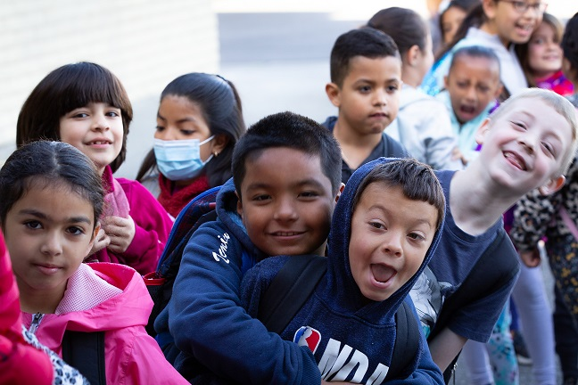
Why does a diverse educator workforce matter?
Improved outcomes for students
Statewide assessment results
Graduation rate
College enrollment
Participation in gifted and accelerated coursework
Fewer absences and rates of exclusionary discipline practices
*U.S Department of Education, Office of Elementary and Secondary Education Non-Regulatory Guidance: Supporting a Diverse Educator Workforce
Notes:
A well-supported and diverse educator workforce can improve the performance of all students, particularly students of color. Research indicates that when students of color are taught by teachers with similar racial and ethnic backgrounds, improved outcomes on statewide assessment data, increased likelihood of graduating high school, and increased likelihood of enrolling in college are all outcomes. Additionally, educator diversity within schools has been associated with more placements in gifted programs, more participation in accelerated coursework, and higher college-going rates for students of color. Further, evidence indicates that Black students taught by novice White teachers who have Black teacher peers have higher reading and mathematics scores that persist over time. Research on the academic achievement of students who are English learners in Florida found an association between teachers being fluent in students’ home language or having bilingual certification and improved achievement for students who are English learners using statewide assessment data.
In addition to student academic performance, a diverse educator workforce can lead to improved student behavior and classroom environments for all students. Such improvements may stem from the ability of educators from diverse backgrounds to build strong relationships with students and classroom environments more conducive to teaching and learning. One study found fewer absences among all students taught by teachers of color, with larger impacts for Black students. Another study found fewer absences among high school students when their teachers shared the same demographic background, particularly for Hispanic or Latino students. Further, studies have found that educators of similar racial and ethnic backgrounds as their students are associated with lower rates of exclusionary disciplinary practices, leading to fewer suspensions and narrowing the racial and ethnic disparity in suspension rates.

Slide 8
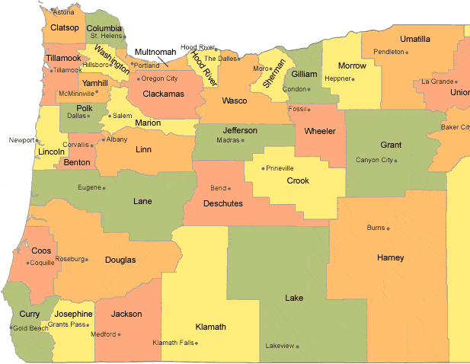
Oregon by the Numbers
Students of color – 42%
Teachers of color – 13.7%
The proportion of first-year teachers identifying as people of color has doubled in the last 10 years (20.6%)
Non-licensed K-12 staff are more racially and ethnically diverse and have grown at a faster rate than licensed staff (25.6%)
*Educator Advancement Council Oregon Educator Equity Report 2024
Notes:
Nationally, 55% of K-12 public school students are students of color and 24% of teachers identify as teachers of color.
Over the past decade, Oregon has more than doubled the proportion of first-year teachers identifying as people of color, reaching 20.6 percent in 2023. However, these new teachers are often placed in schools with few experienced colleagues, high staff turnover, and student populations that potentially need more support – factors that likely contribute to higher turnover rates in this group.
The number of racially and ethnically diverse students choosing education majors and programs remains small but is growing at community colleges.
The number of racially and ethnically diverse students completing educator preparation programs in Oregon continues to decline each year, though the number of racially and ethnically diverse candidates receiving preliminary teaching and administrator licenses continues to increase each year, likely due to many racially and ethnically diverse candidates having been prepared in programs outside of Oregon.
Closure of several Oregon administrator preparation programs, changes to preparation standards and licensing requirements have likely led to significantly lower numbers of administrators completing programs in 2023.

Slide 9
Strategies & Levers Districts Can Utilize
Notes:
Increasing educator diversity requires intentional strategies and policies designed to eliminate barriers into the profession and ongoing support to overcome challenges to stay in the profession.
The guidance outlines four areas, but for today’s purposes we will focus on two: providing financial incentives and creating positive and supportive teaching conditions.
You are going to notice significant overlap with the strategies listed in the guidance document we discussed in February.

Slide 10
What ESEA Says
ESEA Section 2103 (b)(3)
differential and incentive pay for teachers, principals, or other school leaders in high-need academic subject areas and specialty areas
new teacher, principal, or other school leader induction and mentoring programs
teacher, paraprofessional, principal, or other school leader advancement and professional growth, and an emphasis on leadership opportunities, multiple career paths, and pay differentiation
developing feedback mechanisms to improve school working conditions, including through periodically and publicly reporting results of educator support and working conditions feedback
Notes:
Activities must be allowable under Title II-A and conform to all programmatic and fiscal requirements.

Slide 11

Provide financial supports and incentives
Tuition assistance and exam fees
Stipends
Hard to staff subjects
Clinical experiences
Housing assistance
Teacher residency programs
Grow Your Own
Notes:
Provide tuition assistance, compensation (which may include a stipend) for clinical experiences, stipends for books, waivers for educator licensing exam fees, service scholarships, and offering student loan forgiveness for educators who teach in high-need schools or subject areas.
Increase the affordability of teaching in high-cost areas by reducing or offsetting the cost of childcare, transportation, and housing (e.g., rent or downpayment assistance) for educators teaching in high-need and high-cost areas.
Invest in teacher residencies, an evidence-based strategy to help diversify the educator workforce that provides financial support for residents in exchange for a three- to five year teaching commitment. Key features of teacher residencies include (1) strong district/IHE partnerships; (2) coursework and teaching tightly integrated with clinical practice; (3) a full-year residency teaching alongside an expert mentor teacher with whom residents co-teach; (4) cohorts of residents placed in “teaching schools” that model good practices with diverse learners and are designed to help novices learn to teach; and (5) ongoing mentoring and support for graduates.
Invest in Grow Your Own (GYO) programs to recruit and prepare teachers from within communities that schools serve to bring racial, ethnic, and cultural diversity and skills such as bilingualism into schools. GYO programs leverage partnerships between schools, districts, community organizations, and teacher preparation programs. This can include programs such as those allowing current high school students to begin earning credit towards an education degree, at no cost, which can reduce the overall cost of the degree. Other programs support current uncertified staff such as paraprofessionals, in earning their degree, if needed, and teaching certification.

Slide 12

Create positive and supportive teaching conditions
Induction and mentoring programs for teachers
Climate surveys
Affinity groups
Intentional development of school leaders and superintendents that reflect the demographics of your community
Notes:
Support novice teachers from diverse backgrounds to thrive and succeed early in their careers, including matching novice teachers with a veteran mentor teacher, offering seminars, providing classroom assistance, establishing more dedicated teacher collaboration time, and providing coaching and feedback from experienced teachers.
Collecting and disaggregating data from climate surveys and exit interviews and using this data to identify and address areas where educators from diverse backgrounds report not feeling meaningfully included in decision-making, supported, and safe, can improve school climate and support retention efforts.
Improve working conditions by creating and supporting affinity groups for teachers that provide a space for connection with others with common identities, background, and experiences. Affinity groups can offer opportunities for networking, support, and inspiration among educators and help address potential feelings of isolation.
Provide ongoing professional learning opportunities for school and district leaders to build their skills at enhancing school climate and working conditions to support the recruitment and retention of a diverse teaching staff. Equipping school and district leaders with these skills can help establish an inclusive and culturally responsive school climate that may benefit all students and teachers.
Intentionally develop future school leaders and superintendents. School and district leaders from diverse backgrounds can support the recruitment and retention of teachers from diverse backgrounds. Furthermore, school leaders play an important role in developing school culture and climate.

Slide 13
What Oregon Districts are Doing

Slide 14

Jefferson County - Grow Our Own Future Educators
Jefferson County SD represents a diverse community in Central Oregon. Our goal since 2015, with the Oregon Department of Education “Grow Our Own Future Educator Grant” has been to recruit, hire, and retain more teachers who reflect the racial demographics of our students.
Contact: Melinda Boyle mboyle@509j.net

Slide 15
Five Pathways
Bachelors in Education
Working Adults
Have an Associate’s Degree
Partnership with George Fox University
Two Year Program: One evening a week, one Saturday a month
Year Two Co-Teaching
Early Childhood Education CTE Pathway
High School Articulated Program/Dual Credit
Graduate with an Associates Degree
Peer Tutoring
Associate’s Degree Pathway
Working Adults
Early Childhood Education
Contracted Community College Classes
Language Immersion Program Pathway
Native Language or Spanish Endorsement
Associate’s Degree or Bachelor’s Degree
Internship/Co-Teaching Model
Teacher Advancement (Retention)
Endorsement Program Cohorts
Reading, ESOL, SPED
In-district
Teacher Induction and Mentoring

Slide 16
Growth Since 2015
Increasing Diversity of Teaching Staff from 2018 – 2024
Native American: 2% - 7%
Latina: 2% - 7 %
White: 94% - 81%
Other: 2% - 6%
Joined our team as educators: 17
Teacher Advancement: 21 current educators finishing reading endorsement
Early Childhood Pathway: 247 students enrolled (2024-25)
Scholarships Awarded: $320,000 (40 awards)

Slide 17
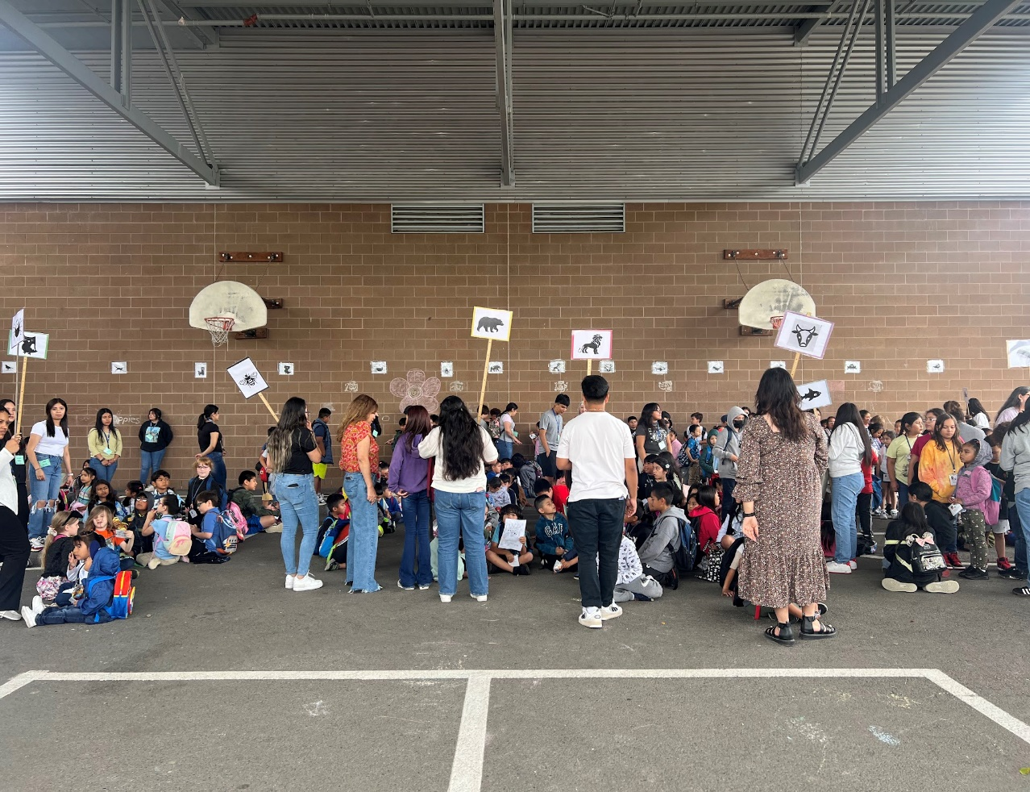

Hillsboro - Supporting Multilingual Learners
WHY: Hillsboro School District’s service to multilingual learners is critical equity work because it leverages our students’ cultural and linguistic wealth to ensure equitable access to quality education by leveraging students’ assets and their identities to enhance the instructional and learning experience of our diverse population.
62% Diverse
22% Active ELs
22% Dual Language Students

Slide 18
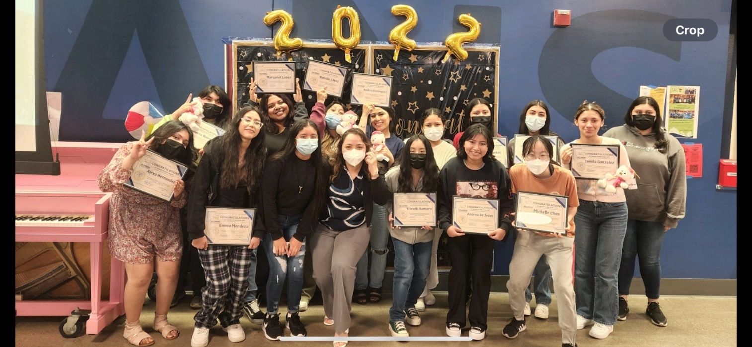
The Power of Braiding Funds
HOW: Title II funds braided with other funds enhance educational outcomes for multilingual leaners by:
Investing in professional development and educator quality (Mentorship/Coaching)
Recruiting, hiring and retaining highly qualified personnel
Grow Your Own:
Classified Staff
Students - Bilingual & Diverse Educator Pathway Scholar
Program (BDEP)
Building Leaders Together
Future Leaders
Executive Leadership
Providing professional development to improve the quality of the teaching workforce. (Institutes, PLCs, Collaborations, Workshops)

Slide 19
Getting Results
WHAT: 23 Educators Employed from BDEP since 2015
6 Elementary Licensed Staff
4 Middle School Licensed Staff
5 High School Licensed Staff
8 Classified staff
Year | 2015 | 2019 | 2024
Percent of Classified Staff who Identify as Diverse | 27.87% (372) | 34.61% (442) | 47.88% (700)
Percent of Licensed Staff who Identify as Diverse | 11.57% (132) | 16.17% (162) | 24.49% (321)
Percent of Administrators & Supervisory/ Technical who Identify as Diverse | 21.2% (22) | 26.4% (29) | 31.4% (44)
Percent of Students who Identify as Diverse | 53.08% (10,510) | 56.33% (10,974) | 62.43% (12,078)
Year | 2018 | 2019 | 2020 | 2021 | 2022 | 2023 | 2024
% of Diverse Licensed Staff | 14.9 % (163) | 16.17% (162) | 17.45 % (176) | 20.16 % (234) | 22.39 % (285) | 24.18% (317) | 24.49% (321)
Overall Change | - | + 1.27% | + 1.28 % | + 2.71 % | + 2.23 % | +1.79% | +.31

Slide 20
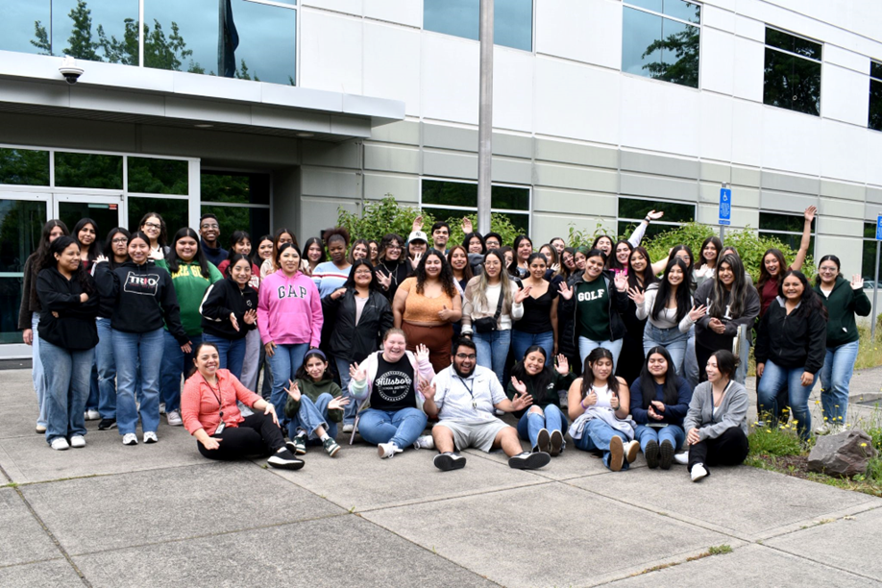
Who to Contact
Arcema Tovar
Director of Multilingual Programs, Hillsboro School District
tovara@hsd.k12.or.us
Brenda Chavez Tapia
Education Liaison for the Bilingual, BDEP Scholar Program
chaveztb@hsd.k12.or.us
Kim Bayer
Education Liaison for the Bilingual, GYO Classified
chaveztb@hsd.k12.or.us

Slide 21
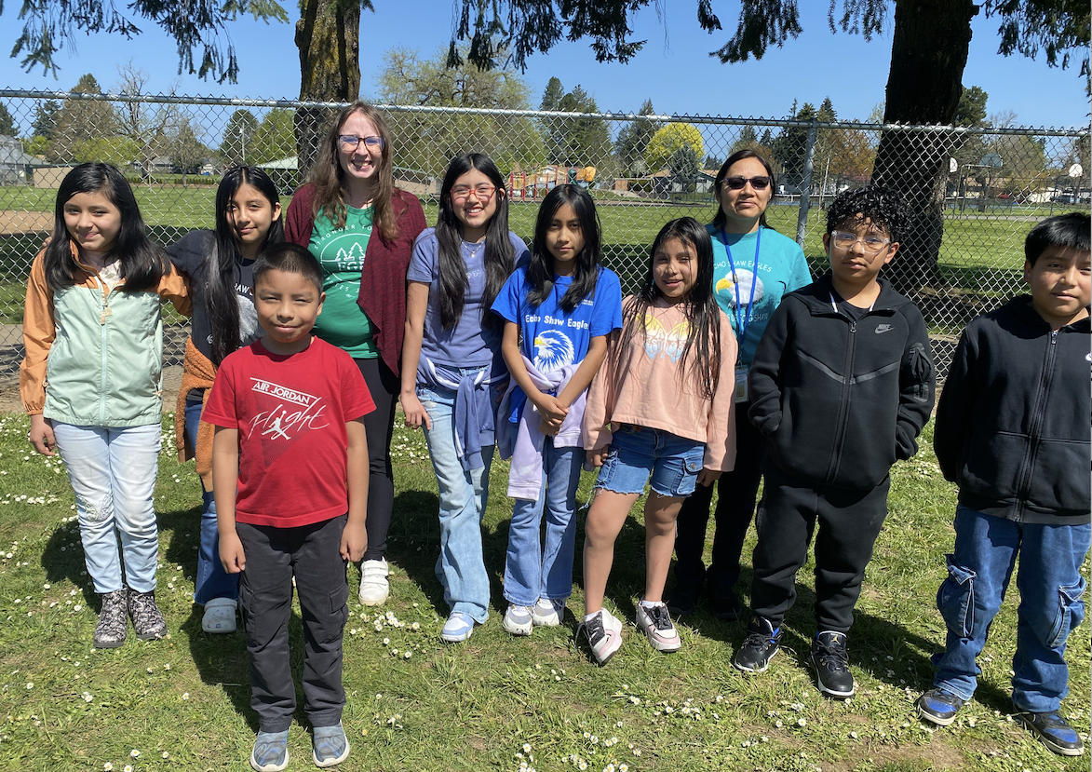

Forest Grove
Goals for Diversifying Workforce
Recruit, hire and retain diverse workforce that matches the ethnic/racial diversity of our student population
Develop multiple pathways for BIPoC (Black, Indigenous, and People of Color) population
Review current hiring practices, recruitment strategies and supports for BIPoC staff
Notes:
Having staff that reflects the demographics of a school district is crucial for several reasons, including enhancing academic outcomes, improving school climate, and breaking down biases. It also helps ensure equitable education and supports students' well-being by providing role models and advocates who understand their cultural backgrounds.

Slide 22
Forest Grove – Our Why
Ethnicity | Teacher Percentage | Student Percentage
American Indian/Alaska Native | 0% | 1%
Asian | 2.8% | 1%
Black/African American | 1% | 0.8%
Hispanic/Latino | 26% | 63%
White | 69% | 37%
Native Hawaiian/Pacific Islander | 1% | 0.4%
Multi-Racial | 6% | 4.4%

Slide 23
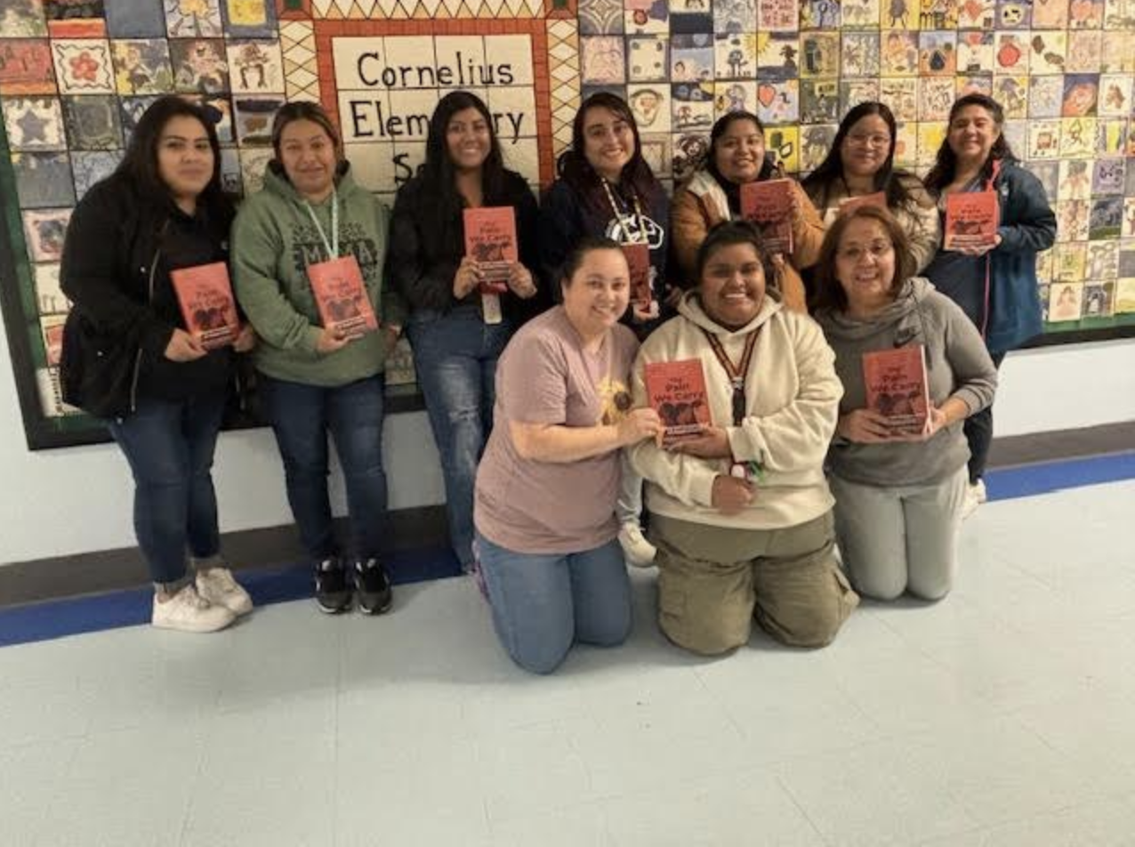
Forest Grove Strategies
Affinity Groups
BIPoC Affinity Groups
LGBTQIA+
Tribal History/Shared History: Mesoamerican Education
Classified Employees
Grow Your Own
Mentoring Program
Teacher Connect
Osvaldo Garcia-Contreras 503-718-4481
ogarcia-contreras@fgsd.k12.or.us
Notes:
Affinity Groups: Objective: Organizing and hosting an affinity group for BIPOC classified staff in which they are able to develop connections and receive support. This space is also critical to process the various challenges that affect our community.

Slide 24

Resources
Supporting a Diverse Educator Workforce to Strengthen Teaching and Learning
Raise the Bar: Eliminate the Educator Shortage
Educator Advancement Council
Oregon Educator Statewide Survey (formerly TELL Survey)

Slide 25

Please reach out!
Jen Engberg Jennifer.Engberg@ode.oregon.gov
Sarah Martin Sarah.Martin@ode.oregon.gov
Lisa Plumb Lisa.Plumb@ode.oregon.gov
Amy Tidwell Amy.Tidwell@ode.oregon.gov
Notes:
Jen Engberg
Clackamas, Columbia Gorge, Multnomah and Northwest Regional
Sarah Martin
Douglas, Lake, Malheur, South Coast and Southern Oregon
Lisa Plumb
Lane, Linn Benton Lincoln and Willamette
Amy Tidwell
Grant, Harney, High Desert, InterMountain, Jefferson, North Central and Region 18

