Slide 1
Braiding Federal Funds
Notes:
As people come in have people fill out form with questions and we can collect and answer as a panel

Slide 2

Intended Outcomes
Deepen knowledge of how braiding works
Understand requirements when braiding with federal funds
Explore example scenarios
Notes:
Help districts maximize use of funds
Assist in sustainability

Slide 3

What does it mean to “braid” funds?
Braiding = Coordinating funds
  Funds tracked separately
  Use of funds must align to program requirements
  Supplement not Supplant (SNS) requirements must be honored
Different than blending
  Blending = Combining funds
  Funds are comingled
  Combined funds have a new “identity”
Notes:
The phrase “braiding and blending” gets used a lot when talking about federal funds. While the goal is similar, it is important to understand that these are two different processes with different rules.
Blending combines funds into a single pot that has its own reporting requirements. The identity of all the funds going into the single pot is lost. Statutory authority is required to blend funds.
Braiding funds happens when districts coordinate funds from different sources for one purpose. Each fund maintains its own identity and reporting requirements.
Braiding is a way for LEAs to use multiple federal and state grants to support various parts of an initiative while maintaining the award-specific identity of the funds and meeting the purpose of each specific grant program. Federal law authorizes LEAs to coordinate spending from different grant programs, provided the activities are permitted under the grant program and the LEA maintains documentation on how federal funds are spent.

Slide 4
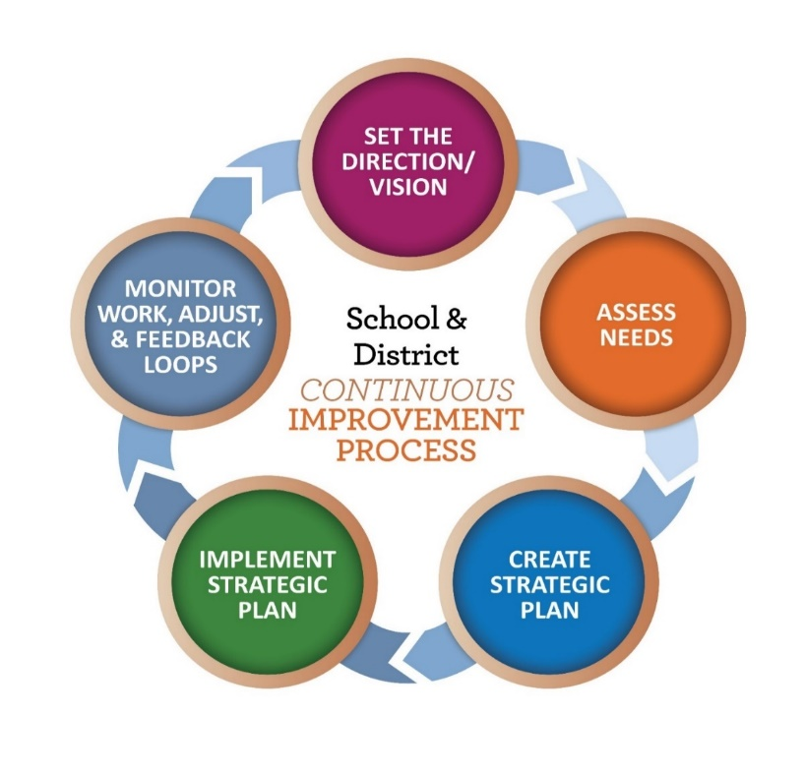
Braiding and Continuous Improvement
The district improvement plan serves as a tool to connect federal funding sources
Consider the priorities identified in your Integrated Guidance plan based on the comprehensive needs assessment
The decision to braid funds is program and situation specific
Notes:
Through the Integrated Guidance process, districts in Oregon engaged their communities in a comprehensive needs assessment process to determine priorities. Priorities identified from these efforts can inform district decisions about braiding with federal funds as well.

Slide 5

To braid or not to braid?
Questions to consider:
  What initiative or activity have we identified as a priority?
  What federal funds are eligible to braid for this initiative?
  What are the intent and restrictions of each federal program?
  How will we ensure allocability, SNS, and maintenance of effort requirements are not violated?

Slide 6
Requirements

Slide 7

Braiding and Allocability
A federal program that funds a portion (or all) of a project, must receive a benefit relative to the contribution it makes. This standard is met if the cost:
Is incurred specifically for the grant award;
Is necessary to the overall operation of the grant
Notes:
There are important administrative considerations when an LEA braids multiple funding sources to support a single project. The LEA must demonstrate that costs charged to each federal program were allocable to that program.
Necessary means that a cost advances the goals of the grant and serves the grant’s intended audience and focus.

Slide 8
Braiding and Supplement not Supplant (SNS)
Federal grant funds may be used only to supplement the educational programs generally offered with state and local funds and to provide supplemental services that would not have been provided had the federal grant funds not been available.
Supplement – to add to; to enhance; to expand; to increase; to extend
Supplant – to take the place of; to replace by something else
SNS rules vary by program, so know before you braid!
Notes:
Most Every Student Succeeds Act (ESSA) programs require districts to supplement, and not supplant, the state and local funds they would otherwise spend on education. Generally, this means ESSA funds should add to (supplement) and not replace (supplant) state and local funds. A few programs also require districts to use federal program funds to add to and not replace other federal funds. The tests for compliance with supplement not supplant requirements vary depending on the federal program being implemented.

Slide 9

Braiding and Maintenance of Effort (MOE)
Districts must annually demonstrate that spending of state and local funds remains at 90% or above what was spent in the preceding year
Even if braiding will not violate SNS requirements, braiding with federal funds could impact Maintenance of Effort.
Oregon Department of Education
Notes:
Maintenance of Effort focuses on spending at the LEA level and requires districts to have a consistent base of state and local funding for public education from year to year. Each year, LEAs receiving funds under ESEA must ensure that district or per-pupil spending of state and local funds remains at 90 percent or above what was spent in the preceding year. ESSA states that funding will be reduced if an LEA fails to meet the 90 percent threshold twice in a five year span. This reduction is made by ODE in the LEA’s Title I-A allocation.
Why is MOE important? To ensure a consistent base of state and local funding from year to year regardless of federal funding.
Districts must annually demonstrate that they have met maintenance of effort. Compliance with MOE is based upon data submitted by districts through the Actual Expenditures, Actual Revenue and Average Daily Membership data collections.

Slide 10
Additional Requirements
Inventory
  Complete and accurate records; accurate and timely tracking
Time and Effort
  Internal controls that ensure accuracy, allowability, and allocability
  Records that accurately reflect the work performed
Allowability
  Is the activity associated with the cost authorized under the grant program?
  Does it meet the cost principles described in the Uniform Grants Guidance (UGG)?
Notes:
LEAs receiving federal funds must maintain an up‐to‐date inventory of equipment (e.g.; whiteboards, computing devices) as well as non‐consumable supplies (e.g.; books, software) purchased with federal funds. This applies to items purchased for the LEA as well as participating non‐public schools. The U.S. Education Department does not spell out a methodology for maintaining inventory records; however, failure to properly keep records of inventory purchased with federal funds is a common error found in federal audits.
Per the Education Department of General Administrative Regulations (EDGAR), Equipment (2 C.F.R §200.33) means tangible personal property (including information technology systems) having a useful life of more than one year and a per‐unit acquisition cost which equals or exceeds $5,000. Supplies (2 C.F.R. §200.94) are defined as all tangible personal property other than those described in equipment. Inventory tracking systems must include both equipment and supplies purchased with federal funds.
Employees paid with federal funds must track and formally document their time and effort. Time and effort reports should be prepared by all certificated and classified staff with salary and benefits that are charged: • to a single federal award; • to multiple federal awards; or • to any combination of a federal award and other federal, state or local fund sources.

Slide 11
Scenarios
Notes:
The scenarios that follow do not include an exhaustive list of all possible activities that are possible to implement through the braiding of funds

Slide 12
Scenario 1 - MTSS
The district has a multi-tiered system of support (MTSS), in which federal program funds are used to serve the students targeted by each program.
  Title I-A: Costs related to the screener, the assessments, and the intervention program
  Title II-A: Costs related to professional learning on the intervention program for all teachers
  Title III: Costs related to supplemental intervention programming for English Learners and immigrant youth
  Title IV-A: Costs related to the technology needs for the program
  IDEA: Costs related to the supplemental intervention programming for children that experience disability
Notes:
The activities are allowable under each grant, and when used together, all students benefit. The funding streams are used collaboratively, but there are no shared costs. The grants continue to maintain their identity. Costs are claimed from each grant individually within EGMS.

Slide 13
Scenario 2 – Unfinished Learning
To address unfinished learning, a district plans to offer a summer school program.
  Title I-A: Costs related to teacher salaries and benefits (in Title I-A funded schools only)
  Title II-A: Costs related to professional development on the summer school program for all staff
  Title III: Costs related to supplemental programming to support English Learners and immigrant youth for the summer school program
  Title IV-A: Costs related to the well-rounded curriculum for summer school program
  Title V-B: Costs related to supplemental materials and supplies for the summer school program
  IDEA: Costs related to supplemental intervention programming for children experiencing disability for the summer school program

Slide 14
Scenario 3 – Inclusive Instruction
To support the inclusion of students experiencing disability in the general education environment, a district wants to increase opportunities for co-teaching by general and special educators.
  Title I-A: Costs related to teacher salaries and benefits (in Title I-A funded schools only)
  Title II-A: Costs related to professional learning on effective models of co-teaching
  Title III: Costs related to supplemental programming to support English Learners and immigrant youth in the co-taught classroom
  IDEA: Costs related to salaries for paraprofessionals to support students experiencing disability in the general education classroom; assistive technology services and supports

Slide 15

Putting it all together
Ensure federal funding sources will supplement, not supplant.
Proper documentation and tracking is vital to successfully braiding funds.
If braided effectively, funds can be used to provide more comprehensive support than would otherwise be available.

Slide 16

Resources
Oregon Federal Funds Guide
ESSA Quick Reference Briefs
  Braiding with Federal Funds
  Determining Allowability
  Inventory
  Time and Effort
  Supplement not Supplant
Effectively Braiding Funds for Summer
National Resources
  Braiding and Blending Federal Funds: A Step-by-Step Guide
  Unlocking State and Federal Program Funds

