Slide 1
Communicating about Title I-A:
Making information available to families
February 6, 2024
Notes:
AMY

Slide 2


Agenda
What must be made available?
Current Promising Practices
Overcoming Challenges/Barriers
Moving Forward Support
Title I-A School Program
Notes:
Today’s topic is finding Title I-A, in other words, how are parents and families learning about Title I-A?
Making materials publically available looks different now.
Part of monitoring, we are looking at websites to see what schools and districts are sharing about Title I-A.

Slide 3

Let’s Chat
If you were a family member, how easy would it be to find information about the Title I-A program at your child’s school?
What do families want to know?
How far do annual meetings go?
Notes:
In a perfect world, what would a family want to have available?
(Brainstorm in chat/talk, have Laura take notes)

Slide 4
Title I-A: What Families Need to Know
Title I-A Requirements
School Level Plan and Goals
Curriculum and Instructional Strategies
Family Rights to access qualifications
Student Compact
Family Engagement Plan
Notes:
In a perfect world, what would a family want to have available?
Annual Meeting: list requirements:
- Explain Title I-A and its requirements
- Family rights
Right to request professional qualifications of their child’s classroom teacher and paraprofessionals
If they are taught by a teacher who does not meeting certification requirements for more than 4 consecutive weeks
- Curriculum and Instructional Strategies Used
- Assessment
- How families can be involved in planning and providing feedback
- Student Compact
Documentation available upon request
•TitleI-A Annual Meeting documentation
•Parent Engagement Plan (reviewed and revised with parent input annually)
•Parent-School Compact (reviewed and revised with parent input annually)
•Building Parent Capacity documentation

Slide 5

The Annual Meeting….AND BEYOND!
The Annual Meeting is just ONE piece of the puzzle
Families should be able to access Title I-A Information in several different ways.
ODE has a template helps schools build a robust meeting
Posting a robust meeting to the website is one way to help
Notes:
Annual Meetings are a requirement of Title I-A. However, they are only piece of a larger picture of family engagement.
Some districts struggle to with parent attendance at annual meetings. Even when combined with a larger event, it’s helpful to have the information available in other formats.

Slide 6


Spotlight on Promising Practices
Based on your community: What is the best way to share?
Aside from the annual meeting, what are other ways do you share information?
Notes:
Discuss as a group, ask for examples. Allow people to share screens, encourage group questions.

Slide 7




Spotlight on Promising Practices:
Districts
Notes:
Here are some ways districts are communicating with families.
Websites:
Medford: Title I-A webpage at district level, all school plans are posted
Harney County 3 (HIGHLIGHT ANNUAL MEETING AS WELL)
Annual Meeting: Eagle Point URCEO – slides are very specific to the school and include a lot of detail about the program
FOREST GROVE: VIDEO OF ANNUAL MEETING

Slide 8
Facing Challenges
What barriers or challenges exist in providing families with information?
Information Overload
Technology
Title I-A Label
People are Busy
Notes:
What challenges have you seen in your district?

Slide 9
Supporting Districts
Notes:
What can we do to support you?

Slide 10
Key Takeaways
Families should have multiple ways to access information about the Title I-A program at their child’s school.
Strong website information does NOT replace the Title I-A meeting.
Title I-A Annual Meeting is just one way to engage families regarding Title I-A.

Slide 11

Resources
Annual Meeting Template
Annual Meeting Checklist
Monitoring Organizational Tool
Self Assessment

Slide 12
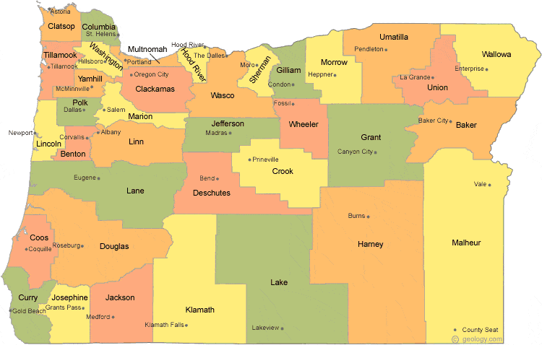
Regional Contacts by ESD
Amy Tidwell
  Grant, Harney, High Desert, InterMountain, Jefferson, North Central and Region 18
Jen Engberg
  Clackamas, Columbia Gorge, Multnomah and Northwest Regional
Lisa Plumb
  Lane, Linn Benton Lincoln and Willamette
Sarah Martin
  Douglas, Lake, Malheur, South Coast and Southern Oregon
Notes:
We have divided up the state into four sections. Each of us serves as the primary contact for the districts in these ESDs

Slide 13

Please reach out!
Jen Engberg
Jennifer.Engberg@ode.oregon.gov
Sarah Martin
Sarah.Martin@ode.oregon.gov
Lisa Plumb
Lisa.Plumb@ode.oregon.gov
Amy Tidwell
Amy.Tidwell@ode.oregon.gov
Notes:
Our team has moved from a programmatic model to a regional support model. Each of us has taken a section of the state to support across Titles IA, IIA, IVA and VB.

