Slide 1
Equitable Services to Private Schools
A Shared Responsibility
February 2023

Slide 2
Equitable Services: Basic Premise
Federal programs are supported by tax dollars, so all children and teachers (both public and private) are eligible to access these programs
Private schools must be “not for profit” to be eligible
Notes:
The term equitable services refers to the process of providing students, teachers, staff and families at eligible Private, Non-Profits (PNPs} fair access to federally funded education programs and services, as appropriate.
Under 34 CFR 77.1, the term “nonprofit” as applied to an agency, organization, or institution, means that it is owned and operated by one or more corporations or associations whose net earnings do not benefit, and cannot lawfully benefit, any private shareholder or entity.

Slide 3

Eligible Programs
Equitable services requirements for non-public/private schools apply to programs under § 1117 or § 8501:
  Title I-A: Basic Academic Programs;
  Title I-C: Education of Migratory Children;
  Title II-A: Supporting Effective Instruction;
  Title III: Language Instruction for English Learners and Immigrant Students;
  Title IV-A: Student Support and Academic Enrichment Grants; and
  Title IV-B: 21st Century Community Learning Centers
Notes:
There are two sections of ESEA that speak specifically to equitable services – Title IA and Title VIII.

Slide 4

Consultation is the heart of Equitable Services
Goal: Reach agreement on how to provide equitable and effective programs for eligible private school children
Consultation should be:
  Timely
  Meaningful
  Ongoing
Notes:
Consultation is at the heart of equitable services. As required under ESSA, all districts that receive federal funds must provide equitable services to any non-public school within its boundaries that wishes to participate. Districts meet this requirement through annual consultation that is timely, meaningful and ongoing, and which results in the school district and private school officials reaching agreement on services to meet the expressed strengths and needs of private school students, teachers, and staff.
Timely:
Before the LEA makes any decisions
During the design and development of program
Throughout the implementation and assessment of services
MEANINGFUL
Genuine opportunity for parties to express their views
Views seriously considered
LEA may initiate consultation with a proposal for services
Consultation must occur before final decision are made by LEA
Meaningful consultation must begin before any services are provided to students, teachers, or other private school educational staff. Although the initial consultation is generally the most critical, ongoing consultation is necessary and required for follow-through, adjustments, and evaluation.

Slide 5
Timely and Meaningful Consultation
Consultation should:
Provide ample time and genuine opportunity:
for all parties to express their views,
to have their views seriously considered, and
to discuss viable options for ensuring equitable participation.
Consultation should NOT:
Include pre-determined program decisions (including transferability) with no input from all parties, such as:
already established third party contract,
already determined services, and
already established timelines.
Notes:
Ongoing consultation process should begin well before the start of the school year, and should continue throughout the full implementation and evaluation of services.

Slide 6
Ongoing Consultation & Documentation
On going consultation can be conducted in person, via e-mails, by mail, and through LEA-organized meetings.
It is important that LEAs document their efforts and the ongoing communication between them and the private schools.
Documentation can include emails, phone call logs, letters, attendance sheets, meeting agendas, webinar information, etc.
Notes:
Meaningful consultation must begin before any services are provided to students, teachers, or other private school educational staff. Although the initial consultation is generally the most critical, ongoing consultation is necessary and required forfollow-through, adjustments, and evaluation.

Slide 7

Consultation Checklist
The following items are examples of what districts should discuss during consultation:
  The strengths and needs of eligible private school children
  Services the LEA will offer to eligible children
  How, where, and who will provide services
  How the equitable services program will be assessed
  The services the LEA will provide to teachers and families of participating private school children
  The methods to provide services to eligible private school students (e.g., by the LEA or third party contract)
  How the proportionate share was determined
  Whether funds will be pooled or distributed on a school-by-school basis
  Written affirmation that consultation has occurred
Notes:
ODE has created private school consultation checklist that outlines what should be discussed during consultation. This is not an exhaustive list.
Affirmation of consultation is sent to ODE Ombudsman Janette Newton

Slide 8
Consultation: Roles and Responsibilities
District
Identify private schools within district boundary
Develop annual consultation calendar
Send out consultation invitation letter
Establish LEA and private schools roles and responsibilities
Discuss/exchange applicable LEA and private school fiscal and program policies
Get private school signature on Affirmation of Consultation
Document, document, document!
Private School
Attend consultation
Conduct annual needs assessment
Provide necessary reports/documentation to district when requested
Identify method for evaluating effectiveness of programs
Work with the district to arrange for billing and payment
Notes:
The LEA and the private school will have specific roles and responsibilities throughout the process that requires the LEA and the private school officials to collaborate to decide how best to use the funding. This involves an in-depth consultation to create a plan. Together, private school officials and LEA staff review screening data (based on multiple, objective and educationally-related criteria)to assess the eligible students’ greatest needs, agree on what types of services will be provided and for whom, and decide how they will be evaluated.
Depending on program requirements, benefits may support students themselves, help their families support their learning, or help educators who work with them more effectively. The LEA implements the plan to provide services, communicating with the private school staff as needed along the way.

Slide 9
Calculating Equitable Share
Varies by program
  Title I-A: Only eligible students (determined by POVERTY and RESIDENCE) generate allocations
  Title II-A and IV-A: All students are included in the formula
  Title III: Home Language Use Survey, ELPA determines eligibility
  Equitable share similar to Title IA
  Title IV-B: Competitive grant, private schools may participate if school is within 21st CCLC attendance area
Private schools must provide the LEA with the essential student information to make calculations
Notes:
Calculation of the equitable share is based on a formula and depends on several factors including attendance area and enrollment. The private school must provide the district with student information needed to make calculations. The data sources to be used are determined during consultation.
The private school must provide the LEA with the essential student information to make calculations. The information exchange and estimated calculations may happen before or during the consultation.

Slide 10
Implementation and Evaluation
LEA Responsibilities
  Monitor implementation of plans to ensure services are provided
  Set up meetings/take other actions to keep things on track
  Ensure services are evaluated for effectiveness
School Responsibilities
  Follow through with plan to ensure benefits are provided as agreed
Notes:
The plans made during the initial consultation should include clear action steps and responsibilities. Measures of impact are determined in consultation between the school and the district. Evaluation ensures the equitable services have the intended result. ESSA equitable participation funds may be available to a school each year, so there is always the opportunity to make adjustments to make services more effective and responsive to needs. Evaluating programs is an important part of continuous improvement and a district responsibility as part of the equitable services process.

Slide 11

Resources
Equitable Services Handbook
Private School Consultation Checklist
Federal Requirements for Equitable Service Programs
Equitable Services Brief
Equitable Services webpage

Slide 12
2023-24 Consultation Resources
2023-24 Affirmation of Consultation
Intent to Participate Letter
Private School District List

Slide 13
Evidence of Consultation Form
Introducing a brand new Smartsheet Form that will be used to collect evidence of consultation!!
Features:
  Private School District List
  Evidence of Consultation FAQs
The Evidence of Consultation Form can be found on the Private School Participation Under ESEA webpage

Slide 14
SY 23-24 changes to submissions by districts
Districts must upload evidence of consultation for every private school in their district, regardless of the private school’s response
ESEA sections 1117(b)(5) and 8501(c)(5) state that “Each local educational agency shall maintain in the agency’s records and provide to the State educational agency involved a written affirmation signed by officials of each participating private school…If such officials do not provide such affirmation within a reasonable period of time, the local educational agency shall forward the documentation that such consultation has, or attempts at such consultation have, take place to the State educational agency.”
This is generally interpreted as:
A requirement for every district that has a private school within its boundaries
To provide to the Ombuds evidence that the district contacted every private school
Regardless of the private school’s response

Slide 15
What should the district upload?
For private schools that participate in equitable services:
Signed Affirmation
For private schools that decline equitable services:
Evidence of their response such as a signed Affirmation, email response, and transcript of a phone call or in-person conversation
For private schools that are non-responsive:
Evidence that the district offered equitable services to the school, such as a certified mail receipt or read email receipt

Slide 16

Please reach out!
Janette Newton, Private School Ombudsman
  janette.newton@ode.oregon.gov
Amy Tidwell
  amy.tidwell@ode.oregon.gov
Jen Engberg
jennifer.engberg@ode.oregon.gov
Sarah Martin
sarah.martin@ode.oregon.gov
Lisa Plumb
lisa.plumb@ode.oregon.gov

Slide 17
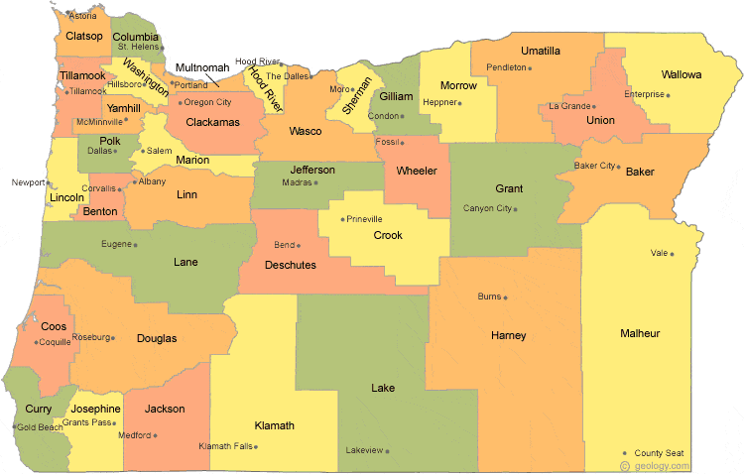
Regional Contacts by ESD
Amy Tidwell
  Grant, Harney, High Desert, InterMountain, Jefferson, North Central and Region 18
Jen Engberg
  Clackamas, Columbia Gorge, Multnomah and Northwest Regional
Lisa Plumb
  Lane, Linn Benton Lincoln and Willamette
Sarah Martin
  Douglas, Lake, Malheur, South Coast and Southern Oregon
Notes:
We have divided up the state into four sections. Each of us serves as the primary contact for the districts in these ESDs

