Slide 1
Family Engagement in
Title I-A Planning

Slide 2

Agenda for Today’s Session
The Power of Partnership
The Impact of Intentional Engagement
Engaging Families in the Development of the Title I-A Plan
Key Takeaways
Notes:
AMY

Slide 3
Quote from Dr. Karen Mapp
“Relational trust is the glue that holds everything together. If you skip over the step of building authentic and trusting relationships with your families and the community, then all of those wonderful initiatives that you attempt to put into place don’t have a strong foundation on which to sit.”
More from Dr. Karen Mapp
Notes:
A senior lecturer at the Harvard Graduate School of Education, Dr. Mapp has spent the last 25 years researching partnerships among families, community members, and educators. Her work seeks to elevate successful family-school partnerships and help schools build trusting relationships with families as co-creators in their children’s learning.
There are four key elements of relational trust: respect, competence, integrity, and personal regard.
Am I seeking input and listening carefully to what all families have to say? (Respect)
Am I demonstrating to families that I am competent and that I am honoring their role as good caretakers? (Competence)
Do I keep my word with families? (Integrity)
Do I show families that I value and care about them as people vs. objects? (Personal Regard)

Slide 4

Impact of Intentional Family Engagement
Parents/guardians are seen as valued partners in their students’ education, which impacts their decision to remain in their school.
Students see themselves as supported in school, which positively impacts engagement and well-being.
Open and ongoing communication builds trusting relationships with families.

Slide 5
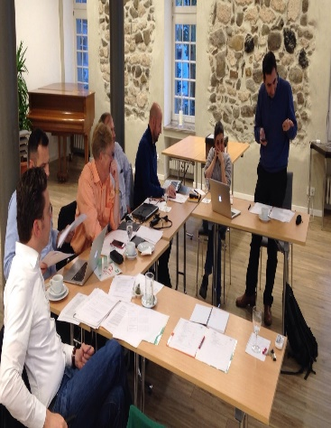
Engaging Families in Developing the Title I-A Plan
Family engagement is a critical component of the Title I-A program
Families should be engaged throughout the year, and have a voice in establishing the goals and activities of the school level Title I-A Plan
Schoolwide Planning Template

Slide 6

Removing Barriers to Participation
Communication with families in their home language(s)
Intentional outreach to families that may not feel connected to the school
Variety of times and locations convenient to families (e.g.; in person/ virtual)
Providing transportation and childcare
Online Presence: Is the Title I-A plan online and easily accessed by families?

Slide 7

The Annual Meeting
All Title I-A schools must host an annual meeting with families to discuss the school wide plan, inform families of their rights under Title I-A, and discuss opportunities for involvement in the school activities
    What do we share with families at the annual meeting?
    How do we communicate about opportunities for family involvement in school activities?
Sample Annual Meeting PPT template
Annual Meeting Quick Reference Brief

Slide 8

The School-Family Compact
The compact is a shared understanding of how families, students, and school staff are all responsible for assisting students in academic achievement
    How are families involved in the design of compacts?
    How are compacts discussed with families and students?

Slide 9

Evaluating the Title I-A Plan
Title I-A school wide plans should be reviewed and updated annually. This review is part of a continuous improvement process and should include all members of the school community.
    How do we include staff, students, families, and district leadership in reviewing this plan?

Slide 10
Evaluating the Title I-A Plan: Questions to Consider
Where did we meet or exceed our goals?
What do we still need to work on, and how do we know?
Based on what we learned, what will next year’s plan look like?
Should our goals or strategies change?

Slide 11
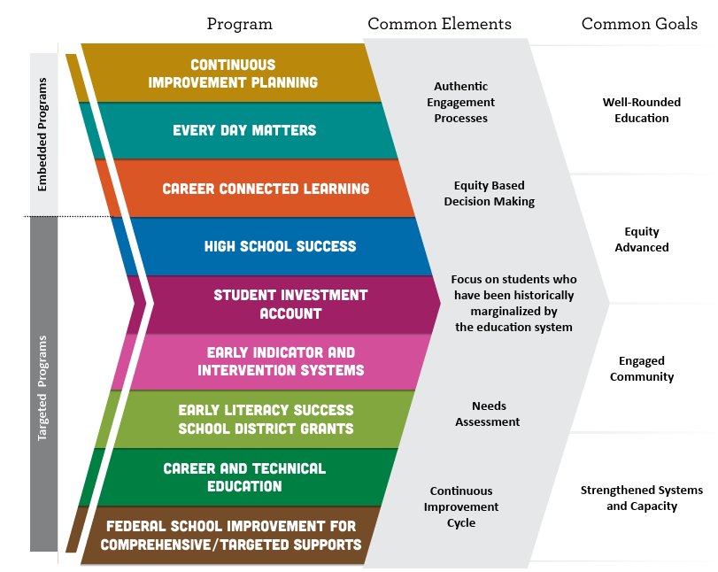

Engagement Resources
District-Level
School-Level
Community Engagement Toolkit
Integrated Guidance: Appendix A
Schoolwide planning template
Sample Annual Meeting PowerPoint
Compact Checklist
Annual Meeting
Building Family Capacity
Family Compact
Family Engagement Plan
Notes:
There are several ODE resources available to support engagement at both the district and school level. Don’t forget that work you are doing on the integrated guidance can be used to feed requirements in Title programs.
However, because Title IA is a school-based program, keep in mind that engagement and needs assessment work needs to be based on school-level data.

Slide 12

Key Takeaways
Family engagement is required by law under Title I-A.
Intentional family engagement positively impacts the success of the school level Title I-A plan.
Ongoing communication using multiple and meaningful pathways increases opportunities for authentic partnership with families.

