Slide 1
Welcome to Title II-A Tuesdays!
Recruitment, Retention, and Professional Learning: New Non-Regulatory Guidance and Examples from Oregon Districts
February 2025
Please put your district name next to your username

Slide 2

Our Time Together Today
The Hierarchy of Federal Rules
Highlighted Strategies for Recruitment, Retention, and Professional Learning
What Oregon Districts are Doing
Resources
Notes:
The US Department of Education released several pieces of non-regulatory guidance in December that relate directly to Title II-A.

Slide 3

Who’s in charge?
Put these in the order that they apply:
Dear Colleague Letter
Statute
Direct communication from ED officials
Non-Regulatory Guidance
Federal Regulations
Notes:
Grantees that receive federal funds must follow all the rules, regulations and other requirements that apply to those funds. These rules and requirements come from a variety of places, so who is in charge?

Slide 4
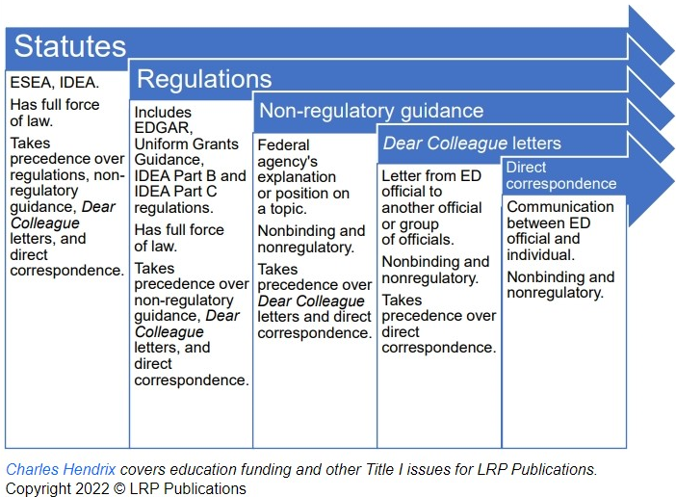
Hierarchy of Federal Rules
Notes:
Text excerpted from Federal Education Grants Management: What Administrators Need to Know, LRP Publications and BruMan Group, 2019
There is a hierarchy of legal authorities that establishes which laws or rules apply and in what order. Generally, federal law is supreme over state law. However, in the context of federal grants, it is fairly common for a federal law to permit a state or local government to follow state or local law so long as certain requirements are met. Where there is a conflict between federal and state law, the federal law will control unless the federal law in question says otherwise.
Statutes can be programmatic or administrative and are passed by Congress.
Regulations are created by federal agencies and fill in practical details about how a law will be implemented. They have the force and effect of law.
Non-regulatory guidance is also issued by federal agencies and provides additional information about the law in plan language format. It does not have the force of law.
Dear Colleague Letters are typically addressed to a group (e.g.; All Title I directors) and do not carry the force of law. They are an important indicator of policy trends at ED.

Slide 5

Non-Regulatory Guidance (NRG) Considerations
Reflect ED’s most user-friendly interpretation of a statute
Statutes and regulations are the “gold standard” for compliance
Updated regularly
Make sure you are using the most current version!
Three new NRG documents released in the last two months that relate to Title II-A
*Courtesy of Federal Education Grants Management: What Administrators Need to Know, LRP Publications and BruMan
Notes:
If SEAs and LEAs comply with non-regulatory guidance, ED’s program offices generally will not later issue a finding of non-compliance. However, it is important to recognize that the guidance is not binding on the department in the same way that statutes and regulations are binding and that program offices occasionally issue multiple versions of guidance on the same subject with different interpretations.
If there is inconsistency between guidance and the relevant statute or regulation, ultimately the statute or regulation controls.
Two documents were released by ED on December 4th that relate to Title II-A.
Using Title II, Part A Funds Strategically to Support Educator Recruitment, Retention, Professional Learning, and Improved Student Outcomes - https://www.ed.gov/media/document/using-title-ii-part-funds-strategically-support-educator-recruitment-retention-professional-learning-and-improved-student-outcomes
Supporting a Diverse Educator Workforce to Strengthen Teaching and Learning - https://www.ed.gov/media/document/supporting-diverse-educator-workforce-strengthen-teaching-and-learning
Of note: neither was released by the Office of Elementary and Secondary Education Title II-A team.

Slide 6
Using Title II-A Funds Strategically
Using Title II, Part A Funds Strategically to Support Educator Recruitment, Retention, Professional Learning, and Improved Student Outcomes
Published December 4, 2024
Replaces the 2016 Non-Regulatory Guidance
Encourages braiding with other funds to support educators
Title I-A, Title III, and IDEA
Multiple reminders about tying activities to identified needs and the supplementary nature of II-A funds
Notes:
To assist State and local planning, this resource advises how Title II, Part A funds can be used to implement five evidence-based policy levers listed below and included in the U.S. Department of Education’s (Department’s) Raise the Bar: Lead the World initiative that help eliminate educator shortages and provide educators and students with what they need to thrive.
This document replaces the guidance published in September of 2016 entitled “Building Systems of Support for Excellent Teaching and Leading”. https://www.ed.gov/sites/ed/files/policy/elsec/leg/essa/essatitleiipartaguidance.pdf
In addition to Title II, Part A funds, several other key federal grants can be used to support educators, including by assisting educators that work with particular students. For example, federal funds under the Individuals with Disabilities Education Act (IDEA) can be used to prepare and support educators who work with children and students with disabilities. 4 ESEA Title III, Part A funds can support educators who work with English learners. ESEA Title I, Part A funds can support educators in their work in schools that receive Title I funding

Slide 7
Remember: Title II-A is about equity of access
While Title II-A can benefit all educators, a key purpose of II-A is to support educators “particularly in schools with a high percentage of
students navigating poverty;
out-of-field, inexperienced, or ineffective teachers; and
students who do not meet the challenging State academic standards.”
Notes:
One of the primary purposes of Title II-A is to ensure that all students have access to excellent, well-prepared, and well-supported educators. Use of II-A funds should be targeted to support schools where inequities exist.

Slide 8
Highlighted Strategies
Improve compensation and working conditions
Create, improve, and expand pathways into the profession
Provide induction and professional learning
Offer educational leadership and career advancement opportunities
Promote educator diversity
Notes:
As long as these activities are used to enhance existing State and local resources and better respond to a local needs assessment and consultation with local stakeholders, Title II, Part A funds can be used, amongst other purposes, to: 1. Improve compensation and working conditions; 2. Create, improve, and expand pathways into the profession; 3. Provide induction and professional learning; 4. Offer educator leadership and career advancement opportunities; and 5. Promote educator diversity.

Slide 9
Compensation & Working Conditions
Increased pay for teacher leaders who take on additional responsibilities
Pay for collaboration outside of the workday (e.g.; PLCs/data teams)
Recruitment and retention bonuses and stipends
Additional certifications in high-need areas

Slide 10

Pathways to the Profession
Teacher residency programs
School Leader residency programs
Grow Your Own (GYO) programs
Career advancement for paraprofessionals
Teacher apprenticeship programs
Notes:
ESEA section 2002(5) defines “teacher residency program” for purposes of Title II and requires that a prospective teacher teach alongside an effective teacher for at least one full academic year, receive concurrent academic instruction to assist with certification or licensure, and demonstrate effective teaching skills.
School leaders can also benefit from residencies through programs that provide support, such as job-embedded leadership training for aspiring school leaders, coaching, and peer connections for new or aspiring school leaders.
Grow Your Own (GYO) programs typically encourage partnerships between LEAs and educator preparation programs at institutions of higher education, sometimes also in partnership with a non-profit organization, to recruit and prepare teachers from the communities the school or district serves and help to build school capacity. When done well, these programs can help address teacher shortages by increasing retention while also enhancing educator diversity.
Registered apprenticeships have the potential to be an effective, high-quality “earn and learn” model that allows candidates to earn their teaching credential while also getting paid by combining coursework with structured, paid, on-the-job learning experiences with a mentor teacher.
This can include paying for paraprofessionals’ coursework, exam preparation, and exam fees to support paraprofessionals in earning full teacher certification.

Slide 11
Induction and Professional Learning
Induction, coaching, and mentoring
Professional Learning*
Must be “sustained, evidence-based, job-embedded, and comprehensive”
Paraprofessionals pursing teacher certification
Bridging early childhood and elementary educators
Supporting multilingual learners and students experiencing disability
*Highlighted in the guidance, not an exhaustive list
Notes:
Induction, coaching and mentoring are generally allowable uses of Title II, Part A funds, provided the funds do not pay for activities required by the State or district for all teachers or that would otherwise be covered with State or local funding.
The ESEA’s definition of “professional development” includes that it is “sustained (not stand-alone, 1-day, or short-term workshops), intensive, collaborative, job-embedded, data-driven, and classroom-focused” (ESEA section 8101(42)).
Title II, Part A funds may be used to provide professional learning support for paraprofessionals pursuing teacher certification.
Title II, Part A funds can be used to support these efforts including professional learning of preschool and kindergarten educators in SEA- and LEA-operated programs. Funds can support instructional practices that are inclusive, culturally responsive, linguistically and developmentally informed, and foundational for early school success. Title II, Part A funds can be used to support targeted professional learning that supports the success of English learners and expands pathways to multilingualism for all students.
As these laws require that students with disabilities are educated in the least restrictive environment, students with and without disabilities often learn alongside one another and are taught by general education teachers, special education teachers, and teachers certified in specific content areas. All these teachers must be prepared to support students with and without disabilities. Collaborative and joint professional learning trains non-special education teachers to better support students with disabilities in their classrooms, and special education teachers on core and content-specific instructional approaches that support learning for students.

Slide 12

Teacher Leadership Opportunities
Mentoring
Instructional Coaching
Leading professional learning
Instructional practice leader
Notes:
In addition to leadership development, highly skilled teachers may expand their practice through teacher leadership roles that support school and student success while providing a career ladder for teachers that allows them to earn additional compensation that accompanies a formal leadership role and supports their retention in such a role.
Serve as an instructional practice leader or teacher leader among their peers, while still teaching their own classes.
Hybrid teacher leadership roles allow educators to continue benefitting students in the classroom while embracing new leadership opportunities in a meaningful, balanced manner.

Slide 13
What Oregon Districts are Doing

Slide 14
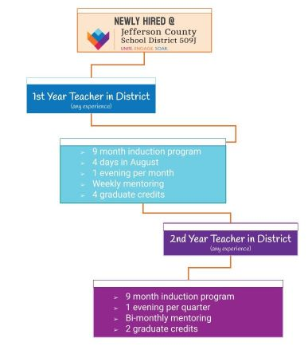

Teacher Mentoring

Slide 15
Jefferson County SD – Teacher Mentoring
What district identified need prompted this strategy/program?
Teacher retention rates for our small rural district were low.
What are 3-4 key things you want to share about what your program looks like in practice?
Teachers receive weekly mentorship during their first year; at the minimum monthly mentoring during their second year.
Teachers receive monthly professional development at the district level as well as earning college credit.
Coaching team collaborates monthly and have attended Jim Knight Coaching Training.
Our retention rates have grown to above 85% in the past 4 years.
Who is the contact if districts have questions or want to learn more?
bwhite@509j.net mboyle@509j.net

Slide 16

Principal Mentoring
Need: Principal Instructional Leadership
Ongoing Coursework in RBT with our ESD consortium
Analyzing Teaching for Student Results – 7days
Differentiated Conferencing - 2 days
Strengthening Teacher Evaluation: Taking Action to Improve Ineffective Teaching 4 days
Building a Strong Adult Professional Culture 4 days

Slide 17
Eugene 4J – Principal Mentoring
Principal PLC – Learning Walks – Instructional Framework
Mentor and Director supports
Principal Pipeline
Is it working? Anecdotally, Yes.
Questions?
Jeffry Johnson, Director of Elementary Education johnson_je@4j.lane.edu

Slide 18

Deep Focus in Mathematics
WHY?
Following our first year of a fully de-tracked math system for students in K-7, our math teachers spoke up about needing a math specialist to support their work
Mathematical literacy continues to be of increasing importance in the world
We have a need to increase teachers’ confidence in their math instruction using principles of Ambitious Math Teaching
Increase student achievement on math assessments

Slide 19
Corvallis SD – Deep Focus in Mathematics
HOW?
Elementary (K-5)
Grade level district wide PD
Instructional Rounds (grade band/opt-in/focus on new to grade/profession)
Individual and/or team coaching upon request
Middle School (6-8)
Studio Model
Administrator PD and feedback instructional rounds
High School (9-12)
Lesson Study Model

Slide 20
Corvallis SD – Mathematics continued
Evidence the strategy is making a difference?
Classroom visits
Principal feedback
Feedback surveys from teachers
Youth Truth/OSAS/9th grade Algebra 1 completion/4 years of HS math
Contact Jenn Vomocil jennifer.vomocil@corvallis.k12.or.us

Slide 21

Grow Your Own
WHY?
Our district faced critical shortages in hard-to-fill positions, including:
English Language Learner teachers
Special Education site-based classroom teacher
Advanced math endorsed teachers
Dual language Spanish immersion teachers

Slide 22
Central Point SD – Grow Your Own
HOW?
Teachers select professional development aligned with their needs and district priorities.
Staff pursuing endorsements in areas of need receive financial support for coursework.
The initiative strengthens teacher retention by investing in existing employees.
Schools benefit from fully endorsed educators, reducing reliance on emergency or temporary licensure.

Slide 23
Central Point SD – Grow Your Own, continued
Evidence the strategy is making a difference
More teachers are earning endorsements in high-need areas
Reduced vacancies and more stable, high-quality instruction
Participants report feeling more supported in their professional growth
Student outcomes improve with access to fully certified educators.
Christine Beck, christine.beck@district6.org, 541-494-6224

Slide 24

Resources
Using Title II-A Funds Strategically to Support Recruitment, Retention, Professional Learning and Student Outcomes
Education Department General Administrative Regulations (EDGAR)
Uniform Grants Guidance (UGG)
USED Title II-A web page
ODE Title II-A web page
Supplement not Supplant Brief

Slide 25

Please reach out!
Jen Engberg Jennifer.Engberg@ode.oregon.gov
Sarah Martin Sarah.Martin@ode.oregon.gov
Lisa Plumb Lisa.Plumb@ode.oregon.gov
Amy Tidwell Amy.Tidwell@ode.oregon.gov
Notes:
Jen Engberg
Clackamas, Columbia Gorge, Multnomah and Northwest Regional
Sarah Martin
Douglas, Lake, Malheur, South Coast and Southern Oregon
Lisa Plumb
Lane, Linn Benton Lincoln and Willamette
Amy Tidwell
Grant, Harney, High Desert, InterMountain, Jefferson, North Central and Region 18

