Slide 1

Students in
Foster Care
Student Rights and School Supports
*Presentation adapted from ODE

Slide 2
Foster care means…
foster family homes (known now as "resource parents")
foster homes of relatives
group homes
emergency shelters
residential facilities (Not OYA, juvenile detention, mental health treatment)
child care institutions and pre-adoptive homes.
Substitute care for children placed by the Oregon Department of Human Services or a Tribal child welfare agency away from their parents and for whom the department or agency has placement and care responsibility, including placements in:

Slide 3
Students in foster care have rights
Under the Every Student Succeeds Act (ESSA), children in foster care have the right to:
Remain in their school district and school of origin, for the duration of time in foster care, even when their foster home placement changes and/or they are living outside of their school boundary.
Immediately enroll in school, with or without all required documents typically needed to enroll.
Automatic eligibility for free school meals.
Participate in school-related activities.
Transportation to their school of origin, as requested by the ODHS caseworker

Slide 4
School of Origin
Definition: "The School of Origin" is the school district/school in which a child is enrolled at the time of placement into ODHS Child Welfare Foster Care.
**A school district/school of origin ONLY changes when there is a Best Interest Finding made by the Juvenile Court.

Slide 5
Immediate Enrollment
If a caseworker or resource parent attempts to enroll a foster care child in school, you must enroll them immediately - even if they do not have all the documents typically needed to enroll.
The resource parent may only have a generic placement letter from ODHS - this is considered proof of guardianship.

Slide 6
School Notification Form
ODHS caseworkers should fill out the School Notification form for each child in foster care.
Please encourage the caseworker to complete the form and send it to the Foster Care POC.
FORM
**This form is NOT needed for immediate enrollment.

Slide 7
Transportation
Children in foster care have the right to school of origin transportation, no matter the address.
ODHS caseworkers must fill out a transportation request form and send it to the Foster Care POC in order for transportation to be arranged.
FORM
**forms are also located on the HSD foster care webpage

Slide 8
Free School Meals
Children in foster care have the right to free school breakfast and lunch.
HSD's Nutrition Services Department coordinates with ODHS directly at the state-level to make sure all foster children are automatically added to the free school meals list.
There is no need to complete a f/r lunch application for a student in foster care.

Slide 9
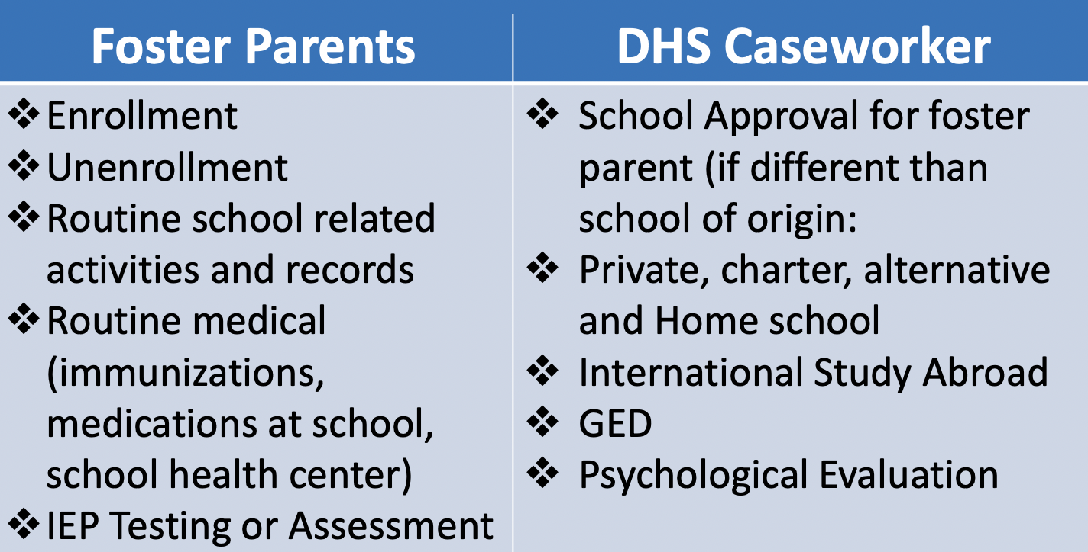
Resource Parent and ODHS Caseworker
Who can consent to what?

Slide 10
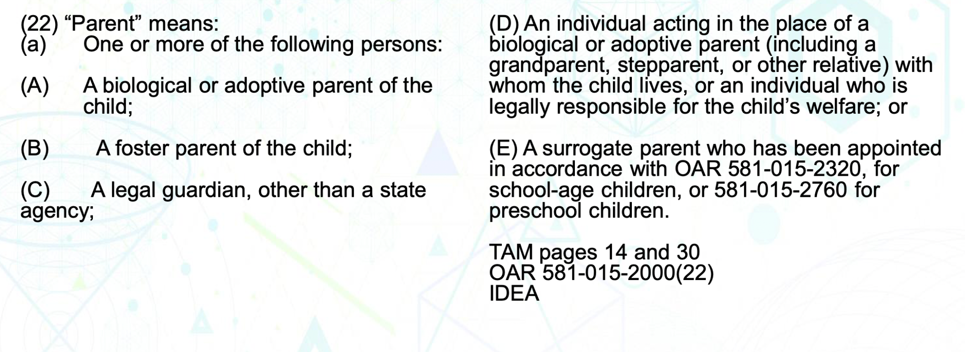
Who is considered a parent?

Slide 11
What is a Foster Care Point of Contact?
A Foster Care Point of Contact (POC) is a designated staff member within a school district who is responsible for coordinating with the ODHS child welfare system and ensuring federal policies are being followed - ESSA and Fostering Connections.
**Each school district is required by law to have a POC

Slide 12
POC Responsibilities
Coordinates with DHS/Child Welfare on implementation of foster care provision
Responsible for receiving and disseminating School Notification forms (each district may develop its own process)
Facilitates transfer of records and immediate enrollment
  Schedule team meeting with school counselor, POC, caseworker, school admin
Develops and coordinate school/district of origin transportation procedures
Facilitates data-sharing, consistent with FERPA and other privacy protocols

Slide 13
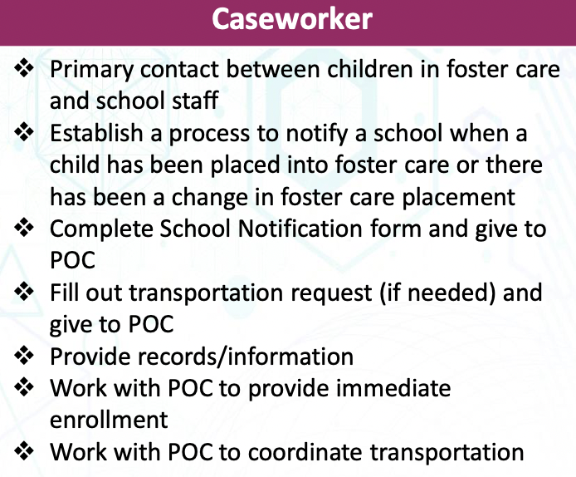
Caseworker Responsibilities

Slide 14

HSD’s Foster Care POC
Courtney Gibb
(she/her)
McKinney-Vento SSWC & Foster Care POC
503-844-1753
Gibbc@hsd.k12.or.us

Slide 15
For more information
Visit the HSD Foster Care webpage or the Oregon Department of Education’s webpage:
Hillsboro Foster Care webpage
Oregon Department of Education Foster Care webpage

