Slide 1
Title I-A District Set Asides

Slide 2

Agenda for Today’s Session
What’s Required
What’s Optional
Recommendations
Resources and Questions
Notes:
Introduce Chris, Marlie and Janette

Slide 3

Set-Aside Basics
What are set-asides?
  Funds reserved for district-level initiatives in Title I-A funded schools only
    Exceptions: Set-asides for students experiencing houselessness and students in Foster Care can be used for any eligible student, regardless of the school they attend
Considerations
  What do our Title I-A schools need?
  How will set-asides impact school allocations?
Notes:
Set-asides are funds that are reserved for district-wide activities that support Title I-A schools. These funds are reserved at the district level before funds are allocated to schools. Some set-asides are required; others are optional. While the law does allow districts to spend Title I-A funds in support of district-wide activities (that benefit Title I-A funded schools only), decisions concerning optional set-asides should be made carefully because the reservation of funds will reduce the funds available for distribution to schools.
Because set asides are taken off the top of the districts allocation, the larger the set-asides, the smaller the remaining pool of funds to distribute to schools.
The share of funds must be based on the total allocation received by the district and be determined prior to any allowable expenditures or transfers by the district.
ESEA Section 1113(c)(3)(A); 1113(c)(3)(B); 1113(c)(3)(C)

Slide 4

Which Set-Asides are required?
Students experiencing housing instability (McKinney-Vento)
Family engagement
Equitable services to private schools
NOTE: If a district does not spend all of its required funds in the initial grant year, unspent funds must be carried over and spend for the same purpose the following year.
Notes:
Some set asides are required, which we will talk about in a moment. These include set asides for students experiencing houselessness, parent and family engagement and equitable services to private schools. Title I-A set-aside for students experiencing houselessness and Foster Care can be used for any eligible student, regardless of the school they attend
NOTE: If an LEA is required to spend a specific amount of its Title I- A allocation in a given year for a specific purpose (e.g. family engagement), the LEA must meet that obligation. If it does not do so in the year for which funds were allocated, unspent funds must be carried over and spent for the specific purpose the following year.

Slide 5
Required Set-Aside (for all districts)
Services for students experiencing houselessness
  Support eligible students in ALL schools, not just Title I-A funded schools
  Consider the number of students identified experiencing houselessness when calculating set-aside
  Primary goal of the set-aside is to remove barriers to student engagement and participation in education (e.g.; transportation for school of origin, fees for extracurricular activities/athletics, extended day programs)
Notes:
CHRIS
Services for children experiencing houselessness. Districts must reserve funds to provide services to students experiencing houselessness in all schools within the district. ESSA does not specify an amount, but the amount should be based on a needs assessment and could include costs for a liaison, transportation for eligible students, and other activities eligible under the McKinney-Vento Homeless Education Act. District Title I Coordinators should work in collaboration with the Homeless Liaison to complete the needs assessment as a way to determine the appropriate amount of Title I set-asides required to meet homeless student needs.
Use the number of students experiencing houselessness identified in the previous school year to project count for upcoming year. A best practice would be increasing the amount allocated by 5% or as your budget allows to account for potential increases in enrollment.
The primary goal of the set-aside is to remove barriers to student engagement and participation in education. This means there is no “right way” to spend the funds, but your description should clearly articulate how the activities the district is undertaking with this set aside will remove barriers for students.
ESEA Section 1113(c)(3)(C)

Slide 6
Required Set-Asides (for some districts)
Equitable Services for private school students
  Equitable services are based on the proportionate share of the district’s total Title I-A allocation
  Calculated before any other set-asides are taken
Notes:
JANETTE
Equitable Services for eligible private school students. This only applies to districts with participating schools. Districts must reserve a proportional amount to serve students who attend private schools (either inside or outside the district’s boundaries) who would otherwise attend a Title I-A funded school within the district. Funds used for costs associated with the school’s Targeted Assistance Program.

Slide 7
Required Set-Asides (for some districts)
Parent and family engagement
  Only required for districts with allocations of $500K+
    Required to set-aside 1% of the total district allocation; 90% of the 1% must go to Title I-A schools
    Districts with participating private schools must engage the parents and families of private school students.
    Engagement of private school participants may look different than engagement of public school participants.
Notes:
Parent and Family Engagement. Districts with Title I-A allocations greater than $500,000 must reserve an amount equal to 1% of the total district allocation and distribute 90% of the reserved 1% to schools receiving Title I-A funds for parent and family engagement activities. The remaining 10% (or less) may remain at the district level. Some examples of allowable costs include parent/family liaisons/coordinators, supplies and materials for Title IA meetings or activities (including food for families), and childcare to support attendance.
ESEA Section 1116(a)(3)(A)
The district is responsible for engaging private school parents because the district runs the TAS program. The district and the school should partner in this engagement, it is not simply the responsibility of the school. Could involve holding separate engagement activities at each school or holding one engagement opportunity for all the private schools in the district. However it is designed, the district and school should work together to ensure that the parents/guardians and families of eligible students understand the services and supports their student are receiving and their rights under Title IA.

Slide 8
Equitable Services Engagement Example
Total district Title I-A allocation | $1,000,000
Percent of students experiencing poverty attending private schools | 5%
Required district set-aside for Equitable Services ($1,000,000 X .05) | $50,000
Required 1% for engagement for Equitable Services ($50,000 X .01) | $500

Slide 9
Required Set-Asides (for some districts)
Services for students without parental supervision
  Only applies to districts with a locally run residential facility within boundaries
  Questions? Contact Jen Engberg (jennifer.engberg@ode.oregon.gov)
Notes:
Services for students without parental supervision. Districts that have within their boundaries a local (not state run) residential facility for students without parental supervision and report this facility in the October caseload count are required to set-aside Title I-A funds to provide services to children in those facilities. The amount of Title I-A dollars reserved for serving children and youth in this category is a per-child amount. ESEA Section 1113(c)(3)(A)
ESEA Section 1113(c)(3)(A)

Slide 10

Optional Set-Asides
District Administration
  Costs to administer in district and equitable services to private schools
Salary Equalization
  Establishes equity in funding between Title I-A funded schools
Extended Time
  Before/after/summer school
Notes:
Administering the Title I program. Administrative costs may include staffing to administer Title I-A programs and other expenses required to carry out the administration of Title I-A services throughout the district for public and private school children. Funds reserved for this purpose should meet the necessary and reasonable guidelines. This is not the cost of teachers in buildings, but staffing costs associated with district-level implementation of IA.
Salary Equalization. Salary Equalization is designed to take into account school-by-school variations in personnel costs, such as seniority-pay differentials or fringe benefit differentials. It is intended to address situations where similar per-child amounts would result in different levels of service because the salary and benefit costs of Title I-A staff at one school are higher for the equivalent staff at another Title I-A school. Salary Equalization is allowable for paraprofessionals as well as teachers.
Extended Time. This set-aside can be used for summer school and/or before and after school programs for students who attend Title I-A schools.
34 CFR Part 200

Slide 11

Optional Set-Asides
Professional Development
  Title I-A schools ONLY
Additional Set-Asides
  Early Learning activities in Title I-A schools
  Supports for students experiencing Foster Care
  Supplement services to students in locally run facilities or community day programs
Notes:
Professional Development. This set-aside can be used to provide professional learning to teachers in Title I-A schools. In schools implementing a schoolwide program this includes all instructors/staff in the school. In schools implementing a targeted program, this includes instructors/staff working with targeted students.
Additional Set-Asides. There are number of purposes for which this set-aside can be used:
Early Learning – Early learning activities for children from birth to the age at which the LEA provides a free public elementary education, including full day kindergarten and preschool.
Foster Care – Assist in the provision of services for students experiencing foster care which may include additional costs to transport children to their school of origin.
Students in Secure Care– Districts that receive Title I-D, Subpart II funds can choose to supplement services to students in locally run facilities or community day programs with this set-aside.

Slide 12
Recommendations
Involve families and community members.
Maintain focus on identified needs of Title I-A funded schools.
Focus on strategies that will have the greatest impact on improving student achievement.
Notes:
Involve families and community members. Districts are required to develop their Title I-A plans with timely and meaningful consultation with teachers, principals and other appropriate school personnel, along with parents and families of children in schools served under Title I-A. Districts should solicit input on the plan and proposed use of funds including optional set-asides.
Maintain focus on the result of the needs assessment. Funds reserved for strategies and activities at the district level for optional set-asides should address needs and strategies identified by Title I-A funded schools.
ESEA Section 1112 (a)(1)(A)

Slide 13

Resources
Set-Aside Quick Reference Brief
Salary Equalization
Calculating the Proportionate Share for Private Schools
Use of Title I-A Set-Asides for Homeless Students
Title I-A Homeless Set-Asides District Needs Assessment & Calculation

Slide 14

Please reach out!
Jen Engberg
jennifer.engberg@ode.oregon.gov
Sarah Martin
sarah.martin@ode.oregon.gov
Lisa Plumb
lisa.plumb@ode.oregon.gov
Amy Tidwell
amy.tidwell@ode.oregon.gov
Equitable Services to Private Schools
janette.newton@ode.oregon.gov
McKinney-Vento
chris.james@ode.oregon.gov
Foster Care
marlie.magill@ode.oregon.gov

Slide 15
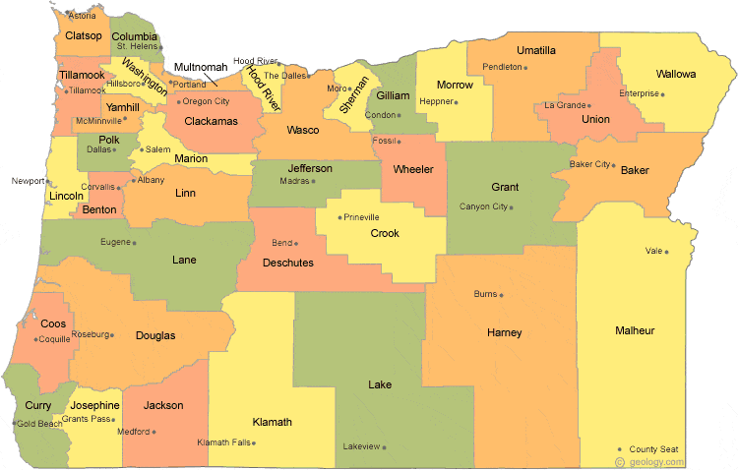
Regional Contacts by ESD
Jen Engberg
  Clackamas, Columbia Gorge, Multnomah and Northwest Regional
Sarah Martin
  Douglas, Lake, Malheur, South Coast and Southern Oregon
Lisa Plumb
  Lane, Linn Benton Lincoln and Willamette
Amy Tidwell
  Grant, Harney, High Desert, InterMountain, Jefferson, North Central and Region 18

