Slide 1
Maintenance of Effort

Slide 2

Outcomes
Maintenance of Effort Basics
Demonstrating Maintenance of Effort
Impacts of not meeting MOE
Resources
Oregon Department of Education

Slide 3
Supplement not Supplant
Federal grant funds may be used only to supplement the educational programs generally offered with state and local funds and to provide supplemental services that would not have been provided had the federal grant funds not been available.
Supplement – to add to; to enhance; to expand; to increase; to extend
Supplant – to take the place of; to replace by something else
ESSA Quick Reference Brief: Supplement Not Supplant
Notes:
Federal funds are required to supplement, and not supplant existing state and local funding. In plain language, this means that federal funds should add to, and not replace, state and local funds. An LEA must be able to operate its schools and its core foundation programs without any federal funds.
Our team has created a brief on this topic that outlines SNS rules by program. Maintenance of Effort is one of the ways districts demonstrate that the use of federal funds is supplemental.

Slide 4

Maintenance of Effort (MOE) Basics
What: Demonstration that spending of state and local funds remains at 90% or above what was spent in the preceding year
Why: To ensure a consistent base of state and local funding from year to year regardless of federal funding
When: Annually, based on district submission of
fiscal data (ODE does the calculations)
Oregon Department of Education
Notes:
Maintenance of Effort focuses on spending at the LEA level and requires districts to have a consistent base of state and local funding for public education from year to year. Each year, LEAs receiving funds under ESEA must ensure that district or per-pupil spending of state and local funds remains at 90 percent or above what was spent in the preceding year. ESSA states that funding will be reduced if an LEA fails to meet the 90 percent threshold twice in a five year span. This reduction is made by ODE in the LEA’s Title I-A allocation.
Districts must annually demonstrate that they have met maintenance of effort. Compliance with MOE is based upon data submitted by districts through the Actual Expenditures, Actual Revenue and Average Daily Membership data collections.

Slide 5

Demonstrating Maintenance of Effort
Aggregate Spending
  Total spending (state and local) from the previous year
OR
Per-Student Expenditures
  Total spending (state and local) divided by number of students in the district
To demonstrate MOE districts must ensure they spent 90% or above what was spent in the preceding year, using one of the above methods
Notes:
An LEA may receive funds under a covered program for any fiscal year only if the SEA finds that either
• the combined fiscal effort per student; or
• the aggregate expenditures of State and local funds with respect to the provision of free public education by the LEA for the preceding fiscal year
was not less than 90 percent of the combined fiscal effort per student or aggregate expenditures for the second preceding fiscal year. [ESEA section 1118(a) and 8521(a)]

Slide 6
Failing to Meet Maintenance of Effort
Requires a reduction in the district grant award
Reduction is in exact proportion to the failure to meet MOE
Percentage most favorable to the district is used
*Must fail in current year and one or more of the five immediately preceding fiscal years to have funding reduced
Notes:
If a district fails to meet the MOE requirements and does not receive a waiver from the requirements by ED, ODE must reduce the amount of the district’s allocation under the covered programs in the exact proportion to the failure to meet the MOE requirement. The calculation used to determine the proportion is the percentage in which the district failed to maintain effort that is most favorable for the district from the tested categories.
Before the implementation of ESSA, ODE was required to reduce a district’s allocation as compared to the preceding fiscal year only. However, ESSA has a look-back provision that requires the reduction to be based on whether the LEA has failed to maintain effort in a given fiscal year and in one or more of the five immediately preceding fiscal years. This means a single failure to maintain effort within a five-year period may not result in the reduction of the LEA’s allocation.

Slide 7
Examples
 | 2020-2021 Net MOE Expenditures | 2019-2020 Net MOE Expenditures | 90% Funding Level Required for 20-21 | Difference | Results
Morning SD Expenditures: | $6,701,574 | $6,779,379 | $6,101,441 | ($600,133) | No reduction
Day SD Expenditures: Enrollment: Per Pupil Expend: | $14,519,606 2,649 students $5,481 | $16,325,278 2,588 students $6,308 | $14,692,750 $5,667 | $178,144 $196 | Reduction of 1.2% 3.6%
Night SD Expenditures: Enrollment: Per Pupil Expend: | $6,108,699 1170 students $5,221 | $6,876,795 1211 students $5,679 | $6,189,116 $5,111 | $80,417 ($110) | 1.1% No Reduction
Notes:
Morning School District: The district spent more funds in 2020-2021 from state/local funds than the 90% needed, thus no reduction is taken for FY21.
Day School District: The district spent less in 2020-2021 than was required by law (90% required funding level). The difference would result in a 1.2% decrease in allocations for FY 21. Running a second test using per pupil expenditure, would result in a 3.6% decrease in allocation. A 1.2% decrease is most beneficial for the district so the allocation would be reduced by this amount if the district had also failed to maintain effort in one or more of the five immediately preceding fiscal years.
Night School District: The district spent less in 2020-21 than was required by law (90% required funding level). The difference would result in 1.1% reduction in allocations. Using the per pupil calculation, the district met the funding requirement. Thus, no reduction is taken for FY21.e or more of the five immediately preceding fiscal years.

Slide 8

Requesting a Waiver
One year waiver requested from USED
Only two reasons:
  Exceptional or uncontrollable circumstances
  Precipitous decline in a district’s financial resources
Process for Calculation of Maintenance of Effort Expenditure
Notes:
Section 8521 of ESSA provides two bases – an exceptional or uncontrollable circumstances or a precipitous decline in a district’s financial resources – to warrant the granting of a waiver from the maintenance of effort requirement. 3 A district that fails to meet the MOE requirement may request a one-year waiver from the U.S. Department of Education (ED).
The Oregon Department of Education (ODE) has no authority to waive the MOE requirement and has no input into decision regarding district waiver requests. More information about the process for requesting a waiver can be found in Process for Calculation of Maintenance of Effort Expenditure.
8

Slide 9

Resources
ESSA Quick Reference Brief: Maintenance of Effort
Supplement not Supplant under Title I, Part A
Title I Fiscal Guidance
Fiscal Changes and Equitable Service Requirements under ESEA
Process for Calculation of Maintenance of Effort Expenditure

Slide 10

Please reach out!
Jen Engberg
Jennifer.Engberg@ode.oregon.gov
Sarah Martin
Sarah.Martin@ode.oregon.gov
Lisa Plumb
Lisa.Plumb@ode.oregon.gov
Amy Tidwell
Amy.Tidwell@ode.oregon.gov
Kyle Walker
Kyle.Walker@ode.oregon.gov

Slide 11
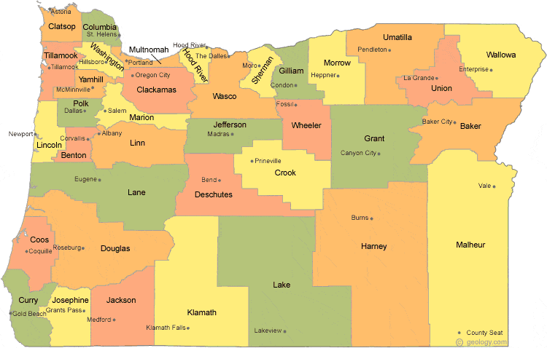
Regional Contacts by ESD
Lisa Plumb
Lane
Linn Benton Lincoln and
Willamette
Amy Tidwell
Grant
Harney
High Desert
InterMountain
Jefferson
North Central and
Region 18
Jen Engberg
Clackamas
Columbia Gorge
Multnomah and
Northwest Regional
Sarah Martin
Douglas
Lake
Malheur
South Coast and
Southern Oregon

